Slide 1
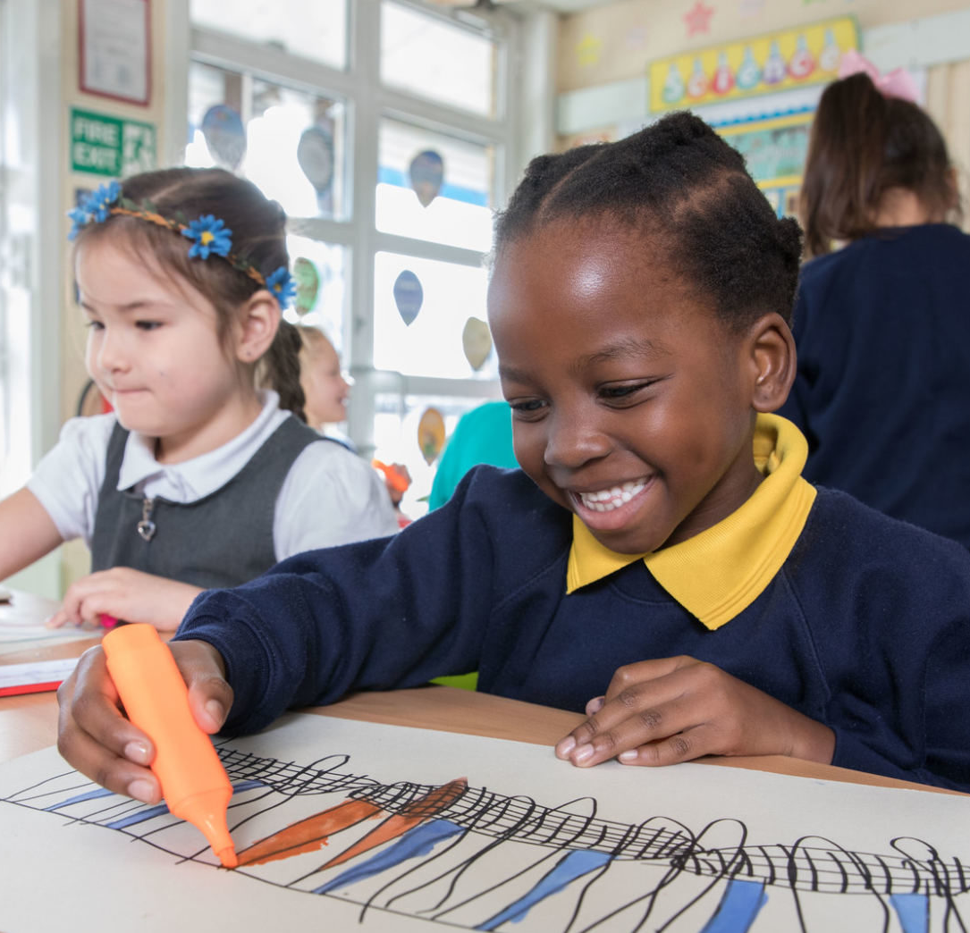
ACTIVITY 2 HOW IS THE UK PROTECTING CHILDREN’S RIGHTS?
© UNICEF/Al-Safadi
© UNICEF/Dawe
Students at a Gold Rights Respecting School in London.

Slide 2
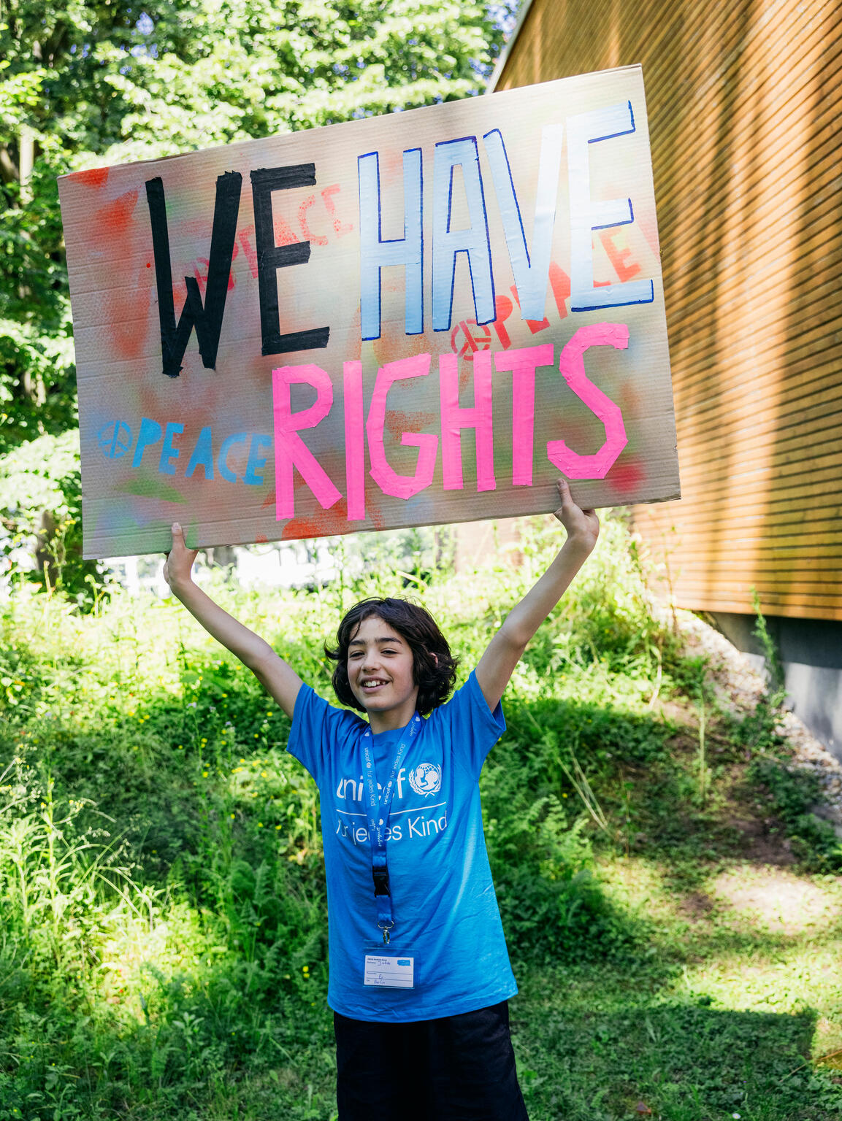
PART 1
REVIEWING YOUR RIGHTS WARM-UP
© UNICEF/Stroisch
A young campaigner at the 2024 Youth Festival, Mannheim, Germany.

Slide 3
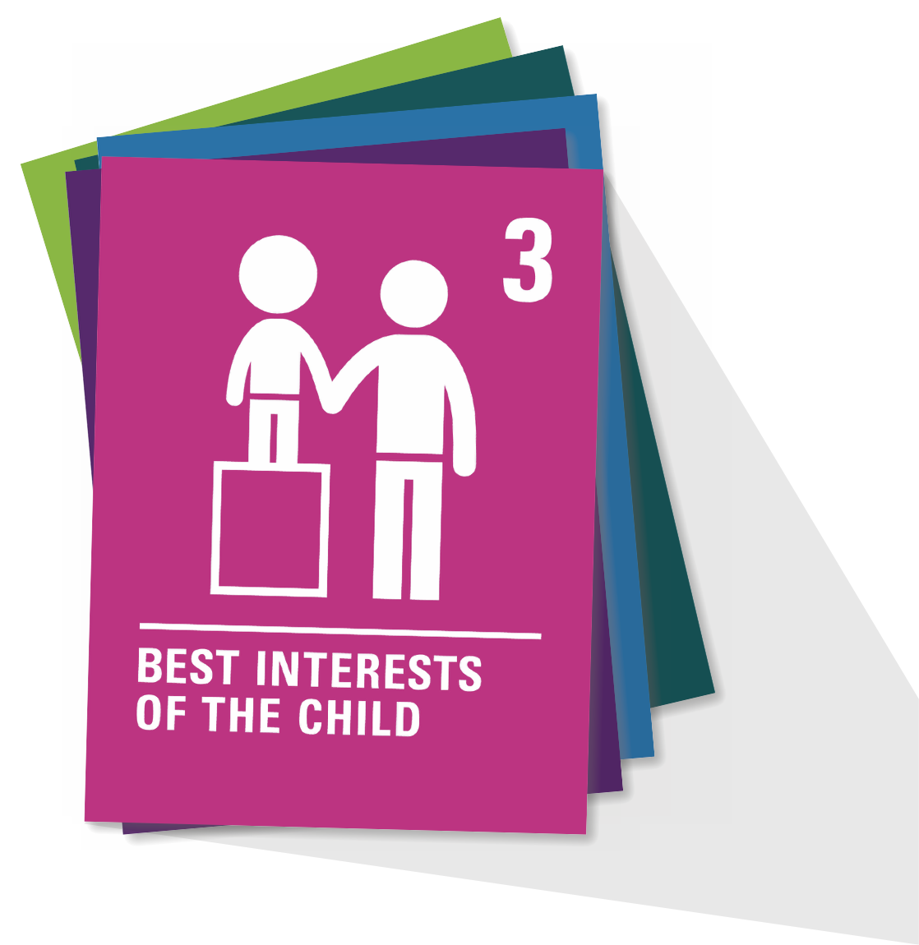
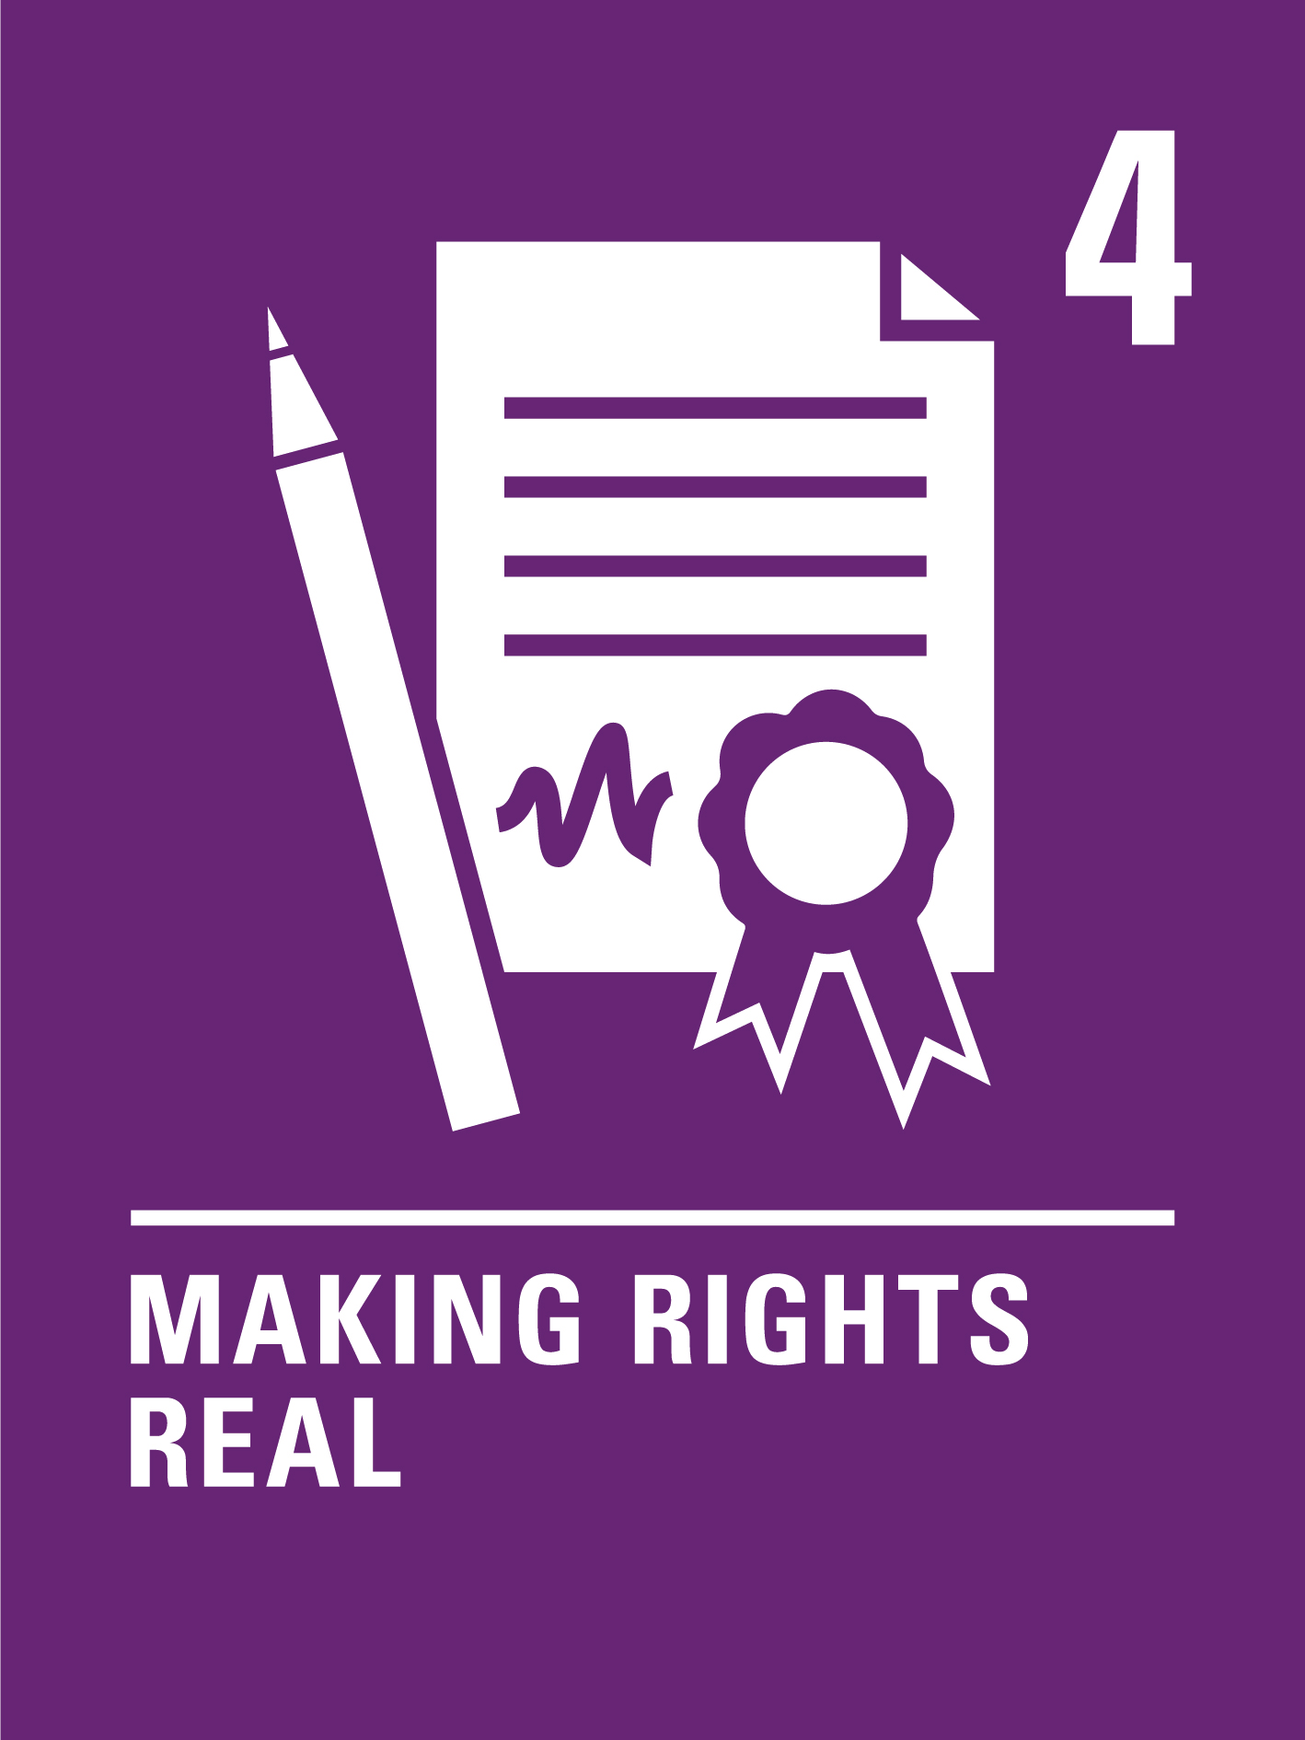
ARTICLE 4
Implementation of the CRC
Governments must do all they can to make sure every child can enjoy their rights by creating systems and passing laws that promote and protect children’s rights.

Slide 4
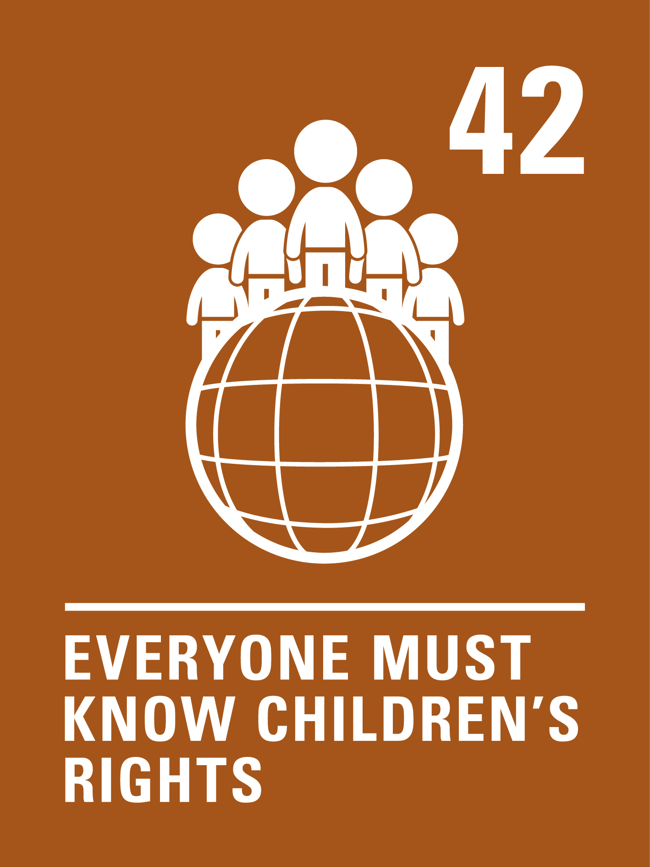
ARTICLE 42
Knowledge of rights
Governments must actively work to make sure children and adults know about the CRC.

Slide 5
PART 2
INTRODUCING THE CONCLUDING OBSERVATIONS

Slide 6
Reviewing young people’s reports to the UN Committee, and child-friendly Concluding Observations:
How could the Concluding Observations help you?
Which reported challenges to children’s rights do ​you also experience?
3 things that surprised you in the report

Slide 7
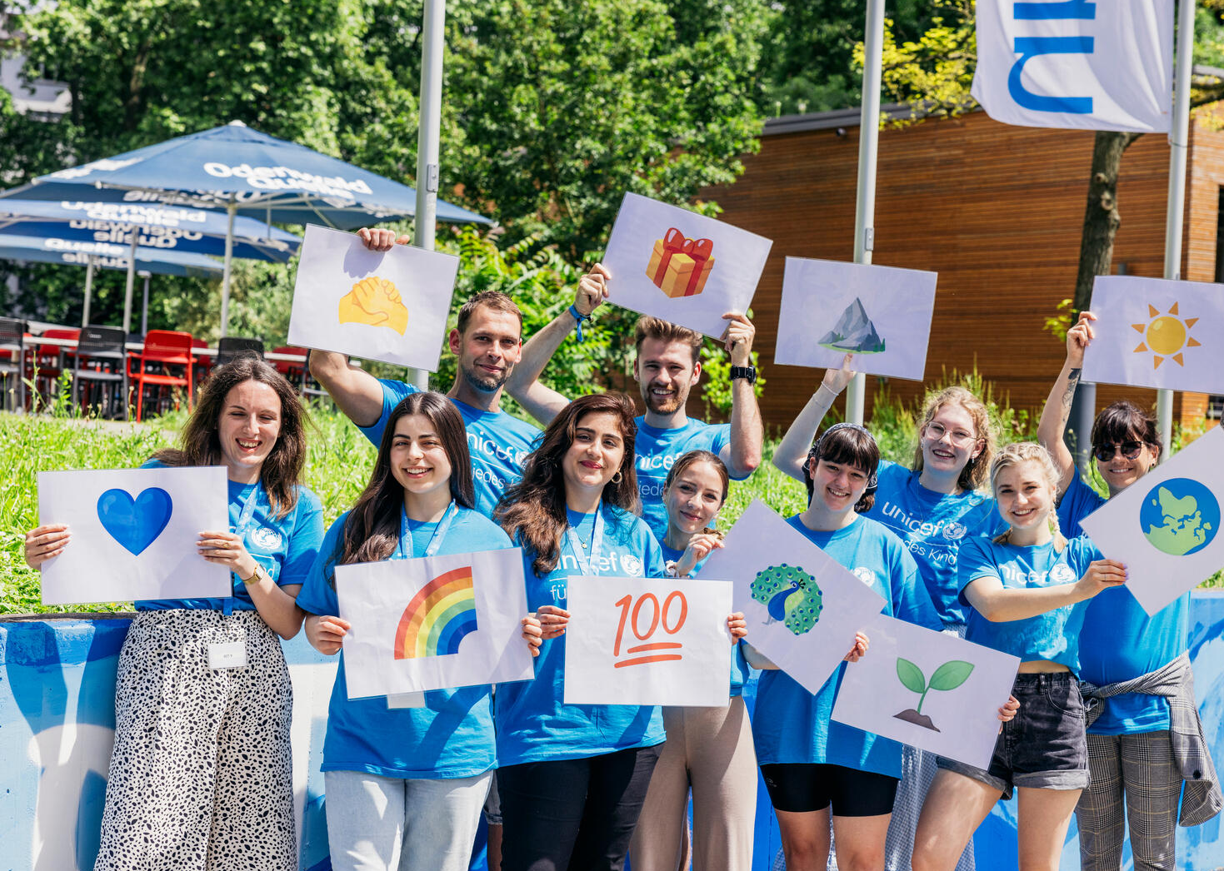
PART 3
CREATE YOUR OWN RIGHTS REPORT
Young people from all over Germany meet in Mannheim for the third UNICEF Youth Festival.

Slide 8
How do you think respect for children’s rights has changed since your interviewees were children?

Slide 9
Did anything surprise you in your discussions with people who were children before there was a CRC?

Slide 10
Did you find out about any times when children did not have their rights respected?

Slide 11
If you interviewed people who grew up outside the UK, what did you learn about differences for children between countries (in the past and now)?

Slide 12
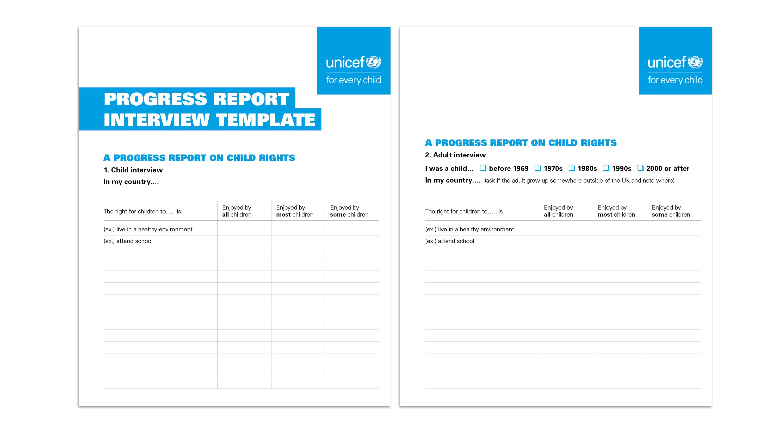
A PROGRESS REPORT ON CHILD RIGHTS

