Slide 1
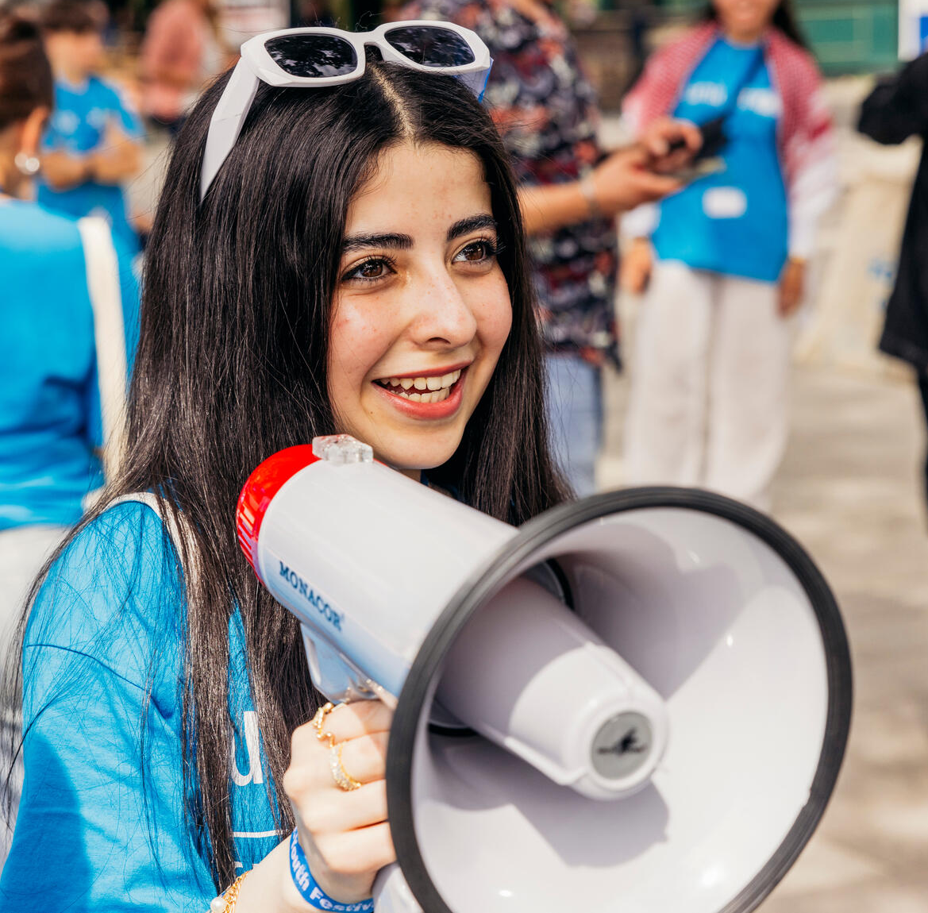
ACTIVITY 3 ELECTIONS AND USING YOUR VOICE IN DEMOCRACY
© UNICEF/Al-Safadi
Jannat, 15, rallies people with a megaphone at the UNICEF Youth Festival, Mannheim, Germany.
© UNICEF/Stroisch

Slide 2
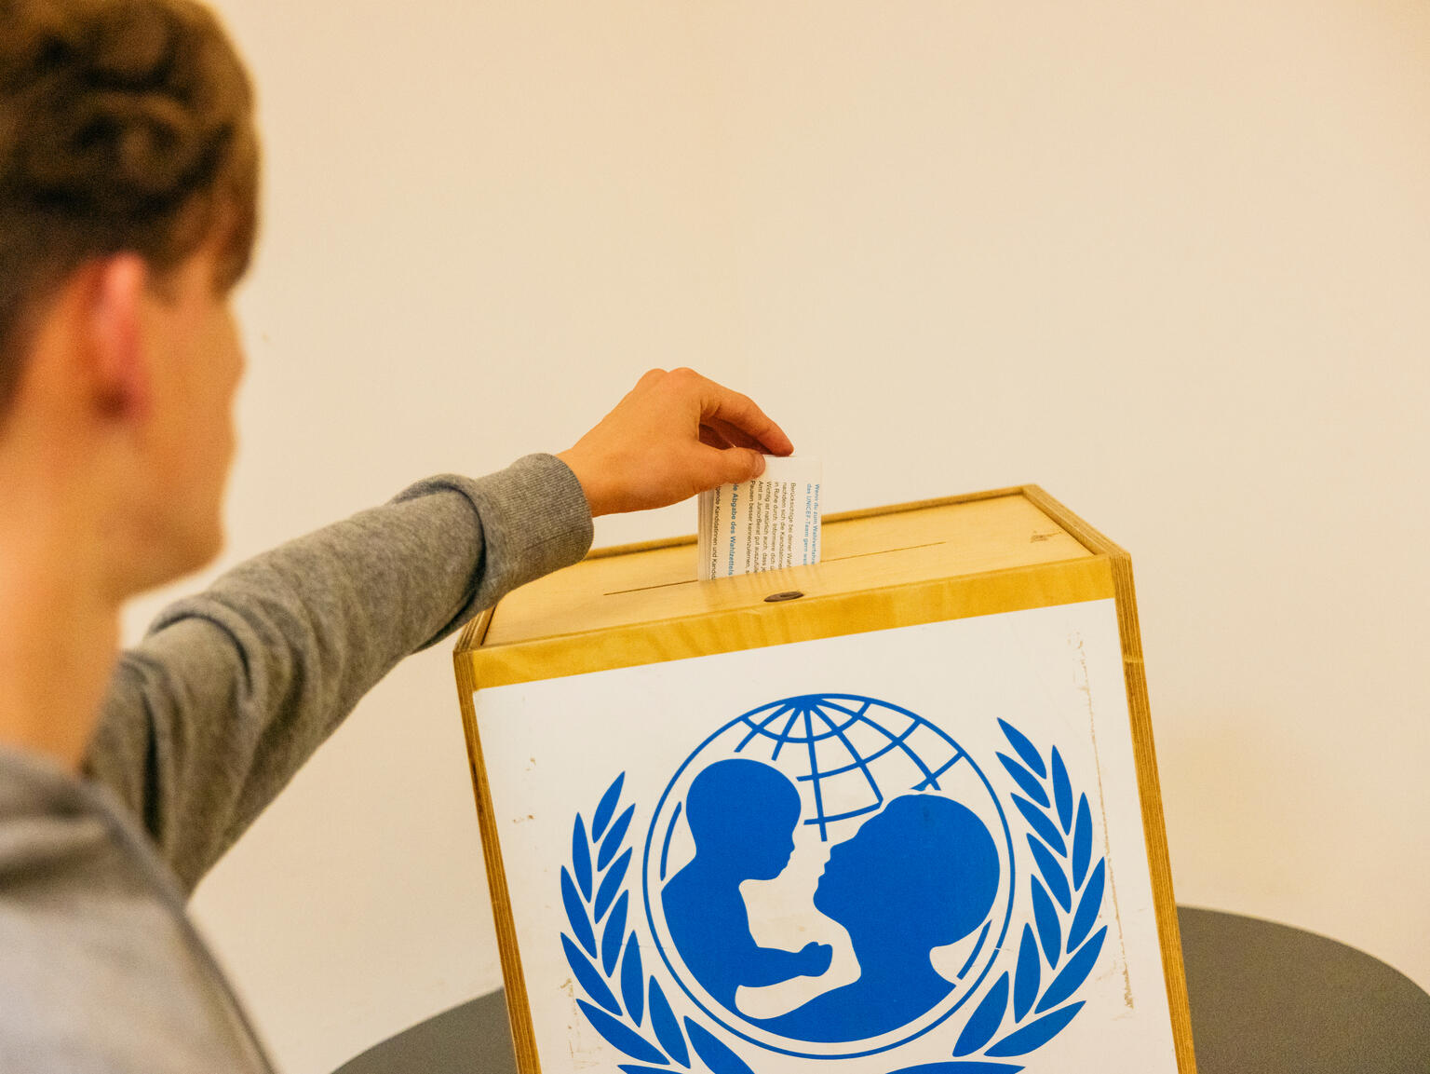
PART 1
REVIEWING YOUR RIGHTS WARM-UP
© UNICEF/Stroisch
Election time for the Youth Advisory Board at the 2024 Youth Festival, Mannheim, Germany.

Slide 3
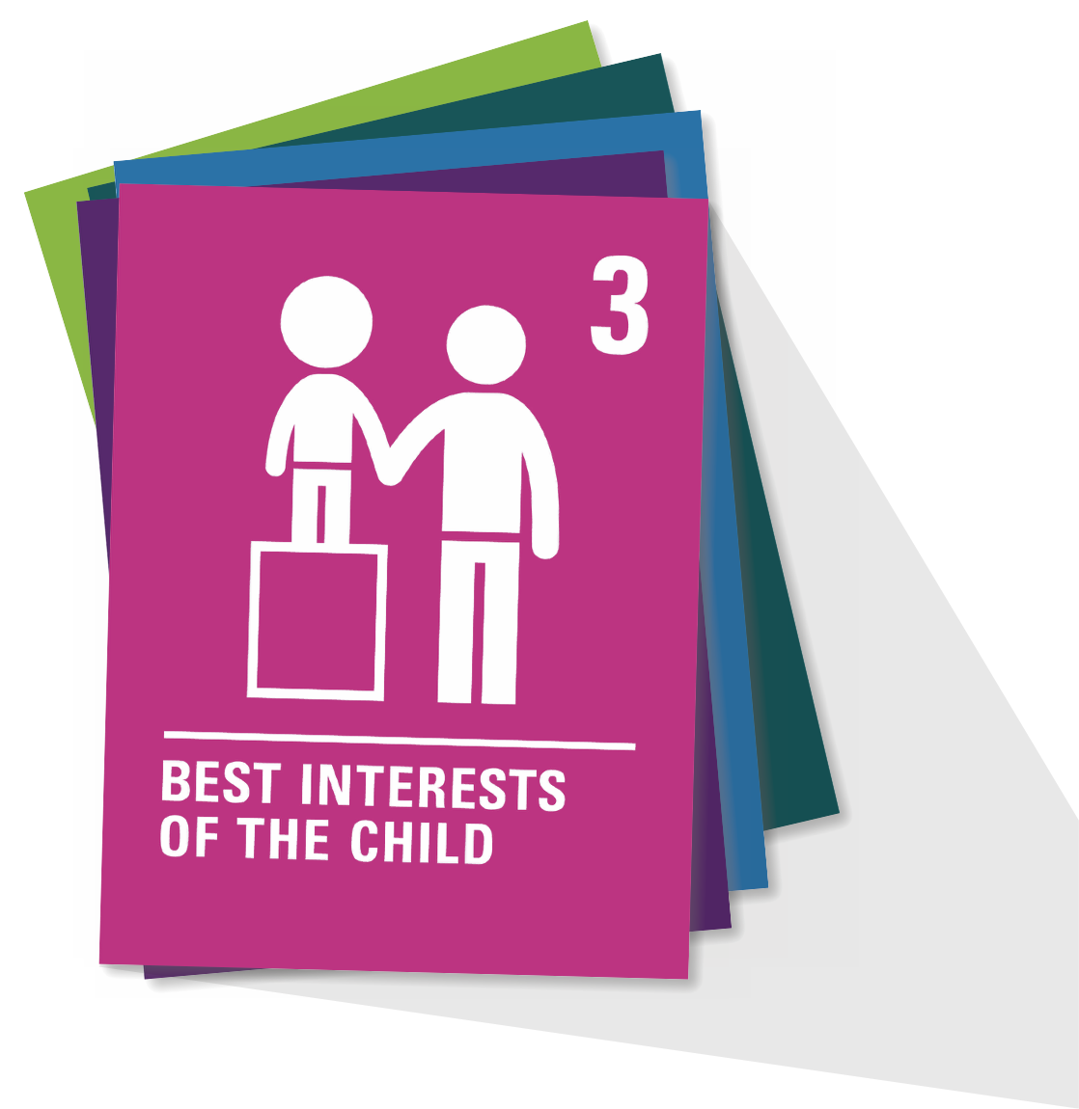
ARTICLE 3
Best interests of the child
The best interests of the child must be a top priority in all decisions and actions that affect children.

Slide 4
ARTICLE 4
Implementation of the CRC
Governments must do all they can to make sure every child can enjoy their rights by creating systems and passing laws that promote and protect children’s rights.

Slide 5
PART 2
QUESTION TIME
What do you know about general elections?

Slide 6
QUESTION 1
What is the role of the Prime Minister in the UK's parliamentary democracy?
a) Head of State
b) Head of Government
c) Chief Justice
d) Adviser to the King

Slide 7
QUESTION 1
What is the role of the Prime Minister in the UK's parliamentary democracy?
b) Head of Government

Slide 8
QUESTION 2
How often are general elections typically held in the UK?
a) Every 4 years
b) At least every 5 years
c) At least every 10 years
d) Only when called by the Prime Minister

Slide 9
QUESTION 2
How often are general elections typically held in the UK?
b) At least every 5 years

Slide 10
QUESTION 3
How many constituencies are represented in the House of Commons?
a) 360
b) 420
c) 500
d) 650

Slide 11
QUESTION 3
How many constituencies are represented in the House of Commons?
d) 650

Slide 12
QUESTION 4
Which UK country does not have its own devolved government?
a) England
b) Northern Ireland
c) Scotland
d) Wales

Slide 13
QUESTION 4
Which UK country does not have its own devolved government?
a) England

Slide 14
QUESTION 5
In the UK, which body is responsible for overseeing elections and ensuring they are conducted fairly?
a) Parliament
b) Electoral Commission
c) Supreme Court
d) House of Lords

Slide 15
QUESTION 5
In the UK, which body is responsible for overseeing elections and ensuring they are conducted fairly?
b) Electoral Commission

Slide 16
QUESTION 6
How old must you to be to vote in a UK general election?
a) 15 if you register with a parent
b) 16
c) 17
d) 18

Slide 17
QUESTION 6
How old must you to be to vote in a UK general election?
d) 18

Slide 18
QUESTION 7
What is the term used to describe the system where citizens elect candidates to represent the majority voice and make decisions on their behalf?
a) Direct democracy
b) Representative democracy
c) Autocracy
d) Monarchy

Slide 19
QUESTION 7
What is the term used to describe the system where citizens elect candidates to represent the majority voice and make decisions on their behalf?
b) Representative democracy

Slide 20
QUESTION 8
The representative from your local area who sits in the House of Commons and represents your voice in Parliament is your:
a) Member of Parliament (MP)
b) Parliamentary candidate
c) Local councillor
d) Cabinet minister

Slide 21
QUESTION 8
The representative from your local area who sits in the House of Commons and represents your voice in Parliament is your:
a) Member of Parliament (MP)

Slide 22
QUESTION 9
Members of Parliament (MPs) are elected by a plurality voting system referred to as:
a) Most votes wins
b) First past the post
c) Popular vote
d) Proportional representation

Slide 23
QUESTION 2
Members of Parliament (MPs) are elected by a plurality voting system referred to as:
b) First past the post

Slide 24
QUESTION 10
A candidate running for MP will publish this document, which publicly declares their views and intentions on issues:
a) Preamble
b) Constitution
c) Manifesto
d) Party pledge

Slide 25
QUESTION 10
A candidate running for MP will publish this document, which publicly declares their views and intentions on issues:
c) Manifesto

Slide 26
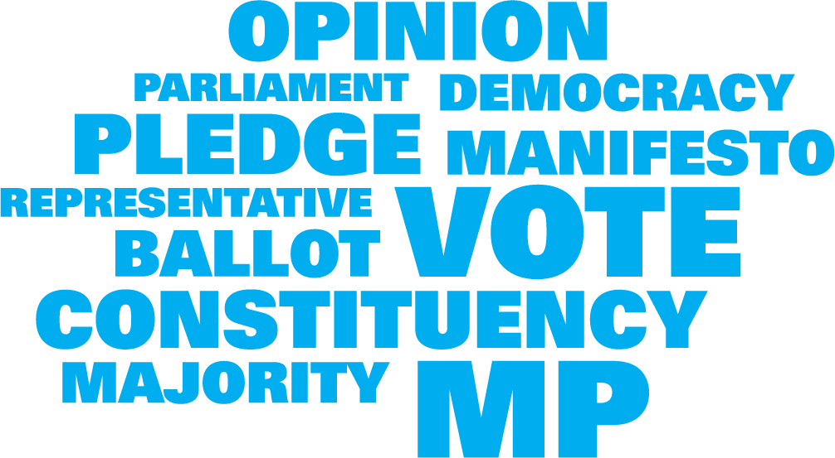
PART 3
VOTING = VOICE IN ACTION

Slide 27
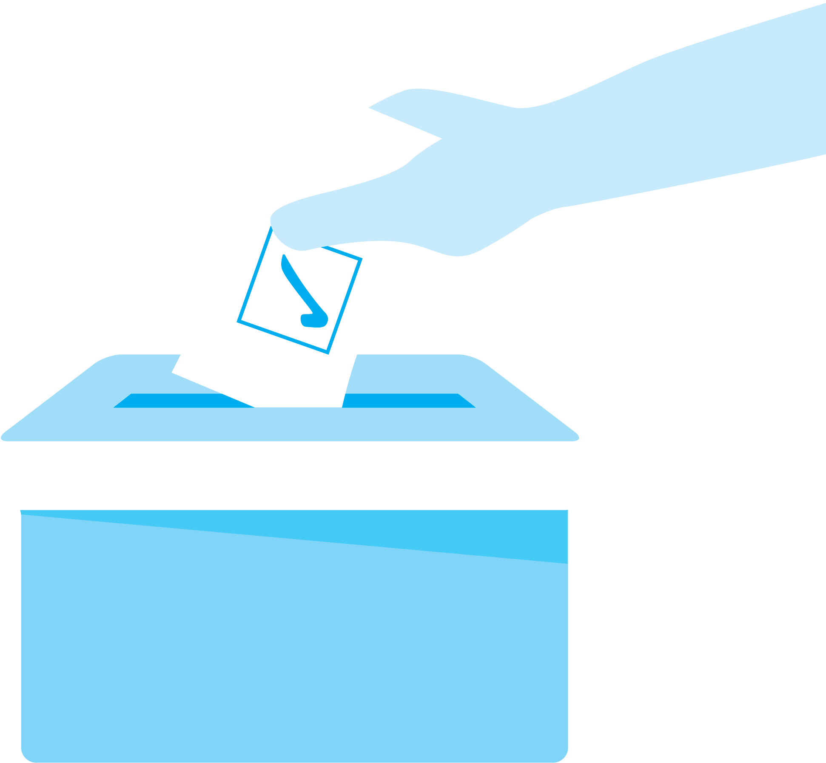
PART 4
MOCK ELECTION
Create your candidate and campaign

Slide 28
PART 5
How easy was it to represent the opinions of everyone in their group when creating your candidate?
How might a real candidate be challenged in representing everyone?
WRAP UP
In small groups with one member from each mock election candidate group,
take turns sharing some of the challenges you faced creating your candidate.
Realising that others have the same rights as you, how do your own words and actions help respect the rights of others?

