Slide 1
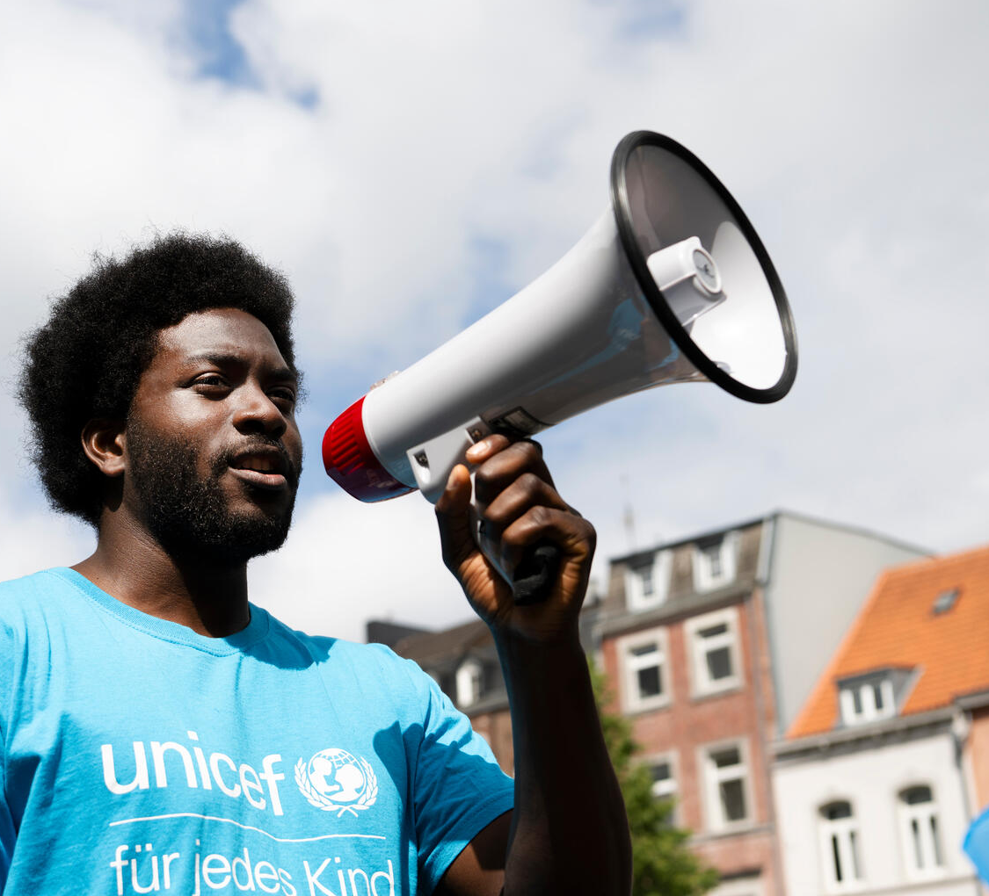
ACTIVITY 4 I AM A GLOBAL CITIZEN
© UNICEF/Al-Safadi
Participant with a megaphone at the annual meeting of UNICEF University Clubs in Aachen, Germany.
© UNICEF/Etges

Slide 2
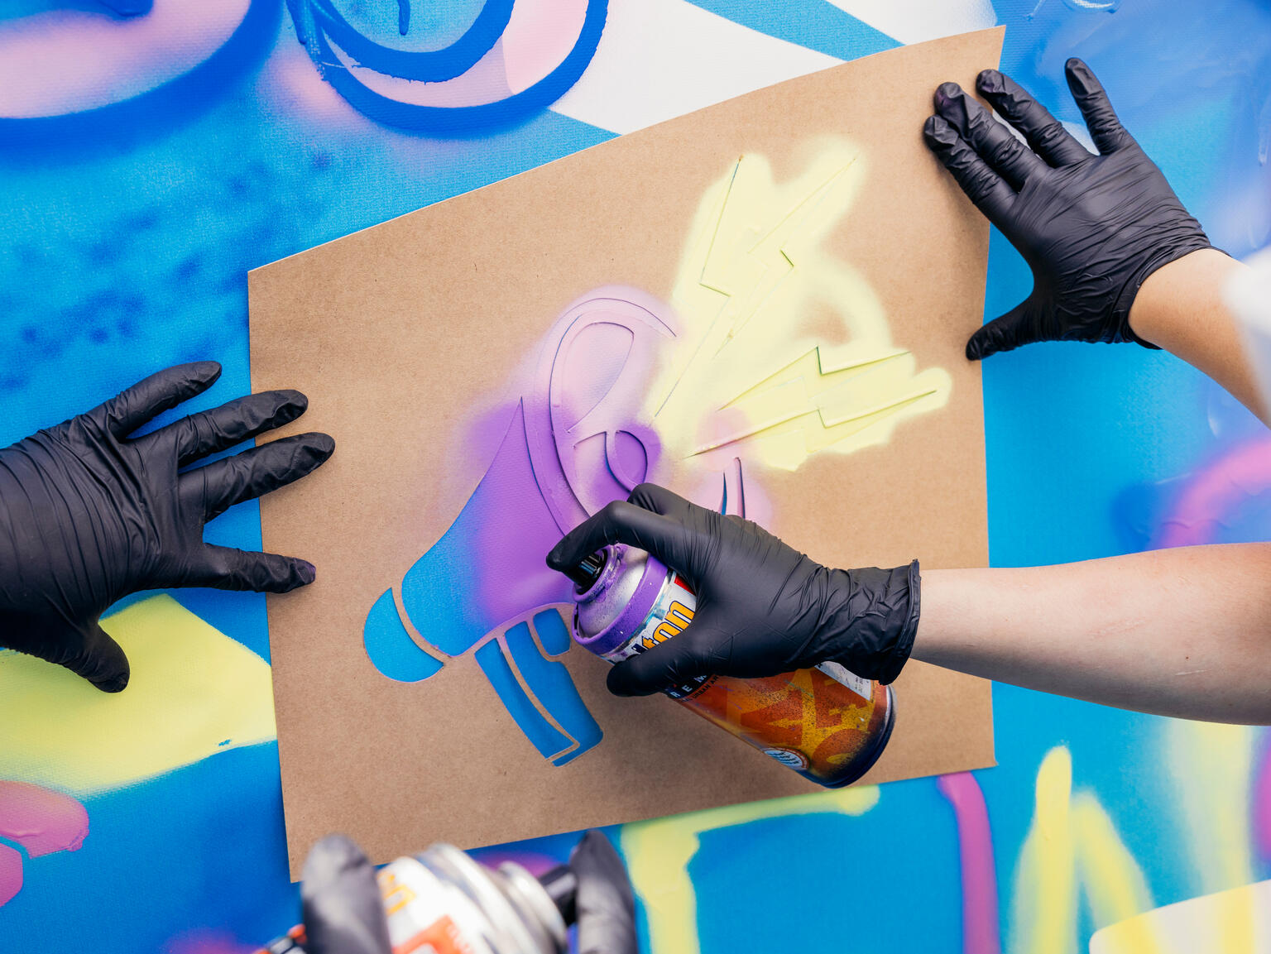
PART 1
REVIEWING YOUR RIGHTS WARM-UP
© UNICEF/Stroisch
Participants spraying during the 'Stand up – Speak up: Stand up for diversity and equal rights for every child' campaign in Mannheim, Germany.

Slide 3
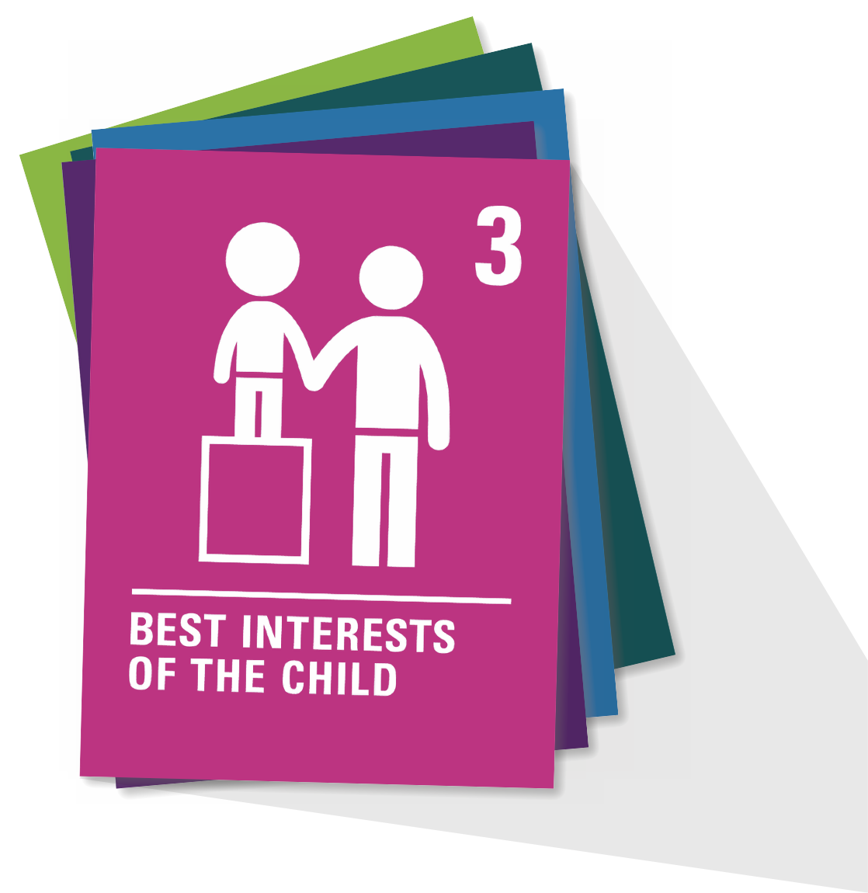
ARTICLE 3
Best interests of the child
The best interests of the child must be a top priority in all decisions and actions that affect children.

Slide 4
ARTICLE 29
Goals of education
Education must develop every child’s personality, talents and abilities to the full. It must encourage the child’s respect for human rights, as well as respect for their parents, their own and other cultures, and the environment.

Slide 5
PART 2
How does a global citizen think?
WHAT DOES
IT MEAN TO
BE A GLOBAL
CITIZEN?
What does a global citizen look like?
What does a global citizen do?
How does a global citizen speak? What do they say?

Slide 6
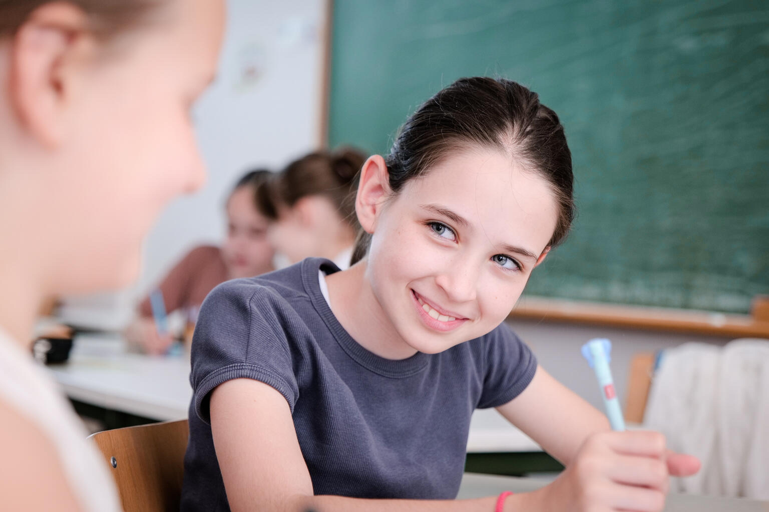
PART 3
UNICEF
GLOBAL CITIZEN
CASE STUDY
Students with developmental disabilities have been provided with educational support technology in Sarajevo.
© UNICEF/Djemidzich

Slide 7
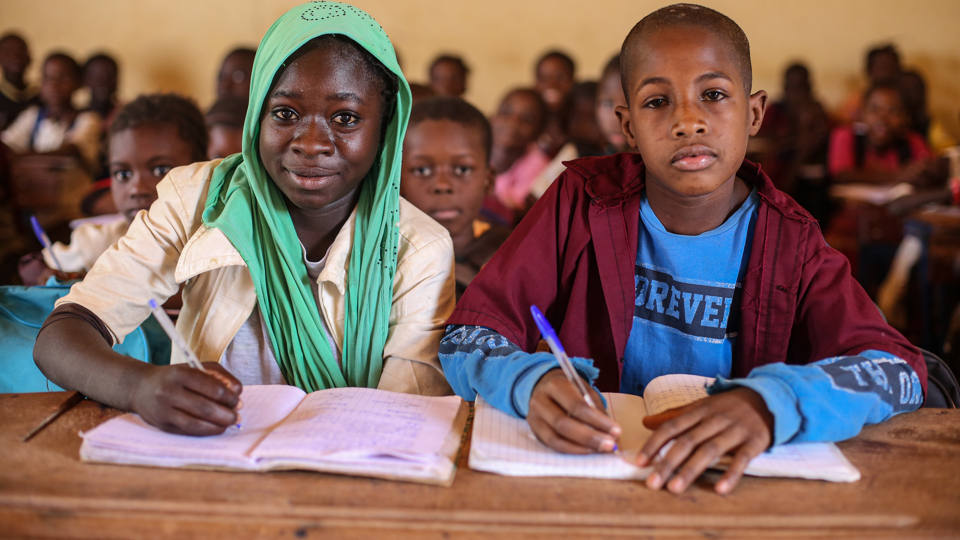
Climate
EDUCATION
© UNICEF/Awad
Grade five pupils at Diam Elementary School for girls participate in a lesson. Schools in Red Sea finally opened in early April 2024, almost a year since the war broke out in Sudan.

Slide 8
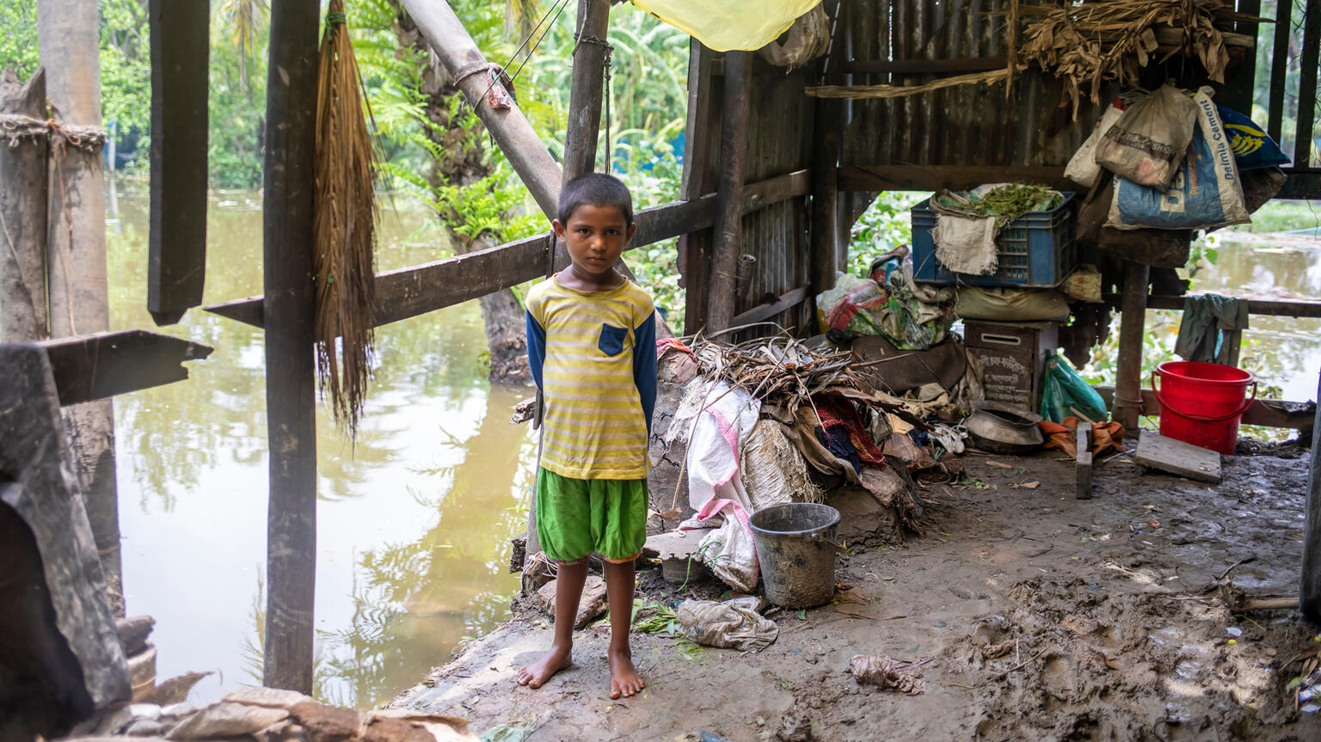
Climate
Sahana, 6, is at her broken and flooded house in Bagerhat District, Bangladesh.
CLIMATE
© UNICEF/Satu

Slide 9
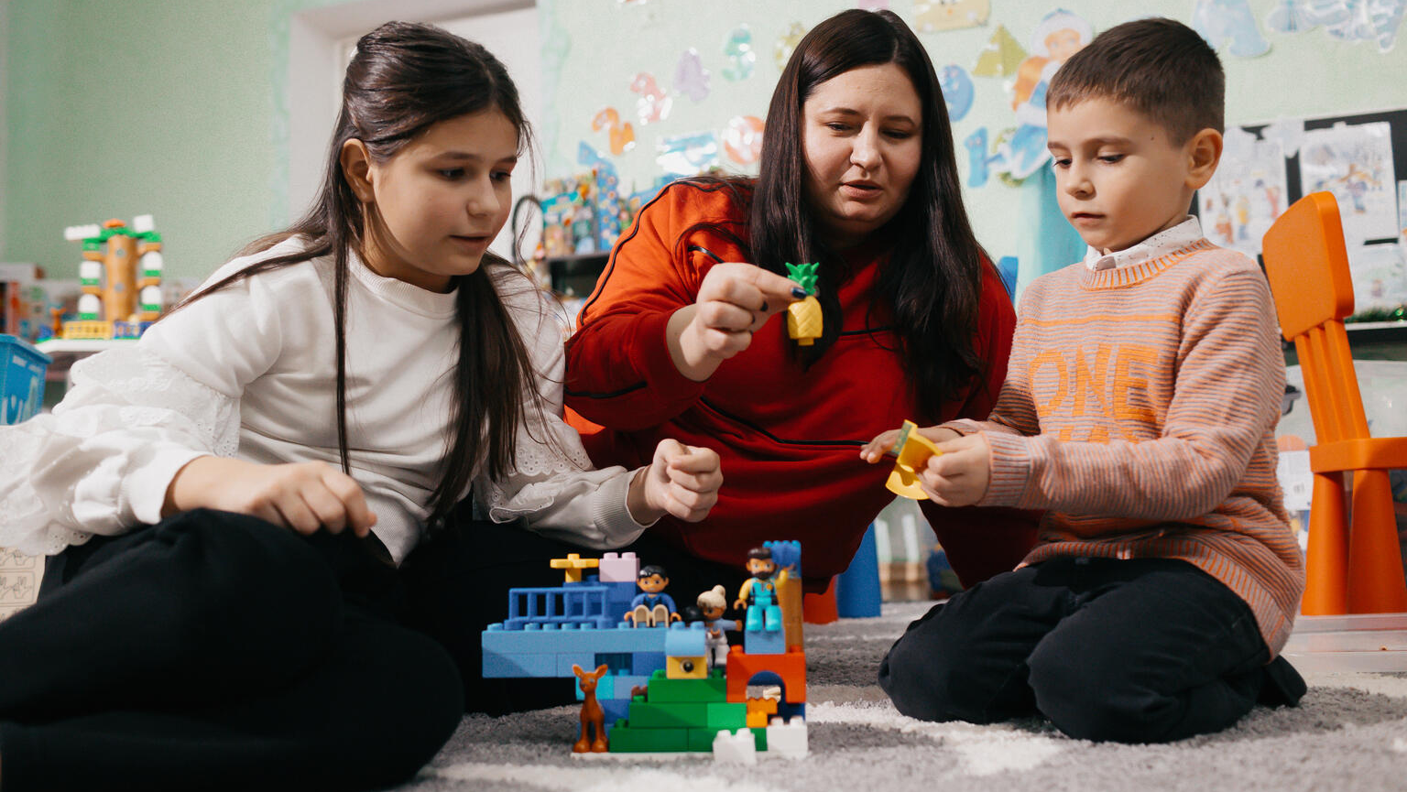
Climate
MIGRATION
© UNICEF/Tapes
Tatiana and her two children, Eva, 10, and Misha, 6, from Odesa, Ukraine, play together at the play and learning hub set up by UNICEF in Balti, Moldova.

Slide 10
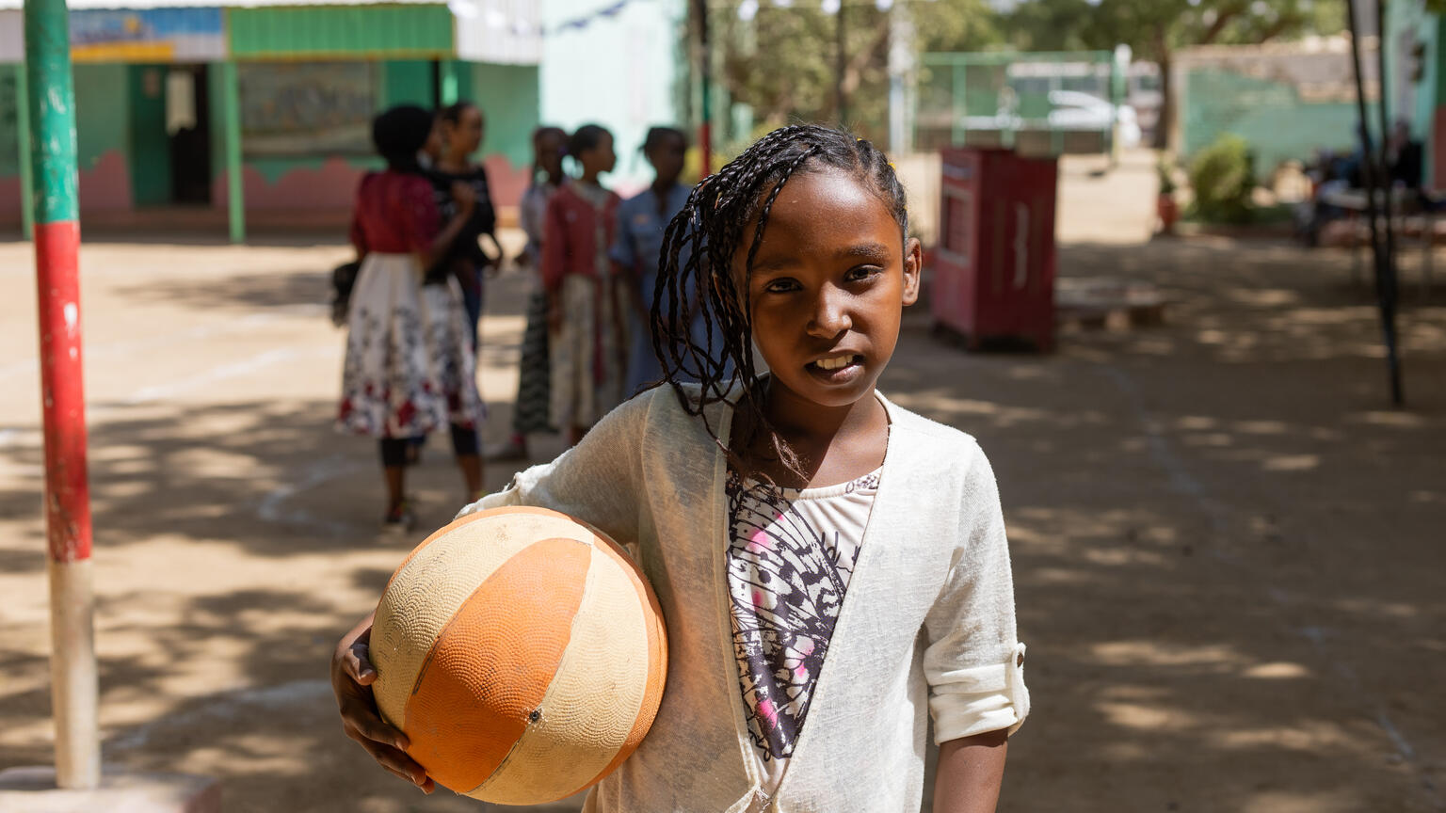
Climate
CONFLICT
© UNICEF/Elfatih
10-year-old Naba enjoys playing basketball with her friends at Alshargia safe learning space, Kassala, Sudan.

Slide 11
PART 4
MANIFESTO MAPPING
The group

Slide 12
Local issues

Slide 13
Global issues
National issues

Slide 14
PART 5
WRAP-UP DISCUSSION
What's one idea of something we could do as a group of global citizens to effect change in one of these issues we’ve talked about?
What's one topic that came up that you'd like to know more about?
In pairs or small groups consider:

