Slide 1
ACTIVITY 5 'I AM A CHANGEMAKER' MANIFESTO
© UNICEF/Al-Safadi
Enya, 8, at a Child Rights School in Lower Saxony, Germany.
© UNICEF/Etges

Slide 2
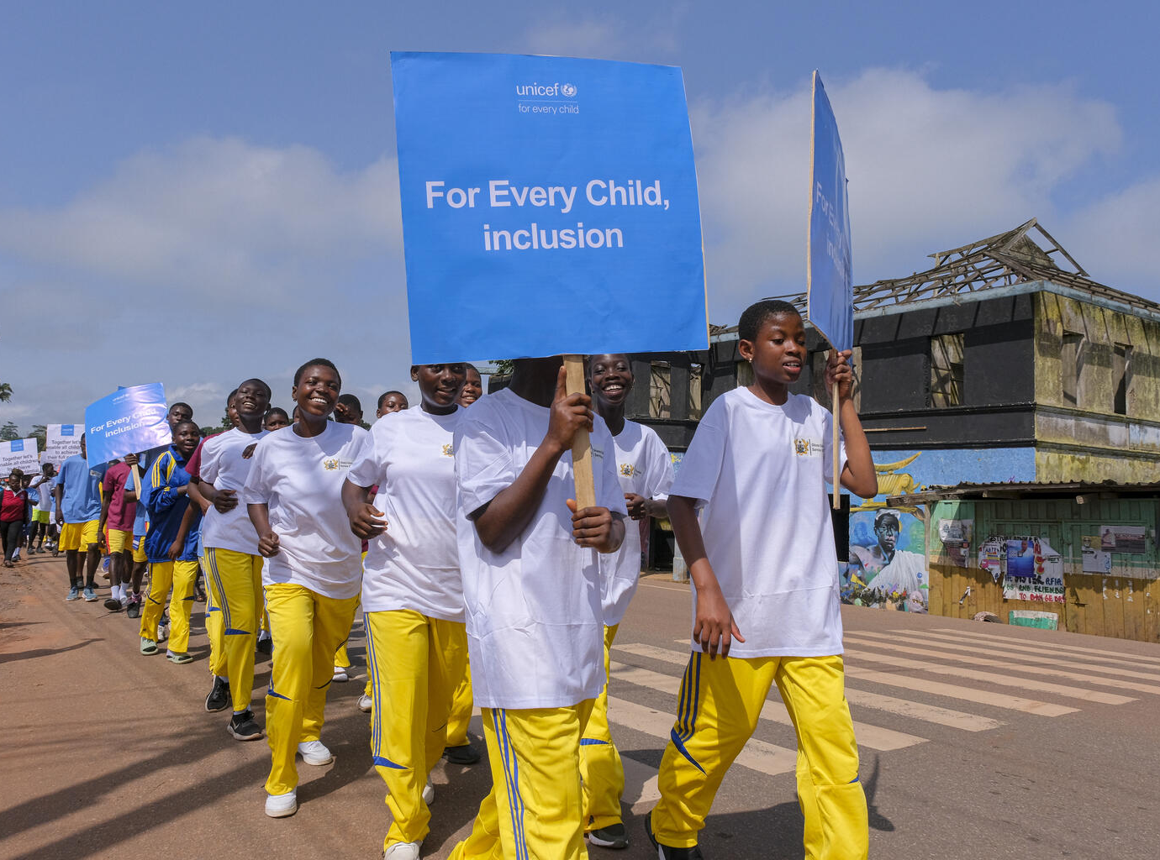
PART 1
REVIEWING YOUR RIGHTS WARM-UP
© UNICEF/Kokoroko
Students march in the streets during the Unified Football for Inclusion tournament held at the Akropong School for the Blind in Akropong, Ghana.

Slide 3
ARTICLE 3
Best interests of the child
The best interests of the child must be a top priority in all decisions and actions that affect children.

Slide 4
ARTICLE 12
Respect for the views of the child
Every child has the right to express their views, feelings and wishes in all matters affecting them, and to have their views considered and taken seriously. This right applies at all times, for example during immigration proceedings, housing decisions or the child’s day-to-day home life.

Slide 5
ARTICLE 13
Freedom of expression
Every child must be free to express their thoughts and opinions and to access all kinds of information, as long as it is within the law.

Slide 6
ARTICLE 29
Goals of education
Education must develop every child’s personality, talents and abilities to the full. It must encourage the child’s respect for human rights, as well as respect for their parents, their own and other cultures, and the environment.

Slide 7
PART 2
YOUNG
ACTIVISTS IN ACTION

Slide 8
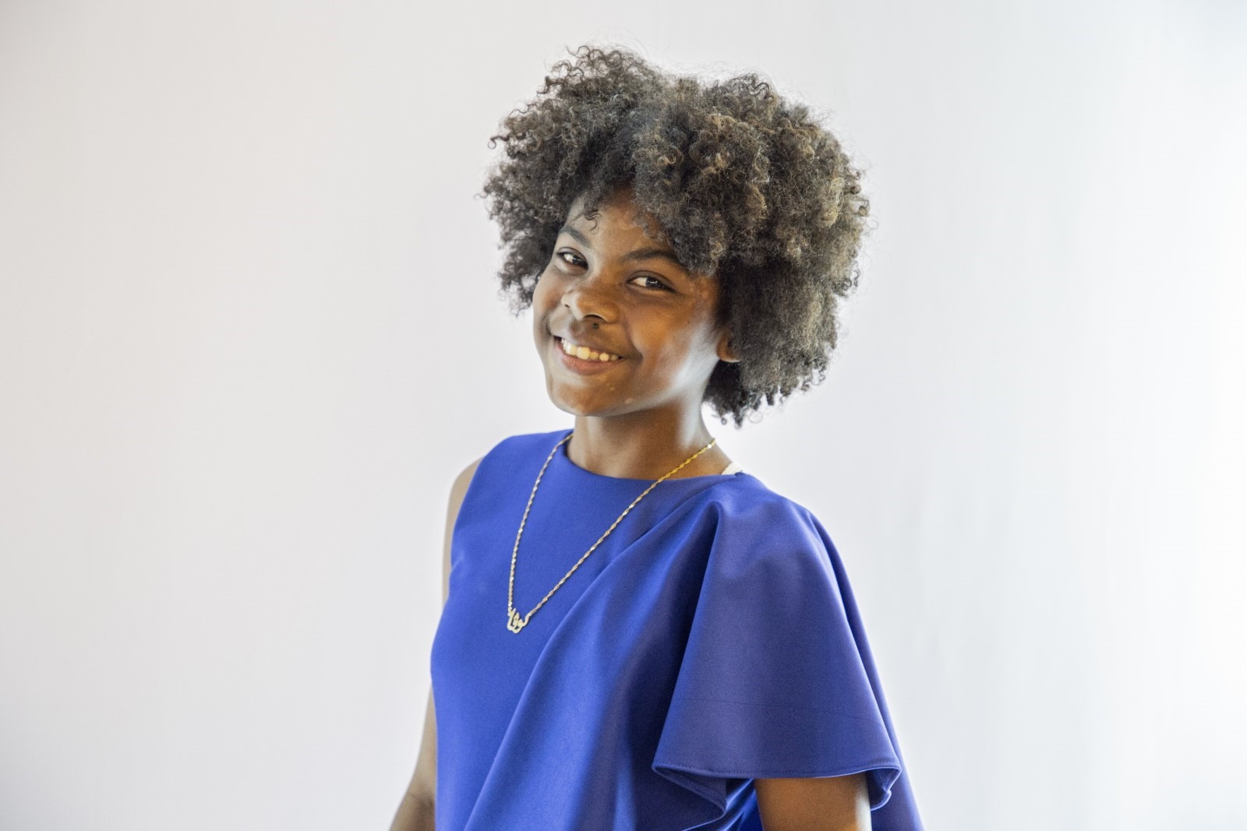
CASE STUDY 1
Lova Renée, 13 Madagascar
© UNICEF/

Slide 9
CASE STUDY 2
Emmanuel Jidisa, 14 Democratic Republic of the Congo (DRC)
© UNICEF/Mulala

Slide 10
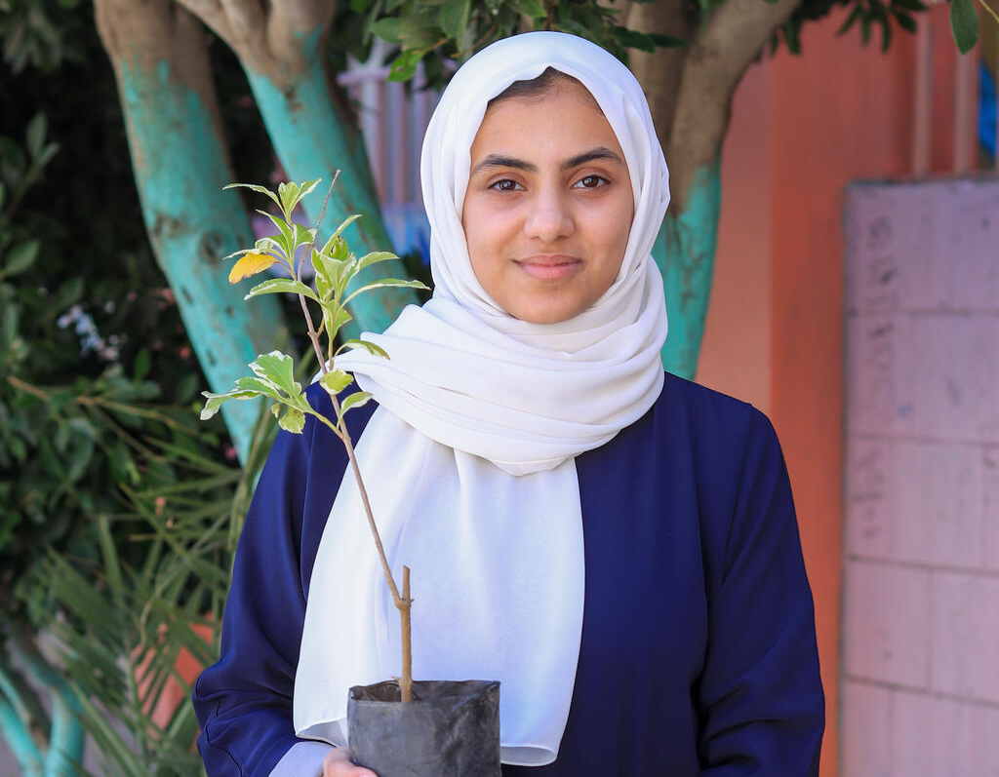
CASE STUDY 3
Areej Essam, 16 Yemen
© UNICEF/Abdullah

Slide 11
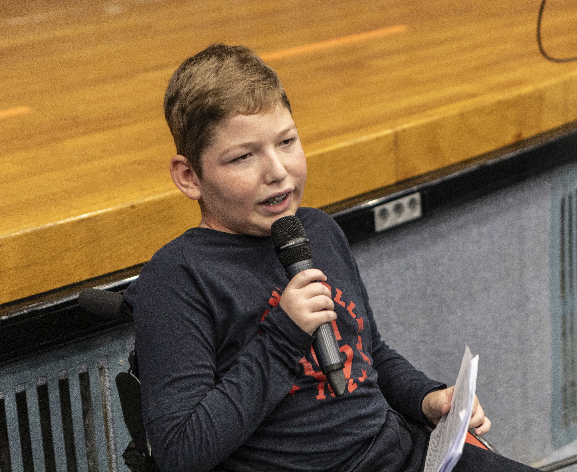
CASE STUDY 4
Panagiotis Raptis, 11 Greece
© UNICEF/

Slide 12
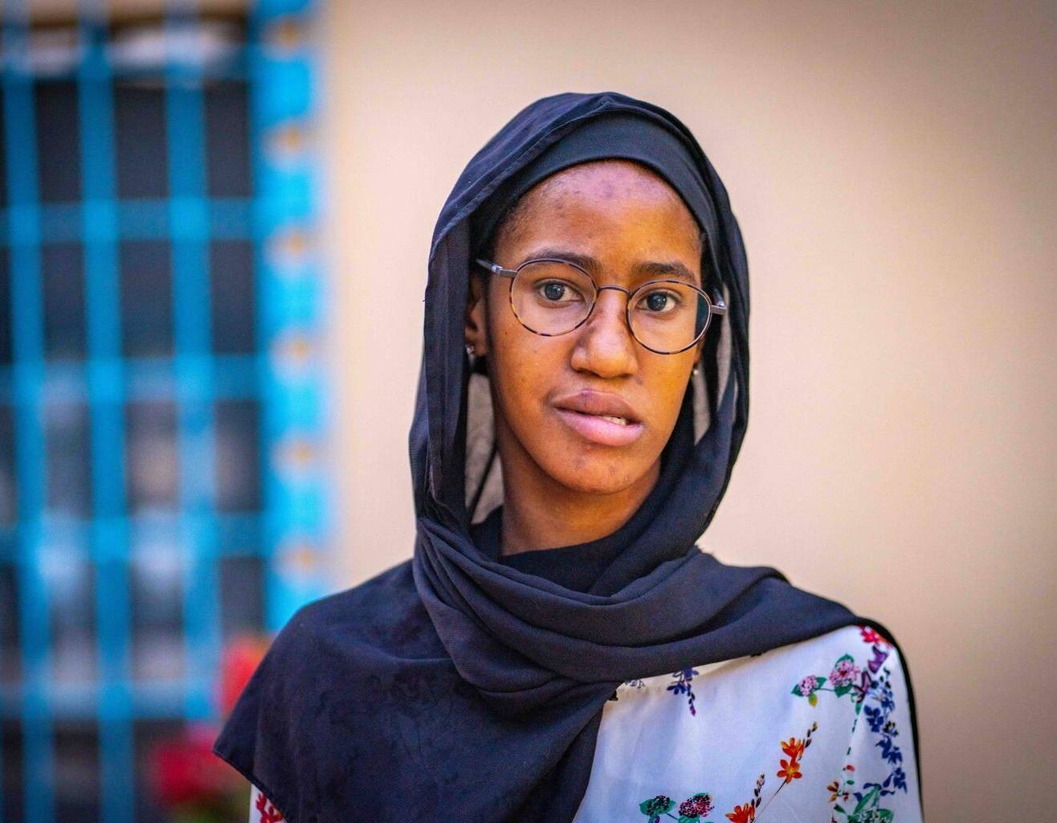
CASE STUDY 5
Aminata Doumbia, 16 Mali
© UNICEF/N'Daou

Slide 13
CASE STUDY 6
Ruairí Holohan, 16 Ireland
© UNICEF/Bindra

Slide 14
PART 3
A changemaking skill I have is...
I AM A CHANGEMAKER
A child-rights issue I care about is...
My vision for change is...

Slide 15
HEAD
HEART
HANDS
What do you want people to know?
Why should they care?
What do you want them to do?
Facts and statistics are important! But you should also try to tell a story about what can change.
Think about how you want people to feel
– what might they care about? Appeal to their specific interests and emotions.
Keep in mind what they can do and what they have power over.

Slide 16
PART 4
1 thing you can do with your skills to work towards change
WRAP-UP DISCUSSION: 1 REFLECTION
1 way you can practice your changemaking skill(s) and become an even stronger changemaker

