Slide 1
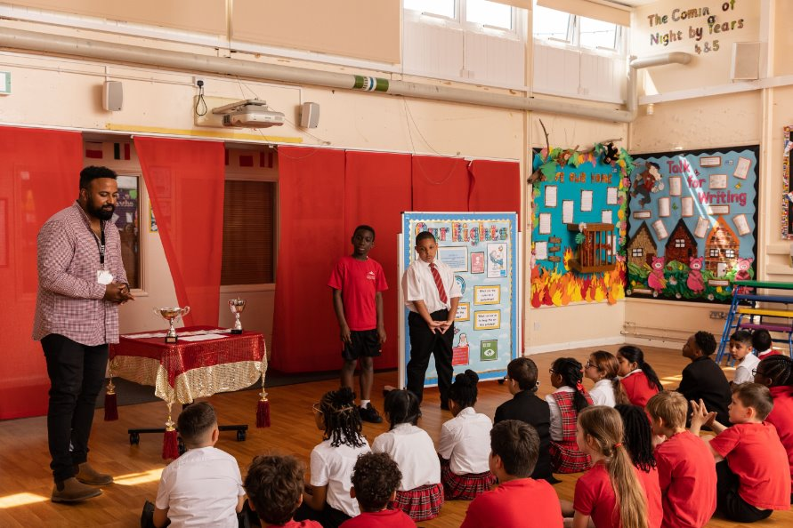
© UNICEF/Maule-ffinch
LEARNING ABOUT RIGHTS
THROUGH THE CURRICULUM
Notes:
Welcome to Spotlight, our latest resource to support RRSA coordinators to develop Rights Respecting practice in school.
Spotlight is aimed at colleagues and is intended to support you in staff briefings or continued professional development (CPD).
Please check guidance in subsequent slide notes.
Image caption: Children at a Gold Rights Respecting primary school take part in an assembly focused on their rights.

Slide 2
CONTENTS
Topic: Rights in the Curriculum
For each slide, please look at the presenter notes for delivery information.
Slide 3: Aims of the Session
Slide 4: Three ways to use this pack
Slide 5 : Introducing this month’s Spotlight
Slide 6: Links to RRSA Outcomes
Slide 7: Links to Articles
Slide 8: Where are we now? Discussion questions
Slide 9: Suggested Activities – Primary
Slide 10: Suggested Activities - Secondary
Slide 11: Case Study
Slide 12: Resources
Slide 13: Reflection

Slide 3
AIMS OF THE SESSION
To consider:
How we currently build teaching and learning about rights into our curriculum. ​
How this could be strengthened.​
How to ensure there is progression in knowledge and understanding of rights as pupils move through our school.
Notes:
Trainer notes: One area both new and experienced Rights Respecting Schools need to consider is how to support children and young people to develop their knowledge and understanding of children’s rights and human rights, and how this knowledge develops and deepens as they move through your setting.​
Whether you are a nursery considering how to introduce basic rights concepts to the youngest learners, a primary school considering how to develop a progression in understanding across your school, or a high school thinking about how to embed rights across a range of subject areas, this CPD session is intended to support you and your colleagues to strengthen our practice in this area.
.

Slide 4
THREE WAYS TO USE THIS PACK
DELETE THIS SLIDE BEFORE USING
Read through the slides and notes pages to identify the most relevant activities for your colleagues and any preparation or resources needed.
If time is tight, use the introduction slide and choose from the key discussion questions to explore with your colleagues.
If you have longer, you can also choose some of the activities to explore.
You may wish to cover the content over a number of staff meeting sessions.
Notes:
Trainer notes: Delete this slide before using.
It would be useful to have copies of the simplified CRC or the icons so that staff can refer to them throughout the session. Unicef.uk/CRC_Icons

Slide 5
SPOTLIGHT ON…
As a Rights Respecting School, we want our learners to develop knowledge and understanding of children’s rights. This could include rights vocabulary, CRC articles and key human rights concepts and values. In this session we will work together to map where we already teach about rights, where there are more opportunities to include rights learning and consider how children’s knowledge and understanding of rights develops as they move through our setting.
Sarah from the RRSA team introduces this month’s Spotlight.
Notes:
The video complements the content of this pack and can also be used separately, when introducing new staff to RRSA for example.

Slide 6
LINKS TO RRSA OUTCOMES
Strand A: TEACHING AND LEARNING ABOUT RIGHTS​
Outcome 1: Children, young people and the wider school community know about and understand the UN Convention on the Rights of the Child and can describe how it impacts on their lives and the lives of children everywhere. ​
​
Strand B: TEACHING AND LEARNING THROUGH RIGHTS​
Outcome 2: In school children and young people enjoy the rights enshrined in the Convention.​
Outcome 7: Children and young people value education and are involved in decisions about their learning.
Notes:
This slide can help you share the ‘structure’ of RRSA with your colleagues and provide and an overview of the programme. These three strands are not unique to the Award, they are recognised globally as the pillars for most human rights education.
These outcomes are particularly relevant to our curriculum. RRSA requires learners need to be learning about engaging with the various articles of the CRC wherever it is relevant to do so.

Slide 7
WHERE ARE WE NOW?
1. How do children and young people currently learn about CRC articles? Are rights included in assemblies? Which topics or subjects include rights?
2. How do children learn rights language and about rights values and principles such as equity, fairness, dignity, justice, the ‘ABCDE’ of rights?
3. What experiences do children take part in linked to rights? Consider developing a charter, being part of a pupil voice group, fundraising, campaigning, advocating.
Notes:
Presenter notes: Choose the questions that are most relevant to your setting and experience. Collect some of the ideas from your colleagues and add them to your action plan/evidence for your next stage of the Award.
Assemblies are great opportunities to discuss rights. How do you ensure coverage of a variety of articles from the CRC? Are rights also discussed in lessons/class/tutor time and is this planned or incidental or a bit of both? How do you know that rights are being discussed outside of assembly time? Is this something the steering group could find out e.g. gathering pupil voice? Would you see and/or hear rights being discussed outside of assemblies?
Again, assemblies are great opportunities to delve into rights language. Perhaps consider how this is further explored with your pupils. Some areas of the curriculum lend themselves particularly well to these conversations such as History and RE. What opportunities are there to explore this language and concepts in your setting?
We would not expect all pupils in all settings to experience all of these different activities but it is useful to consider how a child or young person experiences their rights in your setting.

Slide 8
PRIMARY SCHOOLS
In groups, draw a Rights Respecting classroom onto large pieces of flipchart paper. What do you see, hear and feel in a Rights Respecting classroom?
1. Consider the previous activity analysing where children already learn about rights. Are there any gaps? How could this be strengthened and improved? Is this explicitly mapped out within our planning to ensure that it happens every year?
2. How can we ensure children’s knowledge and understanding is deepening as they move through school? How is their learning about rights progressing as they progress through school?
3. Look at the example from William Fletcher Primary Could we create something similar for our school?
Notes:
Presenter notes: There are three suggestions for activities. Depending on the time you have available, choose one or more activities for your colleagues to work on together to further explore the topic. Different groups could explore different activities. The activities that you do not wish to use can be deleted.
Schools tell us that they use assemblies as a vehicle through which to explore rights which is a great start. How could you build on this? Subjects such as RE, History and PSHCE lend themselves particularly well to further rights discussion. How do you ensure that links are being made and rights are discussed outside of assemblies? How might articles from the CRC come up in less ‘obvious’ curriculum areas?
Once children have a good foundation of rights knowledge, it is useful to consider how this can be deepened and what opportunities there are for progression as they move through the school? Does rights learning look the same in Reception as it does in Y6? How can you ensure that the knowledge and understanding of children’s rights concepts is deepened as pupils learn and grow?
These settings have shared their work to give you ideas of how to strengthen this area of practice.

Slide 9
SECONDARY SCHOOLS
In groups, draw a Rights Respecting classroom onto large pieces of flipchart paper. What do you see, hear and feel in a Rights Respecting classroom?
3. How do you ensure children are deepening their rights knowledge as they move through the school?
Look at the example from The Howard School for ideas.
1. Work in subject or faculty teams. How can we strengthen links to articles within our curriculum?
2. Work in pastoral or year group teams. How do children learn about rights through their personal development programme, tutor time or PSHE?
Notes:
Presenter notes: There are three suggestions for activities. Depending on the time you have available, choose one or more activities for your colleagues to work on together to further explore the topic. Different groups could explore different activities. The activities that you do not wish to use can be deleted.
1. Some subjects lend themselves more readily to rights such as RE, History and PSHCE. Are links to rights included in planning for these subjects? We hope that schools make meaningful links to rights where possible but recognise it is not always possible. For example, some secondary maths departments include statistics based on rights (such as global data on access to clean water, education, vaccinations) as starter activities where relevant. Look at opportunities to make meaningful links.
2. Tutor time is a great opportunity for discussion linked to rights. Are rights included in planning for tutor time? How do you ensure coverage of rights and concepts throughout the year?
3. Does rights learning look the same when pupils start at your school and when they leave? How do you ensure a progression of knowledge and understanding as they move through school?

Slide 10
CASE STUDY
These two examples illustrate the approaches taken in a primary and a secondary school to incorporating children’s rights in the curriculum
Read the full case study online.
William Fletcher Primary School is a Gold Reaccredited Primary School in Oxfordshire.
“The CRC and children’s rights are present in all areas of the curriculum for all key stages. Our planning formats for lessons and units of work identify relevant links with the CRC and these are made explicit to children during lessons. We are in the process of implementing a new English scheme which we feel will really lend itself well to children’s rights, as it covers texts and stories from different cultures and will help us diversify the texts we use and stories we work with.”
The Howard School is an all-boys non-selective secondary school with over 1500 students and a sixth form with girls too. Based in Medway, a unitary authority in Kent, they are a RRSA Gold Reaccredited school.
“​Staff have been trained on the breadth of the CRC and have had opportunities to discuss where our own lessons and practices can make links. Examples include Article 40 in RE when we learn about young offenders, Article 17 when students explore sources of information in English, Article 8 in history as they explore WW2. We also have specific opportunities to discuss articles in our personal development calendar, it's delivered centrally which has many benefits, giving the same message to all students.”
Notes:
The full case study is available on the RRSA website, where you can print it out and share with your colleagues if you are choosing to focus on this as part of your session.

Slide 11
RESOURCES
You may find the following resources useful for your work on embedding rights throughout the curriculum:
Child-friendly CRC text and icons
Article of the Week
Spotlight CPD packs
RRSA and Ofsted framework
RRSA in Secondary Schools
RRSA in Early Years
Case Studies
Useful learning materials and guidance
Notes:
Trainer notes: Encourage your colleagues to explore the RRSA website to find additional resources. If you have time, please explore these links ahead of your session with colleagues. You may well find a particular resource that you want to highlight to all as part of your input. There may be links you want to share with the team ahead of or as follow up to your input with them.

Slide 12
REFLECTION
© UNICEF/Dawe
Imagine your school through the eyes of a pupil at the start of their time with you. What do you hope that they learn and experience in relation to rights?
Now imagine your school through the eyes of a pupil at the end of their time with you. What knowledge and experience in relation to rights do you hope that they have? How will this help them in the next stage of their lives?

