Slide 1
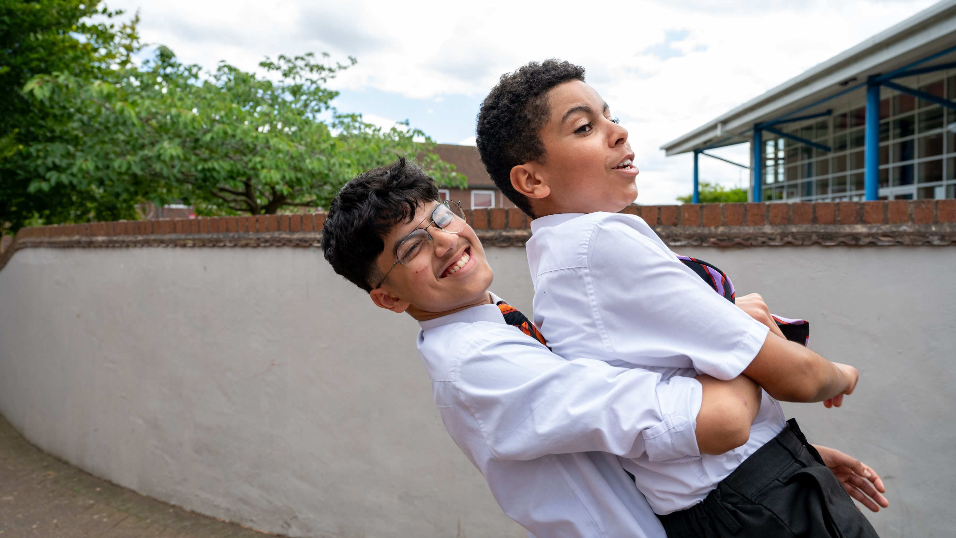


© UNICEF/Maule-ffinch
BALANCING RIGHTS
Notes:
Welcome to Spotlight, our latest resource to support RRSA coordinators to develop Rights Respecting practice in school.
Spotlight is aimed at colleagues and is intended to support you in staff briefings or continued professional development (CPD).
Please check guidance in subsequent slide notes.
Image caption: One student balances while carrying another at a Gold Rights Respecting secondary school.

Slide 2

CONTENTS
Topic: Balancing Rights
For each slide, please look at the presenter notes for delivery information.
Slide 3: Aims of the Session
Slide 4: Three ways to use this pack
Slide 5 : Introducing this month’s Spotlight
Slide 6: Links to RRSA Outcomes
Slide 7: Links to Articles
Slide 8: Let’s Discuss
Slide 9: Activities
Slide 10: Activities
Slide 12: Resources
Slide 13: Reflection

Slide 3

AIMS OF THE SESSION
To recognise that many rights can be limited or qualified in some way. ​
To understand that although rights are interdependent, they may sometimes conflict with each other. ​
To understand how and why rights may need to be balanced or limited.​
To develop confidence in using nuanced language to support learners in understanding the above.
Notes:
Presenter notes: Please edit the aims of the session to suit the time you have available for your session. ​
​
This session is intended to support you in helping staff to develop a more informed understanding about how rights work in practice and to develop confidence in their role of sometimes having to limit and/or balance rights for children and young people. ​
​
The whole Spotlight series is about empowering staff across your setting to embed children’s rights within a wide range of school priorities and practices. ​
.

Slide 4
THREE WAYS TO USE THIS PACK
DELETE THIS SLIDE BEFORE USING
Read through the slides and notes pages to identify the most relevant activities for your colleagues and any preparation or resources needed.
If time is tight, use the introduction slide and choose from the key discussion questions to explore with your colleagues.
If you have longer, you can also choose some of the activities to explore.
You may wish to cover the content over a number of staff meeting sessions.
Notes:
Trainer notes: Delete this slide before using.
It would be useful to have copies of the simplified CRC or the icons so that staff can refer to them throughout the session. Unicef.uk/CRC_Icons

Slide 5


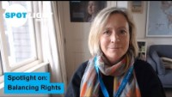
SPOTLIGHT ON…
Rights are unconditional and inalienable, they cannot be taken away. However, they do sometimes need to be qualified or limited in order to balance one right with another or to balance the rights of an individual with the rights of the community. It is the duty bearer’s role to take a decision on if and how such balancing or limitation is managed – this does not mean the right has been taken away, it means that it has been limited for a specified amount of time to protect other rights.
Isobel from the RRSA team introduces this month’s Spotlight.
Notes:
The video complements the content of this pack and can also be used separately, when introducing new staff to RRSA for example.

Slide 6

LINKS TO RRSA OUTCOMES
Strand A: TEACHING AND LEARNING ABOUT RIGHTS​
Outcome 1: Children, young people and the wider school community know about and understand the United Nations Convention on the Rights of the Child and can describe how it impacts on their lives and on the lives of children everywhere.​
Strand B: TEACHING AND LEARNING FOR RIGHTS​
Outcome 2: In school children and young people enjoy the rights enshrined in the United Nations Convention on the Rights of the Child. ​
Outcome 3: Relationships are positive and founded on dignity and a mutual respect for rights.
Notes:
Presenter notes: This month’s theme probingly applies to all the outcomes of the Award. We have highlighted three here:​
Knowledge of rights is not just knowing a range of articles but understanding how rights work. Children and young people need to recognise that for all rights to work together, there sometimes has to be a balancing of competing rights.​
​
Respecting everyone’s rights all of the time requires some compromises – duty bearers in school are there to ensure that Articles 28 and 29 are realised but they also have a duty to ensure that all other rights are enjoyed too. The balancing of rights should always include decisions taken in the best interests of the child, which, in turn, should always include their meaningful participation.​​
​
This slide provides an opportunity to remind colleagues of the ‘structure’ of RRSA which includes three strands: Teaching about rights; through rights; and for rights.​
​
Balancing Rights is particularly relevant to Outcome 1 in Strand A and Outcomes 2 and 3 in Strand B. However, balancing rights is relevant to all the rights in the CRC and can therefore be discussed in relation to any of the outcomes. ​
Strand A, Outcome 1: ​
​
Pupils need to develop knowledge and understanding of children’s rights and how children and young people can access their rights, or not, in their own community and the wider world. This knowledge of the wider world can be developed through assemblies, curriculum topics and subject areas, access to news programmes such as Newsround and Picture News. Balancing Rights can form a useful discussion framework for analysing current affairs and debating issues. ​
​
Strand B, Outcome 2 and 3: ​
​
In Rights Respecting Schools, Rights Holders (the children) and Duty Bearers (the adults) work together to create a rights respecting environment. For this to work, everyone needs to understand how rights sometimes need to be balanced and may need to be limited in certain circumstances. This is all part of learning to respect not just your own rights but the rights of the whole school community.​
​
The full text of the Strands and Outcomes of the Award can be found here:​
www.unicef.org.uk/rights-respecting-schools/wp-content/uploads/sites/4/2015/06/RRSA-Strands-and-Outcomes-at-Silver-and-Gold-1.pdf​
​

Slide 7

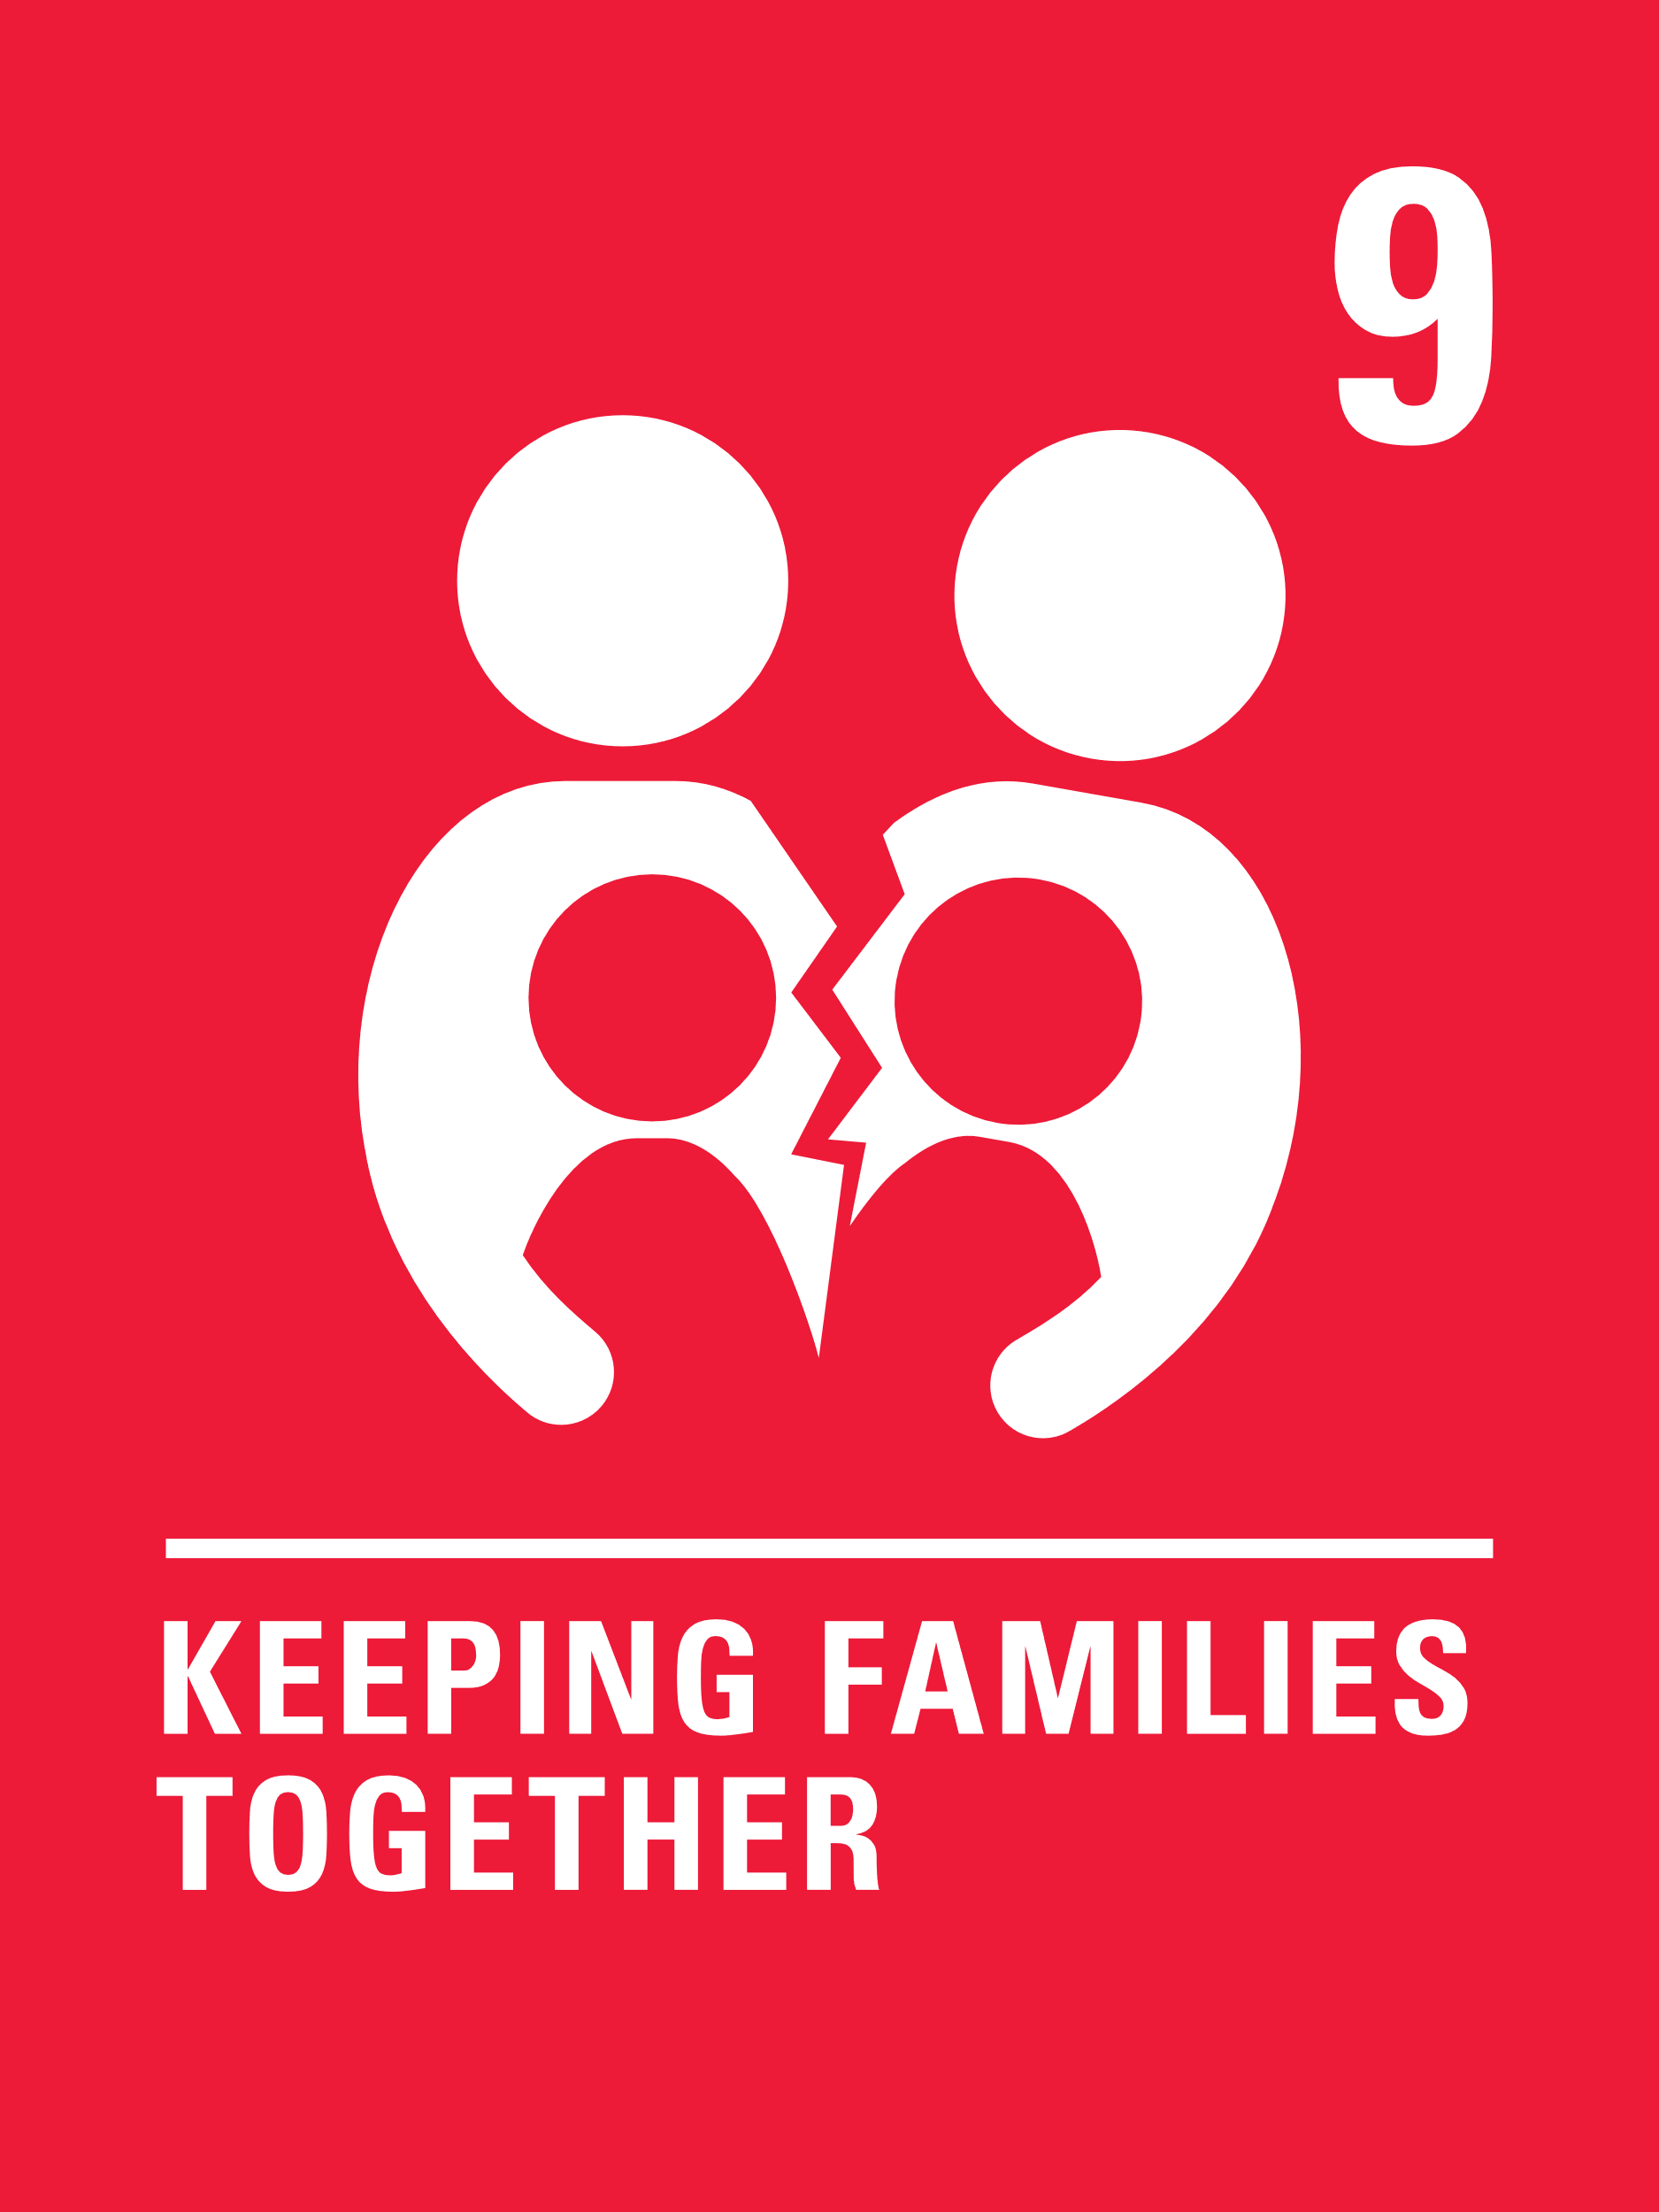


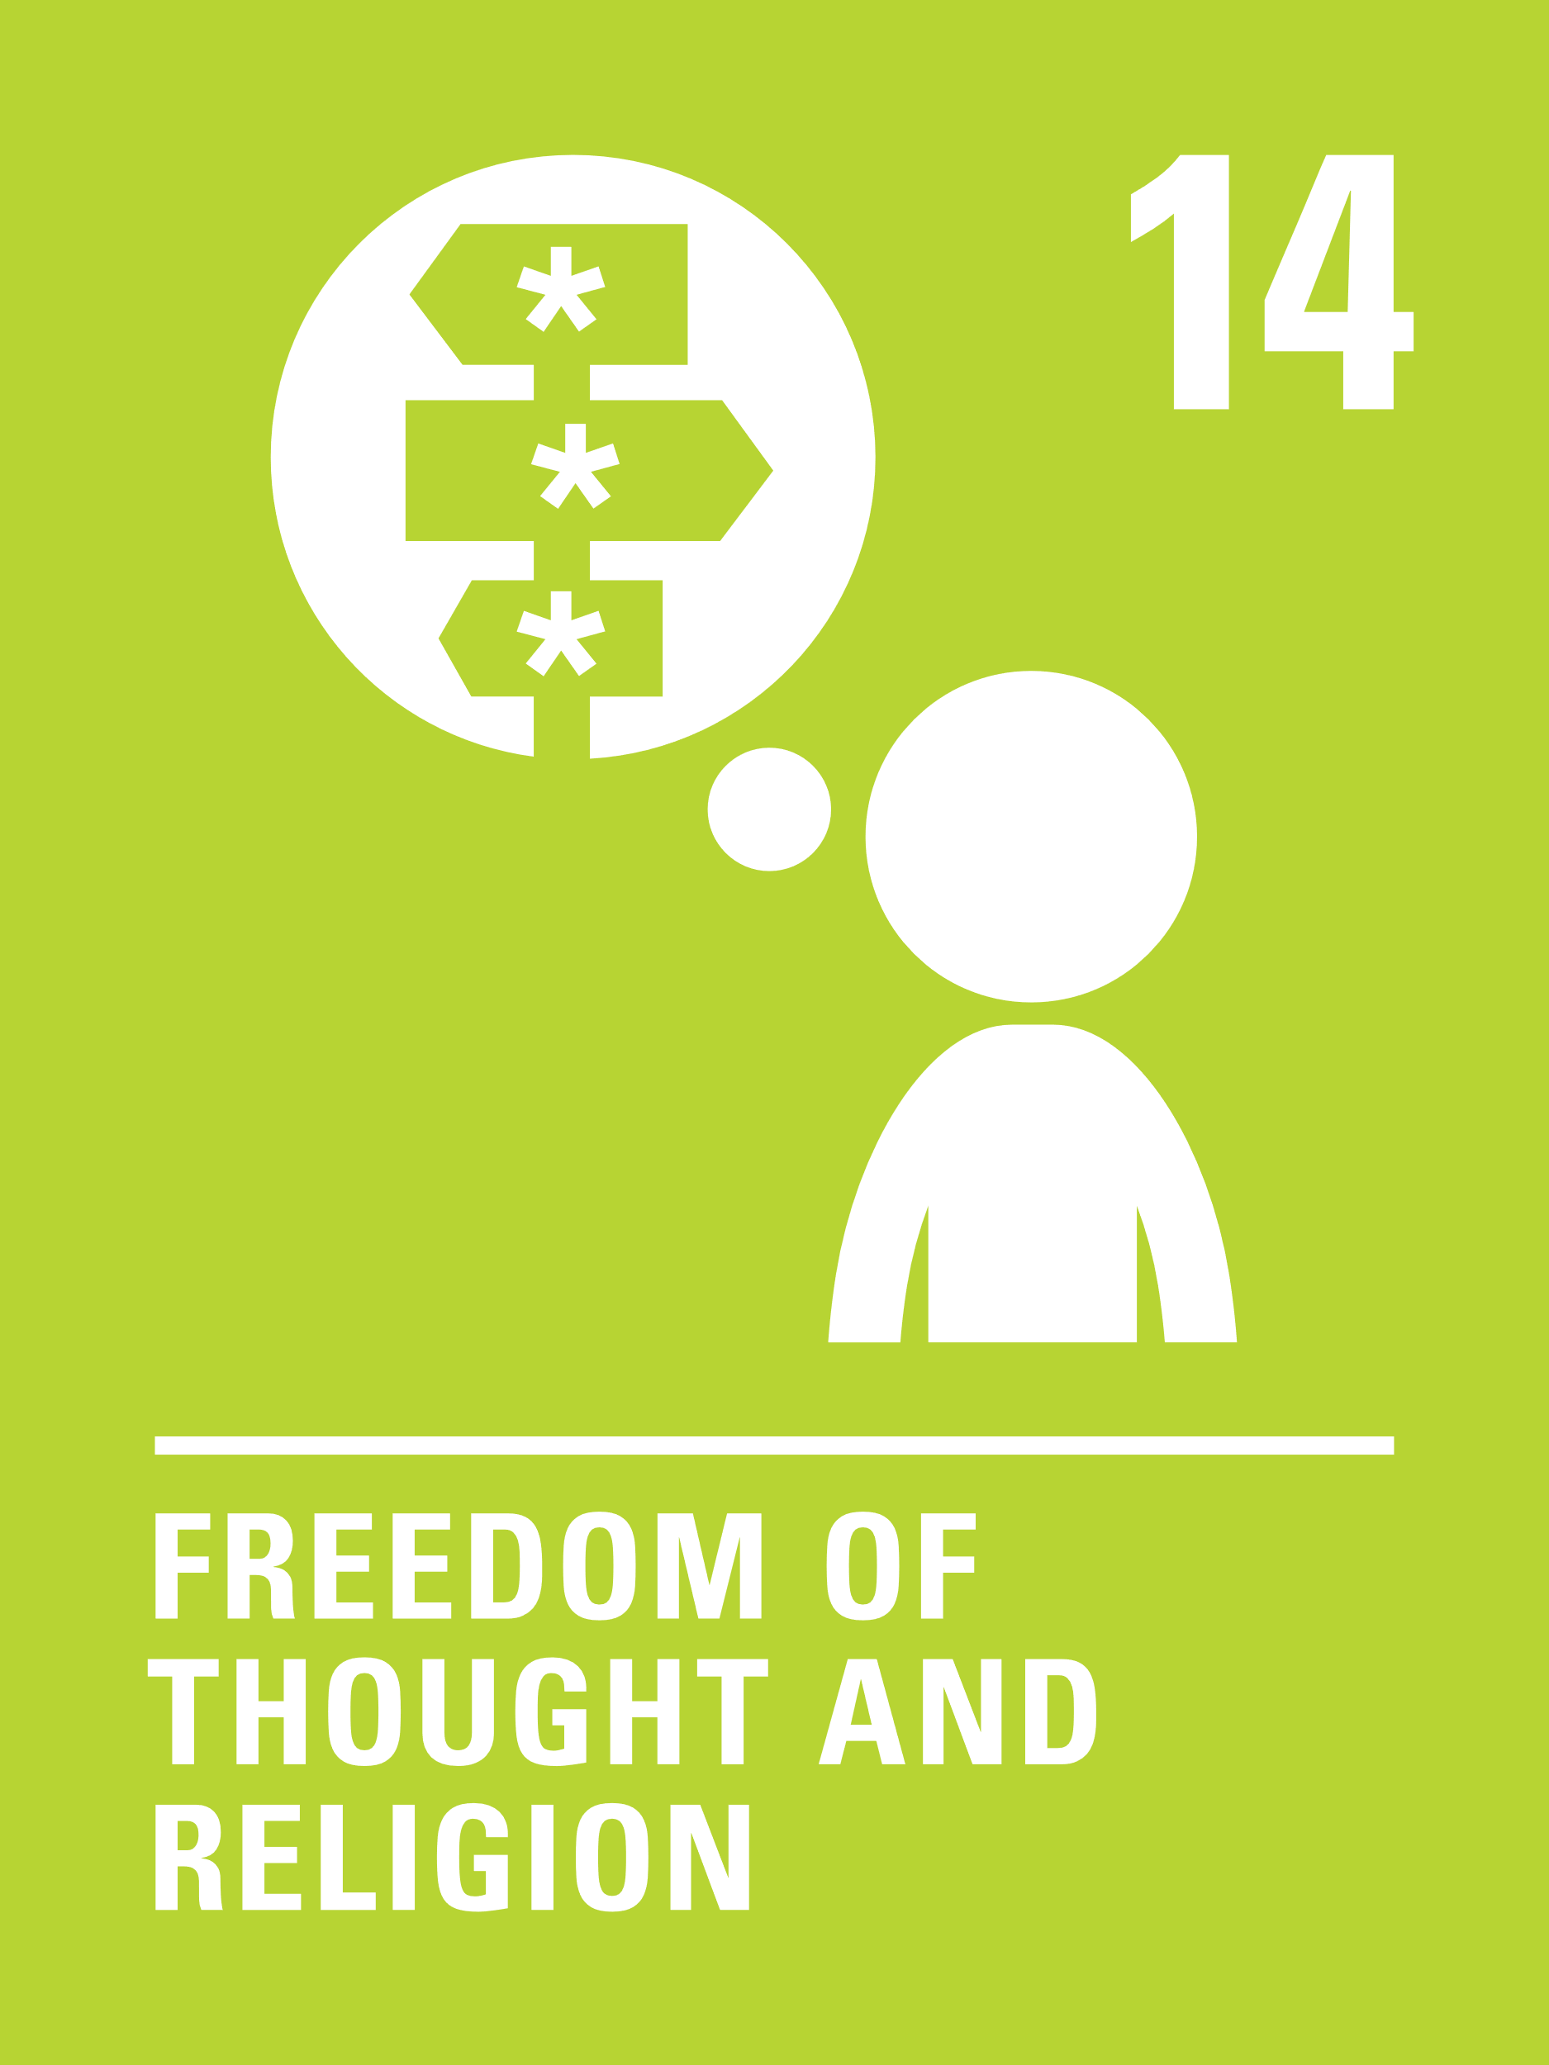
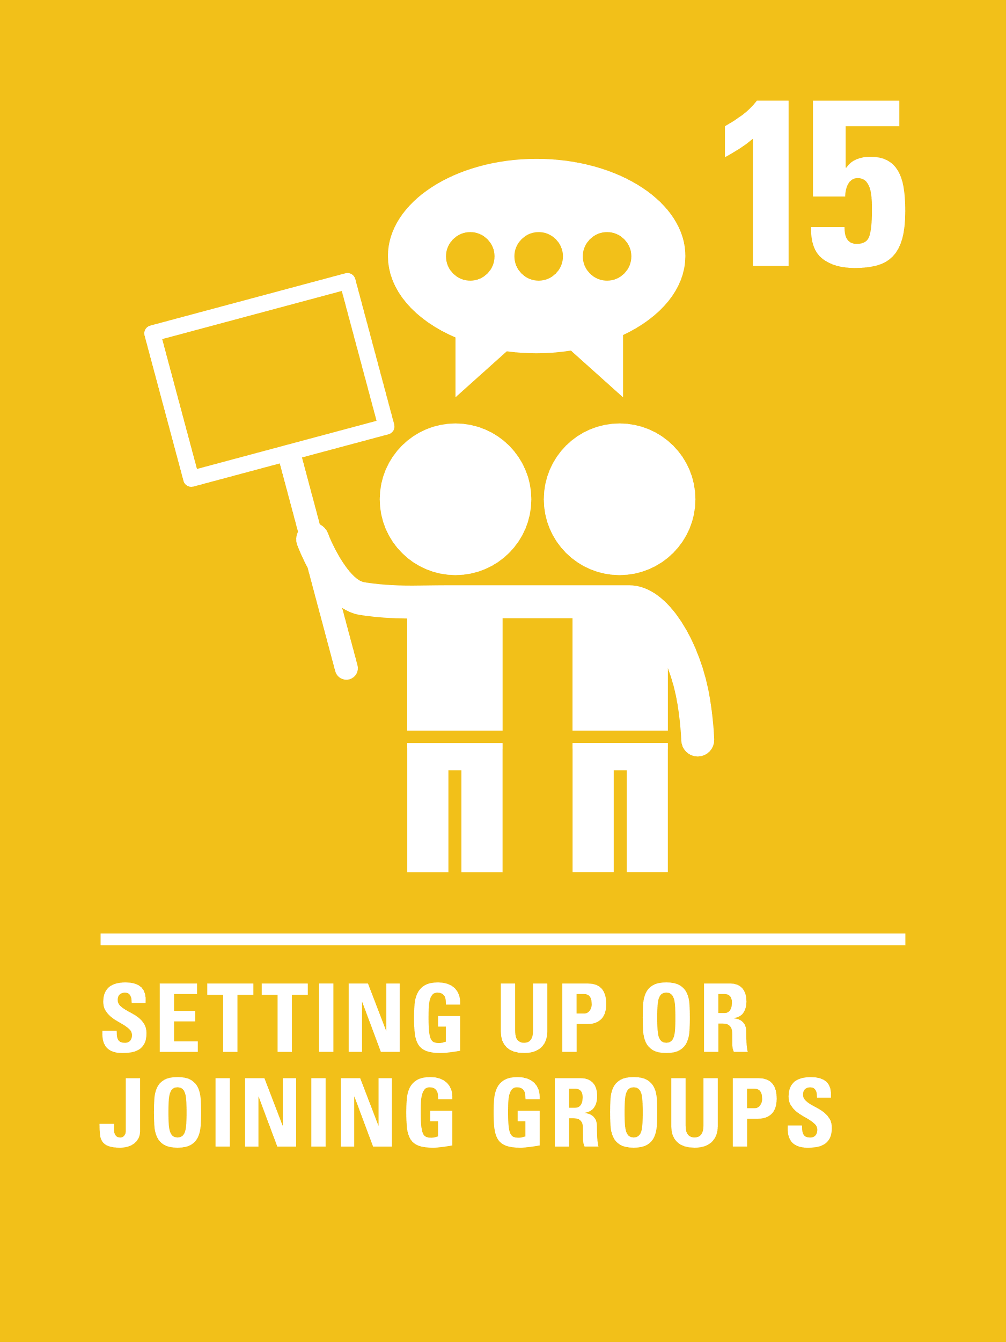
LINKS TO ARTICLES
Look at the summary of the CRC with a partner – which articles explicitly state how or when that right can be limited? Click to reveal.
These are just some examples. As we shall see there are many situations in which duty bearers need to balance competing or conflicting rights, sometimes for an individual child and sometimes between one individual and another or between an individual and a group.
Notes:
Presenter notes: When showing this slide in presenter mode the articles and final paragraph will appear on click. ​
​
The main focus here is to get colleagues looking at the Convention again! Their focus is to realise that some of the articles have explicit limitations or particular restrictions. The phrase ‘as long as’ appears several times. You can make the point that many articles are not ‘absolute’. You may wish to look at the full text of the CRC which has further detail of how rights may be limited or restricted. https://www.unicef.org.uk/wp-content/uploads/2016/08/unicef-convention-rights-child-uncrc.pdf ​
​
​CRC Summary ​
https://www.unicef.org.uk/rights-respecting-schools/wp-content/uploads/sites/4/2017/01/uncrc_summary-1_1.pdf ​
​
​unicef.uk/CRC_Icons ​
https://www.unicef.org.uk/rights-respecting-schools/wp-content/uploads/sites/4/2019/11/UN0332751.pdf​
​
​
​
​

Slide 8

LET’S DISCUSS
1.Think back to the pandemic – how were children’s rights limited ​and balanced?
2. Consider an issue currently in the news, what rights are impacted by the events? Are the decision makers balancing rights? Do you think they are getting the balance right?
3. Can you think of any examples where rights may be in conflict in school life?
Notes:
Presenter notes: Choose the questions that are most relevant to your setting and experience. Collect some of the ideas from your colleagues and add them to your action plan/evidence if relevant. ​
1. ​This was contentious then and is being revisited in the COVID enquiry. It was a child rights issue, though sadly rights were barely mentioned. Some schools explained the restrictions in terms of children’s rights. You may also wish to ask colleagues to consider who was making the decisions, thinking about duty bearers for children’s rights. ​
2. Consider how a rights perspective can give us a different lens to see events unfolding and a different narrative for our discussions. How might this help when discussing news with children?​
3. Obvious tensions between the right to learn and the right to play, or the right to play and the right to be safe. Colleagues may also explore competing and conflicting rights around internet access and safety, and freedom of expression and non-discrimination.

Slide 9

ACTIVITIES
In groups, draw a Rights Respecting classroom onto large pieces of flipchart paper. What do you see, hear and feel in a Rights Respecting classroom?
1. Explore this theme further with one of the activities on our Balancing Rights resource sheet.
2. Draft a staff (or learner) guide to prompt conversations using rights language and the need for balancing competing rights when responding to learner disagreements or harmful behaviours.
3. Choose a curriculum topic or a book read by a class where rights of individuals or groups conflict. Could you add the idea of balancing rights into your planning?
Notes:
Presenter notes: PLEASE LOOK AT BOTH SLIDES 6 and 7 BEFORE DECIDING ON YOUR ACTIVITIES There are 6 suggestions for activities. Depending on the time you have available, choose one or more activities for your colleagues to work on together to further explore the topic. Different groups could explore different activities. The activities that you do not wish to use can be deleted. ​
​Activity 1: This activity uses our resource sheet which encourages colleagues to explore relevant scenarios from the perspective of balancing rights. Feel free to make up your own scenarios, more relevant to your context.​
​Activity 2: Think about how you currently bring rights language into the daily school interactions and/or into practice for supporting positive relationships in school. How could the concept of balancing rights help here? Would it help to clarify why duty bearers take certain decisions?​
​Activity 3: This activity will support your colleagues to think about how the concept of balancing rights could add value to aspects of learning. Everything from ‘good and evil’ in fairy stories through to complex medical ethics can be explored!

Slide 10
ACTIVITIES
In groups, draw a Rights Respecting classroom onto large pieces of flipchart paper. What do you see, hear and feel in a Rights Respecting classroom?
4. Work with colleagues to develop a lesson to help learners understand how and why rights sometimes need to be limited or balanced.
5. Look at articles 2,3,6 and 12. These ‘General Principles’ of the CRC apply to all other rights. Imagine a rights in conflict situation – work through the General Principles to see how they would apply.
6. Work on a newsletter article or workshop plan for parents/carers to help them understand about balancing rights at home.
Notes:
Presenter notes: These are 3 further suggestions for activities. Depending on the time you have available, choose one or more activities for your colleagues to work on together to further explore the topic. Different groups could explore different activities. The activities that you do not wish to use can be deleted. ​
​
Activity 4: In order to support learners to understand the concept of balancing rights, it may be good to dedicate some lesson time to exploring this. Consider the age and stage of the pupils you are planning for and think about some creative ways to help them to understand this concept. ​
Activity 5: This brings people back to the four General Principles of the Convention (good revision). These principles are a key guide for duty bearers when rights need to be balanced – these four articles apply to all the other rights.​
Activity 6: During accreditation visits, parents often talk about how their children claim their rights at home and that this can sometimes be challenging if, for example, they are citing their right to play and relax and refusing to eat their dinner, do their homework or go to bed. Could the concept of balancing rights help here?

Slide 11
RESOURCES
You may find the following resources useful for your work on embedding rights throughout the curriculum:
​Balancing Rights Resource sheet.
Rights Here, Right Now is a citizenship resource that was developed for 11 to 14 year old pupils to learn about their rights under the Human Rights Act. It has a lesson on balancing rights on page 63.
Notes:
Trainer notes: Encourage your colleagues to explore the RRSA website to find additional resources. If you have time, please explore these links ahead of your session with colleagues. You may well find a particular resource that you want to highlight to all as part of your input. There may be links you want to share with the team ahead of or as follow up to your input with them.

Slide 12
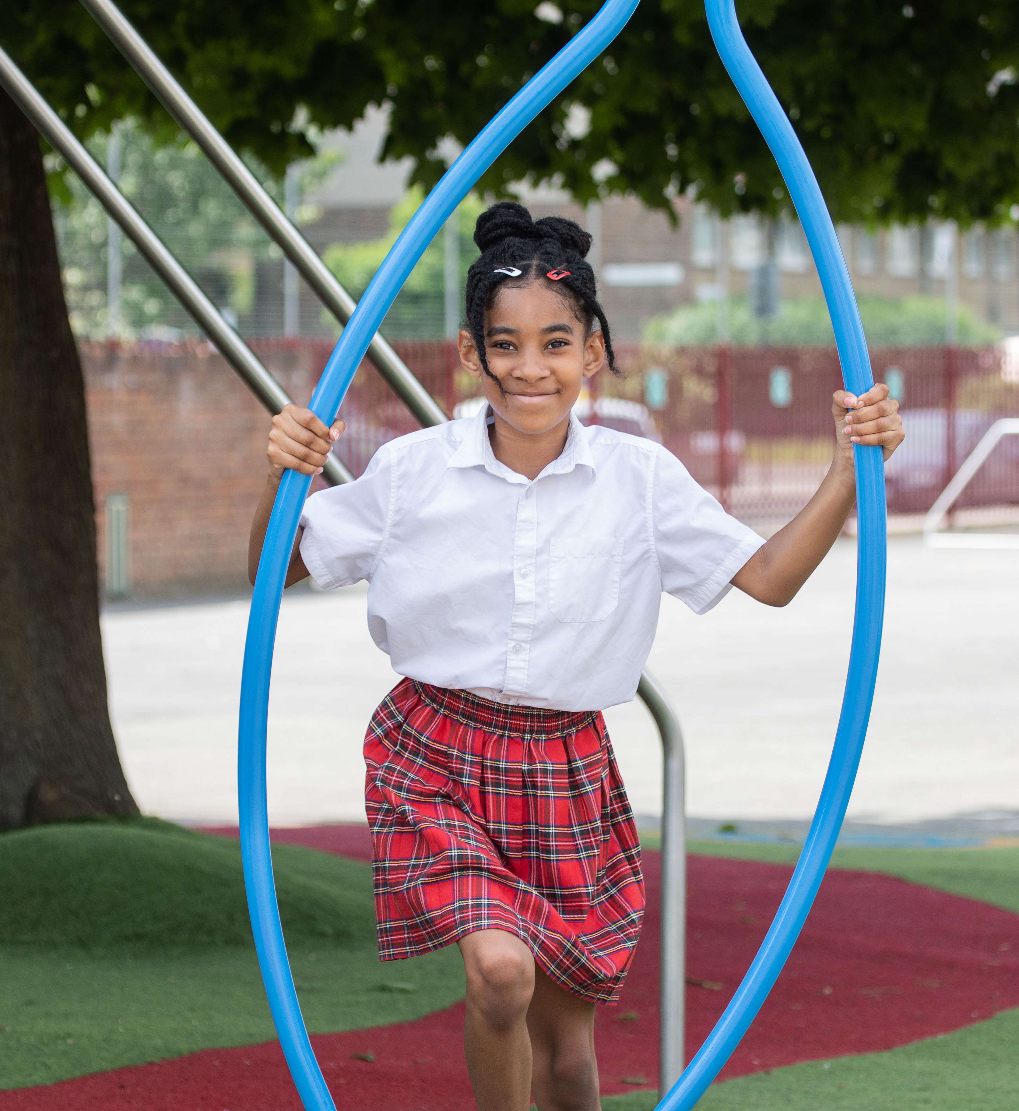
REFLECTION
© UNICEF/Dawe
Take a few moments for personal thought and reflection:​
Why is it good that rights exist…why do they matter?​
How can I, as a duty bearer, help learners by balancing their rights?​
When I have to limit a child’s right, how can I do so in a way that respects them and maintains their dignity?​
Are there any rights which I think should never be restricted or limited?​
How can I add to our school’s culture of mutual respect for rights?
© UNICEF/Dawe
Notes:
Presenter notes: Give yourself and colleagues some personal reflection space as part of your professional development time together. These reflective questions link to the theme of this month’s Spotlight.

