Slide 1
© UNICEF/Maule-ffinch
FAIRNESS & EQUITY
UNICEF/Maule-ffinch
Notes:
Welcome to Spotlight, our latest resource to support RRSA coordinators to develop Rights Respecting practice in school.
Spotlight is aimed at colleagues and is intended to support you in staff briefings or continued professional development (CPD).
Please check guidance in subsequent slide notes.
The image on the cover of this month’s Spotlight was created in collaboration with young people at a Gold secondary school. Osama, 13, who art directed this image with his friend Krishna, said:
“This is about not being racist and when they shake hands there is no difference between them. It’s on the theme of equality. Krishna came up with the idea of using a chess board and we were looking at the white and black chess pieces and the idea of equality, we thought it could be a good idea”

Slide 2
CONTENTS
Topic: Fairness and Equity
For each slide, please look at the presenter notes for delivery information.
Slide 3: Aims of the Session
Slide 4: Three ways to use this pack
Slide 5 : Introducing this month’s Spotlight
Slide 6: Links to RRSA Outcomes
Slide 7: Links to Articles
Slide 8: Case Study
Slide 9: Let’s Discuss
Slide 10: Activities
Slide 11: Activities
Slide 12: Resources
Slide 13: Reflection

Slide 3
AIMS OF THE SESSION
To understand what is meant by fairness and equity. ​
To understand how exploring these concepts can improve outcomes for children. ​
To understand how fairness and equity fit into the RRSA framework.
Notes:
Presenter notes: Please edit the aims of the session to suit the time you have available for your session. ​
​
This session is intended to support you in supporting staff to develop their understanding of what fairness and equity are, and why this is something that you should be supporting children and young people to engage with as part of your Rights Respecting Schools journey.​
​
The whole Spotlight series is about embedding children’s rights within a wide range of school priorities and practices.
​

Slide 4
THREE WAYS TO USE THIS PACK
DELETE THIS SLIDE BEFORE USING
Read through the slides and notes pages to identify the most relevant activities for your colleagues and any preparation or resources needed.
If time is tight, use the introduction slide and choose from the key discussion questions to explore with your colleagues.
If you have longer, you can also choose some of the activities to explore.
You may wish to cover the content over a number of staff meeting sessions.
Notes:
Trainer notes: Delete this slide before using.
It would be useful to have copies of the simplified CRC or the icons so that staff can refer to them throughout the session. Unicef.uk/CRC_Icons

Slide 5
SPOTLIGHT ON…
We know that when children and young people are familiar with their rights and they are included and valued as individuals, they thrive.​
In a Rights Respecting School, pupils are given what they need to succeed in a fair and equitable way.
Listen to Emma speaking about UNICEF UK’s journey towards being more equitable. How is our school doing?
Emma, UNICEF UK’s Diversity and Inclusion Lead, introduces this month’s Spotlight.
Notes:
The video complements the content of this pack and can also be used separately.​
​
Presenter notes: ​
It may be helpful to use some of Emma's explanations to frame discussions around fairness and equity.​
As Emma said, diversity is a fact, how we are all different from each other. When society values some differences above others, there will be barriers for some people. Equality is seeing and treating everyone the same which will perpetuate those barriers. Equity is how we ensure that people are given what they need to access their rights, rather than everyone being given the same. ​
​
Continue to use the language of rights to explain how we need to ensure that everyone is included and empowered to access their rights.

Slide 6
LINKS TO RRSA OUTCOMES
Strand B: TEACHING AND LEARNING FOR RIGHTS​
Outcome 2: In school children and young people enjoy the rights enshrined in the United Nations Convention on the Rights of the Child. ​
Outcome 3: Relationships are positive and founded on dignity and a mutual respect for rights.
Outcome 6: Children and young people are included and valued as individuals.
Notes:
Presenter notes: ​
​
This slide provides an opportunity to remind colleagues of the ‘structure’ of RRSA which includes three strands: Teaching about rights; through rights; and for rights.​
​
Equity is specifically mentioned in Outcome 2 of the framework, but its influence can be seen across Strand B, particularly in Outcomes 3 and 6. ​
​
Strand B: ​
​
Outcome 2 - In school children and young people enjoy the rights enshrined in the United Nations Convention on the Rights of the Child.
At Silver: Many children and young people know and understand how school facilitates them in enjoying a range of their rights. They (and staff) share how they and others act to create a rights respecting environment.
At Gold: Most children and young people are able to share how school, and duty bearers, facilitate them to enjoy a wide range of their rights. They understand the concepts of fairness and equity and can convey how their school promotes such principles and puts them into practice. Most children and young people know and trust that the school will act upon any concerns about their rights not being met. ​
​
Outcome 3 - Relationships are positive and founded on dignity and a mutual respect for rights.
At Silver: Many children and young people can communicate about how positive relationships are encouraged. Rights are used to explore moral dilemmas and rights respecting approaches are developed.
At Gold: Relationships are identified by most children, young people and adults as mutually respectful. There is evidence that respectful relationships are strengthening over time. Many children and young people understand the concept of dignity through their lived experience. They can express how dignity and rights explicitly inform life in school. School systems to address disagreements, conflict and prejudicial attitudes and actions are perceived as transparent, fair and effective by children and adults. ​
​
Outcome 6 - Children and young people are included and are valued as individuals.
At Silver: Many children and young people can share how they are included and valued at school and understand how their actions and those of others contribute to this.
At Gold: Nearly all children and young people interviewed describe how everyone is included and valued and acknowledge how becoming rights respecting contributes to this. The school is actively working towards (or is sustaining) a strong culture of inclusion and can show how this is underpinned by non-discrimination.​
​
The full text of the Strands and Outcomes of the Award can be found here:​
www.unicef.org.uk/rights-respecting-schools/wp-content/uploads/sites/4/2015/06/RRSA-Strands-and-Outcomes-at-Silver-and-Gold-1.pdf​
​
​

Slide 7
LINKS TO ARTICLES
Look at the summary of the CRC with a partner – which articles do you think are particularly relevant to our work on fairness and equity? Click to reveal.
Although many other articles may also be linked. ​
Though not a right in itself, equity is an essential principle in the realisation of rights for all people.
Notes:
Presenter notes: When showing this slide in presenter mode the articles and final paragraph will appear on click. ​
​
The main focus here is to get colleagues looking at the Convention again! Their focus is to realise that some of the articles have explicit limitations or particular restrictions. The phrase ‘as long as’ appears several times. You can make the point that many articles are not ‘absolute’. You may wish to look at the full text of the CRC which has further detail of how rights may be limited or restricted. https://www.unicef.org.uk/wp-content/uploads/2016/08/unicef-convention-rights-child-uncrc.pdf ​
​
​CRC Summary ​
https://www.unicef.org.uk/rights-respecting-schools/wp-content/uploads/sites/4/2017/01/uncrc_summary-1_1.pdf ​
​
​unicef.uk/CRC_Icons ​
https://www.unicef.org.uk/rights-respecting-schools/wp-content/uploads/sites/4/2019/11/UN0332751.pdf​
​
​
​
​

Slide 8
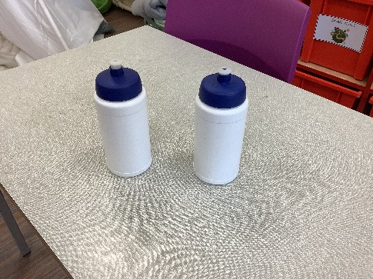
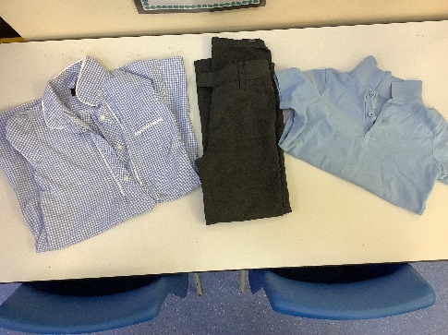
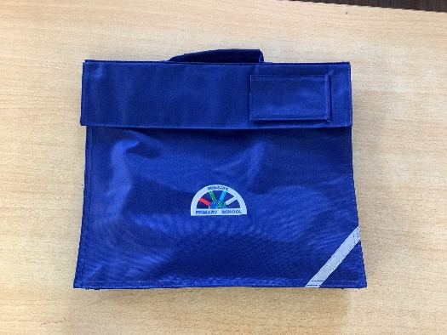
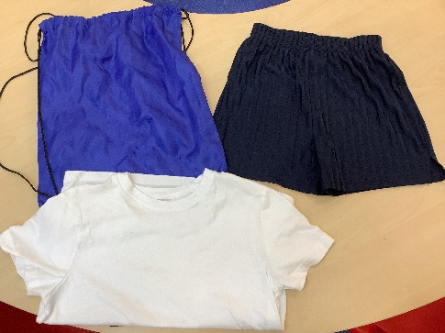
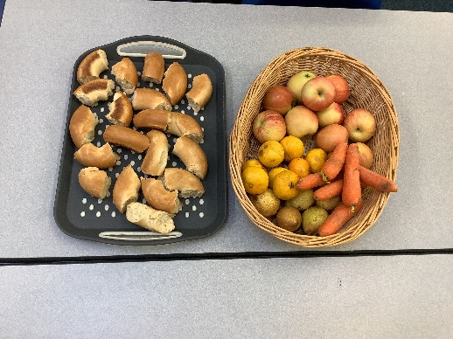
The school provides items such as clean uniform, PE kit, water bottles, bags and food items removing pressure to have the latest fashions or designer items.
CASE STUDY
Wingate Primary School, in the North East of England, have strengthened their focus on equity through their participation in Poverty Proofing.
Read the full case study online.
Poverty Proofing is part of what we do alongside thinking about children’s rights. For example, children understand that it is fairer that we provide water bottles and pencil cases for all pupils removing any pressure on them to have the latest fashions or expensive designer items.
We agreed that asking a child who doesn’t have a PE kit to wear someone else’s kit that probably hasn’t been washed and has been sitting in a box, wasn’t treating them with dignity. So instead, we provide PE bags with clean kit to the children that need it. They can leave the bag in school, and we will wash it. They know it is theirs and they can always wear clean PE kit.
Poverty Proofing ties so closely into our child rights approach: our children know that rights are why we do it. They understand that the government must provide them with their rights so it is our job to ensure everyone has access. It is empowering for children to know that their voices are going to be heard, valued and acted on.
Notes:
The full case study is available on the RRSA website, where you can print it out and share with you staff.

Slide 9
LET’S DISCUSS
Consider the examples from our case study. Here, supplying pencil cases and water bottles is an example of equality (all children receive a pencil case); having clean PE kit is an example of equity the PE kit is there for children who don’t have one.
2. Where do we see equality and equity in our setting?
3. How can we help our school community understand the importance of equity?
1. What's the difference between equality and equity? How do they relate to fairness?
Notes:
Presenter notes: Choose the questions that are most relevant to your setting and experience. Collect some of the ideas from your colleagues and add them to your action plan/evidence. ​
​1. This question offers an opportunity to get people thinking about how the two words mean different things, but are very much related. Whilst the discussion is the important thing, not arriving at the most accurate definition – a simple explanation might see equity thought of as ‘every individual getting what they need’.​
2. Have a think about what is already happening around the school that may link to equality and equity. Is the current approach helping or hindering access to rights? (It might be worth noting some of the examples to use as evidence on your next evaluation.)​
3. From an RRSA perspective, it’s not enough to operate according to the principle of equity, we want pupils and adults to understand the concept and be able to talk about its influence on school life. What sort of lessons and activities, assemblies and staff training, even parent workshops, might help?

Slide 10
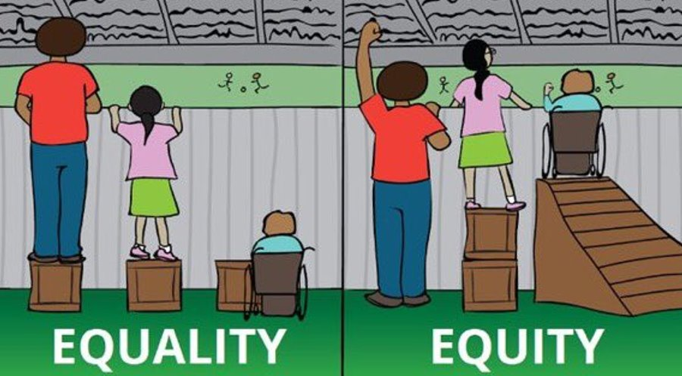
ACTIVITIES
In groups, draw a Rights Respecting classroom onto large pieces of flipchart paper. What do you see, hear and feel in a Rights Respecting classroom?
1. Try creating your own personalised version of this popular graphic.
2. Choose one of the following and discuss how it supports equity:​
breakfast club; classroom aids (e.g. ear defenders); free school meals; soft starts; subsidised/free trips; support for learning; uniform bank.
3. In discussion with a partner, produce a practical idea to improve equity in your setting and share it with the group.
Image: Divided We Fall
Notes:
Presenter notes: There are six suggestions for activities, including the three scenarios on the next slide. Depending on the time you have available, choose one or more activities for your colleagues to work on together to further explore the topic. Different groups could explore different activities. The activities that you do not wish to use can be deleted. ​
​Activity 1: The image is quite a familiar one, commonly referenced when people explore equity. A quick internet search will bring up lots of versions, but what might a version specific to your school look like?​
​Activity 2: Schools are often already doing many things to support equity, but not everyone makes the connection. Explore one from the list or link another one from your own school’s practice. ​
Activity 3: How could you do something new or in a more equitable way that will better support children’s ability to access their rights?

Slide 11
ACTIVITIES
Consider the role of equality and equity in each of the following illustrative scenarios. Check the presenter notes for suggestions.
Consider the role of equality and equity in each of the following illustrative scenarios. Check the presenter notes for suggestions.
In groups, draw a Rights Respecting classroom onto large pieces of flipchart paper. What do you see, hear and feel in a Rights Respecting classroom?
4. A few months ago you started an after-school football team, which is proving to be popular and successful. Another child is keen to participate, but they have mobility difficulties.
5. Your school has a small lift. Only staff and pupils with identified needs have a pass to use it. Other pupils are questioning why they can't all have a lift pass.
6. After their child was hurt by another pupil, a parent is demanding that you punish the pupil in line with your behaviour policy. The pupil has additional needs which can affect their actions towards others.
Notes:
Presenter notes: The last three activities are scenarios. Depending on the time you have available, choose one or more for your colleagues to consider. Different groups could explore different scenarios. The activities that you do not wish to use can be deleted. ​
​
For each scenario, consider the role of equity/equality, what actions you might take and how you would help others to understand the reasons for your actions.

Slide 12
RESOURCES
You may find the following resources useful for your work on equity:
UNICEF UK's Article of the week packs (this one may be especially relevant – Social Security and Adequate Standard of Living – Articles 26 and 27).​
The RRSA Glossary
A guide to a Rights Respecting Classroom​
Further reading: Equity in education: Levelling the playing field of learning - a practical guide for teachers by Lee Elliot Major and Emily Briant ​
There are many other organisations and materials that will help you explore fairness and equity further such as:​ Poverty Proofing the School Day ​
​
Notes:
Trainer notes: Encourage your colleagues to explore the RRSA website to find additional resources. If you have time, please explore these links ahead of your session with colleagues. You may well find a particular resource that you want to highlight to all as part of your input. There may be links you want to share with the team ahead of or as follow up to your input with them.

Slide 13
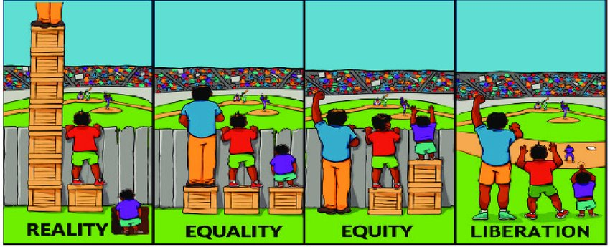
REFLECTION
Look at this alternative version of the equality vs equity illustration. ​
Discuss these images. How does this compare to your experience? ​
Do you think this is the same for others around you?
Image: Divided We Fall
Notes:
Presenter notes: Encourage people to reflect on equity from their personal perspective, perhaps even asking if some are willing to share some examples of positive/negative experiences.

