Slide 1
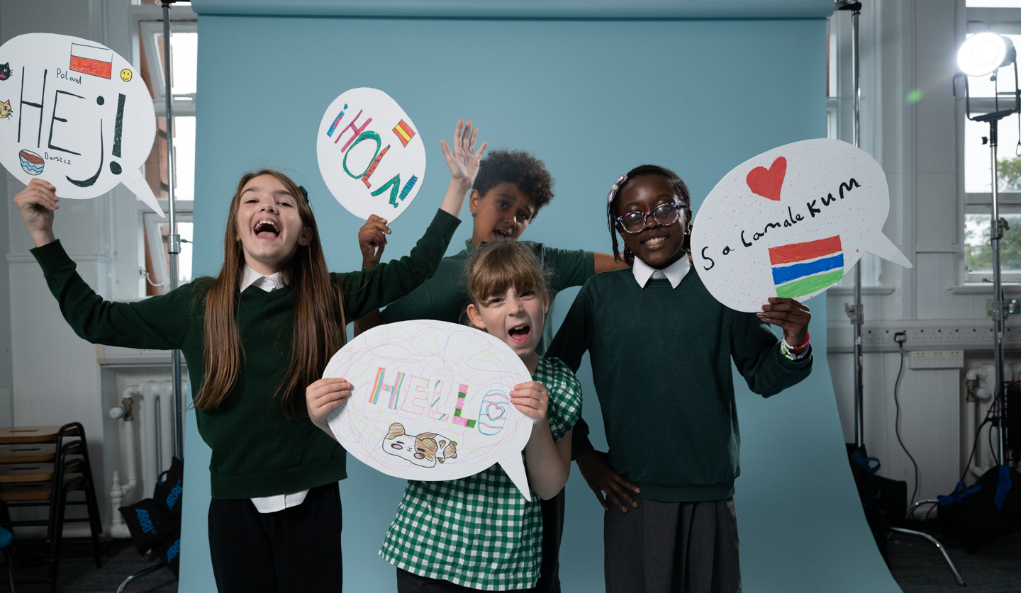
© UNICEF/Maule-ffinch
GLOBAL CITIZENSHIP FROM A CHILD RIGHTS PERSPECTIVE
UNICEF/Maule-ffinch
Notes:
Welcome to Spotlight, our latest resource to support RRSA coordinators to develop Rights Respecting practice in school.
Spotlight is aimed at colleagues and is intended to support you in staff briefings or continued professional development (CPD).
Please check guidance in subsequent slide notes.
The image on the cover of this month’s Spotlight was created in collaboration with young people at a Gold primary school. This image, created by Tarek, Gabi, Jorjo and Madison, is inspired by Article 30 (minority culture, language and religion).
Tarek said: “We wanted to do Article 30 because I speak Spanish and English. Article 30 is important because it helps you keep your history, it would be boring if we were all the same.”
Jorjo said: “I have a religion and a language, Wolof, which is from Gambia. Article 30 is about me! This school is kind with good food, kids and adults.”

Slide 2
CONTENTS
Topic: Global Citizenship from a Child Rights Perspective
For each slide, please look at the presenter notes for delivery information.
Slide 3: Aims of the Session
Slide 4: Three ways to use this pack
Slide 5 : Introducing this month’s Spotlight
Slide 6: Links to RRSA Outcomes
Slide 7: Links to Articles
Slide 8: Case Studies
Slide 9: Let’s Discuss
Slide 10 and 11: Activities
Slide 12: ‘Why, why why?’ activity
Slide 13: Resources
Slide 14: Reflection

Slide 3
AIMS OF THE SESSION
To explore how you can support pupils to develop their understanding of the lived experience of children locally and globally.​
To investigate how a rights lens can be used to challenge stereotypes and discrimination, so all children are seen as rights holders rather than recipients of charity.​
​
Notes:
Presenter notes: Please edit the aims of the session to suit the time you have available for your session. ​
​
This session is intended to support you in helping staff to consider how supporting children to become active global citizens is linked to children’s rights and your work as a Rights Respecting School.
​
The whole Spotlight series is about empowering staff across your setting to embed children’s rights within a wide range of school priorities and practices. ​
​

Slide 4
THREE WAYS TO USE THIS PACK
DELETE THIS SLIDE BEFORE USING
Read through the slides and notes pages to identify the most relevant activities for your colleagues and any preparation or resources needed.
If time is tight, use the introduction slide and choose from the key discussion questions to explore with your colleagues.
If you have longer, you can also choose some of the activities to explore.
You may wish to cover the content over a number of staff meeting sessions.
Notes:
Trainer notes: Delete this slide before using.
It would be useful to have copies of the simplified CRC or the icons so that staff can refer to them throughout the session. Unicef.uk/CRC_Icons

Slide 5
SPOTLIGHT ON…
Global citizenship in a Rights Respecting School promotes the idea of taking action on rights issues and building solidarity with people rather than doing things to or for people.
In a Rights Respecting school, therefore, a global citizen can be defined as someone who believes in global justice and acts to make the world a safer, fairer and more sustainable place in which human rights are protected and respected.
Hilary from the RRSA team introduces this month’s Spotlight.
Notes:
The video complements the content of this pack and can also be used separately, when introducing new staff to RRSA for example.

Slide 6
LINKS TO RRSA OUTCOMES
Strand A: TEACHING AND LEARNING ABOUT RIGHTS​
Outcome 1: Children, young people and the wider school community know about and understand the United Nations Convention on the Rights of the Child and can describe how it impacts on their lives and on the lives of children everywhere.​
Strand C: TEACHING AND LEARNING FOR RIGHTS ​
Outcome 9: Children and young people have taken action to claim their rights and promote the rights of others, locally and globally.
Notes:
Presenter notes: This month’s theme is woven through the knowledge, skills and experience gained across all the outcomes of the Award. We have highlighted two strands that specifically link to learning about global citizenship and taking action.
​
This slide provides an opportunity to remind colleagues of the ‘structure’ of RRSA which includes three strands: Teaching about rights; through rights; and for rights.​
​
Strand A, Outcome 1: ​
​Pupils need to develop knowledge and understanding of children’s rights and how children and young people can access their rights, or not, in their own community and the wider world. This knowledge of the wider world can be developed through assemblies, curriculum topics and subject areas, access to news programmes such as Newsround and Picture News.
​
Strand C, Outcome 9: ​
Once pupils have an understanding of their own rights and the rights of all children, everywhere then their sense of injustice is heightened leading to increased engagement in taking action for the rights of others based on their understating of the CRC.
​
​

Slide 7
LINKS TO ARTICLES
Look at the summary of the CRC with a partner – which articles do you think are particularly relevant to our work on fairness and equity? Click to reveal.
Although many other articles may also be linked. ​
Though not a right in itself, equity is an essential principle in the realisation of rights for all people.
Notes:
Presenter notes: When showing this slide in presenter mode the articles and final paragraph will appear on click. ​
​
The main focus here is to get colleagues looking at the Convention again! Encourage colleagues to look at the articles and discuss links with global citizenship. ​
​
​CRC Summary ​
https://www.unicef.org.uk/rights-respecting-schools/wp-content/uploads/sites/4/2017/01/uncrc_summary-1_1.pdf ​
​
​unicef.uk/CRC_Icons ​
https://www.unicef.org.uk/rights-respecting-schools/wp-content/uploads/sites/4/2019/11/UN0332751.pdf​
​
You may also want to discuss the Global Goals for Sustainable Development. Find out more here: https://worldslargestlesson.globalgoals.org/​
​
​
​

Slide 8
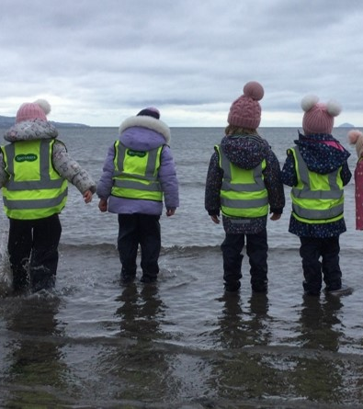
Members of the Global Impactors Group during a beach clean at a local beach.
CASE STUDY
Children at Troon Primary work on global issues in partnership with communities, close to home and further away.
Read the full case study online.
Careful planning provides opportunities to promote children’s rights and talk about global issues. As a result, the children are also confident in bringing their ideas and concerns to us, knowing they will be listened to and their views acted upon.
At the beginning of our Rights Respecting journey, we established global links through a community partnership project. The whole local community came together, working collaboratively to support a town in Haiti recover from the damaging effects of earthquakes, storms and flooding. Children in our P6 classes are our Haiti link stage, joining Zoom calls with the children in Haiti, discussing their rights and lives together to show unity.
After self-evaluation and reflection, children discussed the possibility of all our pupil voice groups coming together to maximise their impact. Over a third of our pupils now work together as the Global Impactors Group. Children supported beach cleans and conducted road safety audits. When learning about their countries, children learned about languages, religions, cultures, and the rights of others.
Notes:
The full case study is available on the RRSA website, where you can print it out and share with you staff.

Slide 9
LET’S DISCUSS
2. All children are rights holders. Rights are an entitlement. It does not mean children are lucky or privileged to have rights. Discuss.
3. Discuss how learning about rights can strengthen children’s understanding of, and engagement with, global citizenship?
1. When you think of ‘charity’ what comes to mind?
Notes:
Presenter notes: Choose the questions that are most relevant to your setting and experience. Collect some of the ideas from your colleagues and add them to your action plan/evidence if relevant. ​
Explore what ‘charity’ means to colleagues. If the idea arises that ‘poor people need our money/help’ challenge this and consider discussing the following terms: challenging injustice, equality and equity, resilience, partnership, allyship, interdependency.
Have you heard this language in school. Share other phrases and terminology. You may find the ABCDE of rights useful: https://www.unicef.org.uk/rights-respecting-schools/resources/teaching-resources/guidance-assemblies-lessons/abcde-of-rights/.
Refer back to the video and initial slides in this pack and you may also find the RRSA Outcomes framework useful to refer to: https://www.unicef.org.uk/rights-respecting-schools/wp-content/uploads/sites/4/2024/08/RRSA-Strands-and-Outcomes-at-Silver-and-Gold-2024-revision-FINAL.pdf.

Slide 10
ACTIVITIES
In groups, draw a Rights Respecting classroom onto large pieces of flipchart paper. What do you see, hear and feel in a Rights Respecting classroom?
1. Reflect on the charities your school supports.
Discuss:
The reasons they are chosen?
What change do you/children want to see?
How is the change communicated to the whole school community?
2. Across your school how do you represent the global majority?
Consider curriculum, books, images, environment etc.
Do you need to do more to challenge stereotypes?
3. Refer to pages 4-5 of the RRSA Global Citizenship guidance.
Use the global learning spectrum to reflect on your current action in school. Choose 1-2 examples to move towards the ‘changing’ end of the spectrum.
Notes:
Presenter notes: PLEASE LOOK AT BOTH SLIDES 9 and 10 BEFORE DECIDING ON YOUR ACTIVITIES There are 6 suggestions for activities. Depending on the time you have available, choose one or more activities for your colleagues to work on together to further explore the topic. Different groups could also explore different activities. The activities that you do not wish to use can be deleted from the slide. ​
Additional notes:
​The aim of this activity is to reflect on current practice and consider how the actions of your school community can make the most impact through challenging injustice, and to explore how children can be empowered through their participation in identifying causes to support and understanding and communicating the impact they wish to see. Record and plan
Our own experiences and biases, our schools values and the community we work in can influence our approach in the classroom. Do you need to be doing more to ensure positive representation and non discrimination across all areas of your school.
Find a definition of 'global majority' here: https://www.ncvo.org.uk/news-and-insights/news-index/why-language-matters-in-building- belonging/#:~:text=Global%20majority%20is%20a%20shortened,racialised%20as%20'ethnic%20minorities’.
The global learning spectrum can be a useful tool to support reflection and development of your global work in school. Read through the guidance in advance and consider sharing with colleagues.

Slide 11
ACTIVITIES
Consider the role of equality and equity in each of the following illustrative scenarios. Check the presenter notes for suggestions.
Consider the role of equality and equity in each of the following illustrative scenarios. Check the presenter notes for suggestions.
In groups, draw a Rights Respecting classroom onto large pieces of flipchart paper. What do you see, hear and feel in a Rights Respecting classroom?
4. Refer to the ‘WHY, WHY, WHY’ model on the next slide which is an example taken from An Introduction to Global Citizenship training.
Then choose a relevant issue and complete your own version.
5. Consider a local or global issue and respond to the following questions:
What does it mean? What does it look like? How is it changing? What things affect it? What can be done about it? How does it relate to me? How might I respond to it?
6. Create an A to Z of vocabulary you consider will help to promote a social justice approach to global citizenship within your school.
Can you turn this into a display or resource?
Notes:
Presenter notes: PLEASE LOOK AT BOTH SLIDES 9 and 10 BEFORE DECIDING ON YOUR ACTIVITIES There are 6 suggestions for activities. Depending on the time you have available, choose one or more activities for your colleagues to work on together to further explore the topic. Different groups could explore different activities. The activities that you do not wish to use can be deleted. ​
Additional Notes:
​Talk through the example on the next slide. You may already take part in litter picking as a community. This is great. However, we could litter pick every week without making a real impact on the cause of the litter. This example shows how to get to the root cause of the problem and how to support children to raise awareness and campaign for lasting sustainable change.
This activity allows colleagues to reflect on their own experience as a global citizen and to explore the issues that are important to them. Gather feedback on how the issue impacts on children the school community. Could exploration of any of these issues be linked to the curriculum?
Refer to the RRSA Global Citizenship guidance: and share our definition and key vocabulary to support exploration and discussion.
https://www.unicef.org.uk/rights-respecting-schools/wp-content/uploads/sites/4/2022/01/RRSA-Global-Citizenship-Guide.pdf

Slide 12
WHY, WHY WHY?
They don’t realise it damages our health
They are not aware of health and child rights
Why is there so much
rubbish in the park? (Article 24)
The council is not prioritising it
They don’t realise it damages wildlife
They haven’t seen or heard about wildlife
They don’t care
People drop it there
There are not enough bins
The council has not provided them
The council do not have enough money
The council is underfunded by central government
There are no fines
There is no way of seeing who is doing it
There are not enough police or CCTV
Notes:
Example of activity useful to develop critical thinking:
Go through animation to show how a ‘why why why’ chain works. (Ask ‘why?’ after each box appears)
You can stop asking why at a particular point and then ask, ‘what could we do about it?’
Ask participants to think of another rights related question they could apply this to. Ask if anyone would like to have a go at verbalising it.

Slide 13
RESOURCES
You may find the following resources useful for your work on strengthening global citizenship:
Introduction and Strengthening Global Citizenship training courses
E-learning: global citizenship in a Rights Respecting School
Spotlight on developing your Campaigning work
A Guide to Global Citizenship in a Rights Respecting School
ABCDE of Rights
Discussing war and conflict in class
Youth Advocacy Toolkit
Worlds Largest Lesson and Global Goals
If you are interested in further reading check out the following research papers:
The Theory and Practice of Global Learning by Douglas Bourn and Soft versus Critical Global Citizenship Education by Vanessa Andreotti.
Notes:
Trainer notes: Encourage your colleagues to explore the RRSA website to find additional resources. If you have time, please explore these links ahead of your session with colleagues. You may well find a particular resource that you want to highlight to all as part of your input. There may be links you want to share with the team ahead of or as follow up to your input with them.

Slide 14
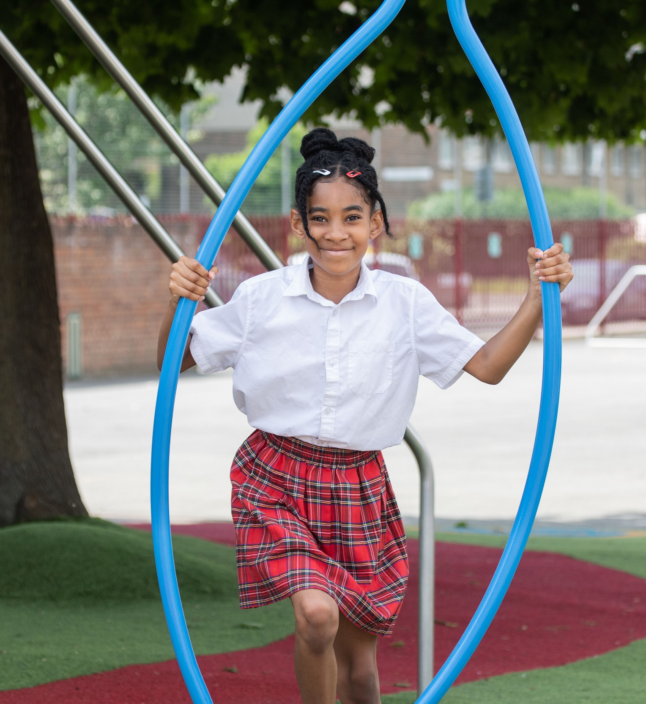
REFLECTION
© UNICEF/Dawe
Take a few moments for personal thought and reflection:​
Develop a list of key points that can be used to help strengthen a rights approach to global citizenship within your school.
How will you promote global citizenship with pupils and your wider school community?
© UNICEF/Dawe
Notes:
Presenter notes: Give yourself and colleagues some personal reflection space as part of your professional development time together. These reflective questions link to the theme of this month’s Spotlight.

