Slide 1
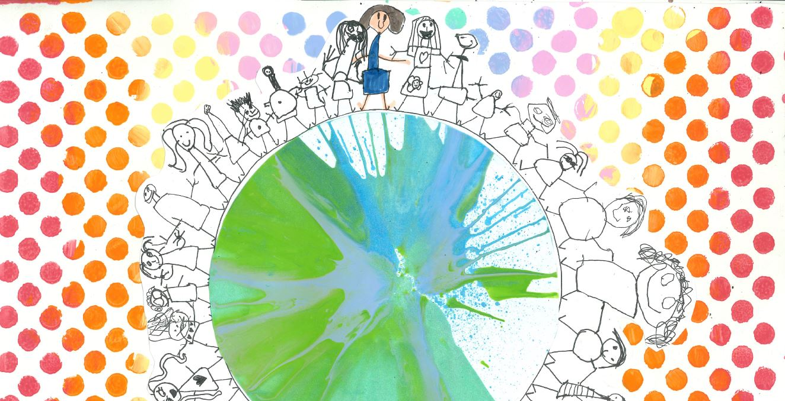
© UNICEF/Maule-ffinch
EXPLORING RIGHTS THROUGH THE ARTS
UNICEF/Maule-ffinch
Notes:
Welcome to Spotlight, our latest resource to support RRSA coordinators to develop Rights Respecting practice in school.
The image on the cover of this month’s Spotlight was created by children in the reception class at Christ Church Primary School. Each year the school runs an art project where all children produce a piece of art linked to a common theme. This image was inspired by Article 2 – non-discrimination.
All the images in this pack are of artwork designed and created by children and young people in Rights Respecting Schools and are inspired by individual rights or provisions within articles of the Convention. We hope they provide inspiration for art projects with students in your settings.
Spotlight is aimed at colleagues and is intended to support you in staff briefings or continued professional development (CPD).
Please check guidance in subsequent slide notes.

Slide 2
CONTENTS
Topic: Exploring rights through the arts
For each slide, please look at the presenter notes for delivery information.
Slide 3: Aims of the Session
Slide 4: Three ways to use this pack
Slide 5 : Introducing this month’s Spotlight
Slide 6: Links to RRSA Outcomes
Slide 7: Links to Articles
Slide 8: Case Study 1: Christ Church Primary, Hampstead
Slide 9: Case Study 2: Maryland Primary, Newham
Slide 10: Let’s Discuss
Slide 11: Activities
Slide 12: Every Child a Song – an art project resource
Slide 13: Exploring Rights through Music
Slide 14: Resources
Slide 15: Reflection

Slide 3
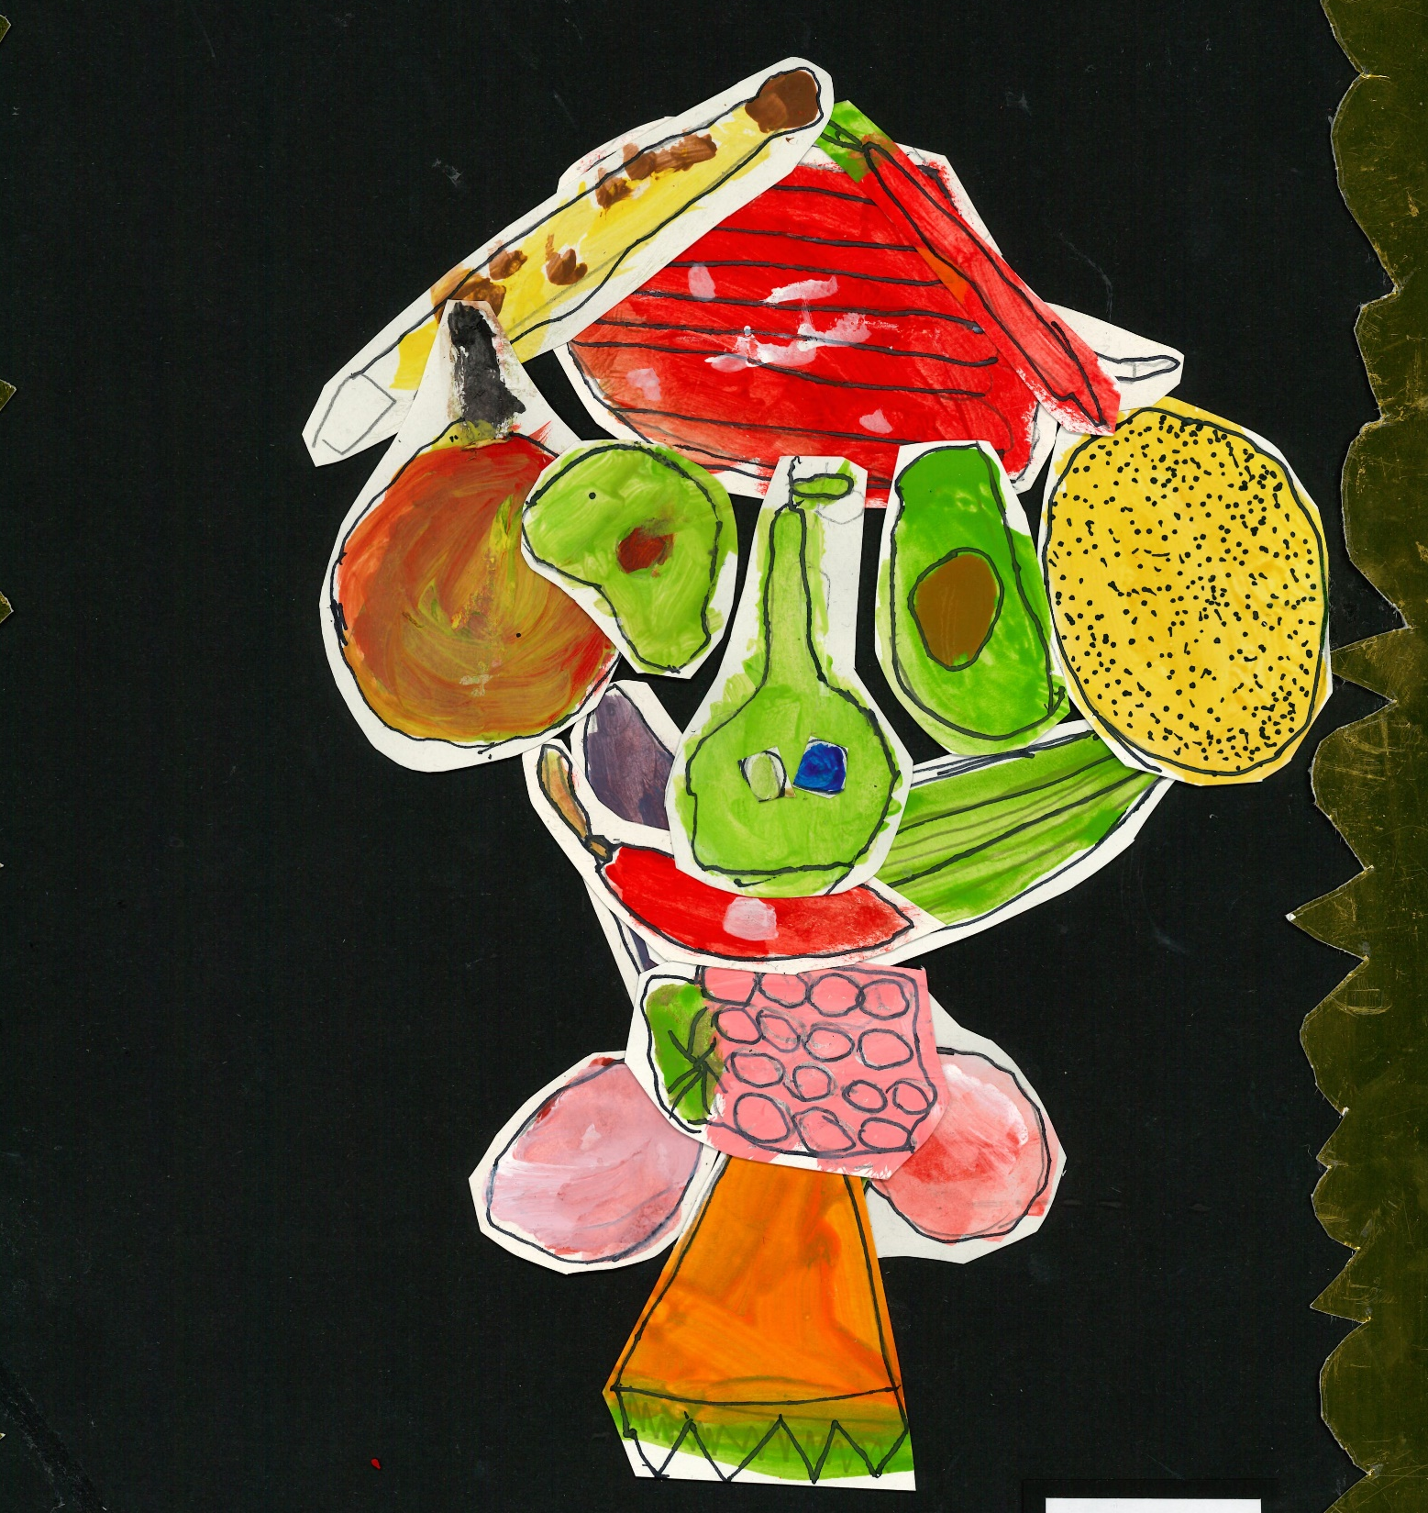
AIMS OF THE SESSION
To reflect on how children in your school access their right to participate in cultural life and the arts.
To reflect on how to use the arts as a vehicle for your pupils to develop and deepen their understanding of children’s rights.
​
​
Notes:
Presenter notes: Please edit the aims of the session to suit the time you have available for your session.
The image on this slide was created by Eric from year 2 at Christ Church Primary School and is inspired by the provision for nutritious food in Article 24.
This session is intended to support staff in Rights Respecting Schools to reflect on your school’s current arts provision and consider how the arts can be used to enable children to explore children’s rights and the principles and values that underpin rights.
The whole Spotlight series is about embedding children’s rights within a wide range of school priorities and practices.
For Secondary Schools, this will be most relevant to your creative arts, music and drama departments. However, it is also linked to cultural capital and every child’s personal development as they move through the school.
​

Slide 4
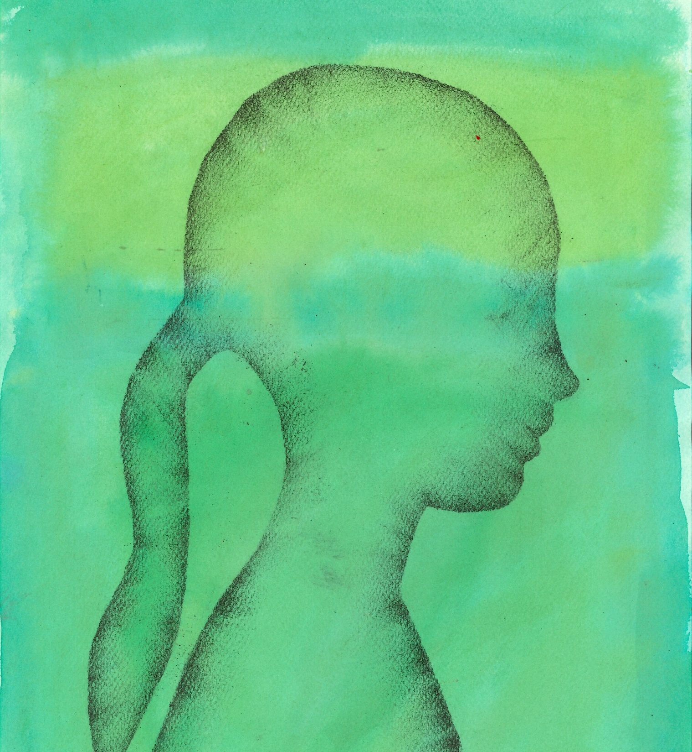
THREE WAYS TO USE THIS PACK
DELETE THIS SLIDE BEFORE USING
Read through the slides and notes pages to identify the most relevant activities for your colleagues and any preparation or resources needed.
If time is tight, use the introduction slide and choose from the key discussion questions to explore with your colleagues.
If you have longer, you can also choose some of the activities to explore.
You may wish to cover the content over a number of staff meeting sessions.
Notes:
Trainer notes: Delete this slide before using.
The image on this slide was created by Victoria in Year 5 at Christ Church Primary School and is inspired by Article 7 – birth registration, name, nationality and care.
It would be useful to have copies of the simplified CRC or the icons so that staff can refer to them throughout the session. Unicef.uk/CRC_Icons

Slide 5
SPOTLIGHT ON…
The arts offer a powerful way to explore children’s rights and the principles and values that underpin rights.
Participation in artistic and cultural activities is also a right itself.
Many Rights Respecting Schools have found the arts an excellent way to explore articles from the Convention and this session will support you to consider how to strengthen links to rights within art, dance, drama and music at your school.
'Last year over 26,000 children joined Create Day 24, a Royal Ballet and Opera Schools event, offering children the opportunity to explore rights through singing dancing and design.
Sign your school up to Create Day 25!

Slide 6
LINKS TO RRSA OUTCOMES
STRAND A: TEACHING AND LEARNING ABOUT RIGHTS
Outcome 1: Children, young people and the wider school community know about and understand the United Nations Convention on the Rights of the Child and can share how it impacts on their lives and on the lives of children everywhere.
STRAND B: TEACHING AND LEARNING THROUGH RIGHTS
Outcome 2. In school children and young people enjoy the rights enshrined in the United Nations Convention on the Rights of the Child.
STRAND C: TEACHING AND LEARNING FOR RIGHTS
Outcome 8. Children and young people know that their views are taken seriously.
Notes:
Presenter notes:
This slide provides an opportunity to remind colleagues of the ‘structure’ of RRSA which includes three strands: Teaching about rights; through rights; and for rights.
In terms of the relevance of this Spotlight to the RRSA framework, consider the following:
Strand A: Teaching and learning about rights – the arts offer a fantastic vehicle for developing children and young people’s understanding of the CRC and the values that underpin children’s rights
Strand B: Teaching and learning through rights – children experience their rights being met at school, underpinned by the principles of dignity, equity and non-discrimination
Strand C: Teaching and learning for rights – children can use the arts to communicate messages about their rights and the rights of others
The full text of the Strands and Outcomes of the Award can be found here:
www.unicef.org.uk/rights-respecting-schools/wp-content/uploads/sites/4/2015/06/RRSA-Strands-and-Outcomes-at-Silver-and-Gold-1.pdf

Slide 7
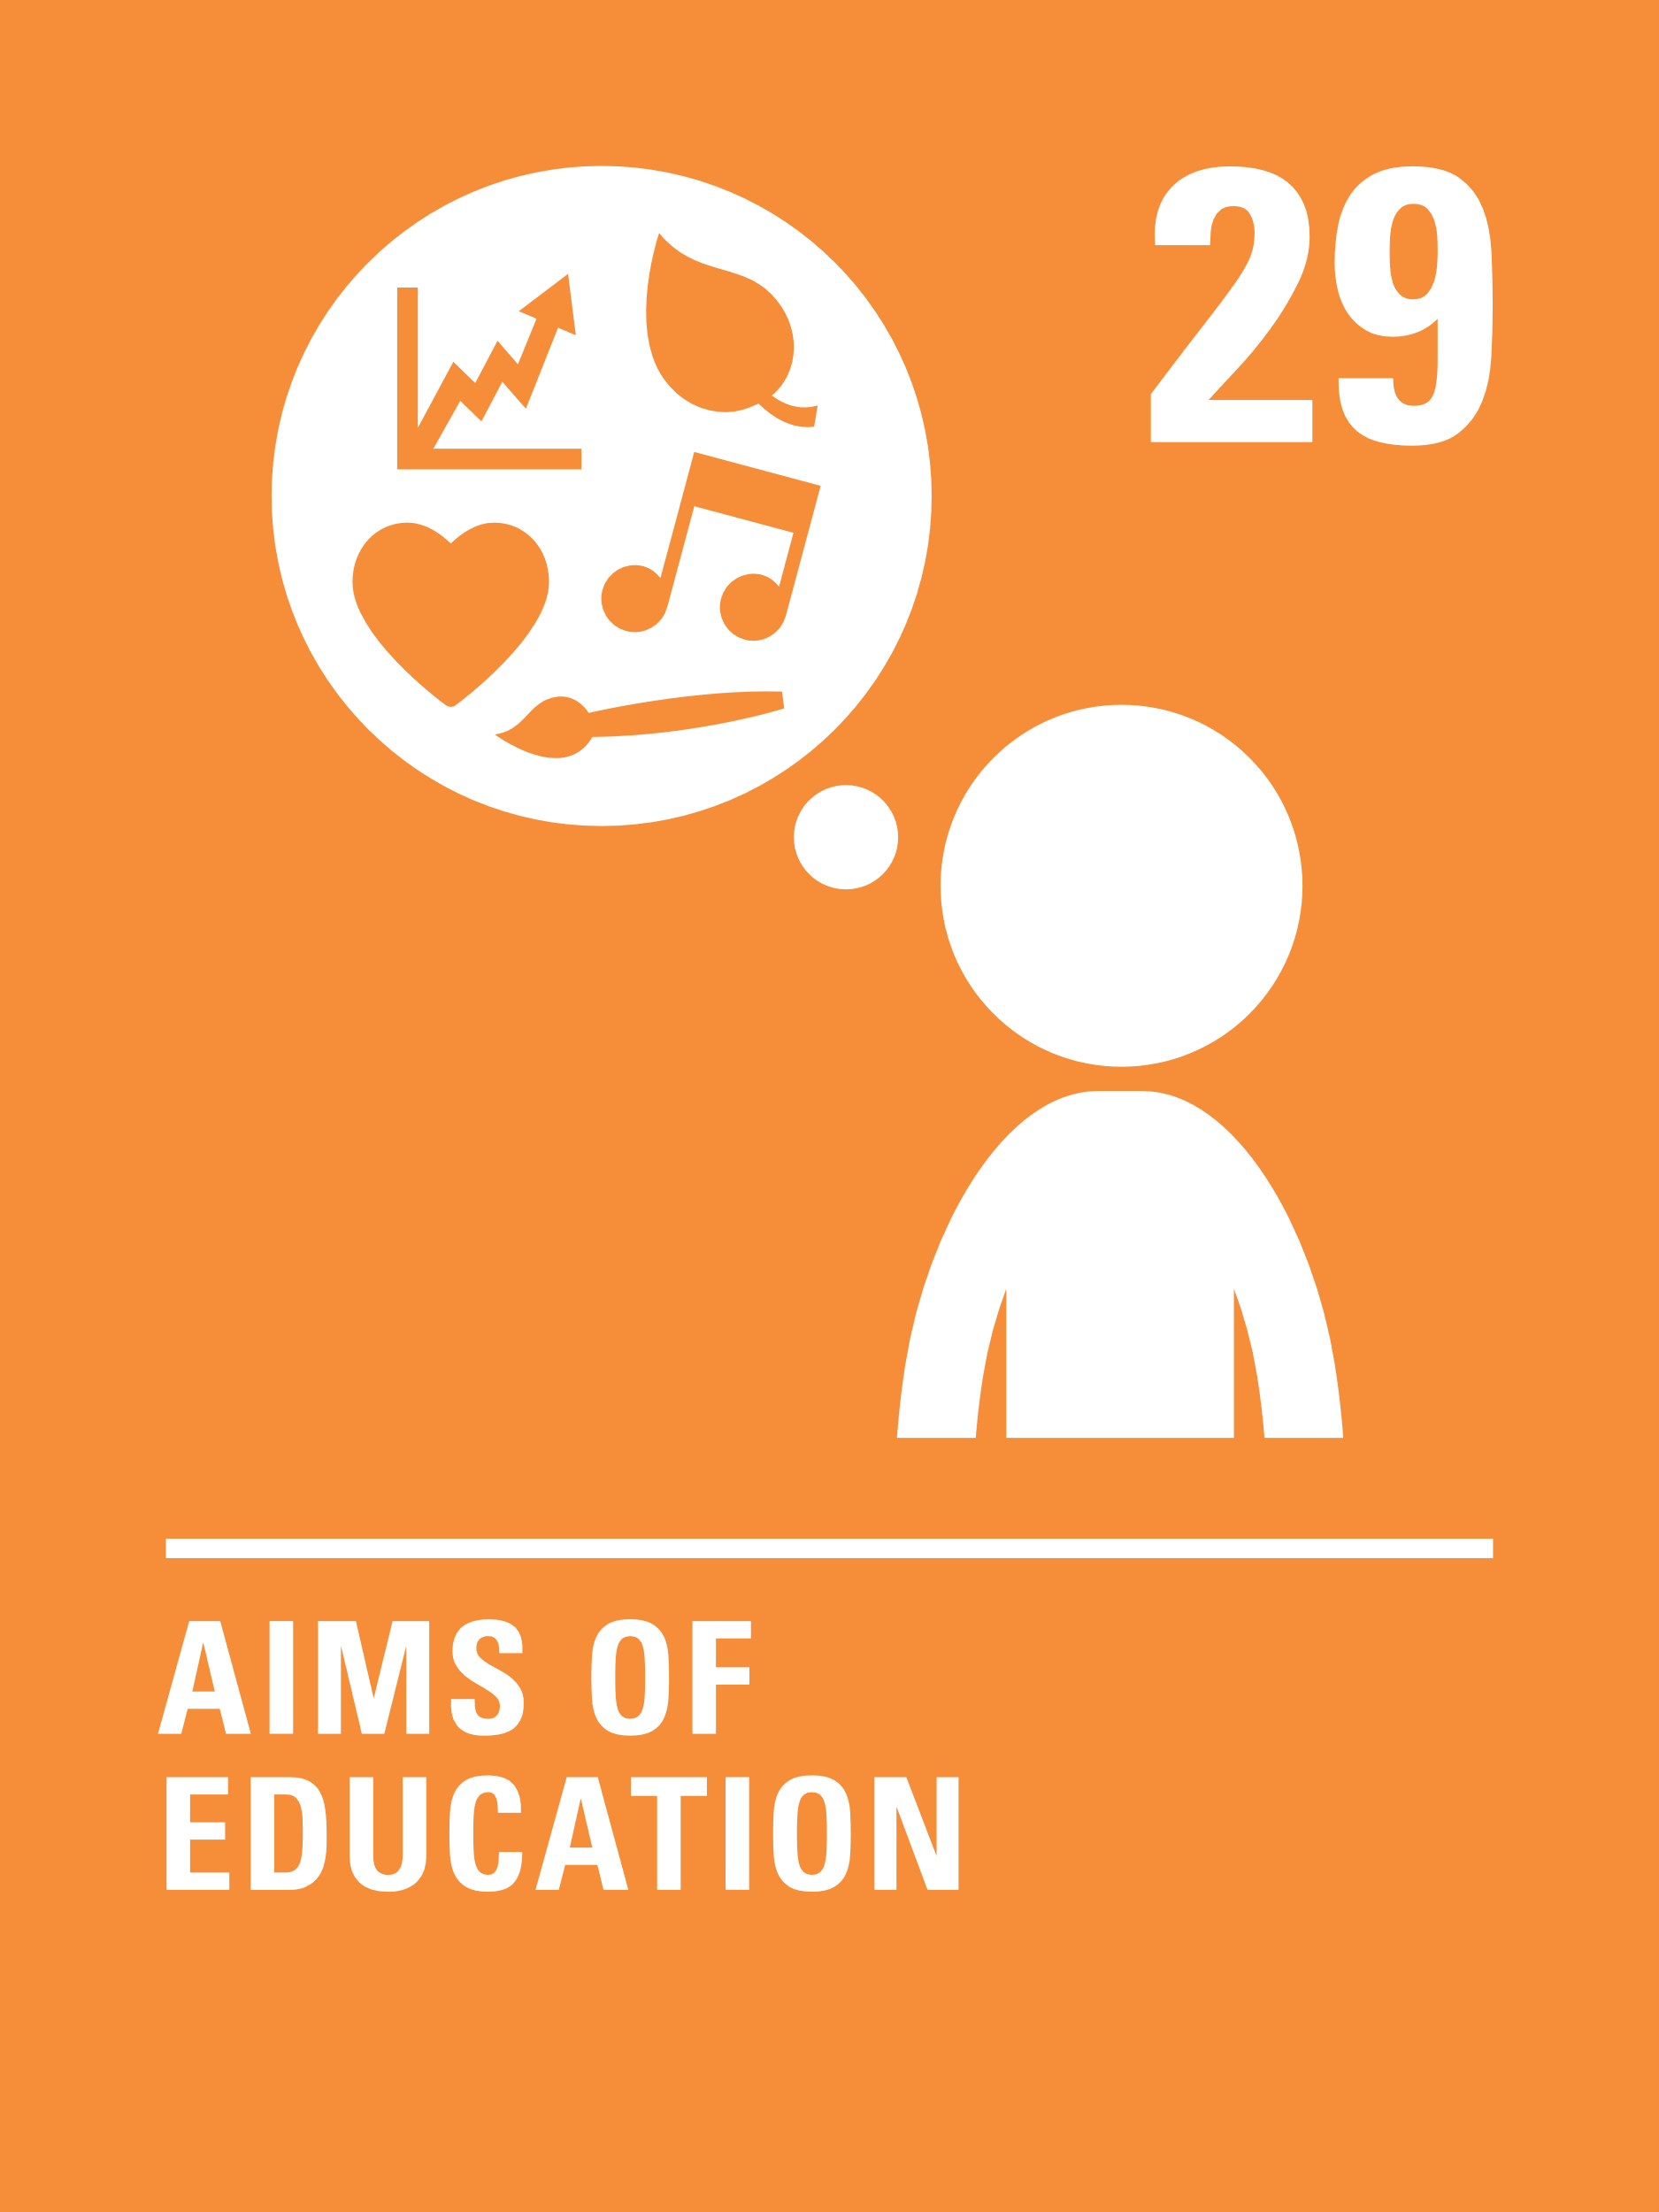
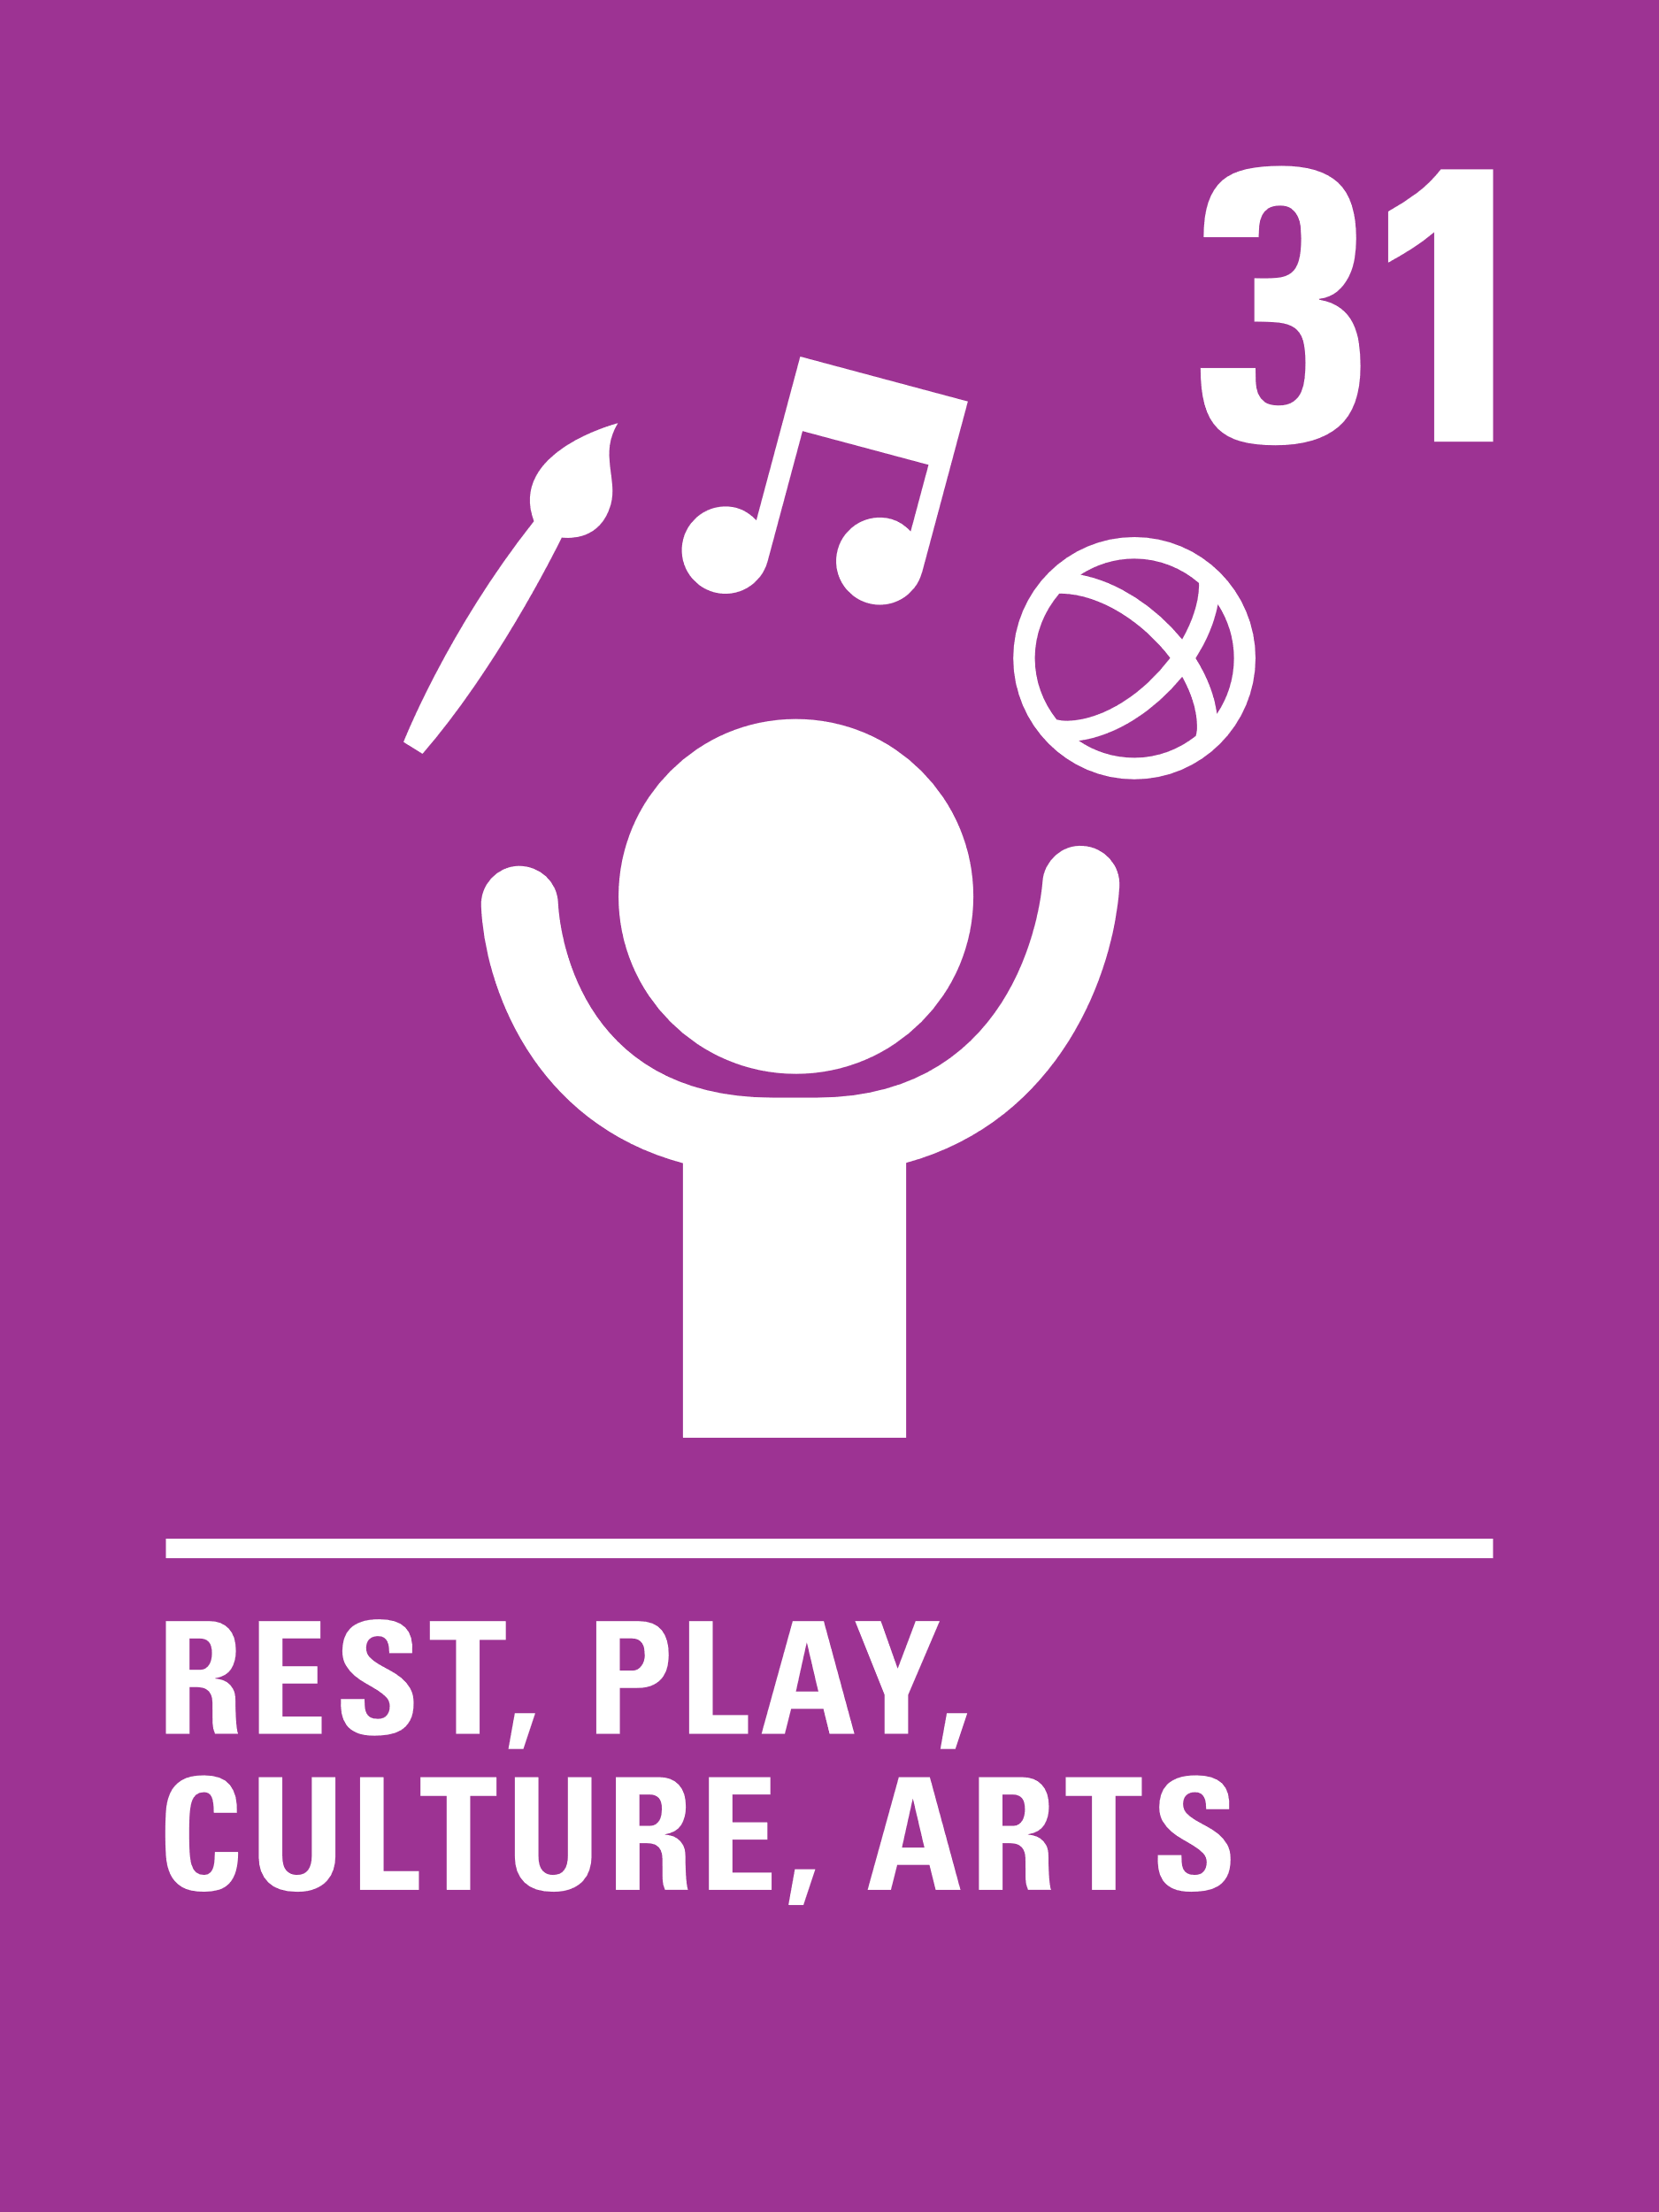
LINKS TO ARTICLES
Look at the summary of the CRC with a partner – which articles do you think are particularly relevant to our work on children’s rights and the arts? Click to reveal.
Although many other articles may also be linked. ​
Notes:
Presenter notes: When showing this slide in presenter mode the articles will appear on click.
You may want to provide copies of the summary of the UNCRC to staff before and during the session to support their engagement with this slide.
Look at the summary of the CRC with a partner – which articles do you think are particularly relevant to the arts? Give good time for people to think about and discuss the links. Your colleagues may identify different articles to the ones displayed. If time permits, encourage staff to explain their choices.
It is worth looking in detail at the text of Article 31 of the CRC which states:
1. States Parties recognize the right of the child to rest and leisure, to engage in play and recreational activities appropriate to the age of the child and to participate freely in cultural life and the arts.
2. States Parties shall respect and promote the right of the child to participate fully in cultural and artistic life and shall encourage the provision of appropriate and equal opportunities for cultural, artistic, recreational and leisure activity.
​
​

Slide 8
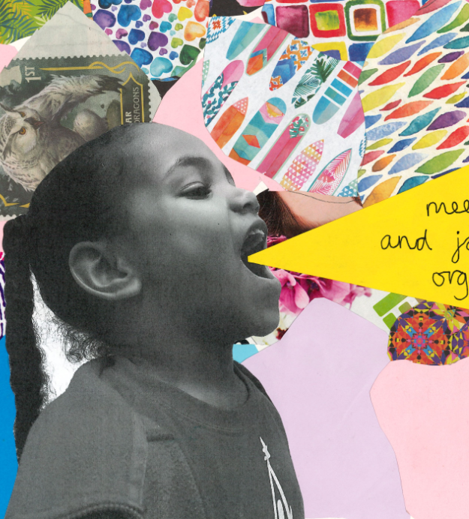
This image is inspired by Article 15, Freedom of Association and was created by a child from Christ Church Primary School.
CASE STUDY
By linking rights to the arts children know that rights are not an ‘add on’ but a part of Christ Church Primary School’s ethos.
Read the full case study online.
By linking rights to the arts, the idea that children’s rights are not an ‘add on’ but a part of the school's ethos is promoted. Using the arts can also be a way for children to ‘have a say’ about specific rights and share knowledge of the rights of the child with others.
​​Each year we run an art project in the autumn term which focuses on every child producing a piece of art linked to a common theme. We frame each child’s art work and showcase all of the art at an art exhibition run after school.
Giving each class a specific article to focus on works well. Linking rights and art is a really good way to also tick off art skills. Having some sort of opportunity to share the artwork is a great way of promoting the rights even further, especially with parents.
Notes:
The full case study is available on the RRSA website, where you can print it out and share with you staff.
The image on this slide is inspired by Article 15, Freedom of Association and was created by a child from Christ Church Primary School.

Slide 9
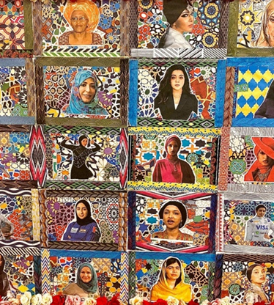
Pupils created paintings, collages, sculptures, and 3D installations inspired by renowned Muslim artists such as Rasheed Araeen and Aisha Khalid.
CASE STUDY
Linking arts and rights helps to address powerful issues at Maryland Primary School.
Read the full case study online.
We have used the arts to explore children’s rights by addressing Islamophobia and promoting equality through a public art exhibition. Pupils created paintings, collages, sculptures, and 3D installations inspired by renowned Muslim artists such as Rasheed Araeen and Aisha Khalid.
​​By expressing their thoughts on respect and inclusion, children highlight the importance of freedom of thought, conscience, and religion while fostering cultural understanding. This approach empowers children to share and celebrate their heritage, creating a more inclusive community where all feel valued and respected.
Encourage pupils to explore issues like discrimination and freedom of thought through art, offering a platform for self-expression and dialogue. Collaborate with communities and draw inspiration from diverse artists to address real-world issues creatively.
Notes:
The full case study is available on the RRSA website, where you can print it out and share with you staff.
Pupils created paintings, collages, sculptures, and 3D installations inspired by renowned Muslim artists such as Rasheed Araeen and Aisha Khalid.

Slide 10
LET’S DISCUSS
1. Why is it important for all children to experience the arts?
2. What access do your children have to the arts? What artistic and cultural activities do children access as they move through your school? E.g. drama, music, dance, visual arts etc.
3. How do you think the arts could support children to develop and deepen their knowledge and understanding of rights?
Notes:
Presenter notes: Choose the questions that are most relevant to your setting and experience. Collect some of the ideas from your colleagues and add them to your action plan/evidence.
This question offers an opportunity to get people thinking about the role of arts in education. What benefits does it bring? What are the challenges? How can we make sure the arts are accessible to all children?
Consider a child’s experience as they move through your setting. What opportunities do they have to participate in making music, art, dance and other art forms? Are these opportunities part of the curriculum or are they extra-curricular? Are there opportunities to go to galleries, and to watch music, dance or theatre performances? How does the principle of equity underpin this offer? Many schools have initiatives designed to support children and young people’s cultural capital: how is this linked to the realisation of their rights?
Are there certain articles that you could explore through art, music or drama? How could this help children to really consider what those articles mean for themselves and other children around the world?

Slide 11
ACTIVITIES
In groups, draw a Rights Respecting classroom onto large pieces of flipchart paper. What do you see, hear and feel in a Rights Respecting classroom?
1. Map the current opportunities to engage in the arts including dance, drama, singing and art. Now plan how you can strengthen links to rights across these.
2. If you have an enrichment programme/cultural capital passport, consider how this could be explicitly linked to the CRC.
3. How could you use the arts to promote children’s rights in the community?
Notes:
Presenter notes: There are three suggestions for activities. Depending on the time you have available, choose one or more activities for your colleagues to work on together to further explore the topic. Different groups could explore different activities. The activities that you do not wish to use can be deleted from the slide.
Activity 1: Reflect upon a number of the arts opportunities that children/young people in your setting experience. How can they be linked to rights? For example, a trip to the theatre to see The Boy in the Back of the Class – what rights do children experience by going to the theatre and what rights are explored through the story itself? Perhaps there is a unit of work inspired by the natural world – could this be linked to the Sustainable Development Goals and the CRC? How can you make the links to rights more explicit so that children and adults see and understand them?
Ideas to engage with:
Primaries: Create Day 2025 – 8th July 2025: https://www.rbo.org.uk/schools/resource/createday
Early Years to Lower Secondary: Author Nicola Davies has created a set of art resources inspired by her book on the UNCRC, Every Child A Song. Explore using this resource in your setting to create some of the fold-out books she shares as examples –find a link to the resource on slide 12. How else could you use this idea of creating pieces of art when exploring rights? You could use any book that relates to rights.
Could you create a song about rights to sing in assemblies. For secondaries, could children write their own songs about rights as part of their music lessons and then perform these for parents/carers? See some songs about rights on slide 13.
Activity 2: Consider the enrichment programme you currently offer. How could you make links to the CRC more explicit? It could mean adding in articles to certain activities, exploring concepts such as fairness, dignity or equity or just raising awareness of rights more generally. Could you involve the Rights Steering Group in this? How can you ensure that the principle of equity underpins your enrichment programme?
Activity 3: Looking beyond the school gates – how could you use arts to promote the CRC in the community? Many schools have shared successful RRSA and art campaigns with the wider community, for example by creating art exhibitions focused on rights and inviting parents/carers and the wider community into school to view them. How could this support your work around Strand A, Outcome 1 and Strand C, Outcome 9. Read the case studies for examples of schools who have used this approach.

Slide 12
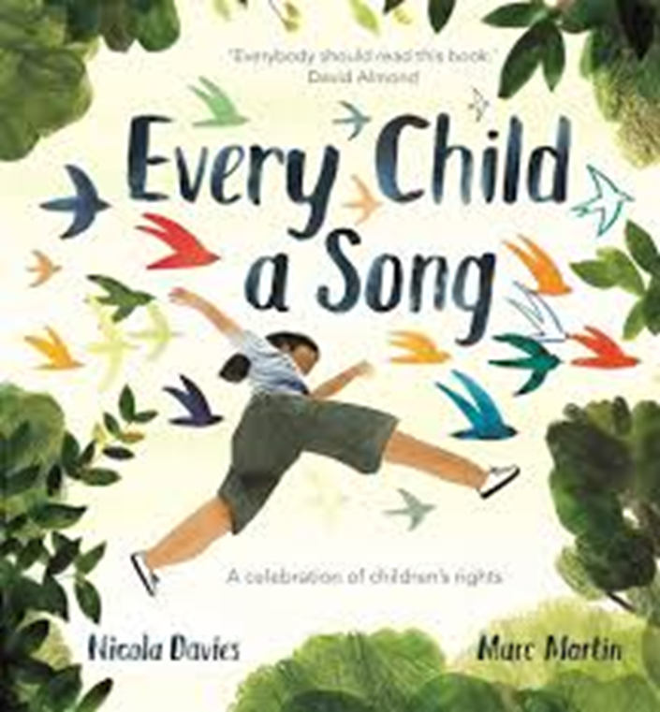
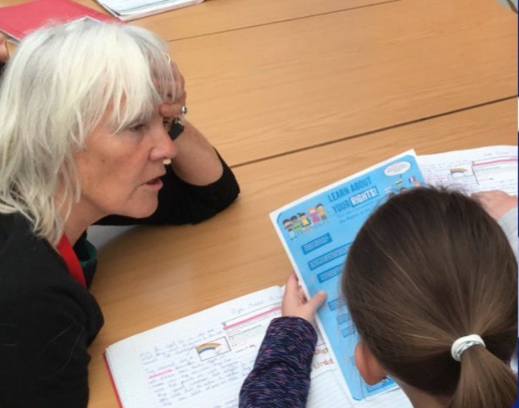
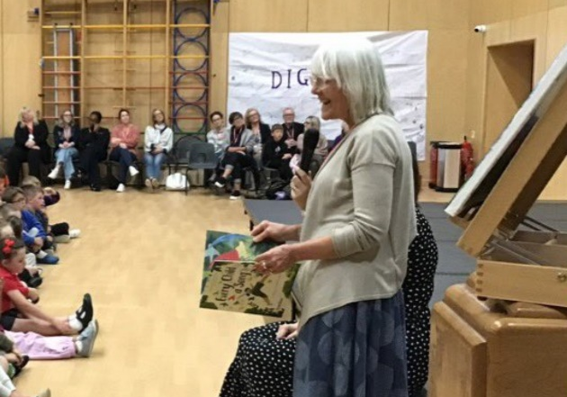
EVERY CHILD A SONG – An Art Project Resource
Author and illustrator Nicola Davies has created an art project for pupils in Rights Respecting Schools. The project supports children to create some art inspired by Nicola’s book Every Child a Song, which is all about children’s rights.
Download the resource
Nicola said, “I was keen to visit a Rights Respecting School and I was delighted to find how children’s rights had been embedded into every aspect of the school’s life.
“For the youngest children the first step towards understanding rights is reflective self awareness. So, I designed an art and writing workshop around my book Every Child A Song which invites children to think about what makes them unique and special. In thinking of their own uniqueness and value they can begin to see those qualities in others.”
Nicola Davies visited Pembroke Dock Community School in Wales to see RRSA in action.
Notes:
Presenter notes:
As a staff team, you could explore this art workshop and consider how it could be used or adapted in your setting. Could you use it within your Year7/S1 art course or as part of a transition day from primary to secondary? Could it form part of your work for World Book Day or a whole school day on the CRC for World Children’s Day in November?

Slide 13
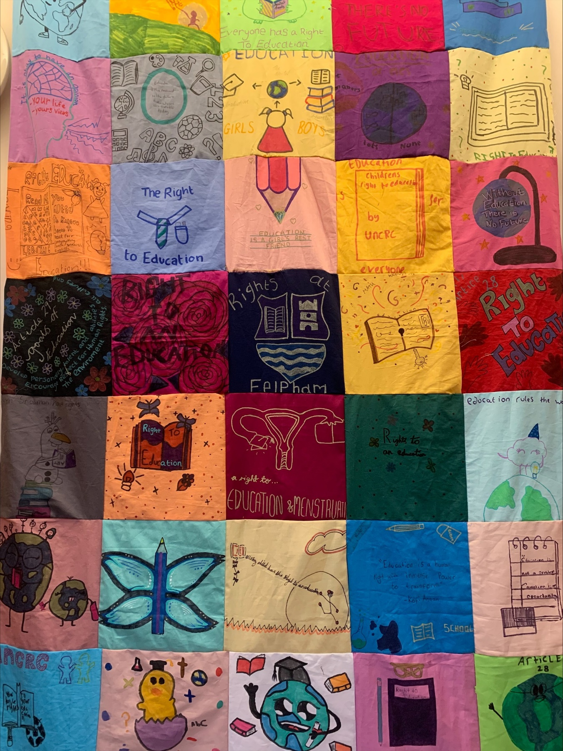
EXPLORING RIGHTS THROUGH MUSIC
Exploring the CRC and principles that underpin rights through music, especially through song, can be very powerful. Some schools even create and perform their own songs about rights.
Pupils and staff from Glade Primary School in Redbridge wrote and recorded this song and were even featured on a local radio station. For Every Child song
Pupils from South Grove Primary School composed and recorded this Rights Rap as part of their work towards their Gold Rights Respecting Schools Award.
St Mary’s RC Primary School in Leith, Scotland, held a music day to celebrate being awarded their Gold Award, culminating in a concert for parents and carers. You can watch a film about the day here:
Rights Respecting Concert clips and Celebrating bring a gold Rights Respecting school through music
Notes:
The image on this slide features Felpham Community Collage’s rights blanket. Following a workshop focused on exploring what rights people have with a focus on the right to education, students were given a fabric panel which they decorated to show their and every child’s right to an education. This was then turned into a blanket which is on display in the school’s library.

Slide 14
RESOURCES
You may find the following resources useful for your work on equity:
UNICEF UK's Article of the week packs (Especially relevant are Article 31 Rest, play, culture, arts Article 31 – published 22 June; World Book Day – Articles 17, 29 & 31).
Author Nicola Davies has created an art project linked to her book based on the CRC, Every Child a Song.
Royal Ballet and Opera Schools - Create Day 2025
Banners and Dragons: The Complete Guide to Creative Campaigning by Dan Jones is an old book but has some great ideas for creative campaigning, ideal for secondary students
Notes:
Presenter notes: If you have time, please explore these links ahead of your session with colleagues. You may well find a particular resource that you want to highlight to all as part of your input. There may be links you want to share with the team ahead of or as follow up to your input with them.

Slide 15
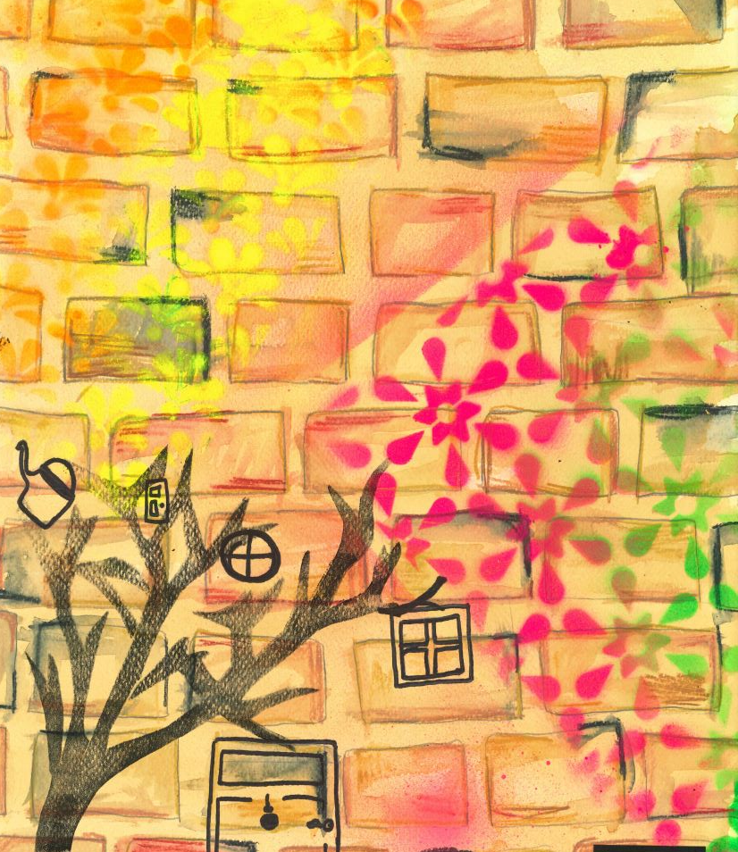
REFLECTION
© UNICEF/Dawe
Take a few moments for personal thought and reflection:​​
​
‘Before a child talks, they sing. As soon as they stand, they dance. Before they write, they draw. Art is fundamental to human expression.’ Phylicia Rashad
Reflect on the statement above and the importance of the right to and rights through the arts. How can you support this in your role?
We would any work you produce inspired by this edition of Spotlight. Please share on our dedicated RRSA Facebook group.
​
Notes:
Presenter notes: Encourage people to reflect on these questions.
The image on this slide was created by a child in year 6 at Christ Church Primary School and is inspired by Article 13 – Freedom of Expression.

