Slide 1
EVERY CHILD A SONG: RRSA AND ART
© UNICEF/Sachse-Grimm
Notes:
© UNICEF/Sachse-Grimm
This image was created by children at a Child Rights School in Cologne, Germany to celebrate World Children’s Day 2024.

Slide 2

Contents
Objectives – slide 3
Introducing Every Child a Song – slide 4
Nicola’s visit to a Rights Respecting School - slide 5
Video workshop – exploring Rights through the Arts – slide 6
Option 1 – The Song of Me - slide 9
Ideal for younger pupils (age 4-7)
This can be done individually or as a group or class project.
Option 2 - Soaring, learning, exploring - slide 15
Ideal for pupils aged 7-11
Option 3 - Nourished, cherished, celebrated - slide 19
Ideal for older pupils aged 9-14
© UNICEF/Dawe

Slide 3
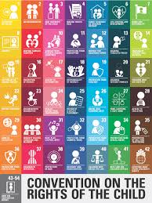
OBJECTIVES
To explore the CRC through art.
To create a zig-zag book that celebrates YOU!
© UNICEF/Sachse-Grimm
Notes:
© UNICEF/Sachse-Grimm
This image was created by children at a Child Rights School in Cologne, Germany to celebrate World Children’s Day 2024.

Slide 4
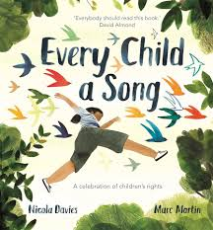
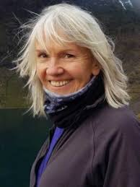
Every Child a Song by Nicola Davies
We are going to create some art inspired by the book Every Child a Song, by author and illustrator Nicola Davies. This book is all about children’s rights and Nicola has shared an exciting art project to help you to explore your rights through art.
Working alongside Nicola, you will create a simple and effective zig zag book that links to articles from the Convention on the Rights of the Child (CRC).

Slide 5
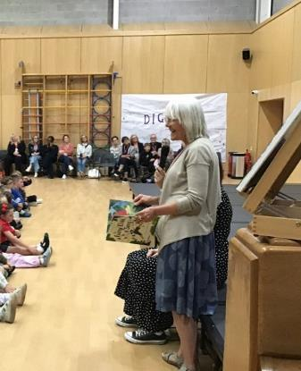
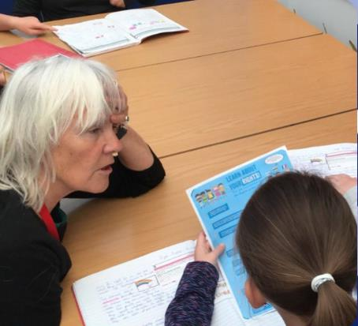
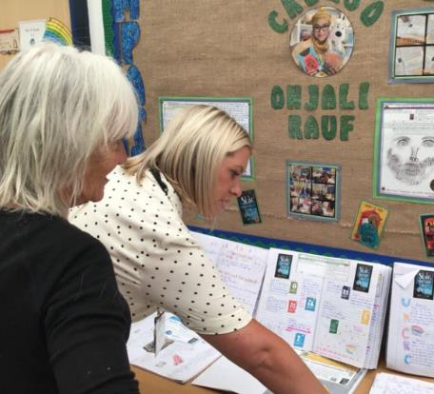
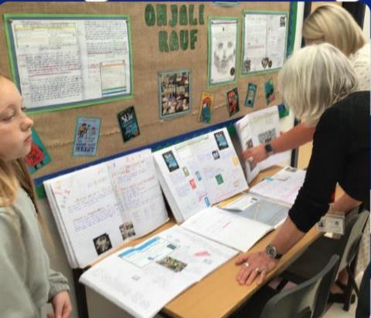
Nicola visited an RRSA Gold school
Nicola said: “Although most of my books for children are about the natural world, I’m also very interested in children’s welfare issues. I’ve written about grief, about disability and about migration so when I was asked to write a non-fiction title about the UN Convention on Rights of the Child, I said yes immediately. I wanted to write to something that embodied what the UNCRC does and what it means for every child on Earth.
“For the very youngest children the first step towards understanding their rights and the rights of others is reflective self-awareness. So, I designed an art and writing workshop around my book Every Child A Song which invites children to think about what makes them unique and special. Thinking of their own uniqueness and value, they can begin to see those qualities in others.”

Slide 6

Exploring Rights through the Arts - Video
This is a video workshop created by Nicola to accompany some of the activities in this pack. You can watch the whole video or just refer to the sections highlighted within Option 1.

Slide 7
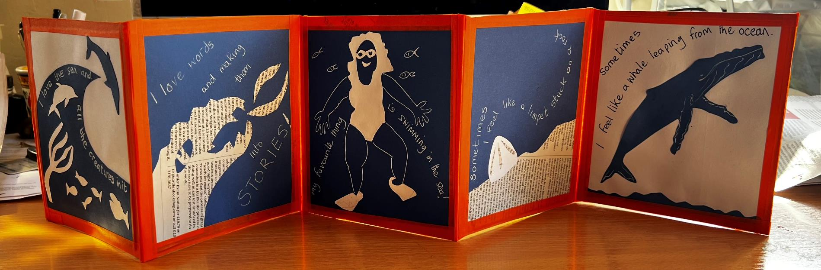


ZIG ZAG BOOK
This is an example of a finished zig zag book that links to Article 8 - identity.
© UNICEF/Dawe

Slide 8
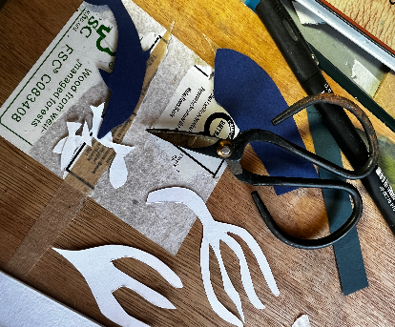
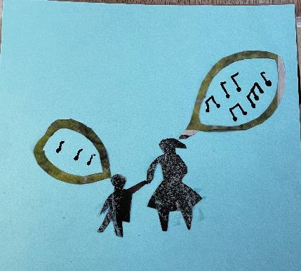

Resources for this activity
Cardboard pieces (Nicola uses squares 15cm x 15cm)
Sticky tape
Coloured paper (you could also use newspaper/magazines)
Coloured pens
Glue
Scissors
© UNICEF/Dawe
Notes:
MOST IMPORTANT THINGS TO REMEMBER
You can do this any way you like.
You don’t have to be good at drawing or painting.
Keep it simple and plan before you start.

Slide 9


Option 1: ‘Song of me’ zig-zag book
Ideal for younger pupils (age 4-7). This can be done individually or as a group or class project.
‘When you were born a song began. A melody the world had never heard before.’
Which articles from the CRC does this quote make you think of?
© UNICEF/Dawe

Slide 10

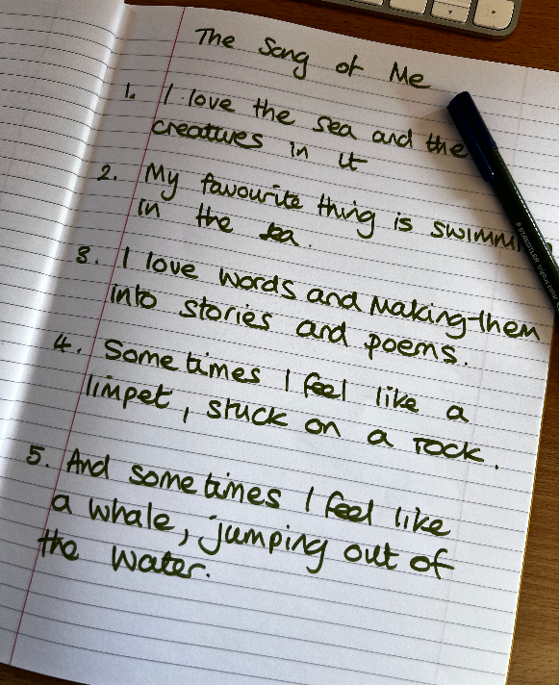
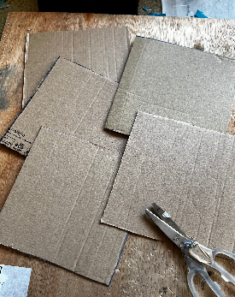
‘Song of Me’ zig-zag book
See the video - 0.45-3.50 mins - to see this in action.
1. Write down 5 things that make you, you! They might be things you like doing, or places that you like to go or the way it feels to be you.
2. Cut out 5 cardboard squares 15cm x 15cm
3. Decide on 3 materials to use in your collage. In the example, Nicola uses blue paper, white paper and newspaper.
© UNICEF/Dawe
Notes:
Using just a few colours that contrast will make your pictures really stand out and look great

Slide 11
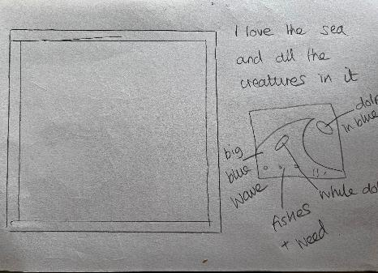
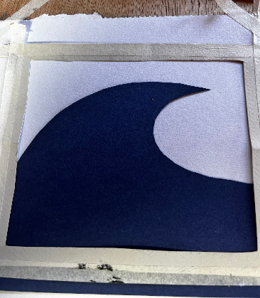
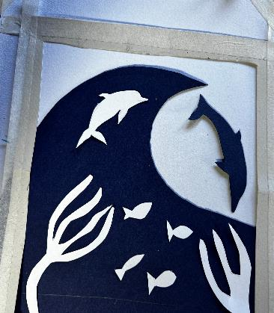

‘Song of Me’ zig-zag book
Watch the video at 3.50- 8.25 mins to see this in action.
4. Decide which picture you want to create for each of the squares. Optional: prepare a frame to make sure the picture will fit on the panel as Nicola does in the video.
5. Make a rough plan.
6. Cut out the shapes that you need for the picture.
7. Place the shapes on the pages where you want them. When you’re ready, stick them down.
8. Add a few words to explain your picture.
© UNICEF/Dawe
Notes:
I took a sheet of paper and drew round one of the squares, and then made a little frame round the edge. This meant that that whatever picture I made would fit in the square and giving it a frame makes it look more professional (my niece who is an artist taught me that!) I thought about what each picture would be.
I thought about what picture I would do for each of my answers.
Remember when you do this that you don’t have to make a picture that says ALL the things the words say.
Keep it simple.
I made a little rough sketch of what my picture would be. Then I cut out the shapes in paper to make the collage.

Slide 12
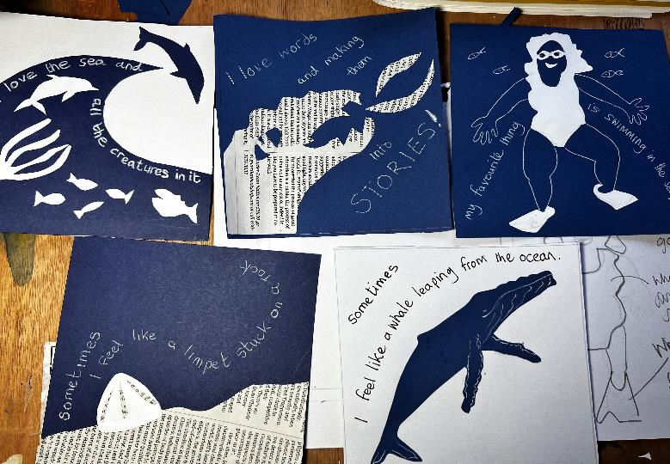
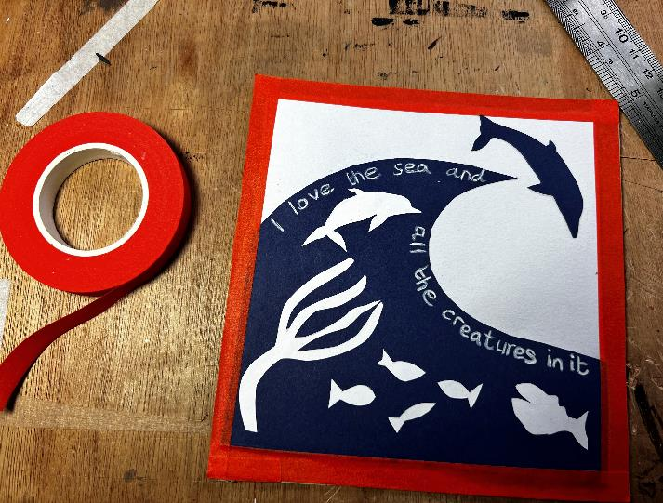

‘Song of Me’ zig-zag book
Watch the video at 8.35- 11.40 to see this in action.
9. Decide which order you want your pictures to be in.
10. Put tape around the edges of each picture to make a border.
© UNICEF/Dawe

Slide 13

‘Song of Me’ zig-zag book
Watch the video at 11.40 – end to see this in action.
11. Use the same tape to stick the panels together.
© UNICEF/Dawe
Notes:
I didn’t do anything on the back of my zig zag but you could add more illustrations or just use patterns to decorate the back.

Slide 14
‘Song of Us’ zig-zag book
Making a ‘Song of Us’ Zig Zag Book in a group
Work with a friend or in a small group. Think of what is special about each of the other people in the group. What are their talents? What do they like to do? Why do you like them? They will do the same for you. For example, “Jaimie is always kind,” or “Zara is a fast runner.”
Write down at least two things for each person.
Choose one of the things that was said about YOU.
Now, swap with a friend so that they have what is special about you, and you have what is special about them. It’s now your job to create a zig zag page picture of your friend about what makes them special.
You should end up with a zig zag panel for everyone in your group or class.
You can tape these together in one HUGE zig zag or just in smaller groups.
Add one last zig zag page that says what is special about all of you together.
Questions to consider:
Do you have more fun together?
Do you listen to each other?
Are you always careful to be kind to each other?

Slide 15



Option 2:
‘Soaring, exploring, learning’ zig-zag book
Ideal for pupils aged 7-11
‘Then with each new step and word, your song picked up its rhythm.
It soared, explored.
It learned the blue of sky, the green of leaves, the red of dawn and sunset.
All around you everywhere other songs are singing.’
Which articles does this quote make you think of?
© UNICEF/Dawe

Slide 16
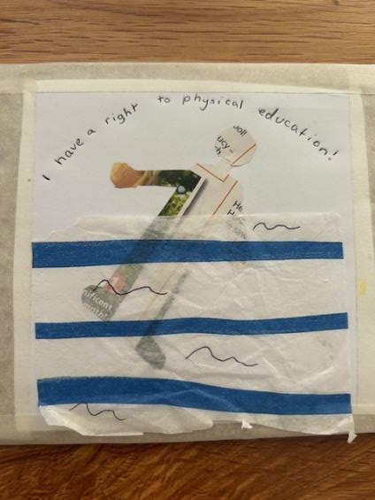
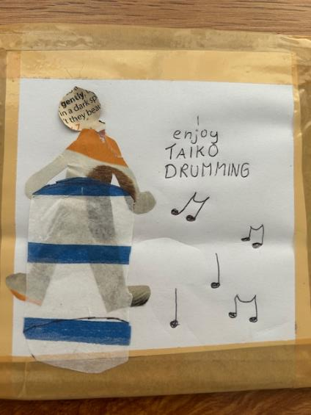
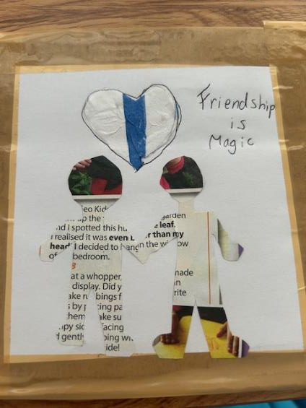
‘Soaring, exploring, learning’ zig-zag book
MAKING YOUR ‘SOARING EXPLORING LEARNING’ ZIG ZAG BOOK
Follow the steps for the Song of Me zig zag book (slides 9-12) but use the ideas on slides 16 and 17 to inspire your images.
© UNICEF/Dawe

Slide 17
‘Soaring, exploring, learning’ zig-zag book
MAKING YOUR ‘SOARING EXPLORING LEARNING’ ZIG ZAG BOOK
There are lots of different ways to make a zig zag about playing and learning. You can probably think of your own, but here are a few suggestions.
Growing up playing
Think about how you played when you were younger. What were your favourite games and who did you play with?
What are your strongest memories of playing from the time when you were little to now?
Think of five moments of playing from your earliest memories to now. What did you feel in those moments? Did you learn anything from them?
Do you think the ‘you’ that you are now is different from the ‘you’ that you were when you started school?
Tell the story of how your playing has changed over time in five sentences and five pictures on one side of your zig zag.
Learning from playing
If you play a sport or a musical instrument this is one for you.
How did you start to play? Did it happen by accident or did someone get you started?
What have been the five most important moments in your life of playing sport/ music?
Do you think getting better at your chosen skill has made you as a person different?
Tell the story of your playing sport of music journey in five sentences and five pictures.
Follow the steps for the Song of Me zig zag book but use these ideas to inspire your images
© UNICEF/Dawe

Slide 18
‘Soaring, exploring, learning’ zig-zag book
Learning from school
Think about some things that you have learned in school and how they have changed your life.
Maybe there’s just one big thing like reading, or learning how to make friends, that has meant that you can do lots more things.
For example…. learning to read has made you able to read stories, find out more about your favourite subject, get loads of books from the library, read to your younger siblings or other family members or maybe just get on the right bus!
Choose either, five different things that you have learned in school, or one thing that has changed your life in five different ways; written a sentence about each one and do an illustration to go with it.
Not playing, not learning
Some children don’t get to play or learn. This might be because they have to work instead, or because they live somewhere were war or famine are happening, or because they are just too ill.
If you couldn’t play or go to school what are the five things that you would miss most? Write a sentence about each of them and illustrate each of your answers.
© UNICEF/Dawe

Slide 19
Option 3:
‘Nourished, cherished, celebrated’ zig-zag book
Ideal for older pupils aged 9-14
‘When you were born a song began…
It needed love to help it grow, to keep it sheltered and protected. Nourished, cherished, celebrated.’
Which articles does this quote make you think of?
© UNICEF/Dawe

Slide 20
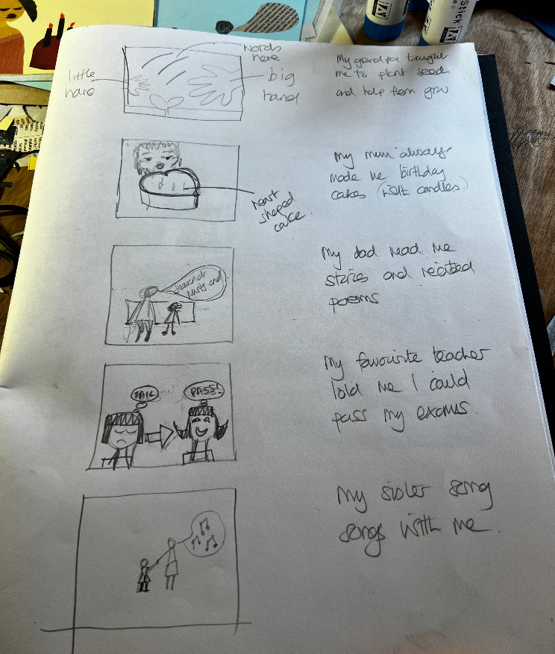
‘Nourished, cherished, celebrated’ zig-zag book
Think about some adults in your life and how they have helped you.
Plan 5 simple pictures that you could make to show these ideas.
© UNICEF/Dawe
Notes:
First I made a list of my answers to the questions about what grown-ups did for me when I was little. And I thought about one, simple picture that could show what the words meant.

Slide 21

‘Nourished, cherished, celebrated’ zig-zag book
These are example ideas…. (with notes below on the images to depict them)
My grandpa taught me how to plant seeds and help them to grow.
A seed with a plant growing from it and a big hand beside a little hand.
My mum always made me a birthday cake with candles on it.
All that is needed to express this idea is a cake with a smiling face and maybe some hearts to show the love baked in the cake.
My dad read me stories and recited poems that he knew by heart.
A child and a grown up sitting together with lots of words coming from the grown ups mouth - which I could do with newspaper.
My favourite teacher told me I could pass my exams even when I thought I couldn’t.
I could show the difference between passing and failing with a sad face and a happy face, one with fail written over it and the other with pass.
My sister sang songs with me.
Cut out shapes of two people one big one little the big one with a puffy skirt like the ones my sister wore, both with speech bubbles full of musical notes.
© UNICEF/Dawe

Slide 22
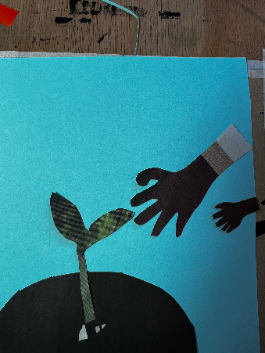

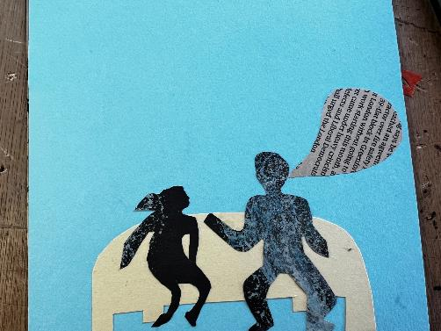
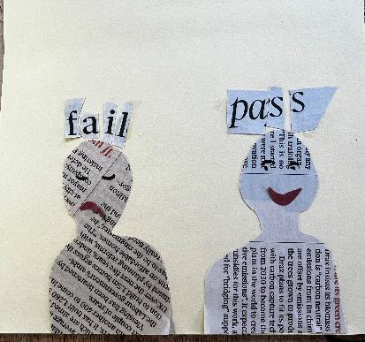
‘Nourished, cherished, celebrated’ zig-zag book
3. Cut out the shapes for each picture.
4. Arrange them how you would like them and when you are ready, stick them down.
© UNICEF/Dawe
Notes:
Then, I searched through the pages of the newspaper and found photos with coloured bits that I could use, words with letters I could cut out and bits of newsprint. I cut out all the shapes I needed then I cut out pieces of yellow and blue card as background.
I put each picture together, arranged the shapes on the card, leaving room to add words later.
Then I carefully stuck everything down and left it to dry.
Remember, keep to a simple colour scheme of around 3 different colours/resource types.

Slide 23
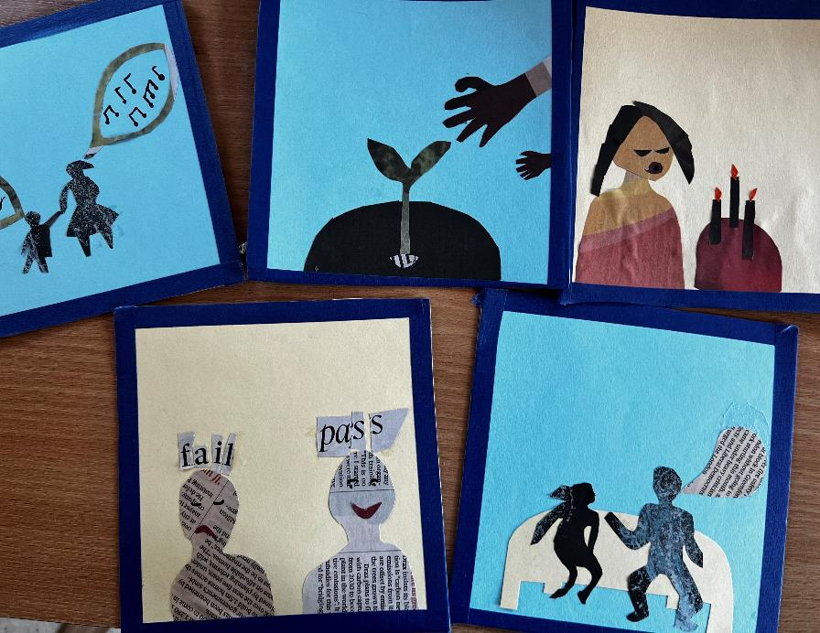
‘Nourished, cherished, celebrated’ zig-zag book
5. Use coloured tape to make a border for each picture.
6. OPTIONAL
Add some text to the back of each image to explain more.
For example:
Because my grandpa taught me how to plant seeds, I now have a garden.
Because my mum made me birthday cakes I always made them for my children.
7. Using the same coloured tape as before, stick the panels together.
© UNICEF/Dawe
Notes:
Here’s what the collaged pictures look like.
Keeping it simple and just using a few colours helps to make your book look good!
I used coloured tape to ‘frame’ each of the panels.
I didn’t stick them together to make a zig zag because I want to add some words to the back first.
Either just in words or with a picture too…. I haven’t decided.
Because my grandpa taught me how to plant seeds, I now have a garden.
Because my mum made me birthday cakes I always made them for my children.
Because my dad read me stories and recited poems I am now a writer.
Because my sister taught me songs we still sometimes sing together.
Because my favourite teachers told me I could pass my exam I went to university.
You can make your zig zags one sided, or two sided. It’s up to you.

