Slide 1

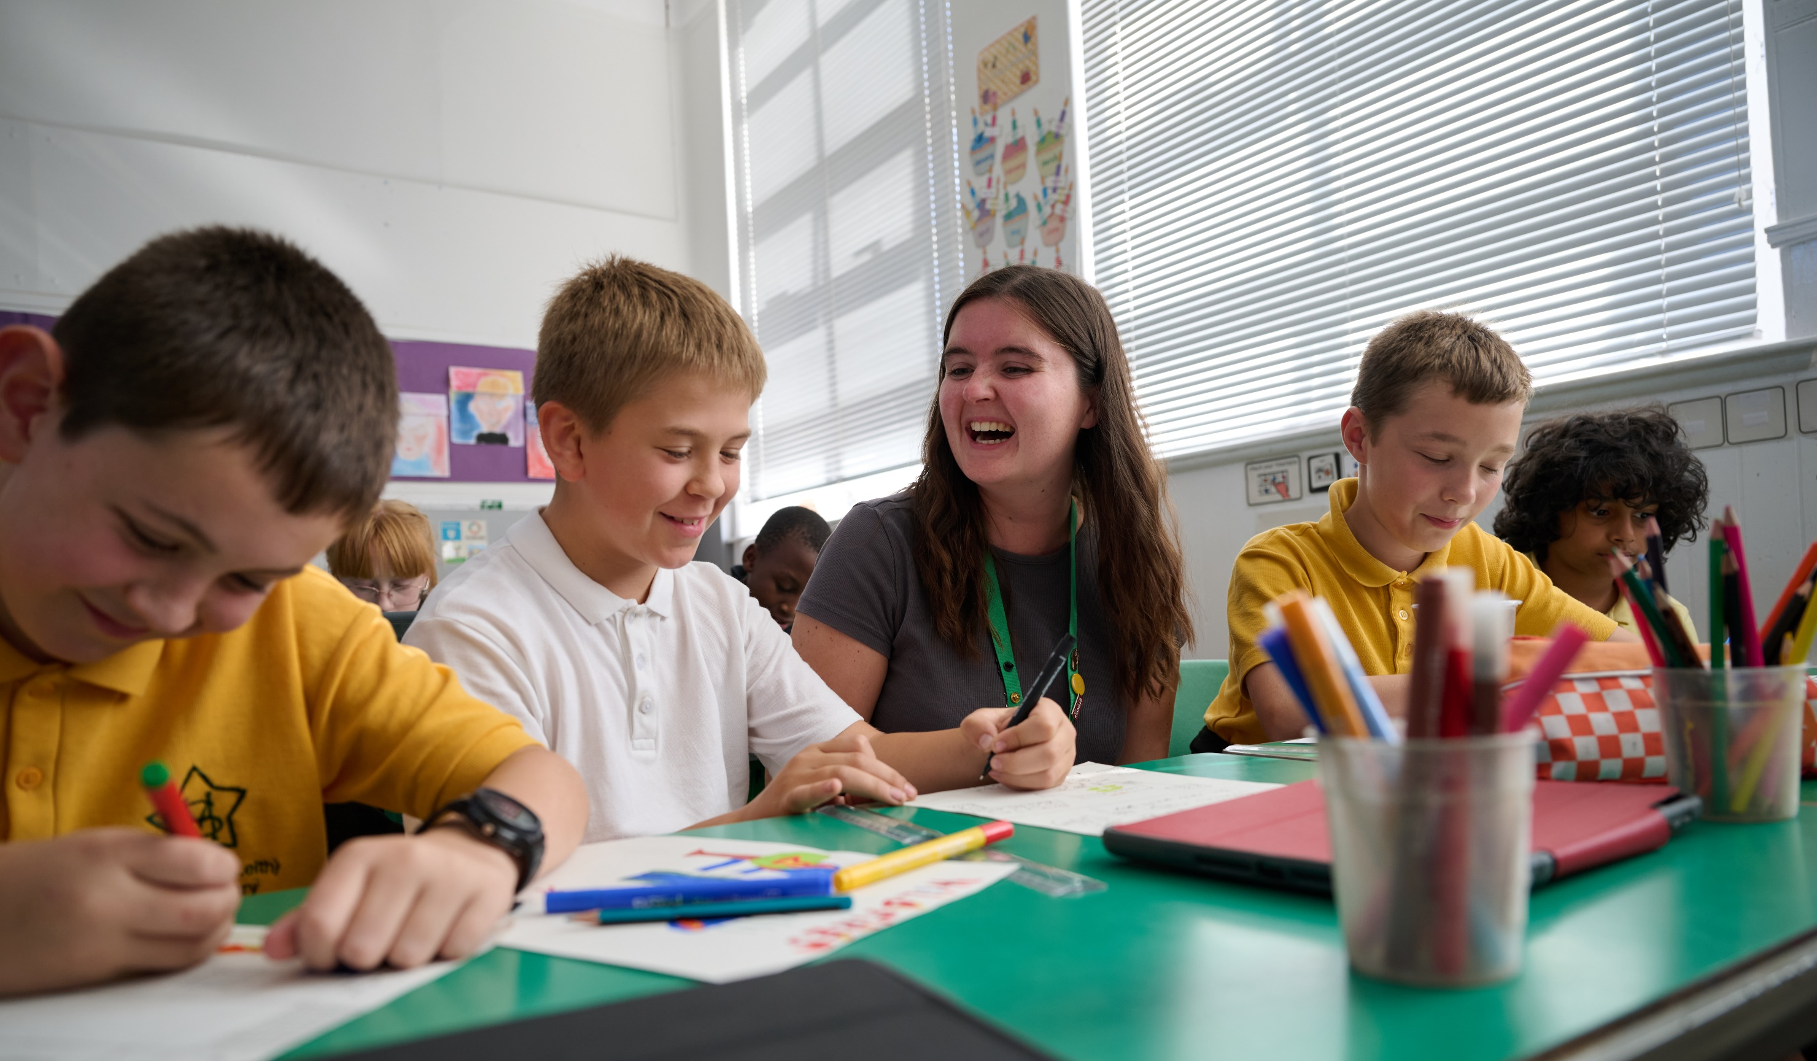

© UNICEF/Maule-ffinch
ENGAGING PARENT COUNCILS WITH THE RRSA
UNICEF/Maule-ffinch
Notes:
Welcome to Spotlight, our latest resource to support RRSA coordinators to develop Rights Respecting practice in school.
The image on the cover of this month’s Spotlight was directed by children at a Gold Rights Respecting School
Spotlight is aimed at colleagues and is intended to support you in staff briefings or continued professional development (CPD).
Please check guidance in subsequent slide notes.

Slide 2

CONTENTS
Topic: Engaging Parent Councils
For each slide, please look at the presenter notes for delivery information.
Slide 3: Aims of the Session
Slide 4: Three ways to use this pack
Slide 5 : Introducing this month’s Spotlight
Slide 6: Links to RRSA Outcomes
Slide 7: Links to Articles
Slide 8: 60 Seconds with a Parent Council Member
Slide 9: Discussion Questions
Slide 10 and 11: Activities
Slide 11: Resources
Slide 12: Reflection

Slide 3

AIMS OF THE SESSION
This session is aimed at Parent Council Members and will support them to strengthen their work to embed rights into the strategic direction of your school including developing your vision and values, school improvement planning, policy development, and monitoring and evaluation. ​
Notes:
Trainer notes: This session is aimed at Parent Council Members and will support them to strengthen their work to embed rights into the strategic governance of your school including developing your vision and values, school improvement planning, policy development, and monitoring and evaluation. ​

Slide 4
THREE WAYS TO USE THIS PACK
DELETE THIS SLIDE BEFORE USING
Read through the slides and notes pages to identify the most relevant activities for your colleagues and any preparation or resources needed.
If time is tight, use the ‘Spotlight on…’ slide and choose from the key discussion questions to explore with your colleagues. You may want to ask colleagues to consider a question before the session.
If you have longer, you can also choose some of the activities to explore.
You may wish to cover the content over a number of staff meeting sessions.
Notes:
Trainer notes: Delete this slide before using.
It would be useful to have copies of the simplified CRC or the icons so that staff can refer to them throughout the session. Unicef.uk/CRC_Icons
Heather Nicholaou, RRSA Lead at Chingford CofE Primary talks about how they have used the Spotlight on Rights Respecting Language as part of their CPD:
“Spotlight was useful, as it provided a clear framework with aims of the session, a representative from UNICEF stating why RRS language is so important and a list of questions for us to work through.”
“Staff were able to discuss RRS language used in our school at the time and how to improve it. The additional sheet with various words and phrases with RRS language was great as it allowed us all to speak about our experiences of the use of each word/phrase and make notes about this.”
“We aim to repeat this session in the new academic year with Learning Support Assistants and new members of staff to ensure that all members of our staff team are role models when it comes to using RRS language throughout the school.”

Slide 5


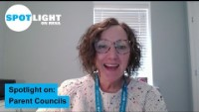
SPOTLIGHT ON…
As Parent Council members you are invited to play your part in your school’s rights respecting journey. How might you work with the school’s leaders to strengthen their work to embed rights into the strategic planning and day to day life of your school. Are rights reflected in your vision and values, school improvement planning, policy development, and monitoring and evaluation?
Hilary from the RRSA team introduces this month’s Spotlight.
Notes:
The video complements the content of this pack and can also be used separately, when introducing new staff to RRSA for example.

Slide 6

LINKS TO RRSA OUTCOMES
Strand A: TEACHING AND LEARNING ABOUT RIGHTS
The United Nations Convention on the Rights of the Child (CRC) is made known to children, young people and adults, who use this shared understanding to work for improved child wellbeing, school improvement, global justice and sustainable living.
Strand B: TEACHING AND LEARNING THROUGH RIGHTS
In school children and young people enjoy the rights enshrined in the United Nations Convention on the Rights of the Child.
Strand C: TEACHING AND LEARNING FOR RIGHTS
Children and young people know that their views are taken seriously.
These strands are broken down into the nine RRSA outcomes ​
against which schools are assessed for the award.​
Notes:
This slide can help you share the ‘structure’ of RRSA with your colleagues and provide and an overview of the programme. These three strands are not unique to the Award, they are recognised globally as the pillars for most human rights education. You make like to share the Outcomes document with your Parent Councillors.

Slide 7






LINKS TO ARTICLES
Look at the summary of the CRC with a partner – which articles do you think are particularly relevant to your role as Parent Council Members? Click to reveal.
Notes:
When we think about being a Rights Respecting School every article applies. However, the six articles identified here are particularly relevant to a shared understanding of what it is to be Rights Respecting.
Article 2: Everyone under the age of 18 has all the rights in the Convention.
Article 3: The best interests of the child must be a top priority in all decisions and actions that affect children.
Article 12: Every child has the right to express their views, feelings and wishes in all matters affecting them, and to have their views considered and taken seriously. This right applies at all times, for example during immigration proceedings, housing decisions or the child’s day-to-day home life.
Article 28: Every child has the right to an education. Primary education must be free and different forms of secondary education must be available to every child. Discipline in schools must respect children’s dignity and their rights. Richer countries must help poorer countries achieve this.
Article 29: Education must develop every child’s personality, talents and abilities to the full. It must encourage the child’s respect for human rights, as well as respect for their parents, their own and other cultures, and the environment.
Article 42: Governments must actively work to make sure children and adults know about the Convention.
You could ask your colleagues which articles they most strongly associate with being Rights Respecting… be prepared to hear Articles 19 and 31 mentioned!

Slide 8

Members of the Global Impactors Group during a beach clean at a local beach.
60 SECONDS WITH…
Parent Council Member, Alison Lyles, has been a Parent Council member at Newtongrange Primary School in Newtongrange, Scotland, for 9 years and sees children at her school able to assert their rights in the world.
As a Parent Council member, I took part in the RRSA Silver Assessment to talk about the school’s work on rights from the Parent Council perspective. I’ve also been involved in recruiting members of the Senior Leadership team and thinking about children’s rights has been a part of this. Some of the work we do as a Parent Council supports children’s rights, for example we have a member who has overhauled our school garden and has worked with lots of the kids in the school to plant food, to do some outdoor learning and this supports their right to health and wellbeing. We also help with fundraising, if pupils have ideas they sometimes come to us to ask for help to fund it.
Read the full interview online.
Notes:
The full interviews are available on the RRSA website, where you can print it out and share with you staff.

Slide 9

DISCUSSION QUESTIONS
1. As a Parent Council member, what do you know about children’s rights and how have you developed this knowledge?
2. As a Parent Council member, what do you know about this school’s work as a rights respecting school?
3. What is the impact of being on the rights respecting journey and how do you know this?
Notes:
Presenter notes: Choose the questions that are most relevant to your setting and experience. Collect some of the ideas from your colleagues and add them to your action plan/evidence if relevant. ​
If your school is at the beginning of its rights journey, we would encourage you to focus on Q1 and 2, and those further along the journey on Q2 and 3
Q1. Have parent council members had access to the e-learning or attended any training on children’s rights. How do you support new members to develop their understanding of RRS. Is it included in induction?
Q2. You could consider how you inform members of your RR journey e.g. headteachers reports, newsletters.
Q3. How are parent council members informed about understanding the impact?

Slide 10

ACTIVITIES
In groups, draw a Rights Respecting classroom onto large pieces of flipchart paper. What do you see, hear and feel in a Rights Respecting classroom?
1. Do your school vision and values reflect the school’s status as a rights respecting school? How can you make sure that your focus on children’s rights is evident in these?
2. How is RRSA embedded within the school improvement plan? E.g. taking recommendations for silver and reflecting these in the SIP. Are there specific, measurable targets?
3. How have the school’s leaders embedded rights within your school policies?
Notes:
Presenter notes: PLEASE LOOK AT BOTH SLIDES 10 and 11 BEFORE DECIDING ON YOUR ACTIVITIES There are 6 suggestions for activities. Depending on the time you have available, choose one or more activities for your colleagues to work on together to further explore the topic. Different groups could also explore different activities. The activities that you do not wish to use can be deleted from the slide. ​
Additional notes:
Think about the level that you are at in your RRSA journey. You may be just getting started or you may be thinking about how you sustain and continue to develop your practice at Gold
A1 – Consider the values that underpin children’s rights such as respect, equity and dignity and also the General Principles of the UNCRC which are Article 2: Non-Discrimination, Article 3: Best Interests of the Child, Article 6: Life, Survival and Development and Article 12: Respect for Children’s Views.
A2 – Ask to see the school’s Action Plan for achieving the next stage of the RRSA journey. How does this fit with your School Improvement Plan? Can this be more explicit? How are children involved in developing the school’s SIP?
A3 – Consider making the links to rights explicit within school policies and other strategic documents. Consider Article 12: Respect for Children’s Views. How are children involved in developing and reviewing policies? Are there child friendly versions of relevant policies? See the resources links at the end of the PPT for guidance on creating child friendly versions of policies.

Slide 11
ACTIVITIES
In groups, draw a Rights Respecting classroom onto large pieces of flipchart paper. What do you see, hear and feel in a Rights Respecting classroom?
4. When you visit the school – how do you know that children’s rights are influencing all aspects of school life? What do you see? What questions do you ask? Have you been involved in an accreditation visit at Silver or Gold? If so how?
5. Some schools have a link Parent Council member for RRSA. Is there a link member for RRSA? How could you develop this role? What might this link member do?
6. Is it linked to professional development for staff, including support staff e.g. in performance management targets?
Notes:
Presenter notes: PLEASE LOOK AT BOTH SLIDES 10 and 11 BEFORE DECIDING ON YOUR ACTIVITIES There are 6 suggestions for activities. Depending on the time you have available, choose one or more activities for your colleagues to work on together to further explore the topic. Different groups could explore different activities. The activities that you do not wish to use can be deleted. ​
Additional notes:
A4. When you visit the school – how do you know that children’s rights are influencing aspects of school life? What do you see? What questions do you ask? Some schools have a link parent council member for RRSA. Is there a link member for RRSA? How could you develop this role? What might this link member do?
A5. Article 12 states that children’s views should be considered when decisions that affect them are made. Work with a pupil group at your school to look at the Child Friendly Version of our RRSA Theory of Change. How well do they feel the school is implementing RRSA and do they have any thoughts on how to take this work further?
A6. Is embedding a child rights approach something that you refer to in staff recruitment? Is it linked to professional development for staff, including support staff e.g. in performance management targets?

Slide 12
RESOURCES
You may find the following resources useful for your work in engaging Parent Councils with RRSA:
Adult Theory of Change and Children’s Theory of Change
Our introduction web page and video
Our eLearning package which parent councils (or equivalent) can work through in their own time
Notes:
Trainer notes: Encourage your colleagues to explore the RRSA website to find additional resources. If you have time, please explore these links ahead of your session with colleagues. You may well find a particular resource that you want to highlight to all as part of your input. There may be links you want to share with the team ahead of or as follow up to your input with them.

Slide 13
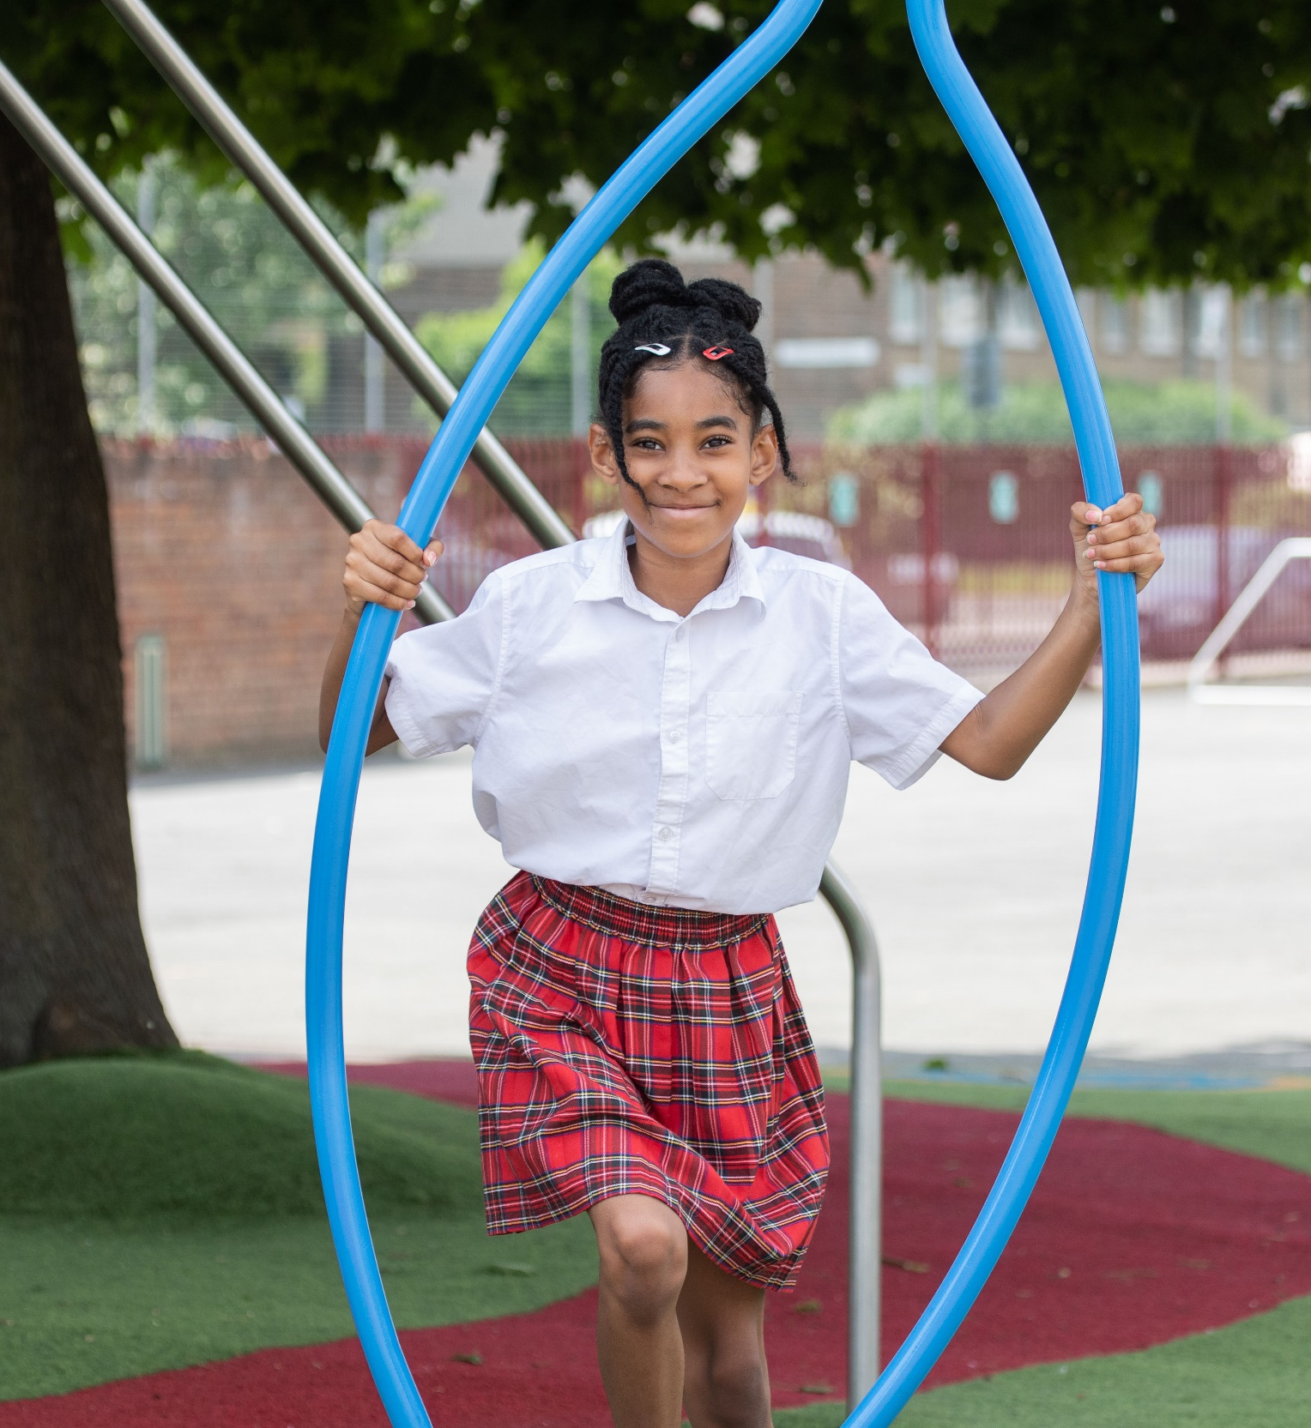
REFLECTION
© UNICEF/Dawe
Take a few moments for personal thought and reflection:​
Develop a list of key points that can be used to help strengthen governance of the RRSA at your school.
From the discussion and activities. What are your next steps with this work?
© UNICEF/Dawe
Notes:
Presenter notes: Give yourself and colleagues some personal reflection space as part of your professional development time together. These reflective questions link to the theme of this month’s Spotlight.

