Slide 1
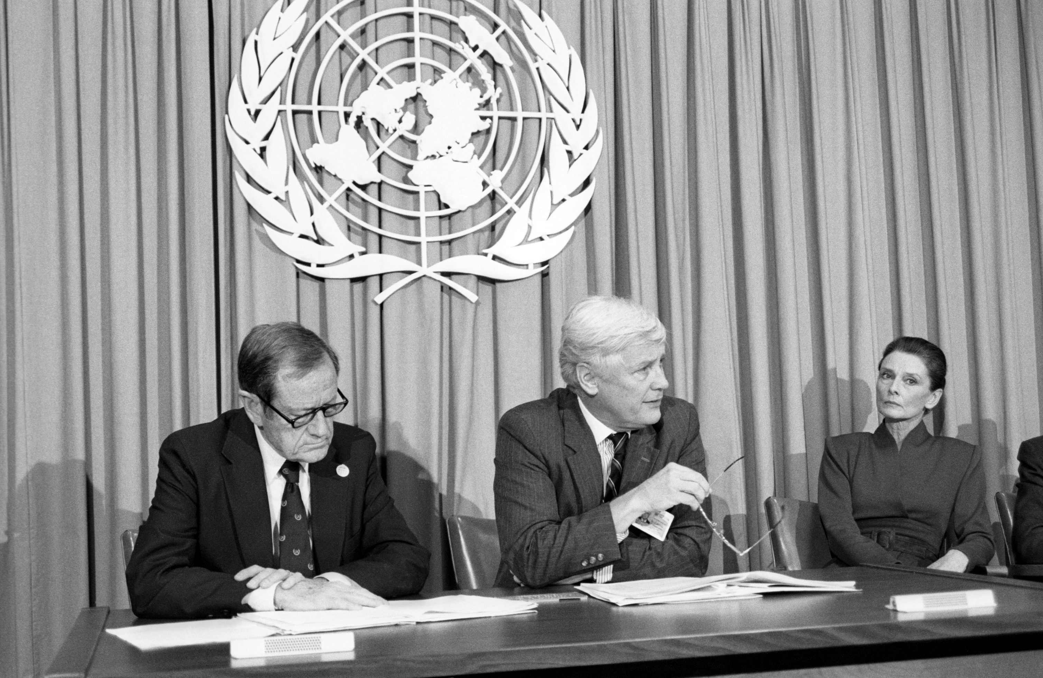
© UNICEF/Isaac
UNDERSTANDING THE
UN CONVENTION ON THE
RIGHTS OF THE CHILD
UNICEF/Maule-ffinch
Notes:
Welcome to Spotlight, our latest resource to support RRSA coordinators to develop Rights Respecting practice in school. Spotlight is aimed at colleagues and is intended to support you in staff briefings or continued professional development (CPD).
The image on the cover shows a UNICEF held press conference as the General Assembly adopts the United Nations Convention on the Rights of the Child in 1989.
From left to right are James Grant (executive Director (UNICEF), Jan Martenson (Under-Secretary-General for Human Rights and Director, United Nations, Geneva) and Audrey Hepburn (Goodwill Ambassador of UNICEF).
On 20 November 1989 at United Nations Headquarters (UNHQ), the UN Convention on the Rights of the Child was adopted by the UN General Assembly, after ten years of negotiations and debate. To celebrate this historic achievement, 500 children from around the world gathered to celebrate, joined by UN Secretary-General Javier Perez de Cuellar, UNICEF Goodwill Ambassador Audrey Hepburn, UNICEF Executive Director James Grant, UN delegates, NGO representatives and the media.
Please check guidance in subsequent slide notes.

Slide 2
CONTENTS
Topic: Understanding the CRC
For each slide, please look at the presenter notes for delivery information.
Slide 3: Aims of the session
Slide 4: Three ways to use this pack
Slide 5 : Introducing this month’s Spotlight
Slide 6: A Brief History of Human Rights
Slide 7: The RRSA Framework
Slide 8: Links to RRSA Outcomes
Slide 9: CRC Summary
Slide 10: 4 General Principles
Slide 11: Let's Discuss
Slide 12: Activities
Slide 13: Reflection
Slide 14: Information Sheet
Slide 15: Resource Sheet
Slide 16: Resources

Slide 3
AIMS OF THE SESSION
To develop and deepen your knowledge of the UN Convention on the Rights of the Child:
A brief introduction to the foundations of children’s rights, exploring the origins of human rights and the development of children’s rights.
A chance to explore articles within the Convention and engage with the 4 General Principles, considering how they impact children’s experiences in education.
Find out how the UK reports on its implementation of the Convention and the role of Children's Commissioners.
Consider the role of duty bearers and explore how the Convention works in practice.
​
Notes:
Presenter notes: Please edit the aims of the session to suit the time you have available for your session. ​
​
This session is intended to support you in helping staff to develop a more informed understanding about how rights work in practice and to develop confidence in explicitly embedding the CRC in your setting. ​
​
The whole Spotlight series is about empowering staff across your setting to embed children’s rights within a wide range of school priorities and practices. ​

Slide 4
THREE WAYS TO USE THIS PACK
DELETE THIS SLIDE BEFORE USING
Read through the slides and notes pages to identify the most relevant activities for your colleagues and any preparation or resources needed.
If time is tight, use the ‘Spotlight on…’ slide and choose from the key discussion questions to explore with your colleagues. You may want to ask colleagues to consider a question before the session.
If you have longer, you can also choose some of the activities to explore.
You may wish to cover the content over a number of staff meeting sessions.
Notes:
Trainer notes: Delete this slide before using.
It would be useful to have copies of the simplified CRC or the icons so that staff can refer to them throughout the session. Unicef.uk/CRC_Icons

Slide 5
SPOTLIGHT ON…
Children's rights are deeply rooted in the broader framework of human rights.
Historically, human rights evolved to protect individuals from oppression and to promote dignity, freedom and equality.
However, children, as a distinct group, require additional protections because they lack legal agency and are more susceptible to exploitation, neglect and abuse.
Equally, their voice, participation and influence needs the status of being an entitlement.
Children should be seen as human beings in their own right, not as ‘human becomings’!
Notes:
The video complements the content of this pack and can also be used separately, when introducing new staff to RRSA for example.
In addition to the notes on the slide, the following may help:
In response to historical injustices, international efforts led to the 1959 Declaration of the Rights of the Child, paving the way for the adoption of the UN Convention on the Rights of the Child in 1989 (CRC). Children's rights are a specialised category of human rights and ensure children receive the appropriate care, protection and opportunities for development. The CRC is the most comprehensive document affirming that children, like adults, have rights but also require special protections.

Slide 6
A BRIEF HISTORY
Notes:
Presenter notes: This slide complements the introduction to this Spotlight. It is a brief outline of the recent history of human rights and shows where children's rights fit into this picture.
You can find more information about the history of child rights below:
Full video on the UN Convention on the Rights of the Child made by Queen's University Belfast: https://www.youtube.com/watch?v=uew8OYvr-UE
History of child rights on the UNICEF.org website - https://www.unicef.org/child-rights-convention/history-child-rights

Slide 7
THE RRSA FRAMEWORK
Strand A: TEACHING AND LEARNING ABOUT RIGHTS
The United Nations Convention on the Rights of the Child (CRC) is made known to children, young people and adults, who use this shared understanding to work for improved child wellbeing, school improvement, global justice and sustainable living.
Strand B: TEACHING AND LEARNING THROUGH RIGHTS
In school children and young people enjoy the rights enshrined in the United Nations Convention on the Rights of the Child.
Strand C: TEACHING AND LEARNING FOR RIGHTS
Children and young people know that their views are taken seriously.
These strands are broken down into the nine RRSA outcomes
against which schools are assessed for the Award.
Notes:
This slide can help you share the ‘structure’ of RRSA with your colleagues and provide and an overview of the programme.
These three strands are not unique to the Award, they are recognised globally as the pillars for most human rights education.
You make like to share the Outcomes document with your colleagues.

Slide 8
LINKS TO RRSA OUTCOMES
Strand A: TEACHING AND LEARNING ABOUT RIGHTS​
Outcome 1: Children, young people and the wider school community know about and understand the United Nations Convention on the Rights of the Child and can describe how it impacts on their lives and on the lives of children everywhere.​
Notes:
Presenter notes: This slide provides an opportunity to remind colleagues of where this learning fits within the ‘structure’ of RRSA which includes three strands: Teaching about rights; through rights; and for rights, as outlined in the previous slide.
This Spotlight ties in nicely with Strand A, Outcome 1: ​
​Pupils (and duty bearers) need to develop knowledge and understanding of children’s rights and how children and young people can access their rights, or not, in their own community and the wider world. This pack helps adults working within a Rights Respecting School to develop and deepen their own knowledge of children’s rights, which will in turn help them to support children and young people to develop their understanding.
​
The full text of the Strands and Outcomes of the Award can be found here:​
www.unicef.org.uk/rights-respecting-schools/wp-content/uploads/sites/4/2015/06/RRSA-Strands-and-Outcomes-at-Silver-and-Gold-1.pdf​
​

Slide 9
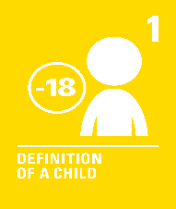
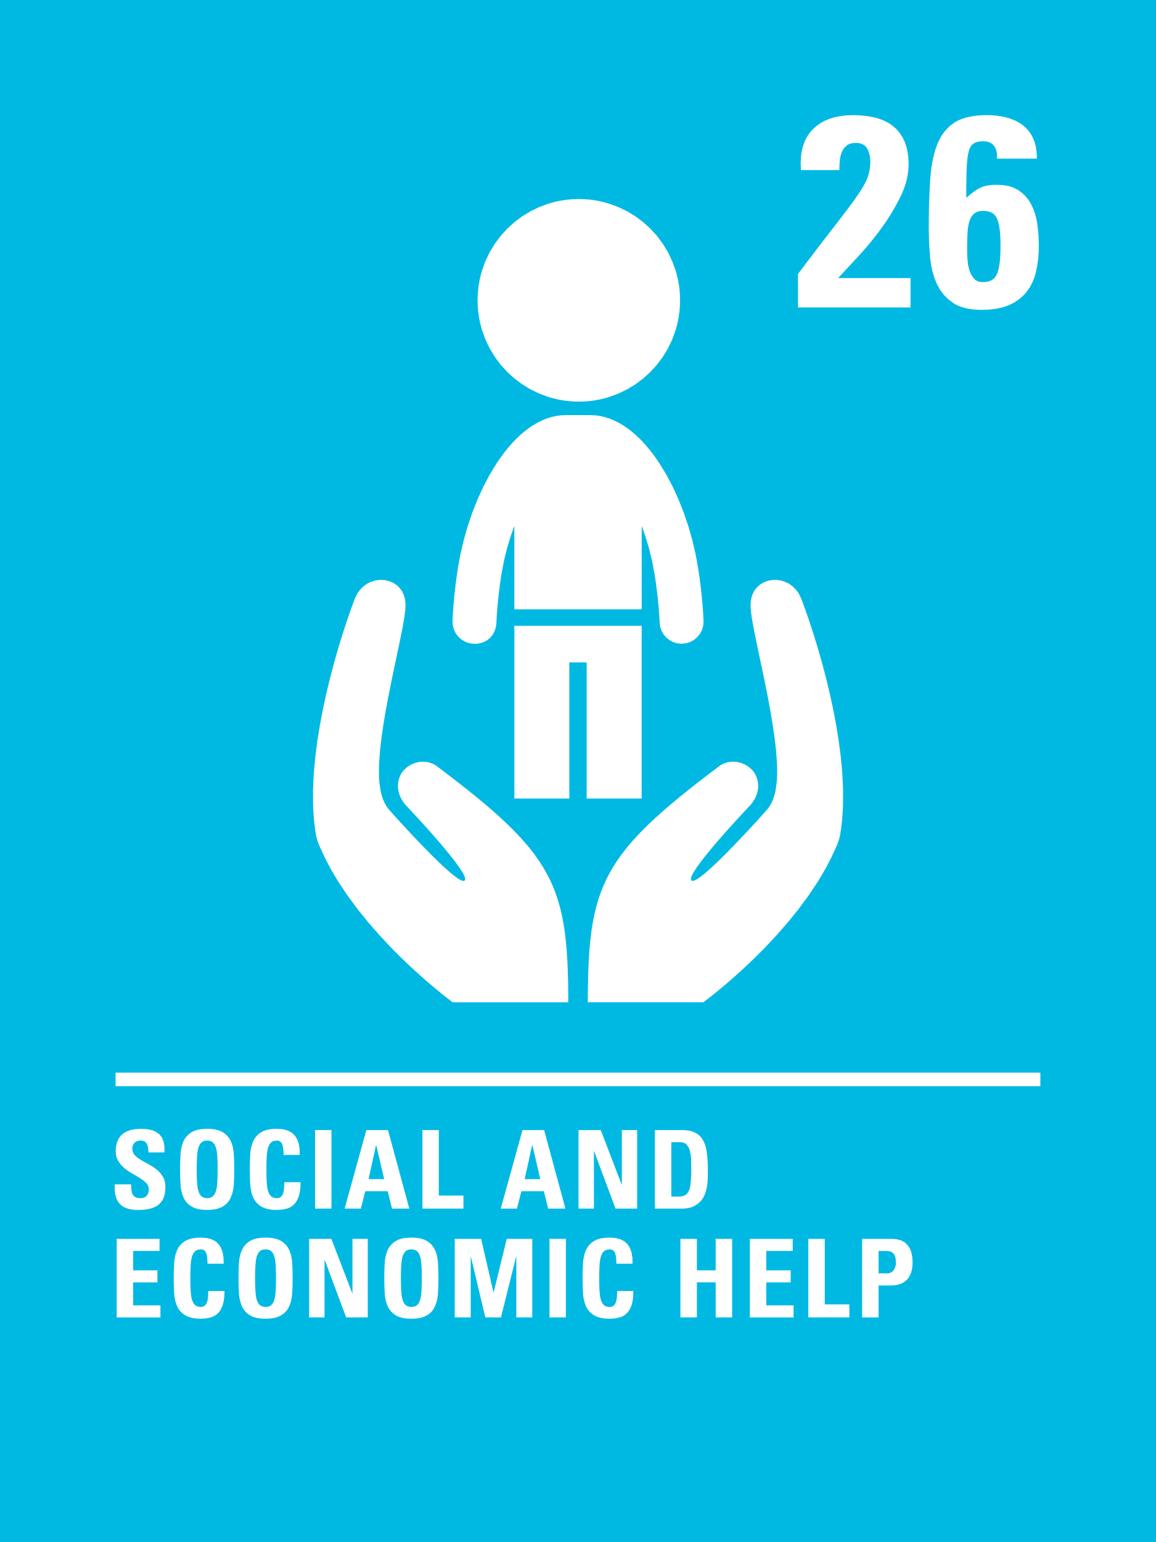
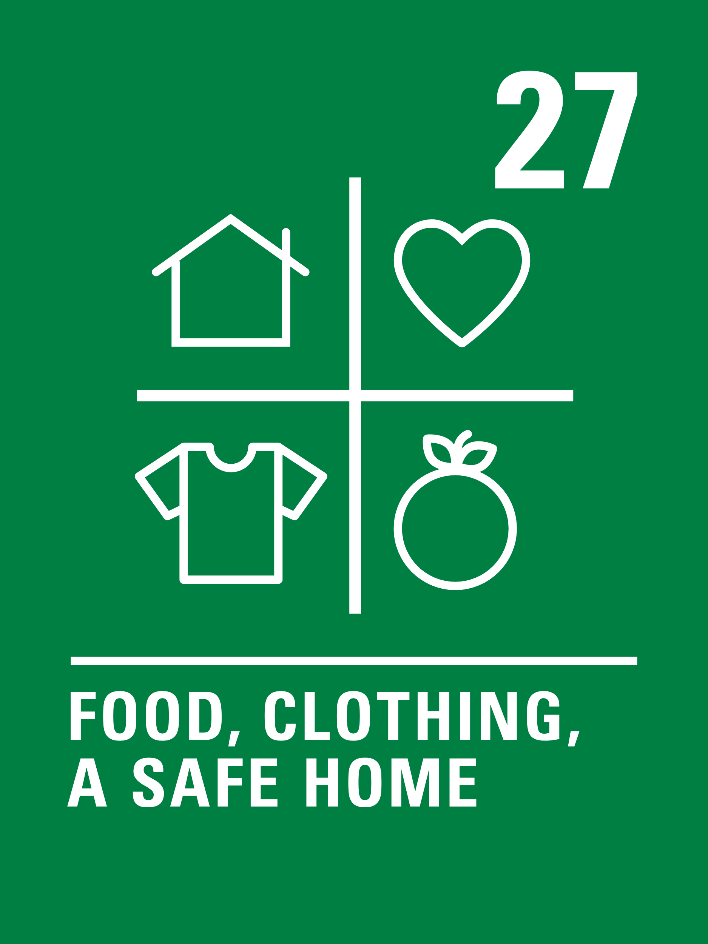
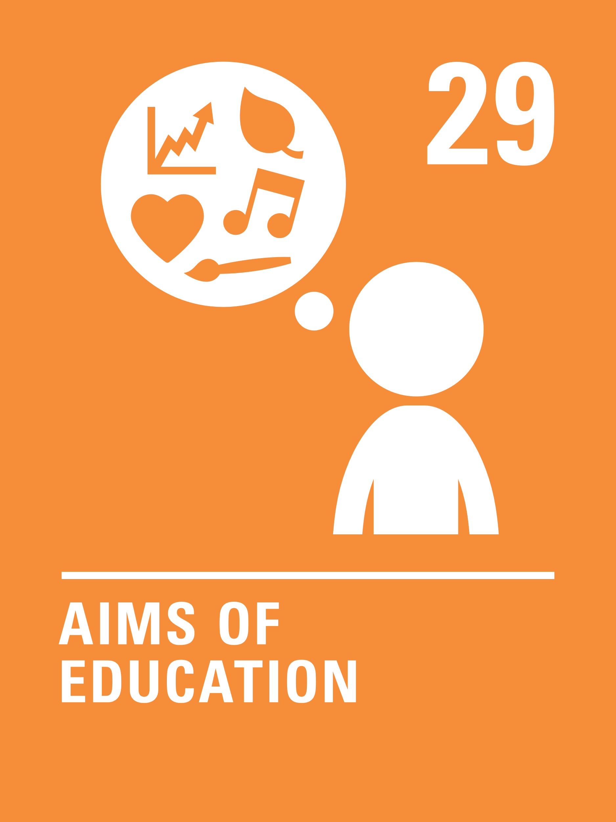
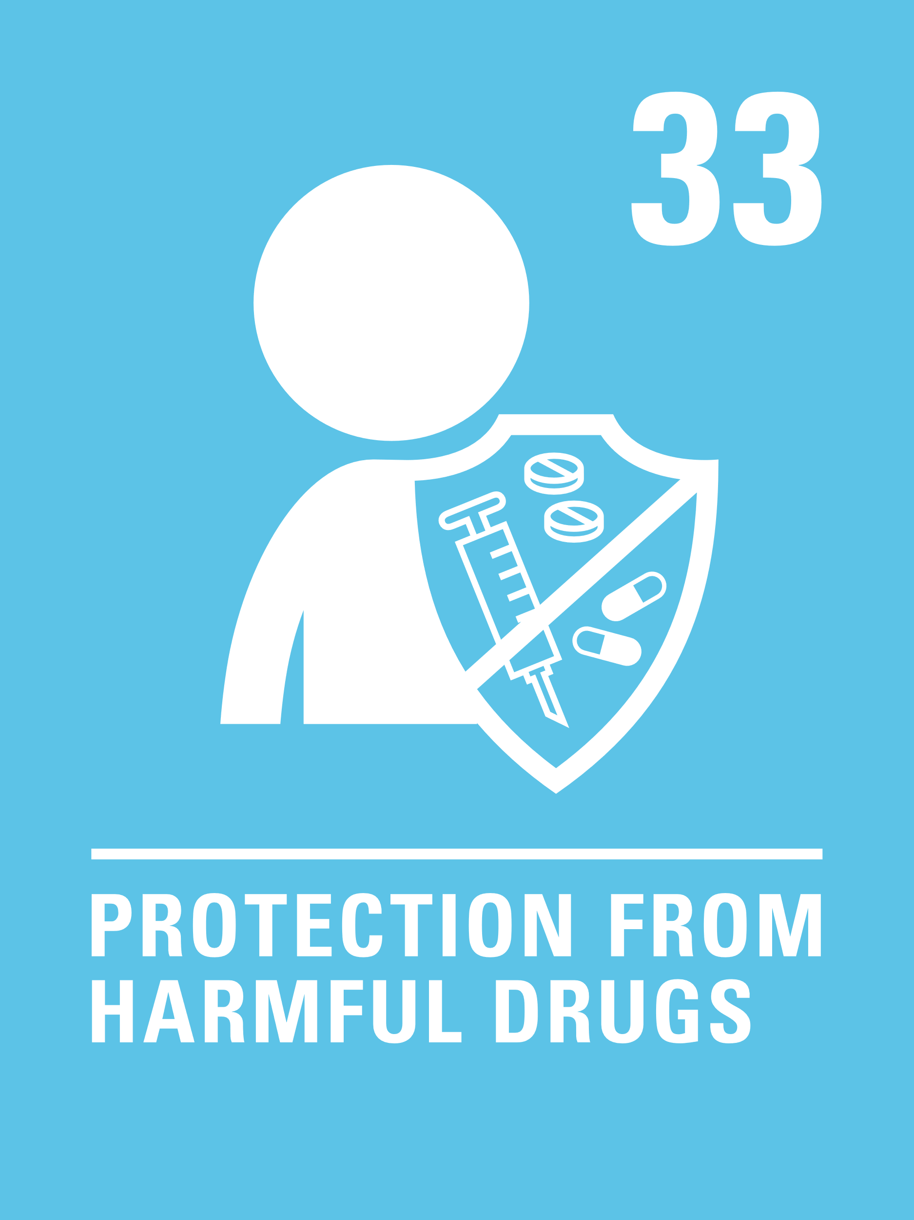
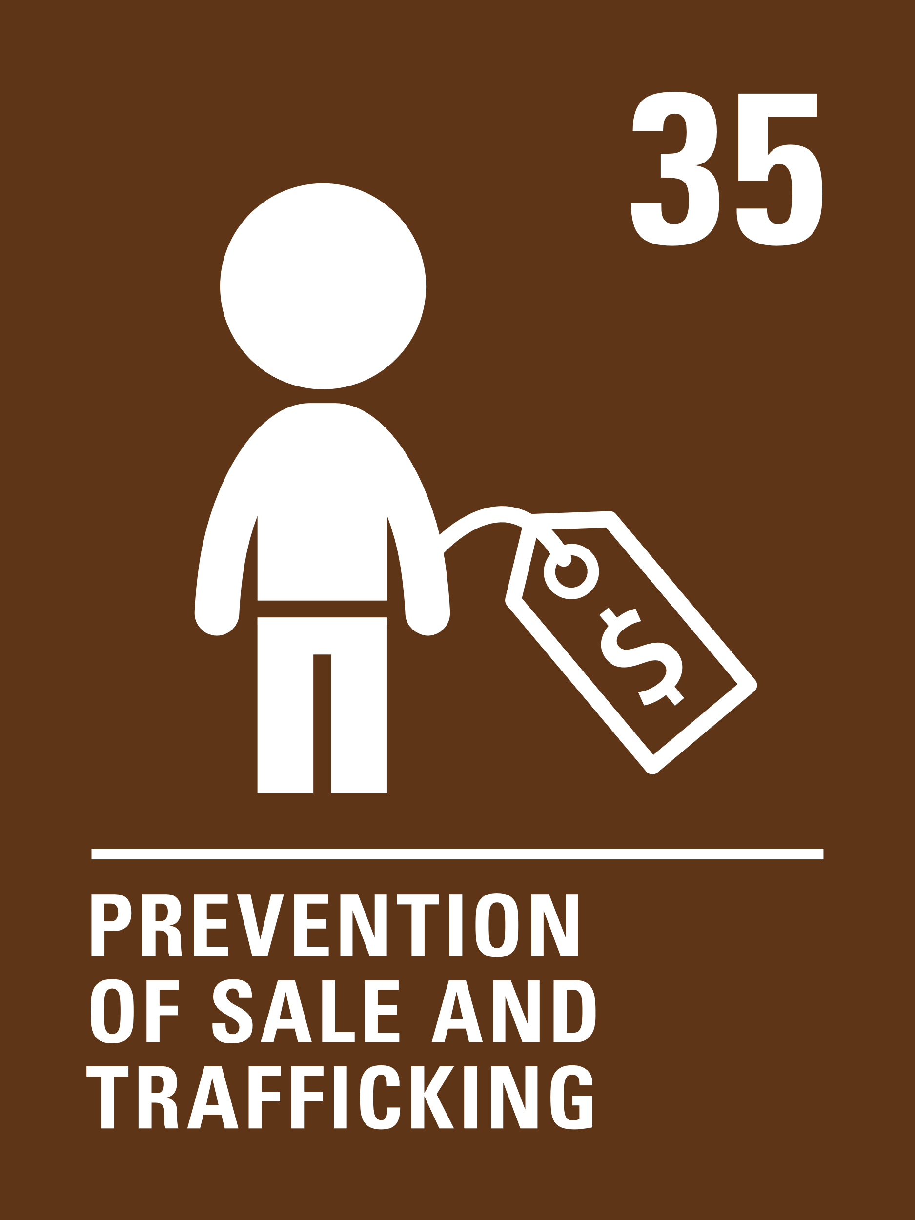
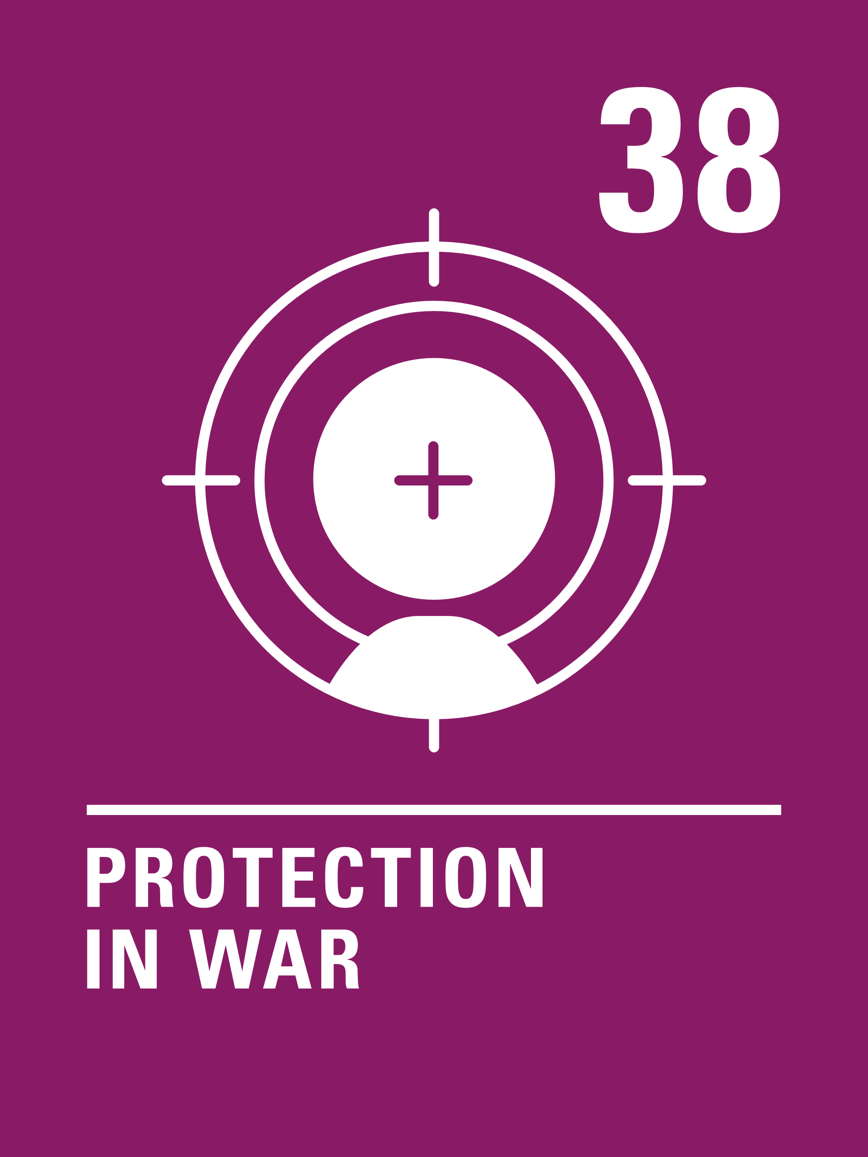
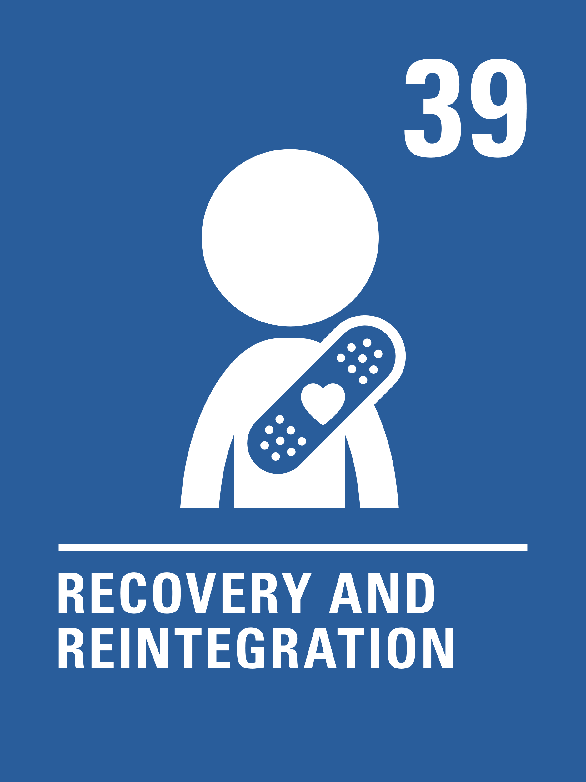
CRC SUMMARY
Look at the summary of the CRC with a partner. Which articles do you feel you have a good understanding of?
Are there any articles you would like to explore further? How are they relevant to your practice in school?
Notes:
Presenter notes: The focus here is to have colleagues look at the Convention again. Encourage colleagues to look at the articles and discuss how they are applied in school.
Encourage sharing and discussion about the articles people are less confident with.​
​
​CRC Summary: ​https://www.unicef.org.uk/rights-respecting-schools/wp-content/uploads/sites/4/2017/01/uncrc_summary-1_1.pdf ​
​unicef.uk/CRC_Icons: https://www.unicef.org.uk/rights-respecting-schools/wp-content/uploads/sites/4/2019/11/UN0332751.pdf​
Different versions of the Convention, individual CRC articles, different languages, GIFs, PowerPoint with rolling CRC articles:
https://weshare.unicef.org/CS.aspx?VP3=SearchResult&STID=2AMZIFJJXAUY
​
​
​

Slide 10
4 GENERAL PRINCIPLES
There are four articles in the Convention that are seen as having a particular role in that they apply to and help interpret all the other articles, playing a fundamental role in realising all the rights in the CRC for all children. They are called 'general principles.'
Choose any other article from the Convention and discuss how all four general principes of the CRC can be applied to your chosen article.
Explore how the four General Principles have a bearing on all aspects of school life.
Notes:
Presenter notes:
The 4 general principles of the CRC serve as a foundation for interpreting and implementing children’s rights. They exist to ensure that every child is treated fairly, protected, supported and given a voice in matters that affect them.
Ideas in response to the second bullet point: They can help shape policies, practices and the school environment so that rights are upheld in daily school life.
Article 2: equal access to education and opportunities regardless of background, gender, race, disability or religion. This can link to policies such as inclusion, anti-bullying, SEND, etc.
Article 3: every decision made by the school, from curriculum design to behaviour policies, should prioritise the overall wellbeing and development of children and young people. This could link to safeguarding policies, SEMH support, teaching & learning strategies, ensuring children’s needs come first.
Article 6: providing safe and supportive environments where children can thrive. This can include access to nutritious meals, healthcare initiatives, physical education, SEMH support, nurture provisions, etc.
Article 12: giving pupils a voice in school decision-making processes including school improvement planning and reviewing and in policy formation. Methods may include school or pupil councils, suggestion boxes, surveys, curriculum audits, classroom discussions, voting/democratic processes, any opportunities that give children the opportunity to feel confident expressing their opinions and knowing that their views are taken seriously. Can you evidence the impact of pupil voice with a ‘You said, We did’ display?
​

Slide 11
LET’S DISCUSS
1) Every five years, countries that have ratified the Convention must report on their progress in implementing it. The last periodic review in the UK took place in 2023. Read the key recommendations from the report here.
As educators, how can you integrate the principles of the Convention to address and reduce educational inequalities?
2) The role of the Children’s Commissioner is to promote, protect and advocate for the rights of children and young people. Do you know who the Children’s Commissioner is in your jurisdiction? Find out who the Children’s Commissioner s where you are and discuss how their existence and role could be promoted in school.
Notes:
Presenter notes: These discussion points will help colleagues consider how the CRC is applied in school contexts.
Discussion 1: If you choose to do this activity we suggest you print off copies of the linked report recommendations in advance.
Encourage colleagues to see the bigger picture. The question about inequalities is about the UK as a whole; but is interesting to reflect on at school level.
This video (https://www.youtube.com/watch?v=dCib7xsFJCs) offers an explainer about the UN Committee on the Rights of the Child and their recommendation to countries to have an Ombudsman (commissioner) – which links to discussion 2.
Discussion 2: We suggest that you print the information slide about Children’s Commissioners (Slide 14) to share with colleagues. If you have time, why not share the relevant website with colleagues?

Slide 12
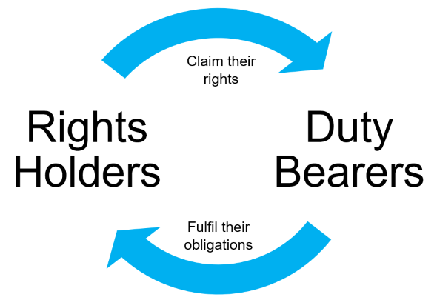
ACTIVITIES
1) International law says duty bearers have a responsibility to protect children’s rights. Although the State (government) is the primary duty bearer, the work of implementing rights often falls to people who are employed by the state, this includes school staff. List other adults in society who are duty bearers and consider which articles in the Convention their role links to.
2) Now that you have developed your knowledge of the Convention, read the scenarios on the resource sheet (slide 15) and consider how to resolve them using a rights-respecting approach. Discuss which articles apply, how you would respond to protect and uphold children’s rights and what practical steps could be taken.
Notes:
Activity 1: Are your colleagues confident in the terminology of ‘rights holders’ and ‘duty bearers’? Use this opportunity to explain. (Parents are technically ‘rights holders’ under the convention as the Government has some duties about supporting them. However, they can also be seen as ‘secondary duty bearers’ as they do play a role in implementing and claiming rights for their children.)
There is more detail and more activities to explore related to this area in our eLearning course, which all staff in your school can access: https://www.unicef.org.uk/rights-respecting-schools/training-and-support/our-online-training-courses/
Think about all of the duty bearers in your school, including teachers, site, catering and administration staff. Do they all understand their role as a duty bearer? Are they clear on the procedures to report if a child’s rights are not being fulfilled?
On a personal note, reflect on your professional role from the point of view of being a duty bearer for children’s rights. What thoughts and feelings come to you?
Activity 2: Please print off the scenario resource sheet (slide 15) or check that it is visible on your screen.

Slide 13
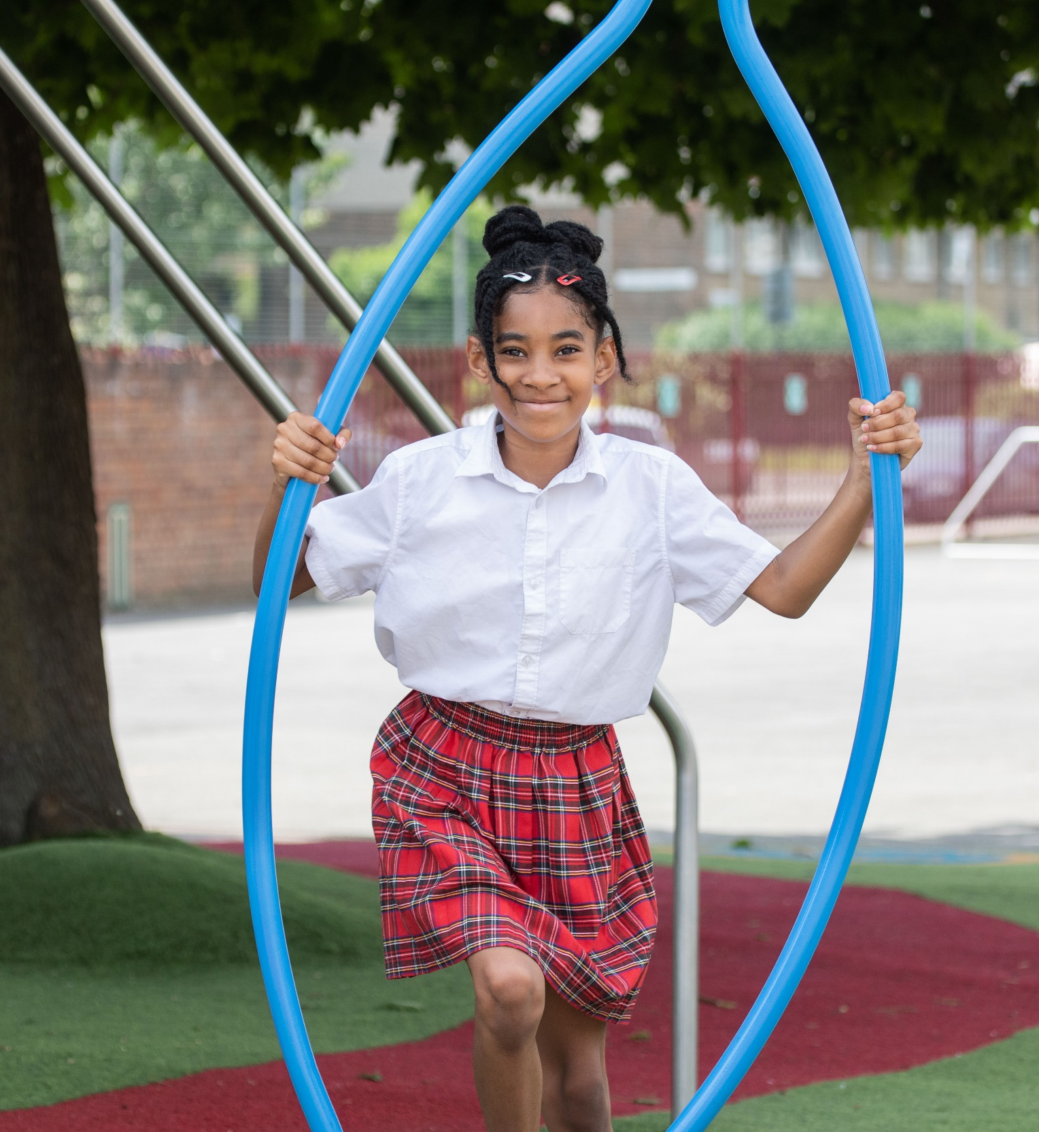
REFLECTION
© UNICEF/Dawe
Take a few moments for personal thought and reflection:​
Article 42: Governments must actively work to make sure children and adults know about the Convention.
Imagine you are talking to someone who has never heard of the CRC. What are 3 key facts that you would share with them?
© UNICEF/Dawe
Notes:
Presenter notes: Give yourself and colleagues some personal reflection space as part of your professional development time together. These reflective questions link to the theme of this month’s Spotlight. Please refer to the links on the resources page for further information about the progress of governments on the CRC.

Slide 14
INFORMATION SHEET
The Role of the Children’s Commissioner The Children’s Commissioner is an independent advocate for children’s rights and welfare, ensuring that governments and public bodies uphold their responsibilities under the United Nations Convention on the Rights of the Child (UNCRC). Their key roles include: Promoting and protecting children’s rights – Ensuring that children’s rights are respected in all areas of life, including education, health, and social care. Listening to children’s voices – Engaging with children and young people, particularly those in vulnerable situations, to understand their experiences and amplify their concerns. Monitoring government policies – Assessing whether laws, policies, and practices align with children’s best interests and holding the government accountable. Investigating complaints – In some jurisdictions, the Commissioner can investigate complaints about public services affecting children, such as education, social services, and care systems. Research and advocacy – Conducting research on issues affecting children and advising policymakers on improvements needed in legislation and service provision. Reporting on progress – Providing reports to the government and international bodies like the UN Committee on the Rights of the Child, ensuring transparency on how children’s rights are being upheld. Each country (or devolved nation within the UK, for example) has its own Children’s Commissioner with specific duties, but their overarching mission is to be a strong, independent voice for children, ensuring their rights and wellbeing are prioritised in decision-making.
England – Children’s Commissioner for England Current Commissioner: Dame Rachel de Souza (since 2021) https://www.childrenscommissioner.gov.uk/ | Scotland – Children and Young People’s Commissioner Scotland Current Commissioner: Nicola Killean (since 2023) https://www.cypcs.org.uk/ | Wales – Children’s Commissioner for Wales Current Commissioner: Rocío Cifuentes (since 2022) https://www.childcomwales.org.uk/ | Northern Ireland – Northern Ireland Commissioner for Children and Young People (NICCY) Current Commissioner: Chris Quinn (since 2023) https://www.niccy.org/ | Jersey – The Office of the Children’s Commissioner for Jersey Current Commissioner: Dr Carmel Corrigan (since 2024) https://www.childcomjersey.org.je/

Slide 15
RESOURCE SHEET
Scenario 1: The school is changing its uniform policy, but students feel their opinions haven’t been considered. Some students want a platform to express their views, while staff worry about maintaining consistency. Discussion: How can the school ensure students feel heard and included in decisions while maintaining fairness? | Scenario 2: A student with additional needs is frequently removed from class due to disruptive behaviour. They feel punished rather than supported, and their parents are concerned about missed learning time. Discussion: How can the school balance behaviour expectations with inclusion and ensure every child has access to education? | Scenario 3: A group of younger students feel excluded from playground activities because older students take over the main play areas. Teachers want all children to have fair access but are unsure how to manage the space. Discussion: What fair and rights-respecting solutions can ensure all students have access to play? | Scenario 4: A new student who speaks little English is struggling to make friends. Some students avoid interacting with them, and teachers notice they are becoming isolated. Discussion: How can the school promote inclusivity and ensure all students feel welcomed and valued? | Scenario 5: A student reports feeling unsafe due to ongoing bullying, but they fear speaking up will make it worse. Some staff believe they should “stand up for themselves,” while others want a stronger intervention. Discussion: How can the school create a safe environment where students feel protected and empowered to speak out?
Notes:
Presenter notes:
Here are some fictional scenarios that may occur in a school setting. These scenarios can be used to support colleagues to consider how the UNCRC applies within the school context and to consider how they can use their knowledge and understanding about the CRC within their role on a day to day basis.
Suggestions to aid discussion:
Scenario 1: Survey all students, School Council input, consultation with whole school community (including parents and carers), if suggestions cannot be actioned ensure feedback is shared as to why not. You said, we did.
Scenario 2: Explore equality and equity and how this impacts on Article 28 for everyone. Consult with all students, staff and families about the issue using Article 28 as a guide. Duty bearers need to ensure that ALL children have access to their education so how can we work together to achieve this?
Scenario 3: Explore playground charters, sports leaders, rotas. Consult with children about dividing up the space into different zones.
Scenario 4: Explore a range of Articles that are relevant to their experience – Article 2, 7 and 8 for example. Are there opportunities for the new student to buddy up with another student who speaks the same language? Explore opportunities to celebrate languages and cultures of all children in the school. Explore the literature that is available in school and if CYP see themselves reflected in the books. P4C and debating to explore.
Scenario 5: Ensure that there is an understanding of how Article 19 is supported in the safeguarding procedures and strategies around school. Work towards a culture of listening and respect so that CYP feel confident and comfortable to speak out. Some schools have worry boxes/talking pebble/website button to log concerns – ensure dignity and confidentiality are considered when exploring individuals’ feelings.

Slide 16
RESOURCES
You may find the following resources useful for your work on the CRC:
Introducing the CRC
Article of the Week
ABCDE of Rights
Queen's University Belfast video
How does the CRC work?
Timeline of the CRC
The CRC within the context of human rights
Video by Committee on the Rights of the Child and the Children's Commissioners
Committee on the Rights of the Child
UK government infographic
Concluding Observations
How the UK government is protecting children's rights: Video 1, Video 2, Video 3
Notes:
Trainer notes: Encourage your colleagues to explore the RRSA website to find additional resources. If you have time, please explore these links ahead of your session with colleagues. You may well find a particular resource that you want to highlight to all as part of your input. There may be links you want to share with the team ahead of or as follow up to your input with them.

