Slide 1
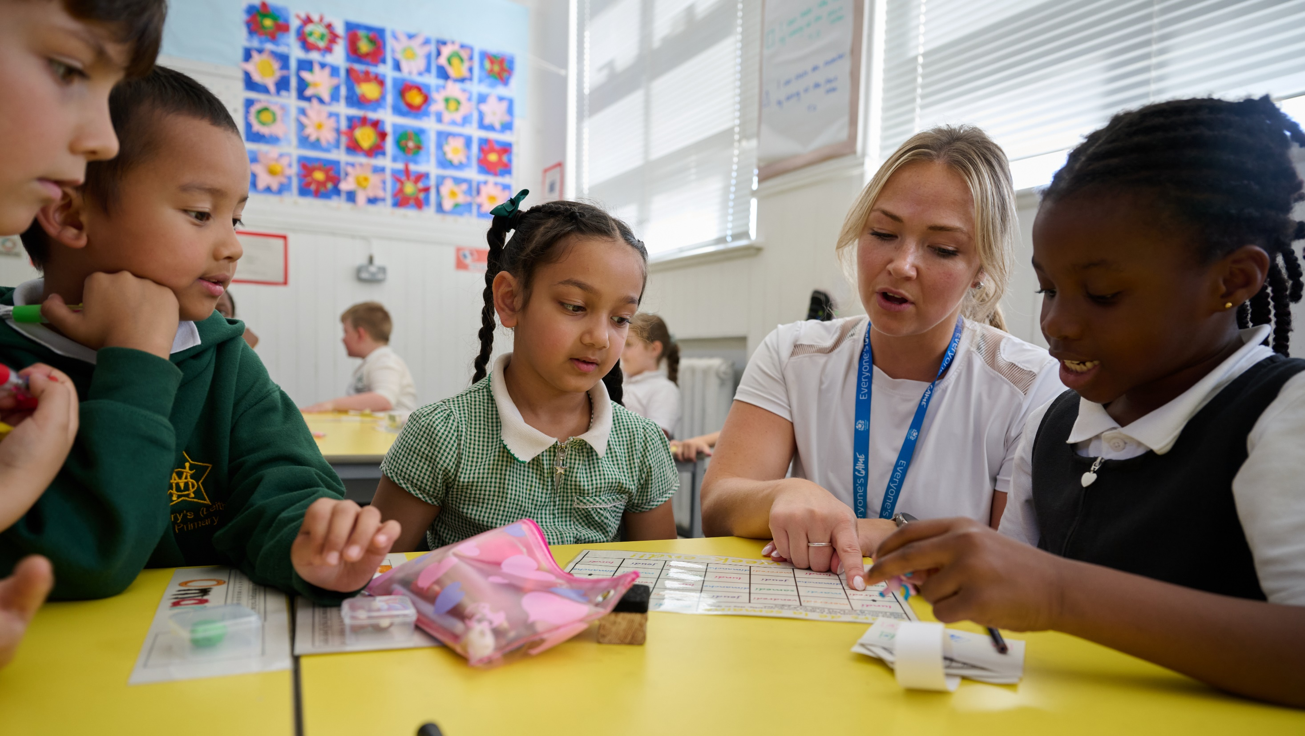
© UNICEF/Maule-ffinch
© UNICEF/Isaac
EXPLORING THE RIGHT TO EDUCATION
UNICEF/Maule-ffinch
Notes:
Welcome to Spotlight, our latest resource to support RRSA coordinators to develop Rights Respecting practice in school. Spotlight is aimed at colleagues and is intended to support you in staff briefings or continued professional development (CPD).
The image on the cover of this month’s Spotlight was co-created with children at a Gold Rights Respecting School, they directed a photographer to take this image to represent how their right to education is realised in school.
Please check guidance in subsequent slide notes.

Slide 2
CONTENTS
Topic: Exploring the Right to Education
For each slide, please look at the presenter notes for delivery information.
Slide 3: Aims of the session
Slide 4: Three ways to use this pack
Slide 5 : Introducing this month’s Spotlight
Slide 6: Links to RRSA Outcomes
Slide 7: CRC Summary
Slide 8: Let's Discuss
Slide 9: Activities
Slide 10: Case Study
Slide 11: Reflection
Slide 12: Resource Links

Slide 3
AIMS OF THE SESSION
To reflect on current practice and identify ways to strengthen learner voice and participation, supporting children's right to an education that helps them value their learning.
To explore practical strategies for empowering children to take an active and meaningful role in their own learning.
To examine how valuing children's voices can positively shape the curriculum and promote greater engagement and motivation.
To identify ways to foster inclusive, respectful classrooms where every child feels heard and where their rights are respected.
​
Notes:
Presenter notes: Please edit the aims of the session to suit the time you have available for your session. ​
​
This session is intended to support you in helping staff to develop a deeper understanding of Outcome 7 of the RRSA: Children and young people value education and are involved in making decisions about their learning. .
​
The whole Spotlight series is about empowering staff across your setting to embed children’s rights within a wide range of school priorities and practices. ​

Slide 4
THREE WAYS TO USE THIS PACK
DELETE THIS SLIDE BEFORE USING
Read through the slides and notes pages to identify the most relevant activities for your colleagues and any preparation or resources needed.
If time is tight, use the ‘Spotlight on…’ slide and choose from the key discussion questions to explore with your colleagues. You may want to ask colleagues to consider a question before the session.
If you have longer, you can also choose some of the activities to explore.
You may wish to cover the content over a number of staff meeting sessions.
Notes:
Trainer notes: Delete this slide before using.
It would be useful to have copies of the simplified CRC or the icons so that staff can refer to them throughout the session. Unicef.uk/CRC_Icons

Slide 5
SPOTLIGHT ON…
Outcome 7 of the Rights Respecting Schools Award focuses on empowering children to be active participants in their learning and wider school life. This is a vital aspect of a rights respecting approach, as it recognises that children are not just passive recipients of education, but individuals with views, ideas and the capacity to influence change. When children are genuinely listened to and involved in decision-making, it strengthens their confidence, motivation and sense of belonging. Embedding pupil voice in school culture not only supports academic outcomes but wellbeing, inclusion and the development of lifelong citizenship skills.
Katelyn Farrenson, Professional Adviser RRSA, introduces this month’s Spotlight.
Notes:
The video complements the content of this pack and can also be used separately.

Slide 6
THE RRSA OUTCOMES
Strand B: TEACHING AND LEARNING FOR RIGHTS​
Outcome 7: Children and young people value education and are involved in making decisions about their learning.
At Silver: Many children and young people are positive about their school and their learning. They understand and can communicate about the role they play in their learning. Many adults explain how rights respecting language shapes a positive learning environment.
At Gold: Most children and young people demonstrate their commitment to the right of others to learn and can describe how they actively respect this right. Nearly all children and young people express how they play an active role in their learning.
Notes:
Presenter notes: This month’s theme applies to outcome 7 of the Award: Children and young people value education and are involved in making decisions about their learning.
At Silver: Many children and young people are positive about their school and their learning. They understand and can communicate about the role they play in their learning. Many adults explain how rights respecting language shapes a positive learning environment.
At Gold: Most children and young people demonstrate their commitment to the right of others to learn and can describe how they actively respect this right. Nearly all children and young people express how they play an active role in their learning.
The full text of the Strands and Outcomes of the Award can be found here:​
www.unicef.org.uk/rights-respecting-schools/wp-content/uploads/sites/4/2015/06/RRSA-Strands-and-Outcomes-at-Silver-and-Gold-1.pdf​
​

Slide 7
LINKS TO ARTICLES
Look at the summary of the CRC with a partner – Which articles can you find that relate to education?
When ready click to reveal.
Article 12 is one of the four General Principles of the CRC. This means that it underpins all other articles in the CRC including Article 28 and 29.
Notes:
Presenter notes: When showing this slide in presenter mode the articles and final paragraph will appear on click. ​
​
The main focus here is to get colleagues looking at the Convention again. It's fine if people suggest articles other than these three. They, for example refer to 'best interests' or 'children with disabilities'.
​CRC Summary ​
https://www.unicef.org.uk/rights-respecting-schools/wp-content/uploads/sites/4/2017/01/uncrc_summary-1_1.pdf ​
CRC Full Text
https://www.unicef.org.uk/wp-content/uploads/2016/08/unicef-convention-rights-child-uncrc.pdf
​unicef.uk/CRC_Icons ​
https://www.unicef.org.uk/rights-respecting-schools/wp-content/uploads/sites/4/2019/11/UN0332751.pdf​
CRC Widget Symbols
https://www.cypcs.org.uk/resources/uncrc-symbols-poster/
https://www.cypcs.org.uk/resources/uncrc-symbols-cards/
​
​
​
​

Slide 8
LET’S DISCUSS
1. How do pupils currently influence what they learn, how they learn and, how they present and evaluate their work?
2. How do pupils work with subject leads to shape the curriculum, participate in learning walks and provide feedback on learning and teaching?
3. Can learners inform the way your classroom is set up? How is your classroom set up to include all learners?
Notes:
Presenter notes: Choose the questions that are most relevant to your setting and experience. Collect some of the ideas from your colleagues and add them to your action plan/evidence if relevant. ​
1. ​ ​Encourage colleagues to think beyond formal curriculum choices. Consider how pupils contribute to topic planning, choose methods of research or presentation, or evaluate their progress. For example, choice in reading texts, project-based learning, or pupil-led enquiry. Link to Articles 12, 13 and 29 – supporting autonomy, voice and individual talents.
2. Explore how pupil voice feeds into school development processes. Are pupils consulted or involved in curriculum reviews? For example, student learning panels, observations, surveys, votes, feedback sessions with subject leads? Encourage colleagues to discuss the idea that children are partners in education, not passive recipients.
3. Invite discussion on the physical, emotional and cultural inclusivity of the classroom environment. Consider layout, accessibility, visuals, charters, how children's identities and experiences are reflected. Reinforce the importance of equity and belonging – Article 2 and Article 29

Slide 9
ACTIVITIES
​
In groups, draw a Rights Respecting classroom onto large pieces of flipchart paper. What do you see, hear and feel in a Rights Respecting classroom?
3. Look at the Circle Framework from Education Scotland. Explore the resource and consider how you can make your primary or secondary classroom more inclusive. Consider three concrete actions you will take in your own classroom.
2. With a partner, produce a set of questions to ask pupils to evaluate your lesson, topic or subject. After today, consider how you will build this element of pupil voice into your practice.
1. Bring a scheme of work and plan additional opportunities for pupils to influence what they learn, how they learn and how they present and evaluate their work?
Notes:
Presenter notes: There are 3 suggestions for activities. Depending on the time you have available, choose one or more activities for your colleagues to work on together to further explore the topic. Different groups could explore different activities. ​
​Activity 1: Encourage staff to look critically at a current or upcoming scheme of work and identify where meaningful pupil input could be increased. How can pupils shape learning objectives? Can they decide how to present their work? Even small changes, like offering options or seeking feedback, can build ownership and agency.
​Activity 2: Encourage colleagues to focus on open-ended, reflective questions that invite pupils to share honest feedback on what worked well and what didn't. Highlight the importance of follow-up activities that show pupils how their feedback is being used. This builds trust and encourages ongoing participation. For example: What helped you learn? What would you change next time? How did this topic connect to something meaningful for you? How can this topic be improved for future learners?
​Activity 3: The Circle Framework supports inclusive classroom practice by focusing on environment, routines, skills and motivation. The CIRCLE Framework is a way of organising and supporting input using a staged system of support, beginning with setting up an inclusive classroom. Checklists and planning tools are included to support discussion, and can be used to document strategies used and record professional learning. It includes the CIRCLE Inclusive Classroom Scale and the CIRCLE Participation Scale developed with practitioners to support identification of changes required and the measurement of progress.
Encourage colleagues to think about how their space, communication style and planning can be adapted to meet a wider range of needs. Ask them to commit to three specific actions – these can be small but should be actionable and tied to inclusion. For example, adding a quiet work area, revisiting charters, diversifying learning materials.

Slide 10
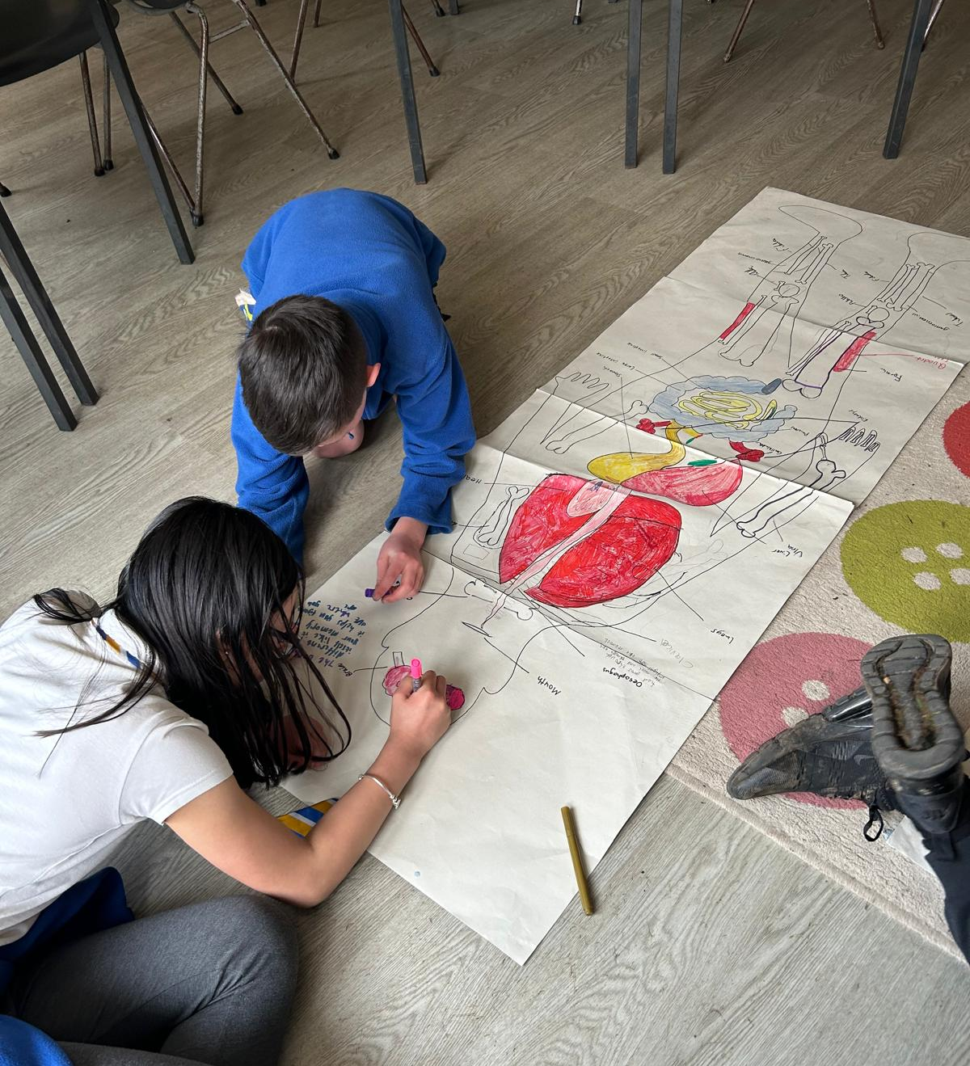
Craigdhu Primary School is an enquiry-based learning school where children take ownership of their learning and can focus on aspects of the curriculum they are interested in.
CASE STUDY
At Craigdhu Primary School, education is shaped by learners and children’s rights are central to everything.
Read the full case study online.
​​We started our Rights Respecting journey by listening to the voices of pupils, parents and all staff within our school community. This was a really rewarding experience as it gave us the opportunity to do a deep dive into our school and look at the vision and values and whether they truly represented us.
Craigdhu Primary School is an enquiry-based learning school. This means that children take ownership of their learning and can focus on aspects of the curriculum they are interested in. The children get the opportunity to use an enquiry cycle to guide them through their learning and this has helped them to become visible learners.
Learning though enquiry gives the children the opportunity to deep dive into subject areas over a period of 6-8 weeks so they can gain a depth and breadth of knowledge. The themes are related to the world around them and so they can see how the knowledge, skills and attitudes transfer into real life. There is strong focus on Learning for Sustainability within the school and the children understand the link that this has to the Sustainable Development Goals and their rights.
Notes:
The full case study is available on the RRSA website, where you can print it out and share with your staff.

Slide 11
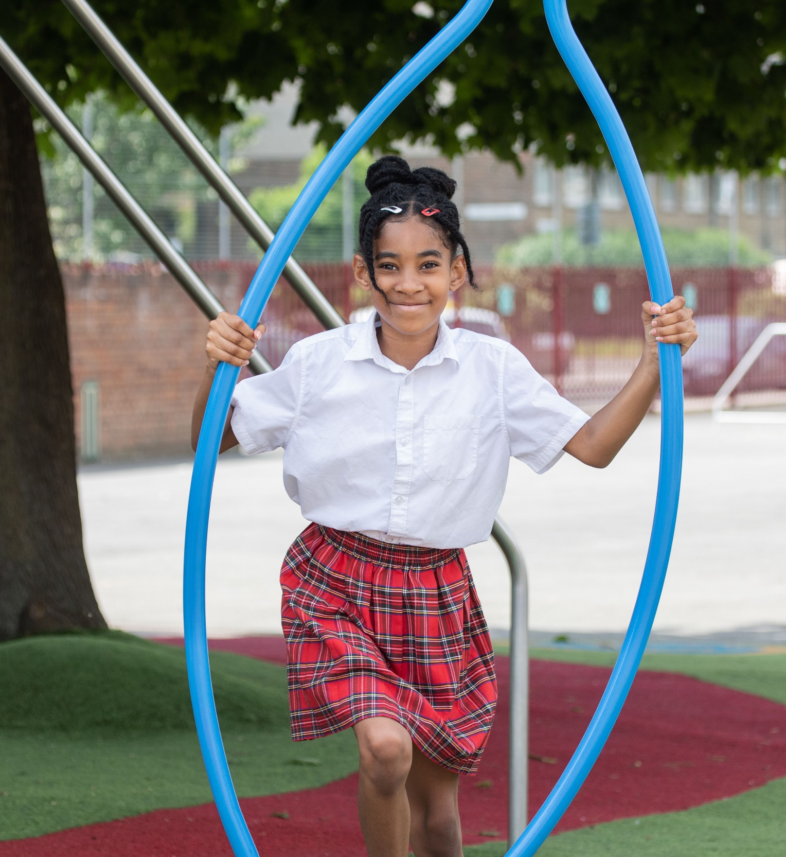
REFLECTION
© UNICEF/Dawe
Take a few moments for personal thought and reflection:​
What are the benefits of including pupils in their learning?
How can I, as a duty bearer, help learners to engage more actively with their learning?​
How can I support pupils to discuss metacognition so that they have the language to talk about shaping what and how they learn?
© UNICEF/Dawe
Notes:
Presenter notes: Give yourself and colleagues some personal reflection space as part of your professional development time together. These reflective questions link to the theme of this month’s Spotlight.

Slide 12
RESOURCES
You may find the following resources useful for your work in including pupils in their learning:
RRSA Training: Strengthening Pupil Participation
UNICEF UK's Article of the week packs (these ones may be especially relevant)
Views of the Child – Article 12, Right to Education – Article 28 and Goals of Education - Article 29
The Lundy Model – Article 12 in Practice
Education Endowment Foundation
Metacognition provides language to help learners to discuss how they learn
Growth Mindset is an approach to build resilience in learning and is used by many schools
Circle resources to support Inclusive Learning and Collaborative Working in Primary and Secondary settings
Notes:
Presenter notes: If you have time, please explore these links ahead of your session with colleagues. You may well find a particular resource that you want to highlight to all as part of your input. There may be links you want to share with the team ahead of or as follow up to your input with them.
Encourage your colleagues to explore the RRSA website to find additional resources. If you have time, please explore these links ahead of your session with colleagues. You may well find a particular resource that you want to highlight to all as part of your input. There may be links you want to share with the team ahead of or as follow up to your input with them.

