Slide 1
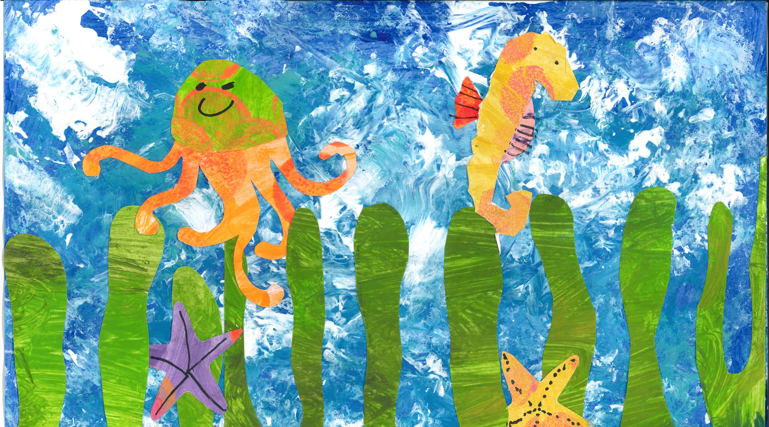
© UNICEF/Isaac
RIGHTS AND THE ENVIRONMENT
UNICEF/Maule-ffinch
Notes:
Welcome to Spotlight, our latest resource to support RRSA coordinators to develop Rights Respecting practice in school. Spotlight is aimed at colleagues and is intended to support you in staff briefings or continued professional development (CPD).
The image on the cover was created by Patrick, from Christ Church Primary School, and he created this piece of art linked to Sustainable Development Goal 14: Life Under Water as part of an art project on sustainability and then his class took actions linked to the SDG’s within their local community.
Please check guidance in subsequent slide notes.

Slide 2
CONTENTS
Topic: Rights and the Environment
For each slide, please look at the presenter notes for delivery information.
Slide 3: Aims of the session
Slide 4: Three ways to use this pack
Slide 5 : Introducing this month’s Spotlight
Slide 6: Links to RRSA Outcomes
Slide 7: CRC Summary
Slide 8: Let's Discuss
Slide 9 & 10: Activities
Slide 11: Case Study
Slide 12: Reflection
Slide 13: Resource Links

Slide 3
AIMS OF THE SESSION
To understand how the work we are doing on the environment, sustainability and climate change links to rights and RRSA.
To explore ways to further link environmental and sustainability themes to our curriculum.
To consider ways to engage learners in taking action for a more sustainable world where rights are protected.
​
Notes:
Presenter notes: Please edit the aims of the session to suit the time you have available for your session.
This session is intended to support staff to develop their understanding of the link between the work your school does on the environment and sustainability, and your work as a Rights Respecting School. Many schools will have Eco Groups, will be working towards the Eco-Schools Award or similar initiatives, will have topics of work linked to climate change and sustainability and will work on the Sustainable Development Goals and all of this closely aligns with protecting children’s rights and elements of the Rights Respecting Schools Award. It is important to see how different initiatives link and to encourage staff to strengthen the links between any work on the environment and sustainability with children’s rights.
The whole Spotlight series is about embedding children’s rights within a wide range of school priorities and practices.

Slide 4
THREE WAYS TO USE THIS PACK
DELETE THIS SLIDE BEFORE USING
Read through the slides and notes pages to identify the most relevant activities for your colleagues and any preparation or resources needed.
If time is tight, use the ‘Spotlight on…’ slide and choose from the key discussion questions to explore with your colleagues. You may want to ask colleagues to consider a question before the session.
If you have longer, you can also choose some of the activities to explore.
You may wish to cover the content over a number of staff meeting sessions.
Notes:
Trainer notes: Delete this slide before using.
It would be useful to have copies of the simplified CRC or the icons so that staff can refer to them throughout the session. Unicef.uk/CRC_Icons

Slide 5
SPOTLIGHT ON…rights and the environment
Deborah Leao, Senior Policy Adviser on Climate Change from UNICEF UK, introduces this month’s Spotlight.
Notes:
The video complements the content of this pack and can also be used separately.

Slide 6
THE RRSA OUTCOMES
Strand A: TEACHING AND LEARNING ABOUT RIGHTS
Outcome 1: Children, young people and the wider school community know about and understand the United Nations Convention on the Rights of the Child and can describe how it impacts on their lives and on the lives of children everywhere.
At Gold: Most children and young people understand how local and global issues and sustainable development are linked to rights.
Strand C: TEACHING AND LEARNING FOR RIGHTS
Outcome 9: Children and young people have taken action to claim their rights and promote the rights of others, locally and globally.
At Gold: Children and young people engage in action to campaign and/or advocate for the rights of children locally and globally. Most children and young people understand their role as global citizens.
Notes:
Presenter notes:
This slide provides an opportunity to remind colleagues of the ‘structure’ of RRSA which includes three strands: Teaching about rights; through rights; and for rights.
Any work that you do around the environment, sustainability and climate change is linked with both Outcome 1 in Strand A and Outcome 9 in Strand C.
Strand A, Outcome 1:
Pupils need to develop knowledge and understanding of children’s rights and how children and young people can access their rights, or not, in their own community and the wider world. This will include knowledge of how climate change is impacting on children’s enjoyment of their rights across the world. This knowledge can be developed through assemblies, curriculum topics and subject areas, access to news programmes such as Newsround and Picture News and awareness of the Sustainable Development Goals. Children should be clear about how their learning about the environment and sustainability links to rights.
Strand C, Outcome 9:
As your school moves through Silver to Gold, it is expected that more and more pupils will have the opportunity to engage in taking action for the rights of others. This may include work you are doing on environmental issues both within your own school grounds, your local community and also any advocacy or campaigning word children take part in linked to the environment and climate change. Be sure to frame any work you are doing in these areas within the context of children’s rights and include them as part of the evidence you submit for your Silver or Gold RRSA Accreditation visits.
The full text of the Strands and Outcomes of the Award can be found here:
www.unicef.org.uk/rights-respecting-schools/wp-content/uploads/sites/4/2015/06/RRSA-Strands-and-Outcomes-at-Silver-and-Gold-1.pdf

Slide 7
LINKS TO ARTICLES
Look at the summary of the CRC with a partner – which articles do you think are particularly relevant to education about the environment, climate change and sustainability?
When ready click to reveal.
Notes:
Presenter notes: When showing this slide in presenter mode the articles will appear on click.
Look at the summary of the CRC with a partner – which articles do you think are particularly relevant to the work your school does on the environment, sustainability and climate change? Give good time for people to think about and discuss the links. Your colleagues may identify different articles to the ones displayed. If time permits, encourage staff to explain their choices.
CRC Summary: unicef.uk/CRC_Icons

Slide 8
LET’S DISCUSS
1. What do we already do to teach children about the environment, sustainability and climate change? Think about the curriculum, clubs and pupil voice groups.
2. How does the environment, sustainability and climate change link with children’s rights? Discuss and then watch this short film, then reflect on the film as a group.
3. View this trailer for the film, 2040.
How can we support our learners to feel positive about a sustainable future and avoid eco-anxiety?
Notes:
Presenter notes:
Create a map of your school’s current work on the environment, sustainability and climate change. Think about where these topics exist within the curriculum, assemblies, extra-curricular opportunities, pupil voice groups, the management of the school building care for school grounds, and policies and practice.
This clip is about the General comment No. 26 (2023) from the UN Committee on the Rights of the Child, on children’s rights and the environment with a special focus on climate change. This General Comment highlights the links between the environment and climate change with children’s rights and makes clear the importance of sustainable development in the protection of children’s rights.
Children (and all of us!) are exposed to lots of negative stories about climate change. This will support you to discuss how you can have a focus on hope and making a difference for children.

Slide 9
ACTIVITIES
​
In groups, draw a Rights Respecting classroom onto large pieces of flipchart paper. What do you see, hear and feel in a Rights Respecting classroom?
1. Consider where there may be opportunities for learning more about sustainable development. Look beyond what may be more obvious subjects, such as Geography and Science. Look at this document to help you think about how to make links to rights more explicit.
3. Map the UN Global Goals with
Articles from the CRC.
How could you make these connections more explicit in displays or in your teaching?
2. Choose one of the UN Global Goals.
What are you already doing in your setting that may support the realisation of this goal?
What more could you do?
Notes:
Presenter Notes: There are 6 activities, choose those that are most useful for your group considering the time you have available.
There are many opportunities to learn about sustainable development across the curriculum, from the texts that you choose to study, to the topics children cover, assemblies etc. The document linked is the child friendly version of General Comment No. 26 (2023) on children’s rights and the environment with a special focus on climate change. This General Comment highlights the links between the environment and climate change with a wide range of articles from the CRC and makes clear the importance of sustainable development in the protection of children’s rights. This document may be one you wish to share with children, particularly any Eco Ambassadors or your Rights Respecting Steering Group.
These links give examples from around the world that might inform your discussions:
Mexico Providing Clean and Safe Water https://www.youtube.com/watch?v=GtJfLTmqDKw
Mozambique Cyclone Proof Schools https://www.youtube.com/watch?v=KcZtHEe4kV8
Facing Floods in South Sudan https://www.unicef.org/southsudan/stories/facing-floods
2. Choose one or more Global Goals to look at in more detail. Are you already doing work that links to this Goal? How can you help the children to see the links? Think about what your pupil groups may already be doing, for example, eco group may be planting flowers (e.g. global goals 15, 13) or school council may run a uniform swap (e.g. global goal 1, 10,12,13). For ideas on what more could be done, see https://www.wwf.org.uk/learn/why-your-footprint-matters
3. You may find that the goals link to more than one article or even all the articles and that's fine!

Slide 10
ACTIVITIES
In groups, draw a Rights Respecting classroom onto large pieces of flipchart paper. What do you see, hear and feel in a Rights Respecting classroom?
4. What action is your school taking to reduce its carbon footprint?
How are children and young people involved in this action?
5. Create a table with three columns representing Practical Action, Awareness Raising and Advocacy. Populate this with ideas for pupil-led activities relating to sustainability issues.
6. Look at the diagrams and definitions related to Sustainable Development and Education for Sustainable Development on this handout.
Which ones resonate with you and why?
Notes:
Presenter notes: There are six suggestions for activities. Depending on the time you have available, choose one of more.
4. A carbon footprint is the total amount of greenhouse gases (including carbon dioxide and methane) that are generated by our actions.
https://www.nature.org/en-us/get-involved/how-to-help/carbon-footprint-calculator/#:~:text=A%20carbon%20footprint%20is%20the,is%20closer%20to%204%20tons.
Or consider joining: https://letsgozero.org/ (In England, all schools must create a climate action plan by 2025 and calculating carbon emissions can be part of this.)
5. There are a range of ways that children can take action on environmental issues. As a team, explore different ideas for supporting children to take action in different ways. For example, you may be taking Practical Action by improving the local environment by doing a litter pick or a beach clean, you then may be doing some Awareness Raising around this issue by putting up posters asking people to keep the environment clean, and then your Advocacy may be writing to your local council or MP about the issue, and asking them to make changes to keep the environment clean.
6. For a deeper dive or if your school is further ahead on your journey with Education for Sustainable Development, look at this resource sheet with your colleagues and discuss the definitions. Here is a longer link to the resource sheet: https://www.unicef.org.uk/rights-respecting-schools/wp-content/uploads/sites/4/2025/05/Resource-Sheet-Definitions-of-Sustainable-Development-and-ESD_Spotlight_May-2025v1.pdf

Slide 11
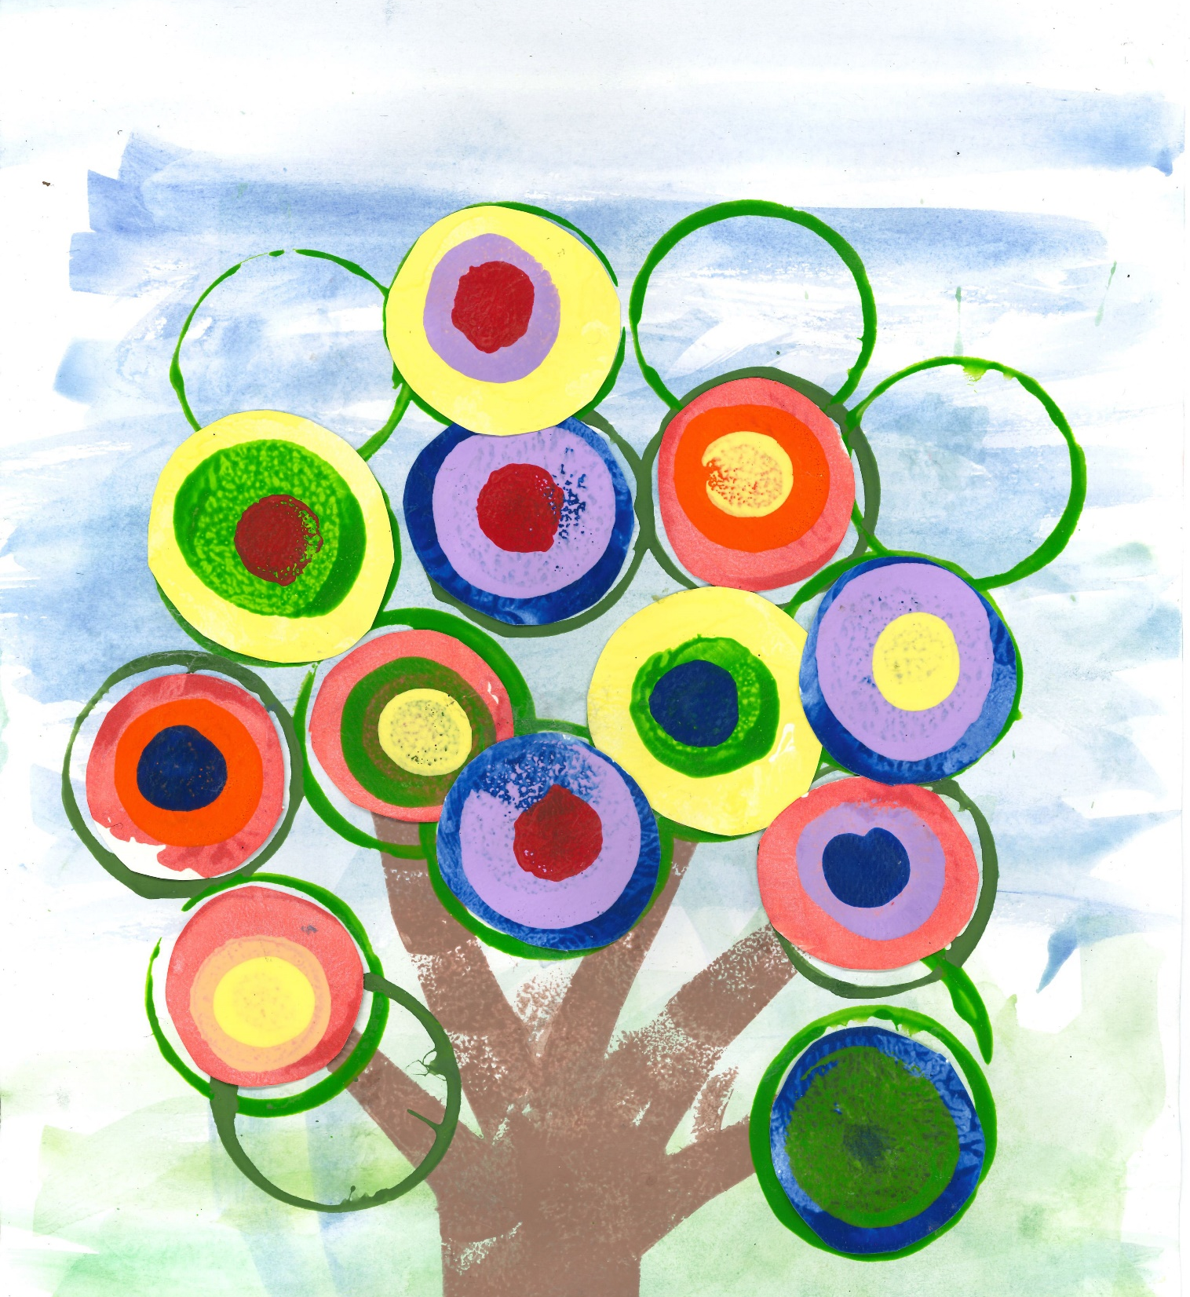
Both pieces of artwork in this month’s pack link to the Sustainable Development Goals and were created by pupils at Christ Church Primary. The piece on the cover of the pack, by Patrick, links to SDG 14: Life Below Water and this piece below, by Vicky, links to SDG 15: Life on Land.
CASE STUDY
Through work on sustainability children at Christ Church Primary, in Hampstead, London, know they can all act and make a difference.
Read the full case study online.
Each year children produce a piece of art linked to a common theme. Last year we chose the UN Sustainable Development Goals. Linked to this children also took actions towards the Global Goals they focused on for the art project and learned that each action, whether small or big, can make a difference.
Children get a feeling of empowerment through learning that we can all act and that each action can make a difference. Children at Christ Church know that raising money is one way to make a difference. They also know they have the power to make a difference themselves in the community and the wider world through actions.
Work on sustainability supports our work on Strand C: Teaching and Learning For Rights. It gives children an opportunity to promote children’s rights while learning about sustainability issues.
Notes:
The full case study is available on the RRSA website, where you can print it out and share with your staff.

Slide 12
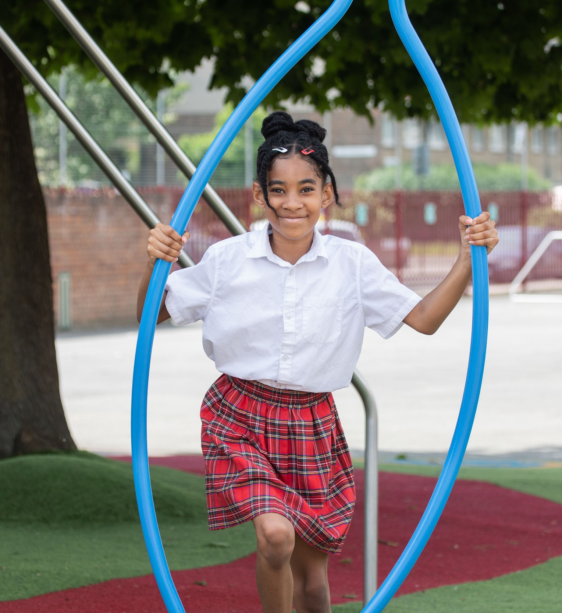
REFLECTION
© UNICEF/Dawe
Reflect on one action you will take to build learning about the environment, sustainability and climate change into your work.
How are you going to make the links with children’s rights clearer?
© UNICEF/Dawe
Notes:
Presenter notes: You could ask people to write down personal commitments in the light of this reflection and collect these in and come back to them at the start of the next term to remind colleagues of their commitment and celebrate any progress.

Slide 13
RESOURCES
You may find the following resources useful for your work on sustainability:
Youth Advocacy Toolkit
UNICEF UK’s OutRight Campaign – see resource for Climate Adaption (23/34)
Guide to Global Citizenship
There are many other organisations and materials that will help you explore sustainability further such as:
General Comment No 26 on Children’s Rights and the Environment – Child Friendly Version
A story about sustainability for young children
Teacher-tested and reviewed resources from across the environmental sector in one place
Let's go zero supporting schools to become zero carbon by 2030
National education nature park practical advice and national mapping to support biodiversity in school grounds
Climate action plans A requirement for schools in England from Department for Education and Skills (England)
Free University College London (UCL) Online professional development courses on Climate and Sustainability for Geography, History, Maths, English and Science.
UN Global Goals and the World’s Largest Lesson
Inspiring Podcast – Teachers share their stories of climate action.
Advice on dealing with eco-anxiety
Notes:
Presenter notes: If you have time, please explore these links ahead of your session with colleagues. You may well find a particular resource that you want to highlight to all as part of your input. There may be links you want to share with the team ahead of or as follow up to your input with them.
Encourage your colleagues to explore the RRSA website to find additional resources. If you have time, please explore these links ahead of your session with colleagues. You may well find a particular resource that you want to highlight to all as part of your input. There may be links you want to share with the team ahead of or as follow up to your input with them.

