Slide 1
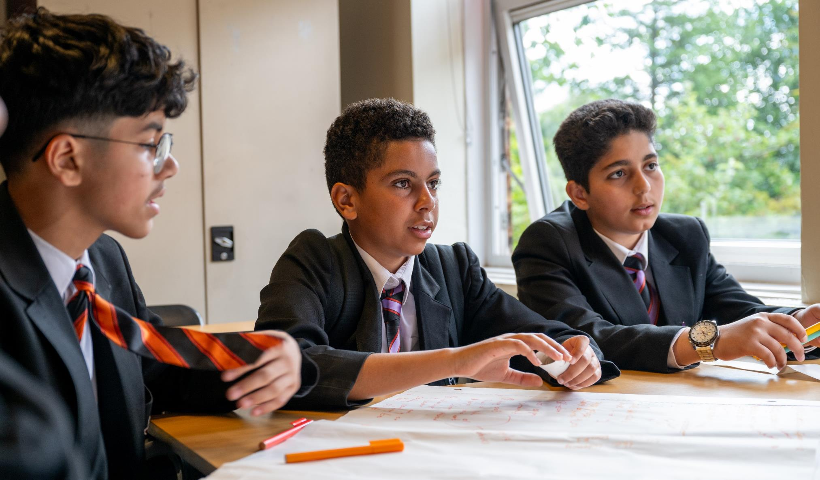


© UNICEF/Maule-ffinch
Notes:
Welcome to Spotlight, our latest resource to support RRSA coordinators to develop Rights Respecting practice in school.
Spotlight is aimed at colleagues and is intended to support you in staff briefings or continued professional development (CPD).
Please check guidance in subsequent slide notes.
Image caption: Young people at a Gold secondary school plan photography to capture what makes their school Rights Respecting.

Slide 2

CONTENTS
Topic: Rights Refeshers
For each slide, please look at the presenter notes for delivery information.
Slide 3: Aims of the Session
Slide 4: Three ways to use this pack
Slide 5 : Introducing this month’s Spotlight
Slide 6: Thank you
Slide 7: Links to RRSA Outcomes
Slide 8: Links to Articles
Slide 9: Discussion Questions
Slide 10: Suggested Activities
Slide 11: Resources
Slide 12: Reflection

Slide 3

AIMS OF THE SESSION
To get your year off to a Rights Respecting start!
To refresh understanding of the Rights Respecting Schools Award.
To recap the important rights concepts including: rights holder and duty bearers, the ABCDE of rights and creating charters.
Notes:
Trainer notes: This session is particularly useful at the start of the new school year (though can be used year round) to encourage all staff to review their understanding of, and commitment to, children’s rights. It will be particularly useful if you have several new staff starting in your school. However, it is always good to have a regular opportunity to come together as a staff team and renew your commitment to children’s rights and consider what your school is already doing to promote and protect rights and share what your priorities as RRSA lead for the year ahead.

Slide 4
THREE WAYS TO USE THIS PACK
DELETE THIS SLIDE BEFORE USING
Read through the slides and notes pages to identify the most relevant activities for your colleagues and any preparation or resources needed.
If time is tight, use the ‘Spotlight on…’ slide and choose from the key discussion questions to explore with your colleagues. You may want to ask colleagues to consider a question before the session.
If you have longer, you can also choose some of the activities to explore.
You may wish to cover the content over a number of staff meeting sessions.
Notes:
Trainer notes: Delete this slide before using.
It would be useful to have copies of the simplified CRC or the icons so that staff can refer to them throughout the session. Unicef.uk/CRC_Icons
Heather Nicholaou, RRSA Lead at Chingford CofE Primary talks about how they have used the Spotlight on Rights Respecting Language as part of their CPD:
“Spotlight was useful, as it provided a clear framework with aims of the session, a representative from UNICEF stating why RRS language is so important and a list of questions for us to work through.”
“Staff were able to discuss RRS language used in our school at the time and how to improve it. The additional sheet with various words and phrases with RRS language was great as it allowed us all to speak about our experiences of the use of each word/phrase and make notes about this.”
“We aim to repeat this session in the new academic year with Learning Support Assistants and new members of staff to ensure that all members of our staff team are role models when it comes to using RRS language throughout the school.”

Slide 5

SPOTLIGHT ON…
Refreshing Rights
As a school involved in the RRSA, it is important that we, as staff, are clear about the key concepts, ideas and principles that underpin this approach.
This session will give us some time and space to refresh our knowledge and understanding so that we can get our year off to a rights respecting start.
Being a Rights Respecting School is special, we are one of around 5000 schools, across the UK, working with UNICEF UK to embed and promote children’s rights.
This is really significant work, and is appreciated by UNICEF UK, and we should not underestimate its importance.
Notes:
The video complements the content of this pack and can also be used separately, when introducing new staff to RRSA for example.

Slide 6

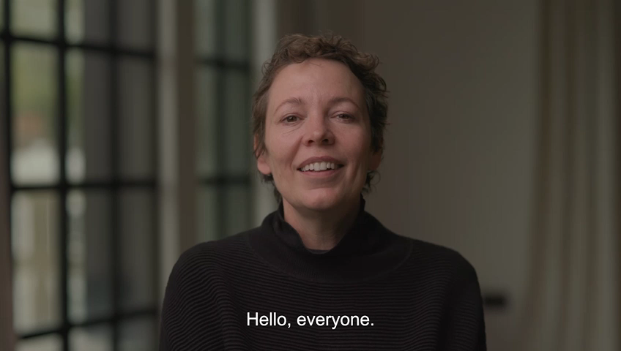
THANK YOU!
Olivia Colman UNICEF UK President thanks Rights Respecting Schools.
Notes:
This was used at our 2023 conference but we thought you might like to share it with your whole staff team.
You may also wish to share our latest RRSA film: unicef.uk/RRSA_Film

Slide 7

THE THREE STRANDS OF RRSA – a reminder
Strand A: TEACHING AND LEARNING ABOUT RIGHTS
The United Nations Convention on the Rights of the Child (CRC) is made known to children, young people and adults, who use this shared understanding to work for improved child wellbeing, school improvement, global justice and sustainable living.
Strand B: TEACHING AND LEARNING THROUGH RIGHTS – ETHOS AND RELATIONSHIPS
Actions and decisions affecting children are rooted in, reviewed and resolved through rights. Children, young people and adults collaborate to develop and maintain a school community based on equality, dignity, respect, non-discrimination and participation; this includes learning and teaching in a way that respects the rights of both educators and learners and promotes wellbeing.
Strand C: TEACHING AND LEARNING FOR RIGHTS – PARTICIPATION, EMPOWERMENT AND ACTION
Children are empowered to enjoy and exercise their rights and to promote the rights of others locally and globally. Duty bearers are accountable for ensuring that children experience their rights.
Notes:
This slide can help you share the ‘structure’ of RRSA with your colleagues and provide and an overview of the programme. These three strands are not unique to the Award, they are recognised globally as the pillars for most human rights education.

Slide 8
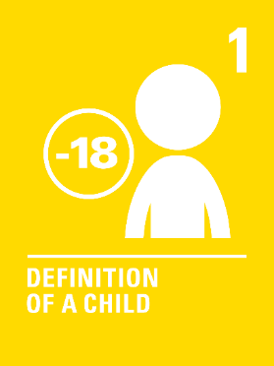





LINKS TO ARTICLES
Notes:
When we think about being a Rights Respecting School every article applies. However, the six articles identified here are particularly relevant to a shared understanding of what it is to be Rights Respecting.
Article 1: Everyone under the age of 18 has all the rights in the Convention.
Article 3: The best interests of the child must be a top priority in all decisions and actions that affect children.
Article 12: Every child has the right to express their views, feelings and wishes in all matters affecting them, and to have their views considered and taken seriously. This right applies at all times, for example during immigration proceedings, housing decisions or the child’s day-to-day home life.
Article 28: Every child has the right to an education. Primary education must be free and different forms of secondary education must be available to every child. Discipline in schools must respect children’s dignity and their rights. Richer countries must help poorer countries achieve this.
Article 29: Education must develop every child’s personality, talents and abilities to the full. It must encourage the child’s respect for human rights, as well as respect for their parents, their own and other cultures, and the environment.
Article 42: Governments must actively work to make sure children and adults know about the Convention.
You could ask your colleagues which articles they most strongly associate with being Rights Respecting… be prepared to hear Articles 19 and 31 mentioned!

Slide 9

DISCUSSION QUESTIONS
The CRC
Where does the CRC and/or individual rights feature across our school day? Where can we develop clear explicit links?
CRC Exploration
In small groups explore the CRC, choose one article and share what you do as a duty bearer to support access to this. Share with your colleagues.
Notes:
Trainer notes: The aim here is to encourage your colleagues to talk about being Rights Respecting and about the Convention. You might want colleagues to work in small groups, each addressing one question. You may wish to delete one of these questions or even add your own to focus on an aspect of RRSA which you know needs attention.
Consider sharing key resources and guidance with staff in advance of your meeting. It may be helpful to direct staff to the website too.
Please do have copies of the CRC on hand to prompt discussion

Slide 10

SUGGESTED ACTIVITIES
In groups, draw a Rights Respecting classroom onto large pieces of flipchart paper. What do you see, hear and feel in a Rights Respecting classroom?
Class Charters
Recap the charter guidance. How can your school/class charter become part of your day-to-day conversations?
Explore a range of scenarios where you could make reference to your charter.
ABCDE of Rights
Use the ABCDE resource to explore how we can promote these concepts around school. Feedback ideas and agree next steps.
Rights Language
In groups complete the RRSA Glossary sheet to refresh understanding of key rights terminology, such as rights holders and duty bearers.
Notes:
Trainer notes: You can delete or modify activities to suit your session.
Activity information:
Rights language: Hand out copies of the CRC glossary to be completed. Collect completed sheets to influence future planning.
Class charters: Share the RRSA Charter Guidance in advance. This activity could also be done with groups of children. Have copies of the CRC to share. You may want to think of some scenarios in advance to share.
ABCDE: this is useful to use with children and young people as well as colleagues.

Slide 11
RESOURCES
Don’t forget that all back copies of Article of the Week can be found here. You might find the Article 42 pack particularly relevant to support pupils engagement in your Rights Respecting School journey.
Charter Guidance
Articles in Action
Myths and Misconceptions
RRSA Glossary
ABCDE of Rights
Child friendly CRC and Icons
Features of a Rights Respecting Classroom
Notes:
Trainer notes: Encourage your colleagues to explore the RRSA website to find additional resources. If you have time, please explore these links ahead of your session with colleagues. You may well find a particular resource that you want to highlight to all as part of your input. There may be links you want to share with the team ahead of or as follow up to your input with them.

Slide 12
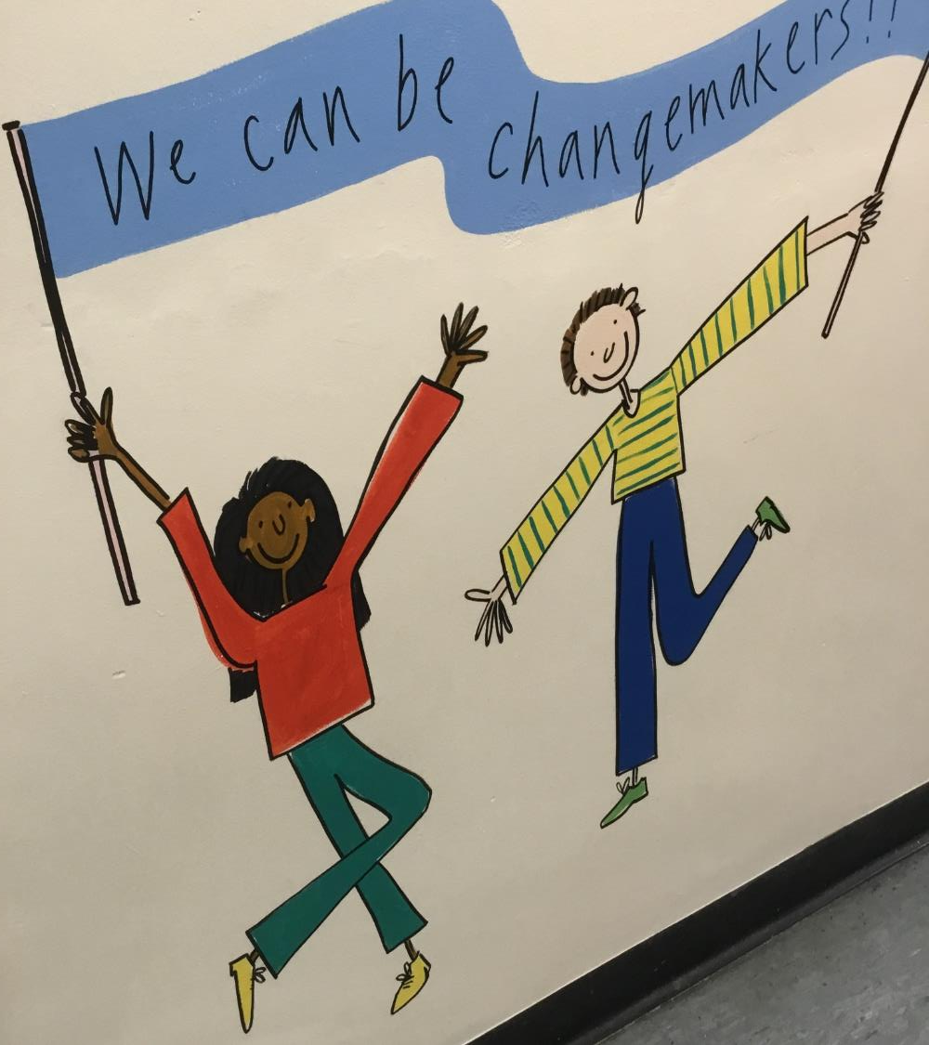
REFLECTION
© UNICEF/Dawe
Write down three things that you, personally, are going to do this term to bring rights to life with your pupils.
Share your intentions with a colleague.
How will you support each other to realise these commitments?
Notes:
Trainer notes: You could collect these in and come back to them at the start of the next term to remind colleagues of their commitment and celebrate any progress.

