Slide 1

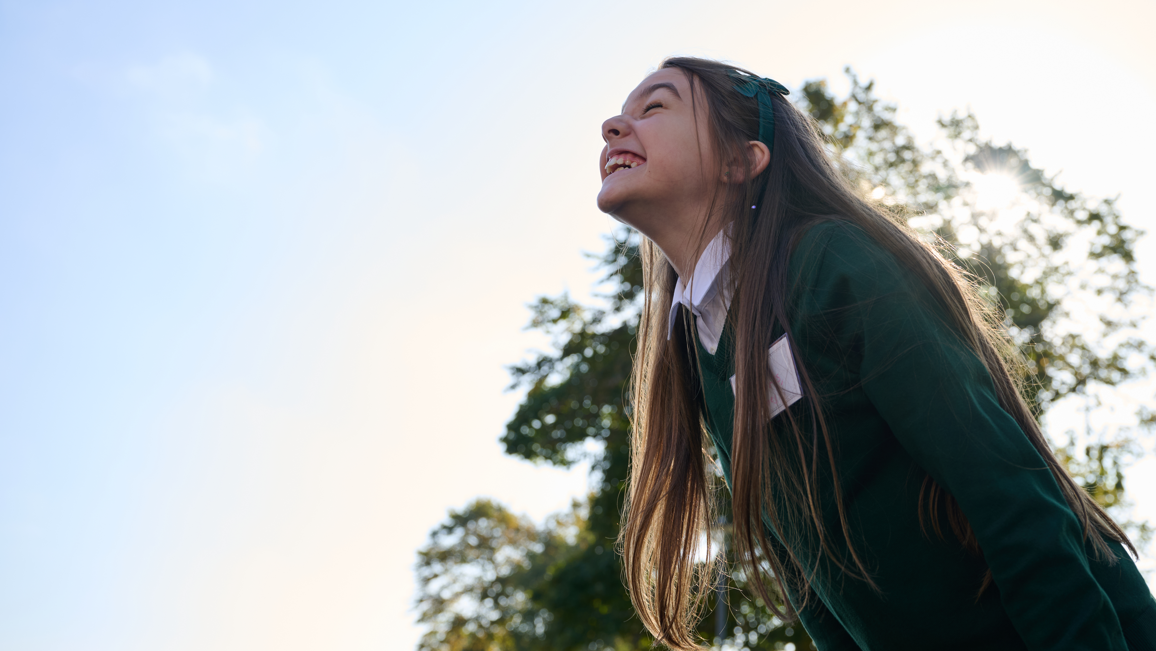

© UNICEF/Al-Safadi
  WELCOME
  TO OUTRIGHT
In 2024, UNICEF UK partnered with two Rights Respecting Schools in the UK to create a set of images relating to rights. These images were co-created with students at the schools, meaning that the subjects, composition and aesthetics of the images were all driven by the students themselves.
© UNICEF/Maule-Ffinch

Slide 2
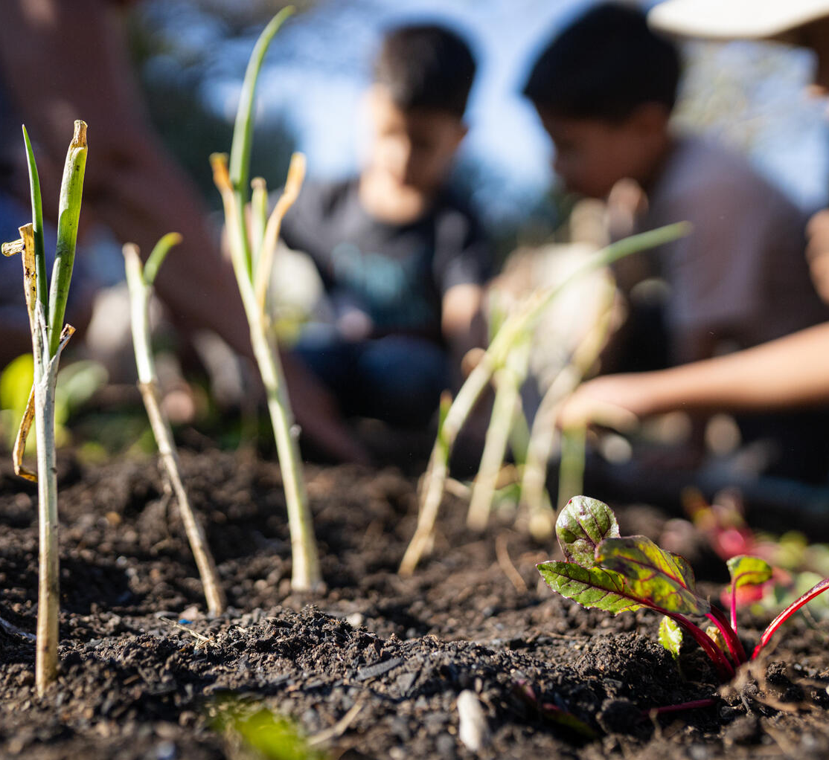
  WHAT IS OUTRIGHT
OutRight is a youth campaign run by UNICEF UK that helps children and young people learn about and speak out on children’s rights across the world.
It’s a campaign by children,
for children.
On 21 February 2024 in zone 5 of Guatemala City, an image of the vegetables that a group of children has just planted in the community garden of the Municipality of Guatemala. Children and adolescents are especially vulnerable to the effects of climate change.
© UNICEF/Willocq

Slide 3

  MAKE YOUR
  VOICE HEARD
OutRight will help children and young
people to stand up for the rights of
children in the UK and around the
world, with the support of our campaign champion, PaddingtonTM.
This year, we’re learning about
International Aid, and the impact
that it can have on children’s rights
around the world.
© P&Co. Ltd./SC 2025

Slide 4
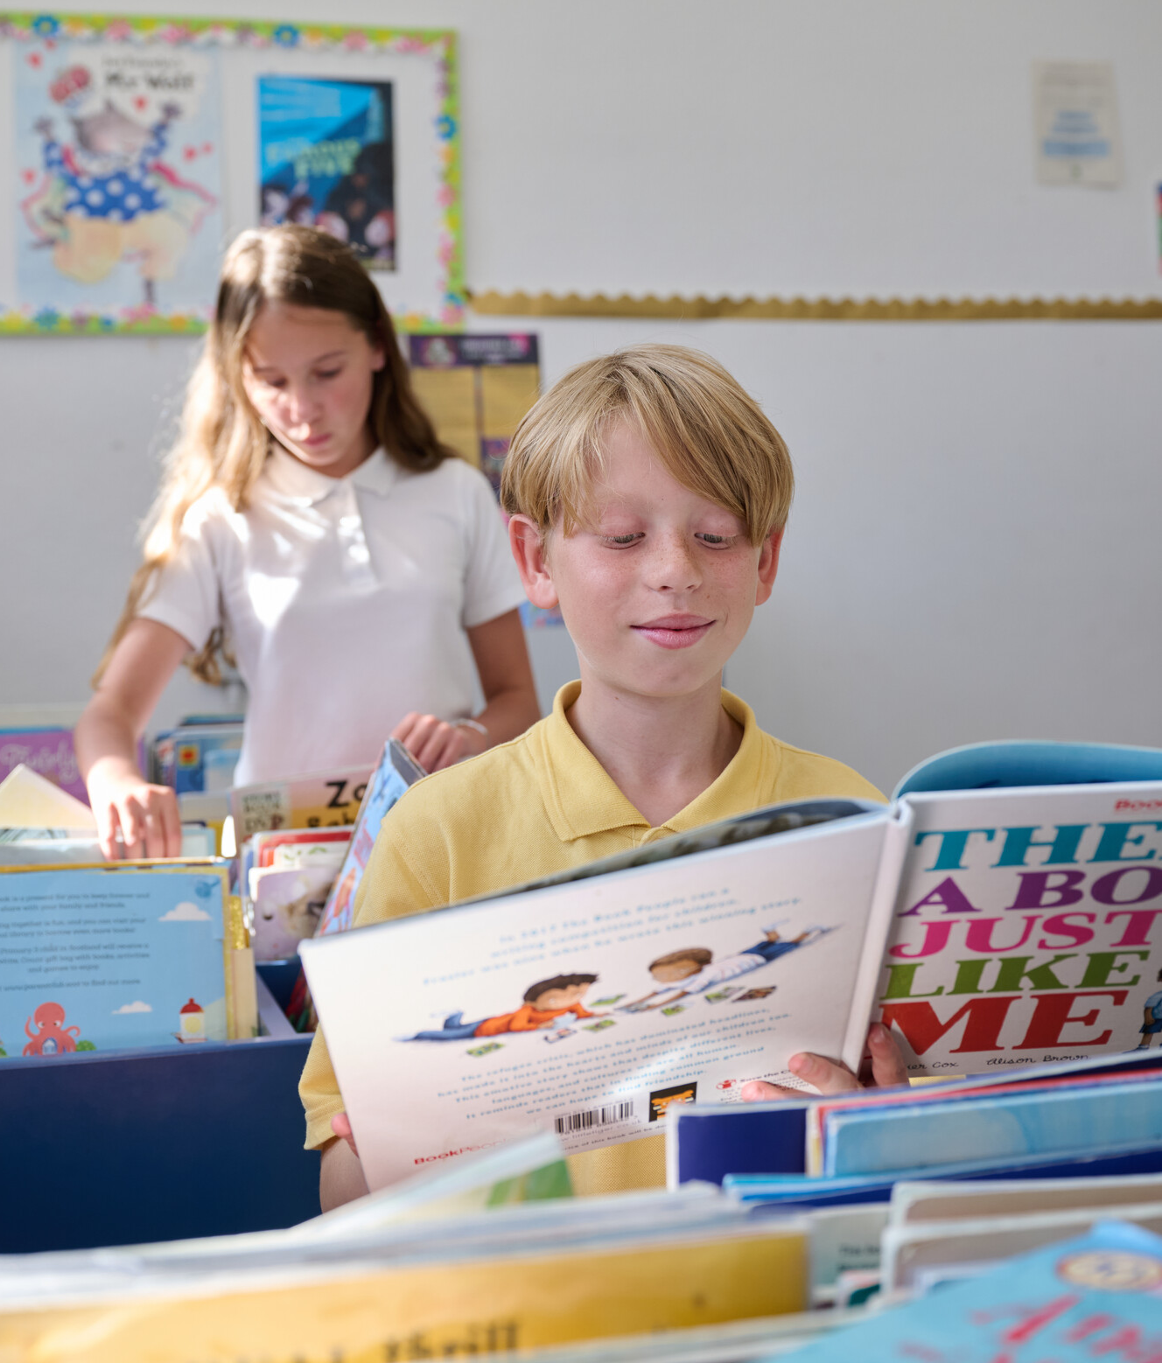
  TAKING PART
  IN OUTRIGHT
We will:
• Learn about the rights which
are connected to international aid
• Understand what international aid
is and why it is important
• Use your voice by telling a decision
maker all about your learning journey.
Students at a Rights Respecting school set up this photo to represent a UNCRC article in a photojournalism style.
© UNICEF/Maule-Ffinch

Slide 5
  WHAT IS
  CAMPAIGNING?
Campaigning is about taking specific and organised actions (like taking part in OutRight!) to bring about positive change on an issue, and influence those in power to act.
Going to a march, writing to your MP or local councillor, or signing a petition are all ways we can campaign for change!
Poppy attends a Youth Advisory Board meeting, in May 2022, to discuss plans for World Children’s Day.
© UNICEF/Flynn

Slide 6
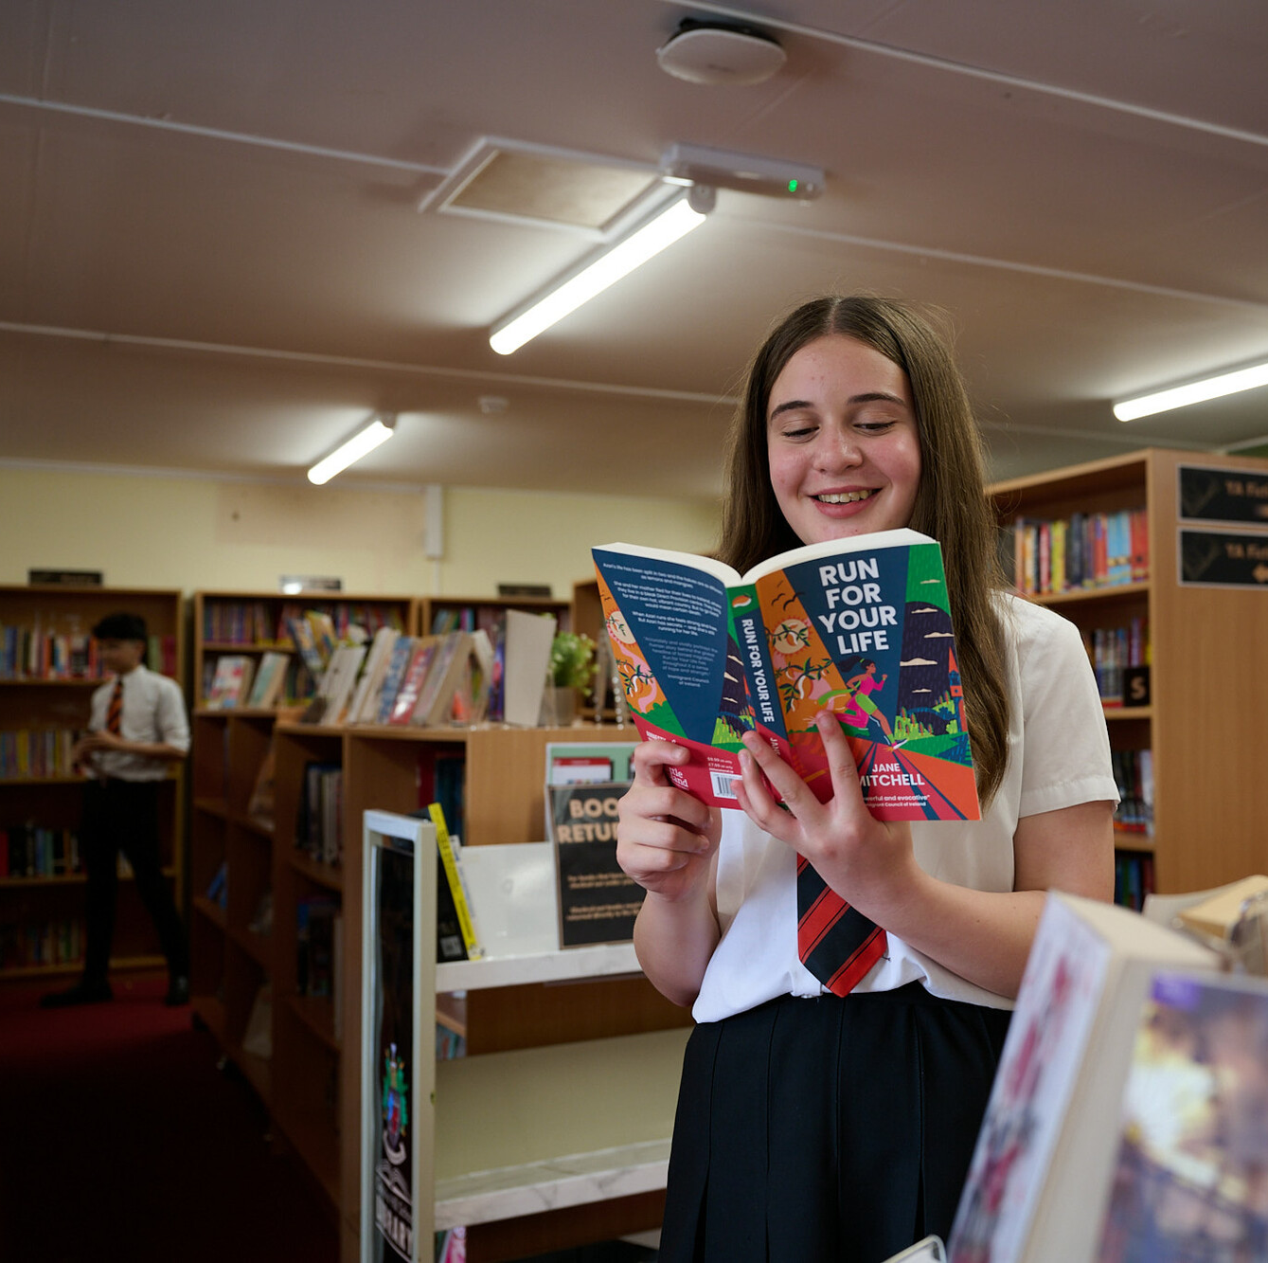
  WHY
  CAMPAIGN?
Children like you have an important role to play in campaigning to create change. Your voices matter and can make a difference!
UN Convention on the Rights of the Child: Article 12
Every child has the right to say
what they think in all matters
affecting them, and to have their
views taken seriously.
Students at Cockshut Hill Secondary school created a series of images in a photojournalism style based on the brief - How does your school support your rights?
© UNICEF/Maule-Ffinch

Slide 7

  MAKE YOUR
  VOICE HEARD
Join our World Children’s Day event and hear about the exciting ways children and young people like you are making a difference.
Complete your learning journey
and finish with
the brand-new campaign action!
We will deliver your messages to the decision maker!

Slide 8
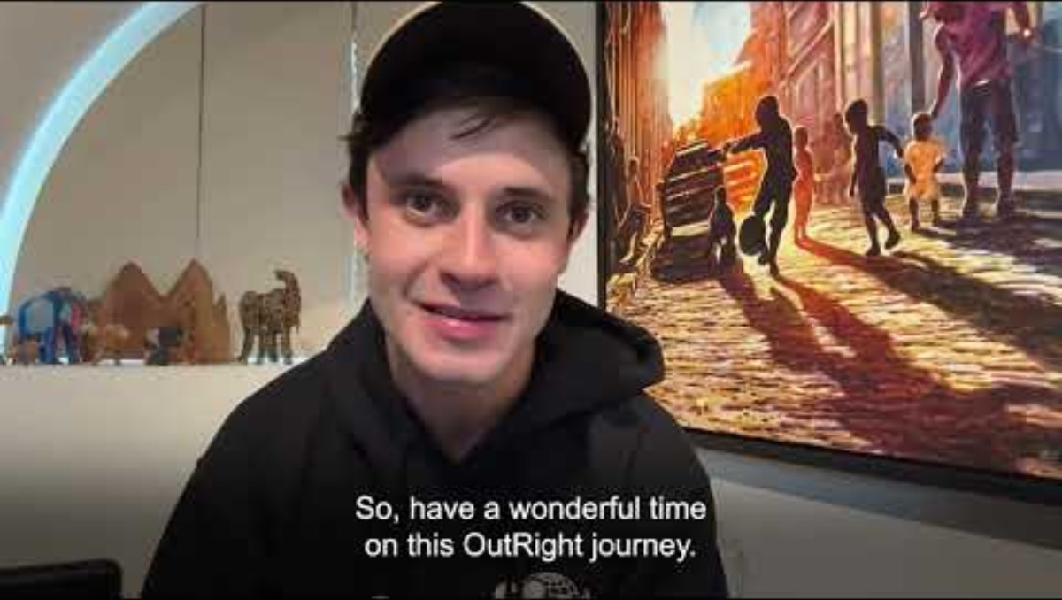
  A MESSAGE
  FROM CEL
Actor and UNICEF UK
Supporter Cel Spellman
has this message for
you about taking part
in OutRight this year…

Slide 9
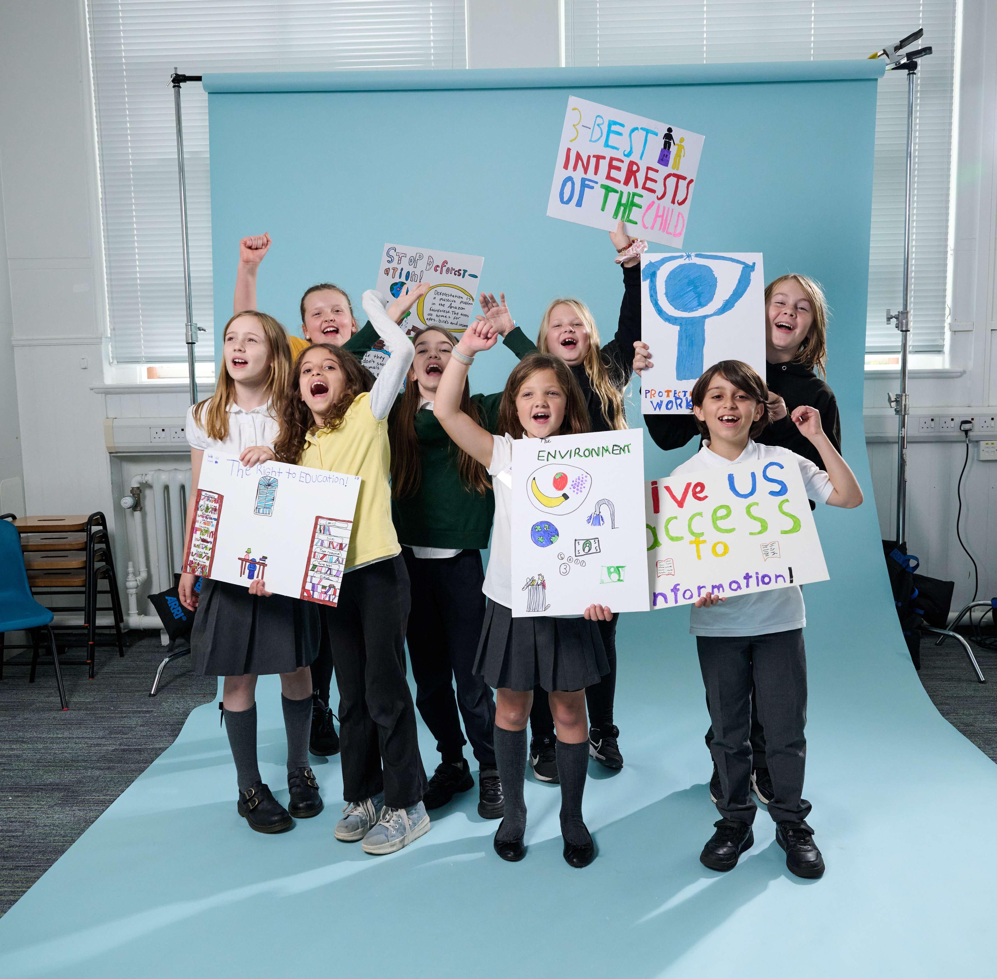
  THANK
  YOU
Thank you so much
for taking part in
OutRight this year
and for making your
voice heard.
While working with the photographer, the
students explained why they chose the right they
did, and why they wanted to photograph it this way.
"We chose article 13, the right to protest.
So we pretended to protest!" Rowan
© UNICEF/Maule-Ffinch

