Slide 1

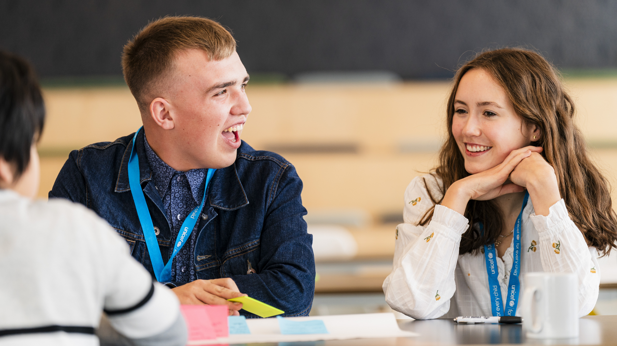

Finn and Ruby attend the Youth Advisory Board handover meeting in November 2023, which saw existing team members meet new ones.
© UNICEF/Al-Safadi
  WELCOME
  TO OUTRIGHT
© UNICEF/Maule-Ffinch

Slide 2
  WHAT IS OUTRIGHT
OutRight is a youth campaign run by UNICEF UK that helps children and young people learn about and speak out on children’s rights across the world.
It’s a campaign by children, for children.
Left to right: Jamie, Arushi and Arthur attend a Youth Advisory Board meeting in May 2022. The group met to discuss plans for World Children’s Day.
© UNICEF/Willocq

Slide 3

  MAKE YOUR
  VOICE HEARD
OutRight will help children and
young people to stand up for the
rights of children in the UK and
around the world.
This year, we’re learning about
International Aid, and the impact
that it can have on children’s rights around the world.

Slide 4
  TAKING PART
  IN OUTRIGHT
We will:
Learn about the rights which are connected to international aid
Understand what international aid is and why it is important
Use your voice by telling a decision maker all about your learning journey.

Slide 5
  WHAT IS
  CAMPAIGNING?
Campaigning is about taking specific
and organised actions (like taking part
in OutRight!) to bring about positive
change on an issue, and influence
those in power to act.
Going to a march, writing to your MP or local councillor, or signing a
petition are all ways we can
campaign for change!
Poppy attends a Youth Advisory Board meeting, in May 2022, to discuss plans for World Children’s Day.
© UNICEF/Flynn

Slide 6
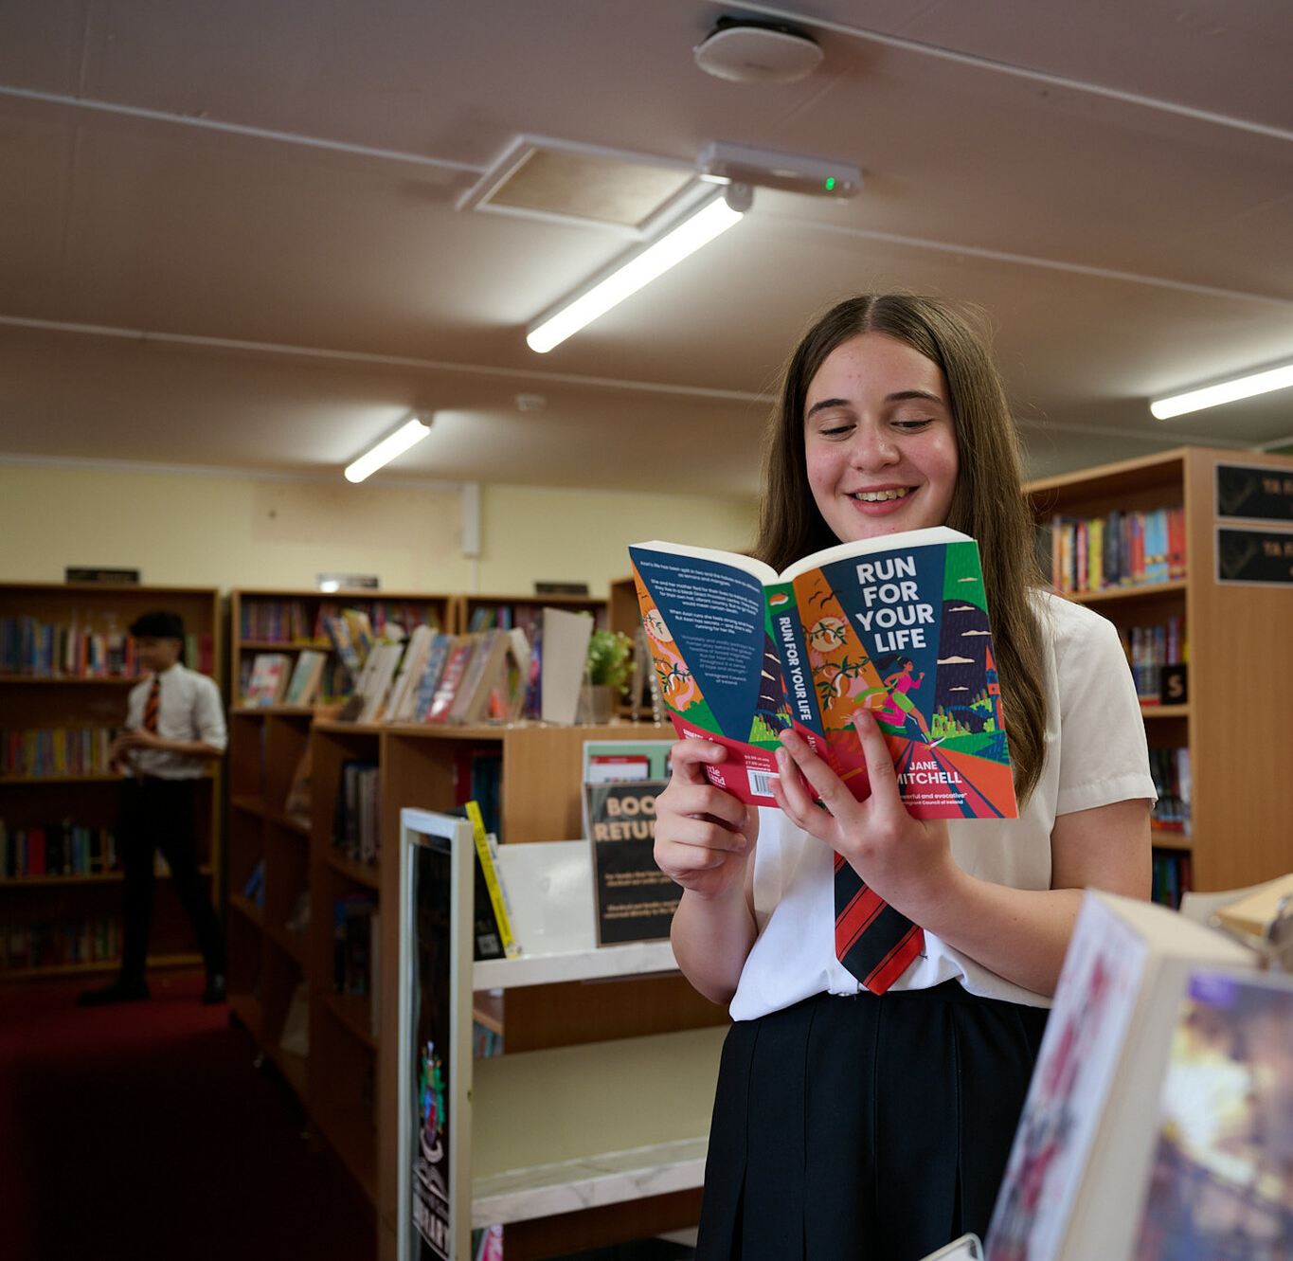
  WHY
  CAMPAIGN?
Children like you have an important
role to play in campaigning to create
change. Your voices matter and can
make a difference!
UN Convention on the Rights of the Child: Article 12
Every child has the right to say
what they think in all matters
affecting them, and to have their
views taken seriously.
© UNICEF/Maule-Ffinch
Students at Cockshut Hill Secondary school created a series of images in a photojournalism style based on the brief - How does your school support your rights?

Slide 7

  MAKE YOUR
  VOICE HEARD
Join our World Children’s Day event and hear about the exciting ways children and young people like you are making a difference.
Complete your learning journey
and finish with
the brand-new campaign action!
We will deliver your messages to the decision maker!

Slide 8
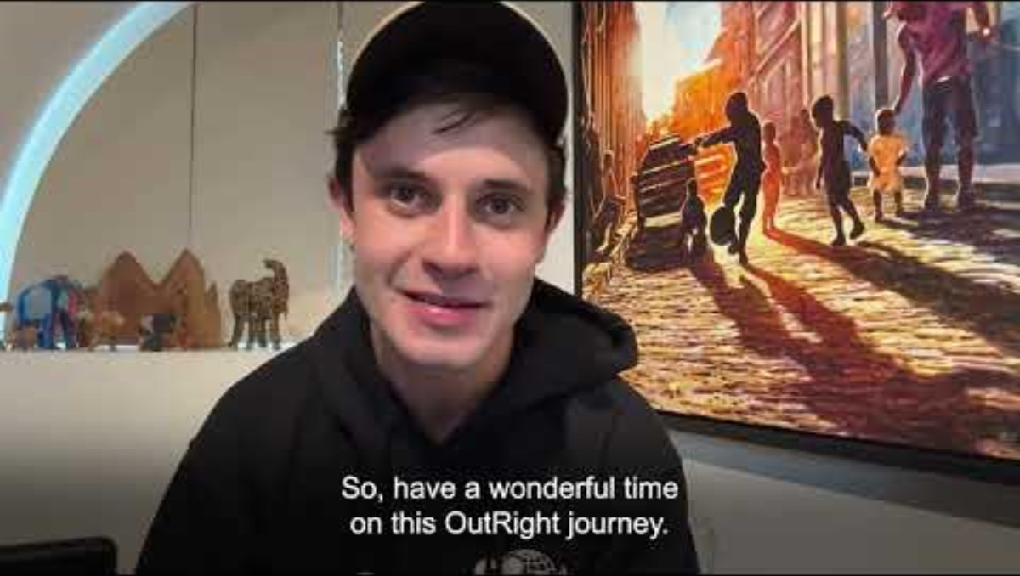
  A MESSAGE
  FROM CEL
Actor and UNICEF UK
Supporter Cel Spellman
has this message for
you about taking part
in OutRight this year…

Slide 9
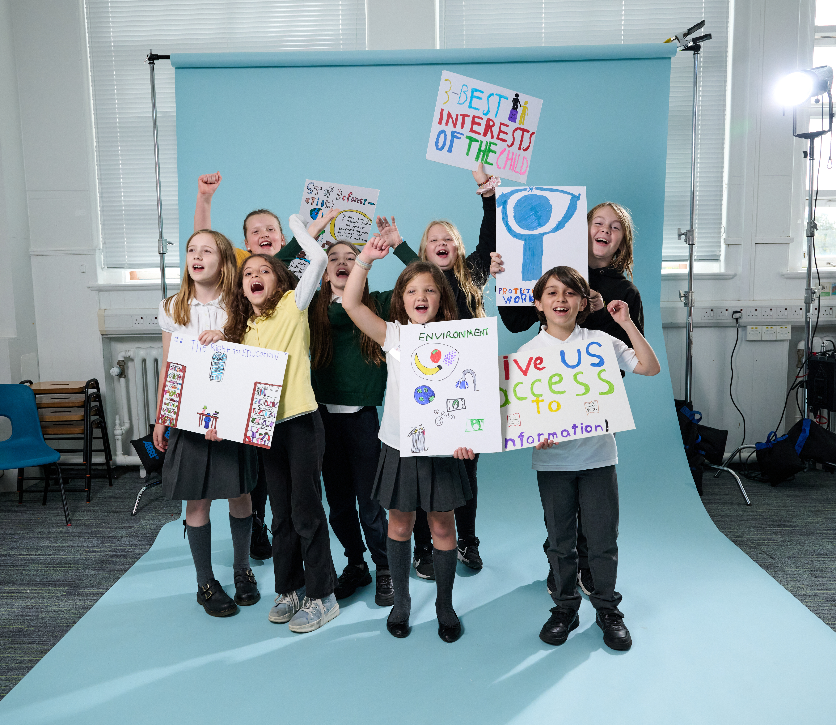
  THANK
  YOU
Thank you so much
for taking part in
OutRight this year
and for making your
voice heard.
© UNICEF/Maule-Ffinch
Students at a Rights Respecting School worked with a photographer to create images that show their rights. “We chose article 13, the right to protest. So we pretended to protest!" says Rowan.

