Slide 1


CAMPAIGN ACTION
Now you’ve finished learning all about international aid, it’s time to take some action!
Campaigning is often about teaching other people the exciting things you’ve learned and hoping that this might change their thinking, and the choices they make.
So, whose choices are we trying to change?

Slide 2
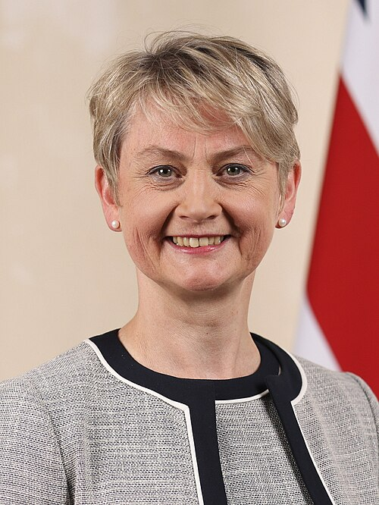
WHOSE CHOICES ARE WE TRYING TO CHANGE?
This year, we’ll be sending your amazing work to the Foreign Secretary, Yvette Cooper.
Yvette Cooper, official portrait, 2024

Slide 3

WHAT DOES THE FOREIGN SECRETARY DO?
The Foreign Secretary is one of the top 4 most important jobs in the UK Government.
The Foreign Secretary is responsible for representing the United Kingdom to the rest of the world.
She manages relationships with other countries, including making decisions when other countries might need support.
This includes decisions around international aid.

Slide 4

WHY IS IT IMPORTANT?
This year, we’ve learned all about how children’s rights around the world can be affected by the cuts to international aid.
We’re asking you to tell the Foreign Secretary what you’ve learned, and to campaign for children’s rights to be protected.

Slide 5

HOW ARE WE GOING TO DO THAT?
We’re asking you to help us create a big book of postcards that we can send to Yvette Cooper, to show her just how many children know about international aid!
You can create your postcard using all the learning you’ve done this year!

Slide 6
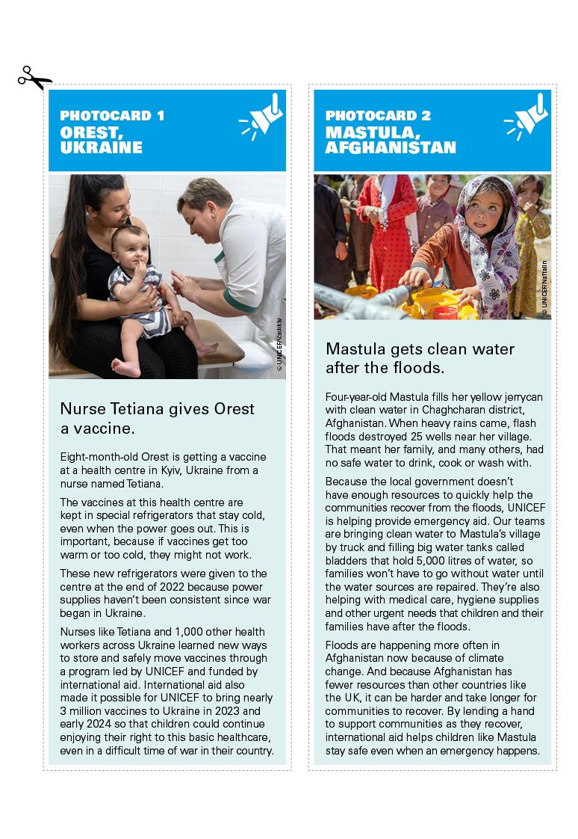
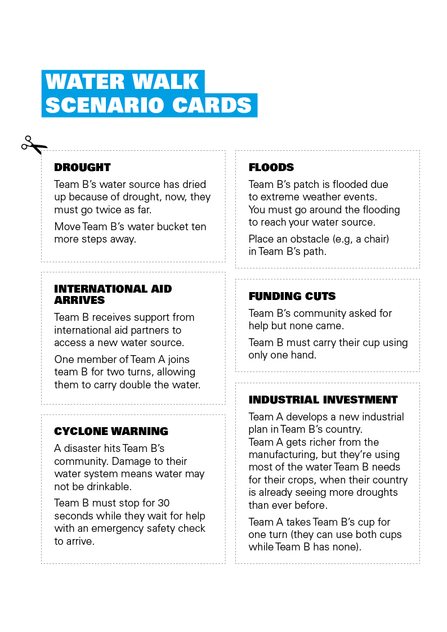
INSPIRATION
Create your postcard however you’d like too!
You could use:
The young people’s stories you’ve seen and heard
Pictures from your murals
Any exciting ideas you’ve had!

