Slide 1


  CAMPAIGN
  ACTION
Now you’ve finished learning all
about international aid, it’s time to
take some action!
Campaigning is often about teaching
other people the exciting things you’ve
learned and hoping that this might
change their thinking, and the choices
they make.
So, whose choices are we trying
to change?

Slide 2
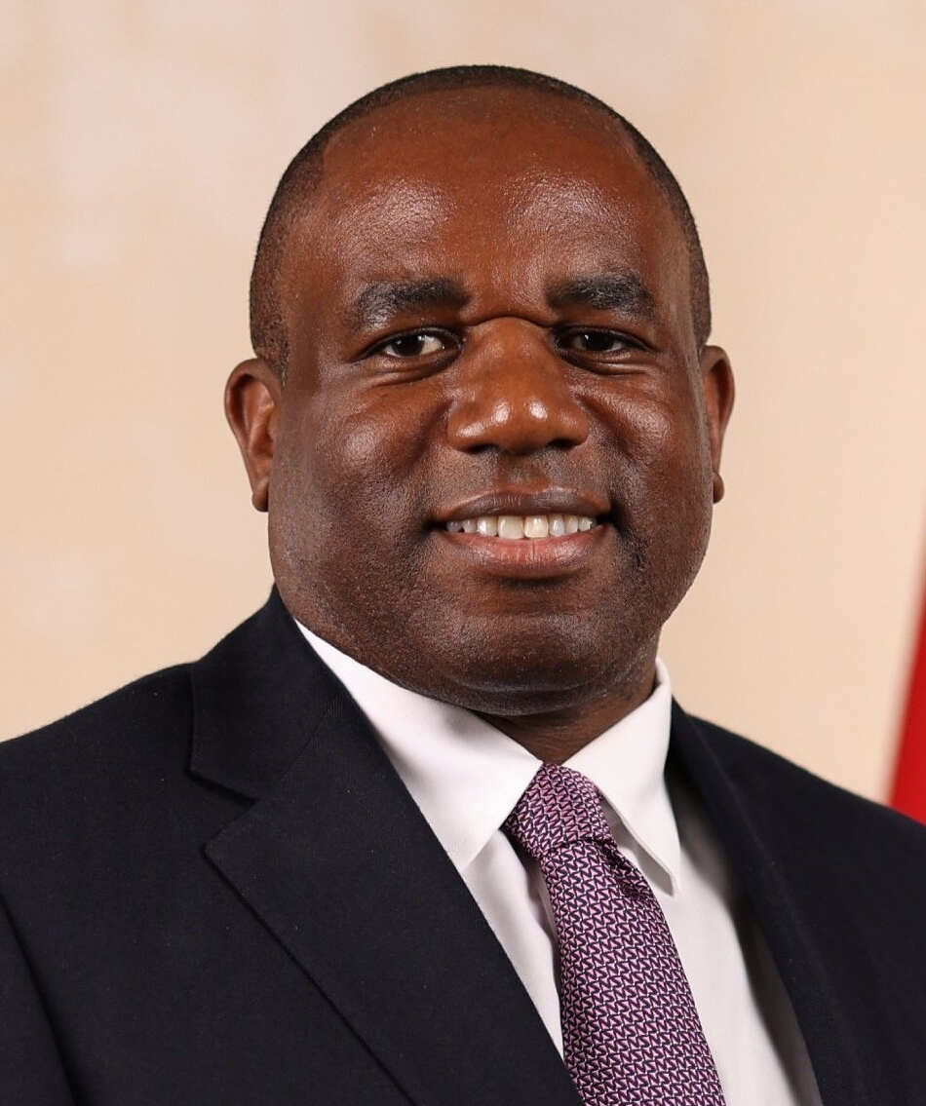
  WHOSE CHOICES
  ARE WE TRYING
  TO CHANGE?
This year, we’ll be sending
your amazing work to the
Foreign Secretary,
David Lammy.
David Lammy, official portrait, 2024

Slide 3

  WHAT DOES
  THE FOREIGN
  SECRETARY DO?
The Foreign Secretary is one of the top 4
most important jobs in the UK Government.
The Foreign Secretary is responsible for
representing the United Kingdom to the rest
of the world.
He manages relationships with other countries,
including making decisions when other
countries might need support.
This includes decisions around
international aid.

Slide 4

  WHY IS IT
  IMPORTANT?
This year, we’ve learned all about how children’s rights around the world can be affected by the cuts to international aid.
We’re asking you to tell the Foreign Secretary what you’ve learned, and to campaign for children’s rights to be protected.

Slide 5

  HOW ARE WE
  GOING TO
  DO THAT?
We’re asking you to help us create
a big book of postcards that we can
send to David Lammy, to show him
just how many children know about
international aid!
You can create your postcard using
all the learning you’ve done this year!

Slide 6
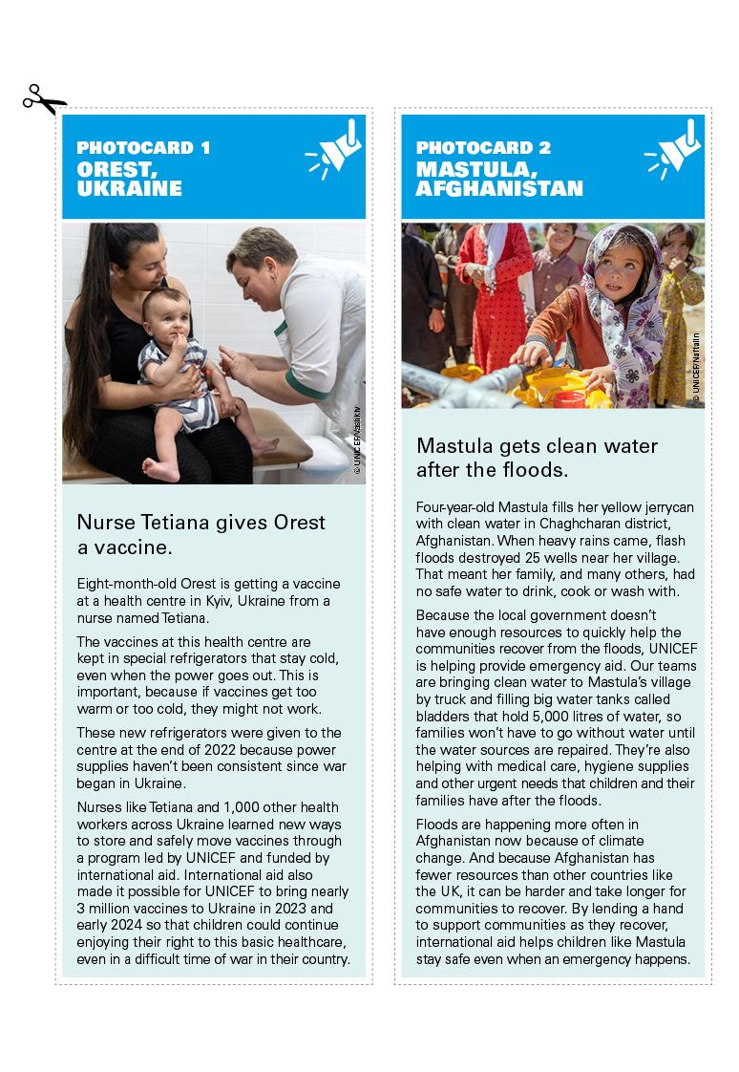
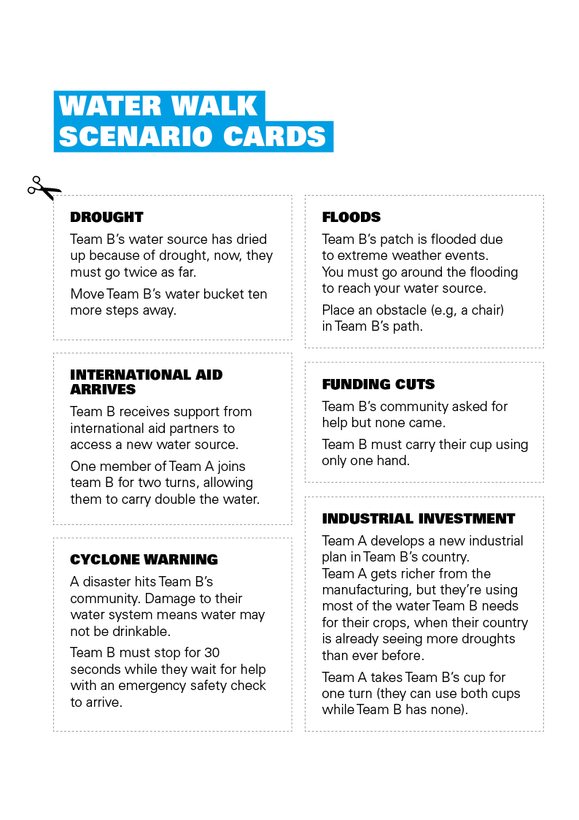
  INSPIRATION
Create your postcard
however you’d like too!
You could use:
The young people’s stories
you’ve seen and heard
Pictures from your murals
Any exciting ideas you’ve had!

