Slide 1

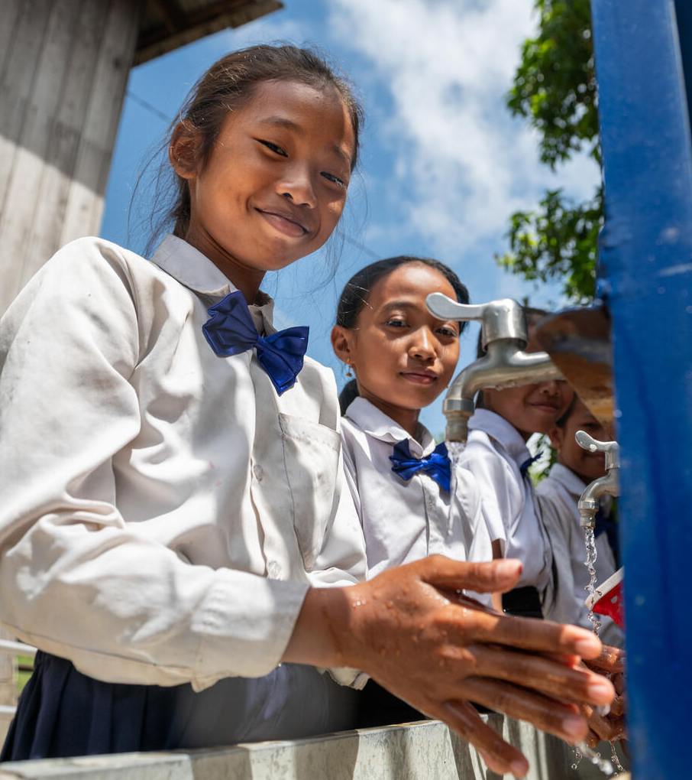

  ACTIVITY 2
  WHAT IS
  INTERNATIONAL
  AID?
© UNICEF/Al-Safadi
Srey Nor (left), and Chhoun Chantra (right), both 12, use the Water, Sanitation and Hygiene (WASH) station at a Primary School in Kratie Province, Cambodia. The WASH station was provided by the Capacity Development Partnership Fund, through UNICEF, to improve education and prevent the spread of illness in rural Cambodian communities.
© UNICEF/Rotzoll

Slide 2


  PART 1
Have you ever helped someone?
What did you do?
Has someone ever helped you?
What did they do?
Have you ever needed help so you could help someone else?
What happened?
Has anyone ever helped you in a way that didn’t feel helpful?
How does someone show they really understand what you need?
How does it feel when someone really listens to you, or stands up for you?
HELPING
HANDS

Slide 3
  PART 2
Emergency aid
International aid
INTERNATIONAL
AID TERMS
Development aid
Charity
Children's rights
Campaigning
Global citizen
UK AID
Sustainable Development Goals

Slide 4
International aid
This is when governments of one (high-income) country give money to help another country with fewer resources. This is more often called Official Development Assistance now.

Slide 5
Charity
Money or support (sometimes food, clothing or
time) given by individuals, groups, or organisations
to others who need it. Often run by volunteers or
private groups, they get money to help through
fundraisers or asking for donations.

Slide 6
Emergency aid
Help that’s given to people during a crisis like a climate disaster
or war. This help is sometimes called humanitarian aid.
It’s meant to save lives, reduce suffering and show care for
people in need. It can include things like providing food, clean
water, shelter or medical care when people don’t have it, or
sending people with special skills to help.

Slide 7
Development aid
Money or support given to countries that have less
money or resources so they can develop over time.
This aid is less for emergencies and urgent needs,
and more for long-term improvements to help people, like
better schools, hospitals, jobs and a healthier environment.

Slide 8
Sustainable Development Goals
A plan of 17 goals that were agreed by all the
countries of the United Nations in 2015 to end
poverty, reduce inequality and build a more
peaceful and prosperous world by 2030.

Slide 9
Children's rights
A list of 54 rights that governments have agreed
that all children in the world have. These belong
to all children, and children do not have to do
anything to earn them.

Slide 10
UK AID
Money given from the UK government to other
countries to help reduce poverty and make life better
and fairer for people around the world. This money
is often used to respond to emergencies and support
education, health and safety.

Slide 11
Foreign, Commonwealth and Development Office (FCDO)
The part of the UK government that works with other countries.
It leads the UK’s international aid work, supports people in
emergencies and helps build strong relationships between the
UK and the rest of the world. This is the government
department responsible for planning and delivering UK Aid.

Slide 12
Campaigning
Taking action and speaking out to
help make the world a better, fairer
place for everyone and every child.

Slide 13
Global citizen
A person who believes in global justice and
acts to make the world a safer, fairer and more
sustainable place in which human rights and
children’s rights are protected and respected.

Slide 14

  PART 3
CIRCLES OF
SUPORT

Slide 15
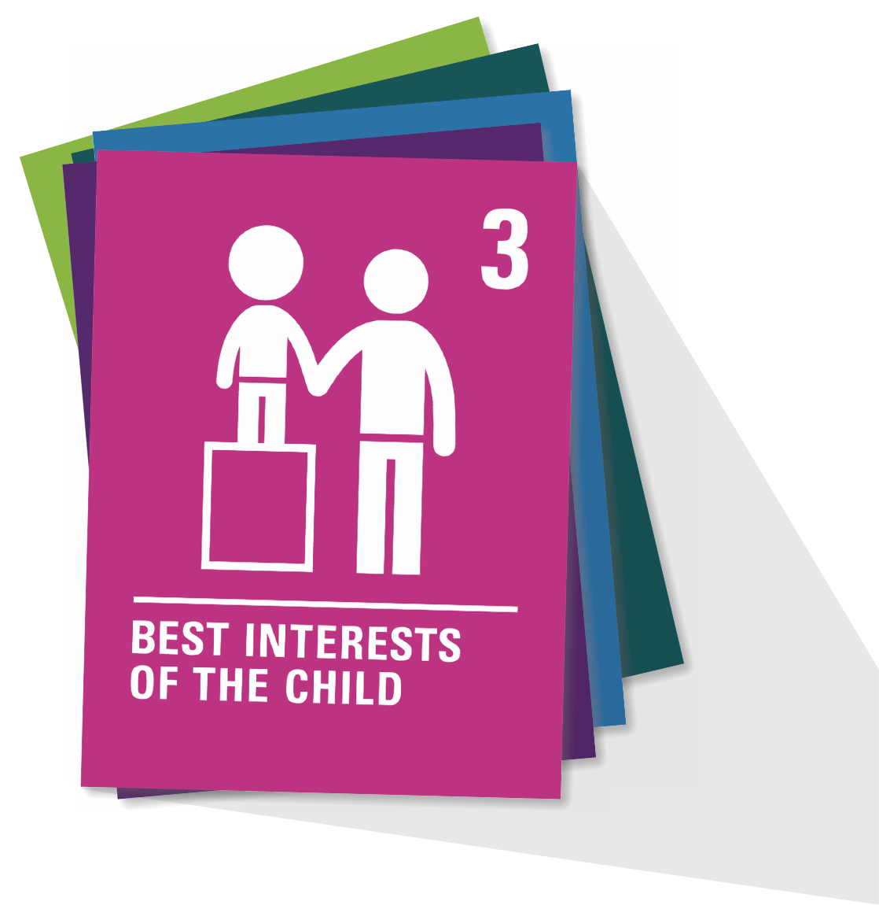
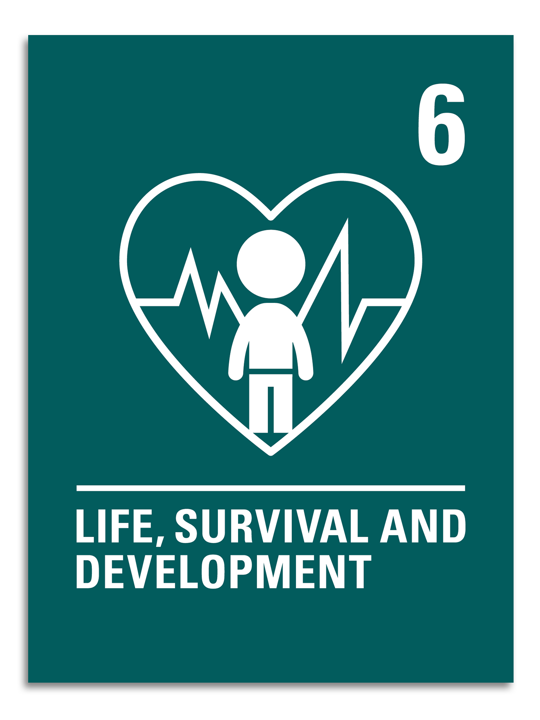
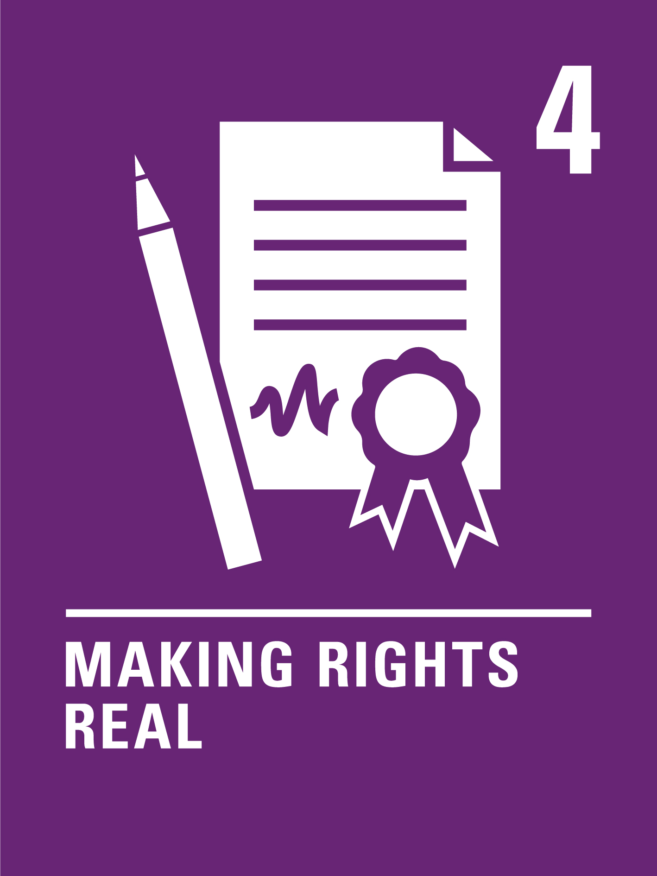
  ARTICLE 6
Life survival and development
Every child has the right to be alive. Governments must make sure that children survive and develop in the best possible way.

Slide 16
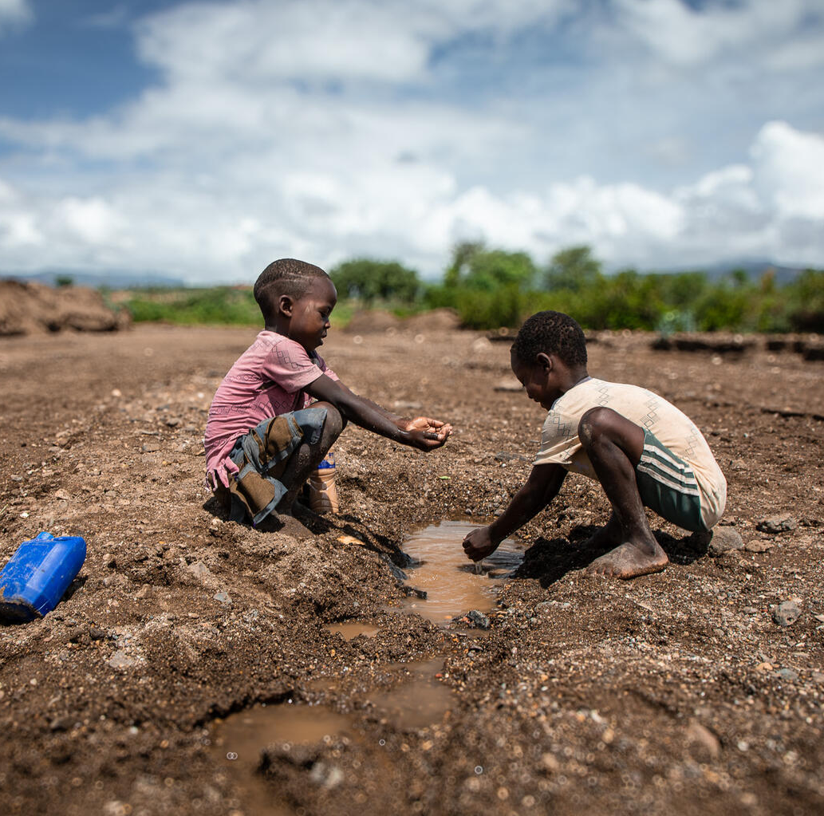
  PART 4
WHAT DOES
AID LOOK LIKE
IN ACTION?
“We came here to drink the water, but we stopped because it doesn't taste
good,” says Bill (left). In drought-affected Ethiopia, water scarcity is forcing children like Bill and his friend, Tesfalegn (right), to drink unsafe water, leading to serious and potentially fatal diseases such as cholera.
© UNICEF/Pouget

Slide 17
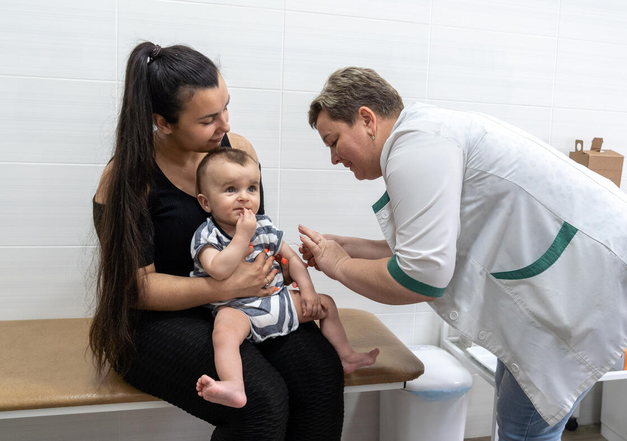
AID IN
ACTION
OREST
UKRAINE
Orest
gets his
vaccine
In Kyiv, Ukraine, eight-month-old Orest looks cheerful, smiling at the people around him. Natalia, his mother, has brought him to this health centre in Kyiv's Shevchenkivskyi district for a vaccination.
© UNICEF/Vashkiv
Notes:
Photocard 1: Orest gets his vaccine
Eight-month-old Orest is getting a vaccine at a health centre in Kyiv, Ukraine from a nurse named Tetiana.
The vaccines at this health centre are kept in special refrigerators that stay cold, even when the power goes out. This is important, because if vaccines get too warm or too cold, they might not work.
These new refrigerators were given to the centre at the end of 2022 because power supplies haven’t been consistent since war began in Ukraine.
Nurses like Tetiana and 1,000 other health workers across Ukraine learned new ways to store and safely move vaccines through a program led by UNICEF and funded by international aid. International aid also made it possible for UNICEF to bring nearly 3 million vaccines to Ukraine in 2023 and early 2024 so that children could continue enjoying their right to this basic healthcare, even in a difficult time of war in their country.

Slide 18
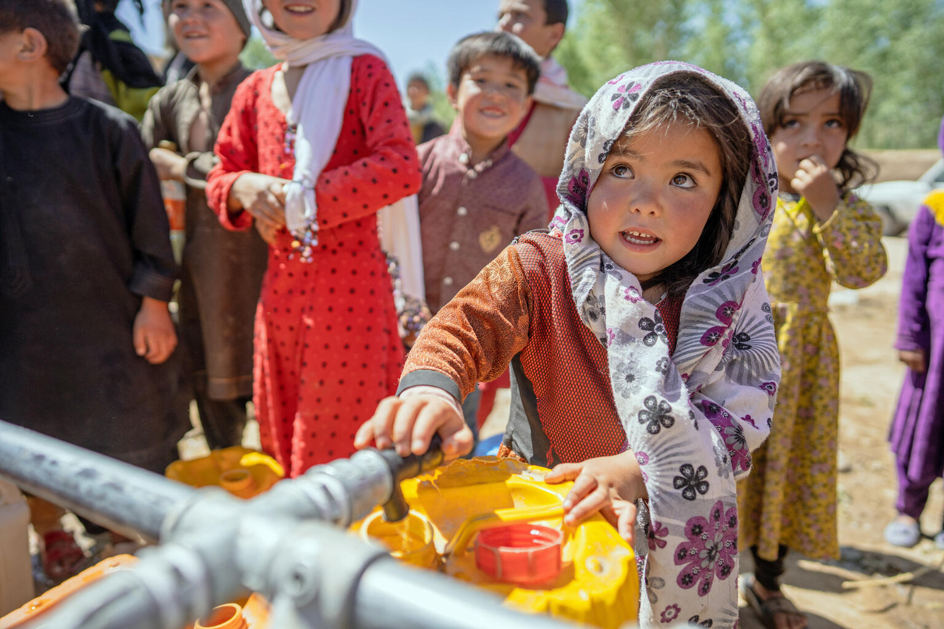
AID IN
ACTION
MASTULA
AFGHANISTAN
Mastula
gets clean
water after
the floods
Mastula, who is four years old, fills her jerry can with water provided by UNICEF in Chaghcharan district, Ghor province in western Afghanistan. The district's wells were destroyed during heavy rains and flash flooding.
© UNICEF/Naftalin
Notes:
Photocard 2: Mastula gets clean water after the floods
Four-year-old Mastula fills her yellow jerrycan with clean water in Chaghcharan district, Afghanistan. When heavy rains came, flash floods destroyed 25 wells near her village. That meant her family, and many others, had no safe water to drink, cook or wash with.
Because the local government doesn’t have enough resources to quickly help the communities recover from the floods, UNICEF is helping provide emergency aid. Our teams are bringing clean water to Mastula’s village by truck and filling big water tanks called bladders that hold 5,000 litres of water, so families won’t have to go without water until the water sources are repaired. They’re also helping with medical care, hygiene supplies and other urgent needs that children and their families have after the floods.
Floods are happening more often in Afghanistan now because of climate change. And because Afghanistan has fewer resources than other countries like the UK, it can be harder and take longer for communities to recover. By lending a hand to support communities as they recover, international aid helps children like Mastula stay safe even when an emergency happens.

Slide 19
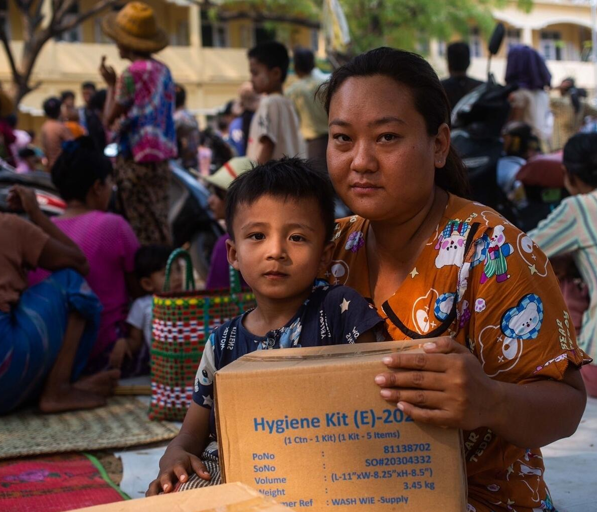
AID IN
ACTION
PHONE PAYAE
MYANMAR
Phone Payae and
his mum receive
emergency aid after
the earthquake
Phone Payae, who is five years old, poses for a photograph with his mother, Ei Phyo Kyaing, 34, after receiving a box of UNICEF's WASH supplies after an earthquake hit Myanmar.
© UNICEF/Htet
Notes:
Photocard 3: Phone Payae and his mum receive emergency aid after the earthquake
Five-year-old Phone Payae is from Myanmar, where just a few months ago, a very big earthquake happened. The earthquake was so big (7.7 on the scale that measures earthquakes) that it was felt as far as the neighbouring country of Thailand. Many buildings fell down, and thousands of people were injured or killed, or went missing.
The government in Myanmar declared a state of emergency, and they asked for other countries and organisations to help.
Organisations like UNICEF, whose job it is to be prepared to rush in when there is an emergency, arrived to help with urgent needs, including clean water, supplies and support to children like Phone Payae. Money from other countries through international aid made this possible.
One of the things Phone Payae and his mother received is a special box called a WASH kit that has water, soap and other supplies to keep them clean and healthy, because after the earthquake they don’t have access to clean water or toilets.

Slide 20
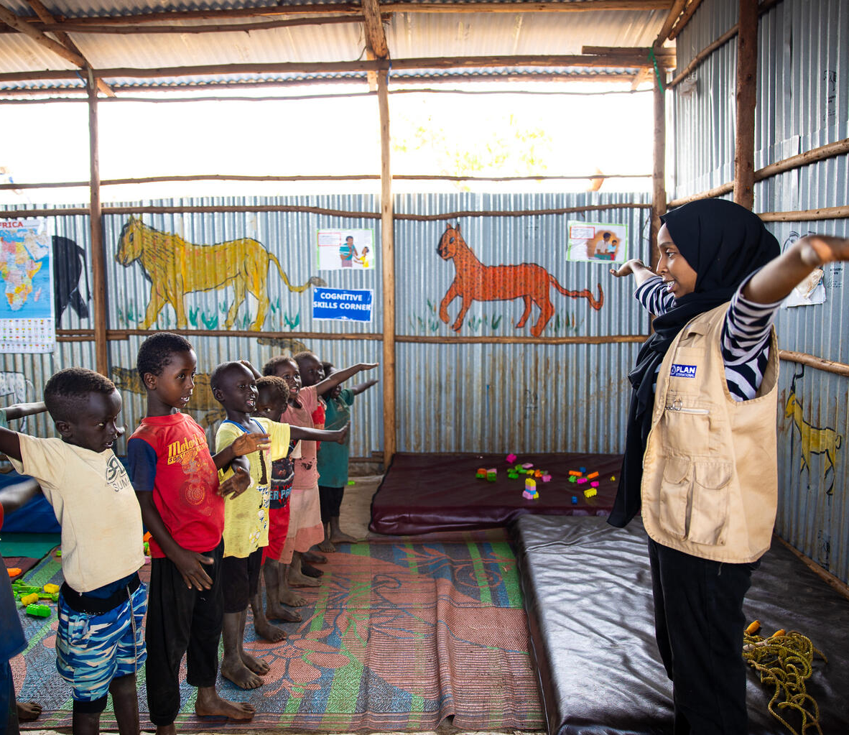
AID IN
ACTION
RUAA
ETHIOPIA
Ruaa helps refugee
children from Sudan
enjoy a safe place
to learn and play
Ruaa is a 22-year-old woman who fled Khartoum and the war in Sudan with her mother and sisters. Forced to stop her studies at university, she became a social worker with Plan International when she arrived at the Ura refugee camp in the Benishangul-Gumuz region of Ethiopia. “I wish to every child to resume their education, to resume their lives, and to live in safety and in peace,” says Ruaa.
© UNICEF/Pouget
Notes:
Photocard 4: Ruaa helps refugee children from Sudan enjoy a safe place to learn and play
Ruaa is 22 years old. She was a student at University, in the capital city of Khartoum, when war broke out in Sudan. For Ruaa, it was too dangerous to stay, so she left her home and moved to the Ura refugee camp, in the neighbouring country of Ethiopia, to be safe.
Now Ruaa works at an area in the camp called a Child-Friendly Space (CFS) – a place where children can come to learn and play together and get the mental health support that they might need.
“When they’re coming here, we try, as social workers, to make a safe environment for the children,” Ruaa said. “We play with them, we chat with them. Playing is very important. They make new relationships with other children. Playing makes their mental health better.”
The Ura refugee camp was started in June 2024 and one year later (June 2025) it is home to nearly 14,000 refugees including more than 300 children. Camps like Ura and the Child-Friendly Spaces in the camps that give special support to children are supported by international aid.
“I wish for every child to resume their education, to resume their lives, and to live in safety and in peace,” Ruaa said.

Slide 21
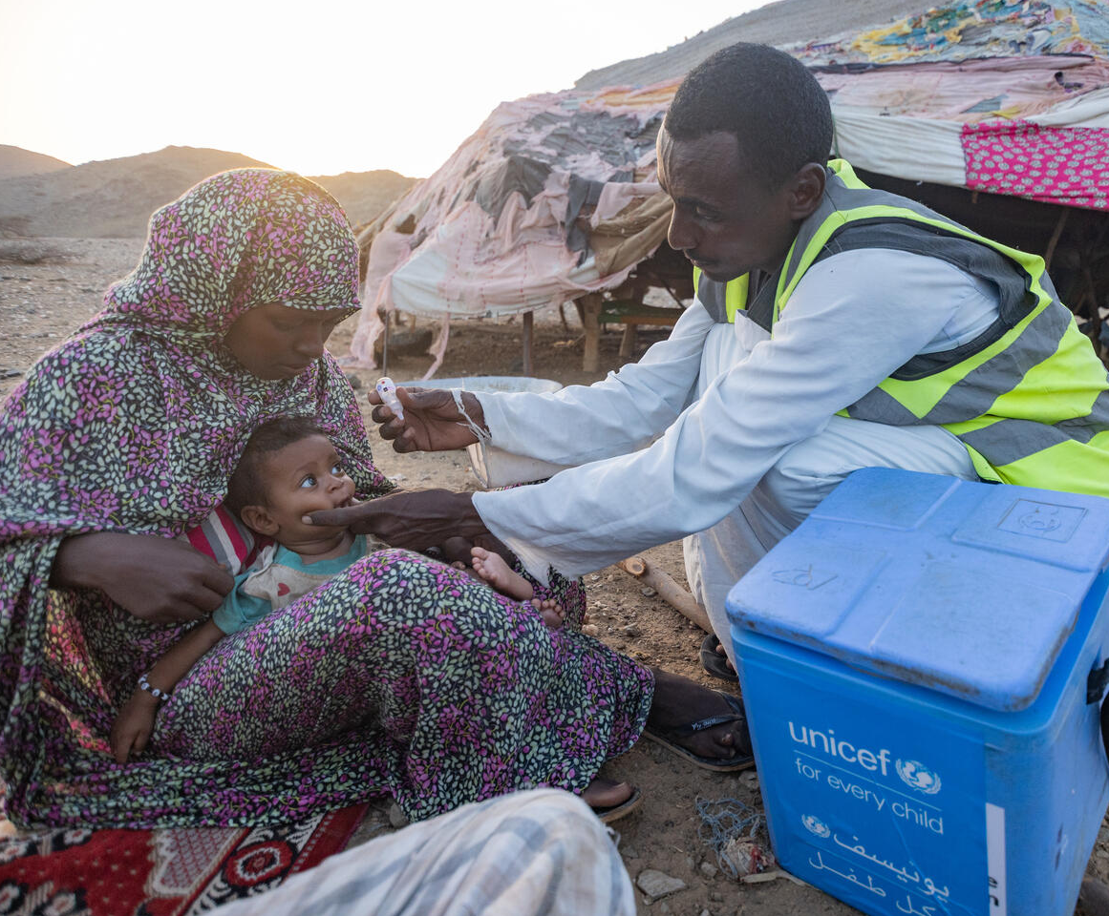
AID IN
ACTION
SHEEBA
SUDAN
Mahmoud gives
Sheeba a polio
vaccine
Sheeba is a vaccination assistant in remote Agig locality located in Red Sea state vaccinates seven-months old Orshia against polio during the house to house polio vaccination campaign.“These are our people and children'' he says .. 'so we make every effort to include them in the health campaigns and routine immunizations.”
© UNICEF/Elfatih
Notes:
Photocard 5: Sheeba geta a polio vaccine
Seven-month-old Sheeba was born in a small village in a very remote area of Sudan. To reach her home from the nearest town takes a 40km car ride and then you have to use camels or donkeys to go the rest of the way because the roads are very rough.
Despite the long journey, one day, a health worker came to her house to give her a special vaccination for the polio virus.
The Ministry of Health in Sudan found polio in her state, so they started a three-day campaign to protect children like Sheeba from this dangerous disease. Because the government didn’t have enough resources themselves for the campaign, they asked for help from the World Health Organization and UNICEF – two organisations who get funding from international aid to solve challenges like this one – and they gave polio shots and vitamin A drops to children under five.
Reaching every child, no matter what, is critical to make sure we meet the SDGs and that no child is left behind. Mahmoud visits the remote villages in the Barqiq valley every month for routine vaccinations and during this campaign, he’s reaching them too.
“These are our people and children, so we make every effort to include them in the health campaigns and routine immunisation,” he says.

Slide 22
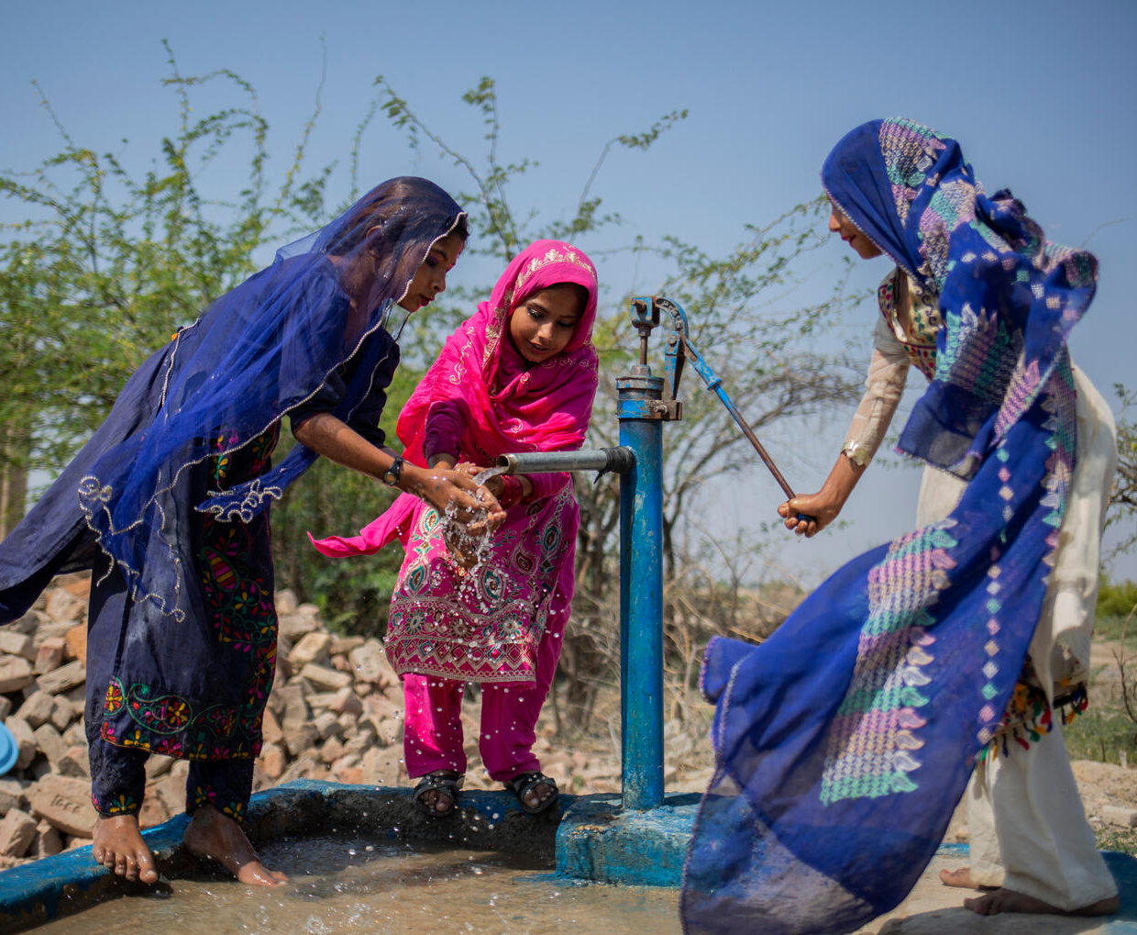
AID IN
ACTION
FARZANA
PAKISTAN
Clean water for
Farzana means
more time for
school
A lack of safe drinking water in the dusty, rural village of Musa Jasser in Umerkot, Sindh Province, meant that 12-year-old Farzana (in the middle) would walk 7 kilometers with her mother to the nearest clean water source, up to three times a day, to collect water for her family.
© UNICEF/Bashir
Notes:
Photocard 6: Clean water for Farzana means more time for school
Farzana (dressed in pink) is 12 and lives in a village in Umerkot, Sindh in Pakistan. For many years, there was no clean water in her village because of water scarcity and then a flood – both climate effects.
Farzana had to walk 7km – as many as 3 times a day – with her mother to collect clean water. Because of the time this took, Farzana couldn’t go to school for four years.
When the flooding happened, the Government of Pakistan led the response, but the effects of the disaster were too much, so they requested the help of international aid and many countries offered support.
With the help of international aid from the Government of Japan, UNICEF was able to help the government of Pakistan, and Farzana’s village specifically, to build a new hand pump. The pump was built on high ground so it stays safe during floods. Now, Farzana and her neighbours can get clean water nearby every day. Farzana is now back in school and learning again.
[ADD AN IMPACT NUMBER HERE ABOUT HOW INTERNATIONAL AID GIVES WASH ACCESS or HOW WASH ACCESS, supported by international aid, means XX more girls have time to access their right to education.]

Slide 23
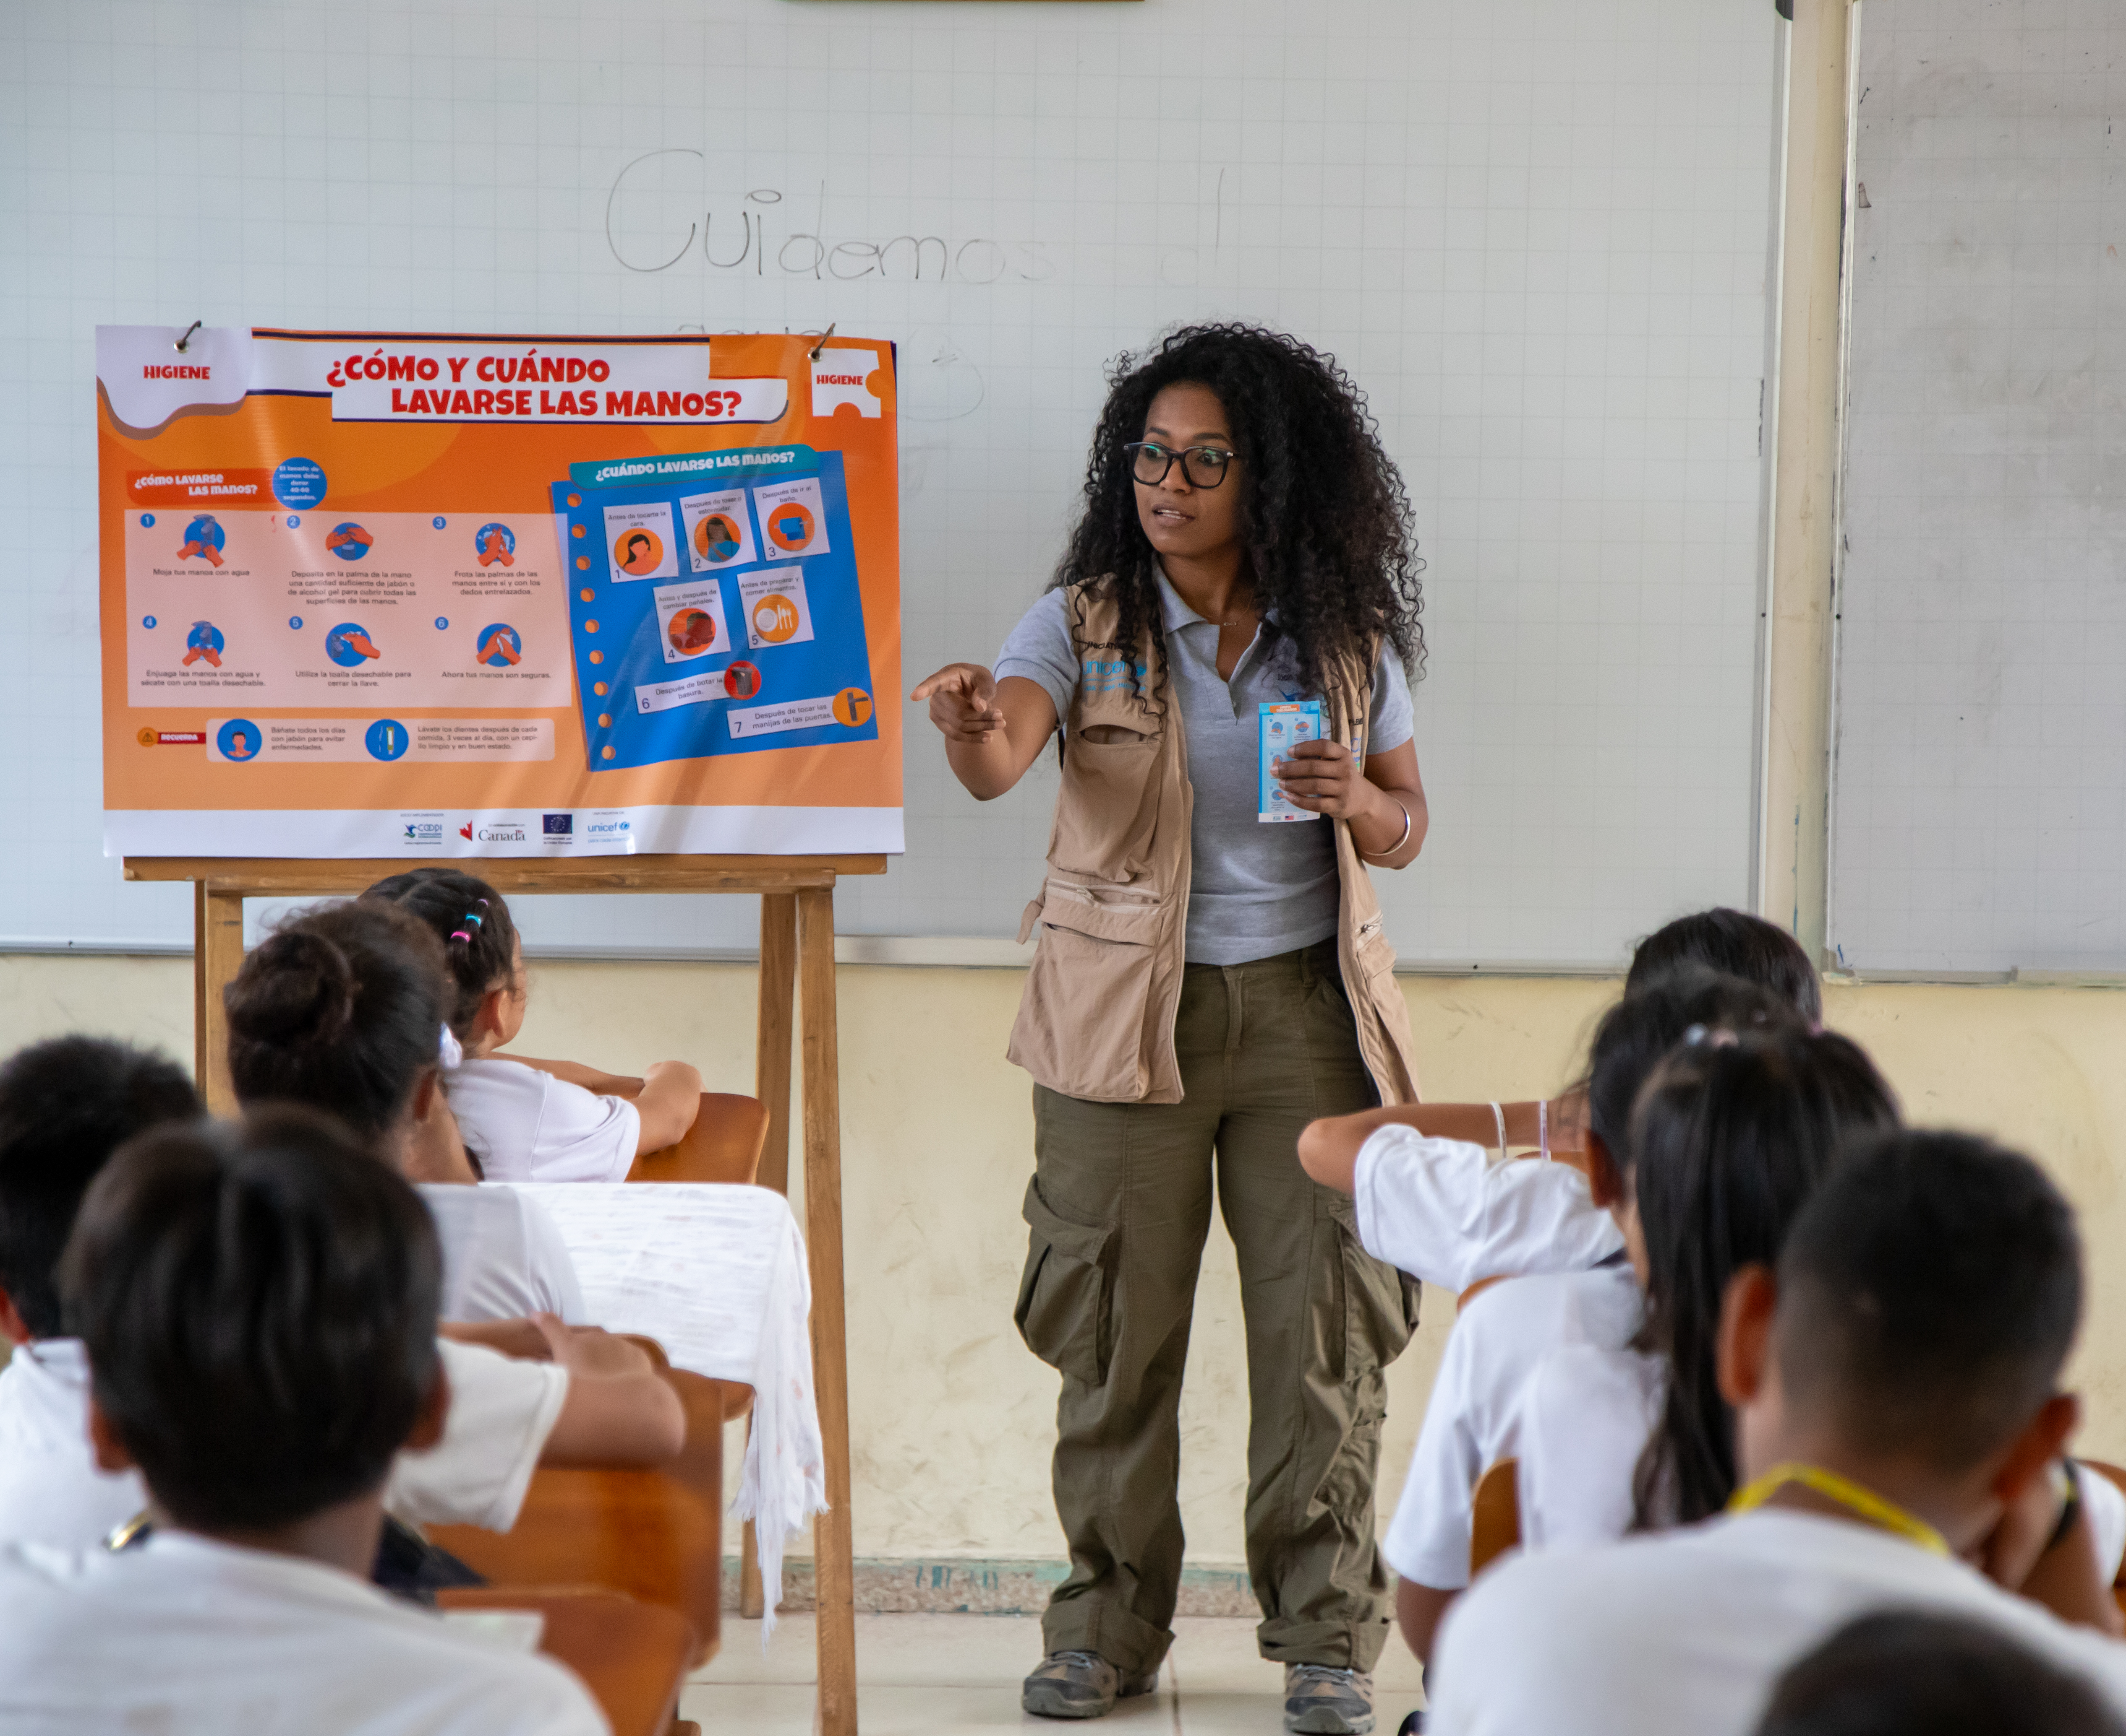
AID IN
ACTION
EQUADOR
Hygiene training supports healthy environments
Viviana Armijos is a COOPI technician at the hygiene and handwashing workshops as part of
UNICEF's Resilient Schools project, where training on hygiene, proper hand washing, and responsible use of water and energy is provided.
© UNICEF/
© UNICEF/Bashir
Notes:
Photocard 7: Hygiene training supports healthy environments
In a school in Ecuador, children are learning how important good hygiene is – like handwashing and keeping their surroundings clean. These lessons are part of a special training organised by the Ministry of Health, with help from the local government and partners, and the support of international aid.
Learning about hygiene is more than just a school activity – it’s about helping children enjoy their right to be as healthy as possible. When children know how to stay clean, it prevents the spread of illness, they can, miss fewer school days, enjoy a healthier life and grow up stronger.
Sharing skills that support public health (keeping communities healthy and preventing illness) is an important part of international aid around the world. Public health information helps stop the spread of diseases, including dangerous viruses like those that can cause pandemics.

Slide 24
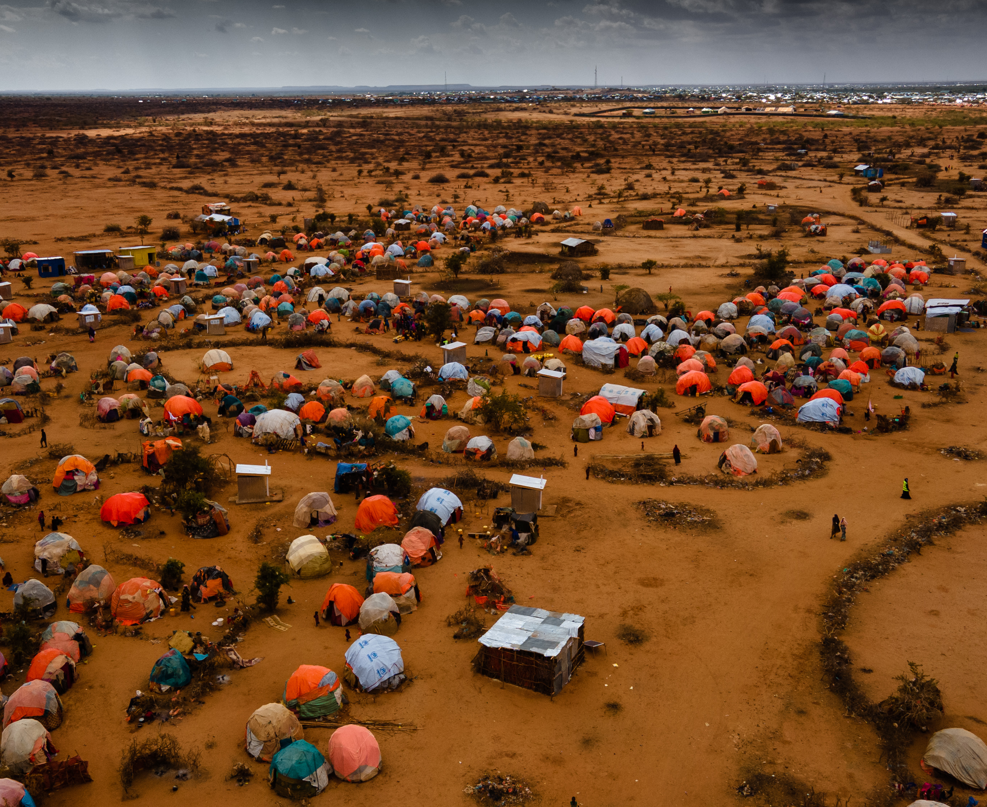
AID IN
ACTION
SOMALIA
A safe place for Fatuma to live and learn amid crisis
When families have to flee their homes to stay safe, they sometimes have to live in camps like this one, the Ladan IDP camp in Dollow, Somalia. Children living in camps can need extra help to protect their rights.
© UNICEF/
© UNICEF/
© UNICEF/Bashir
Notes:
Photocard 8: A safe place to live and learn amid crisis
In Dollow, Somalia, most families who have had to leave their home for safety, now live in informal tent settlements.
Fatuma, who is 11, lives with her parents in a temporary shelter made up of orange plastic sheets and fabric lashed with cord and stripped branches. It’s one of the thousands scattered over dry land.
There are many reasons why families have to leave their homes for safety and find shelter in a camp. Sometimes it is because of conflict, sometimes a climate disaster...
In camps like these, international aid supports the government and the people in many roles. Sometimes they provide urgent supplies like food, water or shelter, and often, like in this camp in Somalia, international aid helps organisations like UNICEF support the children’s rights by constructing Temporary Learning Spaces (TLS), providing school materials for learning and money to support teachers. In this camp in Somalia, the governments of Germany, Finland and the United States are helping support the programs.

Slide 25
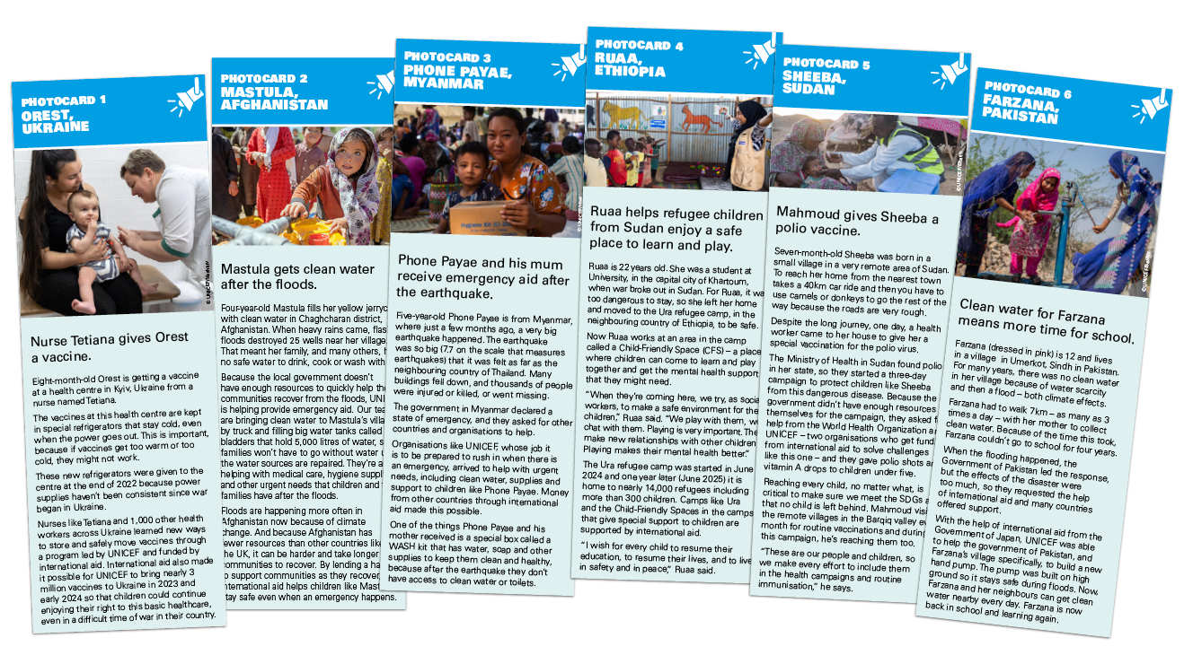
  PART 5
INTERNATIONAL
AID PHOTO
CARDS

Slide 26
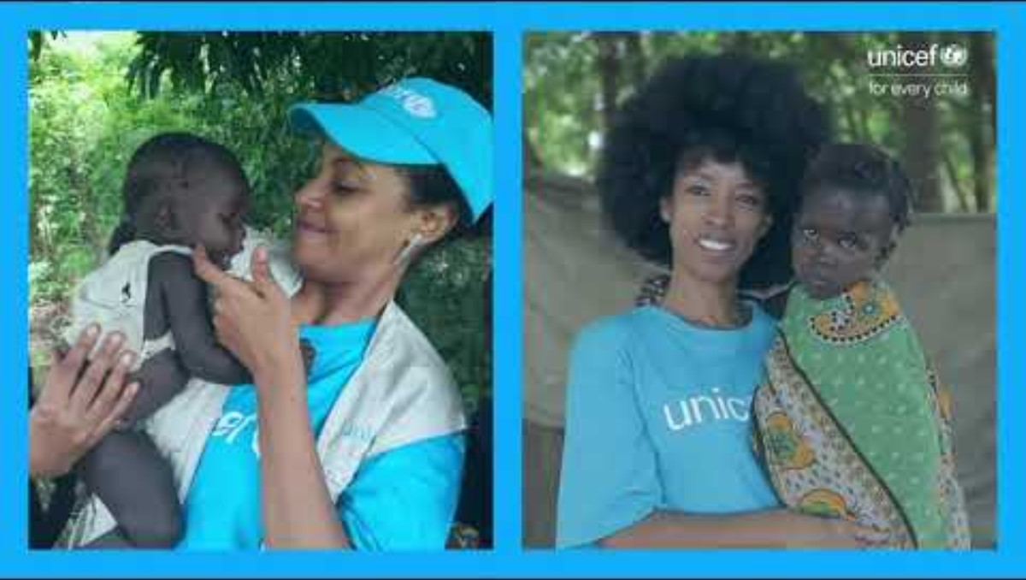
  PART 6
INTERVIEW
WITH AN
AID WORKER

Slide 27

  PART 7
WRAP IT
AND
MAP IT

