Slide 1

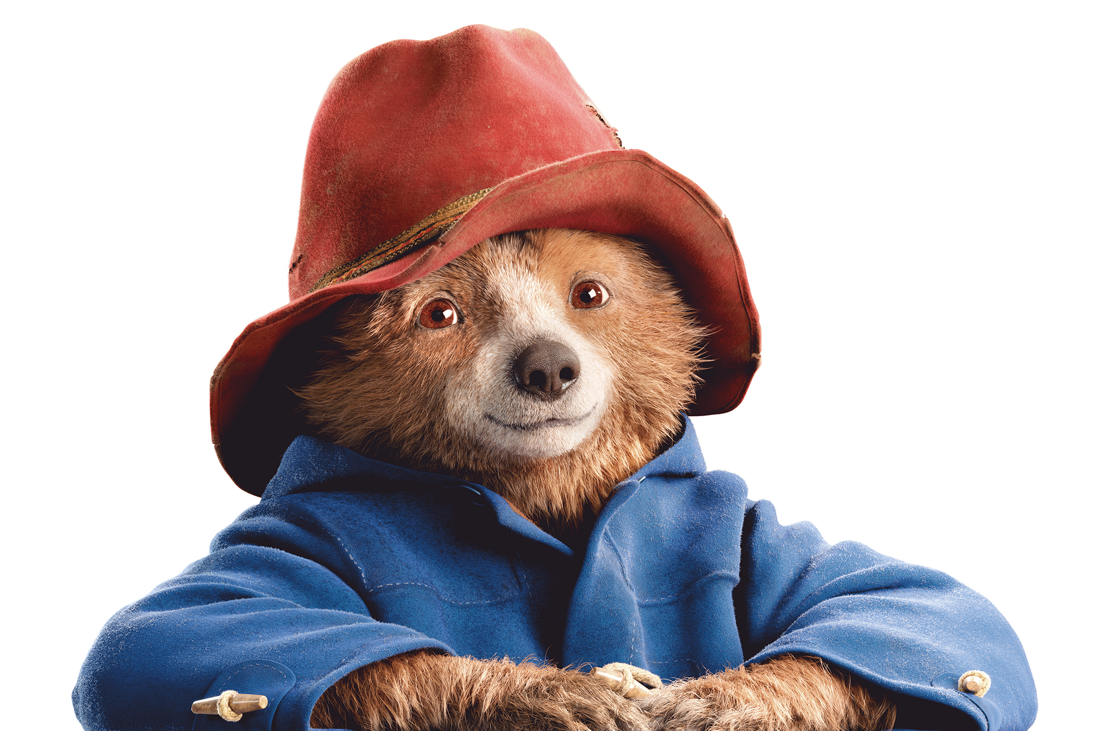

  ACTIVITY 3
  INTERNATIONAL AID
  AND CHILDREN'S
  RIGHT TO
  EDUCATION
© UNICEF/Al-Safadi
© P&Co. Ltd./SC 2025

Slide 2
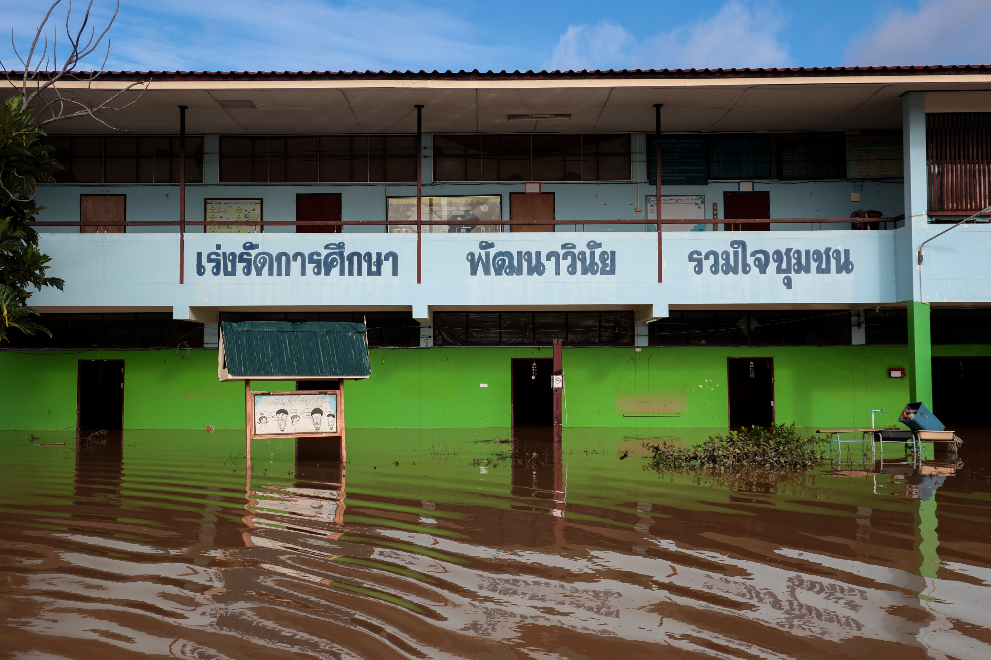
  PART 1
REVIEWING YOUR
RIGHTS
© UNICEF/Janthong
Pracha Uthit School and the Early Childhood Development Center, located in the same area in Sri Samrong District, Sukhothai Province, are among more than 249 schools affected by flooding during August-September 2024.

Slide 3
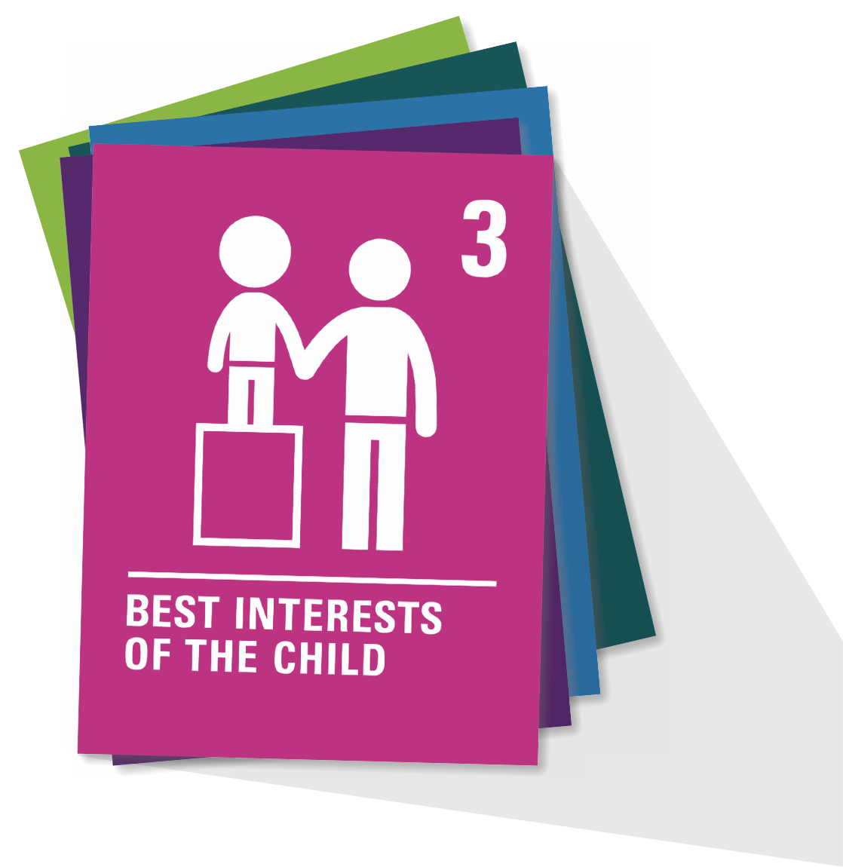

  ARTICLE 28
Access to education
Every child has the right to an education. Primary education should be free. Secondary and higher education should be available to every child. Children should be encouraged to go to school to the highest level possible. Discipline in schools should respect children’s rights and never use violence.

Slide 4
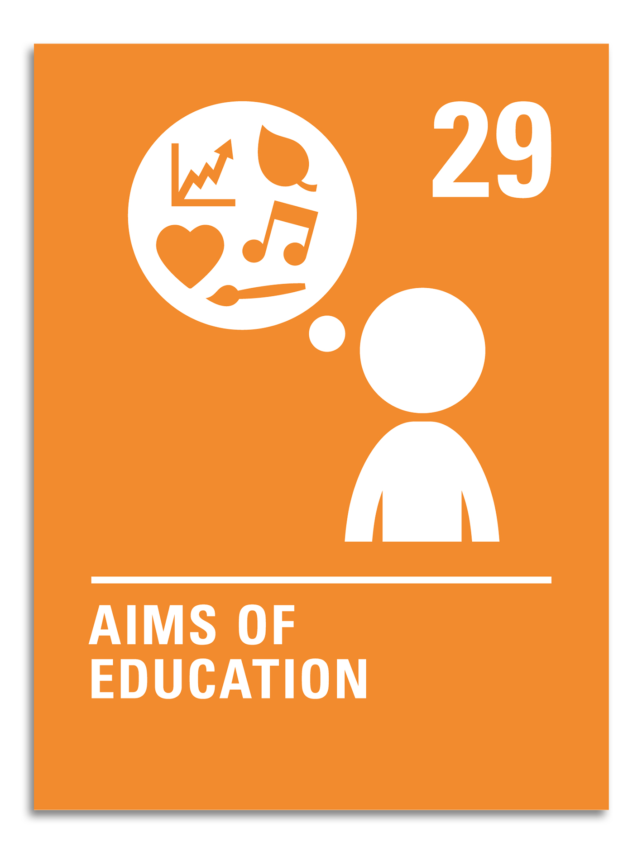
  ARTICLE 29
Aims of education
Children’s education should help them fully develop their personalities, talents and abilities. It should teach them to understand their own rights, and to respect other people’s rights, cultures and differences. It should help them to live peacefully and protect the environment.

Slide 5
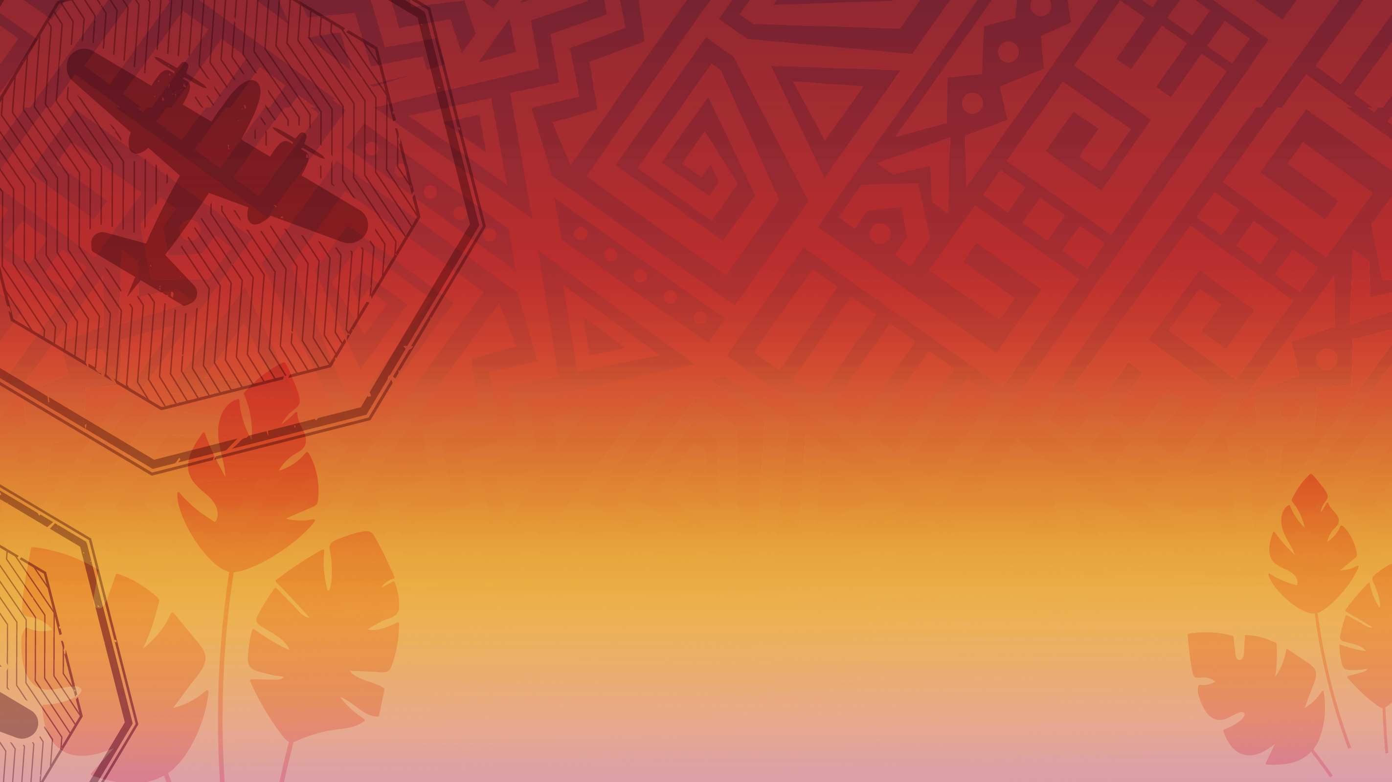

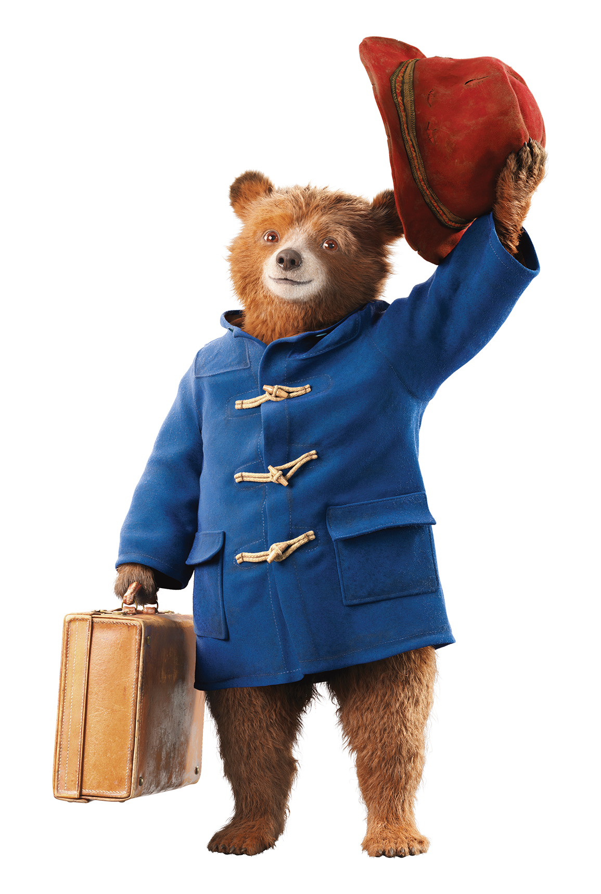


A RIGHT TO
EDUCATION...
OUR EXPEDITION
© P&Co. Ltd./SC 2025

Slide 6
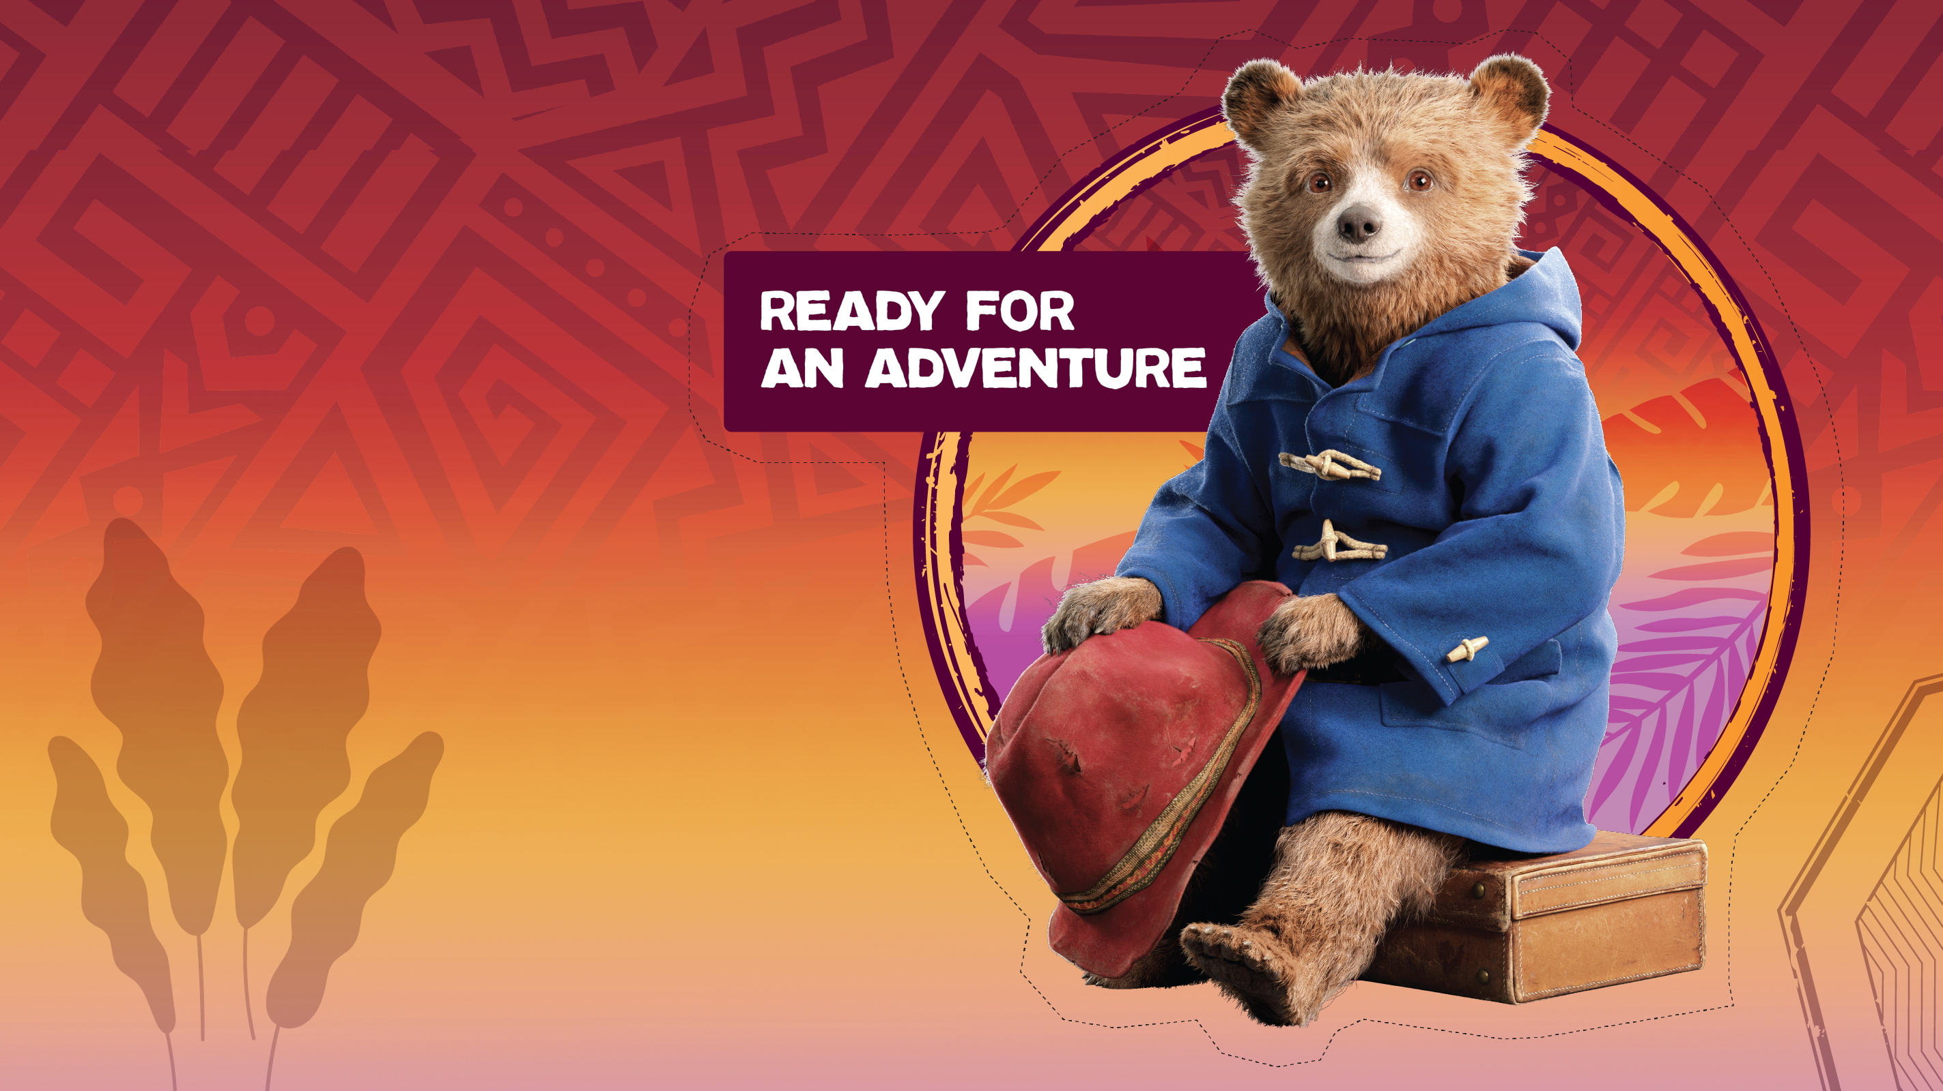
  PART 2
PACKING
FOR THE
TREK
© P&Co. Ltd./SC 2025
Notes:
Ears to listen – As global citizens, the most important thing we can do before we try to support anyone is to pay attention to what people say! The phrase ‘nothing about us, without us’ reminds us that the voices of children, their communities and teachers are the most important to hear, to understand if/how they would like to be helped.
Listen to hear: what are people saying about the challenges they have? What kind of help are they asking for?
On our education expedition, we can listen to hear: What do teachers, parents and communities say are the best ways to keep children learning? What do children think would help them better enjoy their right to education?
Eyes to observe – People in different places around the world all do things differently. As global citizens, we must pay attention to to learn about local customs and notice what others need. In each place, we can watch to see what things are different from, or similar to, how we do things at home.
On our education expedition, we can use our eyes to observe: How does education work in this culture / what does it look like for children to go to school here? (hint: enjoying the right to education doesn’t look the same everywhere!)
Curious mind – When we have a curious mind, we ask questions that will help us better understand challenges and problems. Global citizens like to ask the question “why?” Curious minds uncover creative solutions and innovation.
On our education expedition, we can use our curious minds to ask: Why aren’t children in school or learning here? (Why aren’t children accessing their right to education?) Why are some solutions to help children learn better than others?

Slide 7
A curious
mind
Ears to
observe​
Ears to listen​
Notes:
Ears to listen – As global citizens, the most important thing we can do before we try to support anyone is to pay attention to what people say! The phrase ‘nothing about us, without us’ reminds us that the voices of children, their communities and teachers are the most important to hear, to understand if/how they would like to be helped.
Listen to hear: what are people saying about the challenges they have? What kind of help are they asking for?
On our education expedition, we can listen to hear: What do teachers, parents and communities say are the best ways to keep children learning? What do children think would help them better enjoy their right to education?
Eyes to observe – People in different places around the world all do things differently. As global citizens, we must pay attention to to learn about local customs and notice what others need. In each place, we can watch to see what things are different from, or similar to, how we do things at home.
On our education expedition, we can use our eyes to observe: How does education work in this culture / what does it look like for children to go to school here? (hint: enjoying the right to education doesn’t look the same everywhere!)
Curious mind – When we have a curious mind, we ask questions that will help us better understand challenges and problems. Global citizens like to ask the question “why?” Curious minds uncover creative solutions and innovation.
On our education expedition, we can use our curious minds to ask: Why aren’t children in school or learning here? (Why aren’t children accessing their right to education?) Why are some solutions to help children learn better than others?

Slide 8

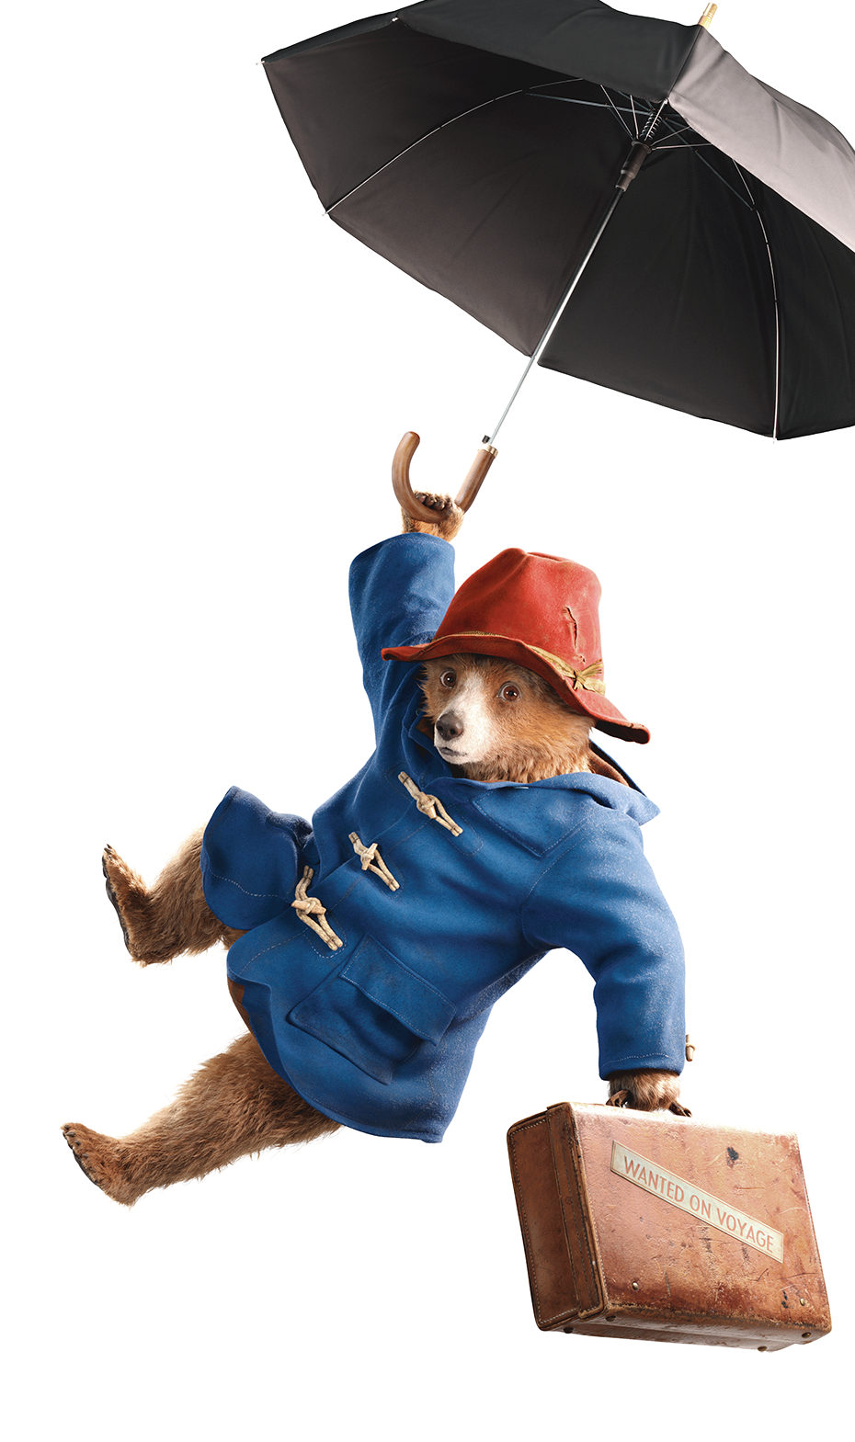



  PART 3
EXPEDITION
EDUCATION
© P&Co. Ltd./SC 2025

Slide 9
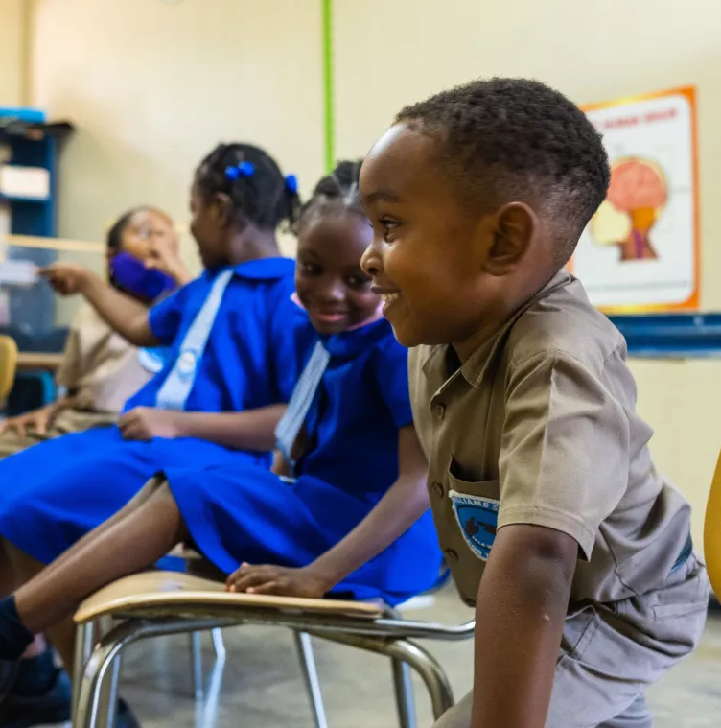
ARI, 6
JAMAICA
Ari is breaking down barriers to his learning and communication. He was diagnosed with Auditory Neuropathy as a baby, a disorder that hinders sound transmitting from the inner ear to the brain. But this does not hold back Ari from finding new ways to express himself. In fact, he has already taught himself Jamaican Sign Language (JSL) using YouTube.
© UNICEF/Johnson
Notes:
Ari is six and goes to the Danny Williams School for the Deaf in Kingston, Jamaica. He has a condition called Auditory Neuropathy, which makes it hard for sounds to travel from his ears to his brain. But that doesn’t stop Ari from learning and having fun.
At school, Ari uses a special app called BookFusion. It has a book called My Brain is My Boss, with sign language videos, pictures, and audio. Ari reads the book, watches the sign language, and mouths the words. Then he teaches what he learns to his grandma at home.
Ari even taught himself Jamaican Sign Language by watching YouTube! His mum says, “I don’t think Ari knows he has a disability. He’s just happy being Ari.” He loves to help his friends at school and sometimes corrects mistakes on the chalkboard. Ari’s best friend is Ma’Kayla, and they like to take turns playing teacher.
With the support of international aid, The Ministry of Education from the Government of Jamaica was able to work with UNICEF to create digital books like this to help children with disabilities learn in fun ways.
Ari shows that with the right tools and support, every country can support all children to enjoy their right to education — to learn and to help others learn too.
Resource for facilitators with video story: https://www.unicef.org/jamaica/blog/how-new-tech-turns-child-disability-his-own-teacher

Slide 10
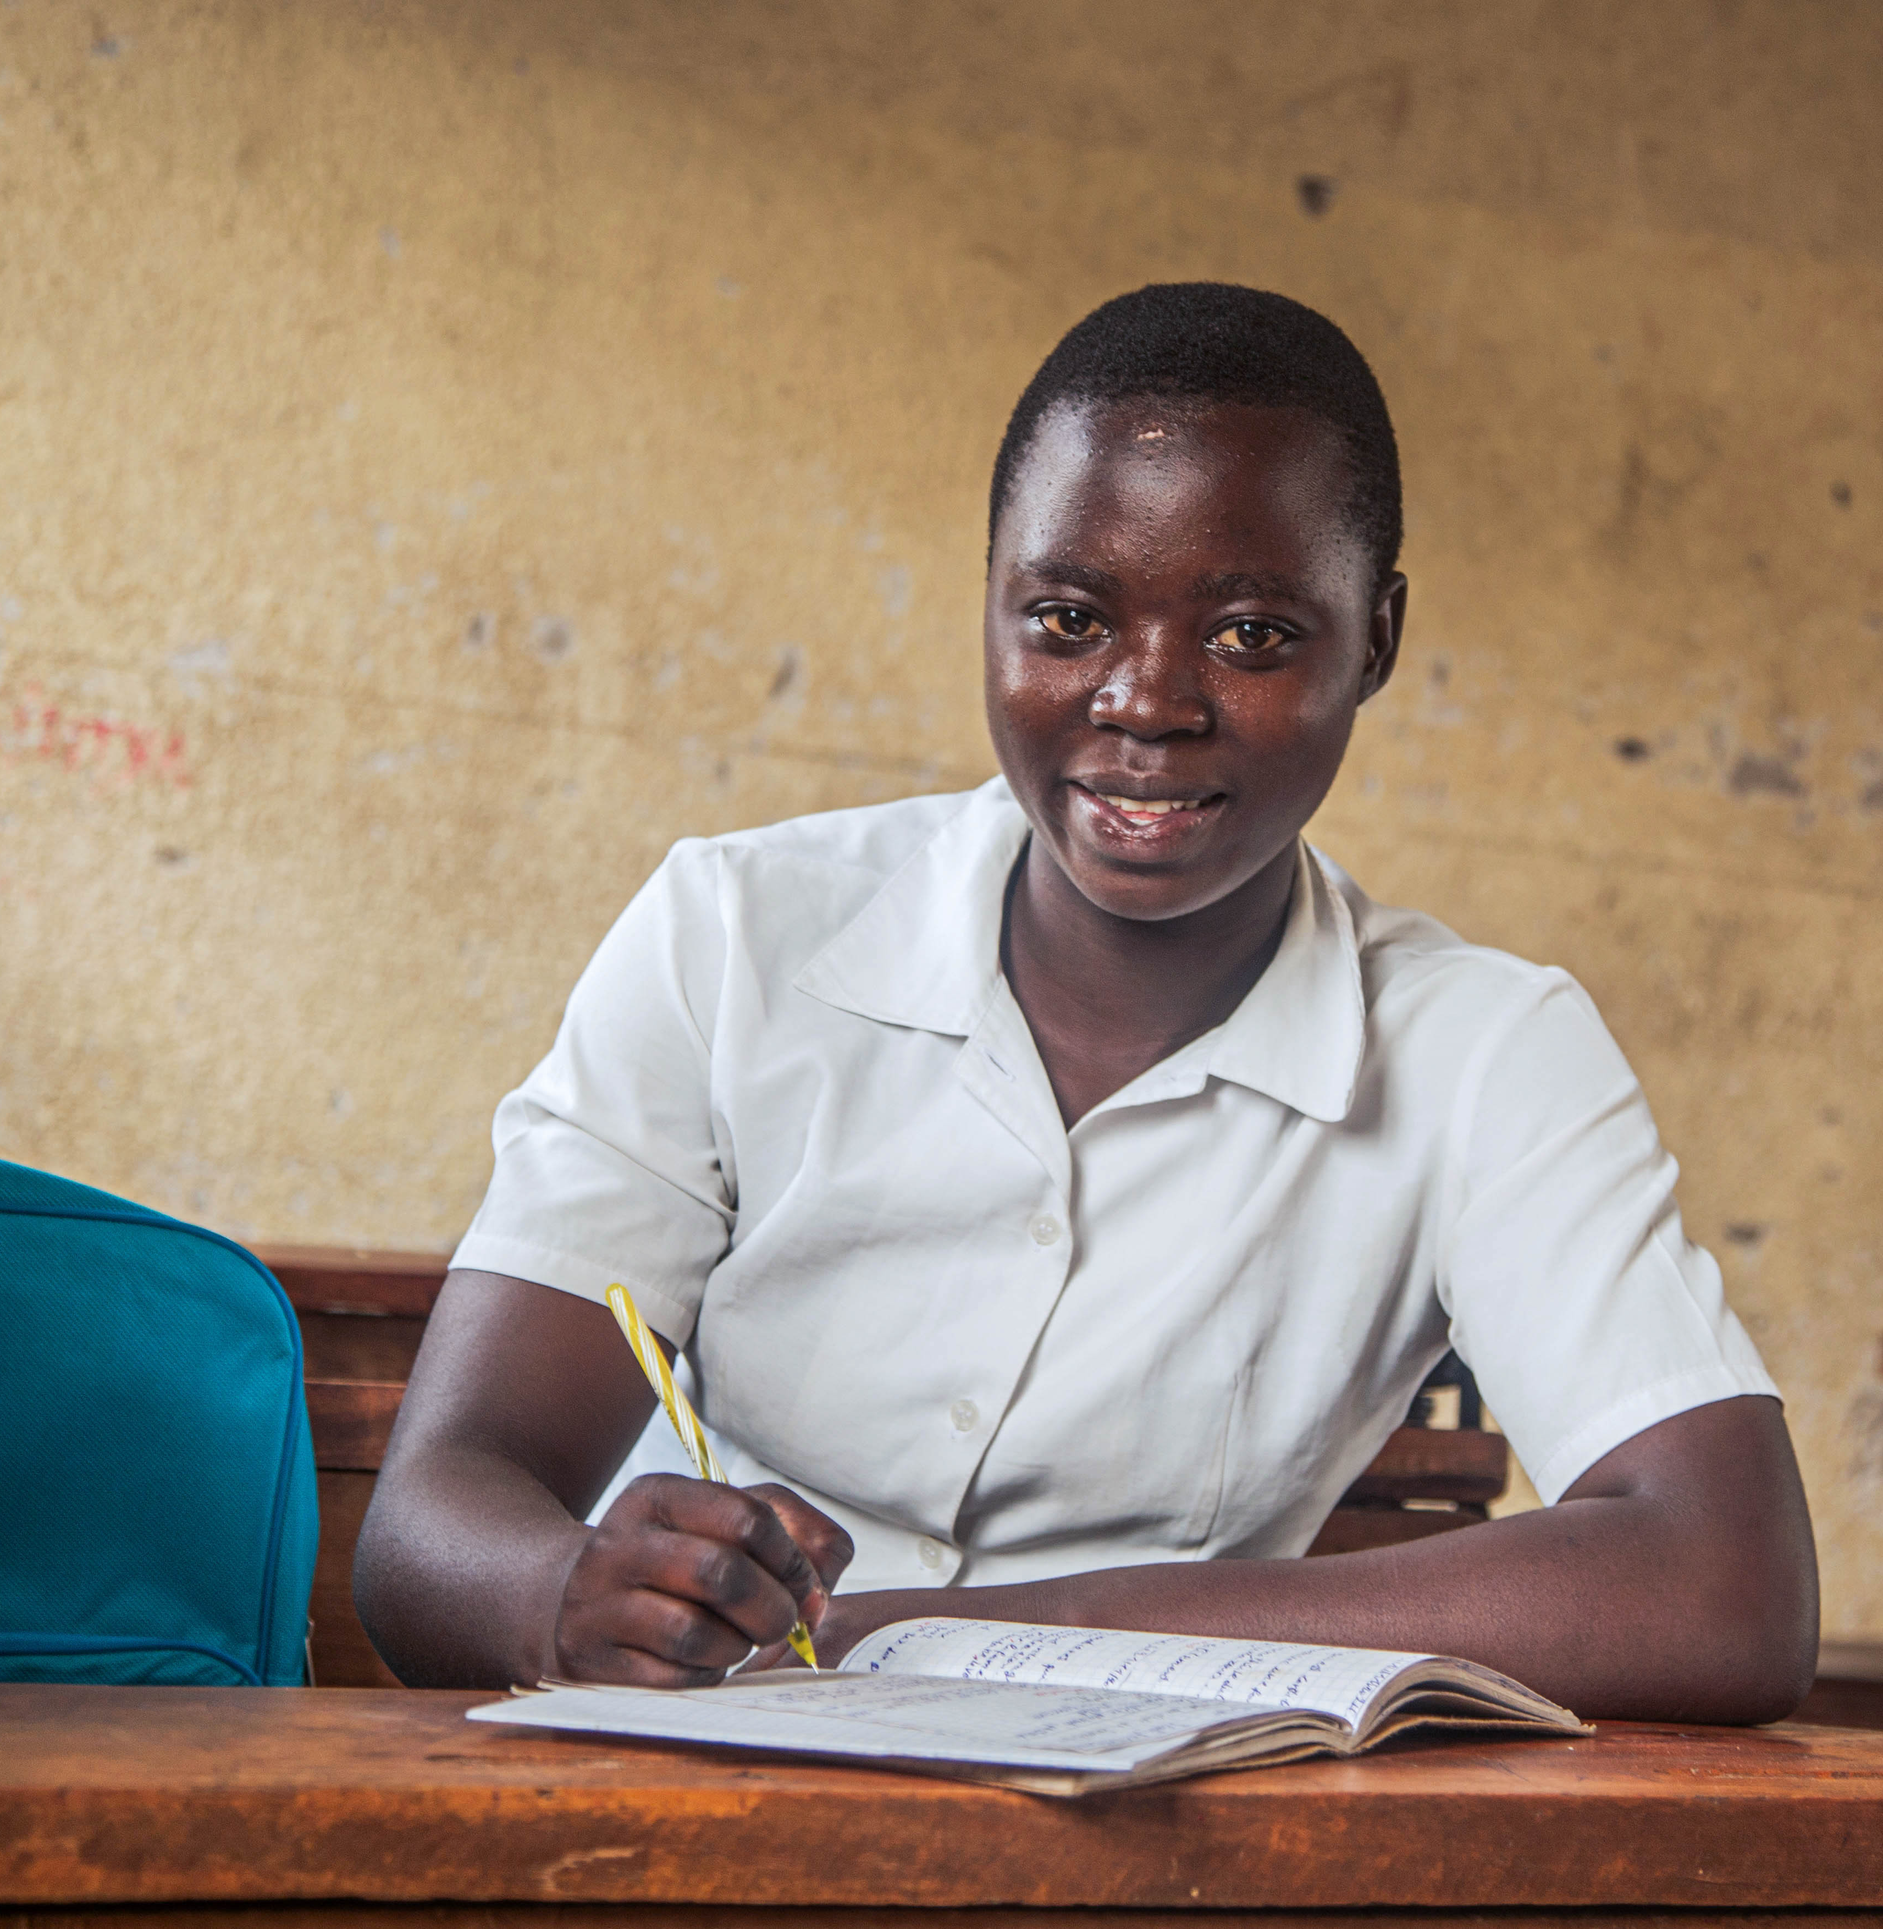
JUSTINE, 13
DEMOCRATIC REPUBLIC
OF THE CONGO
Sitting on a bench at Muningi Primary School in Goma, Justine can't help but smile. She has just received a school bag, pens and notebooks, after losing her school supplies when the Kanyaruchinya site for displaced people was dismantled at the start of February 2025.
© UNICEF/Ushindi
Notes:
Justine is 13 and lives in the Democratic Republic of the Congo (DRC), a country that has faced years of conflict. Her hometown, Rugari, is in a region where armed groups have been fighting.
Since 2021, when she was nine, Justine and her family have moved several times for their safety. They’ve lived in churches, tents and camps for displaced people.
In early 2025, the camp where they were staying was shut down because of fighting in the area, and they were displaced again. Justine’s mother and brothers returned to Rugari to work in the fields, but Justine made a brave decision to stay in the city of Goma to finish her school year at Muningi Primary School, which she has attended since 2023.
For children like Justine who have grown up in conflict, going to school is especially important – not only to learn, but so they have a routine that helps them feel normal, safe and hopeful.
Although education is Justine’s right, she feels lucky to be one of the children still in school. More than 1,930 schools remain closed in the regions where she is staying (North Kivu and South Kivu) because of the fighting and displacement.
More than 732,000 children are missing out on their right to learn. Some schools have been destroyed by the fighting, while other school buildings have been turned into shelters for displaced families.
In DRC, there are many ways that international aid is supporting the government to help children access their rights. For example, UNICEF is working with the government to make sure children have the chance to learn by distributing education supplies to students and teachers, by building classrooms in zones where many classrooms are too damaged, and by organising catch-up classes for children who have missed schooling.
At Justine’s school, and other schools in North Kivu and South Kivu, UNICEF has distributed education kits to more than 43,000 pupils and teachers with the support of international aid from the European Union and its partner organisation Education Cannot Wait.

Slide 11

  PART 4
WRAP IT
AND
MAP IT

