Slide 1
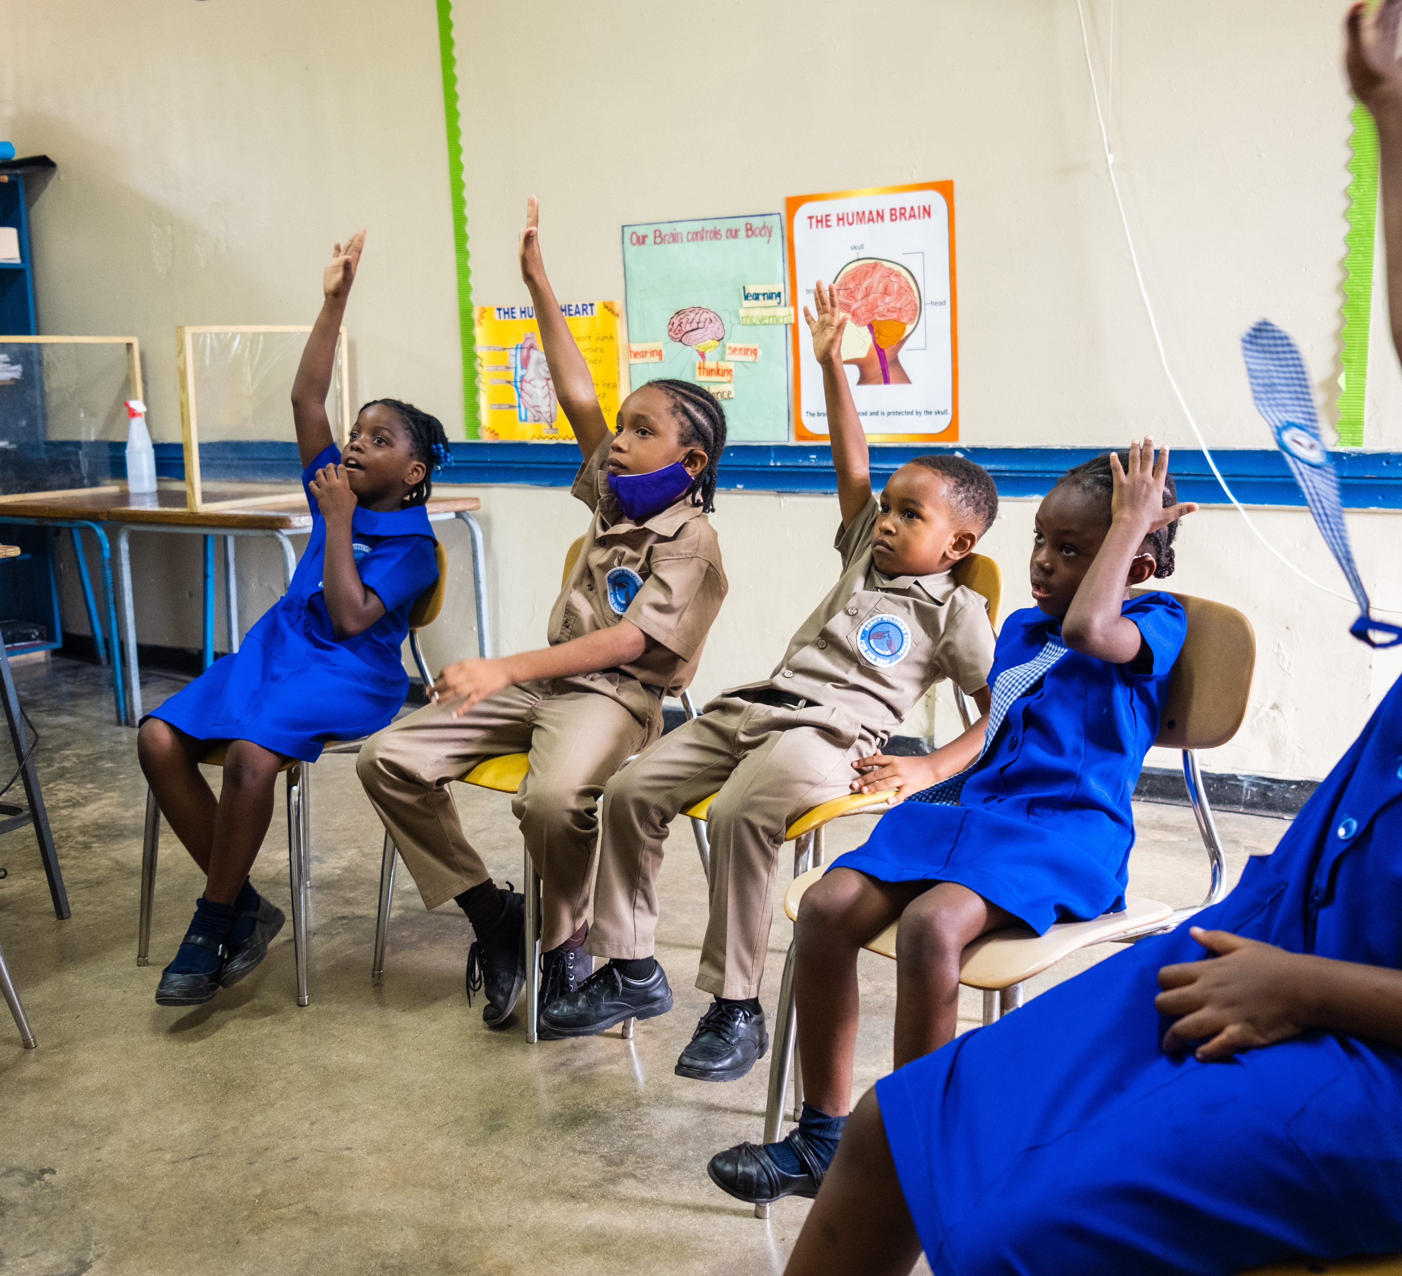


  ACTIVITY 4
  CLIMATE
  CHANGE
  AND RIGHTS
© UNICEF/Al-Safadi
After a full day of school, as soon as six-year-old Ari gets home he wants to share what he has learned with his grandmother. He searches for “My Brain is My Boss” on his tablet and pulls up UNICEF’s Accessible Digital Textbook (ADT) on the BookFusion app.
© UNICEF/Johnson

Slide 2
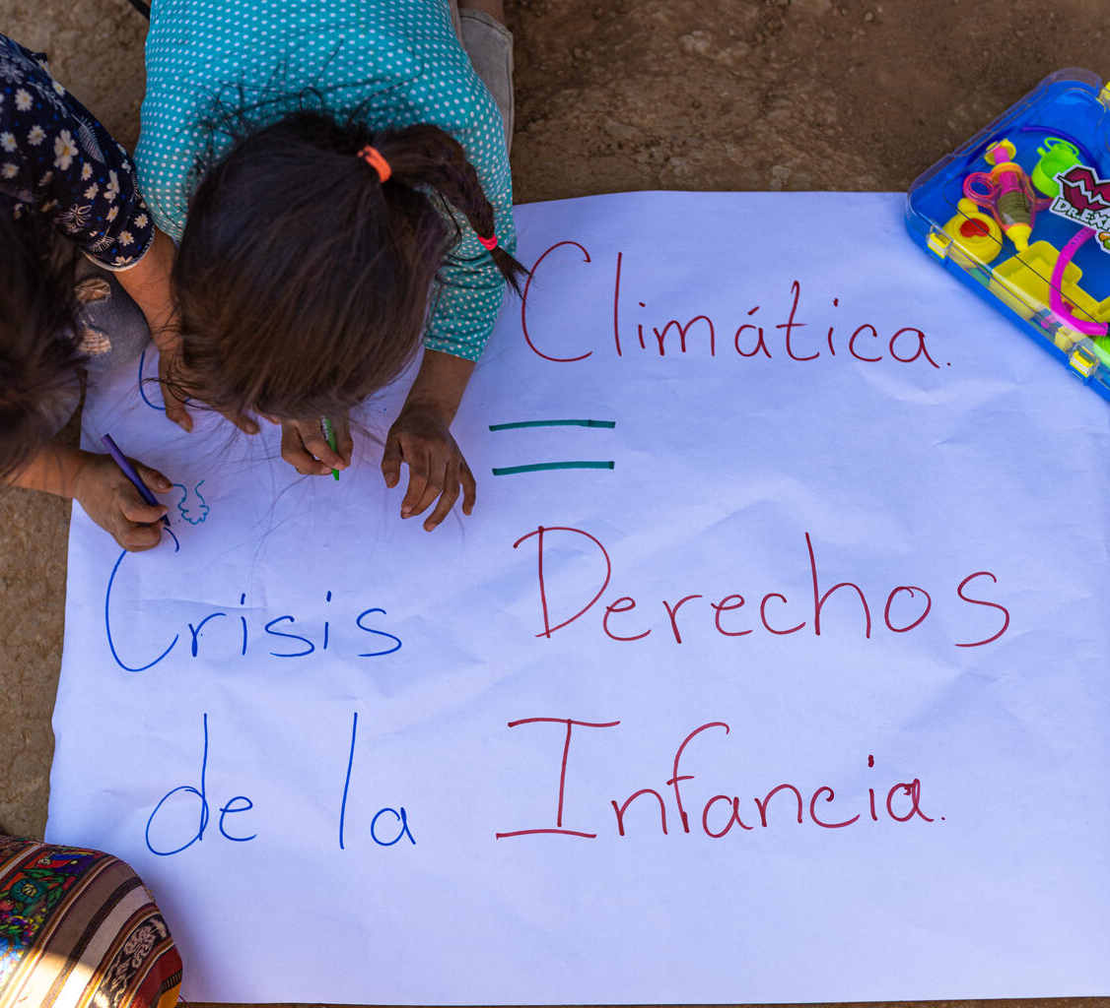
  PART 1
REVIEWING YOUR
RIGHTS
On 1 March 2024, a family prepares a banner to protest outside their house in the village of Patzité, Quiché, Guatemala. The climate crisis is a child rights crisis. It directly threatens a child’s ability to survive, grow, and thrive.
© UNICEF/Willocq

Slide 3
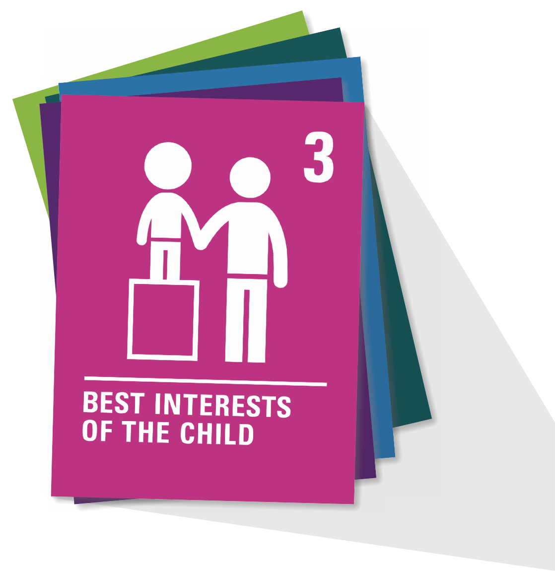
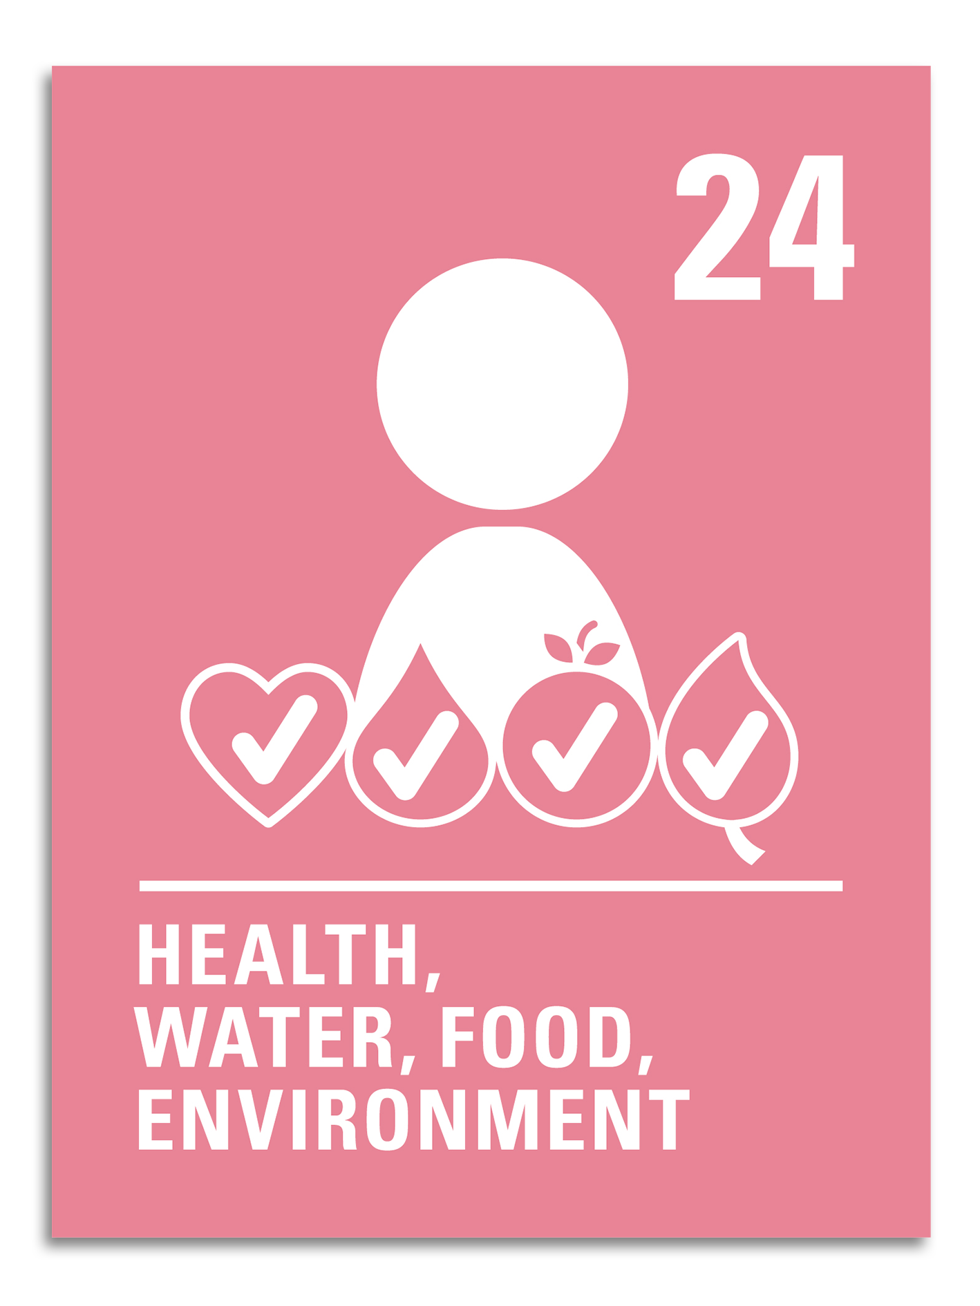
  ARTICLE 24
Health, water, food, environment
Children have the right to the best healthcare possible, clean water to drink, healthy food and a clean and safe environment to live in. All adults and children should have information about how to stay safe and healthy.

Slide 4
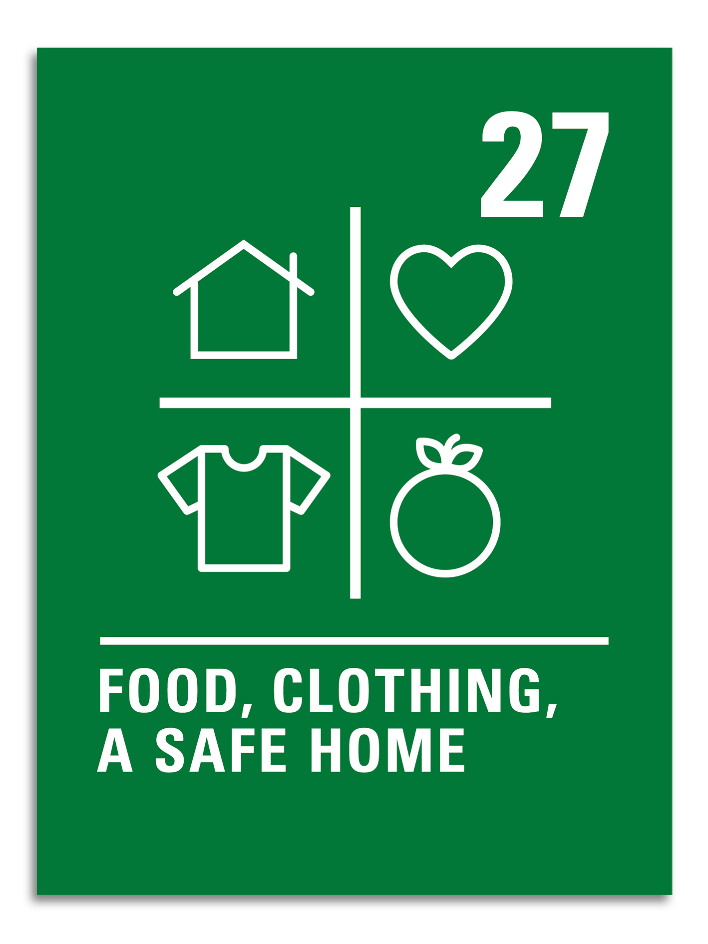
  ARTICLE 27
Food, clothing, a safe home
Children have the right to food, clothing and a safe place to live so they can develop in the best possible way. The government should help families and children who cannot afford this.

Slide 5
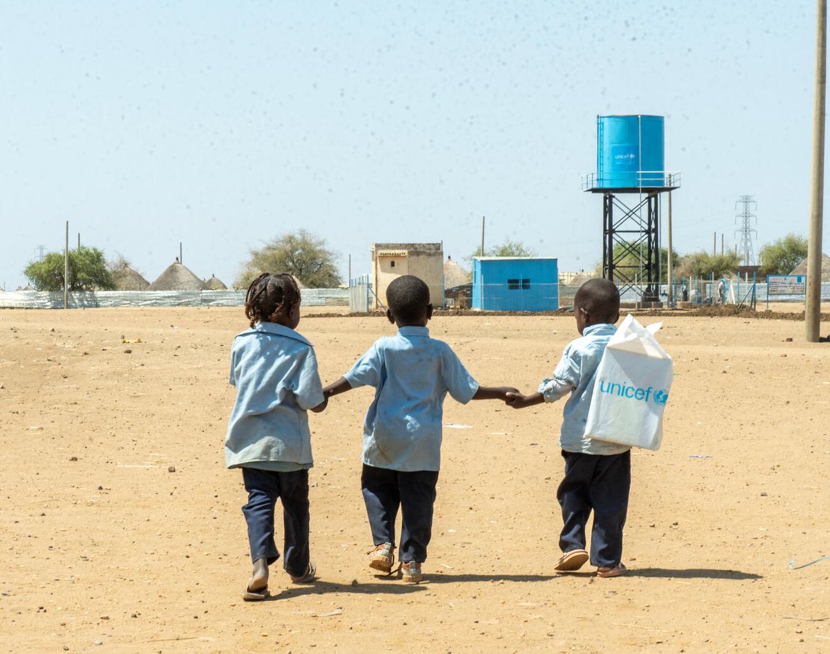
  PART 2
NEIGHBOURHOOD
EXPLORATION
In Sudan, children walk back home from a UNICEF-supported child friendly space in Al Houri internally displaced people’s (IDP) camp in Gedaref State.
© UNICEF/Abdulmajid

Slide 6

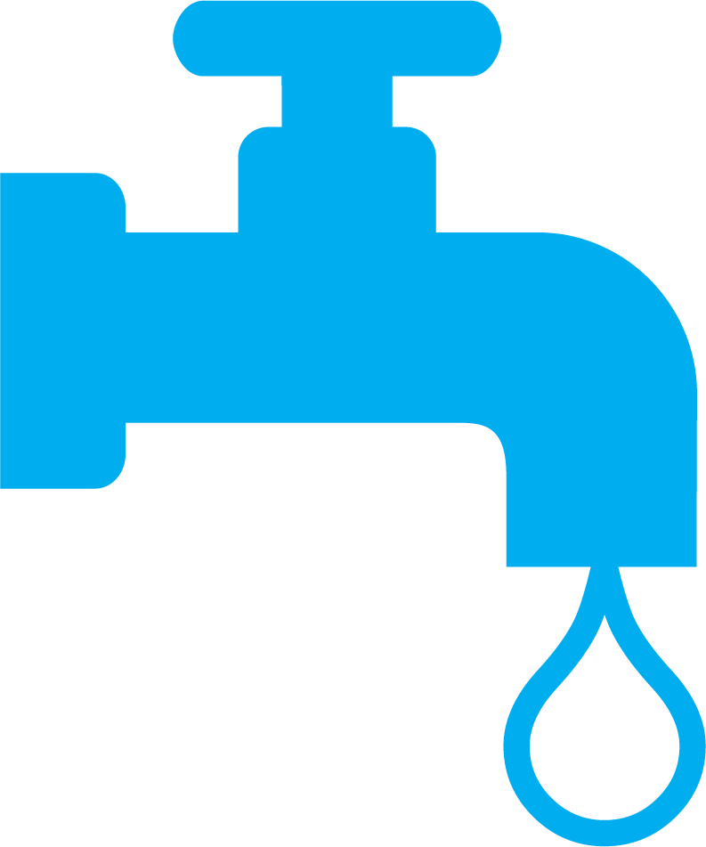


  PART 3
RIGHTS
AND THE
ENVIRONMENT...
OUR
EXPEDITION

Slide 7
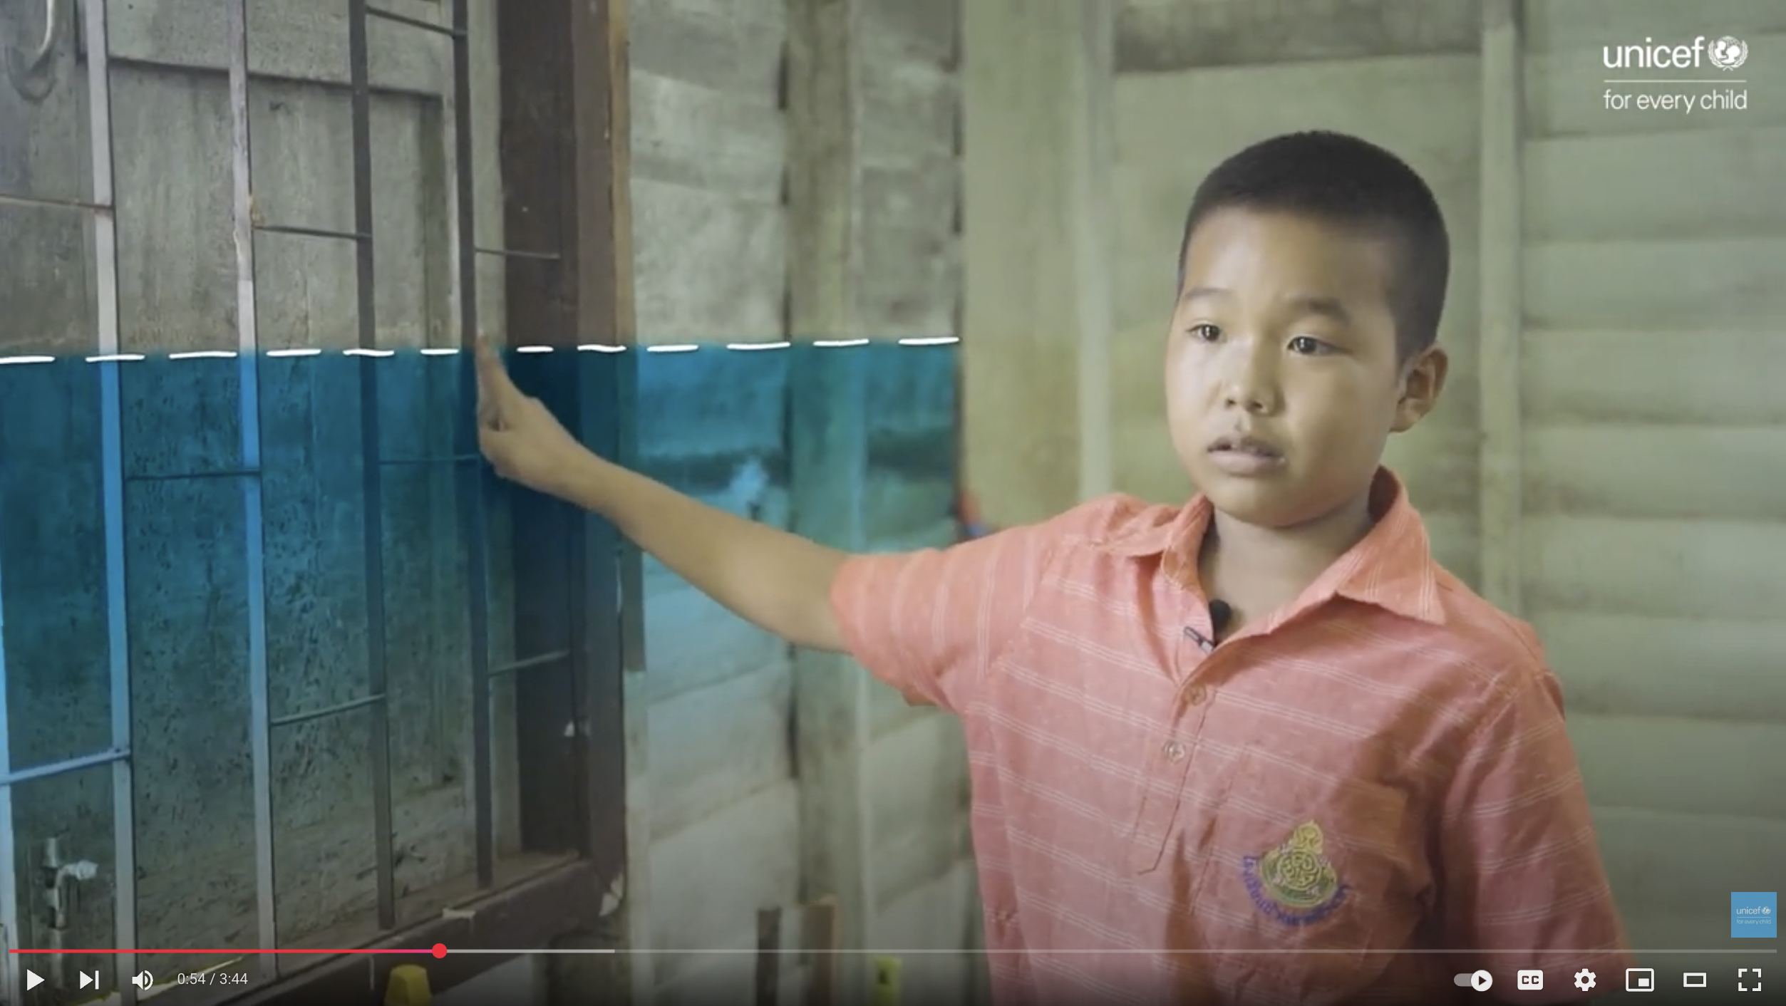
ANUWAT,
THAILAND
"When I see heavy flooding,
I feel really worried. I miss school so much and fear not being able to study. I just wonder if our books will get ruined, and if we'll even have desks and chairs to sit on."
Notes:
Climate Story 1
Ubon Ratchathani is a province in Thailand that’s prone to frequent flooding, especially during the rainy season from July to August.
These floods often force people, including children, to move to higher floors in their homes, away from the water's reach. When flooding comes, families can’t use electricity because it’s dangerous, and sometimes furniture, appliances and even homes are swept away by the water.
In very bad flooding, some children go to live in temples or stay in tents by the roadside for more than 30 days until the floodwaters go down.
This is difficult, and can be scary for children. The floods stop them enjoying their rights to school and a safe and healthy environment.
Next year, floods may come again. Disaster preparedness is when we take action in advance – making plans for what to do if a climate emergency like a flood happens, and being as ready as possible if it does.
Can you think of any ways that Anuwat’s community might help children prepare for the annual flooding? How might international aid support the government in Thailand to help communities be prepared, so that children and their families can access their rights?

Slide 8
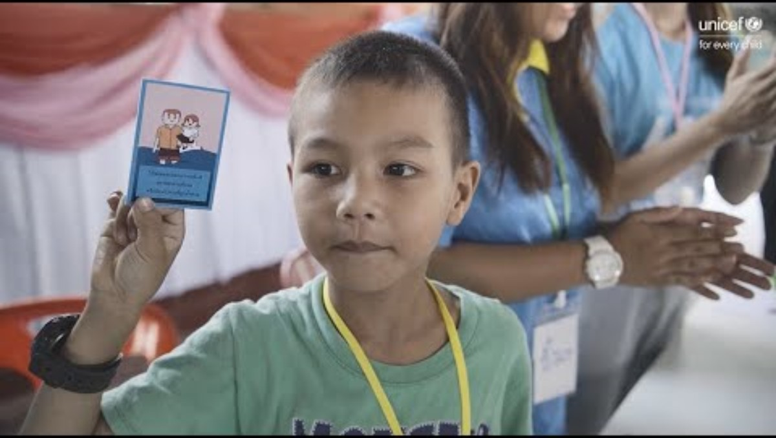
FLOOD
RESPONSE
Children play a card game with UNICEF staff and volunteers, which helps them prepare for floods and learn what to do when they happen.
Notes:
What did you notice people saying? What did you notice people doing?
What did you learn about the obstacles children face, or the help they need to enjoy their rights? [Map it]
How could international aid be used to support the children in the story to enjoy their right to a healthy environment or safe place to live? Who else might be found in their circle of support?
How do you think this story might be different if international aid wasn’t possible?

Slide 9
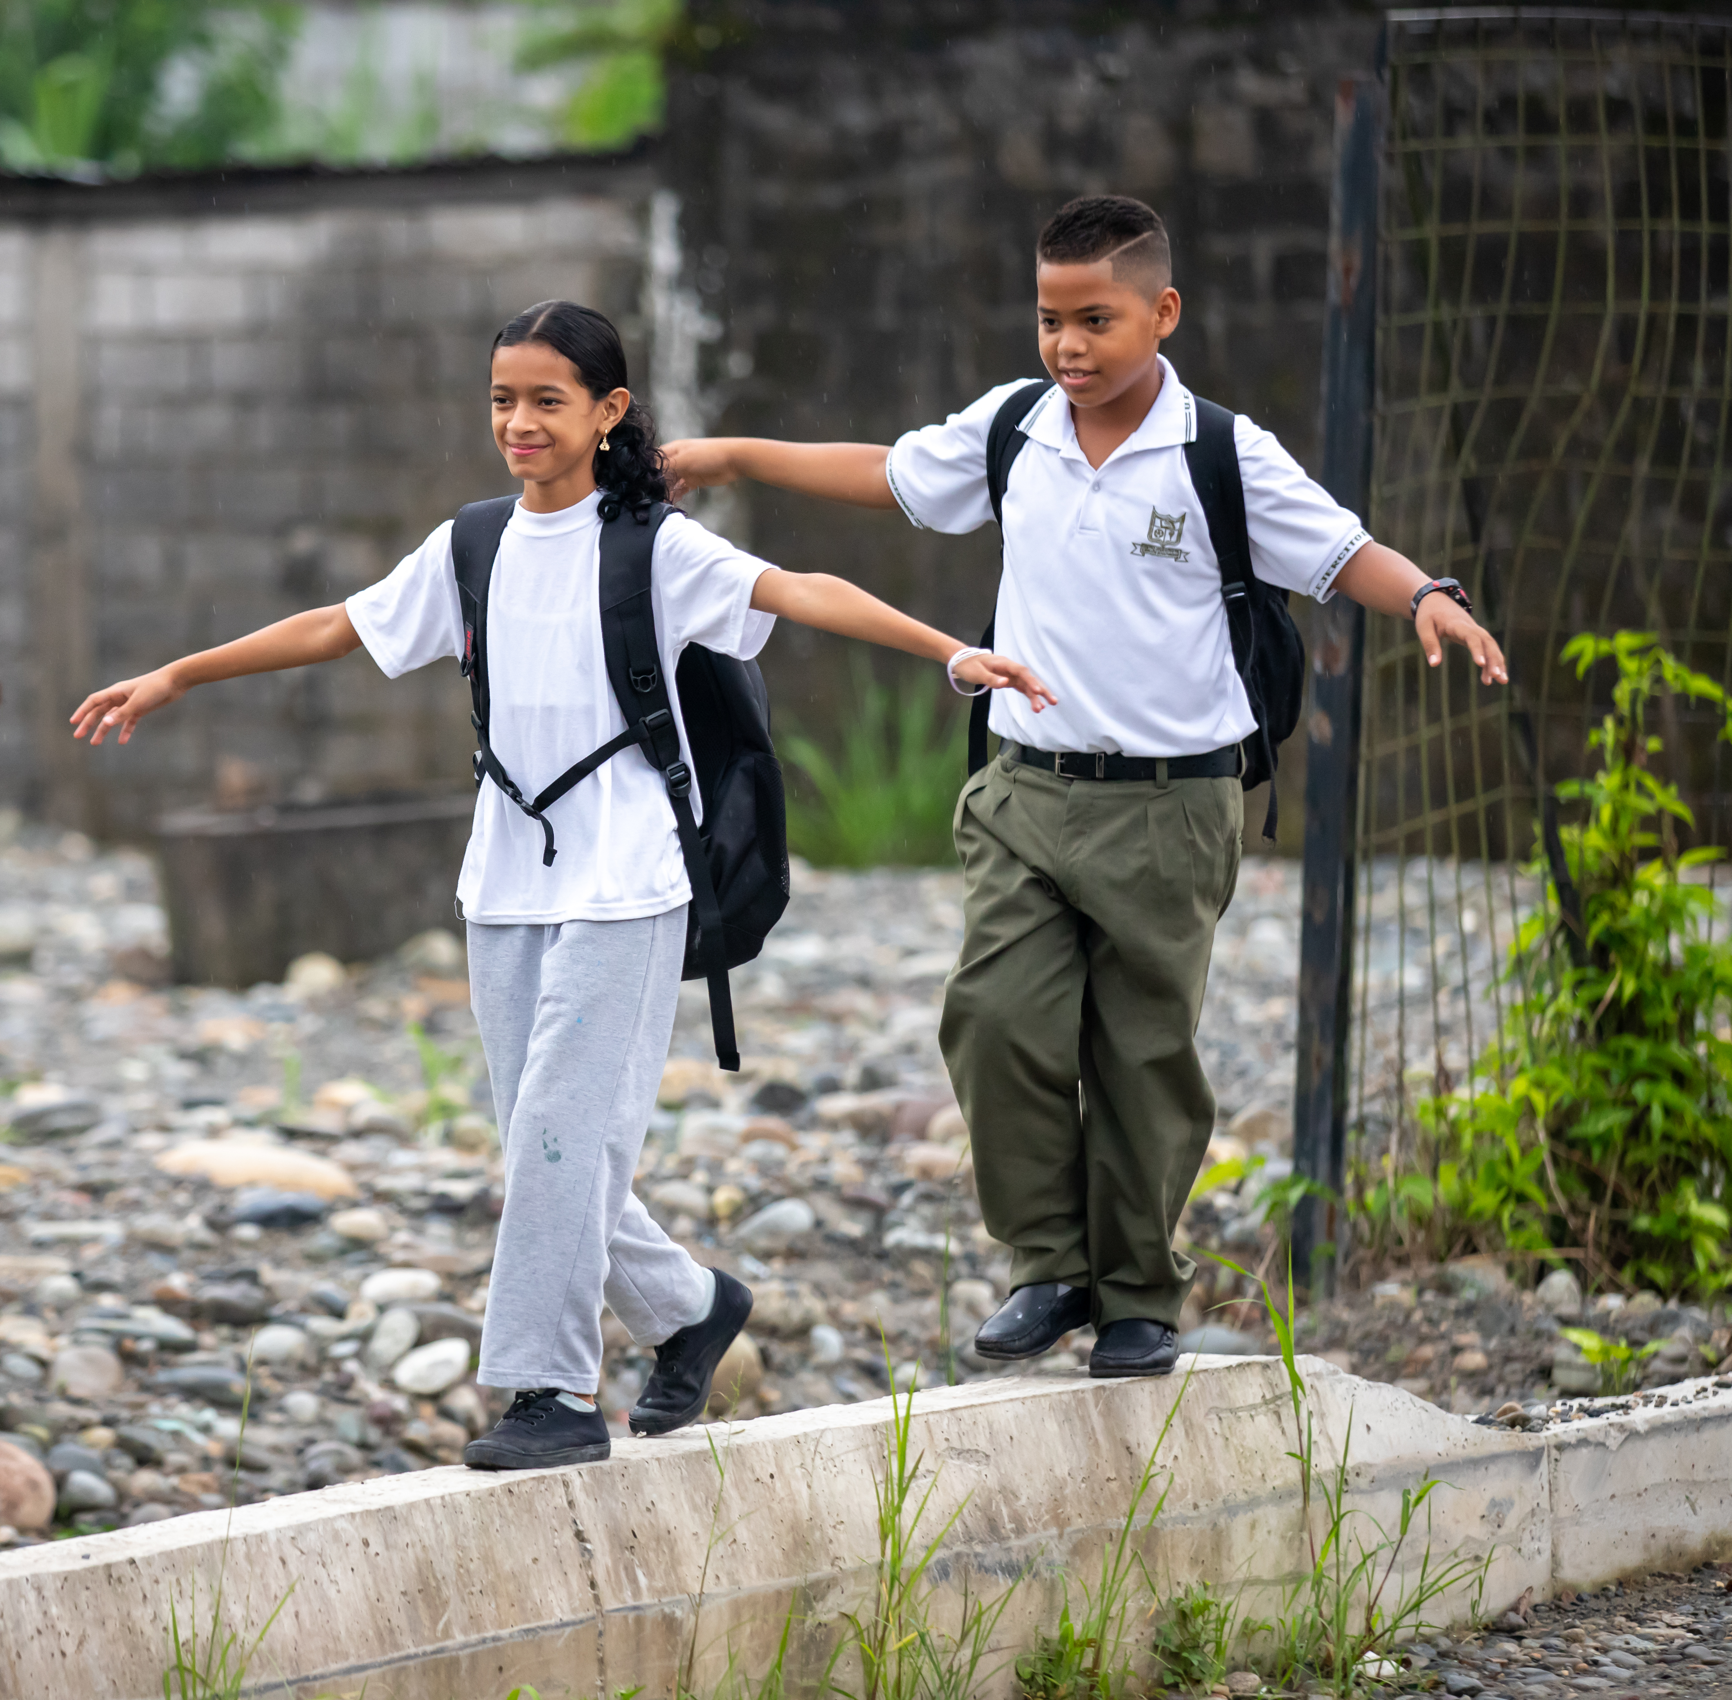
ÁNGEL AND
MERLÍA,
ECUADOR
Because of climate change, children and young people like Ángel and Merlía did not have clean water, and their right to a safe and healthy environment was at risk.
© UNICEF/Terán
Notes:
Climate Story 2:
Angel and Merlia live in Ecuador in an area that’s feeling the effects of climate change, including high temperatures and droughts. Water security – or having enough water for everyone, now and in the future, is a problem the community faces.
Climate adaptation is when we take action to help us live with the effects of the changing climate.
We know that everyone needs safe water to drink, and that clean water is important for children to enjoy their right to the best possible health.
Can you think of what Angel and Merlia’s community might do if they didn’t have water to drink? How might international aid support the government in Ecuador to adapt to this climate effect so that children and their families can access their rights?
https://www.unicef.org/ecuador/en/smart-resilient-schools-children-learn-better?utm_campaign=April%202025%20%7C%20Sustainability%20and%20Climate%20Action%20at%20UNICEF&utm_medium=email&utm_source=Mailjet

Slide 10
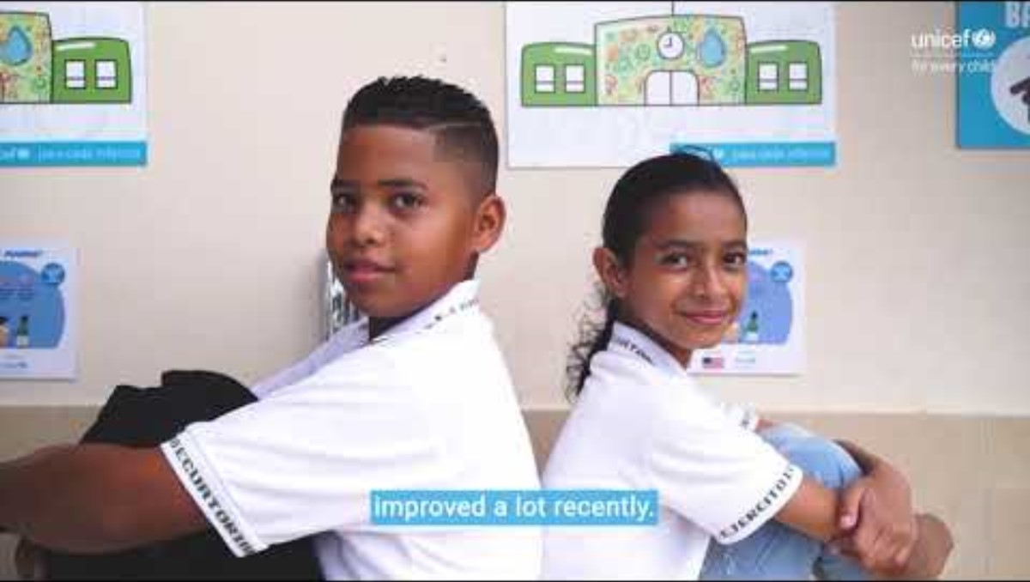
SUPPORTING
SMARTER
SCHOOLS
Ángel and Merlía show us how their school recyles rain water and uses renewable energy to help them enjoy their rights.
Notes:
What did you notice people saying? What did you notice people doing?
What did you learn about the obstacles children face, or the help they need to enjoy their rights? [Map it]
How could international aid be used to support the children in the story to enjoy their right to a healthy environment or safe place to live? Who else might be found in their circle of support?
How do you think this story might be different if international aid wasn’t possible?

Slide 11
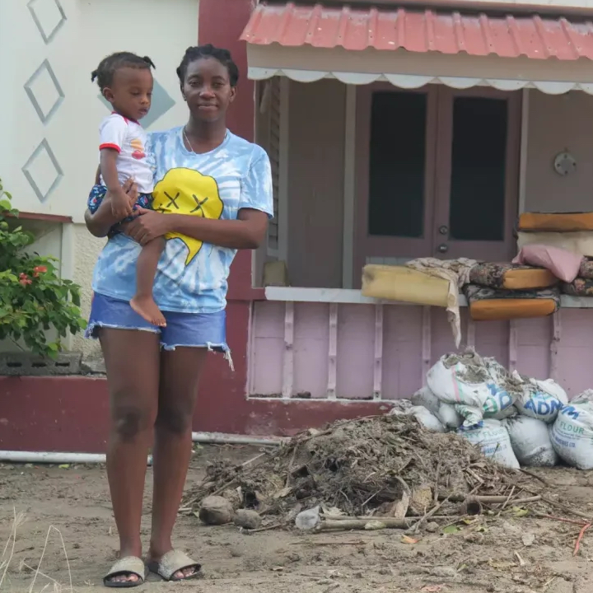

HELEN AND
BABY LUCAS,
GRENADA
"Climate change is real," Helen says.
"We in the Caribbean are paying
the price for what others are doing
to the environment."
© UNICEF/SOproductions
Notes:
Climate Story 3:
Helen and her baby Lucas stand in front of their home in Grenada, an island country in the Caribbean.
In June 2024, Hurricane Beryl, a powerful category 4 storm struck the island where they live. Hurricanes are measured on a scale of 1 to 5, with 5 the strongest, so a category 4 storm is very strong.
“The sea started coming into the road,” Helen said. “My yard started filling up and the sandbags were only able to block some of the water.”
The storm was so powerful that strong winds blew the roof off her home.
Hundreds of families like Helen’s across the northern part of Grenada had to leave their homes behind because of Hurricane Beryl's destruction.
Families lost their homes, schools were destroyed and communities urgently needed shelter, food and water. Many children also needed support for their mental health.
A climate emergency response (or humanitarian response) is when communities need urgent support to meet their immediate needs when a climate event/disaster happens. Sometimes this happens fast (like a hurricane or flood) or more slowly, like a drought or famine.)
How do you think international aid may have supported children and their families in Grenada when a climate emergency like Hurricane Beryl happened?

Slide 12
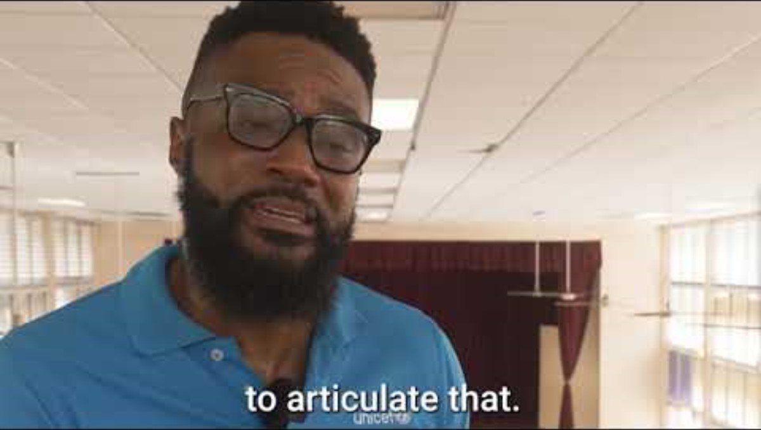
EMERGENCY
AID
Notes:
What did you notice people saying? What did you notice people doing?
What did you learn about the obstacles children face, or the help they need to enjoy their rights? (Do you want to map these on your mural?)
How was international aid used to support the children in the story to enjoy their right to a healthy environment or safe place to live? Who else might be in their circle of support?
How do you think this story might be different if international aid wasn’t possible?

Slide 13
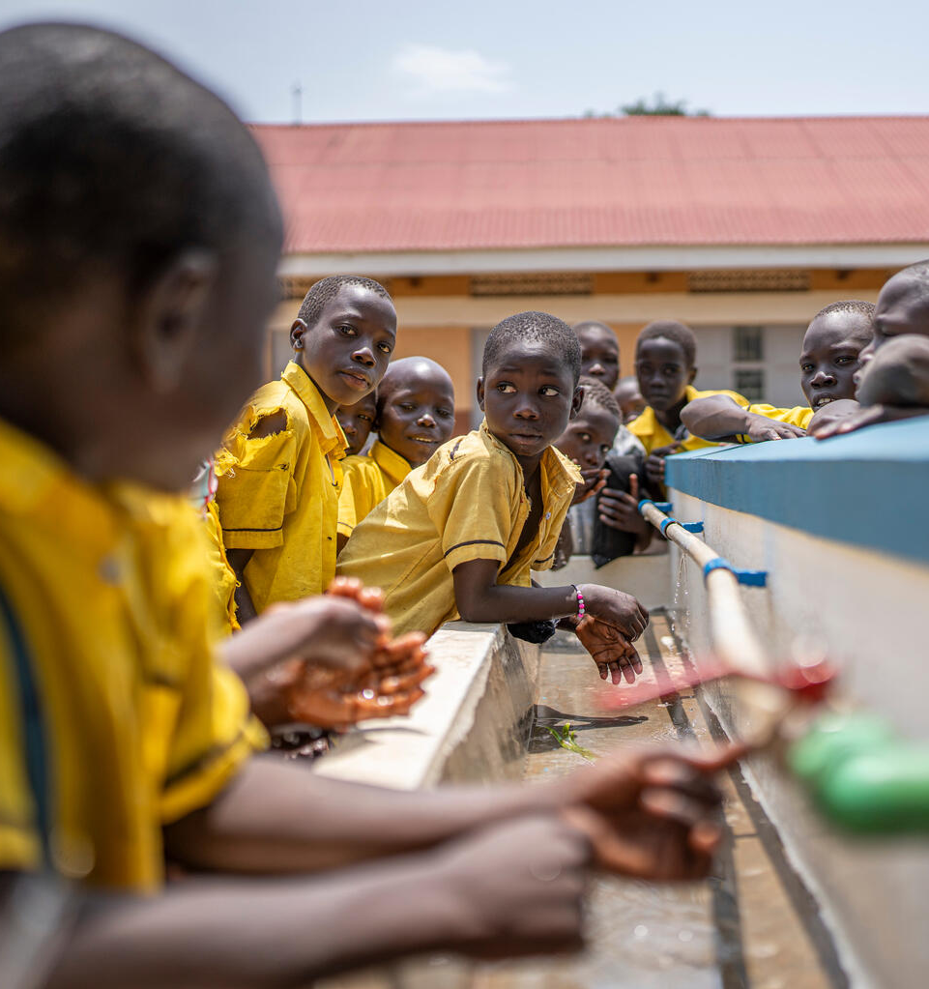
  PART 4
WHAT IS
CLIMATE
JUSTICE?
Climate justice is the idea that countries who are contributing the most to climate change should support the countries who are experiencing the greatest effects of climate change with international aid.
© UNICEF/Rutherford
A student enjoys drinking water from the newly constructed hand washing facility at Aria Primary School, Uganda.

Slide 14

  PART 5
WHAT DID YOU
DISCOVER?
...about rights and the climate?
...about how aid might help?

