Slide 1


  CAMPAIGN
  ACTION
Now you’ve finished learning all
about international aid, it’s time to
take some action!
Campaigning is often about influencing
people, in this case decision makers –
using the information you’ve learned
on a certain topic.
So, who are we trying to influence
with this campaign?

Slide 2
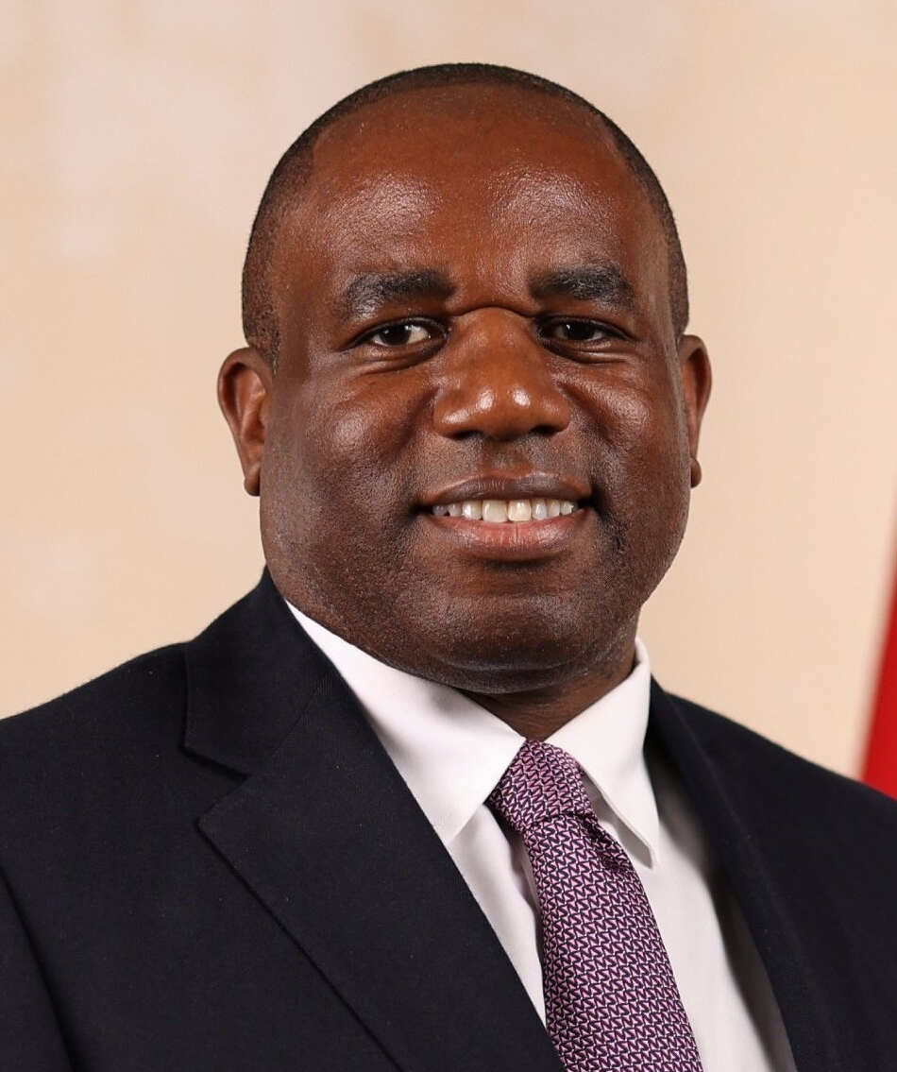
  THE DECISION
  MAKER
This year, we’ll be using your work
to take our campaign message –
about the importance of
international aid to the Foreign
Secretary, David Lammy.
David Lammy, official portrait, 2024

Slide 3

  WHAT DOES THE FOREIGN SECRETARY DO?
The Foreign Secretary is a Secretary of State in the UK Government,
and is responsible for the Foreign, Commonwealth and
Development Office (FCDO). The role of Foreign Secretary is
one of the most senior ministers in the UK Government.
The Foreign Secretary is responsible for representing the United
Kingdom to the rest of the world, by:
Managing relationships with other countries and their governments
Protecting the interests of British people abroad
(when travelling or working)
Representing the UK Government in situations such as
managing conflict, peace treaties etc.
Because the Foreign Secretary is seen as being the representative
for international relations, they are involved in decisions around
international aid.

Slide 4

  WHY IS IT
  IMPORTANT?
This year, we’ve learned all about how children’s rights around the world can be affected by the cuts to international aid.
At UNICEF UK, we’re asking the UK Government to protect children’s rights through investing in international aid.
We’re asking you to tell the Foreign Secretary what you’ve learned, and to use the campaign skills you’ve developed to campaign for children’s rights.

Slide 5

  WRITING AN
  MP BRIEFING
To do that, we’re asking you to write
your very own MP briefing.
An MP briefing is a presentation, or
document that gives MPs (Members of
Parliament) essential, concise information
on a specific problem, so that they can
learn and take action.
At UNICEF UK, we send MP briefings on
a range of topics and often invite MPs to
speak with us about them.

Slide 6
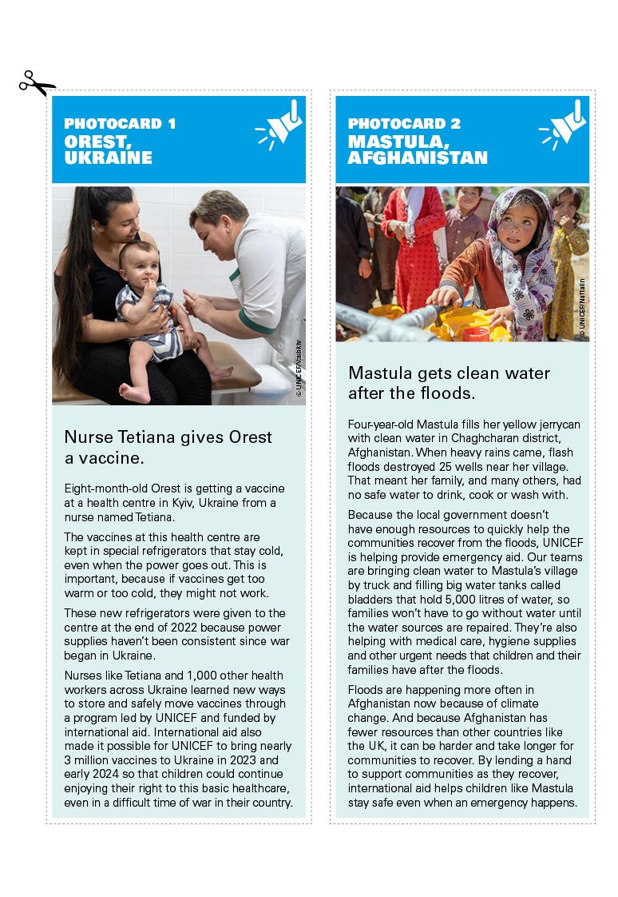
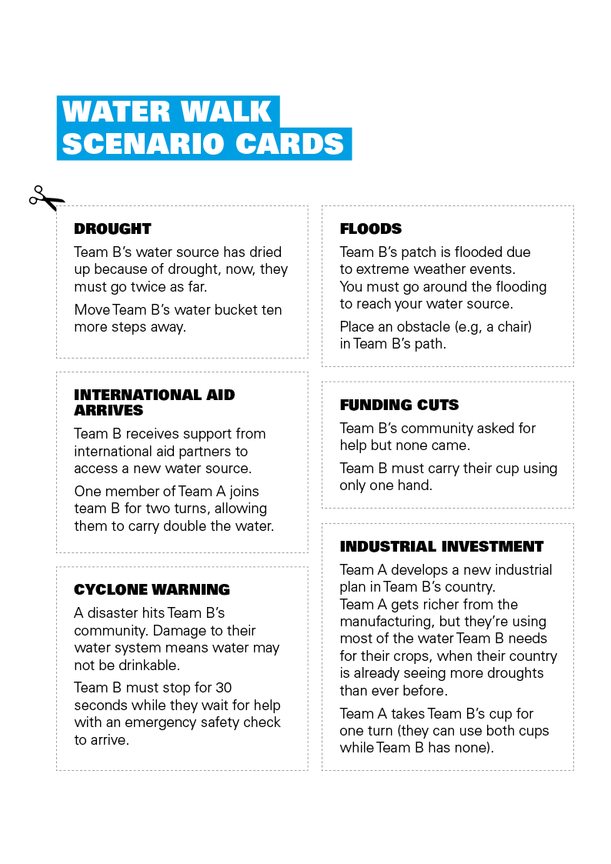
  INSPIRATION
We’ve shared an MP briefing that
we have shared with MPs recently
about OutRight, as inspiration.
Using these, and the learning
you’ve completed this year,
get inspired to write your very
own MP briefing!
The young people’s stories you’ve
seen and heard
Examples from your Campaign Reels
Any exciting ideas you’ve had!

