Slide 1
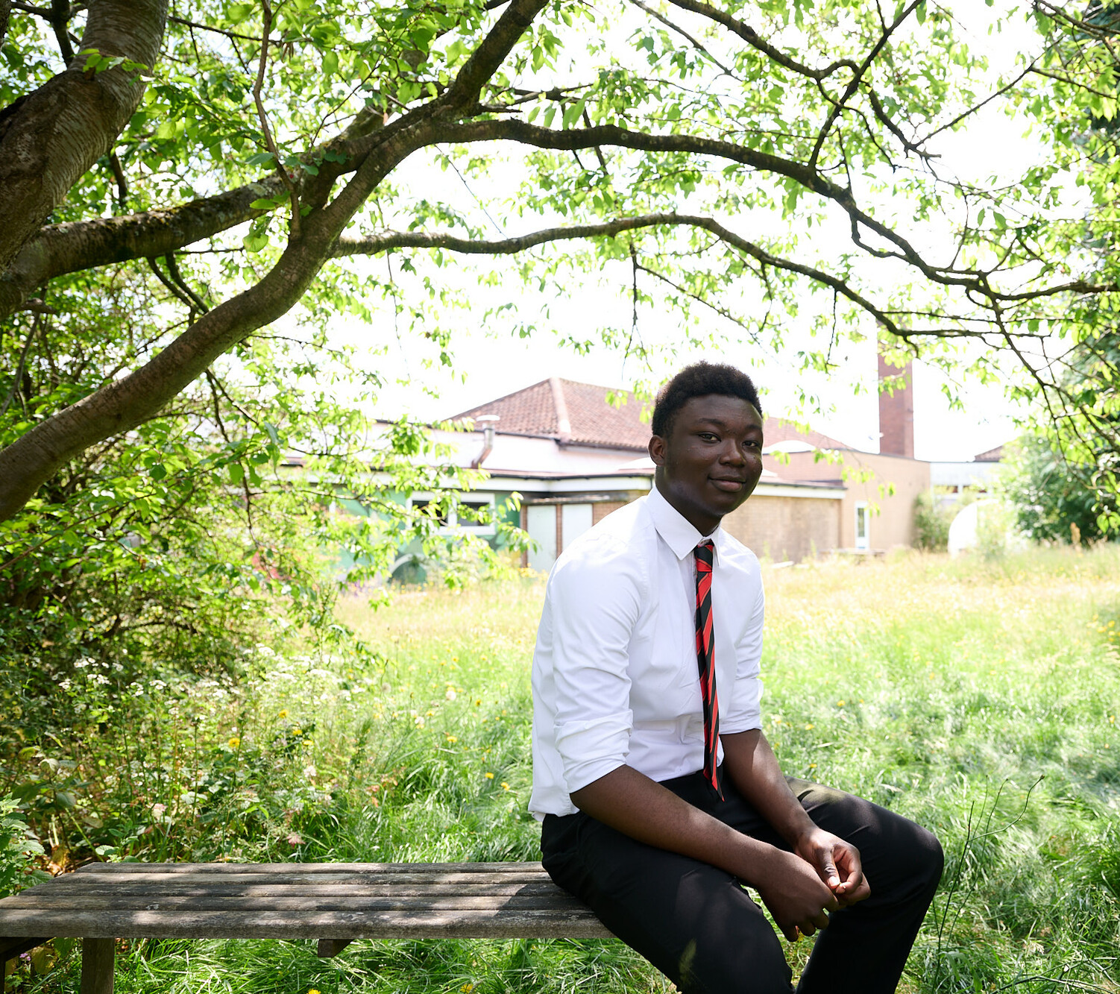


  ACTIVITY 1
  WE ALL
  HAVE
  RIGHTS
© UNICEF/Al-Safadi
Students at Cockshut Hill Secondary school created a series of images in a photojournalism style based on the brief of 'How does your school support your rights?'.
© UNICEF/Maule-Ffinch
Notes:
The United Nations Convention on the Rights of the Child can be known as the UNCRC (or sometimes the CRC).
Articles of the UNCRC describe rights that have been promised to every child, everywhere, by world governments.

Slide 2
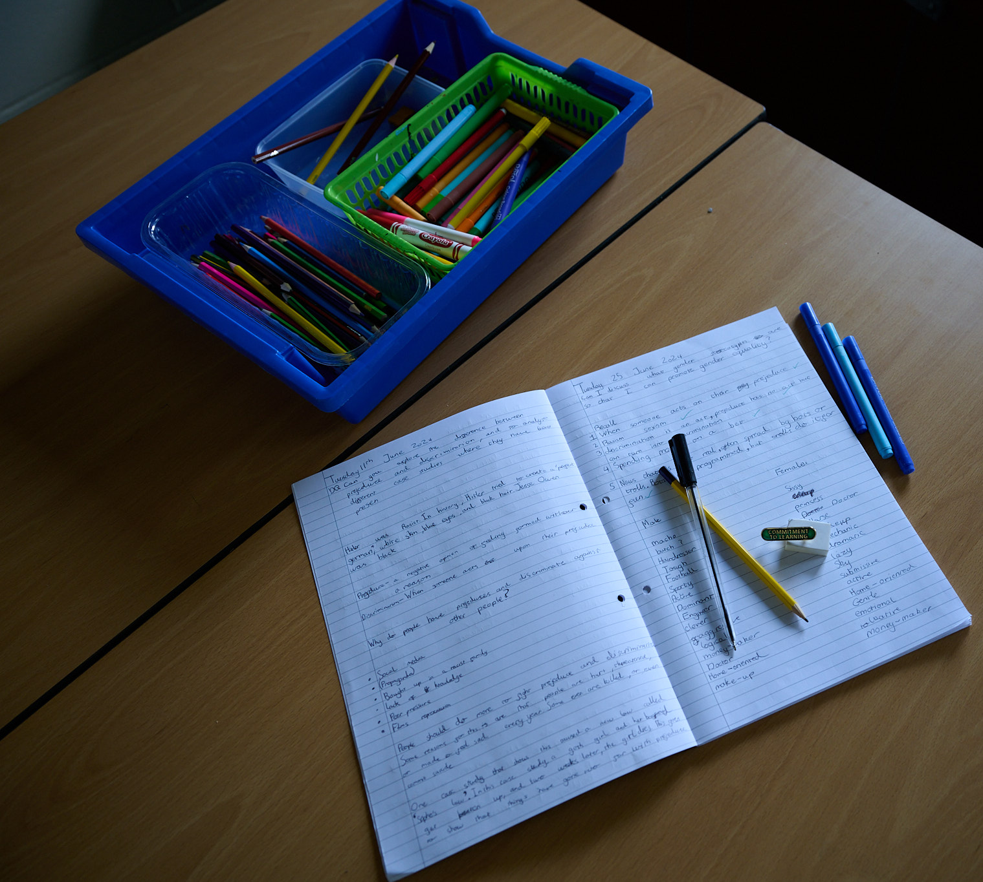
  PART 1
Introducing the
UN Convention
on the Rights
of the Child
(UNCRC)
Students at Cockshut Hill Secondary school created a series of images in a photojournalism style based on the brief of 'How does your school support your rights?'.

Slide 3

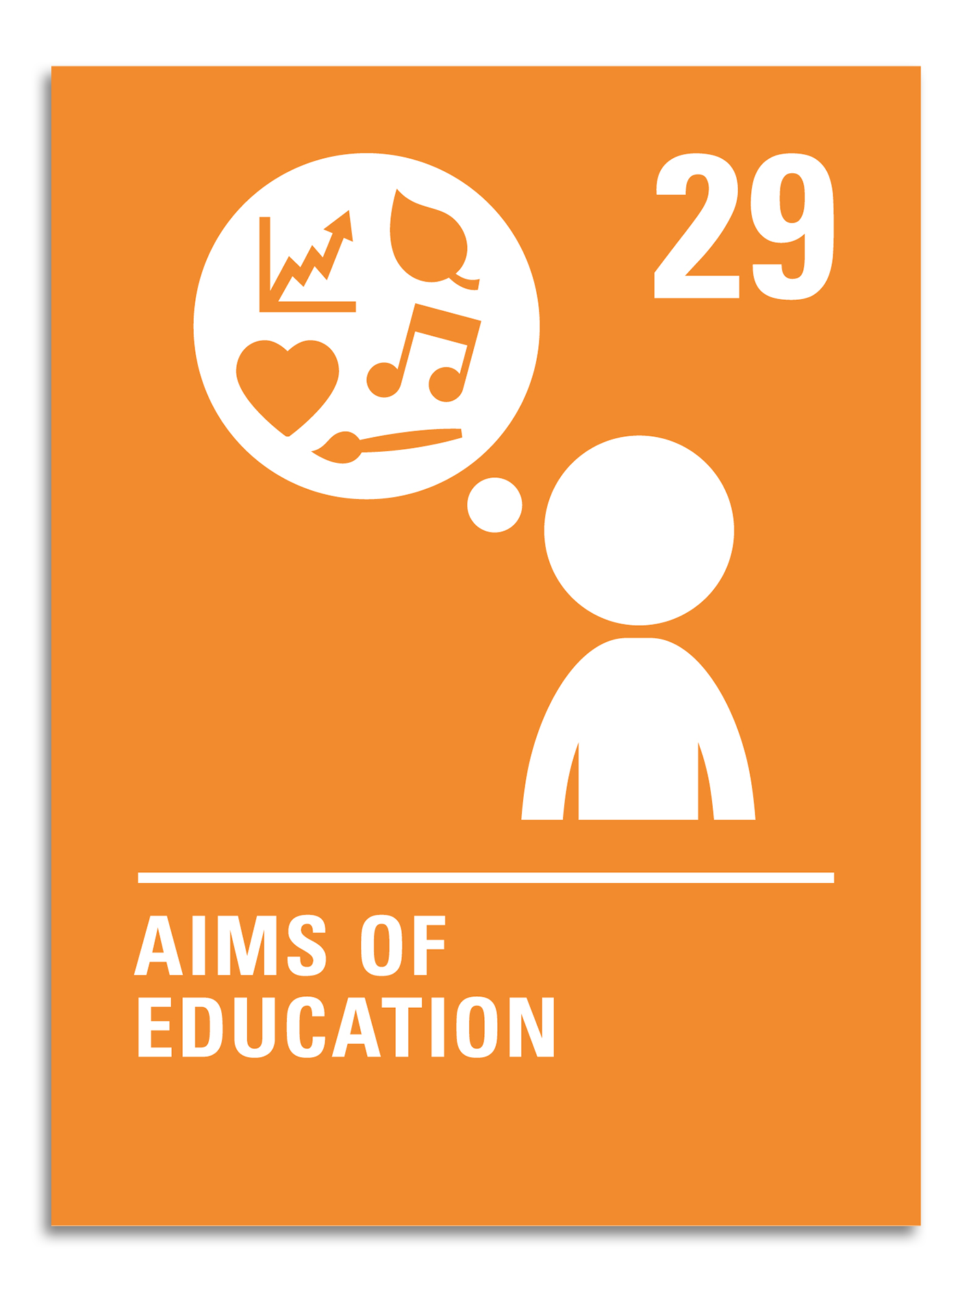
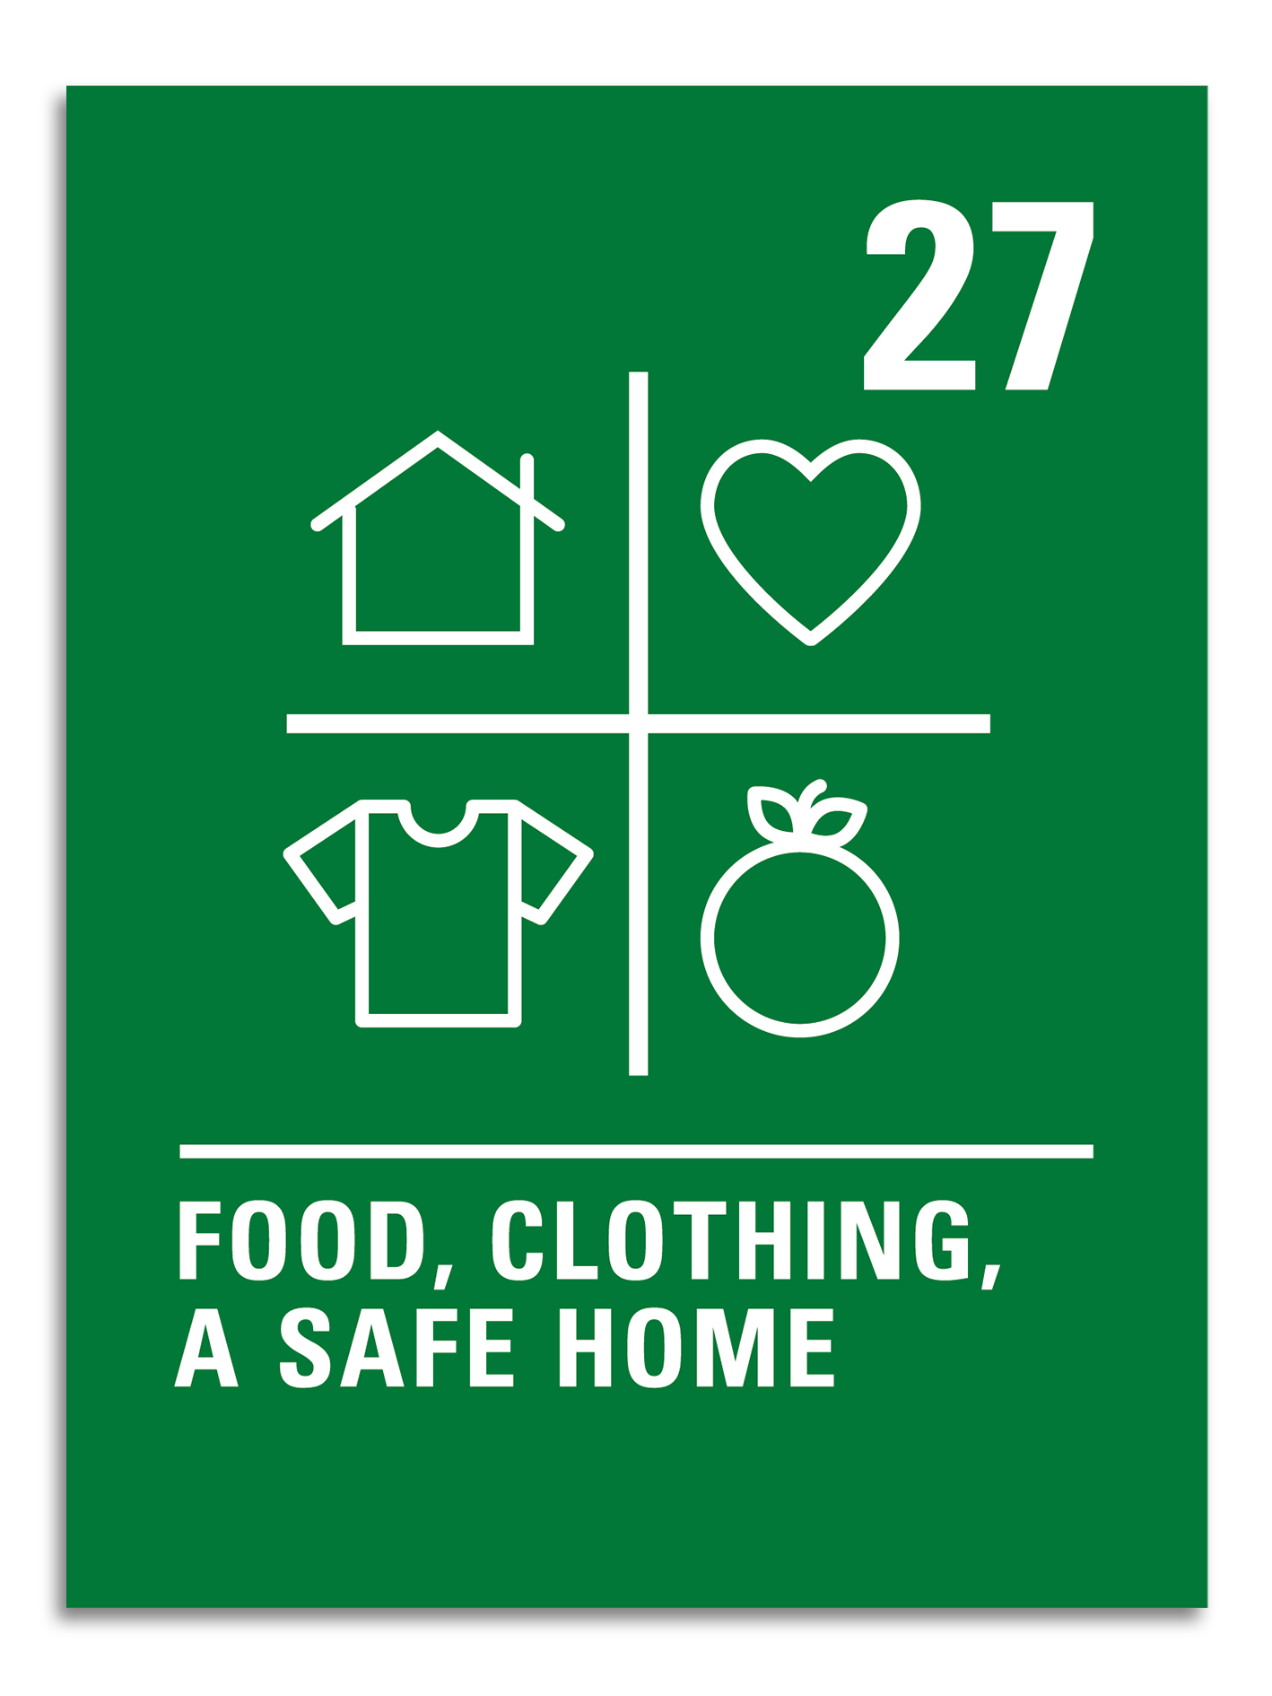
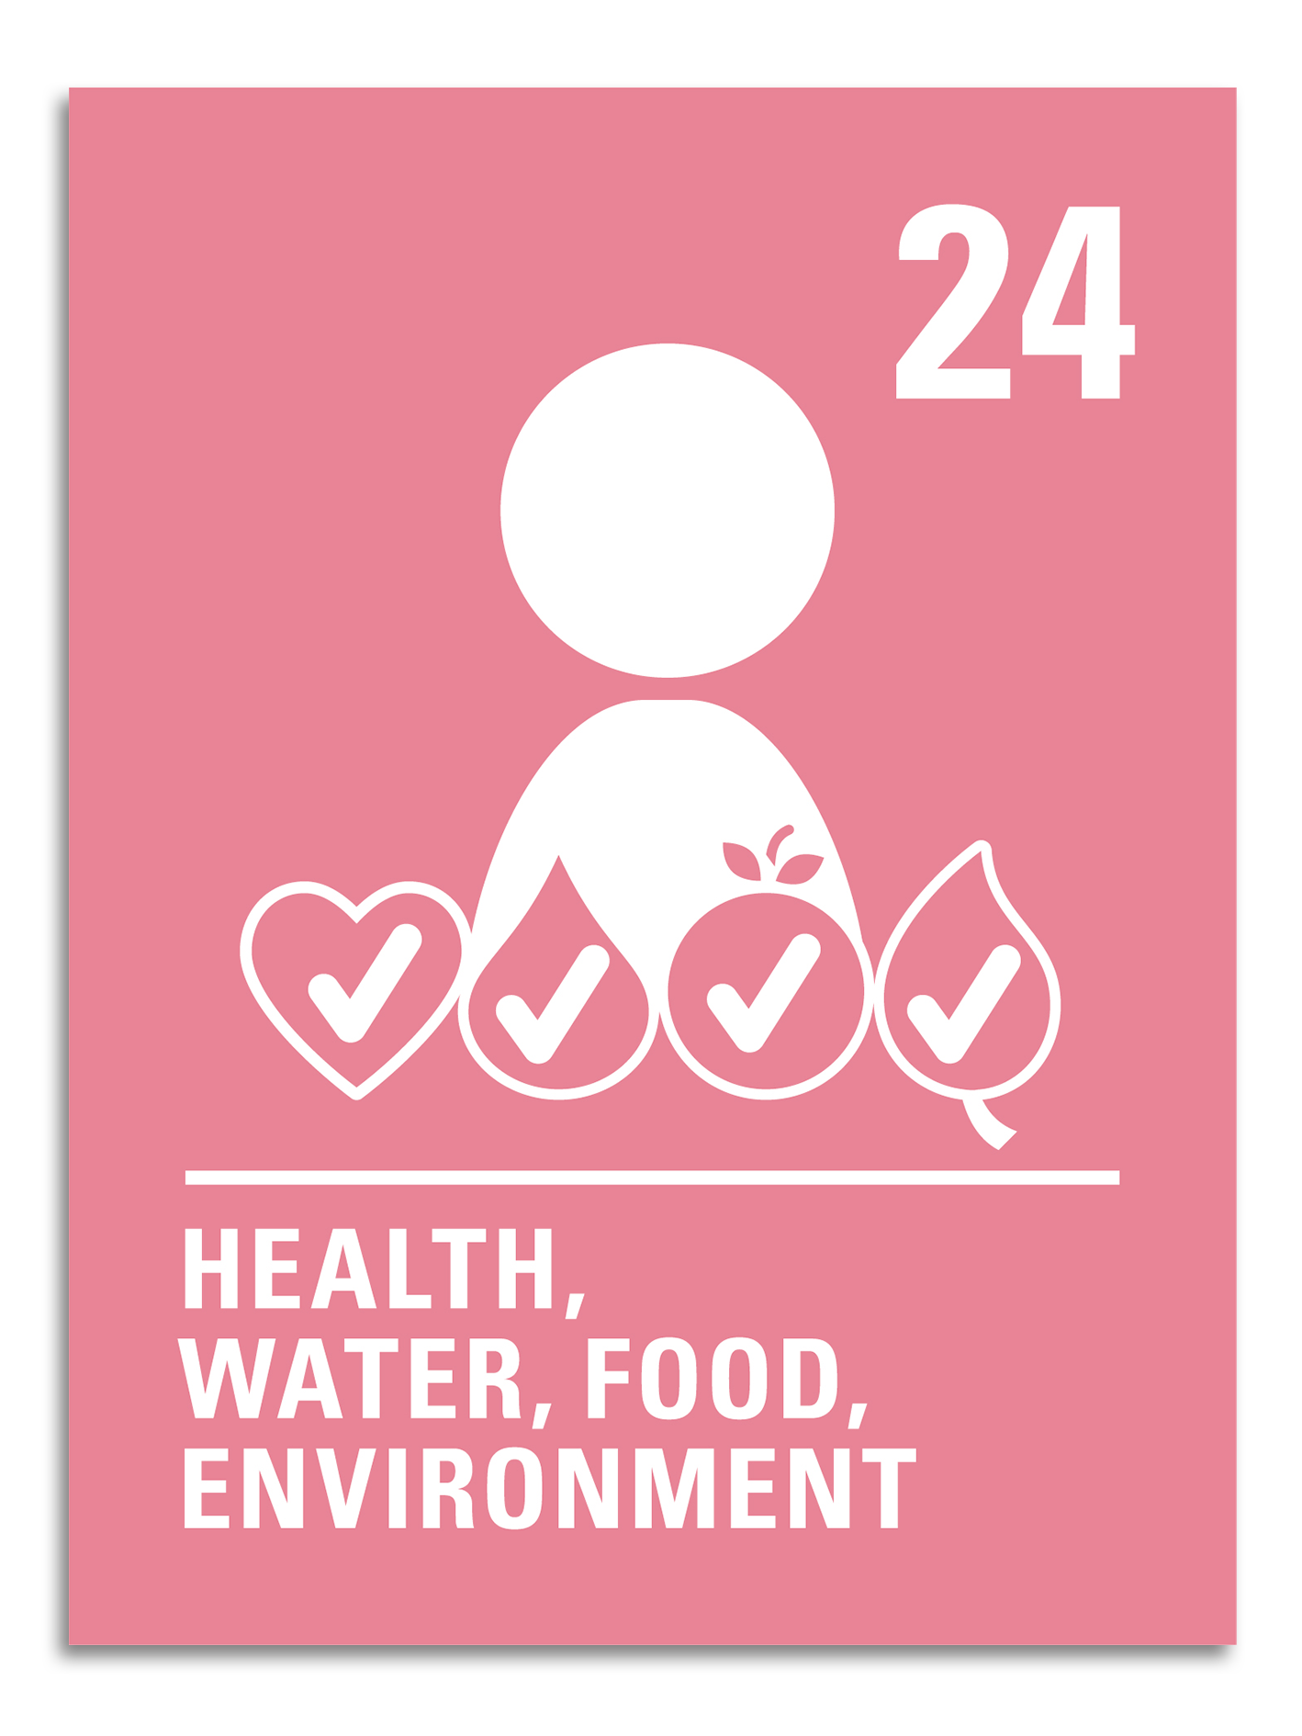

  PART 2
KEY
ARTICLES

Slide 4
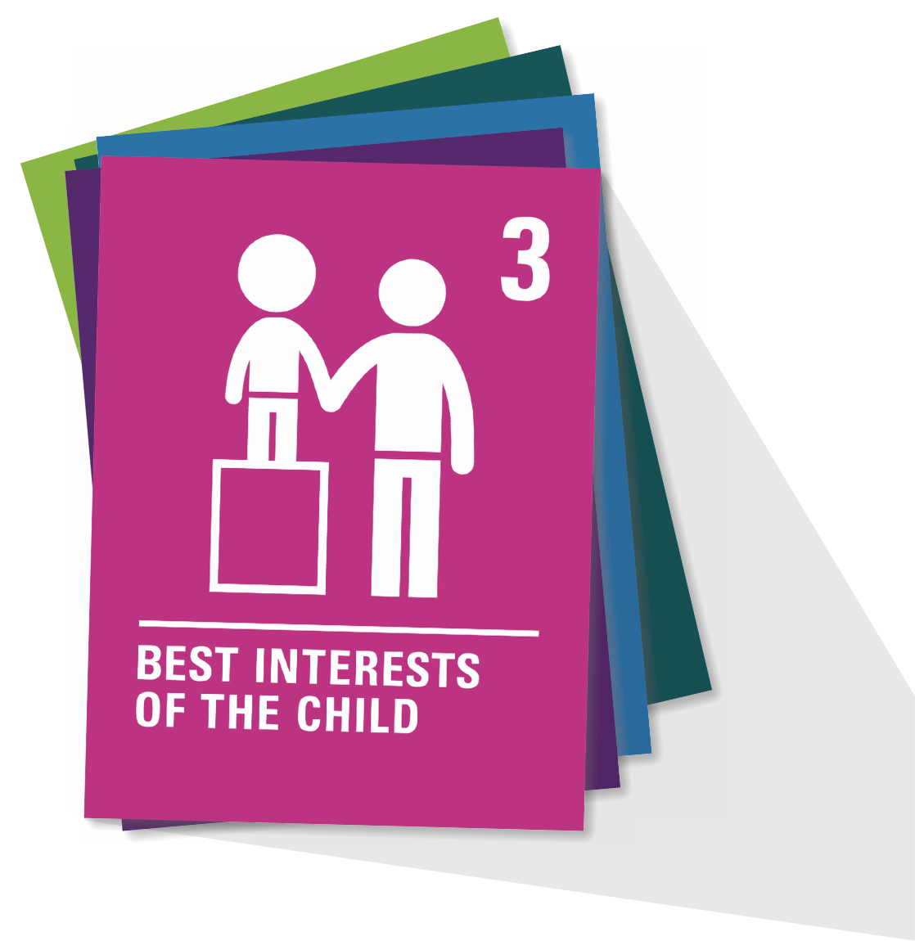

  ARTICLE 6
Life survival and development
Every child has the right to be alive. Governments must make sure that children survive and develop in the best possible way.

Slide 5
  ARTICLE 24
Health, water, food, environment
Children have the right to the best healthcare possible, clean water to drink, healthy food and a clean and safe environment to live in. All adults and children should have information about how to stay safe and healthy.

Slide 6
  ARTICLE 27
Food, clothing, a safe home
Children have the right to food, clothing and a safe place to live so they can develop in the best possible way. The government should help families and children who cannot afford this.

Slide 7
  ARTICLE 28
Access to education
Every child has the right to an education. Primary education should be free. Secondary and higher education should be available to every child. Children should be encouraged to go to school to the highest level possible. Discipline in schools should respect children’s rights and never use violence.

Slide 8
  ARTICLE 29
Aims of education
Children’s education should help them fully develop their personalities, talents and abilities. It should teach them to understand their own rights, and to respect other people’s rights, cultures and differences. It should help them to live peacefully and protect the environment.

Slide 9
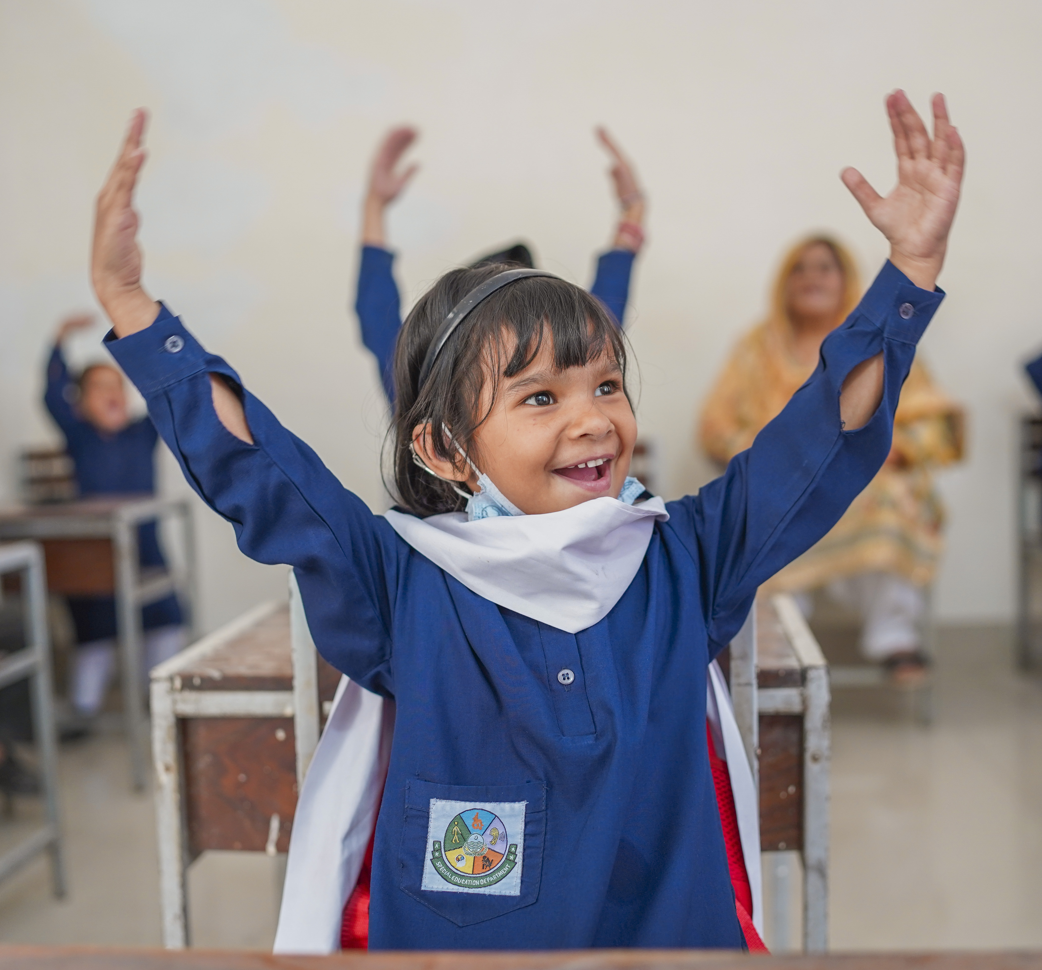
  PART 3
INTERNATIONAL
AID AND
THE UNCRC
International aid is when a high-income country supports a low or middle-income country by giving money or resources to help people, sometimes through organisations that work to protect children’s rights and wellbeing.
© UNICEF/Ahmed
Hoorain, 5, actively participates in the poem and rhymes class in the primary part of a government-run high school for deaf and hearing-impaired girls in Rajgarh, Chauburji, Lahore. Hoorain is deaf, and received hearing aids from UNICEF a month ago.
Notes:
This is also known as Official Development Assistance (ODA)
This is about sharing resources, country to country, to help make sure rights are met everywhere. But we’ll explore this more in OutRight activity 2.

Slide 10
WHAT IS
THE LINK?
How might International Aid
help children enjoy
these rights?

Slide 11
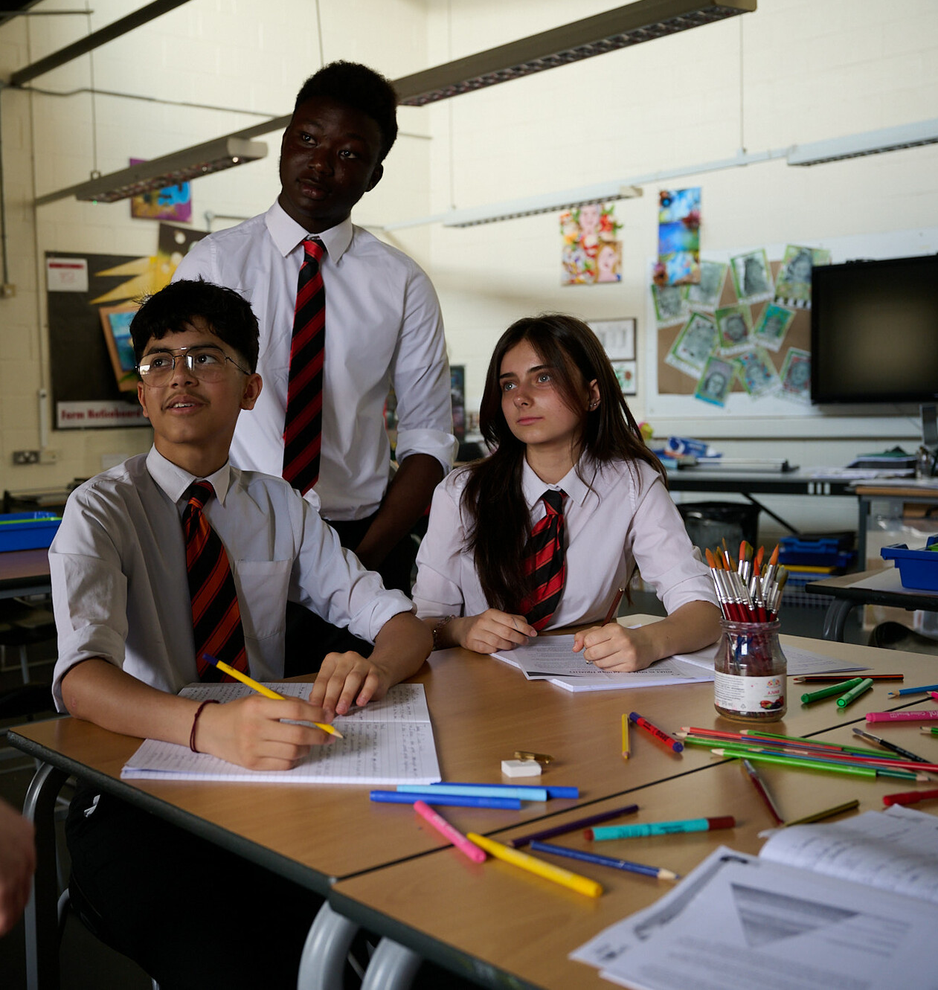
  PART 4
RIGHTS
MURAL
Set a space and
start creating –
your mural will
grow over the course
of your learning.
Students at Cockshut Hill Secondary school created a series of images in a photojournalism style based on the brief of 'How does your school support your rights?'.
© UNICEF/Maule-ffinch

Slide 12
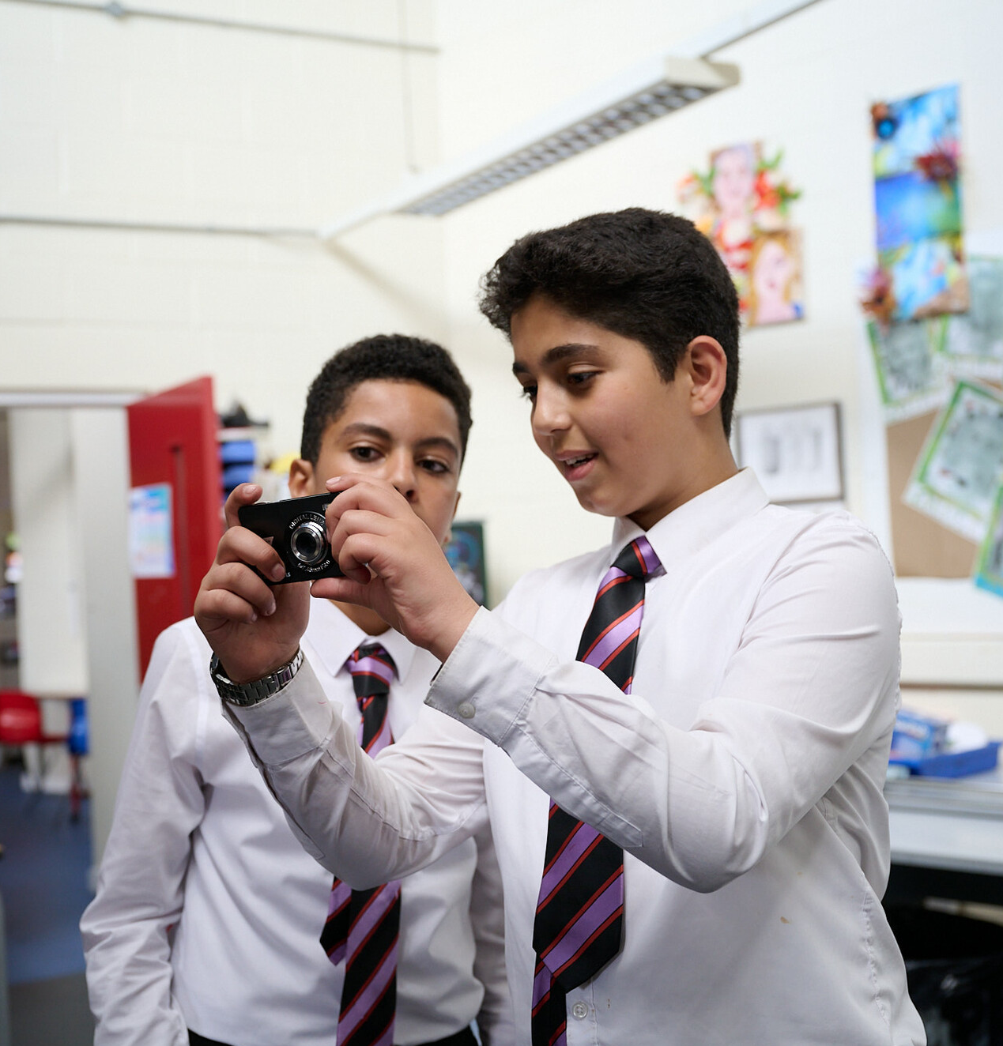
  PART 5
WRAP
UP
What have we discovered?
A group of students at a Rights Respecting School were asked to come up with ideas on how to represent their favourite UNCRC articles in a photojournalism style. In groups, they created their ideas, tested them with their own cameras, and then briefed in the favourites to a professional photographer.
© UNICEF/Maule-ffinch

