Slide 1
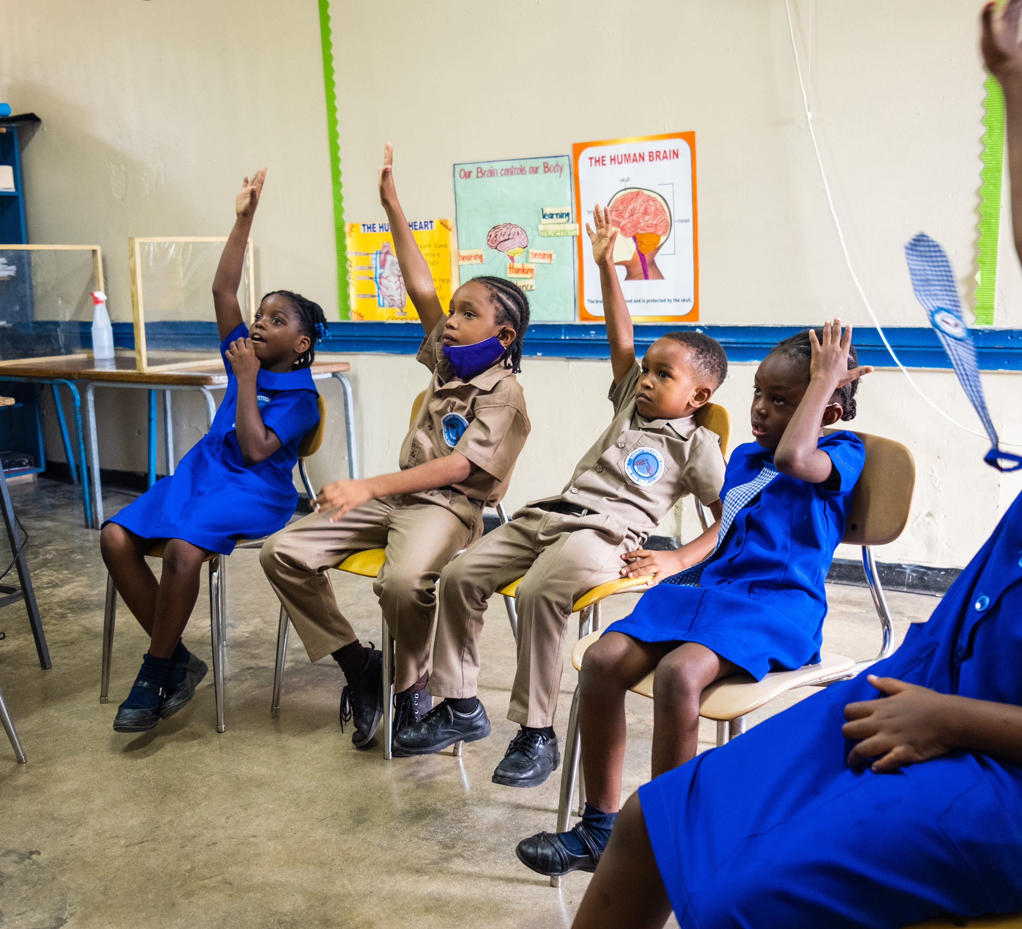


  ACTIVITY 4
  CLIMATE
  CHANGE
  AND RIGHTS
© UNICEF/Al-Safadi
After a full day of school, as soon as six-year-old Ari gets home he wants to share what he has learned with his grandmother. He searches for “My Brain is My Boss” on his tablet and pulls up UNICEF’s Accessible Digital Textbook (ADT) on the BookFusion app.
© UNICEF/Johnson

Slide 2
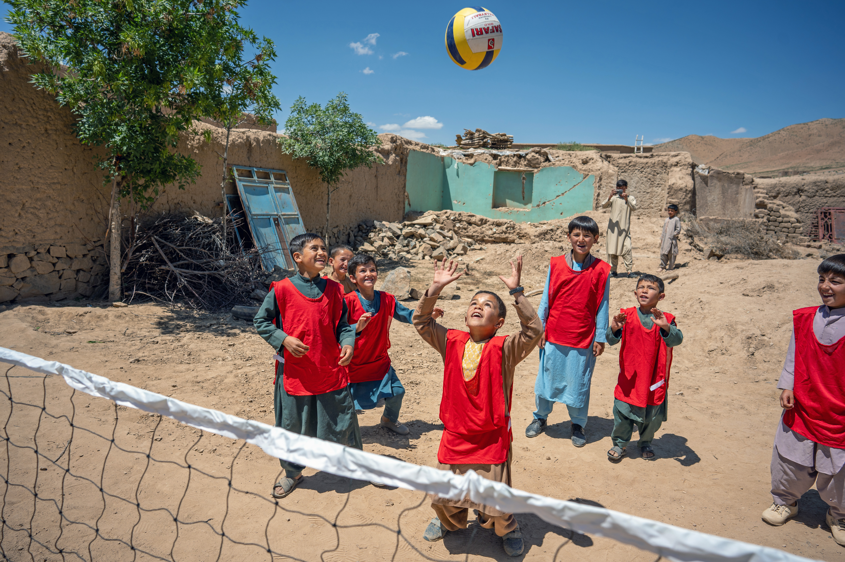
  PART 1
REVIEWING YOUR
RIGHTS
9 year old Farzan (under ball) plays volleyball at the UNICEF-supported Child Friendly Space (CFS) in Chaghcharan district, Ghor province in western Afghanistan.
© UNICEF/Naftalin
Notes:
Why do you think it’s important that children grow up in safe and healthy places?
Can you think of some reasons why children might not have a safe place to live?
How might climate change make it harder for children to enjoy their right to the best possible health?
Can you think of why countries like the UK might have a responsibility to help other countries that are experiencing climate effects so that all children can enjoy their rights?

Slide 3
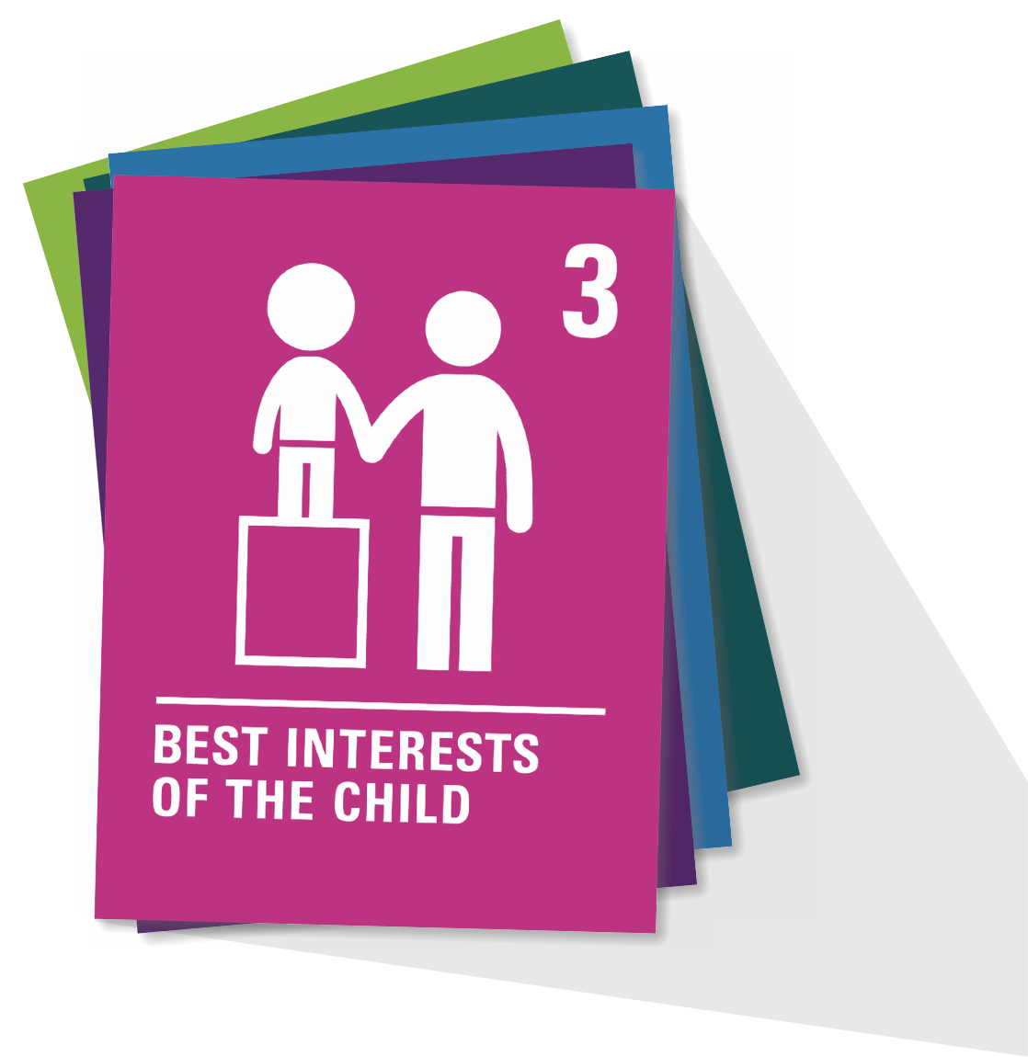
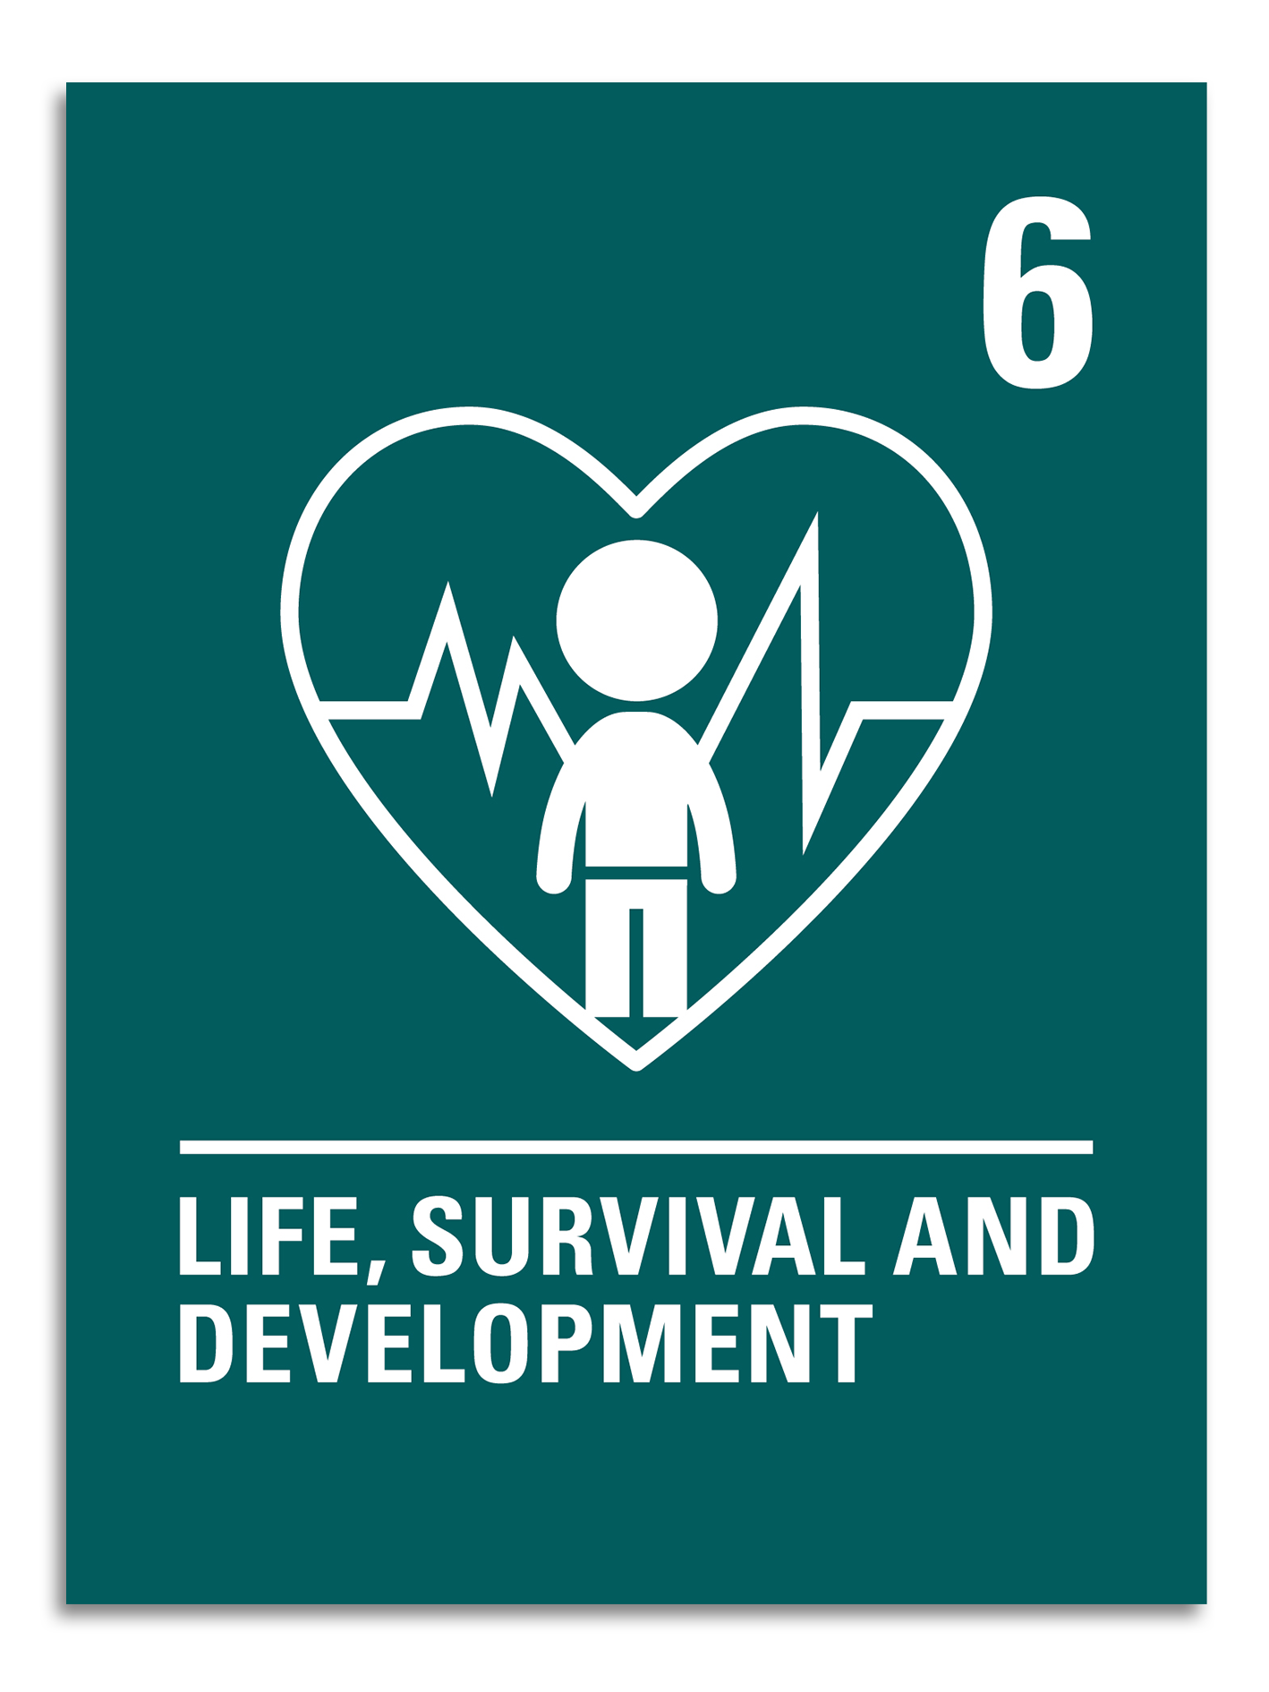
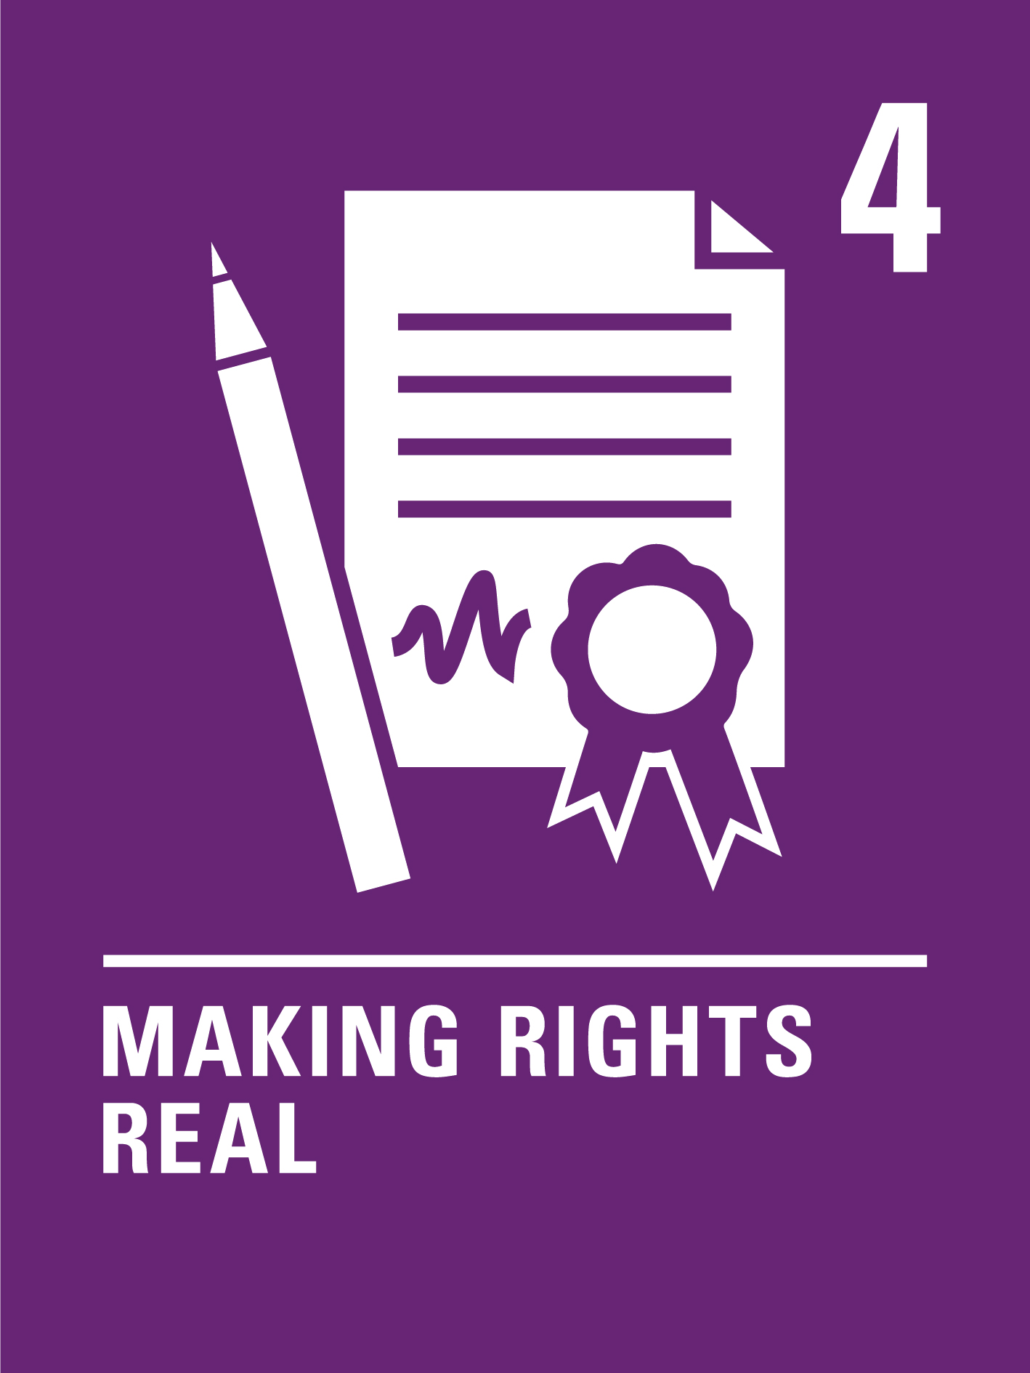
  ARTICLE 6
  ARTICLE 6
Life survival and development
Every child has the right to be alive. Governments must make sure that children survive and develop in the best possible way.
Life survival and development
Every child has the right to be alive. Governments must make sure that children survive and develop in the best possible way.

Slide 4
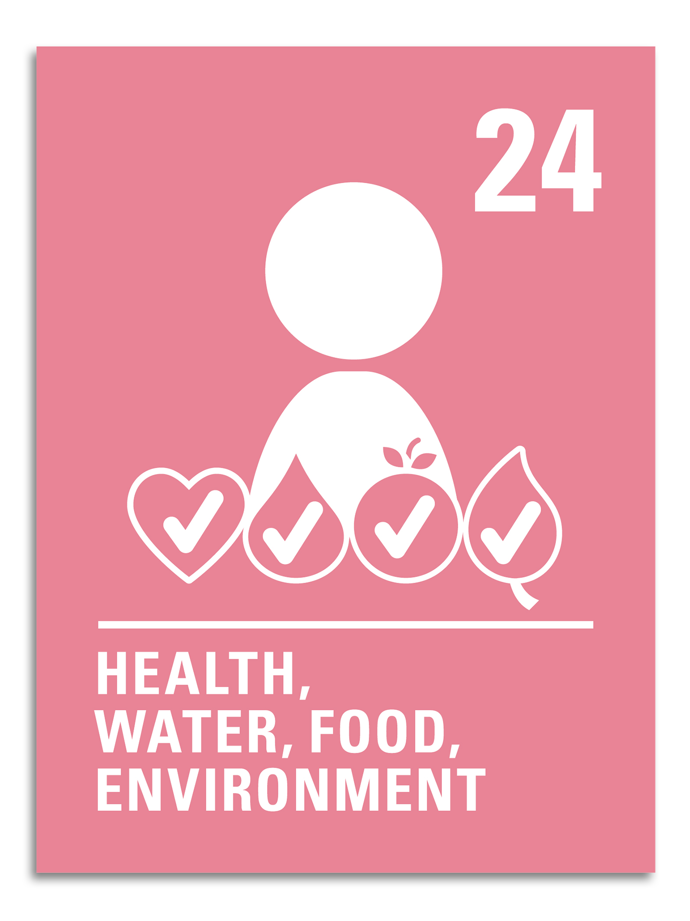
  ARTICLE 24
Health, water, food, environment
Children have the right to the best healthcare possible, clean water to drink, healthy food and a clean and safe environment to live in. All adults and children should have information about how to stay safe and healthy.

Slide 5
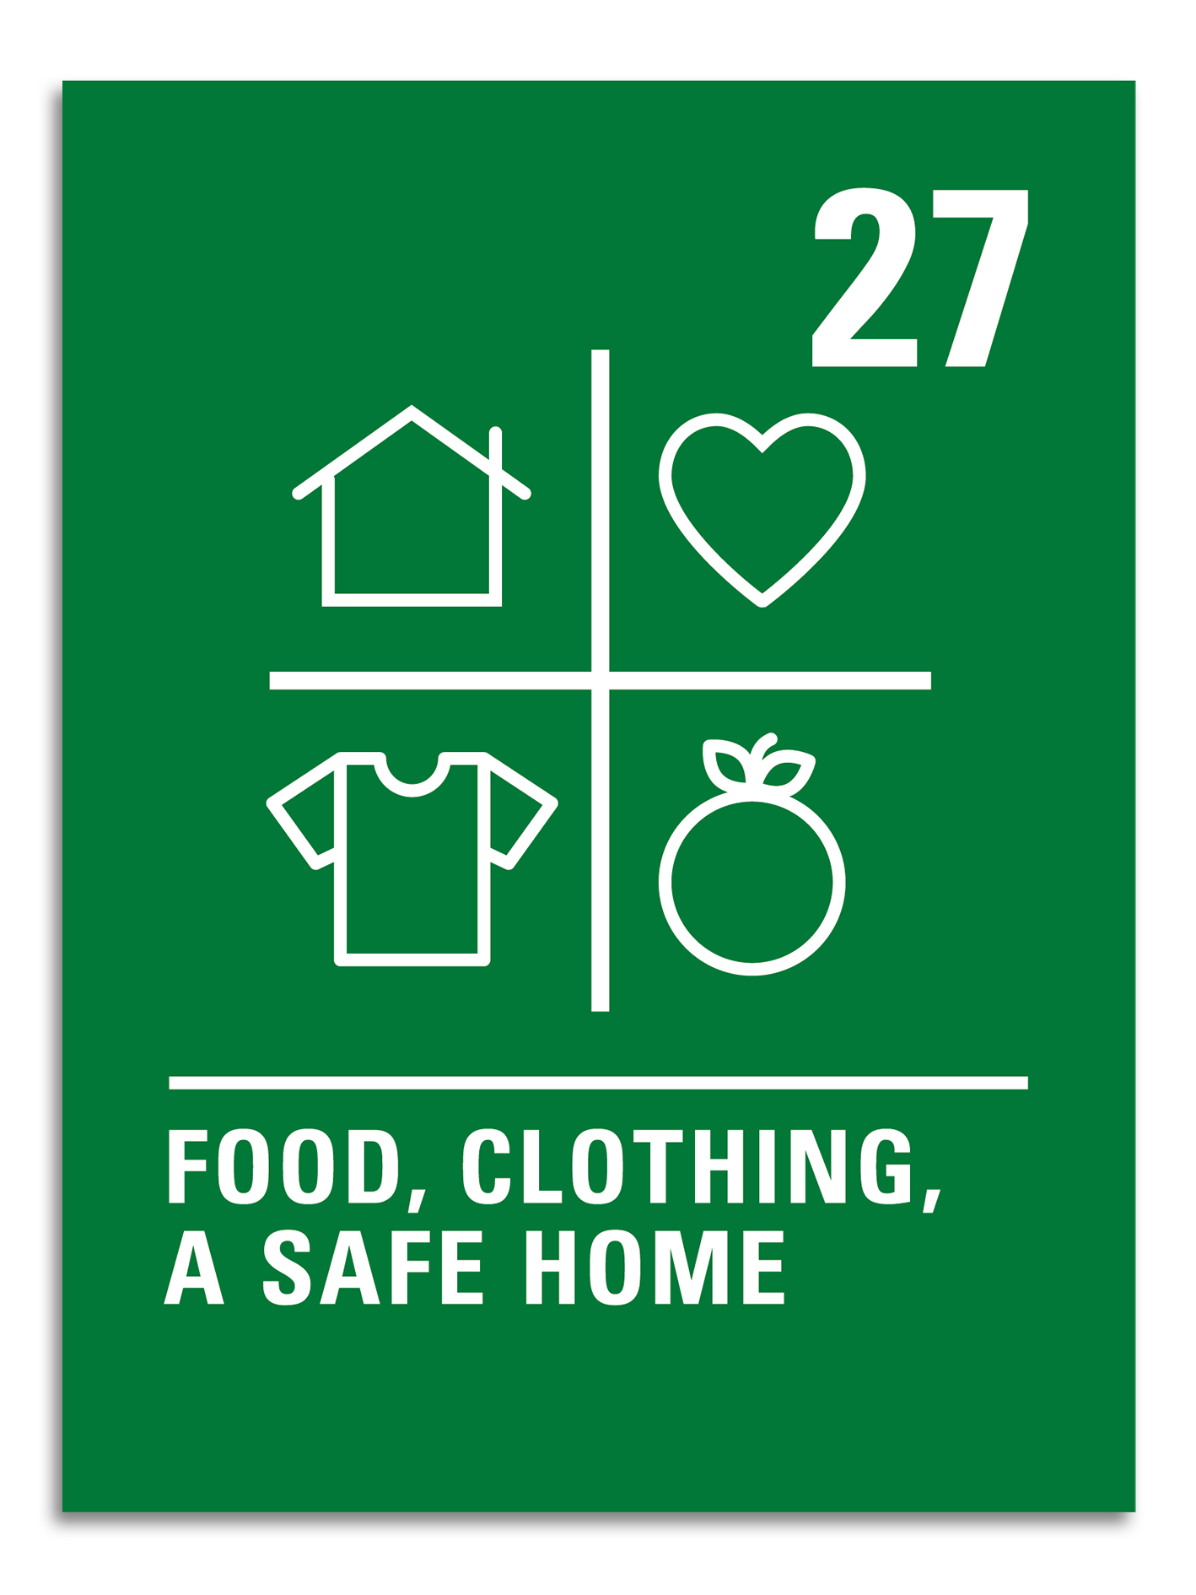
  ARTICLE 27
Food, clothing, a safe home
Children have the right to food, clothing and a safe place to live so they can develop in the best possible way. The government should help families and children who cannot afford this.

Slide 6
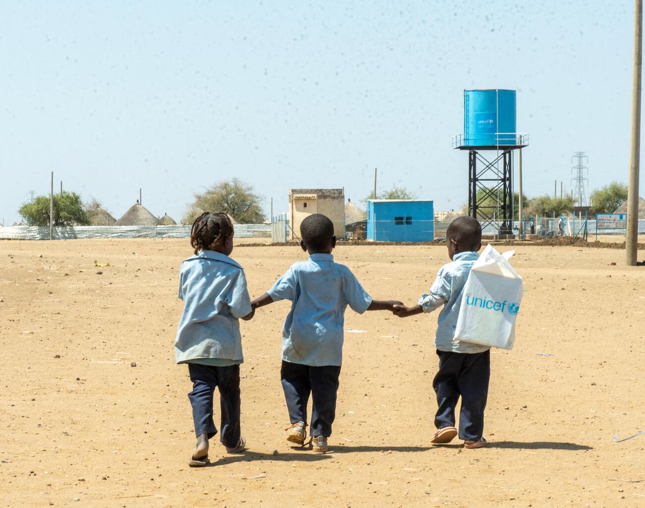
  PART 2
WATER WALK
AND CLIMATE
JUSTICE
In Sudan, children walk back home from a UNICEF-supported child friendly space in Al Houri internally displaced people’s (IDP) camp in Gedaref State.
© UNICEF/Abdulmajid

Slide 7
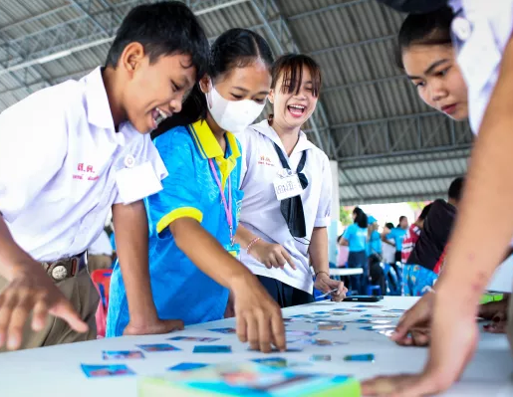
  PART 3
CLIMATE AID
ROLEPLAY
© UNICEF/Preechapanich
Student volunteers take part in a Know the Flood activity with the community in Ubon Ratchathani.

Slide 8

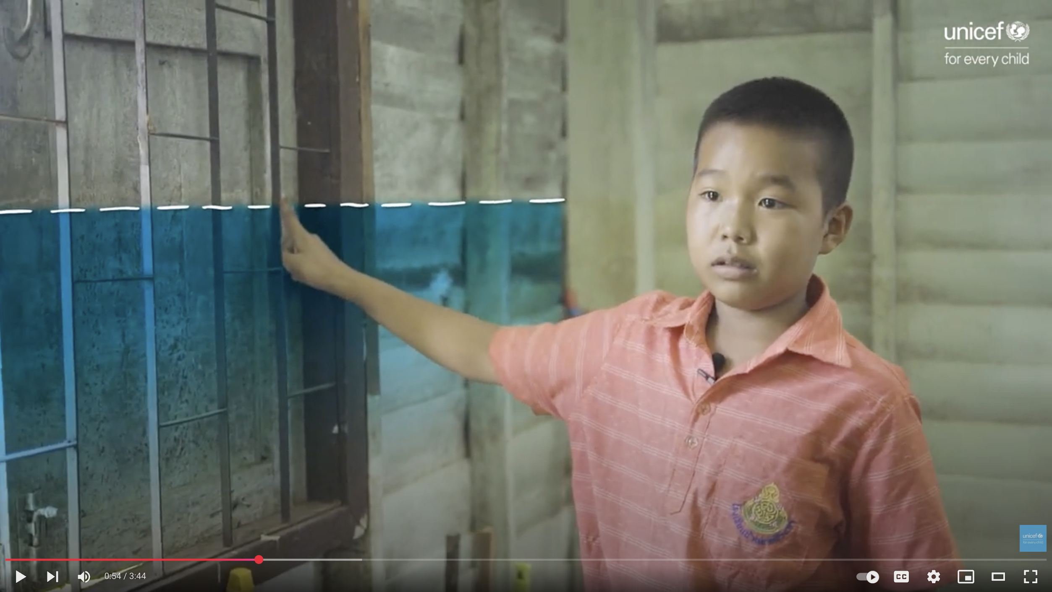
ANUWAT,
THAILAND
"When I see heavy flooding,
I feel really worried. I miss school so much and fear not being able to study. I just wonder if our books will get ruined, and if we'll even have desks and chairs to sit on."
Notes:
Climate Story 1
Ubon Ratchathani is a province in Thailand that’s prone to frequent flooding, especially during the rainy season from July to August.
These floods often force people, including children, to move to higher floors in their homes, away from the water's reach. When flooding comes, families can’t use electricity because it’s dangerous, and sometimes furniture, appliances and even homes are swept away by the water.
In very bad flooding, some children go to live in temples or stay in tents by the roadside for more than 30 days until the floodwaters go down.
This is difficult and can be scary for children. The floods stop them enjoying their rights to school and a safe and healthy environment.
Next year, floods may come again. Disaster preparedness is when we take action in advance – making plans for what to do if a climate emergency like a flood happens and being as ready as possible if it does.
Can you think of any ways that Anuwat’s community might help children prepare for the annual flooding? How might ODA support the government in Thailand to help communities be prepared, so that children and their families can access their rights?

Slide 9
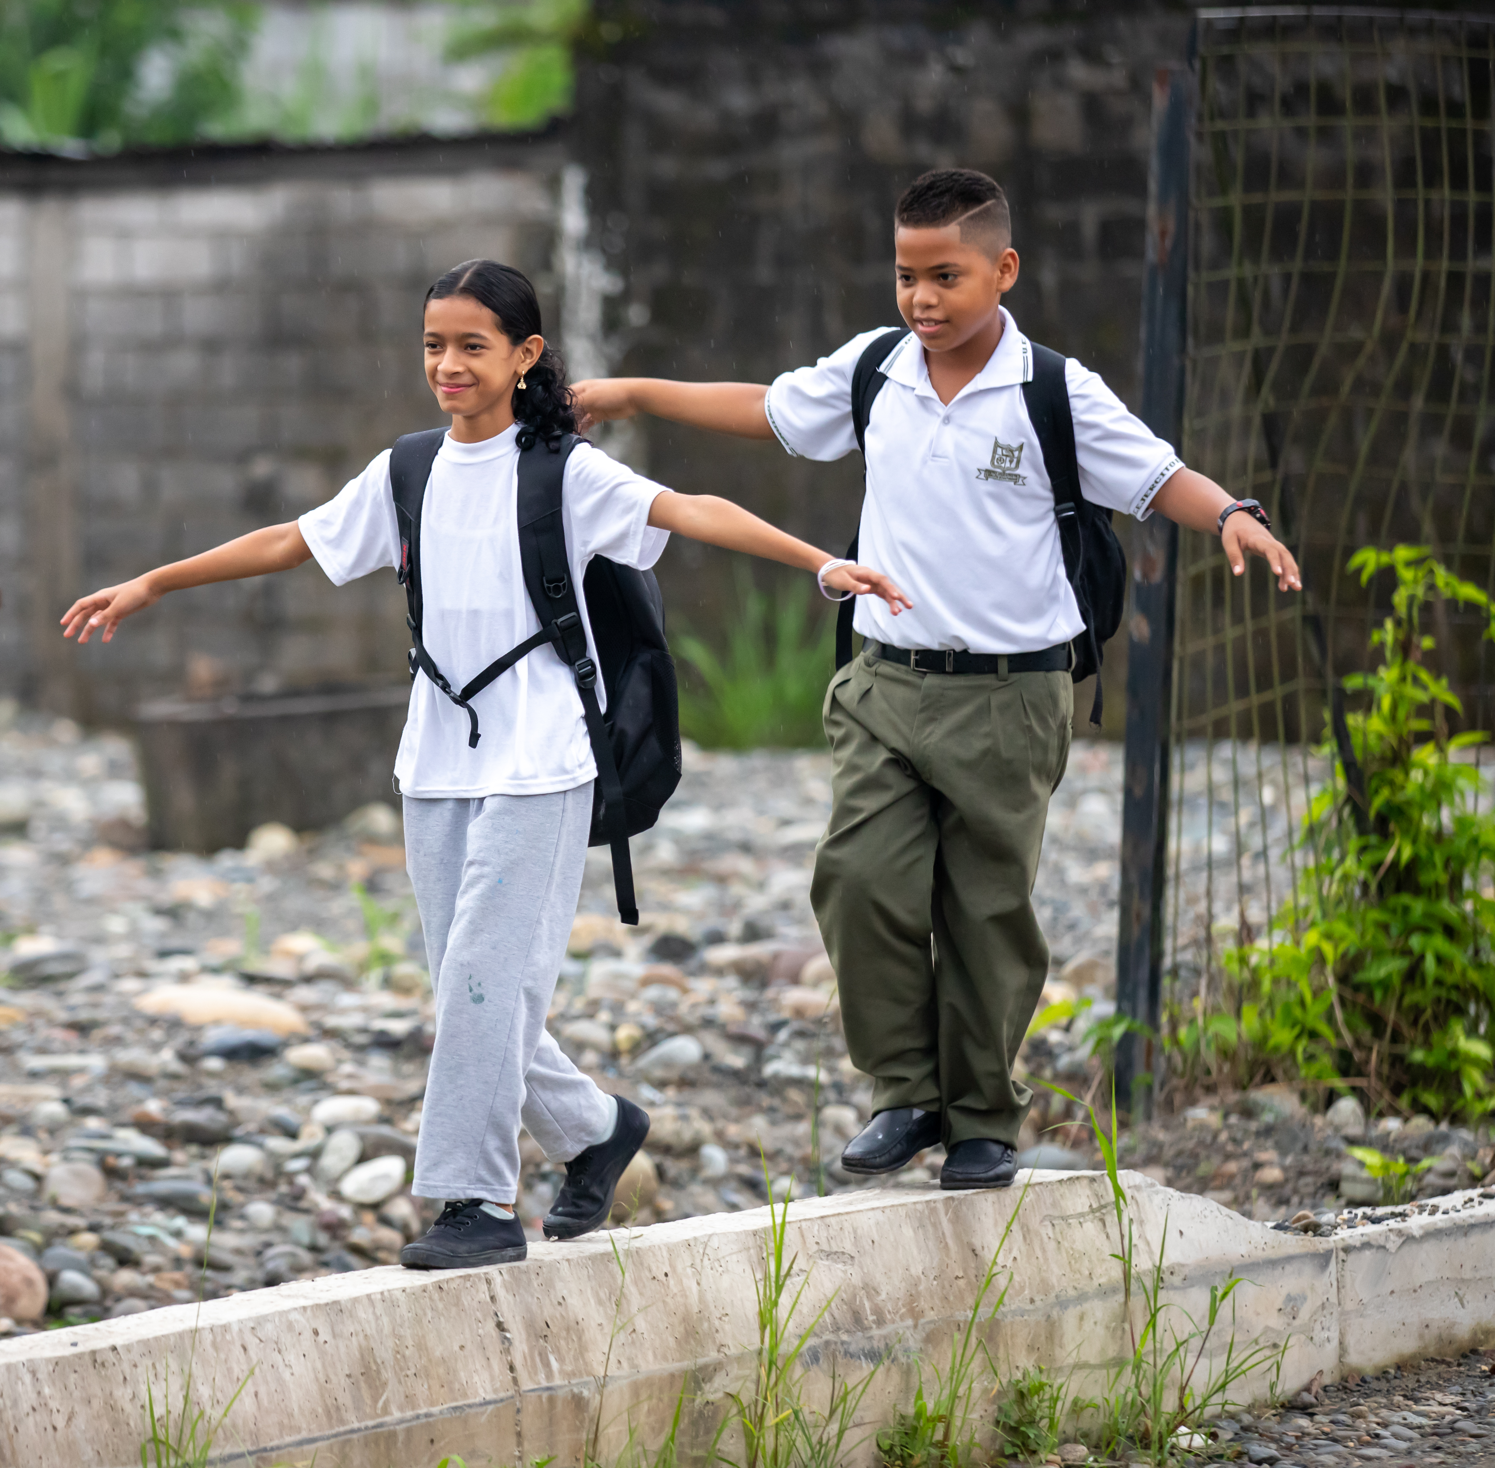
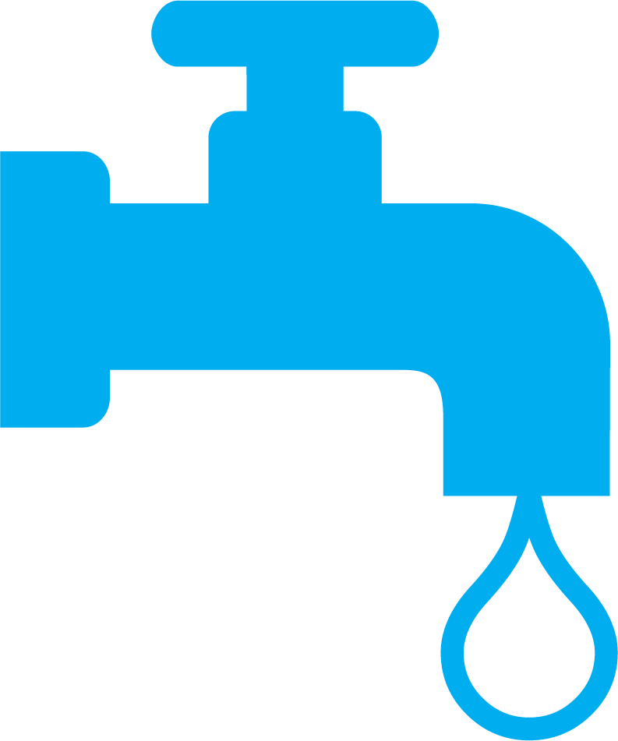
ÁNGEL AND
MERLÍA,
ECUADOR
Because of climate change, children and young people like Ángel and Merlía did not have clean water, and their right to a safe and healthy environment was at risk.
© UNICEF/Terán
Notes:
Climate Story 2:
Angel and Merlia live in Ecuador in an area that’s feeling the effects of climate change, including high temperatures and droughts. Water security – or having enough water for everyone, now and in the future, is a problem the community faces.
Climate adaptation is when we take action to help us live with the effects of the changing climate.
We know that everyone needs safe water to drink, and that clean water is important for children to enjoy their right to the best possible health.
Can you think of what Angel and Merlia’s community might do if they didn’t have water to drink? How might ODA support the government in Ecuador to adapt to this climate effect so that children and their families can access their rights?

Slide 10
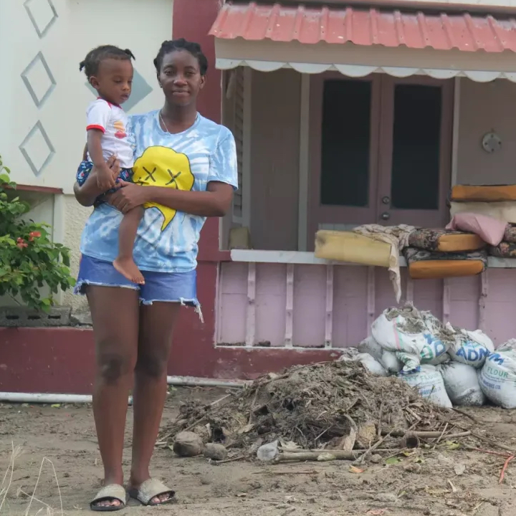

HELEN AND
BABY LUCAS,
GRENADA
"Climate change is real," Helen says.
"We in the Caribbean are paying
the price for what others are doing
to the environment."
© UNICEF/SOproductions
Notes:
Climate Story 3:
Helen and her baby Lucas stand in front of their home in Grenada, an island country in the Caribbean.
In June 2024, Hurricane Beryl, a powerful category 4 storm struck the island where they live. Hurricanes are measured on a scale of 1 to 5, with 5 the strongest, so a category 4 storm is very strong.
“The sea started coming into the road,” Helen said. “My yard started filling up and the sandbags were only able to block some of the water.”
The storm was so powerful that strong winds blew the roof off her home.
Hundreds of families like Helen’s across the northern part of Grenada had to leave their homes behind because of Hurricane Beryl's destruction.
Families lost their homes, schools were destroyed and communities urgently needed shelter, food and water. Many children also needed support for their mental health.
A climate emergency response (or humanitarian response) is when communities need urgent support to meet their immediate needs when a climate event/disaster happens. Sometimes this happens fast (like a hurricane or flood) or more slowly, like a drought or famine.)
How do you think international aid may have supported children and their families in Grenada when a climate emergency like Hurricane Beryl happened?

Slide 11
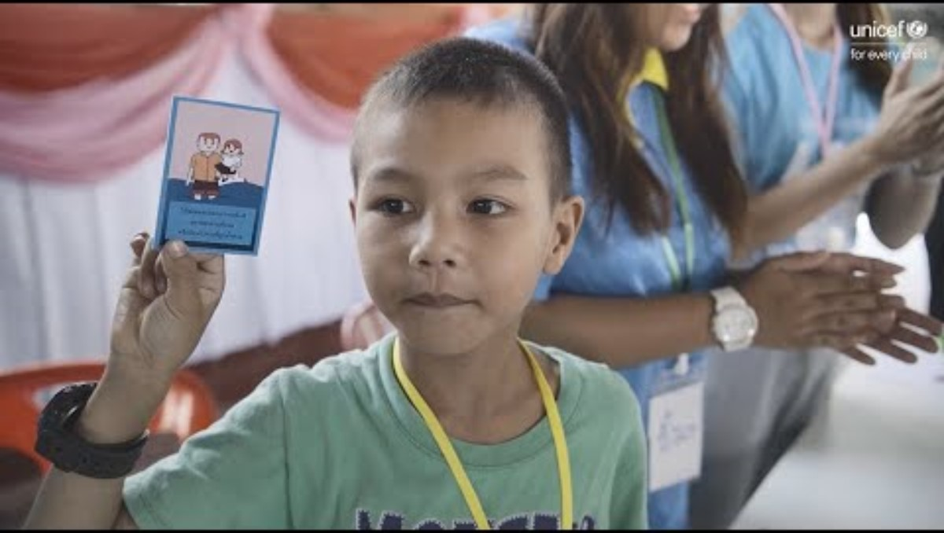
FLOOD
RESPONSE
How ODA is supporting Anuwat’s community in Thailand to prepare themselves for annual flooding.
Notes:
How was ODA used to support the children in the story to enjoy their right to a healthy environment or safe place to live? Who else might be found in their circle of support?
How do you think this story might be different if ODA wasn’t possible?
What did you learn about the obstacles children face, and how ODA can support their government to help make sure children can access their rights? [Map it]

Slide 12
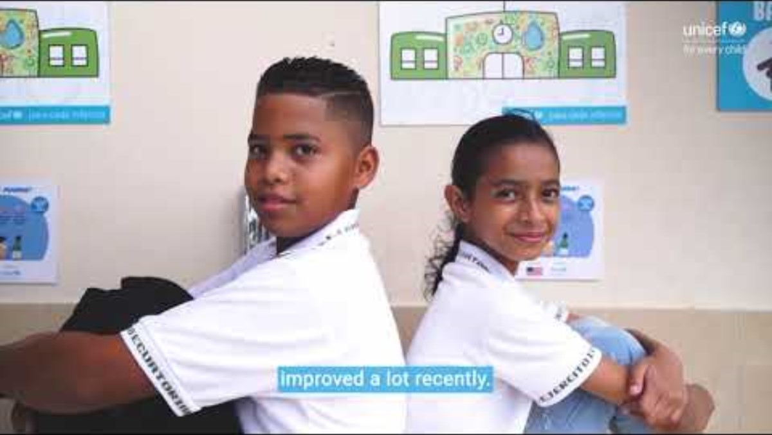
CLIMATE
CHANGE
RESPONSE
How ODA is supporting the government in Ecuador to help Angel and Merlia’s community have access to clean water.
Notes:
How was used to support the children in the story to enjoy their right to a healthy environment or safe place to live? Who else might be found in their circle of support?
How do you think this story might be different if ODA wasn’t possible?
What did you learn about the obstacles children face, and how ODA can support their government to help make sure children can access their rights? [Map it]

Slide 13
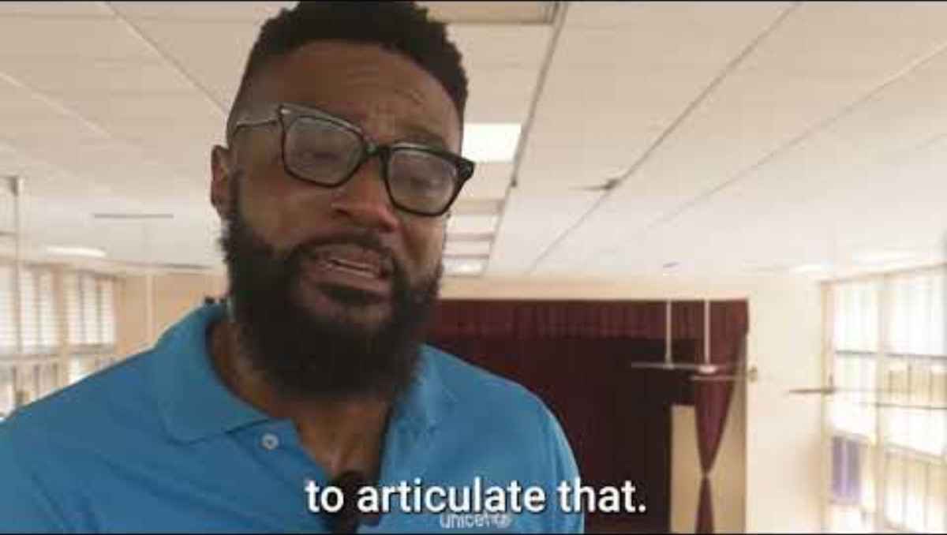
HURRICANE
RESPONSE
Notes:
How was used to support the children in the story to enjoy their right to a healthy environment or safe place to live? Who else might be found in their circle of support?
How do you think this story might be different if ODA wasn’t possible?
What did you learn about the obstacles children face, and how ODA can support their government to help make sure children can access their rights? [Map it]

Slide 14
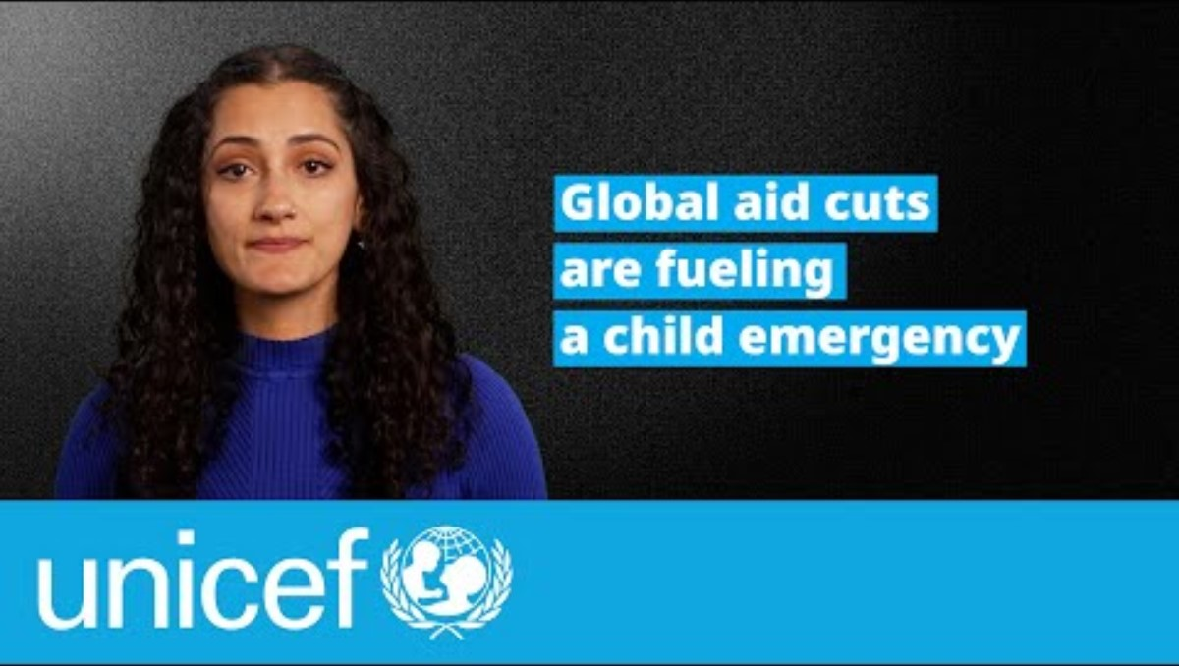
  PART 4
COUNTING
THE COST OF
AID CUTS

Slide 15
  PART 5
What do
we want?
Climate
justice!
WRAP
UP
Climate justice for children.
Speaking
out for
climate
justice
When do
we want it?
Now!

