Slide 1
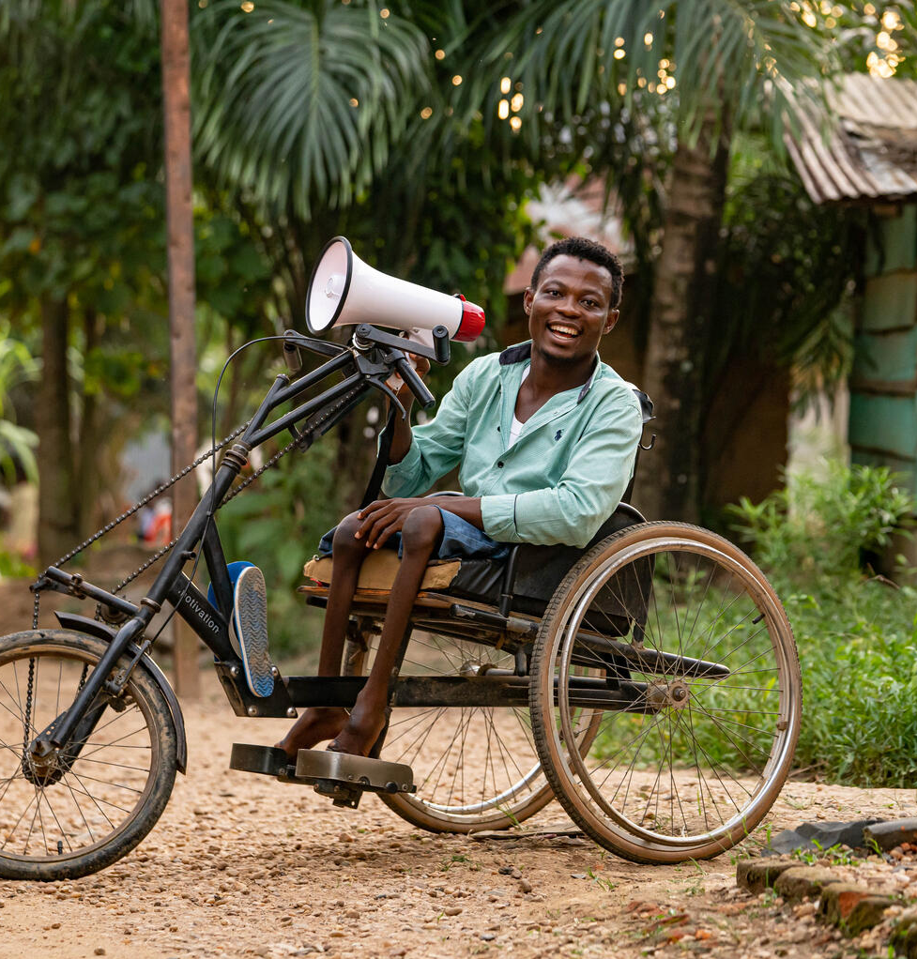


  ACTIVITY 5
  CAMPAIGNING
  AND CONTENT
© UNICEF/Al-Safadi
Rajabu Vambise, 27, polio survivor and UNICEF-supported community worker, educates parents in his neighborhood about vaccinating children against polio in Kindu, Maniema province, DR Congo, March 27, 2024.
© UNICEF/Mulala

Slide 2
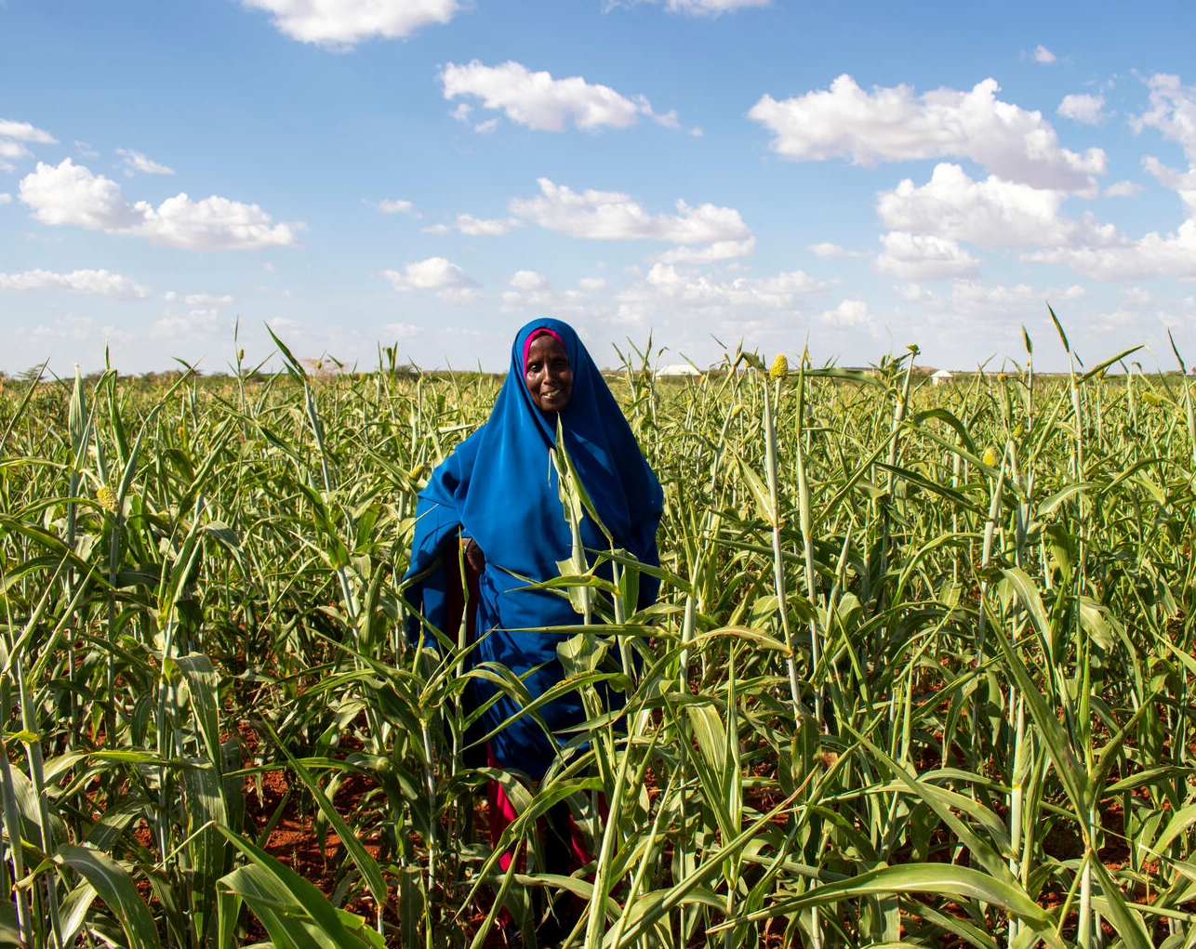
  PART 1
REVIEWING
YOUR
RIGHTS
In 2018, Fatuma Abdulahi Mohamed had lost all her livestock to the drought. She had to leave her home in Hudor, and walk alone with her 9 children, looking for assistance. She eventually reached Kabasa IDP camp in Dollow, Somalia. Fatuma has been tending to the plot of land given to her. She enjoys seeing the vegetables growing over time because it “brings hope.”
© UNICEF/Hill

Slide 3
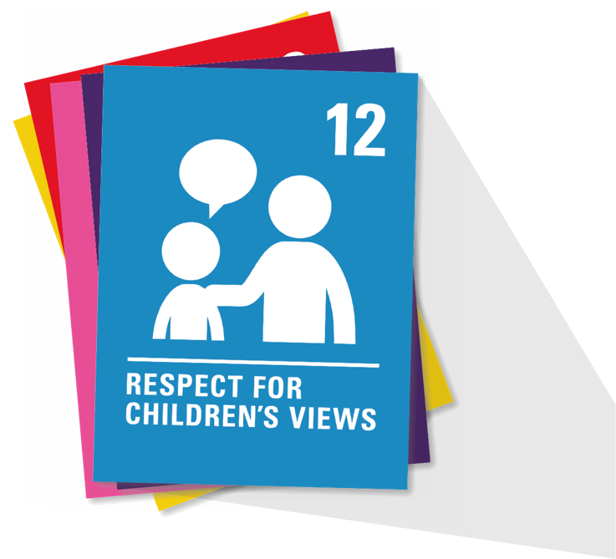
  ARTICLE 12
  Respect for the views of the child
  Every child has the right to express their views, feelings and wishes in all matters affecting them, and to have their views considered and taken seriously. This right applies at all times, for example during immigration proceedings, housing decisions or the child’s day-to-day home life.

Slide 4

  ARTICLE 13
  Freedom of expression
  Every child must be free to express
  their thoughts and opinions and to
  access all kinds of information,
  as long as it is within the law.

Slide 5
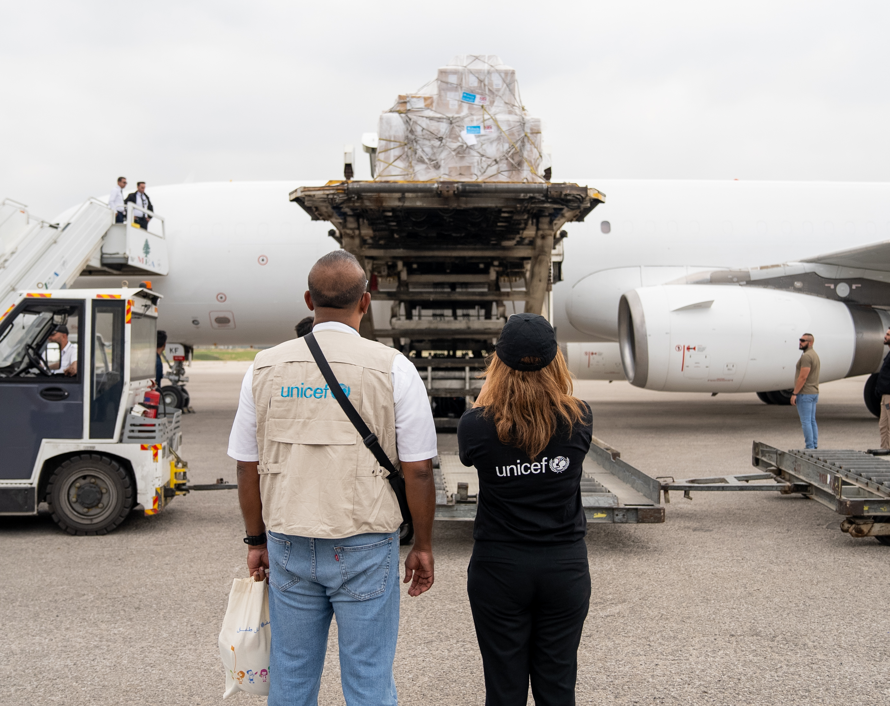
  PART 2
AGREE OR
DISAGREE –
THE DEBATE
FOR ODA
UNICEF delivered 25 tons of emergency medical supplies to the Ministry of Public Health at the Beirut international airport in response to the escalation of conflict in Lebanon.
© UNICEF/Choufany

Slide 6
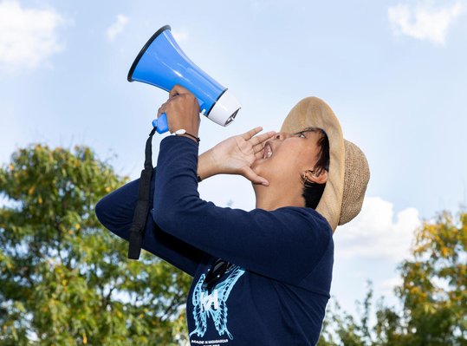
  PART 3
MEET THE
YOUTH
ADVOCATES
© UNICEF/Znidarcic
Youth Advocate Mamisoa Fiderana at United Nations Headquarters in New York, in September 2024. Mamisoa is an Immunization and Health Advocate from Madagascar.

Slide 7
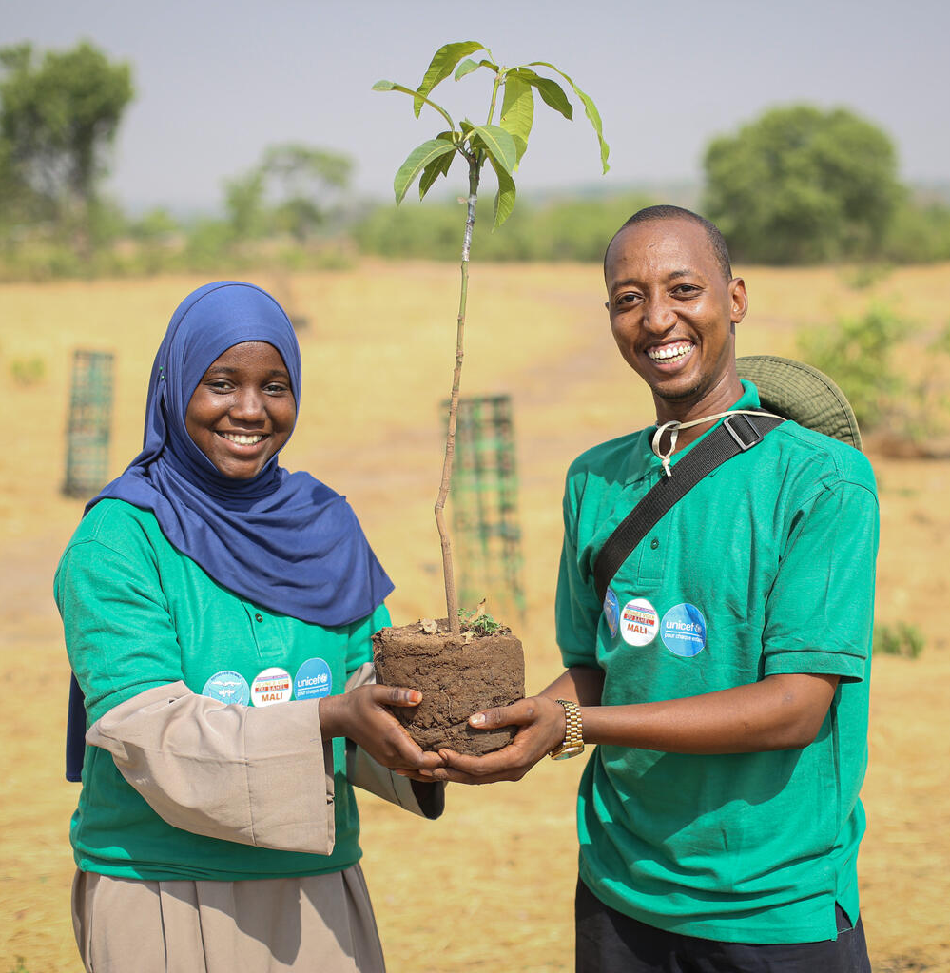
YOUTH
ADVOCATE
AHMED,
MALI
"Each individual has the power to contribute to the protection of our planet and to reduce our carbon footprint. That's why, with other young people, I regularly organise recycling workshops for students and take part in conferences and awareness campaigns to inform and educate people about current environmental issues. I strive to show people the importance of changing our consumption habits and taking actions that protect our environment."
© UNICEF/Keïta
© UNICEF/Pouget
Notes:
Ahmed is a young climate activist from Mali. He wanted to do something to help protect the planet, especially for children like him who are already feeling the effects of climate change. With support from UNICEF and international aid from the Government of Germany (BMZ), Ahmed joined with 20 other young people to take action in a village called Chetou.
Through this project, Ahmed learned how to plan, work in a team, and speak up for the environment. On Earth Day, they travelled from Bamako to Chetou to raise awareness. The school there had no trees, and it got too hot for children to stay all day and children could not to fully enjoy their right to education.
Ahmed and his team taught the students about climate change and why trees are important for a safe and healthy environment. The children then helped plant trees, and each one promised to care for a tree of their own.
Ahmed believes that even simple actions – like planting a tree or changing daily habits – can make a big difference. He also runs recycling workshops and helps teach others about protecting the Earth. In Mali, where most of the population is young, Ahmed believes that children and young people can lead the way toward a healthier planet.
For more details read Ahmed’s story here:
https://www.voicesofyouth.org/blog/becoming-eco-responsible-generation
https://www.voicesofyouth.org/blog/mon-experience-la-cop29

Slide 8
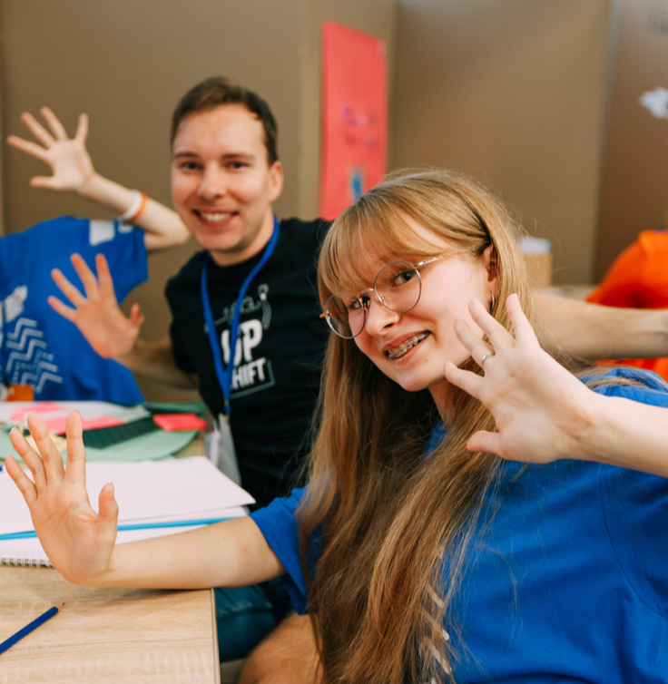
YOUTH
ADVOCATE
MARTA,
UKRAINE
“I started my own project focused on teaching children in my community about hygiene and healthy living. My team consists of my friends Milana, Darina, Viktoria and Nazar. Many of us do not have access to proper sanitation and this becomes a big health problem, especially for children. I have seen this in our schools, where sometimes there are no basic facilities for washing hands. So, I decided to act.”
© UNICEF/Yevtushenko
© UNICEF/Pouget
Notes:
Marta, 16, is from Ukraine. She leads a project that helps children in her community stay healthy. After learning about young people creating a sign language course to help others enjoy their right to education, Marta was inspired to make a difference too.
Marta joined the UPSHIFT programme — a programme supported by UNICEF and funded through international aid from the European Union and other international governments. This programme supports young people in Ukraine to contribute in positive ways in their own communities by starting projects to help others, even during the challenging conflict.
Through Uplift, Marta learned how to plan, work with others and take action. With her friends, she started teaching children about hygiene and how to stay healthy, especially in schools that don’t have clean water or places to wash hands. They run lessons, hand out posters, and help children become “cleanliness ambassadors” in their families. Now they are also teaching about saving water and protecting the Earth. Marta believes that even small steps can lead to big change, and she’s proud to see children becoming active and confident.
For more details read Marta’s story here:
https://www.voicesofyouth.org/blog/how-children-can-change-world-my-experience-promoting-health-and-hygiene
https://www.unicef.org/ukraine/en/upshift

Slide 9
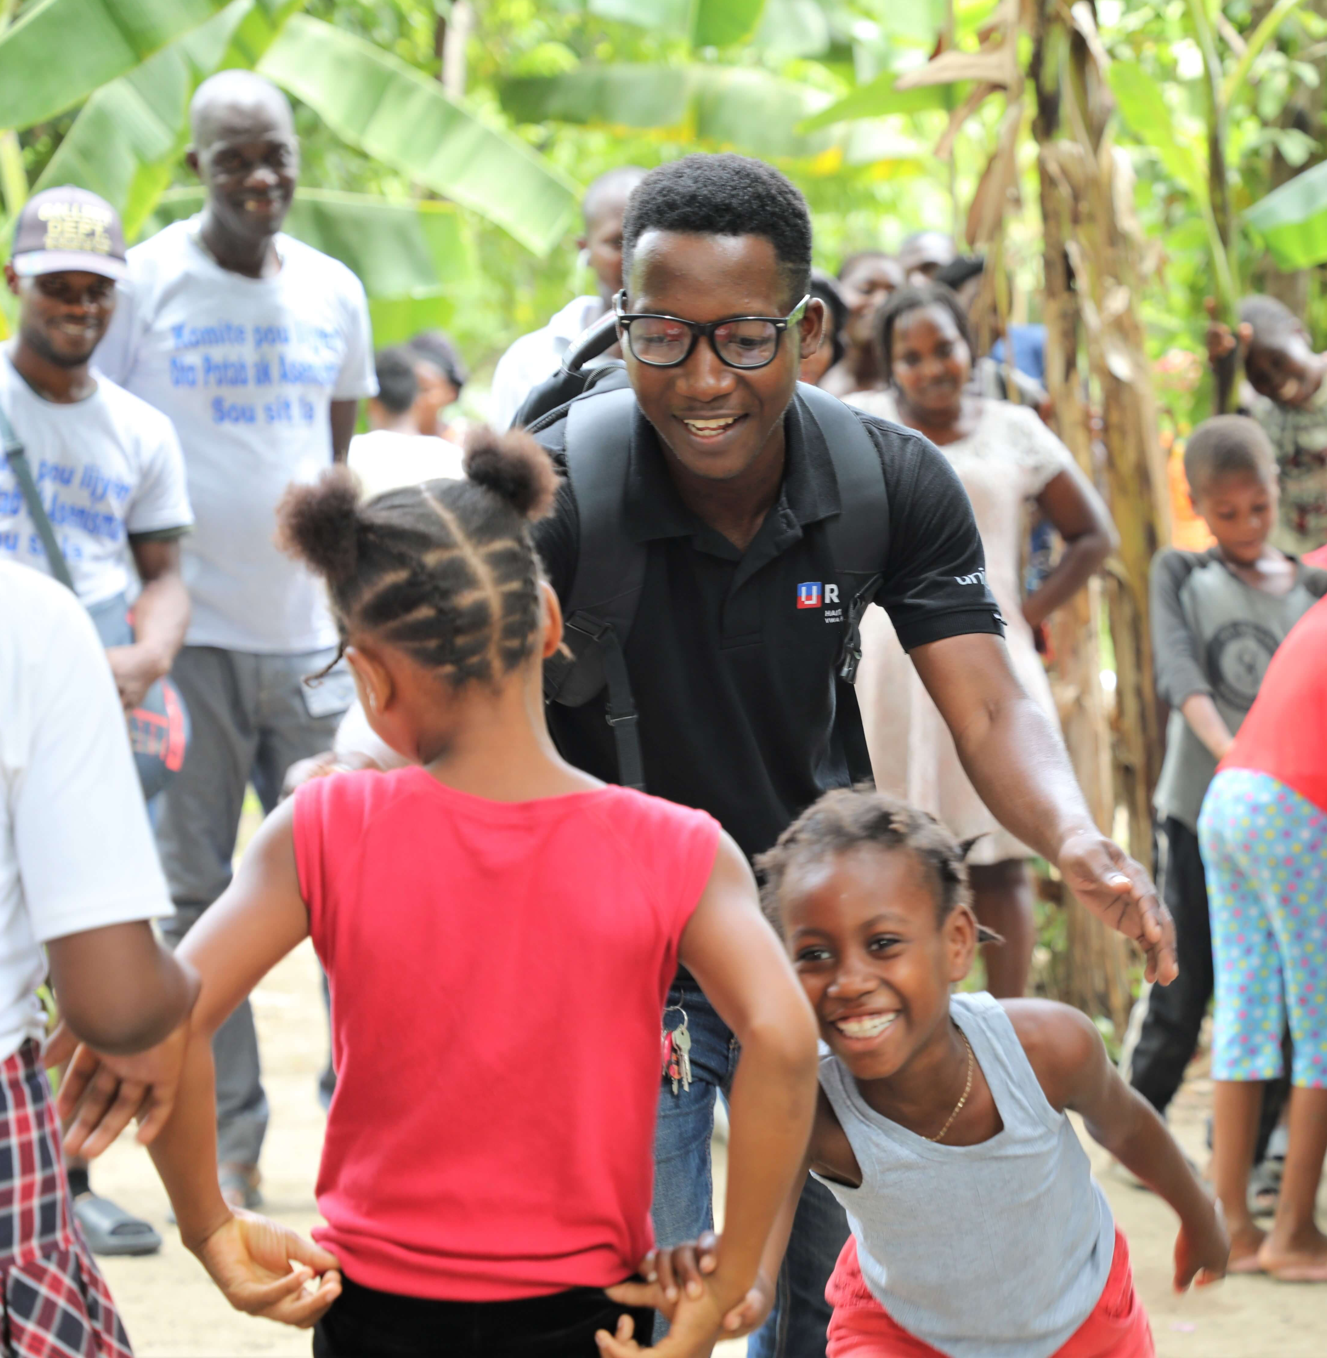
YOUTH
ADVOCATE
JOSEPH,
HAITI
“For me, it’s a duty to come here every day. I talk to the children and their families, and I help them find some comfort in these difficult times.”
© UNICEF/Opota
© UNICEF/Pouget
Notes:
Joseph is 23 years old and from Haiti. He is a member of UNICEF’s U-Report team of youth advocates. In the past years, Joseph’s country of Haiti has been a very challenging place to live. There has been fighting between armed groups, causing danger for families. Many children are going without food and healthcare due to the crisis. Schools have been closed, and many children have been displaced from their homes and are living in camps.
Joseph cares a lot about the rights of children in his country, so he’s working in the camp in Léogâne to support displaced children. He helps to organise psychosocial activities (these are activities that help children to express themselves and be in the best mental health possible) and he teaches children about hygiene and wellness so they can stay as healthy as possible.
“For me, it’s a duty to come here every day. I talk to the children and their families, and I help them find some comfort in these difficult times.”
Read more of Joseph’s story here

Slide 10
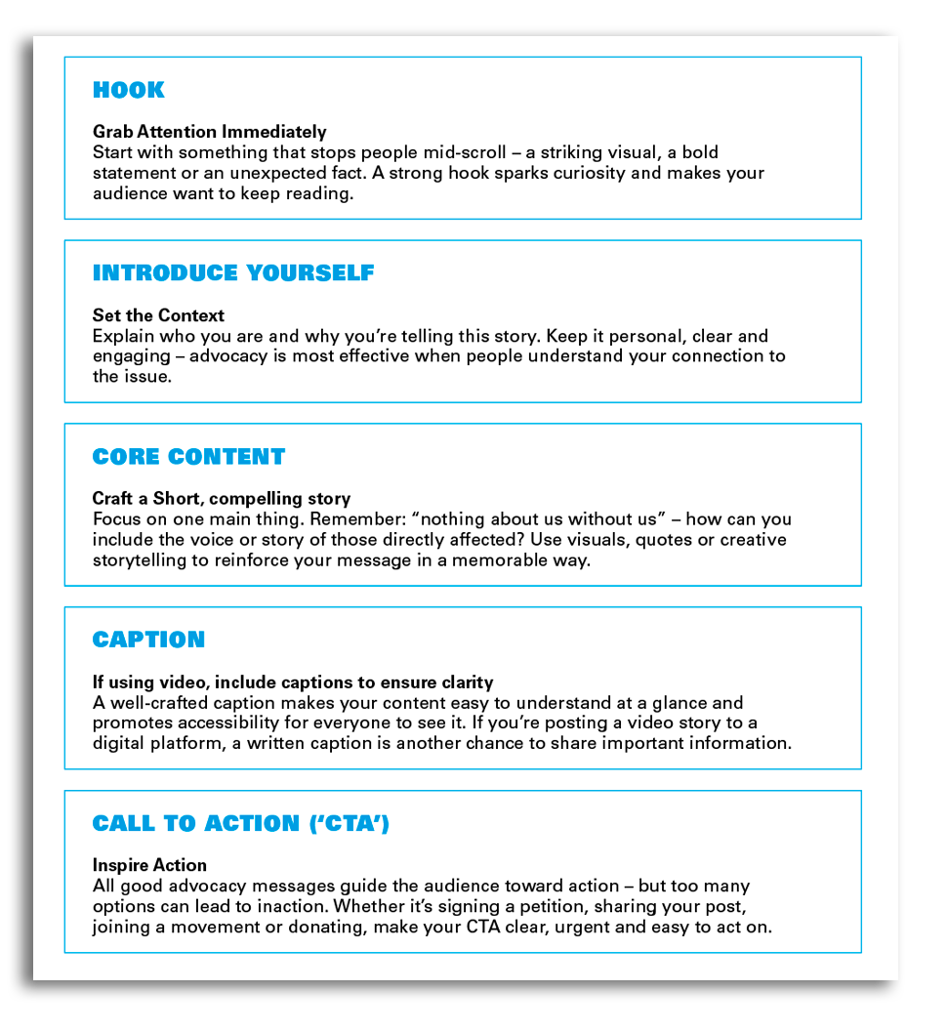
  PART 4
RIGHTS
REEL

Slide 11
Campaigning
with content
Create a message or "ask" for change
Research the issue/data to understand
root causes and solutions
"I saw..., I heard..., I learned... and I care because..."
Listen to people experiencing a problem

Slide 12
  PART 5
Guided Reflection Prompts
1. What did you hear that surprised you?
Let’s take a moment to walk along our mural.
Is there a story that surprised you or made you think differently?
Stand by/stick a note on the part of the mural that meant
the most to you.
2. Was there anything you saw in the stories shared that
you’ve never seen before? Maybe it was an experience
children face in another country, or how aid helped them
gain access to their rights. What caught your attention?
3. Where do you see yourself in the Circles of Responsibility?
In which circles might you use your voice to advocate for the
rights of children?
4. What is one thing you learned about ODA?
5. What might be some of the consequences to children around
the world if funding for ODA is cut further, or even ends?
WRAP
UP

