Slide 1
Inclusive learning in Jamaica

Slide 2
How to use this resource
Rights Around the World is a regular resource series from UNICEF UK’s Rights Respecting Schools Award. It focuses on global citizenship and UNICEF’s work to protect children's rights around the world.
If you are a Rights Respecting School, this resource will help you to meet Outcomes
1 and 9 of RRSA accreditation:
Children, young people and the wider school community know about and understand the United Nations Convention on the Rights of the Child and can share how it impacts on their lives and on the lives of children everywhere.
Children and young people have taken action to claim their rights and promote
the rights of others, locally and globally.
This resource is separated into two parts.
For use in assemblies, tutor time, circle time or a similar session where adults present and discuss a story or topic with children and young people.
PART
1
Filled with activity ideas for building greater understanding on the themes within the story as well as ideas for taking the learning out into the world or building on that learning through creation of a Rights Around the World display board or a passport (or learning journal).
Throughout the pack you will see some items labeled with stars. These are to give you, as the educator, an idea of the level at which the content is pitched.
One star: For children in early years settings and/or those more confident with simpler concepts.
Two stars: For children and young people who have a good level of comprehension and reflection ability.
Three stars: For young people who have the confidence and maturity to explore more challenging themes, concepts and ideas.
Always review content before you use it within your setting. The notes linked to each slide provide guidance and extra information.
PART
2

Slide 3
Presentations for assemblies or group sessions
PART
1

Slide 4

This month we are in…
Jamaica

Slide 5

Traveller's guide
T
Jamaica
Jamaica is the third biggest island in the Caribbean. It would fit into the UK 22 times.
Jamaica has a population of 2.8 million.
Kingston
The official language is English but Patois is also spoken. Patois is a Creole dialect which has aspects of many other languages.
Kingston is the capital of Jamaica. It is a UNESCO City of Music.
Jamaica sits on top of a vast underwater mountain.
The Jamaican flag is one of only a few in the world that doesn’t feature red, white or blue.
Jamaica gained independence from 300 years of British rule in 1962.
Notes:
Edit the facts suit your audience. Boxes can be deleted if you would prefer to focus on fewer facts.
Sources:
Third biggest island: https://caribbeanwarehouse.co.uk/blog/2021/12/facts-about-jamaica/
Population: 2.8 million (UK population: 65 million): https://kids.nationalgeographic.com/geography/countries/article/jamaica
Official language English, Patois creole dialect: https://kids.nationalgeographic.com/geography/countries/article/jamaica
Capital Kingston: https://kids.nationalgeographic.com/geography/countries/article/jamaica
Sits on top of underwater mountain: https://kids.nationalgeographic.com/geography/countries/article/Jamaica
Jamaican flag: https://caribbeanwarehouse.co.uk/blog/2021/12/facts-about-jamaica/
Independence: https://caribbeanwarehouse.co.uk/blog/2021/12/facts-about-jamaica/

Slide 6
Intro to UNICEF in Jamaica
UNICEF’s work in Jamaica is guided by the Convention on the Rights of the Child which Jamaica ratified in 1991, the same year that it was ratified by the UK.
There are 5 priority areas that UNICEF Jamaica work on:
Keeping children safe
Working with children to promote climate action and sustainable development
Developing policies and services that help children become free from poverty
Every Jamaican child to get the best possible start in life
Education: ensuring every child in Jamaica can learn in a safe environment
We are going to explore UNICEF Jamaica's work supporting children to access education.
Notes:
Use this slide to make the link to UNICEF’s work. The following slides will bring this to life through the case study of Ari's story.
Learn more about UNICEF in Jamaica: https://www.unicef.org/jamaica/
You may wish to explore what the word ‘ratified’ means with your pupils. When a country ratifies a law, it means that they have agreed to it. In other words, when a country 'ratifies' the CRC it means that the people in charge (government) agree to do all they can to make sure children have their rights.

Slide 7
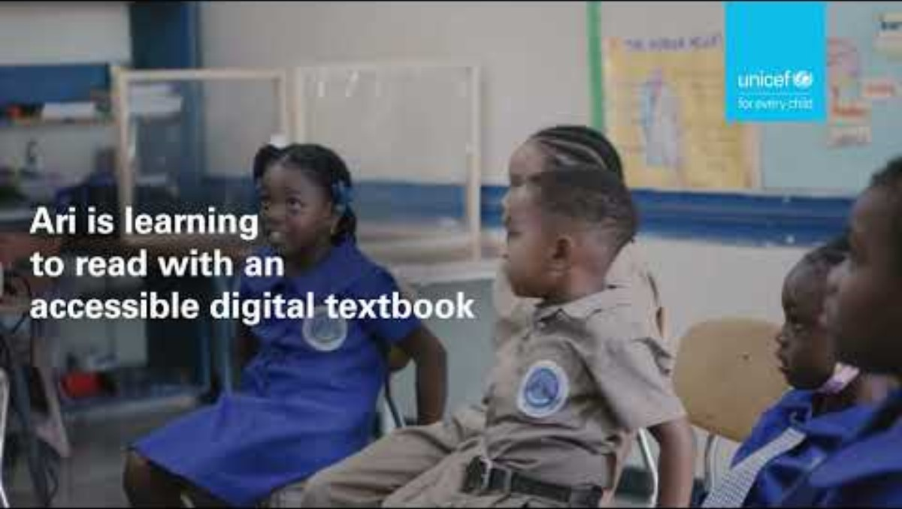
Ari's story
Ari is 6 years old and lives in Kingston, Jamaica.
He is deaf and uses Jamaican Sign Language to communicate, which he taught himself using YouTube.
UNICEF has helped to fund a project where deaf children can learn to read using digital textbooks.
Notes:
The video in this slide is 30 seconds long.
Slide 7 and slide 8 offer the same content in different levels of detail.
Select the slide that is most appropriate for your pupils.
Remember to play the video full screen, and you have the choice to display captions.
There is a longer version of Ari’s story on the next slide. You may wish to watch this before deciding which video to share.
Pupils could be encouraged to reflect on Ari's feelings about using the accessible digital textbook.
You could also delete the text if you prefer to read this out to your pupils:
Ari is 6 years old and lives in Kingston, Jamaica.
He is deaf and uses Jamaican Sign Language to communicate, which he taught himself using YouTube.
UNICEF has helped to fund a project where deaf children can learn to read using digital textbooks.

Slide 8
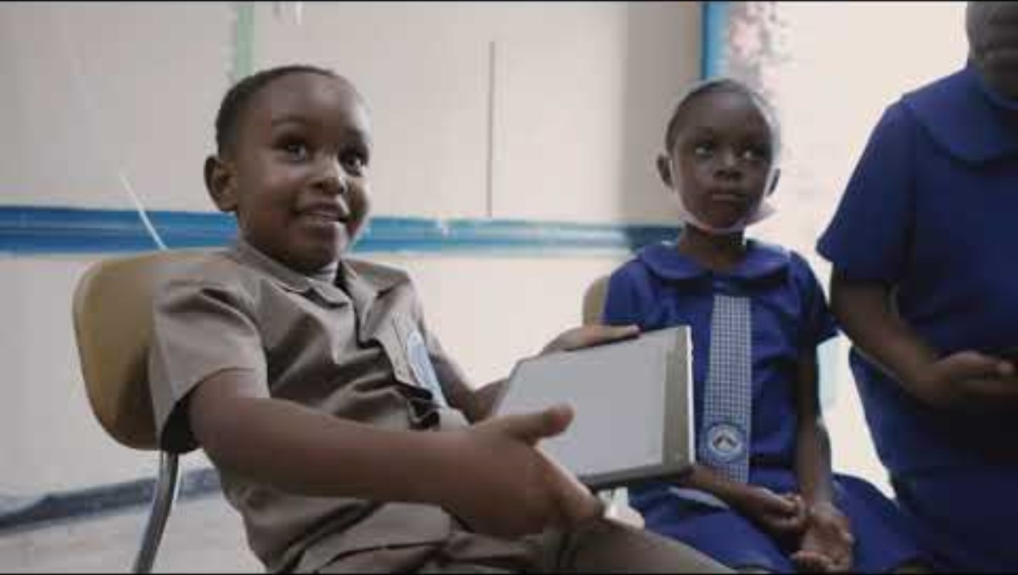
Ari’s story
Ari is 6 years old and lives in Jamaica. He was diagnosed with Auditory Neuropathy as a baby, a disorder that hinders sound transmitting from the inner ear to the brain. But this does not hold Ari back from finding new ways to express himself. In fact, he has already taught himself Jamaican Sign Language using YouTube.
As soon as he gets home from school, Ari wants to share what he has learned with his grandmother. He searches for ‘My Brain is My Boss’ on his tablet (a UNICEF Accessible Digital Textbook) on an app called BookFusion.
Ari’s success helped to motivate UNICEF to work with other organisations to share Accessible Digital Textbooks with more children.
Notes:
The video in this slide is 2 minutes and 50 seconds long.
Slide 7 and slide 8 offer the same content in different levels of detail. This is a longer video for older children or those more able to cope with complex ideas.
Select the slide that is most appropriate for your pupils.
Remember to play the video full screen, and you will need to put the subtitles/ closed captions on.
Pupils could be encouraged to reflect on Ari's feelings about using the accessible digital textbook.
You could also delete the text if you prefer to read this aloud to your pupils:
Ari is 6 years old and lives in Jamaica. He was diagnosed with Auditory Neuropathy as a baby, a disorder that hinders sound transmitting from the inner ear to the brain. But this does not hold Ari back from finding new ways to express himself. In fact, he has already taught himself Jamaican Sign Language using YouTube.
As soon as he gets home from school, Ari wants to share what he has learned with his grandmother. He searches for ‘My Brain is My Boss’ on his tablet (a UNICEF Accessible Digital Textbook) on an app called BookFusion.
Ari’s success helped to motivate UNICEF to work with other organisations to share Accessible Digital Textbooks with more children.

Slide 9
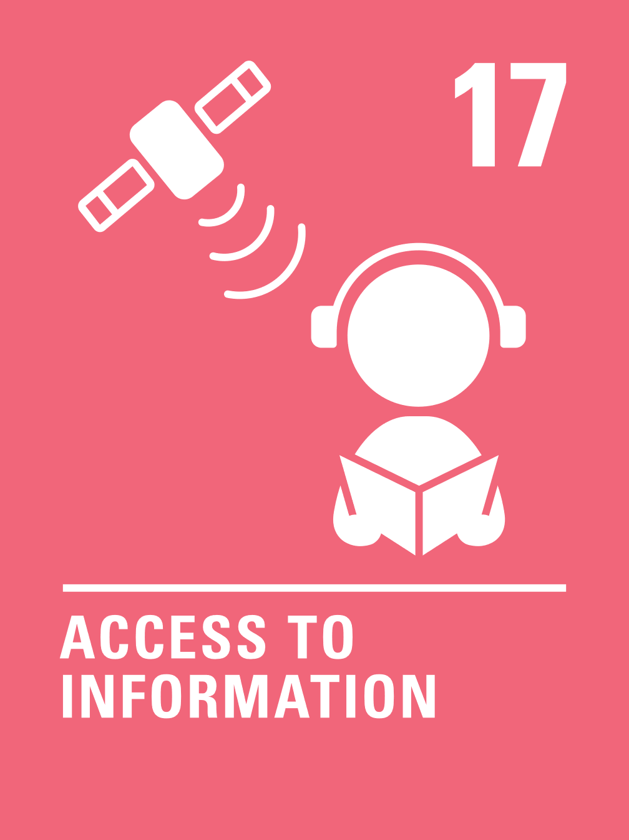
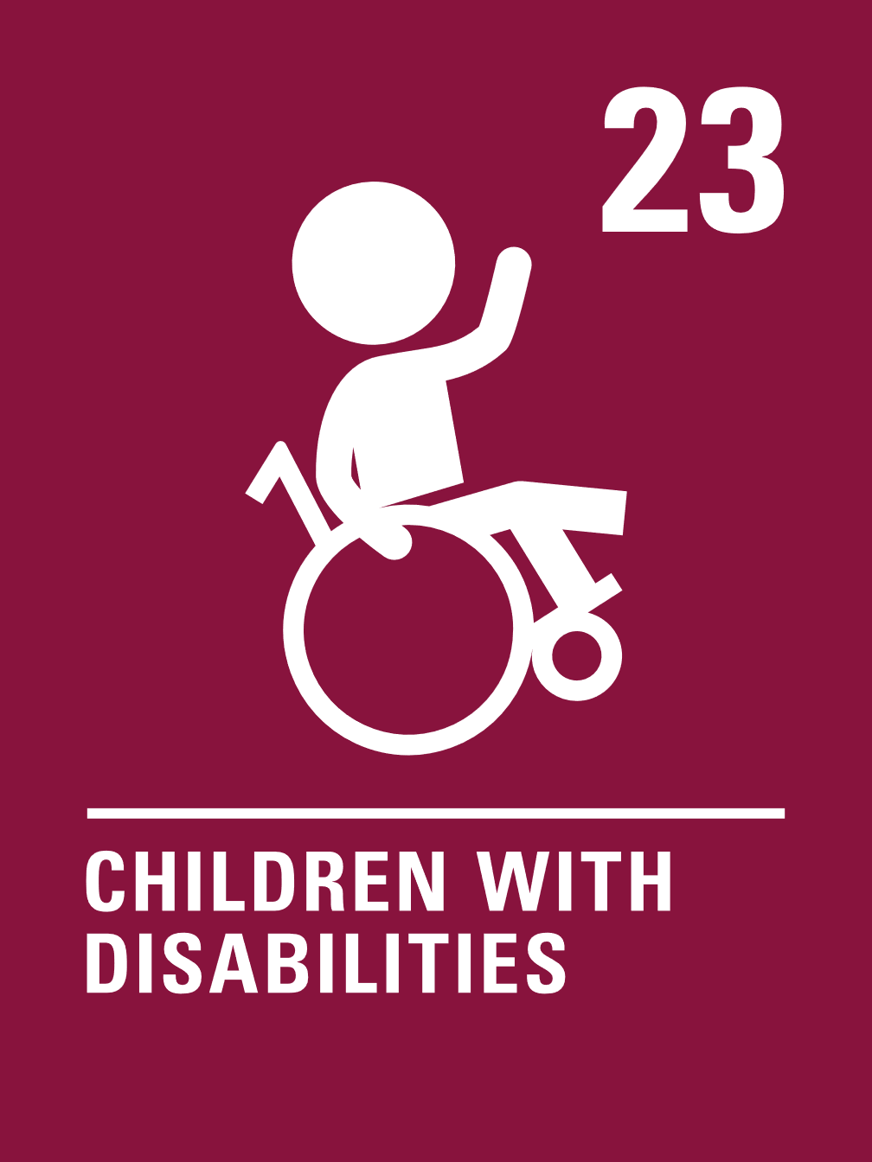

Linking to children’s rights
Think about the rights that you know.
Which articles are particularly relevant to this case study?
Click to reveal some examples.
Why do you think we’ve highlighted this selection?
Did you identify others?
Notes:
Adapt to suit your pupils.
You may wish to spend some time recapping what children’s rights are. You could even add a visual of the whole CRC to your presentation.

Slide 10
Linking to the Global Goals
Why do you think we’ve highlighted this selection?
Did you identify others?
Notes:
Optional slide
If your pupils are not currently familiar with the Global Goals please remove this slide and the next one.
To find out more about the Global Goals: https://worldslargestlesson.globalgoals.org/ or https://globalgoals.org/.

Slide 11
Linking to the Global Goals
Why do you think we’ve highlighted this selection?
Did you identify others?

Slide 12



Reflection
Think back to what you have learnt about Jamaica, Ari and UNICEF’s work.
Is there anything that surprised you or you thought was particularly interesting?
Is there anything you would like to learn more about?
Notes:
Before ending the session encourage pupils to reflect on what they have learnt. You could ask them to share their reflections in pairs, small groups or to the whole group.

Slide 13
Now choose your activities
PART
2
Notes:
The following 3 slides offer a range of activities linked to the assembly topic of inclusion. Please read through and edit choosing those that are suitable for the children and young people you are working with. Do edit and elaborate as you see fit. You could also create your own activities inspired by the presentations in part one.

Slide 14
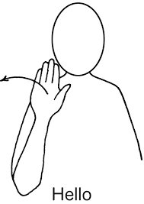
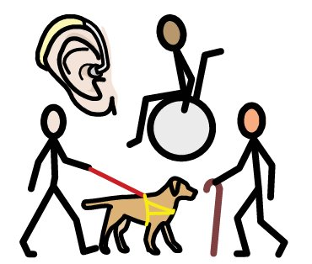
Build Your Understanding
.
.
Makaton is a sign language often used by people who have communication difficulties. Do you know any Makaton? There are lots of resources online to support you to learn Makaton. Why not learn some signs and use them around your school?
There are different types of disabilities, for example some children may need to use a wheelchair or need support to walk, some may find it hard to see or to hear, and some may need support to stay calm. Tour your school with an adult to find areas that could be tricky for some children with disabilities. How could these be changed?
Ari is reading a book with his friends. Why not have a go at reading the same book? Look at the person signing in Jamaican sign language. Where else have you seen people signing – perhaps on TV programs or if you have been to a concert with your family?
.
Hold a circle time activity to discuss a selection of symbols from this version of the CRC. What do you think the symbols mean? What rights could they represent? Do the symbols make rights easier to understand? Place these symbols around your school to remind people about rights.
Notes:
This month’s story was about inclusive education in Jamaica. The activities here will support learners to explore this topic in more detail. Choose one or more activities as featured here or amend them to suit your setting. You could also create your own activities inspired by the presentations in part one.
Some resources that you might like to use to accompany some of these activities:
PECS (Picture Exchange Communication System) https://www.speechandlanguagekids.com/picture-exchange-communication-system-pecs-non-verbal-children/
Here is the book that Ari is reading:
https://reader.bookfusion.com/books/2592566-my-brain-is-my-boss-unicef?type=epub
Makaton charity https://www.makaton.org/
Inclusive symbol CRC icons: https://www.cypcs.org.uk/wpcypcs/wp-content/uploads/2020/02/UNCRC-Symbols-Cards.pdf

Slide 15
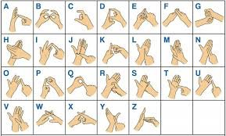

Build Your Understanding
.
.
UNICEF has used technology to support Ari to access his right to an education.
Design an invention that could help someone with a disability to access their right to an education, linked to Article 28 and Article 23.
British Sign Language (BSL)
is a visual means of communication using gestures, facial expression and body language used in
the UK. Challenge yourself
to spell out your name in BSL.
.
Read the simplified wording of Article 23. UNICEF Jamaica is working to support children to access education. Create and conduct a survey to ask children how accessible your school is.
Review your findings and think about what you could do to make changes so that all pupils can access all parts of school and learning successfully.
How does it feel for a sighted person to follow instructions without being able to see? Sit back-to-back with a partner. Partner A has a simple picture that they describe to Partner B who follows the instructions, keeping their eyes closed. How accurate is Partner B’s drawing?
Notes:
This month’s story was about inclusive education in Jamaica. The activities here will support learners to explore this topic in more detail. Choose one or more activities as featured here or amend them to suit your setting. You could also create your own activities inspired by the presentations in part one.
Some resources that you might like to use to accompany some of these activities:
There are over 300 different sign languages used across the world. Sign languages across the world
The CRC in International Sign Language https://bit.ly/crciconsvideo
British Sign Language: https://www.british-sign.co.uk/
A BBC Newsround video about how to include children with a hearing impairment
Symbol version of the UNCRC: https://www.cypcs.org.uk/wpcypcs/wp-content/uploads/2020/02/UNCRC-Symbols-Cards.pdf

Slide 16
Build Your Understanding
Revisit the wording of Article 23. Discuss the kinds of things that you do regularly such as going to the shops, getting public transport, going to the park. Explore how it is to do those things with different kinds of physical and/or communication difficulties.
Are these spaces and activities accessible to everyone or are there changes that could be made? .
Think about how festivals and big events make sure that they are fully inclusive. Think about interpreters, accessible viewing platforms etc. Watch the video included in this toolkit from RIBA and look at their Inclusive Events Checklist. How could you ensure that events run by your school are more accessible in line with Article 23? Create your own accessibility checklist for school events.
Conduct a survey to look at how accessible your school is.
What could you do as a school to ensure that all pupils can access all parts of school and learning successfully?
. .
Explore how UNICEF Jamaica supports other children with disabilities. Check out Shemoya and Kyle’s stories.
Share what you have learnt and carry out research on how the UK government supports children with disabilities in the UK to access education.
Explore the wording of Article 17 and consider how this links with Article 23.
Discuss how your school (or local community) ensures that people have access to information in different ways so that people with a range of needs can access them.
. .
Notes:
This month’s story was about inclusive education in Jamaica. The activities here will support learners to explore this topic in more detail. Choose one or more activities as featured here or amend them to suit your setting. You could also create your own activities inspired by the presentations in part one.
RIBA stands for The Royal Institute of British Architects. They are an organisation who try to make buildings and places more inclusive.
Some resources that you might like to use to accompany some of these activities:
Sign languages across the world
PECS (Picture Exchange Communication System) https://www.speechandlanguagekids.com/picture-exchange-communication-system-pecs-non-verbal-children/
Here is the book that Ari is reading:
https://reader.bookfusion.com/books/2592566-my-brain-is-my-boss-unicef?type=epub
Makaton charity https://www.makaton.org/
Inclusive symbol CRC icons: https://www.cypcs.org.uk/wpcypcs/wp-content/uploads/2020/02/UNCRC-Symbols-Cards.pdf
British Sign Language: https://www.british-sign.co.uk/
A BBC Newsround video about how to include children with a hearing impairment
Jamaican Association for the Deaf: Jamaica Association for the Deaf
UNICEF Jamaica’s YouTube Channel: https://www.youtube.com/@UNICEFJamaica
General Comment Number 25 is about children’s rights in relation to the digital environment General comment No. 25 (2021) on children’s rights in relation to the digital environment | OHCHR. There is also a young people’s version. In_Our_Own_Words_Young_Peoples_Version_Online.pdf This may be useful to consider when thinking about Article 17 and it’s implications

Slide 17
Take your learning into the world
Take Action​
Think about accessibility challenges you have identified in your school or local community. Are there any improvements you think should be made? Contact your school Governors or local Councillor to discuss your ideas.
Get creative
Reflect on your learning about UNICEF Jamaica and Ari.
Using words or pictures, present barriers to learning some children might experience and what you have done to make your school more inclusive.
Add to your passport
Add information about what you have learned to your Rights Around the World passport.
Include interesting facts about Ari’s story and any actions you took because of your learning.
Notes:
Take Action:
Children may have explored how to make their school or community more inclusive. To support Outcome 9 of RRSA, children can use this learning to take an action and create a positive change.
Get Creative:
You have the option to use display materials (found here: https://www.unicef.org.uk/rights-respecting-schools/resources/teaching-resources/rights-around-the-world/) to create a display of your learning and/or actions.
Add to your passport:
You have the option to use the Rights Around the World passport (found here: https://www.unicef.org.uk/rights-respecting-schools/resources/teaching-resources/rights-around-the-world/) These materials can be used to create individual passports for children or to create a class floor book to record learning.

Slide 18
Further information & OutRight
The next Rights Around the World Resource will be shared on 2nd October 2025.
If you have enjoyed using this resource, you may also enjoy using UNICEF UK's OutRight resources. This year OutRight will focus on International Aid. Children and young people will develop their understanding of their rights, international aid and why it is an important part of being a global citizen. We’ll learn about the impact that international aid can have on both climate change and education globally.
You can use OutRight as evidence in your RRSA accreditation journey, and you’ll receive support and additional resources along the way.
https://www.unicef.org.uk/rights-respecting-schools/resources/teaching-resources/outright/
Notes:
This slide is for information only and not for class presentation

