Slide 1



© UNICEF/Al-Safadi
  WELCOME
  TO OUTRIGHT
In 2024, UNICEF UK partnered with two Rights Respecting Schools in the UK to create a set of images relating to rights. These images were co-created with students at the schools, meaning that the subjects, composition and aesthetics of the images were all driven by the students themselves.
© UNICEF/Maule-Ffinch

Slide 2
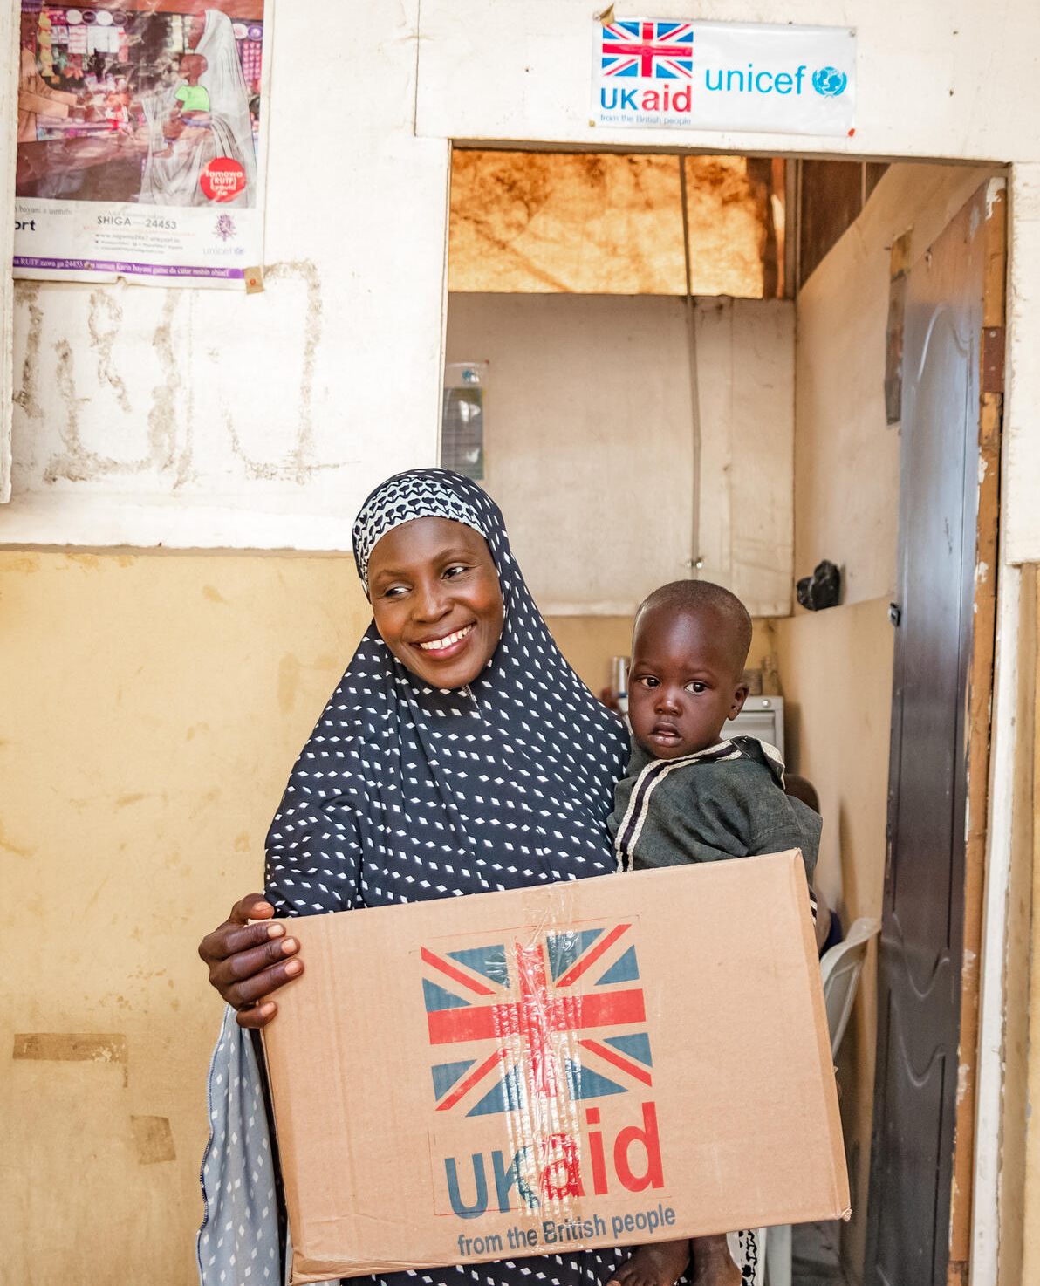
  THE CAMPAIGN
This year, children and young people taking part in OutRight will develop their knowledge of:
Relevant children’s rights and the UNCRC
What international aid is and why it is important (using climate change and education as examples)
How to use their voices on international issues that matter to them and their community, by contacting decision makers.

Slide 3
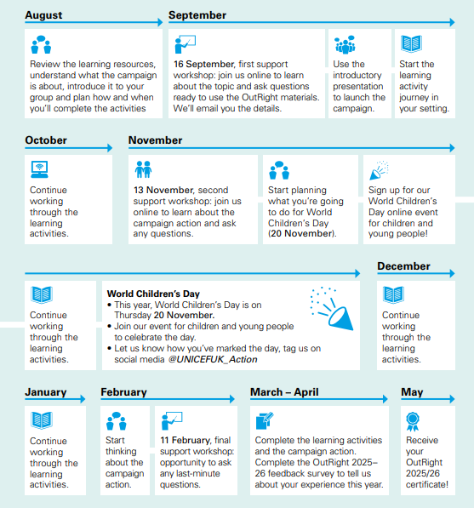
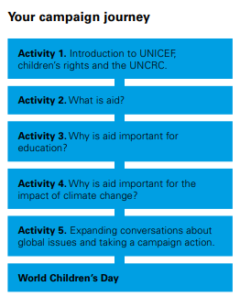

Slide 4



Slide 5
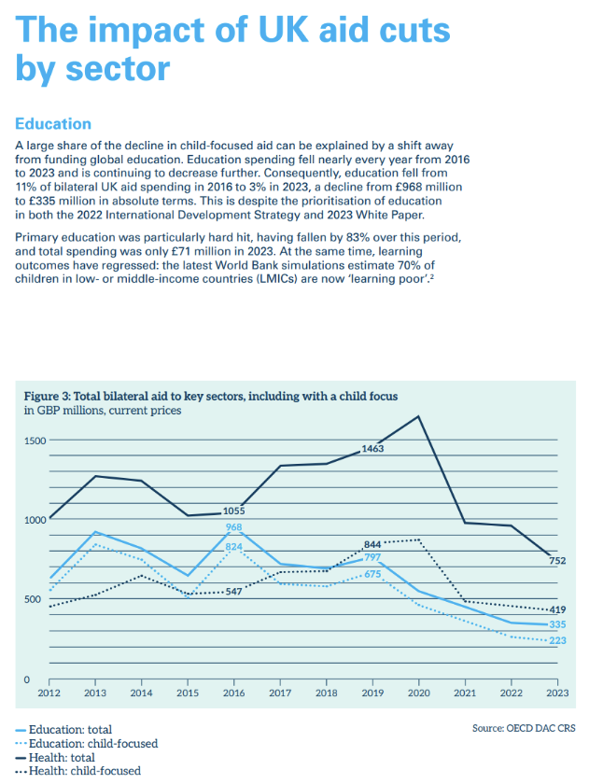
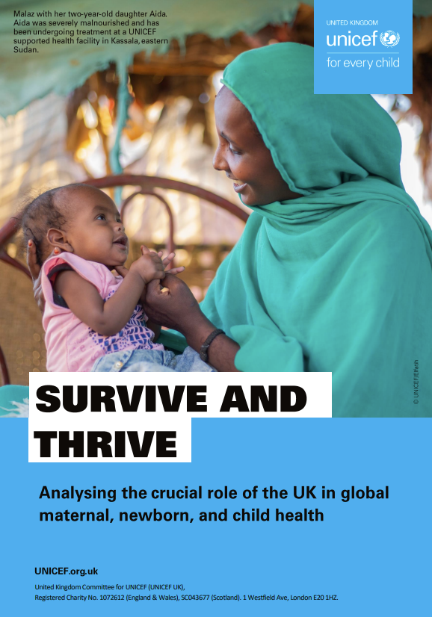
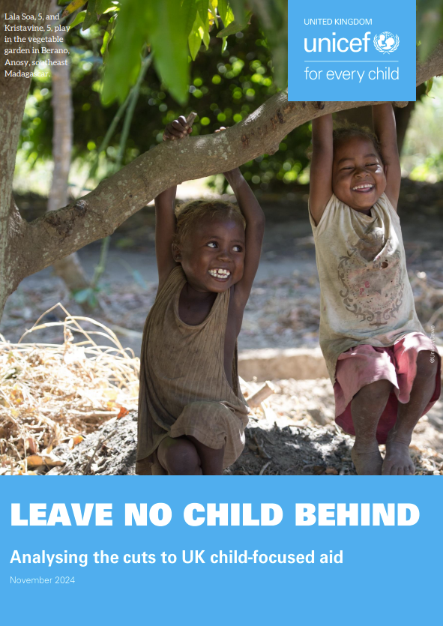
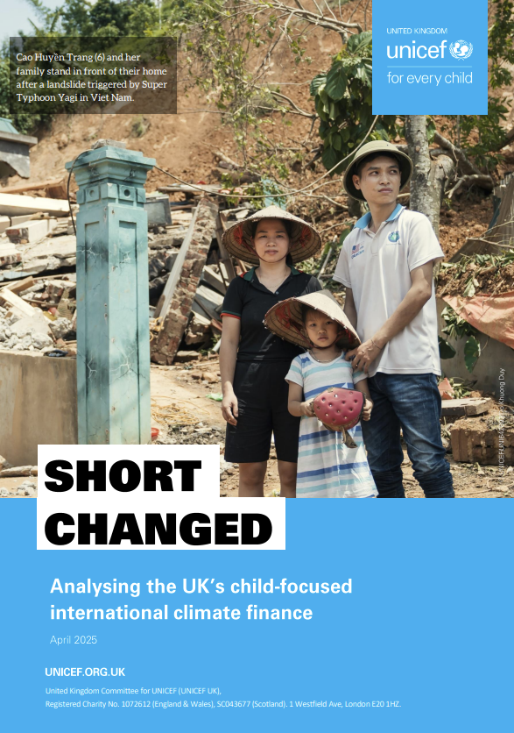
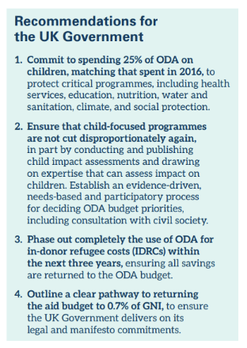
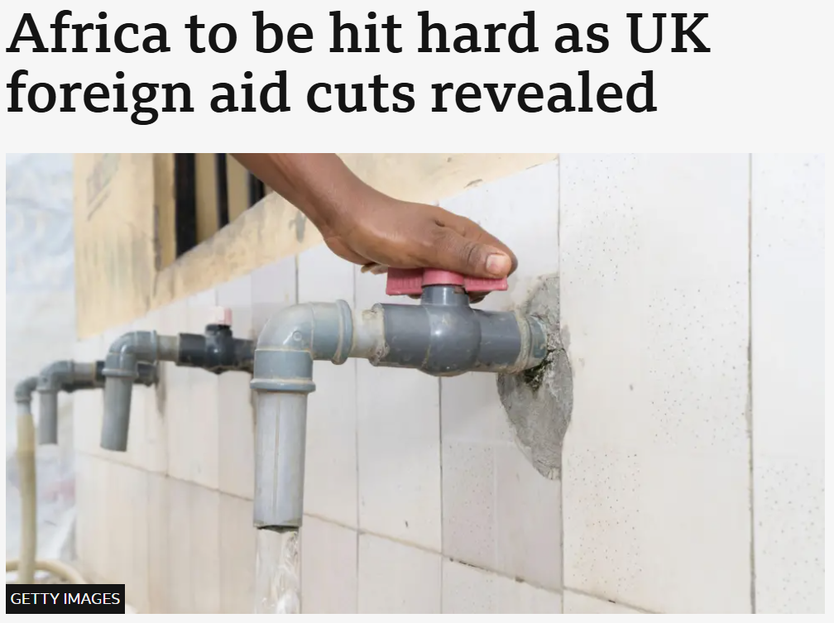
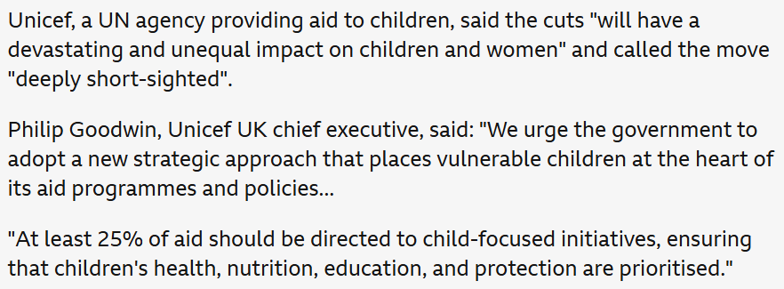
What is (International) Policy?

Slide 6
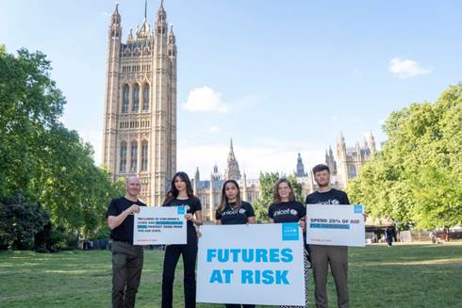
Outright x International Policy
Why we are excited to work with you
SHORT TERM: since February 2025, our top priority as a team has been to ensure the protection of programmes for critical services for children are protected from further aid cuts.
We know that UK children are supportive of helping other children around the world to achieve their rights.
LONG TERM: We also know that the aid system is not perfect. We welcome the next generation being supported to better answer the complex questions about how to support global development.

Slide 7
What is international aid?
Who gives international aid and why?
What people generally refer to as international aid is officially called Official Development Assistance or ODA and is defined by the OECD Development Assistance Committee (DAC).
The UK is one of 31 countries and the European Union who are members of the DAC.
The DAC defines ODA as activities carried out with the economic development and welfare of developing countries as their main objectives.
How do countries give international aid?
International aid takes many different forms, including supplies, grants to community groups, money for training or for research, technical support to governments.
Countries including the UK also provide aid in response to humanitarian emergencies, such as war, famine and climate disasters.
International aid is spent via two channels:
Bilateral aid – flows from official (government) sources directly to the recipient country or indirectly through a delivery partner.
Multilateral aid – contributions from official (government) sources to multilateral agencies.

Slide 8
UK international aid: a brief history
2005 – 15 EU countries, including the UK, commit to reaching the target of spending 0.7% of their Gross National Income on international aid by 2015.
2013 – the UK achieves this target for the first time.
2015 – the UK introduces legislation which makes it a statutory duty to meet this target every year.
2020 – the UK Government announces that aid spending will be cut to 0.5% of GNI as a ‘temporary measure’ in response to the COVID-19 pandemic’s effects on the UK’s public finances and economy.
2024 – despite committing in its manifesto to returning the international aid budget to 0.7% of GNI, the new Labour Government announces that the budget will remain at 0.5% of GNI for 2024/25.
2025 – the Government announces it will cut the international aid budget to 0.3% by April 2027.
2019 | £15.2 billion (0.7% of GNI)
2024 (most recent data) | £14.1 billion (0.5%)
2027 (budgeted) | £9.4 billion (0.3%)

Slide 9
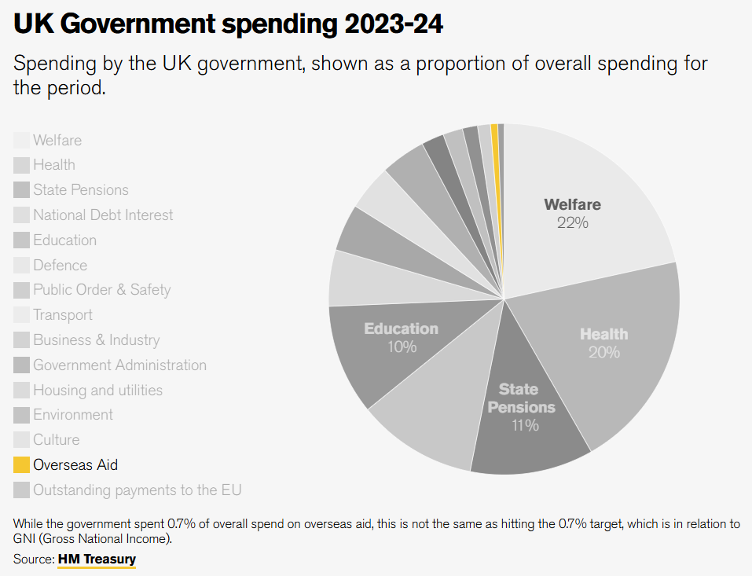

Slide 10
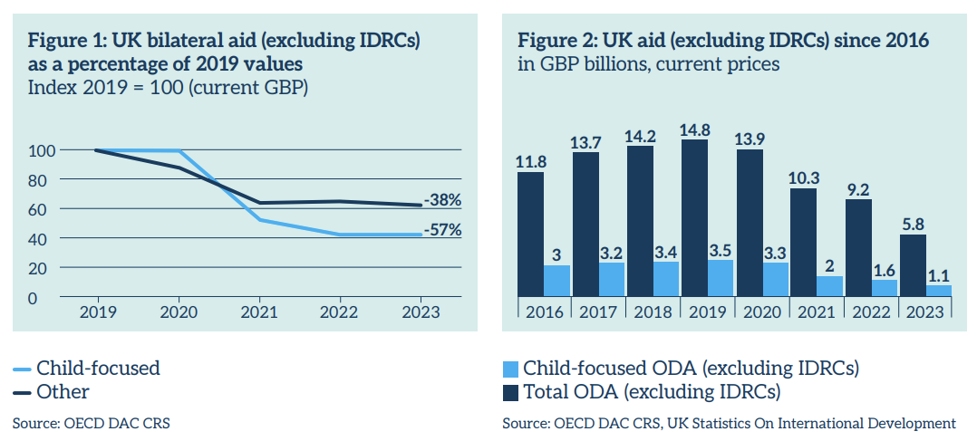
How child-focused is UK international aid?
Last year, UNICEF UK published an analysis to see how much UK international aid was being spent on children – e.g. on education, nutrition and immunisation programmes.
What we found was:
The amount of UK aid spent on children has been falling since 2016
Cuts to international aid since 2020 have disproportionately fallen on children.

Slide 11

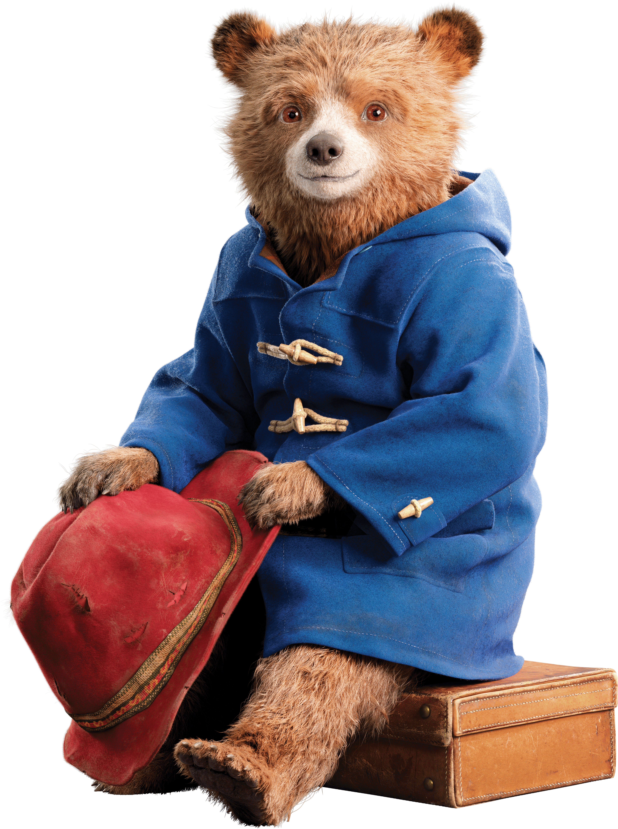

Slide 12
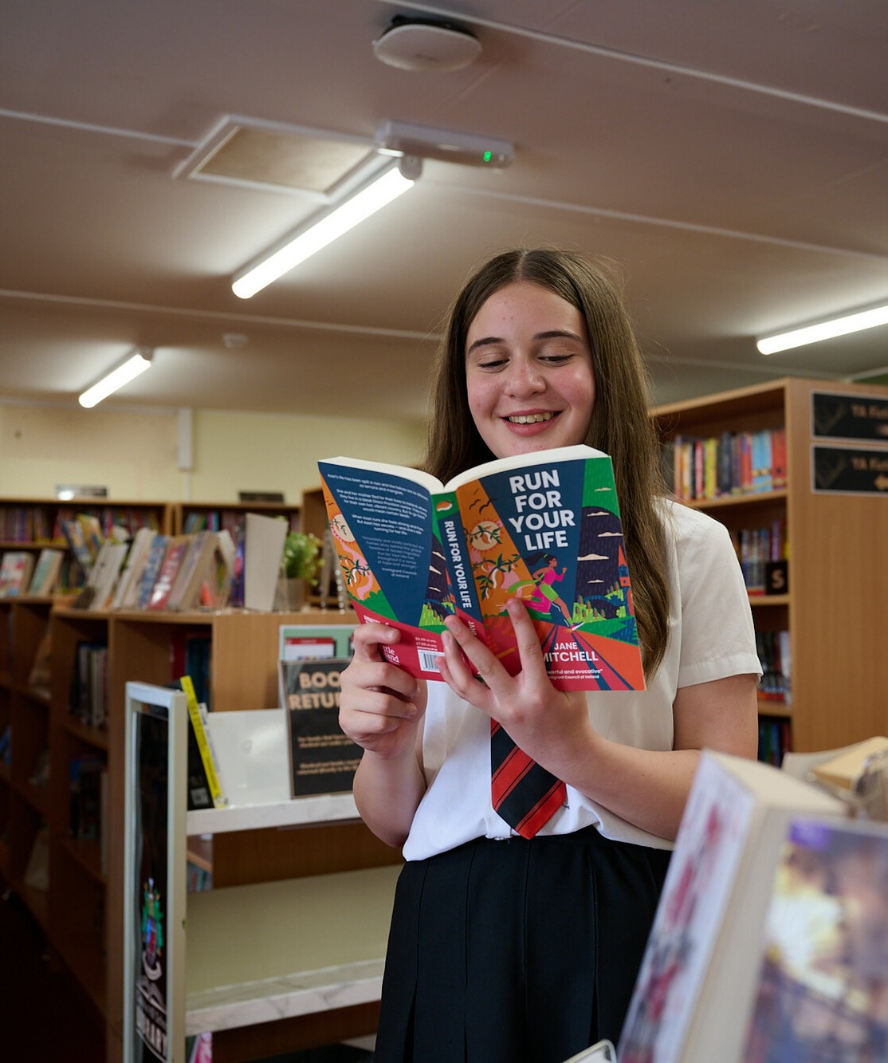
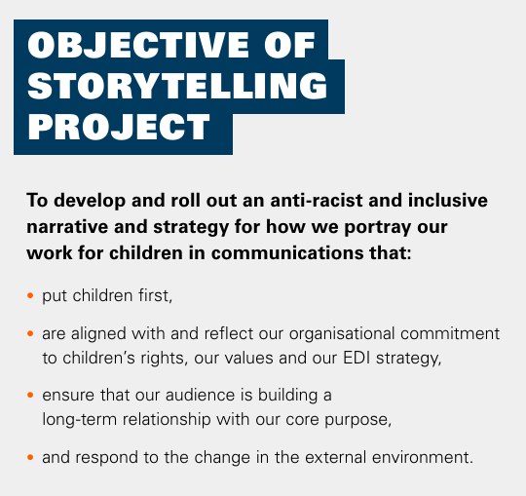
© UNICEF/Maule-Ffinch
Students at Cockshut Hill Secondary school created a series of images in a photojournalism style based on the brief - How does your school support your rights?

Slide 14


  MAKE YOUR
  VOICE HEARD
Join us to hear a little bit more about the storytelling values, learning activity 3 & 4, and begin to think about the Campaign Action.
Join us as we explore the campaign action, and how to smoothly wrap up the campaign.
Support Workshop 2
Join our World Children’s Day live event!
Share how your campaign is going and hear what others are doing.
Support workshop 3:

