Slide 1
Vaccinations in Mongolia

Slide 2
How to use this resource
Rights Around the World is a regular resource series from UNICEF UK’s Rights Respecting Schools Award that pairs global citizenship with learning about rights and selected stories from UNICEF’s work around the world.
If you are a Rights Respecting School, this resource will help you to meet Outcomes
1 and 9 of RRSA accreditation:
Children, young people and the wider school community know about and understand the United Nations Convention on the Rights of the Child and can share how it impacts on their lives and on the lives of children everywhere.
Children and young people have taken action to claim their rights and promote
the rights of others, locally and globally.
This resources is separated into two parts.
For use in assemblies, tutor time, circle time or a similar session where adults present and discuss a story or topic with children and young people.
PART
1
Filled with activity ideas for building greater understanding on the themes within the story as well as ideas for taking the learning out into the world or building on that learning through creation of a Rights Around the World display board of a passport (or learning journal).
Throughout the pack you will see some items labeled with stars. These are to give you, as the educator, an idea of the level at which the content is pitched.
One star: simple - for children in early years settings and/or those more confident with simpler concepts.
Two stars: intermediate - for children and young people who have a good level of comprehension and reflection ability.
Three stars: advanced – for young people who have the confidence and maturity to explore more challenging themes, concepts and ideas.
You know your children and young people best so feel free to adapt this resource and always review content before you use it within your setting.
PART
2

Slide 3
For assemblies or group sessions
PART
1

Slide 4
This month we are in…
Mongolia

Slide 5
Traveller's guide
T
Mongolia
The first discovery of a fossilised dinosaur egg was in Mongolia’s Gobi Desert.
Bactrian Camels are native to Mongolia and have 2 humps.
Ulaanbaatar
Mongolia is the 19th largest country by area in the world but has a population of only 3.1 million.
The annual Naadam festival consists of traditional wrestling, horseracing and archery competitions and is a popular gathering time for families and friends.
The capital of Mongolia is Ulaanbaatar. It has the lowest average temperature of any national capital city.
Fermented horse milk, known as airag, is Mongolia’s national drink.
Notes:
Edit the facts to suit your audience. Boxes can be deleted if you would prefer to focus on fewer facts. ​
​
Sources: ​
First dinosaur egg: https://kids.nationalgeographic.com/geography/countries/article/mongolia
Population 3.1 million and size 19th largest: https://www.adaptation-undp.org/explore/europe-and-central-asia/mongolia
Camels: https://kids.nationalgeographic.com/geography/countries/article/mongolia
National drink: https://factsinstitute.com/countries/facts-about-mongolia/
Capital temperature: https://mongolianembassy.us/about-mongolia/geography-and-climate/
Festival: https://factsinstitute.com/countries/facts-about-mongolia/

Slide 6
Intro to UNICEF in Mongolia
UNICEF’s work in Mongolia is guided by the UN Convention on the Rights of the Child which Mongolia ratified in 1990, the year before it was ratified by the UK.
The priority areas that UNICEF Mongolia works on are:
Supporting children’s right to health
Education: empowering children with the skills and resilience they need to succeed
Child protection: ensuring that children grow up in a safe and protective environment
Supporting access to clean air, clean water and basic toilets and promoting good hygiene
Supporting social inclusion, giving every child an equitable chance in life
We are going to explore UNICEF Mongolia’s work supporting children to access vaccines, linked to their work on the right to health.
Notes:
Use this slide to make the link to UNICEF’s work. The following slides will bring this to life through the case study of Ari's story.
Learn more about UNICEF in Mongolia: https://www.unicef.org/mongolia
You may wish to explore what the word ‘ratified’ means with your pupils. When a country ratifies a law, it means that they have agreed to it. In other words, when a country 'ratifies' the CRC it means that the people in charge (government) agree to do all they can to make sure children have their rights.

Slide 7
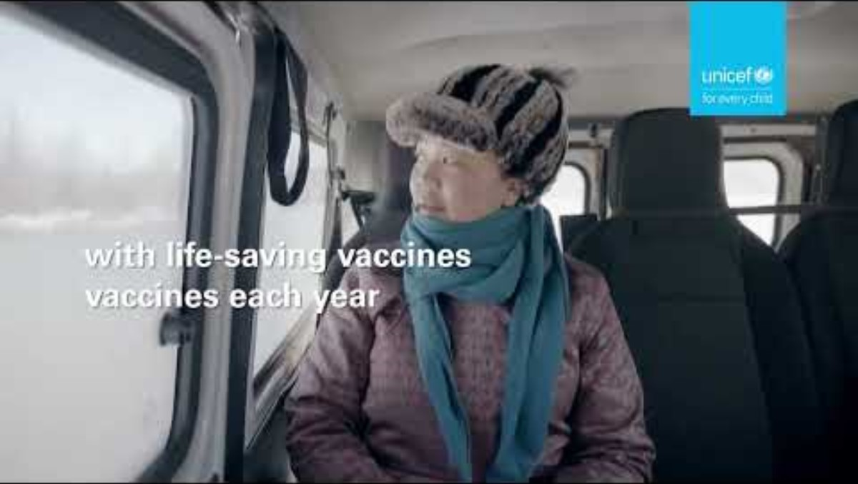
Anirlan’s story
Anirlan is 2 years old and lives in the snowy forests of northern Mongolia.
She needs vaccinations to stay healthy, but the nearest doctor is far away.
Watch to see how UNICEF helps her get the vaccine she needs, even when it’s hard to reach her home.
Notes:
The video in this slide is 51 seconds long.
Slide 7 and slide 8 offer the same content in different levels of detail.
Select the slide that is most appropriate for your pupils.
Remember to play the video full screen, and please turn ON captions (CC button) for translation of what Anirlan’s mother is saying. You will need to read the captions out to the children to explain what Anirlan’s mother is saying and read the text to the children. You may find it best to mute the video.
Pupils could be encouraged to reflect on Anirlan’s feelings about getting a vaccine and can reflect on their own experiences of vaccines or medicines.
You could also delete the text if you prefer to read this out to your pupils:
Anirlan is 2 years old and lives in the snowy forests of northern Mongolia.
She needs vaccinations to stay healthy, but the nearest doctor is far away.
Watch to see how UNICEF helps her get the vaccine she needs, even when it’s hard to reach her home.

Slide 8
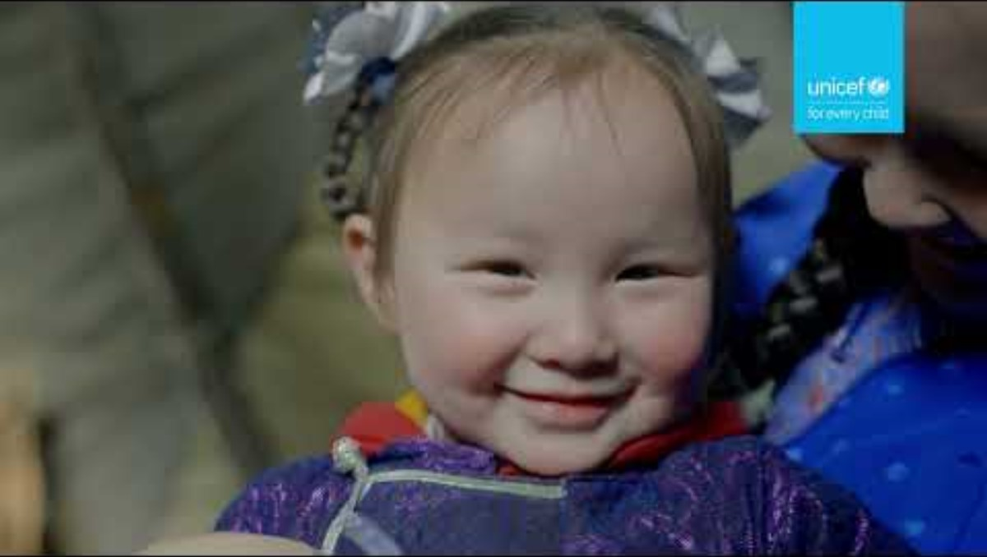
Anirlan’s story
Anirlan’s story
Anirlan’s story
Anirlan is 2 years old and lives deep in the snowy forests of northern Mongolia, far from the nearest hospital or clinic. In winter, temperatures drop far below freezing and the roads are often blocked by snow and ice. Without vaccinations, Anirlan is at serious risk of catching dangerous diseases and getting medical help to her home is not easy.
In this film, you’ll see how UNICEF works with local health workers to make sure children like Anirlan get life-saving vaccines. They travel long distances across the frozen landscape, using unusual methods of transport to reach families living in remote areas. Can you guess what surprising way the health workers might travel before you press play?
Notes:
The video in this slide is 51 seconds long.
Slide 7 and slide 8 offer the same content in different levels of detail.
Select the slide that is most appropriate for your pupils.
Remember to play the video full screen, and you will need to display captions (CC button).
Pupils could be encouraged to reflect on Anirlan’s feelings about getting a vaccine and can reflect on their own experiences of vaccines or medicines.
You could also delete the text if you prefer to read this out to your pupils:
Anirlan is 2 years old and lives deep in the snowy forests of northern Mongolia, far from the nearest hospital or clinic. In winter, temperatures drop far below freezing and the roads are often blocked by snow and ice. Without vaccinations, Anirlan is at serious risk of catching dangerous diseases and getting medical help to her home is not easy.
In this film, you’ll see how UNICEF works with local health workers to make sure children like Anirlan get life-saving vaccines. They travel long distances across the frozen landscape, using unusual methods of transport to reach families living in remote areas. Can you guess what surprising way the health workers might travel before you press play?

Slide 9
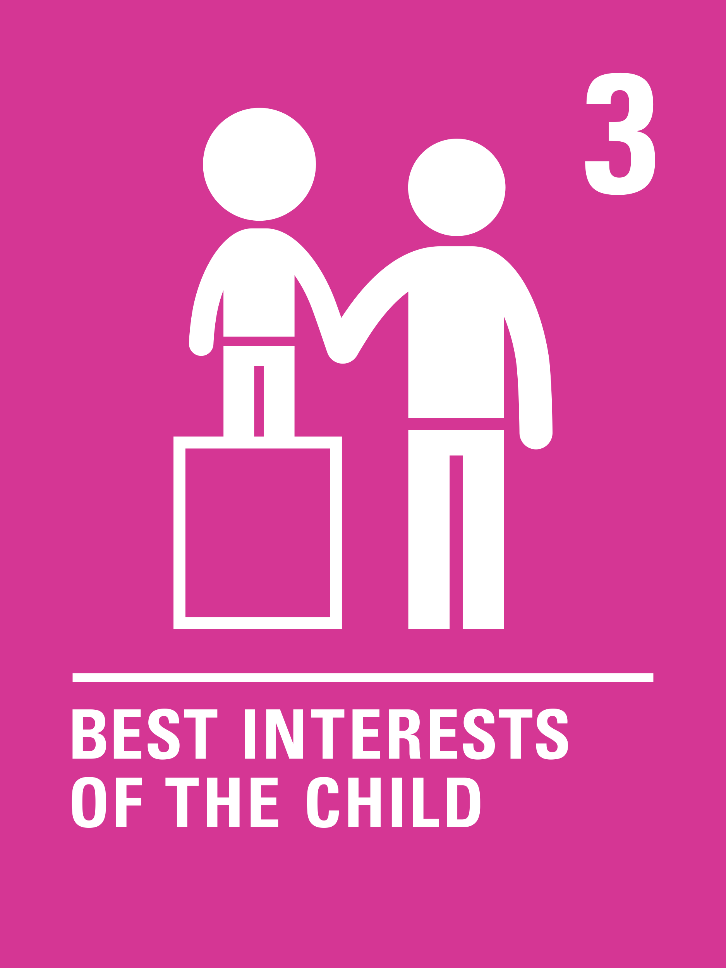
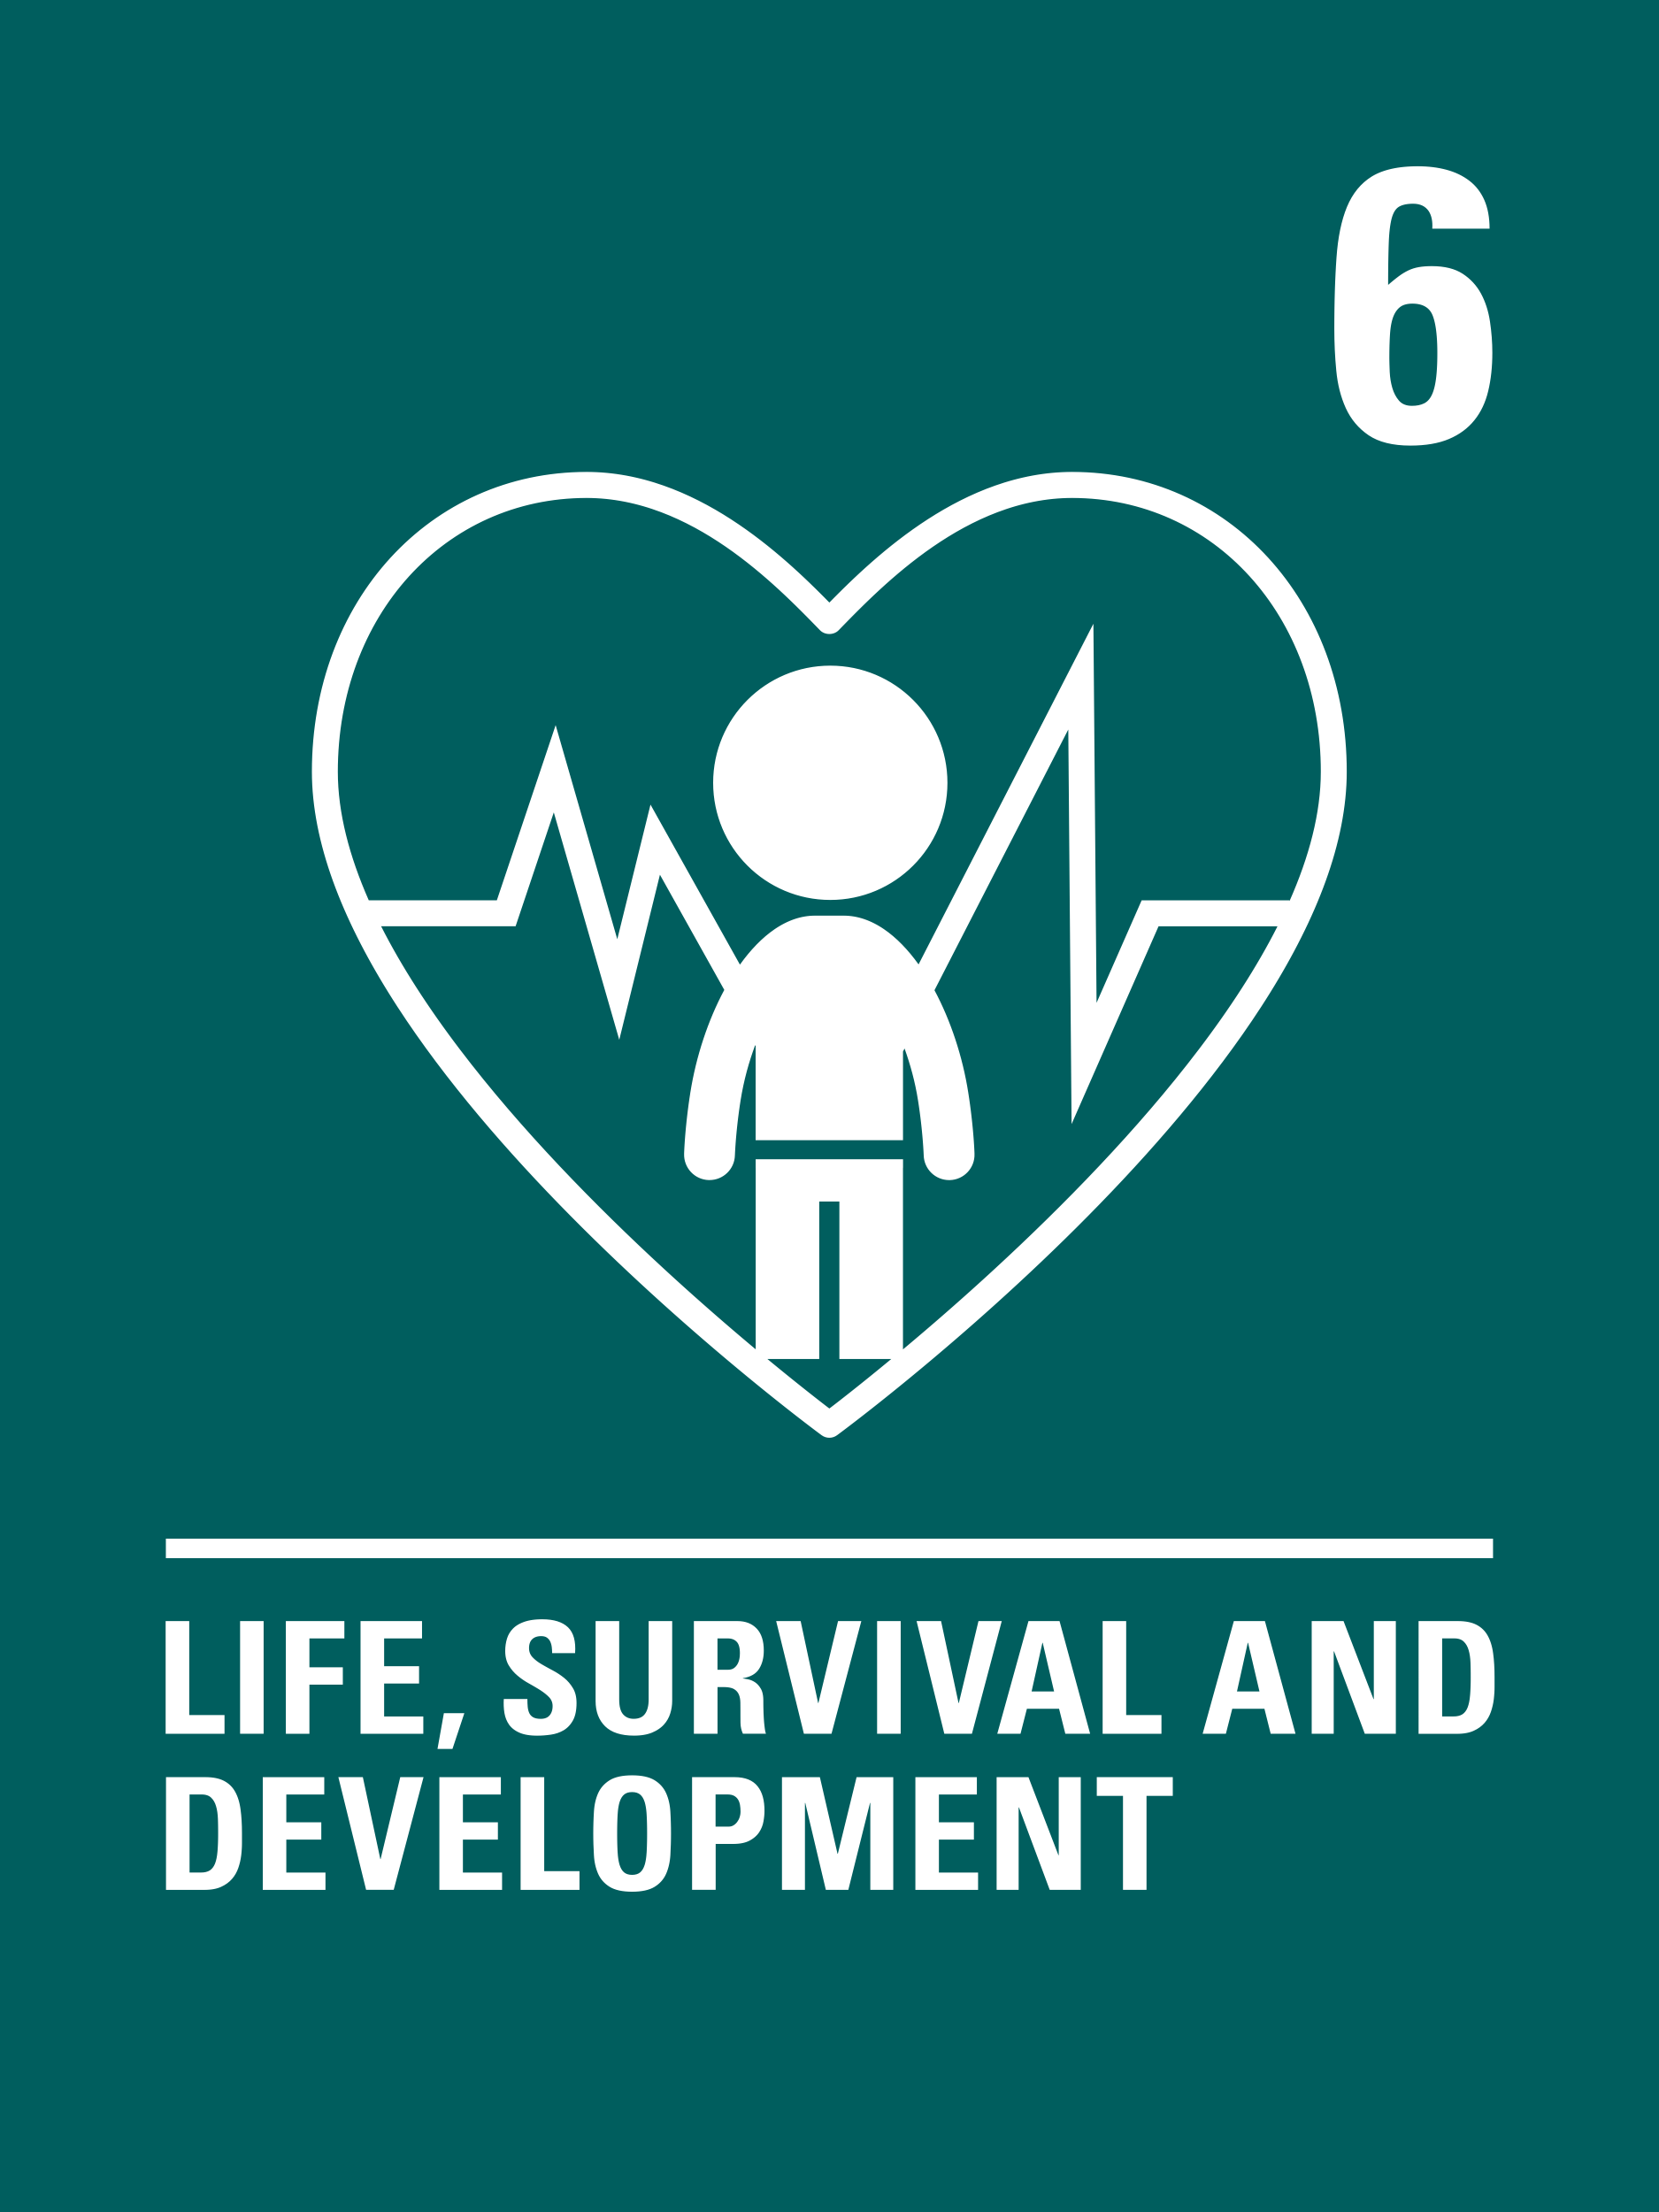
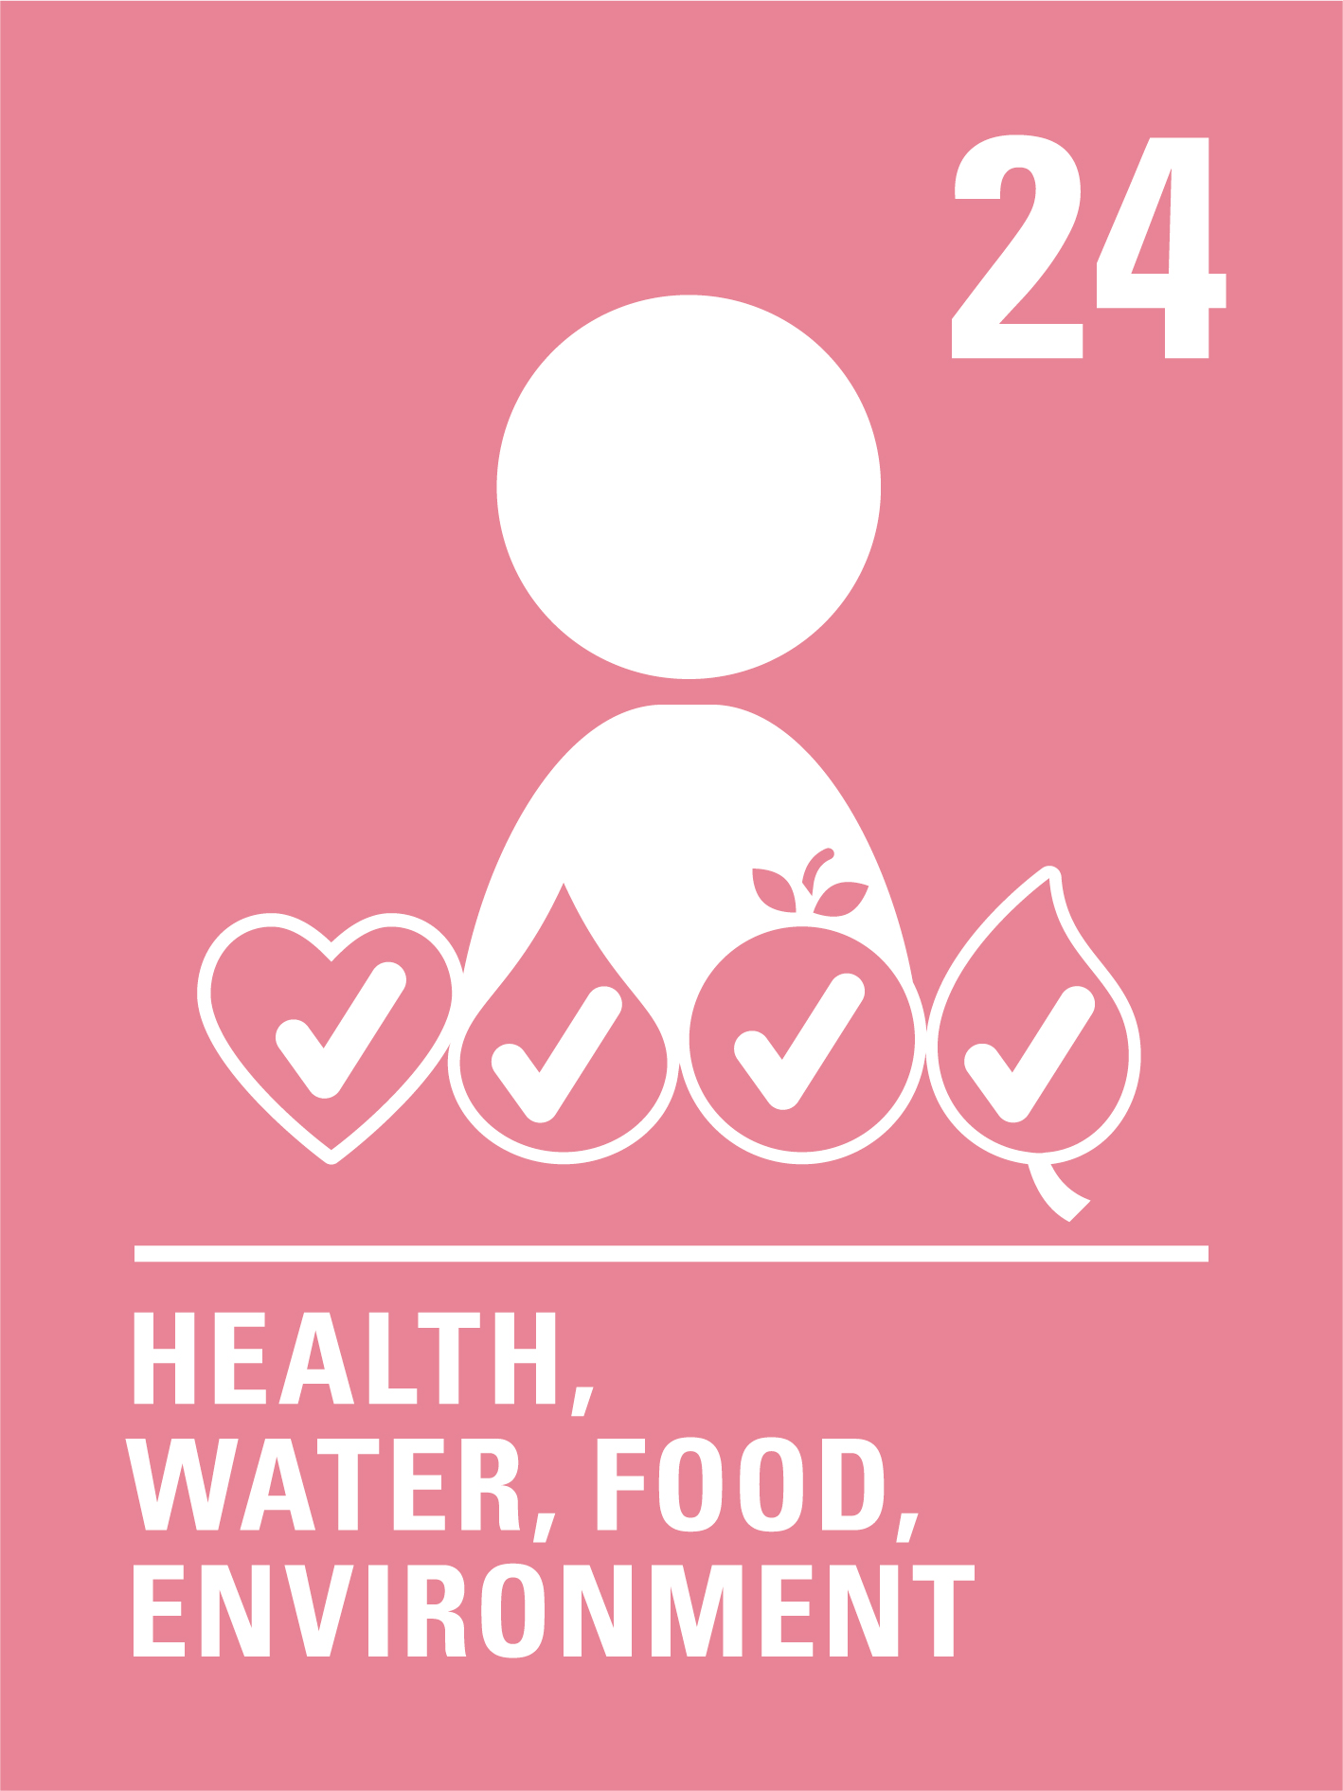
The rights link...
Think about all the rights you know. With a partner, discuss the articles you think relate to Anirlan's story.
Click to reveal some examples.
Why do you think we’ve highlighted this selection?
Did you identify others?
Notes:
You may wish to have copies of the CRC available if your pupils are less familiar with the articles from the convention.
You can find a simplified version here: https://www.unicef.org.uk/wp-content/uploads/2019/10/UNCRC_summary-1_1.pdf
And you can access the icons here: https://www.unicef.org.uk/rights-respecting-schools/wp-content/uploads/sites/4/2019/11/UN0332751.pdf

Slide 10
...and what about the Global Goals?
Why do you think we’ve highlighted this selection?
Did you identify others?
Notes:
Optional slide​
​
If your pupils are not currently familiar with the Global Goals please remove this slide and the next one.​
​
To find out more about the Global Goals: https://worldslargestlesson.globalgoals.org/ or https://globalgoals.org/. ​

Slide 11
...and what about the Global Goals?
Why do you think we’ve highlighted these ones?
Did you identify others?
Notes:
SDG 3: Good Health and Well-being
More information about this global goal can be found here: https://globalgoals.org/goals/3-good-health-and-well-being/
Target 3.B of this goal includes supporting research, development and universal access to affordable vaccines and medicines.
SDG 9: Industry, Innovation and Infrastructure
More information about this global goal can be found here: https://globalgoals.org/goals/9-industry-innovation-and-infrastructure/
Target 9.1 of this goal includes developing quality, reliable and sustainable infrastructure, including regional and transborder infrastructure, to support economic development and human wellbeing, with a focus on affordable and equitable access for all.
You can find resources about the SDGs on the World’s Largest Lesson website: https://worldslargestlesson.globalgoals.org/

Slide 12



Reflection
Think about what you have learnt about Mongolia, Anirlan and UNICEF’s work.
Is there anything that surprised you or you thought was particularly interesting?
Is there anything you would like to learn more about?
Notes:
Before ending the session encourage pupils to reflect on what they have learnt. You could ask them to share their reflections in pairs, small groups or to the whole group.

Slide 13
Activities
PART
2

Slide 14
Build your understanding
Watch this Bing Bunny vaccination clip and think about how Bing's friends are feeling. Think about ways you can help a friend who is worried about their vaccination. Use puppets or teddies to act out your ideas. Create your own 'brave' stickers that you could give to a friend who is feeling worried.
During circle time, look at pictures, props or objects to represent people who help us enjoy Article 24, our right to stay healthy such as doctors, nurses or dentists. Can you name all the people that help us and explain how they help? Create an ‘Article 24 Healthy Helpers' wall display with drawings or photos from your circle time.
Create a role play vaccination clinic with chairs, a desk and a vaccination station with clipboards, toy syringes and plasters. Choose your role such as, nurse, patient or receptionist. Take turns to practise checking in, having a pretend vaccination and saying goodbye. Use teddies, dolls or practise on each other.
Read Maya's Marvellous Medicine where Maya learns about vaccines and how they help the immune system to be strong. The immune system is like your body's own hero, keeping you healthy. Create your own 'Immune Hero' using paint, collage or pens and pencils.
Notes:
This month’s story is about access to vaccinations as part of the right to be healthy, linking also to the right to life, survival and development and the best interests of the child. The activities here will support children in early years or learners who are more confident with hands on, practical activities to explore this topic in more detail. Choose one or more activities as featured here or amend them to suit your setting. You could also create your own activities inspired by the presentations in part one.

Slide 15
Build your understanding
After watching the video about Anirlan, think about how you enjoy Article 24, your right to health, and the journey you would take to visit your doctor or a nearby hospital. Create a visual representation of your journey – such as a map, a comic strip, a diagram or a picture. (You could even add a key for symbols to show significant parts of your journey.)
Watch this BBC Bitesize video to explain what vaccinations are and how herd immunity works. https://www.bbc.co.uk/newsround/av/50000690
Discuss with a partner or in a small group why vaccinations are an important element of your right to health, then write a persuasive letter or create an information poster to share what you’ve learned.
As you saw in Anirlan’s story, UNICEF works hard to transport vaccines around the world and must keep the vaccine cold. Work in small groups to design a route in your playground to represent a vaccine’s journey and a method to keep ice cubes (representing the vaccine) frozen for the entire journey. What materials provide the “best” insulation and how will you know? Try it out and present your findings to the rest of the class (or school).
Watch this video song about Edward Jenner to find out more about his role in developing vaccines.
What unusual vaccination would you invent if you could and why? How would this help you and others to enjoy your rights?
Notes:
This month’s story is about access to vaccinations as part of the right to be healthy, linking also to the right to life, survival and development and the best interests of the child. The activities here will support children in upper primary to explore the issues further. Choose one or more activities as featured here or amend them to suit your setting. You could also create your own activities inspired by the presentations in part one.These are a set of activities that could be explored in upper primary.

Slide 16
Build your understanding
Watch this video about Article 24 of the UNCRC. This says all children have the right to the best possible health and access to health services. In small groups, discuss: What health services do you think are the most important? Why are vaccines important for children’s health and how do they protect communities? What challenges might stop children in different parts of the world from getting vaccines?
Research vaccine access in both the UK and Mongolia including what vaccinations children receive in each country. Using Anirlan’s story as your starting point, create a ‘Vaccine Journey Map’ showing all the steps from when a vaccine is made to when a child receives it. Think about things like storage and transport as well as any possible problems that could stop vaccines reaching children. What are some solutions?
Measles cases are rising in the UK, partly because fewer people are vaccinated against this disease. Using the Economist Educational Foundation resource as a starting point, organise a class debate with the following motion: Should vaccinations be mandatory or should people always have the right to choose? Work in two groups to present your arguments. At the end, have a class vote to see who has been most persuasive.
In small groups, plan and create a short campaign video to show why vaccines are important. Your campaign should be clear, positive and aimed at encouraging people your age to get vaccinations. Ensure your campaign includes a reference to Article 6, Article 24 and other relevant articles from the CRC, and includes lots of powerful facts about why vaccinations are important. You may find this information useful.
Notes:
This month’s story is about access to vaccinations as part of the right to be healthy, linking also to the right to life, survival and development and the best interests of the child. The activities here will support older learners or those able to explore more complex ideas to explore these concepts further. Use in tutor time in secondary schools, with your rights group or within personal development lessons or equivalent. Choose one or more activities as featured here or amend them to suit your setting. You could also create your own activities inspired by the presentations in part one.
If your pupils are looking for reliable sources of information and data on vaccines, UNICEF has a data site that may be useful to explore: https://data.unicef.org/topic/child-health/immunization/
As with all resources, please check the suitability for your pupils before using.

Slide 17
Take your learning into the world
Take action
What could you do to encourage more children to get access to vaccinations? Perhaps you could raise awareness in the local area, e.g., at the GP surgery, or contact your local MP to ask how the UK is supporting children around the world to access vaccinations.
Get creative
Reflect on your learning about UNICEF Mongolia and Anirlan. Using words or pictures, present some of the barriers to children receiving vaccinations and what could be done to make vaccinations more accessible.
Add to your passport
Add information about what you have learned to your Rights Around the World passport. ​
Include interesting facts about Anirlan’s story and any actions you took because of your learning.
Notes:
Take Action:
Children will have explored why vaccines are important and how this links to children’s rights. To support Outcome 9 of RRSA, children can take this learning out into the world and create positive change by raising awareness of the importance of vaccines, or by contacting your local MP to ask how we are supporting children around the world to access vaccinations.
Get Creative:
You have the option to use display materials (found here: https://www.unicef.org.uk/rights-respecting-schools/resources/teaching-resources/rights-around-the-world/) to create a display of your learning and/or actions.
Add to your passport:
You have the option to use the Rights Around the World passport (found here: https://www.unicef.org.uk/rights-respecting-schools/resources/teaching-resources/rights-around-the-world/) These materials can be used to create individual passports for children or to create a class floor book to record learning.

Slide 18
Further information & OutRight
The next Rights Around the World Resource will be shared on 6th November 2025.
If you have enjoyed using this resource, you may also enjoy using UNICEF UK's OutRight resources. This year OutRight will focus on International Aid. Children and young people will develop their understanding of their rights, international aid and why it is an important part of being a global citizen. We’ll learn about the impact that international aid can have on both climate change and education globally.
You can use OutRight as evidence in your RRSA accreditation journey, and you’ll receive support and additional resources along the way.
https://www.unicef.org.uk/rights-respecting-schools/resources/teaching-resources/outright/
Notes:
This slide is for information only and not for class presentation

