Slide 1
Water in Malawi

Slide 2
How to use this resource
Rights Around the World is a regular resource series from UNICEF UK’s Rights Respecting Schools Award that pairs global citizenship with learning about rights and selected stories from UNICEF’s work around the world.
If you are a Rights Respecting School, this resource will help you to meet Outcomes 1 and 9 of RRSA accreditation:
Children, young people and the wider school community know about and understand the United Nations Convention on the Rights of the Child and can share how it impacts on their lives and on the lives of children everywhere.
Children and young people have taken action to claim their rights and promote the rights of others, locally and globally.
This resource is separated into two parts.
For use in assemblies, tutor time, circle time or a similar session where adults present and discuss a story or topic with children and young people.
PART
1
Filled with activity ideas for building greater understanding on the themes within the story as well as ideas for taking the learning out into the world or building on that learning through creation of a Rights Around the World display board or a passport (or learning journal).
Throughout the pack you will see some items labeled with stars. These are to give you, as the educator, an idea of the level at which the content is pitched.
One star: for children in early years settings and/or those more confident with simpler concepts.
Two stars: for children and young people who have a good level of comprehension and reflection ability.
Three stars: for young people who have the confidence and maturity to explore more challenging themes, concepts and ideas.
You know your children and young people best so feel free to adapt this resource and always review content before you use it within your setting.
PART
2

Slide 3
For assemblies or group sessions
PART
1

Slide 4
This month we are in…
Malawi, Africa

Slide 5
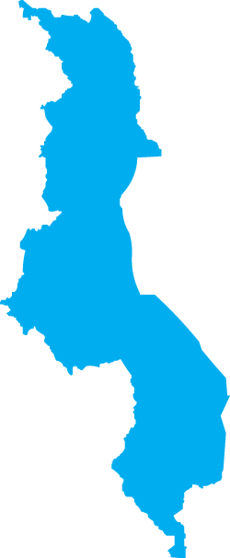
Traveller's guide
T
The capital of Malawi is Lilongwe.
22 million people live in Malawi. Around 40% of the population is younger than age 15.
In Malawi, over 80% of people work in agriculture (farming). Important crops include maize, tobacco, tea and sugar. Many Malawians grow their own maize and other food to eat.
Lilongwe
67% of households in Malawi have access to basic drinking water. In countryside areas, 37% of households spend 30 minutes or more to fetch drinking water.
Malawian culture is known for a huge variety of traditional songs and dances that feature the drum.
Malawi gained independence from British rule on 6th July 1964.
Notes:
Edit the facts to suit your audience. Boxes can be deleted if you would prefer to focus on fewer facts.
Consider how colonialism, and the effects of climate change impact access to clean and safe drinking water. You might use the reference to independence to explore colonialism and that fact that during British rule Malawi’s land, natural resources and people were exploited.
Sources:
Farming: Trading Economics – Malawi Employment in Agriculture
Population: World Population Dashboard -Malawi | United Nations Population Fund
Drinking Water: UNICEF Malawi – WASH
Examples of Malawi's drum beats. You might enjoy sharing these Youtube links Malawi drum beats Malawi drum beats 2

Slide 6
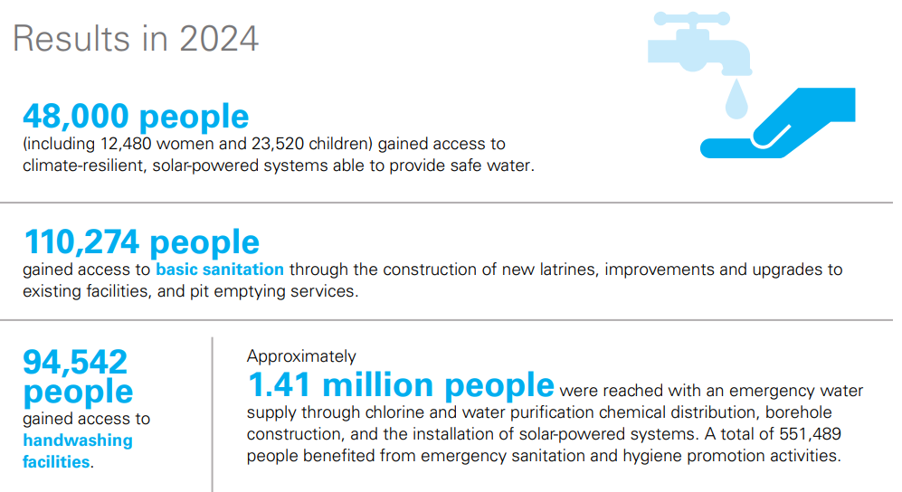
Intro to UNICEF in Malawi
UNICEF’s work in Malawi is guided by the UN Convention on the Rights of the Child which Malawi ratified in 1991.
Programmes in Malawi UNICEF supports the Government of Malawi to help all children in Malawi to realise their rights. Today, we are exploring how UNICEF is helping children and their families to access clean water, sanitation and hygiene facilities.
UNICEF is funding solar powered water pumps for clean water, new and improved toilets, handwashing facilities and emergency water supplies.
Notes:
Use this slide to make the link to UNICEF’s work. The following slides will bring this to life through some case studies.
Learn more about UNICEF in Malawi - UNICEF Malawi
The infographic is from a 2024 UNICEF Annual Report on work in Malawi.https://www.unicef.org/malawi/media/12446/file/Malawi_Annual_Report_2024_Final.pdf
This shows how people in Malawi are increasingly accessing safe water and sanitation. Please delete the infographic image if it’s too complex for your learners.
You may wish to explore what the word ‘ratified’ means with your pupils. When a country ratifies a law, it means that they have agreed to it. In other words, when a country 'ratifies' the CRC it means that the people in charge (government) agree to do all they can to make sure children have their rights.​

Slide 7
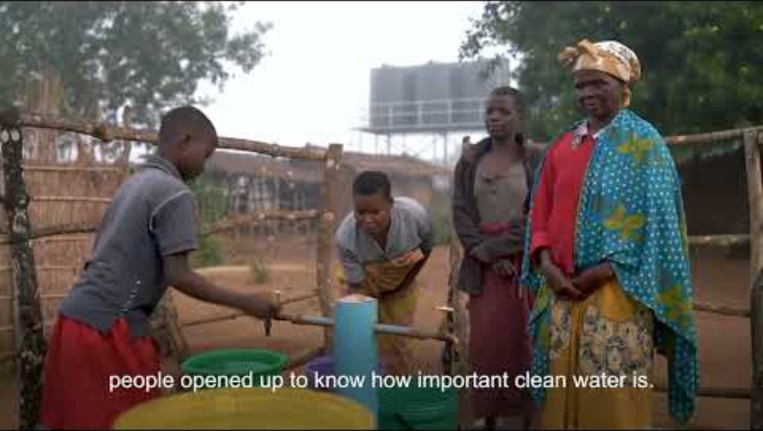
Robina's and Jenifer’s story
Robina used to help her mum, Jenifer, collect water.
It took a long time and the water wasn't safe or clean.
New water taps are connected to a clean water supply.
It's much quicker, so Robina has more time to learn and play.
.
.
Notes:
©UNICEF/SmilePleasePhotography
The video in this slide is 57 seconds long. ​
Slide 7, 8 and 9 offer different case studies with varying levels of complexity. Select the slide that is most appropriate for your pupils. ​
​Remember to play the video full screen. You will need to read the captions out to the children to explain what is being said in the video. You may find it best to play it once so the children can hear the people speaking in their own language, and then play it again with the video muted to explain to them what is being said. ​
​Pupils could be encouraged to reflect on Robina and Jennifer’s feelings about having the solar powered taps and how this impacts on their lives. ​
​
You could also delete the text if you prefer to read this out to your pupils: ​
Robina used to help her mum, Jenifer, collect water.
It took a long time and the water wasn't safe or clean.
New water taps are connected to a clean water supply.
It's much quicker, so Robina has more time to learn and play.

Slide 8
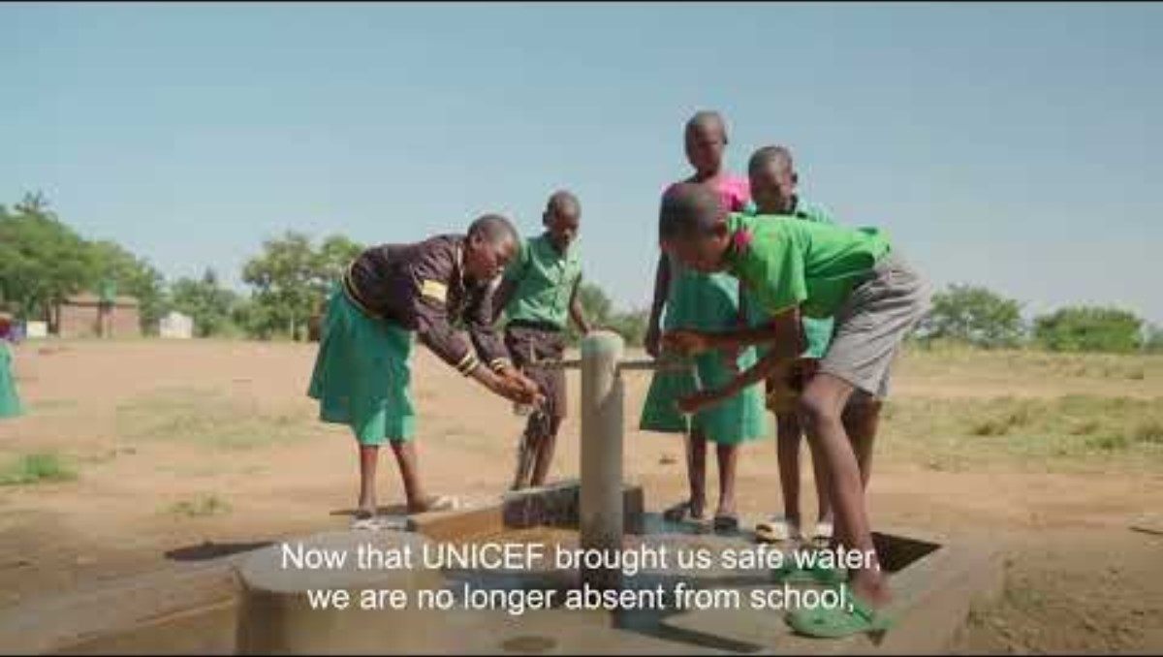
Mike’s Story
Mike lives in the Blantyre district of Malawi in Southern Africa. He is going to take you on a tour of his village.
Where Mike lives, men and women share tasks like collecting water.
They used to collect water from the river which was dirty because the animals used the same water.
Drinking dirty water increased diseases like cholera which meant many children were often sick and could not go to school.
UNICEF worked with the Malawi Ministry of Health to create some wells with water taps so now there is clean water.
Notes:
The video in this slide is 1:21 minutes long. ​
Slide 7, 8 and 9 offer different case studies with varying levels of complexity. Select the slide that is most appropriate for your pupils. ​
​Remember to play the video full screen. ​Pupils could be encouraged to reflect on Mike’s feelings about having the new wells and taps and how this impacts on his family’s life. ​They could also explore some similarities and differences between their own lives and Mike’s life.
​
You could also delete the text if you prefer to read this out to your pupils: ​
Mike lives in the Blantyre district of Malawi in Southern Africa. He is going to take you on a tour of his village.
- Where Mike lives, men and women share tasks like collecting water.
- They used to collect water from the river which was dirty because the animals used the same water.
- Drinking dirty water increased diseases like cholera which meant many children were often sick and could not go to school.
- UNICEF worked with the Malawi Ministry of Health to create some wells with water taps so now there is clean water.
.

Slide 9
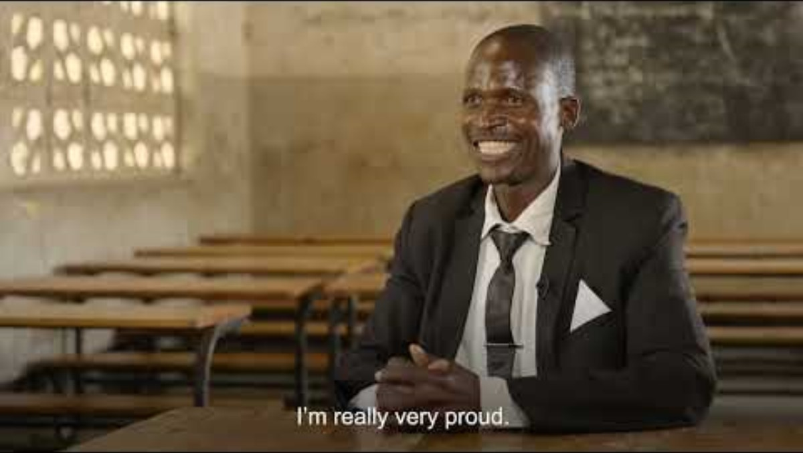
Solar-Powered Water
In Nsanje District of Malawi, a solar powered water pump has been installed by UNICEF for the school and surrounding community.
Previously, students missed a lot of school because they had to walk so far to collect water
The water they collected came from the river which is also used by livestock and is not clean.
Since the installation of the solar powered pumps and taps, fewer children drop out of school and rates of diseases such as cholera have reduced.
The whole community are involved in maintaining the water pumps.
Notes:
The video in this slide is 2:35 minutes long. ​
Slide 7, 8 and 9 offer different case studies with varying levels of complexity. Select the slide that is most appropriate for your pupils. ​
​Remember to play the video full screen. ​Pupils could be encouraged to reflect on what they see in this video. Is there anything that surprised them. Is there anything that they would like to learn more about. You might like to explore why solar panels are linked to the provision of water. In most of the UK our piped water arrives under pressure, we don’t see any pumping happening. The scheme in the video needs power to pump the water from under the ground – the solar panels provide the electricity to power the pumps
​
You could also delete the text if you prefer to read this out to your pupils: ​
In Nsanje District of Malawi, a solar powered water pump has been installed by UNICEF for the school and surrounding community.
- Previously, students missed a lot of school because they had to walk so far to collect water
- The water they collected came from the river which is also used by livestock and is not clean.
- Since the installation of the solar powered pumps and taps, fewer children drop out of school and rates of diseases such as cholera have reduced.
- The whole community are involved in maintaining the water pumps.
.

Slide 10
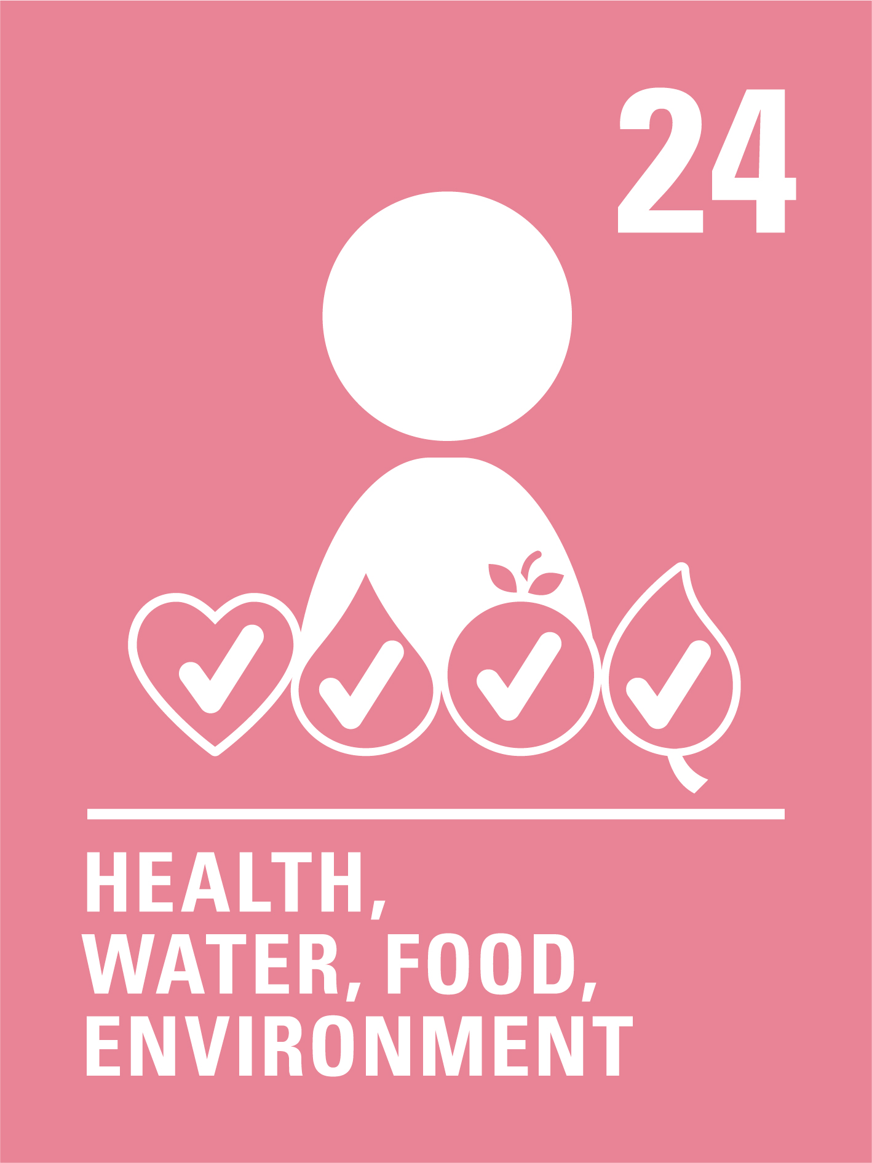

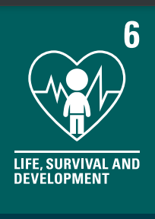
The rights link...
Think about all the rights you know. With a partner, discuss the articles you think relate to the story you have watched.​
Click to reveal some examples.​
Why do you think we’ve highlighted this selection?
Did you identify others?
Notes:
You may wish to have copies of the CRC available if your pupils are less familiar with the articles from the convention.​
​You can find a simplified version here: https://www.unicef.org.uk/wp-content/uploads/2019/10/UNCRC_summary-1_1.pdf​
And you can access the icons here: https://www.unicef.org.uk/rights-respecting-schools/wp-content/uploads/sites/4/2019/11/UN0332751.pdf

Slide 11
...and what about the Global Goals?
Which do you think are most relevant?
Did you identify others?
Notes:
Optional slide​​
​​
If your pupils are not currently familiar with the Global Goals please remove this slide and the next one.​​
​​
To find out more about the Global Goals: https://worldslargestlesson.globalgoals.org/ or https://globalgoals.org/

Slide 12
...and what about the Global Goals?
Why do you think we’ve highlighted this selection?
Did you identify others?
Notes:
SDG 3: Good Health and Well-being​
Target 3.9 of this goal includes reducing illness from pollution in water.
More information about this global goal can be found here: https://globalgoals.org/goals/3-good-health-and-well-being/
SDG 4: Quality Education
Target 4.9 includes building schools that are safe learning environments for all. More information about this global goal can be found here: https://globalgoals.org/goals/4-quality-education/
SDG 5: Gender Equality
Target 5.4 includes valuing household work through government-provided services and encouraging shared responsibility within the household and family.
More information about this global goal can be found here: https://globalgoals.org/goals/5-gender-equality/
SDG 6: Clean Water and Sanitation Target 6.1 includes safe drinking water.
More information about this global goal can be found here: https://globalgoals.org/goals/6-clean-water-and-sanitation/
SDG 7: Affordable and Clean Energy
Target 7.2 includes increasing renewable energy sources, such as solar power.
More information on this global goal can be found here: https://globalgoals.org/goals/7-affordable-and-clean-energy/
SDG 13: Climate Action
Target 13.1 includes becoming more resilient and adaptive to climate-related hazards. More information on this global goal can be found here: https://globalgoals.org/goals/13-climate-action/
Target 14: Life Below Water
Target 14.1 includes reducing marine pollution. This topic is explored further in an activity on slide 16.
More information on this global goal can be found here: https://globalgoals.org/goals/14-life-below-water/

Slide 13



Reflection
Think back to what you have learnt about Malawi and UNICEF’s work.
Is there anything that surprised you or you thought was particularly interesting?
Is there anything you would like to learn more about?
Notes:
Before ending the session encourage pupils to reflect on what they have learnt. You could ask them to share their reflections in pairs, small groups or to the whole group.

Slide 14
Now choose your activities.
PART
2
Notes:
The following 3 slides offer a range of activities linked to the assembly topic of inclusion. Please read through and edit choosing those that are suitable for the children and young people you are working with. Do edit and elaborate as you see fit. You could also create your own activities inspired by the presentations in part one.

Slide 15
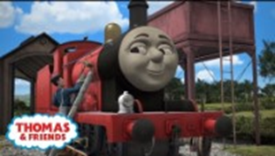
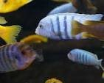
Build your understanding
Team up with Thomas and Friends to learn about the importance of clean water and Global Goal 6: clean water and sanitation for all. Talk about and draw pictures of ways you use water at home and where water is found and how it is used in your local community and area.
B
ecause we all need water to stay alive. Think about all the times water is important to you in your day, like on a hot day after you have been playing. Draw pictures of you or your friends enjoying water. use we all need water to stay alive. Think about all the times water is important to you in your day, like on a hot day after you have been playing. Draw pictures
One of the best ways to prevent the spread of germs and illnesses is by washing your hands with clean water and soap. Watch these step-by-step instructions for good handwashing and then practice it by miming the actions with a friend. Put photographs or posters by your school sink areas to remind everyone what to do and remind them this links to article 24, their right to health.
Water walk - find different containers that could hold water. Walk around the school grounds to show how much time children in Malawi spend collecting clean water to use. Reflect on how heavy water is to carry, especially over a distance. By spending time getting their right to clean water, which other rights might children not be able to enjoy?
Look at the country Malawi on a world map. Find Lake Malawi and see where there are rivers. Make a group or class collage/display of different kinds
of fish found in the lakes or rivers in
Malawi. Which children's rights do
you think clean rivers and lakes help
children to enjoy?
Notes:
These are a set of simpler more hands-on activities linked this this month’s topic, they are idea for early years or learners who are more confident with hands on, practical activities.
Choose one or more activities as featured here or amend them to suit your setting. You could also create your own activities inspired by the presentations in part one.

Slide 16
Build your understanding
Go outside and explore your school grounds. Can you spot places where you, animals or insects could find water? Make a list of what you see and think about what’s missing. If wildlife can’t find clean water, how does that affect us too? Work together to think of ideas for how your school could add more water sources for humans and animals in a safe way.
In teams, collect some muddy water and see if you can make it cleaner by using different materials like different cloths, or filters like sand or charcoal. Which team can make the cleanest water? This video shows how to set up a water filtering system.
Find out about plastic pollution in UK rivers. How does it harm fish, animals, and people? Talk about why clean rivers matter for everyone’s health and rights. Is it fair that some children struggle to access their right to clean water because of pollution? Work together to make something that raises awareness about safe, clean water - this could be a poster, a letter to your MP, or even a campaign in school to reduce plastic use.
Think about how much water you and your school use each day - from taps and toilets to water fountains. What can you do to use less and respect your right to clean water? Create a 'Water Charter' for your school or think about creating 'Water Champions' to remind everyone to protect this right.
Notes:
These are a set of activities linked this this month’s topic, they are idea for KS2/progression step 2&3/P4-7

Slide 17
Build your understanding
The UN is monitoring progress against Global Goal 6 on water and sanitation – compare the data for Malawi and United Kingdom in relation to drinking water and water quality – what are the differences and why do you think these differences exist?
In the UK, everyone has access to clean drinking water. However, rivers, lakes and the sea are polluted by storm overflow from sewage treatment works. Research this issue here. Check out the live data from the ‘Surfers Against Sewage’ map on sewage going into the sea.
Discuss: Did anything surprise you about what you have found out? If nothing is done to address the problem what rights might be impacted?
Research where tap water comes from in your area and how it is cleaned to make it safe to drink. How is the UK water supply being affected by climate change and what is being done to address this? Drinking water | Water UK Does your school have any plans on addressing climate change and conserving water? How could you raise awareness of the issues?
In the video about the Nsanje District of Malawi, the headteacher explains that the whole community is involved in the water project, stating “The whole support and management of the scheme is in our hands.” Discuss why you think UNICEF always tries to involve the local community in the projects it supports. Why do you think this is important?
Notes:
These are a set of activities linked to this month’s topic, ideal for secondary school students.

Slide 18
Take your learning into the world
Take action
Consider what you have learnt in this pack and plan a campaign to raise awareness of the importance of the right to clean water. You could explore organisations working to protect the right to water in the UK and in other countries and find out how to support them.
Coni
Get creative
On a raindrop shaped template, draw or stick on pictures and write a water promise for what you will do to try and ‘save every drop’ of water and not waste it. Hang up or display all your classes’ raindrops and share them on your school's newsletter, social media channels and school website.
Add to your passport
Create a page on the right to clean water in your Rights Around the World passport. Include a fact file on the situation in the case study country and anything you have found out about water in the UK.
Notes:
Take Action:​
Children will have explored why access to clean water is important and how this can impact on a number of children’s rights. To support Outcome 9 of RRSA, children can take this learning out into the world and create positive change by raising awareness of the importance of the right to clean water. The Youth Advocacy Toolkit can help you to create a campaign. Download our Youth Advocacy Toolkit - UNICEF UK
​
Get Creative:​
You have the option to use display materials (found here: https://www.unicef.org.uk/rights-respecting-schools/resources/teaching-resources/rights-around-the-world/) to create a display of your learning and/or actions.​ Why not ask classes to create their own raindrops and add them to this display.
Add to your passport:​
You have the option to use the Rights Around the World passport (found here: https://www.unicef.org.uk/rights-respecting-schools/resources/teaching-resources/rights-around-the-world/) These materials can be used to create individual passports for children or to create a class floor book to record learning. ​

Slide 19
Further information & OutRight
The next Rights Around the World Resource will be shared on January 8th 2026. If you have enjoyed using this resource, you may also enjoy using UNICEF UK's OutRight resources. This year OutRight will focus on International Aid. Children and young people will develop their understanding of their rights, international aid and why it is an important part of being a global citizen. We’ll learn about the impact that international aid can have on both climate change and education globally.
You can use OutRight as evidence in your RRSA accreditation journey, and you’ll receive support and additional resources along the way.
https://www.unicef.org.uk/rights-respecting-schools/resources/teaching-resources/outright/
Notes:
This slide is for information only and not for class presentation

