Slide 1



© UNICEF/Al-Safadi
  WELCOME
  TO OUTRIGHT
In 2024, UNICEF UK partnered with two Rights Respecting Schools in the UK to create a set of images relating to rights. These images were co-created with students at the schools, meaning that the subjects, composition and aesthetics of the images were all driven by the students themselves.
© UNICEF/Maule-Ffinch

Slide 2
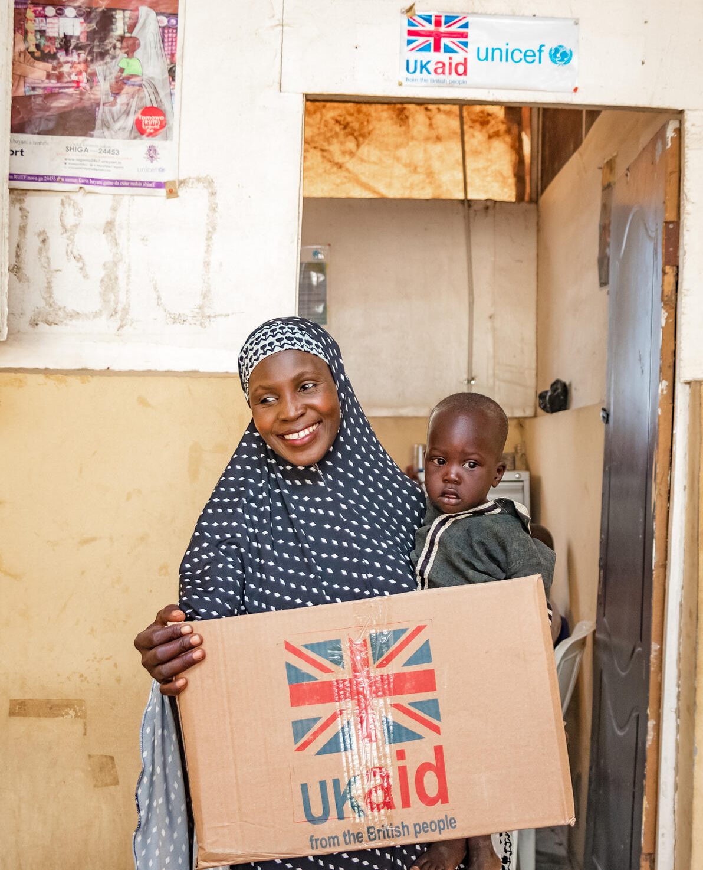
  THE CAMPAIGN
This year, children and young people taking part in OutRight will develop their knowledge of:
Relevant children’s rights and the UNCRC
What international aid is and why it is important (using climate change and education as examples)
How to use their voices on international issues that matter to them and their community, by contacting decision makers.

Slide 3
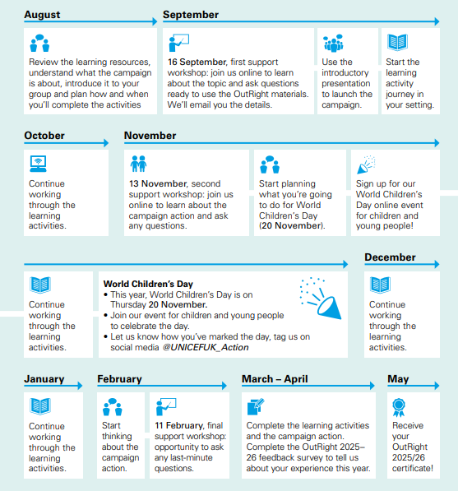
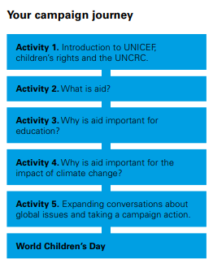

Slide 4

RESOURCES

Slide 5
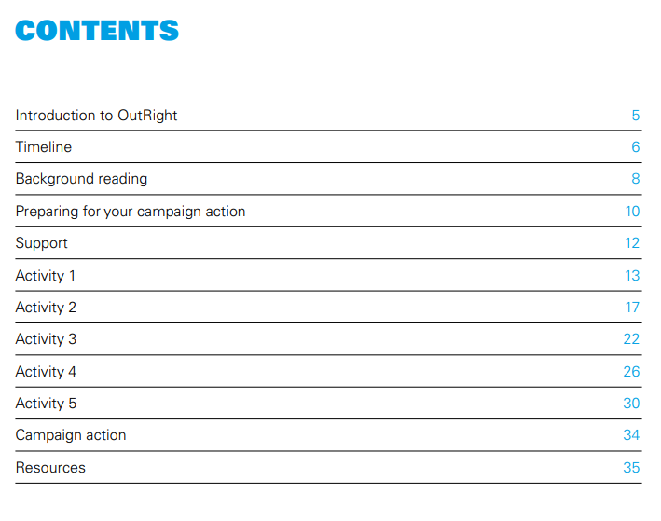

Slide 6
STORYTELLING VALUES

Slide 7
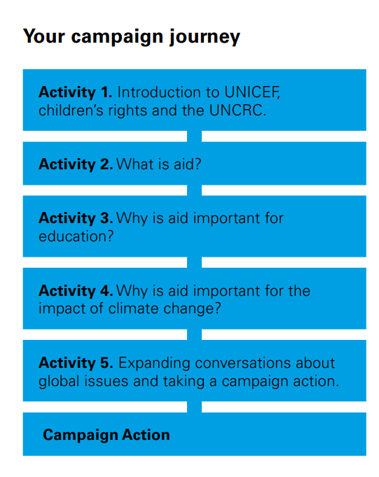
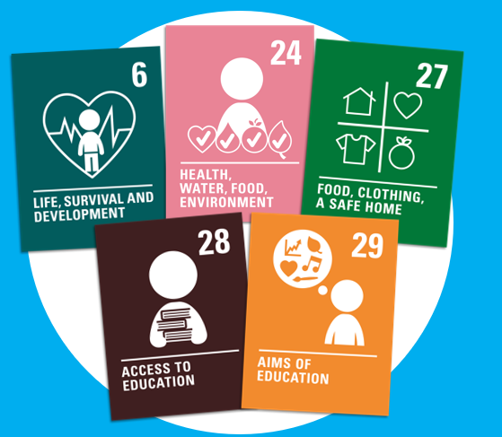

Slide 8
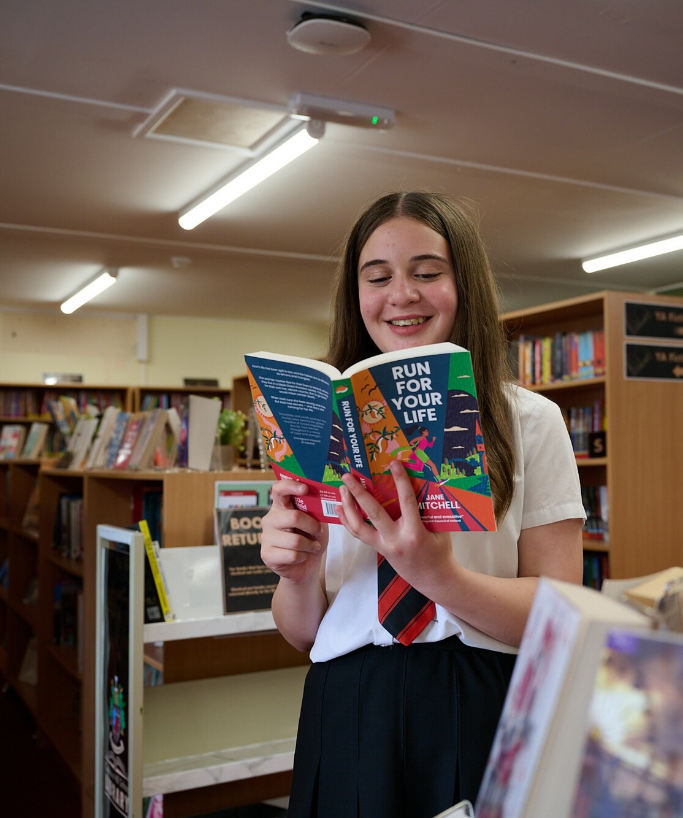
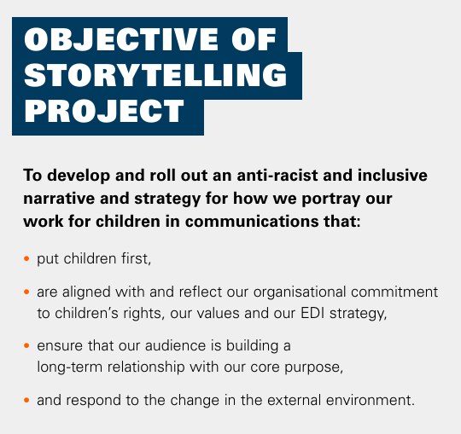
© UNICEF/Maule-Ffinch
Students at Cockshut Hill Secondary school created a series of images in a photojournalism style based on the brief - How does your school support your rights?

Slide 9
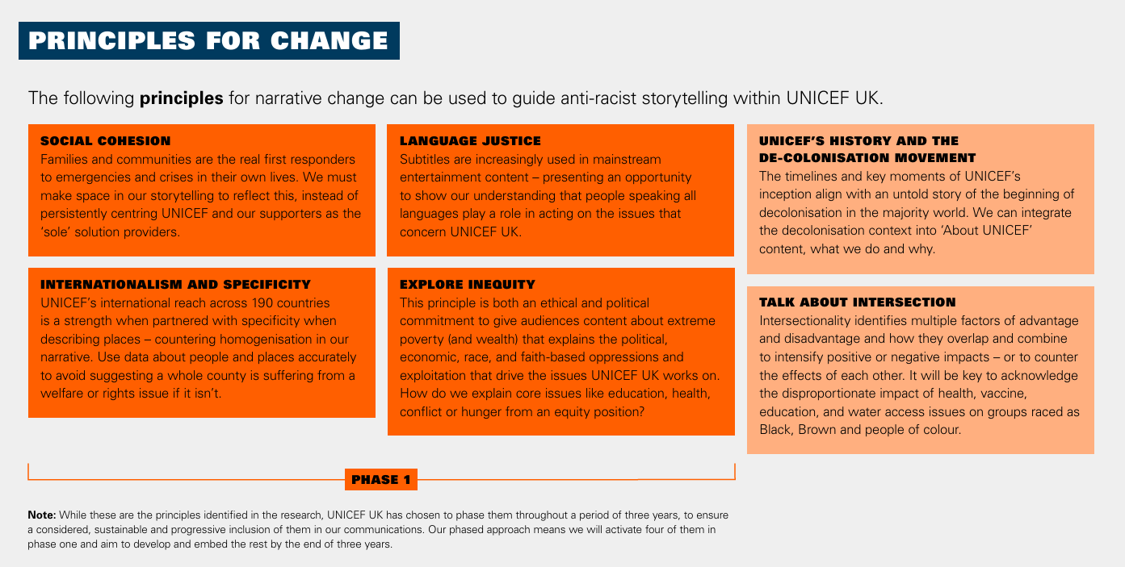

Slide 10
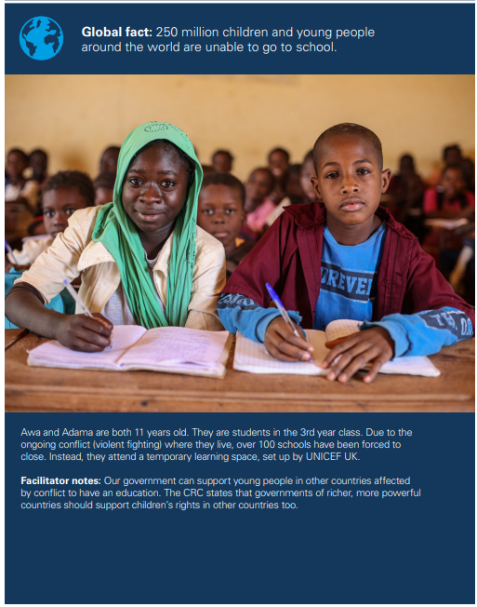
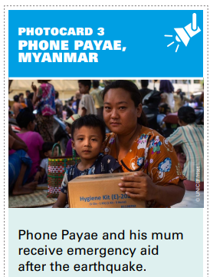
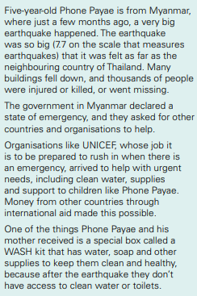

Slide 11
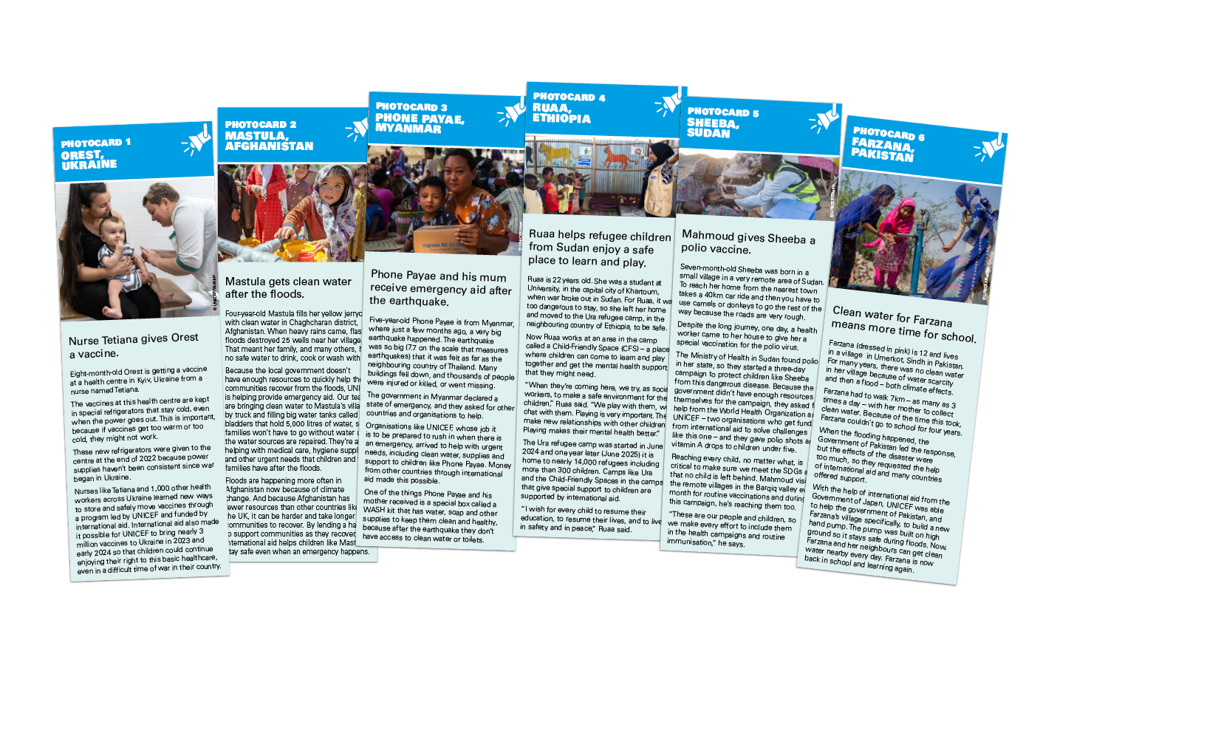

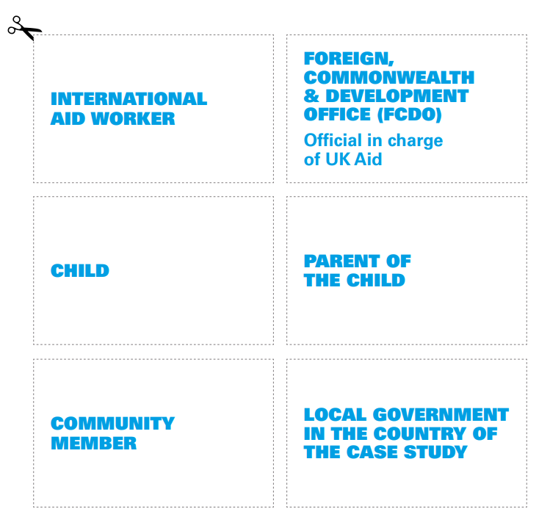
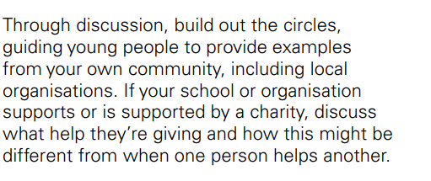
  SOCIAL COHESION

Slide 12
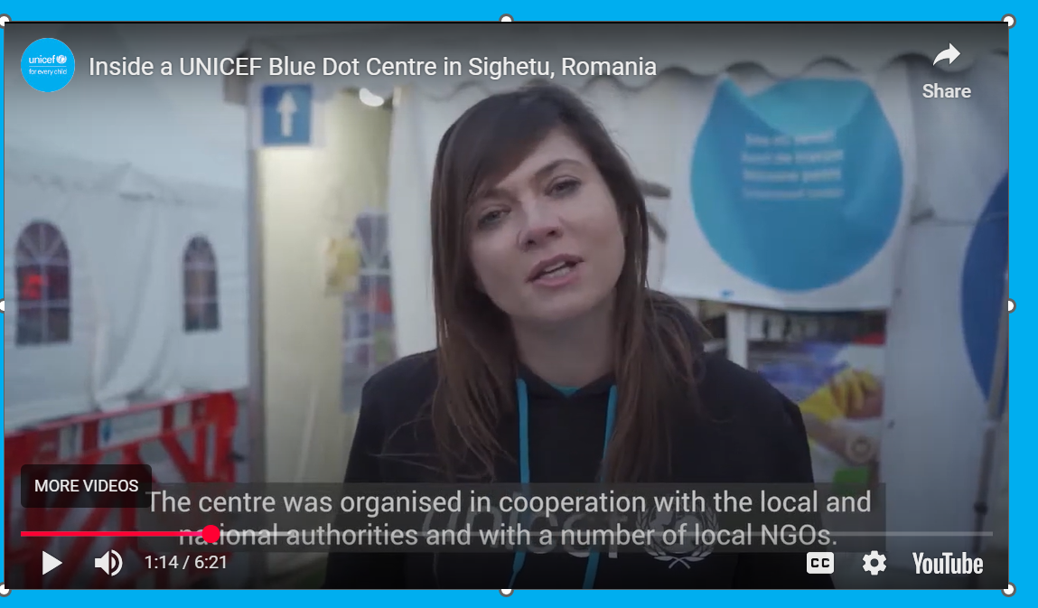
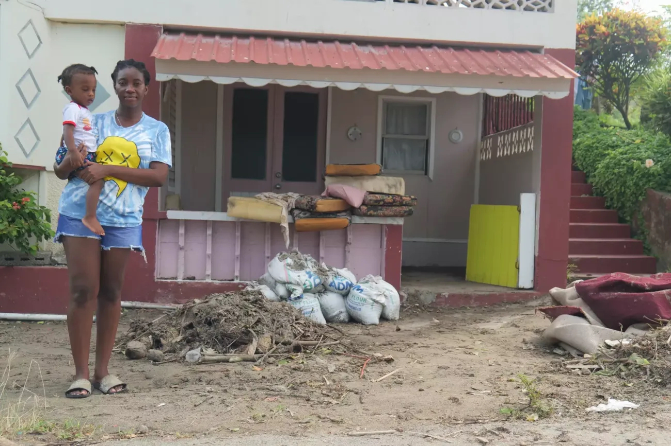
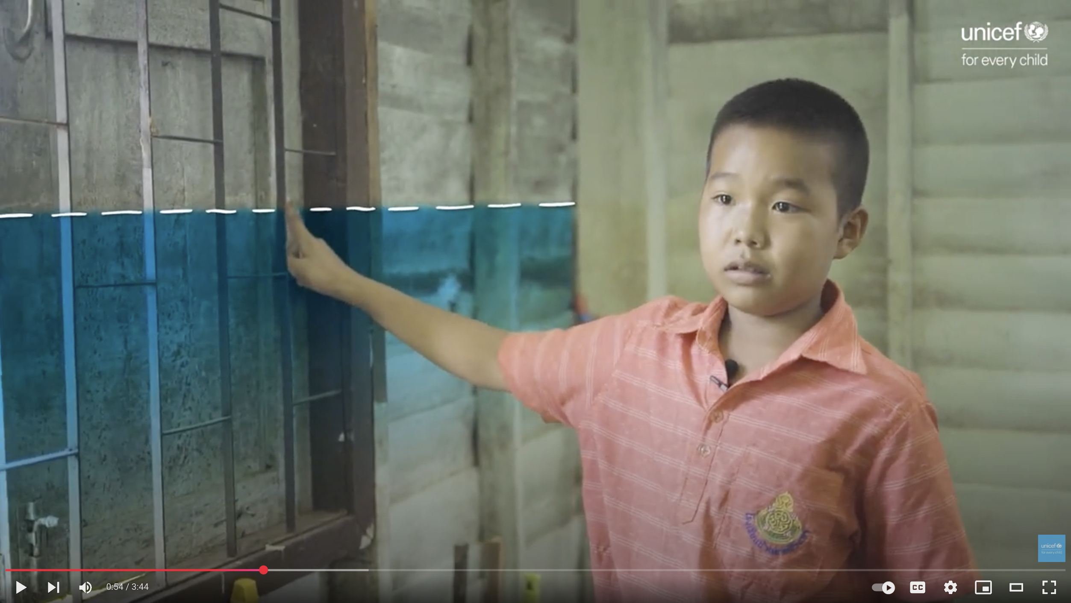


  LANGUAGE JUSTICE
HELEN AND
BABY LUCAS,
GRENADA
ANUWAT,
THAILAND

Slide 13
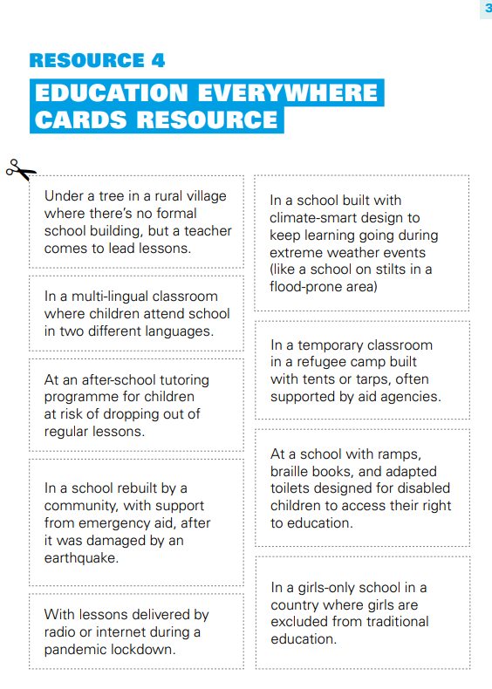
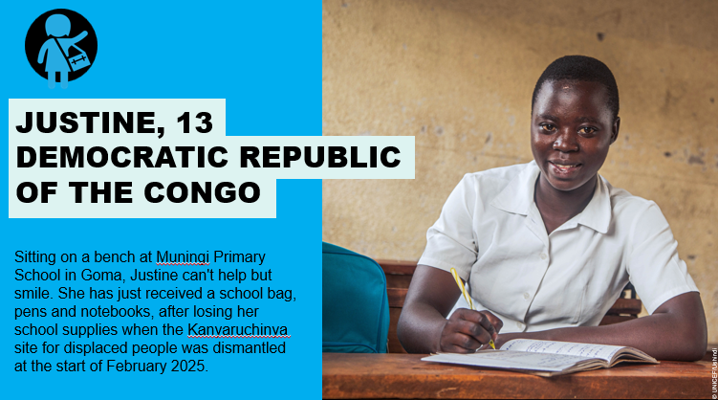
  INTERNATIONALISM AND SPECIFITIY

Slide 14
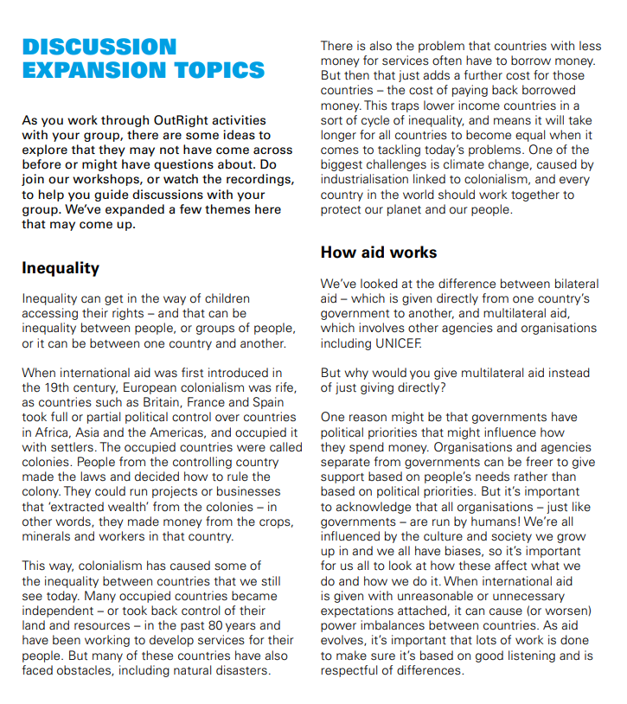
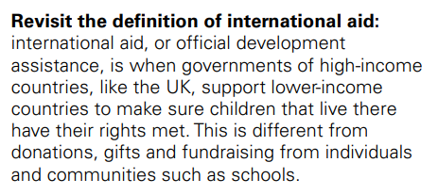

  EXPLORE INEQUITY

Slide 15
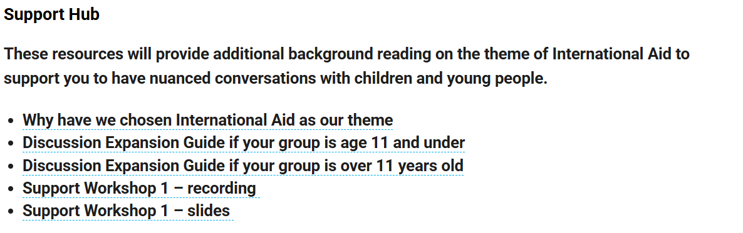
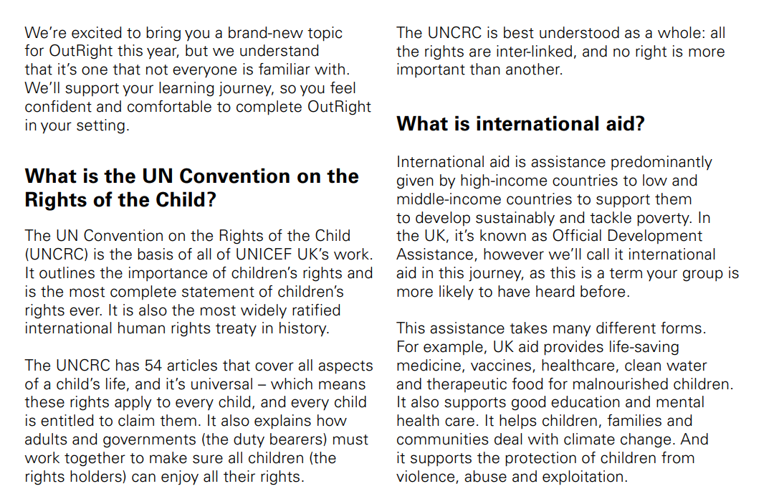
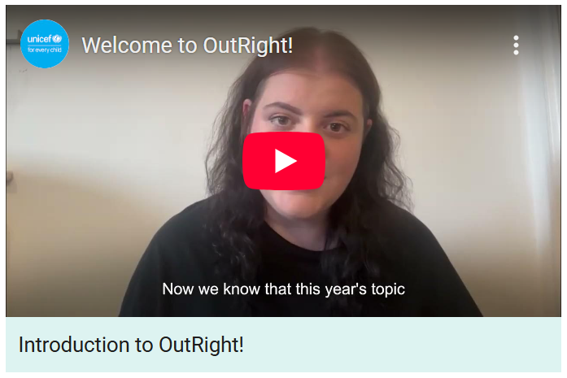
  LEARNINGS
Resources

Slide 16
WORLD CHILDREN’S DAY

Slide 17


  MAKE YOUR
  VOICE HEARD
Join our World Children’s Day events on Thursday 20th November.
Join us for Support Workshop 3 – which will prepare you for campaign actions.
Support Workshop 2

Slide 18
ANY QUESTIONS?
Notes:
© UNICEF/UN0460333/Al-Bash
Yemen 2021
https://weshare.unicef.org/archive/-2AMZIFR7EPY7.html
CAPTION:
Kholood (middle row, right) at school in Taiz, Yemen, which is near a fighting zone. “I feel afraid when I walk to school because cars are speeding, and I’m scared of the shelling.” UNICEF is helping to pay teachers and supply school materials.
(info about UNICEF support to schools in Taiz is from https://www.unicef.org/media/135316/file/Yemen-Humanitarian-SitRep-(End-of-Year)-31-December-2022.pdf, page 7)

