Slide 1
Introducing UNICEF UK's Rights Respecting Schools Award
Leon (third from right) and Lana (left) chose to show how children are their school are passionate about standing up for their rights by creating this protest image,
Notes:
Title Slide
About the image in this deck: In 2024, UNICEF UK partnered with two Rights Respecting Schools in the UK to create a set of images relating to rights. These images were co-created with students at the schools, meaning that the subjects, composition and aesthetics of the images were all driven by the students themselves. The images were created across two different disciplines, with students learning about the processes in both reportage and studio photography, before ideating in groups, and telling UNICEF on how they thought to best represent their rights in images for both techniques.

Slide 2
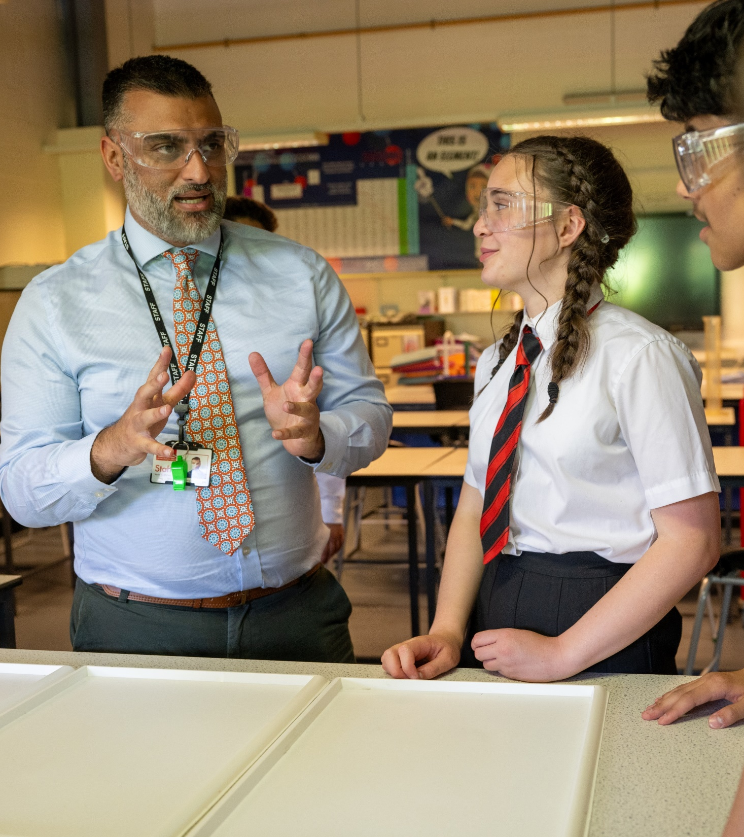
@UNICEF/Dawe
What is the RRSA?
© UNICEF/Maule-Ffinch
UNICEF UK works with schools across the United Kingdom to transform education through children’s rights.
This helps give young people the best chance to grow up empowered and inspired, ready to make a difference in the world.
The Rights Respecting Schools Award does this by helping schools teach students about their rights and uses these rights to put pupil participation at the heart of school life.
Notes:
RRSA is widely being recognised by headteacher’s and senior leaders as a contributing factor to school improvement. Children and young people say that being in a rights respecting school helps them to feel safer, listened to, respected and creates a sense of belonging. ​

Slide 3
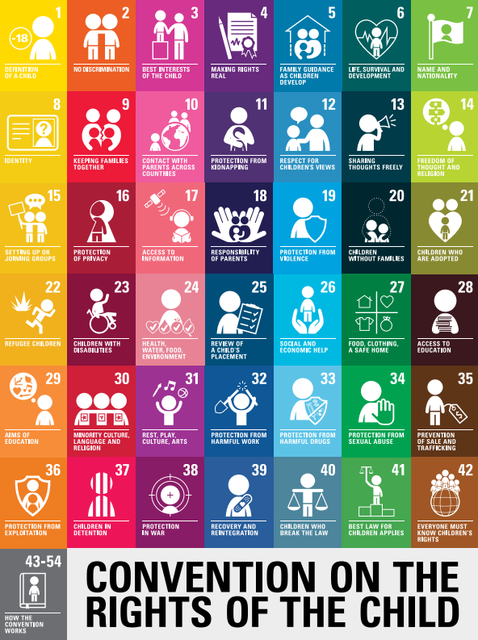
Using the UNCRC and its impact
When your school signs up to the award, you will work with school staff to follow all the rights in the UNCRC and make your school a rights respecting environment. Research shows that when schools become rights respecting: - Students enjoy coming to school - It supports everyone’s wellbeing - It helps everyone to feel safe and welcome In rights respecting schools, children and young people have a real say in how the school is run and take the lead on projects to support rights in the school, the community and the wider world.

Slide 4
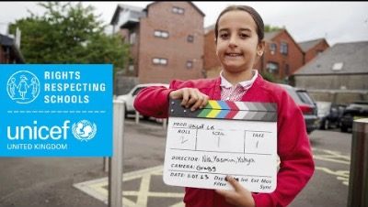
Notes:
A film about the RRSA.
You can also choose to share this film introducing the wider work of UNICEF: https://youtu.be/pz0ca4gD2Es

Slide 5
Three Stands of the Award
Strand A ​
Everyone in school learning about rights
Strand B ​
Life in school being lived and shaped through rights
Strand C​
Speaking up and taking action for rights: your own and other people’s
Notes:
Explain that there are three strands for the Award grouped under the three Strands outlined here. ​
​
There are 9 outcomes under these three strands and when the school is ready, an assessment visit by UNICEF UK takes place involving detailed discussion with children and adults in the school. This is a supportive learning visit with an emphasis on celebrating progress to date and sharing ideas and recommendations to progress to Gold: Rights Respecting which is the highest stage of the programme. ​
​
RRSA IS NOT ‘YET ANOTHER INITIATIVE’ - Rather than seeing the journey to rights respecting status as additional everything else, schools tell us that:​
​
‘It underpins everything else’……..’It brings it all together’….. ‘It makes sense of everything we do, it provides a framework’ ​
​

Slide 6
Optional Slide: RRSA in your school
Strand A - Learning about rights
Insert information about how you learn about rights at your school

Slide 7
Optional Slide: RRSA in your school
Strand B - Learning through rights
Insert information about how you have created a rights respecting ethos in your school

Slide 8
Optional Slide: RRSA in your school
Strand C - Learning for rights
Insert information about pupil voice, campaigning and fundraising to support rights

Slide 9
Optional Slide: RRSA in your school
What difference has it made?
Insert some information or quotes from pupils, staff and/or parents/carer about the impact of RRSA at your school and why they think children's rights are important.

Slide 10
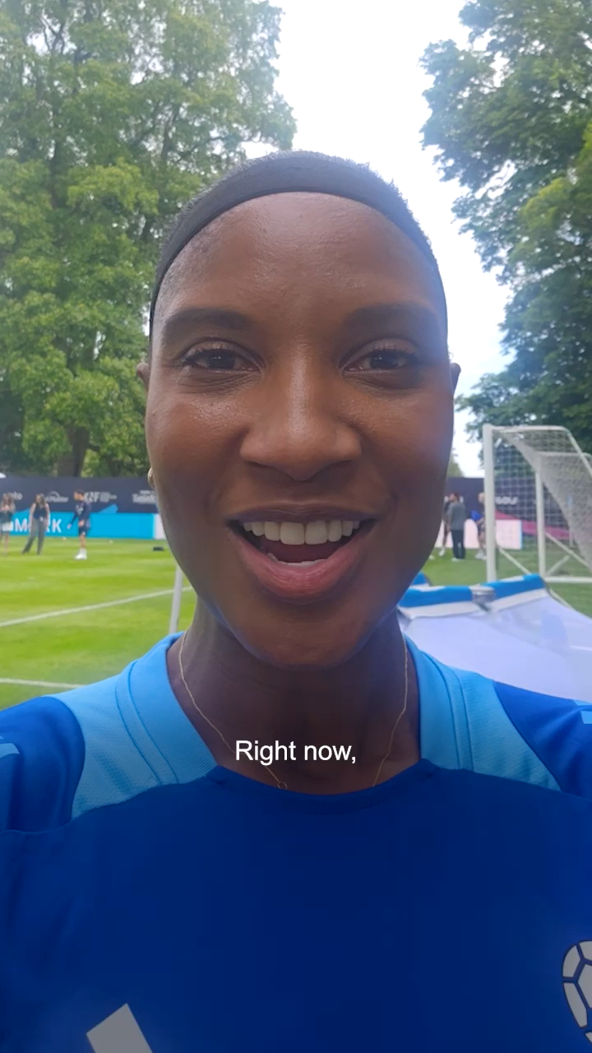
Join us for free!
Over 690 schools in London are taking part in the RRSA for free thanks to the Mayor of London’s Violence Reduction Unit funding.
Register online to get started and receive a free pack of resources!
Notes:
Share the news from Denise Lewis – RRSA is free to London schools!

