Slide 1
Sudan

Slide 2
How to use this resource
Rights Around the World is a regular resource series from UNICEF UK’s Rights Respecting Schools Award that pairs global citizenship with learning about rights and selected stories from UNICEF’s work around the world.
If you are a Rights Respecting School, this resource will help you to meet Outcomes 1 and 9 of RRSA accreditation:
Children, young people and the wider school community know about and understand the United Nations Convention on the Rights of the Child and can share how it impacts on their lives and on the lives of children everywhere.
Children and young people have taken action to claim their rights and promote the rights of others, locally and globally.
This resources is separated into two parts.
For use in assemblies, tutor time, circle time or a similar session where adults present and discuss a story or topic with children and young people.
PART
1
Filled with activity ideas for building greater understanding on the themes within the story as well as ideas for taking the learning out into the world or building on that learning through creation of a Rights Around the World display board of a passport (or learning journal).
Throughout the pack you will see some items labeled with stars. These are to give you, as the educator, an idea of the level at which the content is pitched.
One star: simple - for children in early years settings and/or those more confident with simpler concepts.
Two stars: intermediate - for children and young people who have a good level of comprehension and reflection ability.
Three stars: advanced – for young people who have the confidence and maturity to explore more challenging themes, concepts and ideas.
You know your children and young people best so feel free to adapt this resource and consider any sensitivities regarding war. Always review content before you use it within your setting.
PART
2
Notes:
Please note that this pack speaks of the impact of war and conflict on children. As ever, we know that you will want to make choices about how you address these important issues in a way that is appropriate for your children and young people. You might find this additional guidance helpful.

Slide 3
For assemblies or group sessions
PART
1

Slide 4
This month we are in…
Sudan, Africa
Notes:
Sudan and South Sudan:
Sudan is a large country in Africa. For many years it was divided into northern and southern regions. Different groups of people lived in the two regions. Fighting between the two groups led to a long civil war. In 2005, however, the fighting stopped. The peace agreement led to an official split between the two parts of Sudan in 2011. The new country of South Sudan came into being in July of that year.
https://kids.britannica.com/kids/article/Sudan/345791

Slide 5

Traveller's guide
T
Sudan, Africa
The capital of Sudan is Khartoum.
Sudan ratified the CRC in August 1990, one of the first countries to do so.
Sudan is the third-largest country in Africa and shares borders with seven other countries: Egypt, Libya, Chad, Central African Republic, South Sudan, Ethiopia, and Eritrea.
Arabic and English are official languages, but more than 100 other languages are spoken.
Sudan has more pyramids than any other country, with over 200 in total.
Notes:
Edit the facts to suit your audience. Boxes can be deleted if you would prefer to focus on fewer facts.
Sources:
https://www.worldvision.org.uk/about/blogs/interesting-facts-about-sudan/
https://www.unicef.org/sudan/convention-rights-child

Slide 6
What is happening in Sudan?
In Sudan, there are two main groups fighting each other for control of the country. Most people in Sudan are not fighting. Because of the fighting, millions of people in Sudan are unsafe and have had to leave their homes. Many do not have enough food or medicine, and many children cannot go to school.
15.3 million children in Sudan need help and protection.
Notes:
Source: https://www.unicef.org.uk/donate/sudan-appeal/?gad_source=1&gad_campaignid=20028312605&gbraid=0AAAAAD6VRshOv5iRc40qNP13kI57XEu7u&gclid=CjwKCAiA55rJBhByEiwAFkY1QOraI_6PafGC9PKXco_8jju3Vg4Tvgb1jQg5SNdH52xGYKfRTX2gCRoCyRkQAvD_BwE
This is a very simple description for children who are in their early stages of learning. For teachers, it may still be useful to read the next slides for greater context.
Please note that this pack speaks of the impact of war and conflict on children. As ever, we know that you will want to make choices about how you address these important issues in a way that is appropriate for your children and young people. You might find this additional guidance helpful.

Slide 7
What is happening in Sudan?
Since 2023, two groups are fighting each other for control of the Sudan – the government's Sudanese Armed Forces and the Rapid Support Forces. Most people in Sudan are civilians; they are not fighting. Because of the fighting, many people in Sudan are unsafe and have had to flee their homes. Millions of Sudanese people are displaced, do not have enough food or medicine and many children cannot go to school.
Sudan is the world’s largest humanitarian crisis. 15.3 million children need protection and assistance.
Notes:
Sources:
https://www.bbc.co.uk/news/articles/cjel2nn22z9o
https://www.unicef.org.uk/donate/sudan-appeal/?gad_source=1&gad_campaignid=20028312605&gbraid=0AAAAAD6VRshOv5iRc40qNP13kI57XEu7u&gclid=CjwKCAiA55rJBhByEiwAFkY1QOraI_6PafGC9PKXco_8jju3Vg4Tvgb1jQg5SNdH52xGYKfRTX2gCRoCyRkQAvD_BwE
For further information on the war in Sudan and how this is impacting on children, you could watch this BBC Newsround clip aired in October 2025 https://www.bbc.co.uk/newsround/videos/crmx7dmk840o
Please note that this pack speaks of the impact of war and conflict on children. As ever, we know that you will want to make choices about how you address these important issues in a way that is appropriate for your children and young people. You might find this additional guidance helpful.

Slide 8
What is happening in Sudan?
Sudan is the world’s largest humanitarian crisis.
In 2018, people across Sudan began protesting because of economic collapse. People could not afford their basic needs, such as food and fuel. People protested for access to these rights and demanded that President Omar al-Bashir should resign, after ruling for nearly 30 years. In 2019, the army removed the President, but protestors continued to protest as they wanted a civilian rule, not a government led by the army.
While most people in Sudan wanted a democratic government, in 2023 two groups began fighting – the government's Sudanese Armed Forces and the Rapid Support Forces. They are fighting each other for control of Sudan. This is not only a civil war but also an international war as several foreign governments are supporting different groups in Sudan. Most people in Sudan are civilians; they are not fighting. Because of the fighting, many people in Sudan are unsafe and have had to flee their homes. Millions of Sudanese people are displaced, do not have enough food or medicine and many children cannot go to school.
15.3 million children require protection and assistance.
Notes:
Sources:
https://www.bbc.co.uk/news/articles/cjel2nn22z9o
https://www.unicef.org.uk/donate/sudan-appeal/?gad_source=1&gad_campaignid=20028312605&gbraid=0AAAAAD6VRshOv5iRc40qNP13kI57XEu7u&gclid=CjwKCAiA55rJBhByEiwAFkY1QOraI_6PafGC9PKXco_8jju3Vg4Tvgb1jQg5SNdH52xGYKfRTX2gCRoCyRkQAvD_BwE
https://www.bbc.co.uk/news/world-africa-58970193
https://www.wilsoncenter.org/article/conflict-sudan-map-regional-and-international-actors
For further information on the war in Sudan and how this is impacting on children, you could watch this BBC Newsround clip aired in October 2025 https://www.bbc.co.uk/newsround/videos/crmx7dmk840o
Please note that this pack speaks of the impact of war and conflict on children. As ever, we know that you will want to make choices about how you address these important issues in a way that is appropriate for your children and young people. You might find this additional guidance helpful.

Slide 9
Intro to UNICEF in Sudan
UNICEF is working with other organisations and local communities in Sudan to deliver life-saving food, water and sanitation.
For example, UNICEF has helped millions of people in Sudan access safe drinking water and food. In 2025, UNICEF helped more than 1.3 million children access learning.
UNICEF is raising money so that in 2026 they can help:
12 million people access safe drinking water
1.6 million children access learning
3.6 million children and women access health care
Notes:
Reference: https://www.unicef.org.uk/donate/sudan-appeal/?gad_source=1&gad_campaignid=20028312605&gbraid=0AAAAAD6VRshOv5iRc40qNP13kI57XEu7u&gclid=CjwKCAiA55rJBhByEiwAFkY1QOraI_6PafGC9PKXco_8jju3Vg4Tvgb1jQg5SNdH52xGYKfRTX2gCRoCyRkQAvD_BwE
https://www.unicef.org/sudan/convention-rights-child
Some of the following types of support UNICEF have provided to children and families include:
Rolling out malaria vaccines for the first time in the country to benefit children under the age of 12 months.
Reaching millions of families with safe drinking water.
Providing malnutrition screening to children so they can receive life-saving treatment.
Offering psychosocial counselling, education and protection services to millions of children and their caregivers.
Supporting families with cash, information and other critical services.

Slide 10
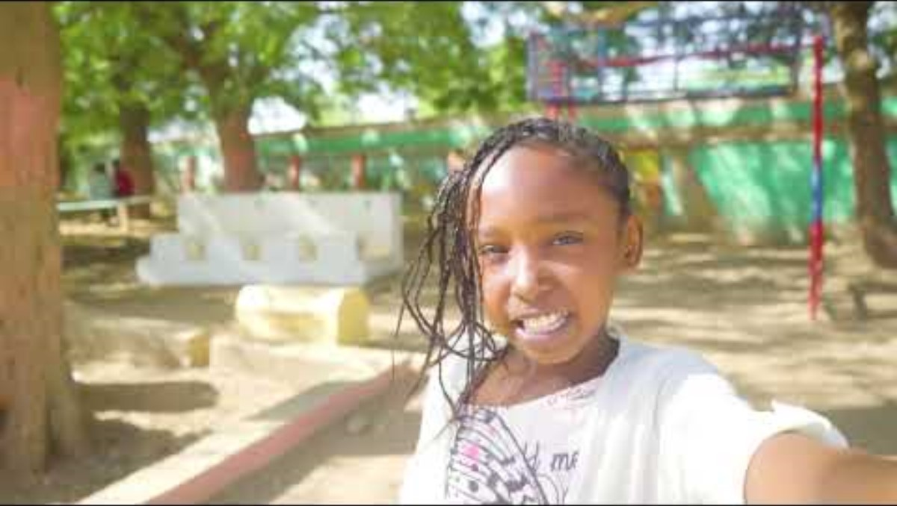
Naba's Story
Naba is a child from Sudan and she has left her home because of the war.
She spends time at a makanna which means ‘our space’ in Arabic.
At the makanna children can access their right to education, their right to clean water, and their right to rest and play with their friends.
Notes:
The video in this slide is 41 seconds long.
Slide 10 and 11 offer the same case study with varying levels of complexity. Select the slide that is most appropriate for your pupils.
Remember to play the video full screen. You will need to read the captions out to the children to explain what is being said in the video. You may find it best to play it once so the children can hear the people speaking in their own language, and then play it again with the video muted to explain to them what is being said. To activate subtitles play the video on full screen and click the 'CC' button on the bottom right of the screen.
Pupils could be encouraged to reflect on Naba's feelings about having a makanna where she can access education, clean water, rest and play.
You could also delete the text if you prefer to read this out to your pupils:
Naba is a child from Sudan and she has left her home because of the war.
She spends time at a makanna which means ‘our space’ in Arabic.
At the makanna children can access their right to education, their right to clean water, and their right to rest and play with their friends.

Slide 11
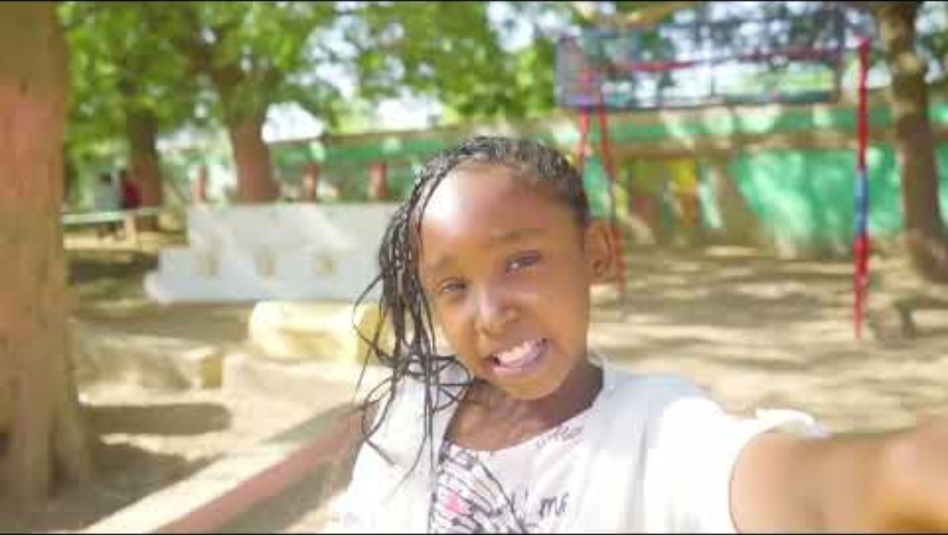
Naba's Story
The war in Sudan has forced millions of children, like Naba, to flee across the country to makannas.
Makanna is an Arabic word for ‘our space’. They provide a safe space for families displaced by war.
In this video Naba takes us on a tour around the makanna.
Children can access their right to education through eLearning classrooms, their right to clean water and sanitation, and their right to rest and play with their friends.
UNICEF is working to increase the access to makannas for children like Naba.
Notes:
The video in this slide lasts for one minute.
Slide 10 and 11 offer the same case study with varying levels of complexity. Select the slide that is most appropriate for your pupils.
Remember to play the video full screen. You will need to read the captions out to the children to explain what is being said in the video. You may find it best to play it once so the children can hear the people speaking in their own language, and then play it again with the video muted to explain to them what is being said. To activate subtitles play the video on full screen and click the 'CC' button on the bottom right of the screen.
Pupils could be encouraged to reflect on Naba's feelings about having a makanna where she can access education, clean water, rest and play.
You could also delete the text if you prefer to read this out to your pupils:
The war in Sudan has forced millions of children, like Naba, to flee across the country to makannas.
Makanna is an Arabic word for ‘our space’. They provide a safe space for families displaced by war.
In this video Naba takes us on a tour around the makanna.
Children can access their right to education through eLearning classrooms, their right to clean water and sanitation, and their right to rest and play with their friends.
UNICEF is working to increase the access to makannas for children like Naba.

Slide 12

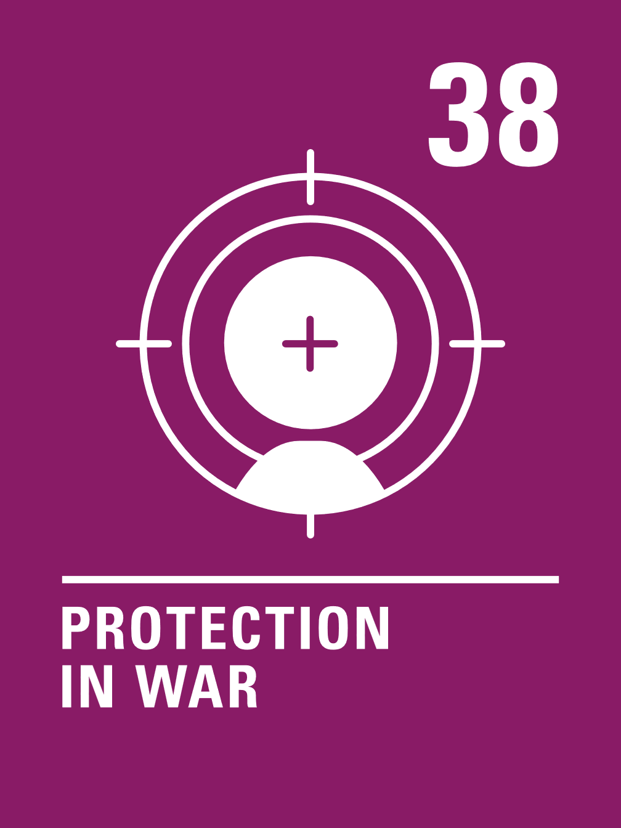
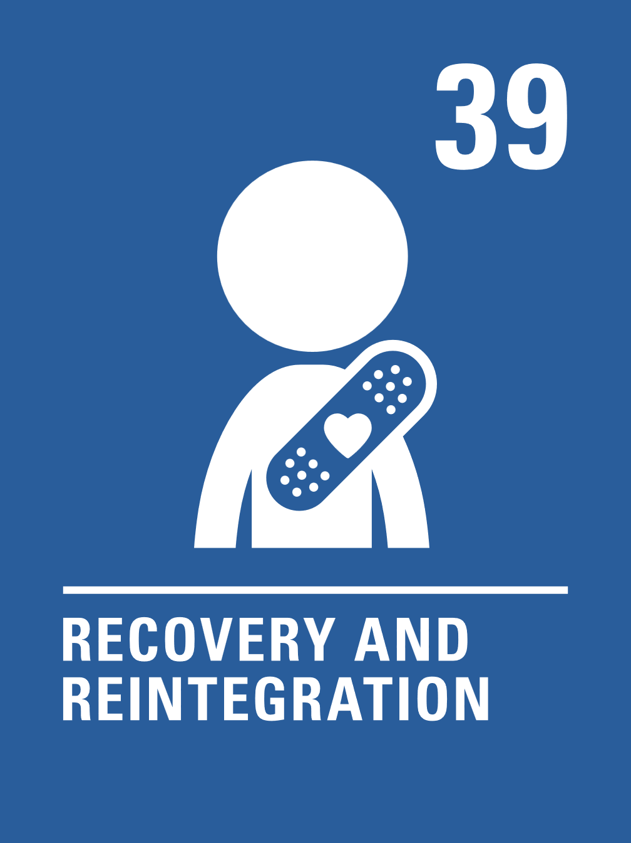
The rights link...
Look at the summary of the CRC with a partner – which articles do you think are particularly relevant to this case study? (Click to reveal some examples)
Why do you think we’ve highlighted this selection?
Did you identify others?
Notes:
You may wish to have copies of the CRC available if your pupils are less familiar with the articles from the convention.
You can find a simplified version here: https://www.unicef.org.uk/wp-content/uploads/2019/10/UNCRC_summary-1_1.pdf
And you can access the icons here: https://www.unicef.org.uk/rights-respecting-schools/wp-content/uploads/sites/4/2019/11/UN0332751.pdf

Slide 13
...and what about the Global Goals?
Why do you think we’ve highlighted this selection?
Did you identify others?
Notes:
Optional slide
If your pupils are not currently familiar with the Global Goals please remove this slide and the next one.
To find out more about the Global Goals: https://worldslargestlesson.globalgoals.org/ or https://globalgoals.org/

Slide 14
...and what about the Global Goals?
Why do you think we’ve highlighted this selection?
Did you identify others?
Notes:
SDG 3: Good Health and Well-being
Target 3.9 of this goal includes reducing illness from pollution in water.
More information about this global goal can be found here: https://globalgoals.org/goals/3-good-health-and-well-being/
SDG 16: Peace, Justice and Strong Institutions Target 16.1 of this goal includes reducing violence everywhere.
Target 16.2 of this goal includes protecting children from abuse, exploitation, trafficking and violence
More information on this global goal can be found here: https://globalgoals.org/goals/16-peace-justice-and-strong-institutions/

Slide 15



Reflection
Think back to what you have learnt about Sudan and UNICEF’s work.
Is there anything that surprised you or you thought was particularly interesting?
Is there anything you would like to learn more about?
Notes:
Before ending the session encourage pupils to reflect on what they have learnt. You could ask them to share their reflections in pairs, small groups or to the whole group.

Slide 16
Activities
PART
2

Slide 17
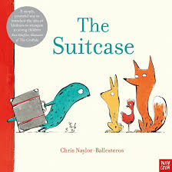
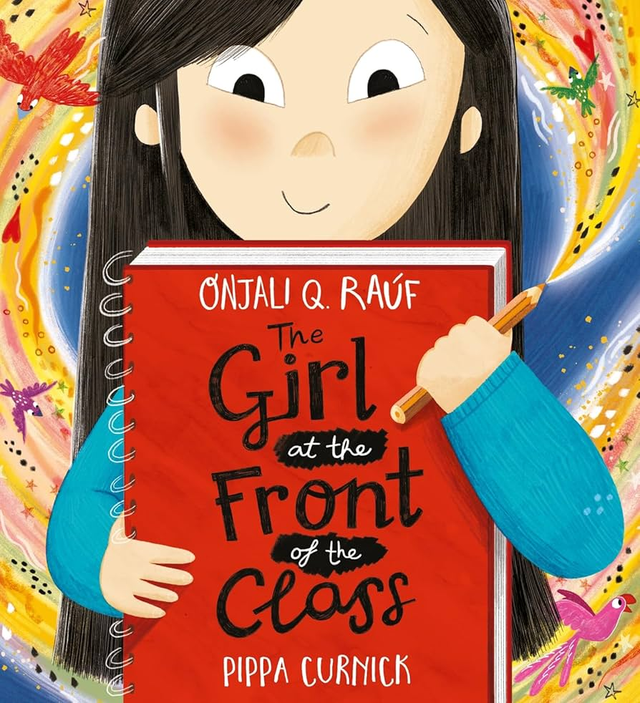
Build your understanding
Read, or listen along to, The Suitcase by
Chris Naylor-Ballesteros. If you had to
leave home quickly and could only take
5 things, what would you take with you
and why? Did your classmates choose the same or different things and why?
Makanna means ‘our space’. Is there a corner of your classroom that you could make into a makanna for your class? What could you put inside it to make it feel cosy and safe? How can this space support your rights to be made real?
Make a class collage of duty bearers (adults) who help you to enjoy your right to be safe and protected. For example, think about when you are at home, at school, at clubs or activities, out shopping or if there was a medical emergency.
Read The Girl at the Front of the Class by Onjali Q Raúf and think about how you can welcome children who join your nursery or school.
How can you make sure they know
where things are and what is important?
What about if they come from another
country or are a refugee?
Notes:
The activities here will support learners to explore this topic in more detail. Choose one or more activities as featured here or amend them to suit your setting. These are a set of simpler activities linked this this month’s topic, they are idea for early years or learners who are more confident with hands on, practical activities.
There are some excellent book recommendations to support younger children learn about this topic on the Book Trust website: Books about refugees and asylum seekers for younger… | BookTrust
Please note that this pack speaks of the impact of war and conflict on children. As ever, we know that you will want to make choices about how you address these important issues in a way that is appropriate for your children and young people. You might find this additional guidance helpful.

Slide 18
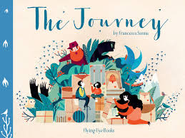
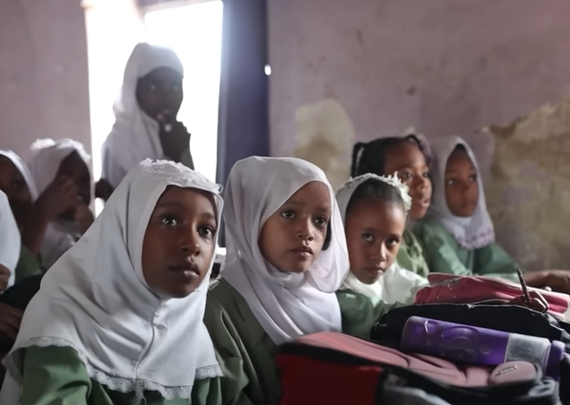
Build your understanding
Read, or listen along to, The Journey by Francesca Sanna. In small groups each make a freeze frame of different parts of the journey.
Can other people guess which
part of the journey you chose?
Which children's rights do you
think link with the story?
Children are sometimes forced into being child soldiers. Watch this video about UNICEF Goodwill Ambassador Ishmael Beah. Discuss how UNICEF helped this child to enjoy their rights again and how UNICEF changed their life. Find out about other UNICEF Ambassadors and how they help to promote the rights of children.
Watch this video to find out about the Back to School campaign in the Blue Nile state in Sudan. What resources did the children receive in their backpacks? How could this help them access Article 28, their right to education? How does this link to Global Goal 4?
Everyone has a right to be safe. Sometimes children need extra support to cope with things that happen to them. This is linked to Article 39, recovery and integration. In the video, Naba explained that she receives support from a psychologist at the makanna. What support could your school provide for a child who has experienced suffering?
Notes:
The activities here will support learners to explore this topic in more detail. Choose one or more activities as featured here or amend them to suit your setting. You could also create your own activities inspired by the presentations in part one.
Please note that this pack speaks of the impact of war and conflict on children. As ever, we know that you will want to make choices about how you address these important issues in a way that is appropriate for your children and young people. You might find this additional guidance helpful.

Slide 19
Build your understanding
Children who are victims of war must receive special support to help them recover according to Article 39. A growing number of children and young people joining schools in the UK are refugees fleeing countries at war. How can schools support refugee pupils and help them to feel welcome? What role can you and your fellow students play in this? Create an illustrated Welcome Charter or booklet for new pupils joining your school. Link this to children's rights.
The video ‘My name is Younis - I am a child, not a soldier’ shows how poverty led one child in Sudan to be caught up in conflict at a young age. While you watch it think about which rights were denied to Younis, then read articles 38 and 39 again. Discuss what role organisations like UNICEF have in working with young people like Younis to turn lives around. What do you think governments should be doing?
What is happening in Sudan is often referred to as the ‘forgotten conflict’. Why do you think it is called that? In pairs or groups choose one or more different rights from the UNCRC and create a piece of journalism to raise awareness of this 'forgotten war'. Highlight rights that children are being denied and explore the positive impact that raising awareness of the conflict can make.
Read and discuss the following article: Khalid’s colors of hope. Organise an exhibition or display of artefacts or other created pieces within your school/community that represent peace and/or hope. Show how these link to articles from the UNCRC and that children in Sudan need help now and for the war to stop. Explore ways to share your exhibition and message as widely as possible.
Notes:
The activities here will support learners to explore this topic in more detail. Choose one or more activities as featured here or amend them to suit your setting. You could also create your own activities inspired by the presentations in part one. These are a set of activities linked to this month’s topic, ideal for secondary school students.
There may be some parts of the articles or clips from the videos below that could also be shared with pupils:
Video: Life inside Sudan’s refugee camps | Unreported World
Article: Darfur diary: the road to El Fasher | The Observer
This video highlights the role of women in Sudan's 2018 protests. https://www.youtube.com/watch?v=B69OGag1JUY
Please note that this pack speaks of the impact of war and conflict on children. As ever, we know that you will want to make choices about how you address these important issues in a way that is appropriate for your children and young people. You might find this additional guidance helpful.

Slide 20
Take your learning into the world
Take action
Fundraise for UNICEF's Emergency Sudan appeal.
Get creative
Reflect on your learning about UNICEF Sudan and Naba.
Create a welcome display for children who might be new to the school.
Add to your passport
Add information about what you have learned to your Rights Around the World passport.
Include interesting facts about Naba's story and any actions you took because of your learning.

Slide 21
Further information & OutRight
The next Rights Around the World Resource will be shared on February 5th 2026. If you have enjoyed using this resource, you may also enjoy using UNICEF UK's OutRight resources. This year OutRight will focus on International Aid. Children and young people will develop their understanding of their rights, international aid and why it is an important part of being a global citizen. We’ll learn about the impact that international aid can have on both climate change and education globally.
You can use OutRight as evidence in your RRSA accreditation journey, and you’ll receive support and additional resources along the way.
https://www.unicef.org.uk/rights-respecting-schools/resources/teaching-resources/outright/
Notes:
This slide is for information only and not for class presentation

