Slide 1
Baby Friendly in the UK

Slide 2
How to use this resource
Rights Around the World is a regular resource series from UNICEF UK’s Rights Respecting Schools Award that pairs global citizenship with learning about rights and selected stories from UNICEF’s work around the world.
If you are a Rights Respecting School, this resource will help you to meet Outcomes 1 and 9 of RRSA accreditation:
Children, young people and the wider school community know about and understand the United Nations Convention on the Rights of the Child and can share how it impacts on their lives and on the lives of children everywhere.
Children and young people have taken action to claim their rights and promote the rights of others, locally and globally.
This resources is separated into two parts.
For use in assemblies, tutor time, circle time or a similar session where adults present and discuss a story or topic with children and young people.
PART
1
Filled with activity ideas for building greater understanding on the themes within the story as well as ideas for taking the learning out into the world or building on that learning through creation of a Rights Around the World display board of a passport (or learning journal).
Throughout the pack you will see some items labeled with stars. These are to give you, as the educator, an idea of the level at which the content is pitched.
One star: simple - for children in early years settings and/or those more confident with simpler concepts.
Two stars: intermediate - for children and young people who have a good level of comprehension and reflection ability.
Three stars: advanced – for young people who have the confidence and maturity to explore more challenging themes, concepts and ideas.
You know your children and young people best so feel free to adapt this resource and always review content before you use it within your setting.
PART
2

Slide 3
Teacher notes
How babies are fed and cared for can raise issues for everyone. This pack covers several areas that may be sensitive for staff delivering the resources as well as for children and families in your school community, particularly families with experience of babies who have been unwell or families who have had difficulties with breastfeeding. Please review the resources carefully and determine which ones are most suitable for your context. You know your children and families best and are therefore best placed to decide how to approach this issue.
It is also worth noting that the full text of Article 24 of the UNCRC includes the right to learn about the benefits of breastfeeding for both children and families: “e) To ensure that all segments of society, in particular parents and children, are informed, have access to education and are supported in the use of basic knowledge of child health and nutrition, the advantages of breastfeeding, hygiene and environmental sanitation and the prevention of accidents.”
We have taken care to craft a resource that builds on children’s and families’ experiences and is informed by our organizational values and reputable resources already used by educators.

Slide 4
For assemblies or group sessions
PART
1

Slide 5
This month we are in…
UK

Slide 6
Traveller's guide
T
The UK
The United Kingdom, known as the UK, is made up of four countries: England, Wales, Scotland and Northern Ireland.
The UK has the third longest coastline in Europe (12,430 km/ 7,723 miles) after Norway and Denmark (Greenland).
The UK’s highest mountain is Ben Nevis in Scotland at 1,345 m/4,412 ft.
In line with the World Health Organisation (WHO), the UK government’s advice is that infants should be exclusively breastfed, receiving only breastmilk for the first 6 months of life.
There were approximately 660,000 babies born in the UK in 2024.
There are around 69 million people living in the UK.
Notes:
Teacher Notes: Please edit the facts to suit your audience. Boxes can be deleted if you would prefer to focus on fewer facts. ​
​Sources: ​
UK made up of 4 countries: https://www.bbc.co.uk/bitesize/articles/z2wjqfr
Coastline: https://www.kids-world-travel-guide.com/uk-facts.html
Highest mountain: https://www.kids-world-travel-guide.com/uk-facts.html
Population: https://www.ons.gov.uk/peoplepopulationandcommunity/populationandmigration/populationestimates/bulletins/annualmidyearpopulationestimates/mid2024
Number of births: Please note that the data shows figures for 2024, as the data for 2025 has not yet been released.
England & Wales: https://www.ons.gov.uk/peoplepopulationandcommunity/birthsdeathsandmarriages/livebirths/bulletins/birthsummarytablesenglandandwales/2024
Northern Ireland: https://www.nisra.gov.uk/publications/registrar-general-annual-report-2024-births
Scotland: https://www.nrscotland.gov.uk/publications/vital-events-reference-tables-2024/
Government advice on breastfeeding –Breastfeeding - Best Start in Life - NHS
World Health Organisation Breastfeeding

Slide 7
Intro to UNICEF in the UK
UNICEF UK is guided by the UN Convention on the Rights of the Child which the UK ratified in 1991.
We have been delivering programmes for children in the UK for more than 30 years. In 2024,
Rights Respecting Schools reached 1.75 million children in 5,000 schools.
Baby Friendly Initiative supported around 660,000 newborn babies.
Child-Friendly Cities reached nearly 1 million children.
We also fundraise in the UK and in 2024 raised,
£16.6 million for children in emergencies in more than 75 countries and territories.
£15 million for children from Soccer Aid for UNICEF.
Notes:
Teacher Notes:
Learn more about UNICEF in the UK here: https://www.unicef.org.uk/what-we-do/
You may wish to explain to your pupils that they money raised by UNICEK UK is mainly used to support UNICEF's international work, not the UK-based programmes. Funds raised help provide emergency aid in crises, vaccinations and healthcare, access to education and protection for children affected by war, disaster or displacement. In 2024, money raised in the UK supported children in emergencies across more than 75 countries.
You might want to make it clear, that donations raised from the public are focused on children facing the greatest challenges globally, while our UK programmes, which focus on improving children's rights and wellbeing within the UK, are funded mainly through partnerships, fees, grants or other non-public fundraising income.
Additional Sources of Information:
https://www.unicef.org.uk/about-unicef-uk/,
https://www.unicef.org.uk/fundraise/fundraising-faqs/,
https://www.unicef.org.uk/wp-content/uploads/2025/06/UNICEFUKAnnualReport2024w-1.pdf,
https://www.unicef.org/partnerships/united-kingdom

Slide 8

ABCDE of rights
Can you remember what these letters stand for?
A Rights are for ALL children. UNIVERSAL
B Rights are there from BIRTH. INHERENT
C Rights CANNOT be taken away. INALIENABLE
D Rights DO NOT need to be earned. UNCONDITIONAL
E All rights are EQUALLY important. INDIVISIBLE
We know that rights apply to children from birth. In this pack we will explore B in more depth; what it means to respect rights for babies and young children and what UNICEF UK does to support this.

Slide 9
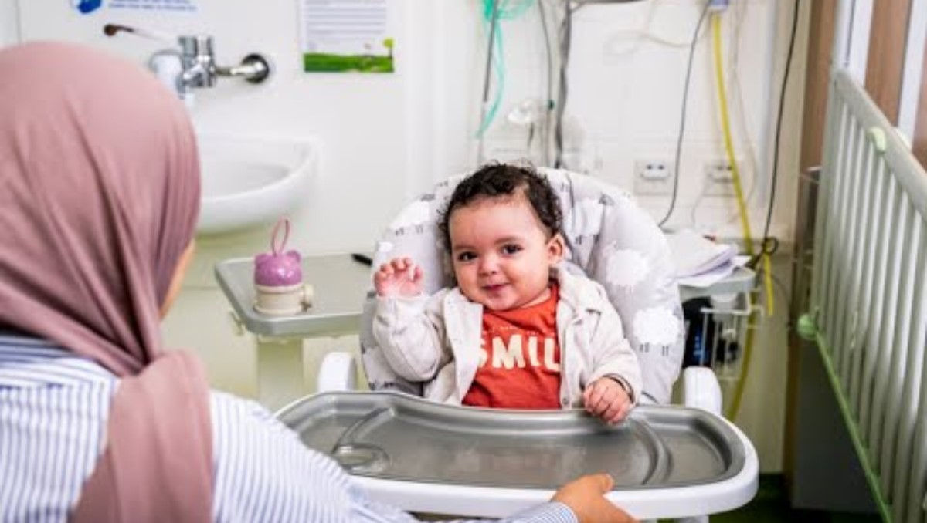
The Baby Friendly Initiative
Notes:
We would like to thank the fantastic Evie, aged 6, for recording the voiceover for this video.
Teacher Notes:
This video gives children an introduction to the UNICEF UK Baby Friendly Initiative (BFI). The UNICEF UK Baby Friendly Initiative helps hospitals, doctors and nurses give babies the best start in life. It teaches them how to help mothers feed their babies safely, whether with breastmilk or a bottle, and how to make babies feel safe, loved and cared for. It reminds everyone that cuddles, kindness and time together help babies grow healthy and happy. A ‘Baby Friendly’ award means a hospital or clinic is doing a great job caring for babies and their families because every child has the right to the best possible health.
This programme is guided by the UN Convention on the Rights of the Child, just like the Rights Respecting Schools Award. It makes sure all children get the best start in life and can access their rights from the moment they are born.
Please note that whilst the CRC does not include the right to be loved, the CRC preamble does state that children, "should grow up in a family environment, in an atmosphere of happiness, love and understanding," and that close, loving relationships are a key part of the BFI Theory of Change.
Source: https://downloads.unicef.org.uk/wp-content/uploads/2010/05/UNCRC_united_nations_convention_on_the_rights_of_the_child.pdf

Slide 10
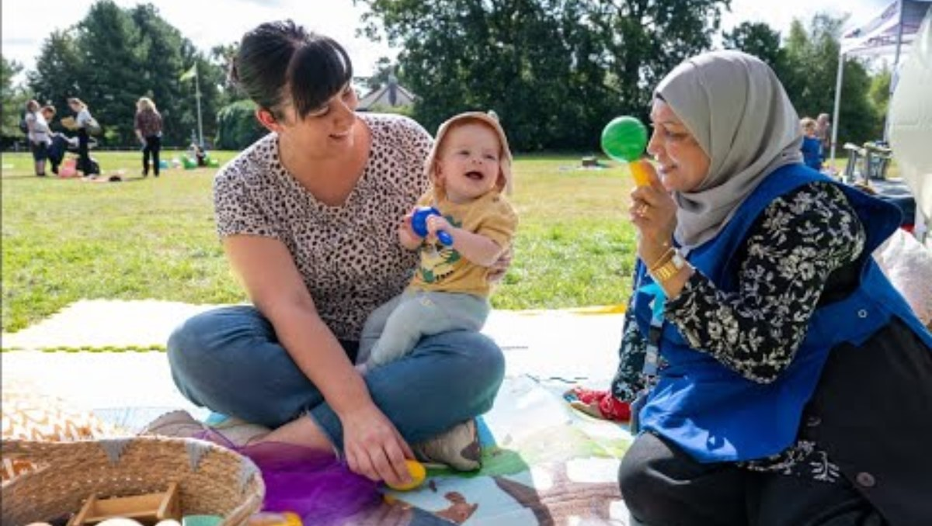
The Baby Friendly Initiative
Notes:
Teacher Notes:
This video gives children and young people an introduction to the UNICEF UK Baby Friendly Initiative (BFI). The UNICEF UK Baby Friendly Initiative is a programme that helps hospitals and community health services give babies the best start in life, guided by the UN Convention on the Rights of the Child, particularly Article 24. It supports staff to help mothers feed their babies confidently, whether by breastfeeding or bottle feeding, in a safe and caring way. It also focuses on helping parents and babies build close, loving relationships through things like cuddling, talking and skin-to-skin contact. Services that meet these high standards can earn a special ‘Baby Friendly’ award, which shows that they give families excellent care and guidance. The programme, which is guided by the UN Convention on the Rights of the Child, also makes sure that the information families receive is based on science and up-to-date knowledge. Overall, it’s about giving every baby the best chance to grow up strong and loved, because every child has the right to the best possible health.
The Baby Friendly Initiative works alongside the Rights Respecting Schools Award to create real change for babies and children. Together, they influence health, education and local communities to champion children’s rights, raise children’s voices and encourage active participation. They ensure every child is valued, heard and given the best possible start in life, so that children here in the UK can access their rights from birth.
Please note that whilst the CRC does not include the right to be loved, the CRC preamble does state that children, "should grow up in a family environment, in an atmosphere of happiness, love and understanding," and that close, loving relationships are a key part of the BFI Theory of Change.
Source: https://downloads.unicef.org.uk/wp-content/uploads/2010/05/UNCRC_united_nations_convention_on_the_rights_of_the_child.pdf

Slide 11

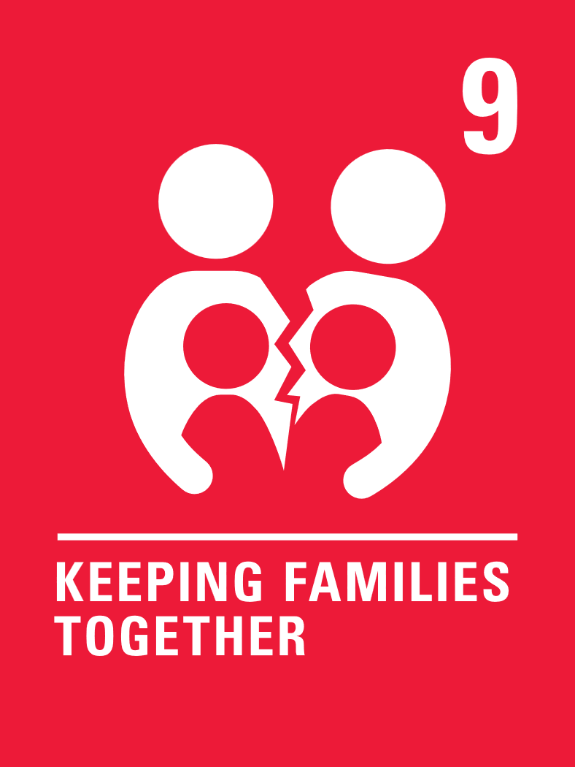
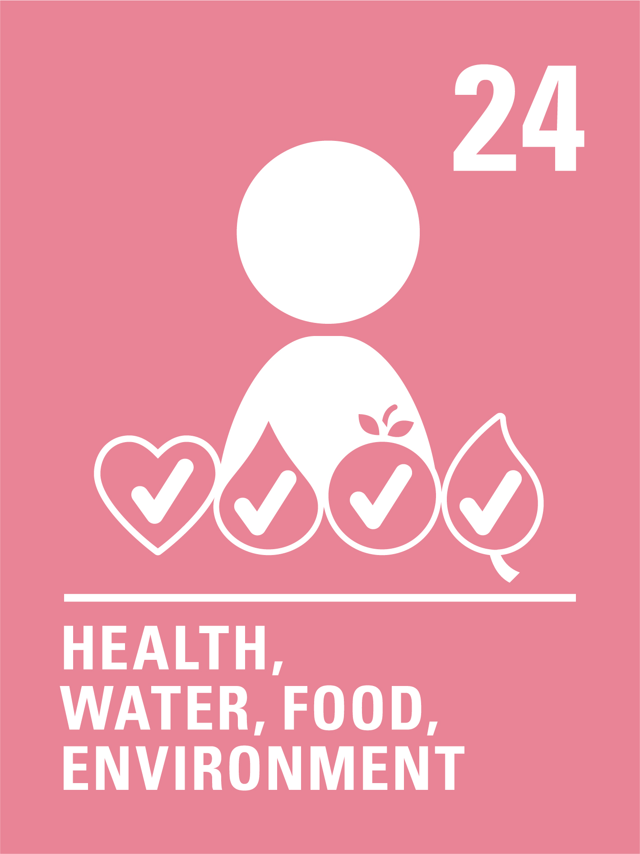
The rights link...
Think about all the rights you know. With a partner, discuss the articles you think relate to the Baby Friendly Initiative.
Click to reveal some examples.
Why do you think we’ve highlighted this selection?
Did you identify others?
Notes:
There are many articles in the CRC that relate to the Baby Friendly Initiative. You may wish to have copies of the CRC available if your pupils are less familiar with the articles from the Convention.
The following articles underpin BFI's Theory of Change:
Article 2: Non-discrimination – All children receive the best start in life, regardless of their social status, ethnicity, gender, etc.
Article 3: Best interests of the child – Breastfeeding and close and loving relationships promotes optimum emotional and physical wellbeing.
Article 5: Parental guidance and a child’s evolving capacities
Article 6: Life, survival and development – Breastfeeding and close and loving relationships supports brain development and health outcomes.
Article 9: Separation from parents – Close and loving relationships is a key standard of Baby Friendly, ensuring that parents and babies are not separated, particularly if babies are unwell and need hospital care.
Article 18: Parental responsibilities and state assistance
Article 24: Health, water, food, environment – This includes an obligation to protect and support breastfeeding, with the full text of Article 24 explicitly stating, "(e) To ensure that all segments of society, in particular parents and children, are informed, have access to education and are supported in the use of basic knowledge of child health and nutrition, the advantages of breastfeeding, hygiene and environmental sanitation and the prevention of accidents;"
The Baby Friendly standards
-ensure there is support for those who are pregnant with importance of breastfeeding and early relationships;
-protect, initiate and support breastfeeding;
-ensure informed decisions regarding introduction of food/fluids other than breastmilk;
-support with close and loving relationships and
-ensure parents are seen as partners in care.
CRC links:
You can find a simplified version here: https://www.unicef.org.uk/wp-content/uploads/2019/10/UNCRC_summary-1_1.pdf
You can access the icons here: https://www.unicef.org.uk/rights-respecting-schools/wp-content/uploads/sites/4/2019/11/UN0332751.pdf

Slide 12
...and what about the Global Goals?
Notes:
Optional slide​
​
If your pupils are not currently familiar with the Global Goals please remove this slide and the next one.​
​
To find out more about the Global Goals: https://worldslargestlesson.globalgoals.org/ or https://globalgoals.org/. ​

Slide 13
...and what about the Global Goals?
Why do you think we’ve highlighted these ones?
Did you identify others?
Notes:
Teacher Notes:
The Baby Friendly Initiative links to the following Global Goals:
Global Goal 2: BFI helps babies get the nutrition and food they need to grow strong and healthy.
BFI promotes breastfeeding which helps babies get the nutrition they need at the very start of life, which is essential for growth and brain development. Early nutrition shapes lifelong eating habits and health outcomes, which includes awareness of the impact of ultra-processed foods and formula, supporting families to make informed choices.
Global Goal 3: BFI supports parents so babies and mothers stay healthy.
BFI improves health for both babies and parents. Breastfeeding and good early feeding support can lower the risk of illness, help emotional wellbeing, and support bonding between parent and baby.
Global Goal 10: BFI helps all families get fair support, no matter who they are or where they live.
Not all families have the same access to information or support. BFI works to make sure every family, whatever their background, income or culture, receives respectful and non-judgemental care.

Slide 14



Reflection
Think about what you have learnt about UNICEF's role in the UK and especially how the Baby Friendly Initiative helps to make rights real for babies.
Is there anything that surprised you or you thought was particularly interesting?
Is there anything you would like to learn more about?
Notes:
Teacher Notes:
Before ending the session, encourage pupils to reflect on what they have learnt. You could ask them to share their reflections in pairs, small groups or to the whole group.

Slide 15
Activities
PART
2

Slide 16
Build your understanding
Hold a circle time activity giving each child a doll or soft toy so they can practice feeding and cuddling a baby. Discuss how you can help this baby feel safe and close to their family. What might you say to make the baby feel happy and loved? How might the baby feel when you sing them a nursery rhyme? Link this to a discussion about what children enjoy about spending time with their own parents and carers.
Listen to a story about babies and families, like Guess How Much I Love You, or watch this clip of Baby I Love You being read out loud. What makes the baby in the story feel safe and cared for? Draw a picture to show how to care for a baby and make them feel loved, linking this to Article 3, the best interests of the child.
Trace around your hands on paper and write or draw the different things babies need to give them the best start in life, including their rights. Create a display of all the hands you have made together and share it with parents/carers at your school who may have babies at home.
Set up a pretend hospital or clinic with dolls and blankets. Label your hospital ‘Baby Friendly’ and display Article 24, the right to the best possible health. Take turns being nurses, doctors and parents. Practice asking for help and giving advice explaining how to care for newborn babies. Think about how you can link this to children’s right to the best possible health.
Notes:
Teacher Notes:
This month’s resource is about UNICEF UK's Baby Friendly Initiative (BFI). The activities here will support children in early years or learners who are more confident with hands on, practical activities to explore the work BFI do to support the rights of babies and young children in more detail. Choose one or more activities as featured here or amend them to suit your pupils and setting. You could also create your own activities inspired by the presentation in part one.
Activity 1 – Try to make links with relevant articles as you talk to the children. For example, you could link to Article 9 – keeping families together and encourage children to reflect on why it is important for babies and children to be with their parents, carers and families, and Article 3 which is doing things in the best interests of the children.
Additional information for teachers:
We have specifically encouraged you to use dolls or toys to practice feeding babies without the use of baby bottles to promote breastfeeding and encourage children to learn about the importance of breastfeeding and breastmilk. You may want to adapt the activities to think about how animals/mammals feel their young using pictures of animals or toys.
What do you think you need to know about breastfeeding? https://vimeo.com/708013616/9e797ea8ff?share=copy

Slide 17
Build your understanding
All children have the right to adequate nutrition according to Article 24. Think about what this means for young babies. What do you know about breastfeeding? Do you ever see people breastfeeding in your local community or in books or TV programmes? How do you think breastfeeding supports children’s rights? Look at the following resources to find out more. Mini Milks or UNICEF UK/BFI
Watch this ‘Relationship Building’ video (up to 4:26) to learn about the benefits of developing close, loving relationships with babies. Think about how babies can express themselves (Article 13) and how we listen to and respond to babies (Article 12). Discuss with your teacher the meaning of any words you do not know (e.g. instinct, oxytocin, reciprocal, emotions, responsive).
How often do babies visit your school and why? Is your school baby friendly? Design a Baby Friendly area in your school, for when babies do visit your school. You could draw this out and/or create a checklist of the things you must have to make babies and families feel welcome and included (for example, changing mats). Is this design possible in your school? Remember to think about which articles from the CRC are the most relevant.
Some babies are born early or sick and need special care in a neonatal unit (NICU), respecting their right to Article 24. Even when parents can't hold them all the time, babies can stay close by using bonding squares, soft fabric pieces worn by the parent and placed near the baby so they can smell their parent and feel comforted. This supports love, connection and the right to family closeness. Design or make your own bonding squares.
Notes:
Teacher Notes:
This month’s resource is about UNICEF UK's Baby Friendly Initiative (BFI). The activities here will support children in upper primary to explore BFI further. Choose one or more activities as featured here or amend them to suit your pupils and setting. You could also create your own activities inspired by the presentation in part one. These are a set of activities that could be explored in upper primary.
Activity 1 - Mini Milks has a PowerPoint lesson about breastfeeding designed for use with KS2 children – this is children aged 7-11.
Activity 4 – You may wish to create a display of your bonding squares and explain what they are used for. Some hospitals may accept donations but please do check first so that children aren’t disappointed.
For more information, have a look at the BFI website: UNICEF UK/BFI
The benefits of breastfeeding - Best Start in Life - NHS
The Breastmilk Is Magic video. Breastmilk is magic (compressed).mp4

Slide 18
Build your understanding
In small groups, look at copies of the CRC and choose some key rights to focus on. Think about how these rights can be made real for babies from birth to three years old. How do their needs change as the baby grows to a toddler? Do you see any difficulties in applying these rights for babies. Think beyond physical needs and towards emotional needs. Share your ideas with your class.
Watch this ‘Relationship Building’ video (up to 4:26) to learn about the benefits of developing close, loving relationships with babies. Think about how this helps babies' brains to develop linked to Article 6, life, survival and development. For more information on brain development and social and emotional development in early childhood, have a look at these animations from The Centre for Early Childhood.
Create a short poster, video or leaflet to raise awareness of the rights of babies and their families and how we can meet those rights. Include one key message, a strong image or phrase, and a clear ask (e.g., more local spaces for breastfeeding). Explain how this links to different articles of the CRC, such as Article 3 and Article 24.
Breast feeding in Scotland has risen to all time highs. Do some research into breastfeeding rates in the rest of the UK. How many babies are breastfed? What do you think about this? Using the BFI standards, what actions could hospitals and health professionals take to raise the rate of breastfeeding in the UK? Have a look at this 'Call to Action' video for more information.
Notes:
Teacher Notes:
This month’s resource is about UNICEF UK's Baby Friendly Initiative (BFI). The activities here will support older learners or those able to explore more complex ideas to explore BFI further. These activities could be used in tutor time in secondary schools, with your rights group or within personal development lessons or equivalent. Choose one or more activities as featured here or amend them to suit your pupils and setting. You could also create your own activities inspired by the presentation in part one.
For more information, have a look at these websites:
https://www.annafreud.org/
https://developingchild.harvard.edu/key-concept/brain-architecture/
https://developingchild.harvard.edu/wp-content/uploads/2024/10/Childrens-Emotional-Development-Is-Built-into-the-Architecture-of-Their-Brains.pdf

Slide 19
Take your learning into the world
Take action
Think about how your community could better support new parents and babies. Could your class create posters or information leaflets about the importance of the early stages of a baby’s life? You could share these in your local GP surgery, library or children’s centre to ensure that your community is supporting children’s rights from birth.
Get creative
Create a piece of art, poem, or short video called “Every Baby’s Right” that celebrates the care every baby needs to grow and thrive. You could include drawings of caring moments between families, or key words linked to the right to health. Display your work in school or share it with parents and carers.
Add to your passport
Add what you’ve learned about the Baby Friendly Initiative to your Rights Around the World passport. Include a fact about how hospitals in the UK are supporting babies’ right to health, and one idea for how your school could become more baby friendly.
Notes:
Take Action: Children will have explored The Baby Friendly Initiative and how this links to children’s rights. To support Outcome 9 of RRSA, children can take this learning out into the world and create positive change by raising awareness of the importance of a baby friendly approach, or by contacting your local GP, library or children's centre/family hub to ask how your area is supporting BFI standards. Get Creative: You have the option to create a piece of art, poem or short video called 'Every Baby's Right' inspired by the work that BFI do.
Add to your passport: You have the option to use the Rights Around the World passport (found here: https://www.unicef.org.uk/rights-respecting-schools/resources/teaching-resources/rights-around-the-world/) These materials can be used to create individual passports for children or to create a class floor book to record learning.

Slide 20
Further information & OutRight
The next Rights Around the World Resource will be shared on 5th March 2026. If you have enjoyed using this resource, you may also enjoy using UNICEF UK's OutRight resources. This year OutRight focuses on International Aid. Children and young people will develop their understanding of their rights, international aid and why it is an important part of being a global citizen. We’ll learn about the impact that international aid can have on both climate change and education globally.
You can use OutRight as evidence in your RRSA accreditation journey, and you’ll receive support and additional resources along the way.
https://www.unicef.org.uk/rights-respecting-schools/resources/teaching-resources/outright/
Notes:
This slide is for information only and not for class presentation.
Further resources you may wish to explore with your class include the following:
Association of Breastfeeding Mothers Resources for Schools: Resources for Schools – ABM
The Breastfeeding Network has resources designed to align with the Scottish curriculum but easily adaptable for use in other nations: School Lesson Plans - The Breastfeeding Network

