Slide 1
Girls leading learning in India

Slide 2
How to use this resource
Rights Around the World is a regular resource series from UNICEF UK’s Rights Respecting Schools Award that pairs global citizenship with learning about rights and selected stories from UNICEF’s work around the world.
If you are a Rights Respecting School, this resource will help you to meet Outcomes 1 and 9 of RRSA accreditation:
Children, young people and the wider school community know about and understand the United Nations Convention on the Rights of the Child and can share how it impacts on their lives and on the lives of children everywhere.
Children and young people have taken action to claim their rights and promote the rights of others, locally and globally.
This resources is separated into two parts.
For use in assemblies, tutor time, circle time or a similar session where adults present and discuss a story or topic with children and young people.
PART
1
Filled with activity ideas for building greater understanding on the themes within the story as well as ideas for taking the learning out into the world or building on that learning through creation of a Rights Around the World display board of a passport (or learning journal).
Throughout the pack you will see some items labeled with stars. These are to give you, as the educator, an idea of the level at which the content is pitched.
One star: simple - for children in early years settings and/or those more confident with simpler concepts.
Two stars: intermediate - for children and young people who have a good level of comprehension and reflection ability.
Three stars: advanced – for young people who have the confidence and maturity to explore more challenging themes, concepts and ideas.
You know your children and young people best so feel free to adapt this resource and always review content before you use it within your setting.
PART
2

Slide 3
For assemblies or group sessions
PART
1

Slide 4
This month we are in…
Assam, India

Slide 5

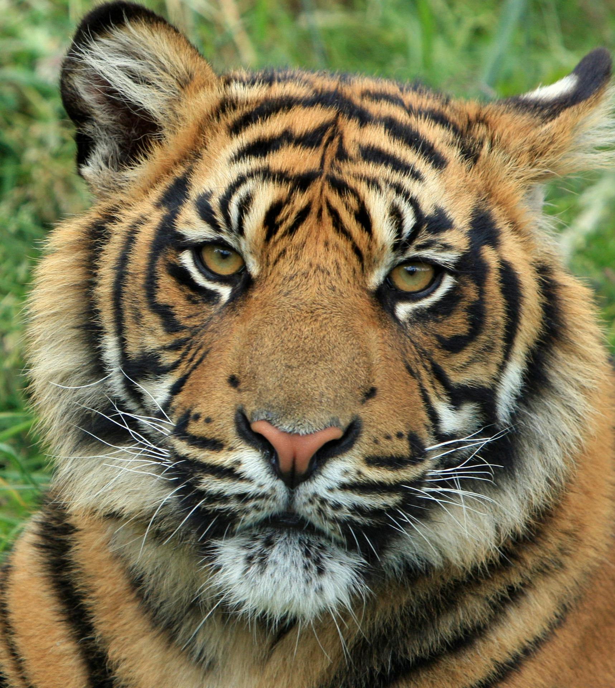

Traveller's guide
T
Assam, India
There are 1.4 billion people living in India. India is the country with the largest population in the world.
India gained its independence from British colonial rule in 1947.
Assam state produces more tea than any other state in India.
The Taj Mahal in India is one of the
Seven wonders of the modern world.
121 languages are spoken in India.
The national animal of India is the tiger,
and the national bird
is the peacock.
India has six weather seasons: Spring, Summer, Monsoon (Rainy Season), Autumn, Pre-winter, and Winter.
Notes:
Edit the facts suit your audience. Boxes can be deleted if you would prefer to focus on fewer facts.
Sources:
There are 1.4 billion people living in India. India is the country with the largest population in the world. https://www.worldometers.info/world-population/india-population/
India gained its independence from British colonial rule in 1947. https://www.bbc.co.uk/bitesize/articles/zn6496f
The Taj Mahal is one of the Seven wonders of the modern world https://www.originaltravel.co.uk/travel-guide/india/fun-facts
121 languages spoken in india. https://rubric.com/en-us/how-many-languages-in-india/
India has six seasons, not four. India’s traditional calendar recognizes six seasons: Spring, Summer, Monsoon, Autumn, Pre-winter, and Winter. https://www.globaladmissions.com/blog/50-incredible-facts-about-india
India’s national identity iscelebrated through its symbols:the tiger, lotus flower, and peacockwhich stand for strength, purity,and beauty. https://www.globaladmissions.com/blog/50-incredible-facts-about-india
India gained its independence from British colonial rule on August 15,1947. https://www.bbc.co.uk/bitesize/articles/zn6496f
Assam state produces more tea than any other state in India. http://www.agriculturejournal.org/volume13number3/dynamics-of-tea-production-in-assam-a-time-series-forecasting-approach/

Slide 6
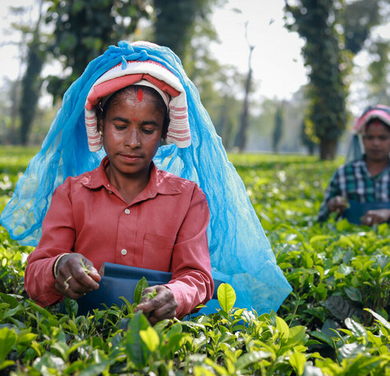
Picking tea in Assam
Most parts of India are hot and have lots of rain. This weather is ideal for growing tea.
Assam is a place in India where a lot of tea is grown.
Tea is mostly grown on large plantations called estates. The leaves are picked by hand, it is hard work.
Many estates are very large, so families often live nearby so they can walk to work easily.
Women picking tea leaves in a tea estate in Assam, India.
Notes:
Please note there is a glossary in later slides, should you want to explain any certain terms to pupils

Slide 7



UNICEF India and the Ethical Tea Partnership
UNICEF India works to support children's rights in India.
The Ethical Tea Partnership (ETP) helps tea workers and their families in India. They help make sure people who pick tea get fair pay, work in safe places, and protect nature.
The Improving Lives Programme
UNICEF India and ETP created The Improving Lives Programme which helps children and families living in 204 tea estates in Assam.
The Improving Lives Programme helps families living on tea estates by giving them better healthcare, food and helping children go to school. They want to make life better for families so children can grow up healthy, happy and safe.
Notes:
To find out more about the Ethical Tea Partnership click on this link.
To find out more about the Improving Lives Programme click on this link.
Reference for slide text: https://www.unicef.org.uk/corporate-partners/etp/#:~:text=The%20Improving%20Lives%20programme%20aims,drive%20sustainable%20change%20for%20children.
The ETP focuses on long term change so that everyone who works in tea-producing regions can have a better standard of living and working conditions, while helping the tea sector become more sustainable for the future.
In comparison, Fairtrade and Rainforest Alliance are certification organisations. This means they set standards and allow products to carry a label if they meet those standards. Whereas the ETP works with the tea industry to drive change across the whole sector.

Slide 8
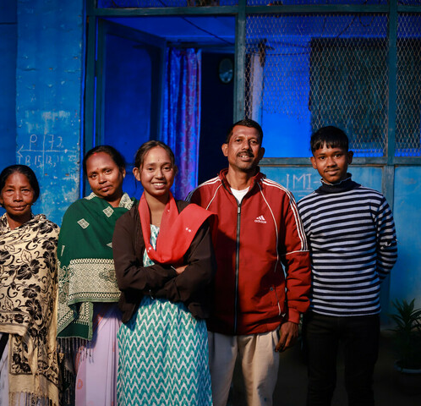
Ankita's Story
Ankita lives in with her family on a tea estate in Assam, India.
Her parents both work in the tea estate.
Ankita wanted to learn about computers but her parents didn’t have enough money to pay for the computer class.
Ankita, with her parents, brother and grandmother.
Notes:
Slides 8-11 are a simplified version of Ankita's Story for children in early years settings and/or those more confident with simpler concepts. Slide 12 contains a more complex version of the story, which teachers might be interested to view for context (https://youtu.be/12_uWrZ1-Xw)
Please note there is a glossary in later slides, should you want to explain certain terms to pupils

Slide 9
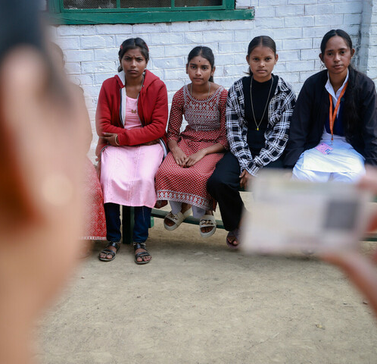
Ankita's Story
Ankita joined a youth group aimed at supporting girls.
The group helped her learn that to get money for school you need something called an 'identity card' and a 'bank account'
With help from the group, Ankita opened a bank account. This helped her get money called a 'scholarship' to pay for computer classes.
Ankita and friends at the youth group

Slide 10
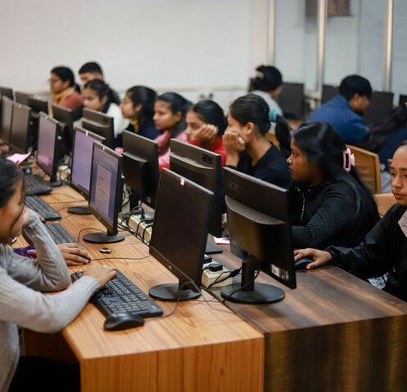
Ankita's Story
With the scholarship, Ankita joined a computer class.
She also helped one of her friends to find out about scholarships so that she could join the class.
Ankita used the rest of the scholarship money to buy books and save up for college.
Ankita at the computer centre.

Slide 11
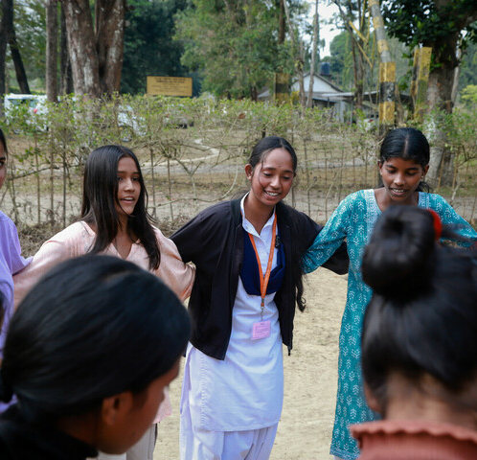
Ankita's Story
Ankita is now a leader at the youth group. She helps other girls open bank accounts and get scholarships too.
Ankita said:
“Many girls are too shy to come out, ask questions and talk to people. We bring them to the youth group, so we can learn together.”
Ankita and friends at the youth girls Group.

Slide 12
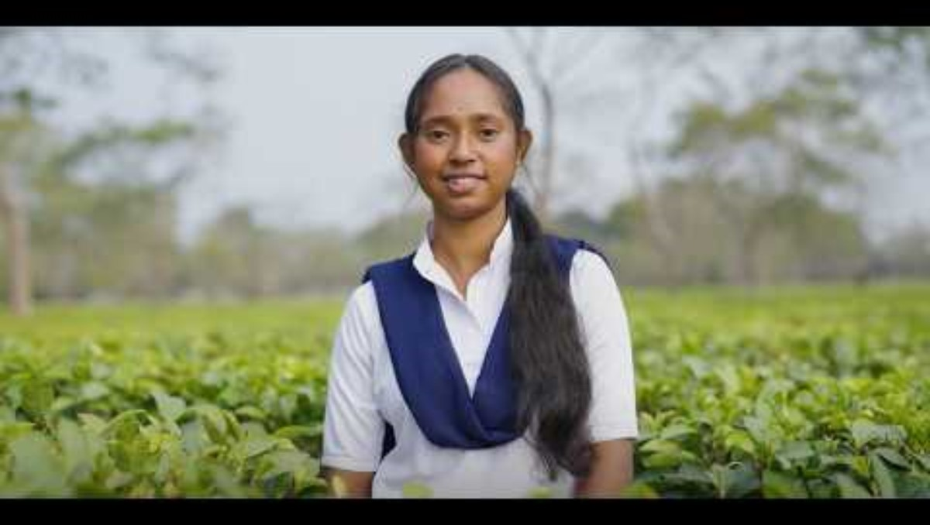
Ankita’s story
Ankita lives in with her family on a tea estate in Assam, India. Ankita wanted to learn about computers, but her parents did not have enough money to pay for the computer class.
With the help of her youth group and the Improving Lives Programme, Ankita was able to access a scholarship to pay for the computer class.
In Ankita’s words:
“Many girls are too shy to come out, ask questions and talk to people. We bring them to the Youth Group, so we can learn together.”
Notes:
This slide is a more complex version of Anikta's story for a higher level of understanding. Read more about the Improving Lives programme: Social inclusion initiatives in Doomur Dullung Tea Estate, India

Slide 13
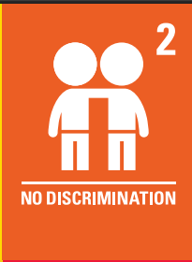

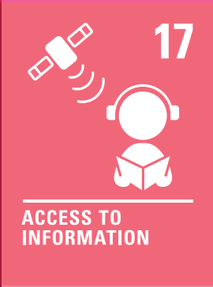

The rights link...
Look at the summary of the CRC with a partner – which articles do you think are particularly relevant to this case study? (Click to reveal some examples)
Why do you think we’ve highlighted this selection?
Did you identify others?
Notes:
You may wish to have copies of the CRC available if your pupils are less familiar with the articles from the convention.
You can find a simplified version here: https://www.unicef.org.uk/wp-content/uploads/2019/10/UNCRC_summary-1_1.pdf
And you can access the icons here: https://www.unicef.org.uk/rights-respecting-schools/wp-content/uploads/sites/4/2019/11/UN0332751.pdf

Slide 14
...and what about the Global Goals?
Why do you think we’ve highlighted this selection?
Did you identify others?
Notes:
Optional slide
If your pupils are not currently familiar with the Global Goals please remove this slide and the next one.
To find out more about the Global Goals: https://worldslargestlesson.globalgoals.org/ or https://globalgoals.org/.

Slide 15
...and what about the Global Goals?
Why do you think we’ve highlighted this selection?
Did you identify others?
Notes:
Optional slide
If your pupils are not currently familiar with the Global Goals please remove this slide and the next one.
To find out more about the Global Goals: https://worldslargestlesson.globalgoals.org/ or https://globalgoals.org/.

Slide 16



Reflection
Think back to what you have learnt about India, Assam, Ankita and the work of UNICEF and the Ethical Tea Partnership.
Is there anything that surprised you or you thought was particularly interesting?
Is there anything you would like to learn more about?
Notes:
Before ending the session, encourage pupils to reflect on what they have learnt. You could ask them to share their reflections in pairs, small groups or to the whole group.

Slide 17
Activities
PART
2

Slide 18
Build your understanding
What do you know about India? Why not read a book, such as India, Incredible India by Jasbinder Bilam, to learn more. Or watch some more videos from UNICEF India and discuss what rights are being protected. What can you find out about children's lives in India?
Ask an adult to show you some of the boxes of tea from the staffroom or from home or visit your local supermarket. Does the tea box say whether the tea producer is part of the Ethical Tea Partnership or can you see a Fairtrade or Rainforest Alliance logo? Why is it important to make sure the people who grow the tea are treated fairly?
Ankita is part of a girls' group in her tea estate. In many parts of the world, girls and boys are still given different opportunities. Can you think of ways boys and girls are sometimes treated differently? Why is it important to make sure all children are treated fairly?
Ankita wanted to do a computer class to develop her skills. Do you do any clubs in the evenings or at the weekends? What amazing skills do you have? You could create a display of all of the different activities your class or group do and your fabulous skills.
Notes:
These are a set of simpler more hands-on activities linked this this month’s topic, they are idea for early years or learners who are more confident with hands on, practical activities.
The way the picture story is told for the youngest does not explicitly refer to discriminatory treatment of girls. Please give some thought to discussing gender equality/equity with your class.

Slide 19
Build your understanding
Ankita faced barriers to accessing her right to education. Think about the different barriers she faced and how she overcame these barriers to achieve her goal. You could plot this out on a piece of paper and make links to CRC articles.
Ankita was part of a girls' group and also wanted to take part in computer lessons. What clubs or activities can you join at school? Does your school have pupils running or supporting the activities? Think about how you could be more involved or suggest a club that you would like to have in school. Create a proposal for a new club.
Ankita is part of a girl's group in her tea estate. In many parts of the world, girls still face discrimination and need extra support to achieve their goals (equity). Find out about some amazing women that have overcome challenges to achieve fantastic things. Discuss some ideas to mark International Women's Day on 8th March.
Antika had to have an identity document (ID) to get a bank account. Talk about identity documents, what they are e.g. passports, birth certificates, and why they are important. Create your own ID document by drawing a self-portrait and adding things that are important to you such as family/carers/friends, special items and places.

Slide 20
Build your understanding
Find out more about the Ethical Tea Partnership. What does it aim to do and how does this support children’s rights? How is this different to Fair Trade or the Rainforest Alliance? You could create a table to compare and contrast the different schemes and then think about how to encourage people to be aware of them when they buy tea.
Ankita was part of a girl's club in her tea estate, linked to Article 15. Survey your friends to see if there is a club that they would like to see in school. Come up with a proposal for a club, including any relevant details on potential barriers to overcome, funding, venues, staffing, accessibility, equity etc. Pitch your idea to your duty bearers and see if you can get your club up and running.
Why do you think there is a girl's club in the Tea Estates? Read about UNICEF’s work on gender equality and then discuss why this is particularly important during the teen years. Think about Article 2 and discuss or write about how we can support all children and young people to achieve their potential.
Article 28 says that primary education should be free and compulsory, but that secondary education should be available and accessible to every child, with financial assistance available in case of need. UNICEF and ETP's programme supported Ankita to access education through a scholarship fund. Find out more about how many children across the world access secondary education and think about how you could campaign for access to be increased.

Slide 21
Take your learning into the world
Take action
Set up an Article 2 group and decide on a campaign that focuses on one aspect of the protected characteristics. You might want to focus on gender equality as March 8th is International Women's Day.
Get creative
Draw a teacup or mug and decorate this to show what you have learned about Ankita and UNICEF's work with Ethical Tea Partnership. Add this to your Rights Around the World display.
Add to your passport
Create a page on Assam in your Rights Around the World passport. Include a fact file on the situation in the case study and any actions you took as a result of your learning.

Slide 22
Glossary
Ethical: What is morally right. Acting in a way that treats people and the environment well.
Tea garden: A place where tea plants are grown and people work picking the leaves.
Tea estate: The tea gardens and surrounding areas where the people who work in the tea gardens live their lives.
Equity: When things are fair, and all people have the same opportunities as others.
Financial literacy: Understanding money - how to earn, spend, save, and manage it wisely so you can make good decisions in life.
Scholarship: Money or support given to help someone go to school, college, or learn new skills, especially if they wouldn’t be able to afford it otherwise.

Slide 23
The next Rights Around the World Resource will be shared on April 16th 2026. If you have enjoyed using this resource, you may also enjoy using UNICEF UK's OutRight resources. OutRight's latest focus is on International Aid. Children and young people will develop their understanding of their rights, international aid and why it is an important part of being a global citizen. We’ll learn about the impact that international aid can have on both climate change and education globally.
You can use OutRight as evidence in your RRSA accreditation journey, and you’ll receive support and additional resources along the way.
https://www.unicef.org.uk/rights-respecting-schools/resources/teaching-resources/outright/

