Slide 1
Enjoying the right to play in Guatemala

Slide 2
How to use this resource
Rights Around the World is a regular resource series from UNICEF UK’s Rights Respecting Schools Award that pairs global citizenship with learning about rights and selected stories from UNICEF’s work around the world.
If you are a Rights Respecting School, this resource will help you to meet Outcomes
1 and 9 of RRSA accreditation:
Children, young people and the wider school community know about and understand the United Nations Convention on the Rights of the Child and can share how it impacts on their lives and on the lives of children everywhere.
Children and young people have taken action to claim their rights and promote
the rights of others, locally and globally.
This resources is separated into two parts.
For use in assemblies, tutor time, circle time or a similar session where adults present and discuss a story or topic with children and young people.
PART
1
This month we have two core activities designed for all levels: one based on a photography project, and another exploring Soccer Aid for UNICEF. Both offer ideas for building greater understanding of the themes within the stories, as well as suggestions for taking learning out into the world and building on it through creative outcomes such as a Rights Around the World display board or a passport (or learning journal).
One star: simple - for children in early years settings and/or those more confident with simpler concepts.
Two stars: intermediate - for children and young people who have a good level of comprehension and reflection ability.
Three stars: advanced – for young people who have the confidence and maturity to explore more challenging themes, concepts and ideas.
You know your children and young people best so feel free to adapt this resource and always review content before you use it within your setting.
PART
2
Notes:
This month we have two core activities designed for all levels: one based on a photography project, and another exploring UNICEF UK’s Soccer Aid.

Slide 3
For assemblies or group sessions
PART
1

Slide 4
This month we are in…
Guatemala

Slide 5
Traveller's guide
T
Guatemala
The name Guatemala comes from an indigenous word meaning “place of many trees.”
About 18 million people live in Guatemala, making it the most populous country in Central America.
Spanish is the official language of Guatemala and there are many indigenous Mayan languages spoken, such as K’iche and Q’eqchi.
Guatemala has two coastlines, the Pacific Coast in the West and the Caribbean Sea in the East.
The colourful quetzal bird is the national bird of Guatemala.
Guatemala has lots of volcanoes, about 30 of them!
Notes:
References:
Volcanoes in Guatemala: https://kids.nationalgeographic.com/geography/countries/article/guatemala
National bird – the quetzal: https://kids.britannica.com/kids/article/Guatemala/345699
Name meaning (“place of many trees”): https://www.britannica.com/place/Guatemala
Coastlines of Guatemala: https://www.cdc.gov/yellow-book/hcp/americas-caribbean/guatemala-and-belize.html#:~:text=Guatemala%20is%20bordered%20by%20Mexico,Pacific%20Ocean%20to%20the%20southwest.
Languages spoken (Spanish and Mayan languages): https://kids.britannica.com/kids/article/Guatemala/345699
Population (largest in Central America): https://www.britannica.com/summary/Guatemala

Slide 6
Intro to UNICEF in Guatemala
UNICEF’s work in Guatemala is guided by the UN Convention on the Rights of the Child, which Guatemala ratified in 1990.
UNICEF works across Guatemala to help keep children healthy, safe, and able to learn. They support families by preventing child malnutrition, especially in areas affected by drought, and provide mobile health units that check children’s growth and wellbeing.
UNICEF also helps protect children who are migrating or have been forced to move, making sure they have food, safety, and emotional support.
UNICEF works with the government to create safe spaces, promote sports for girls, and improve access to clean water and sanitation. Their projects focus on giving every child the chance to go to school, feel safe, and have opportunities for a brighter future.
Notes:
Learn more about UNICEF in Guatemala: https://www.unicef.org/guatemala/en
You may wish to explore what the word ‘ratified’ means with your pupils. When a country ratifies a treaty, it means that they have agreed to it. In other words, when a country 'ratifies' the CRC it means that the people in charge (government) agree to do all they can to make sure children have their rights.

Slide 7
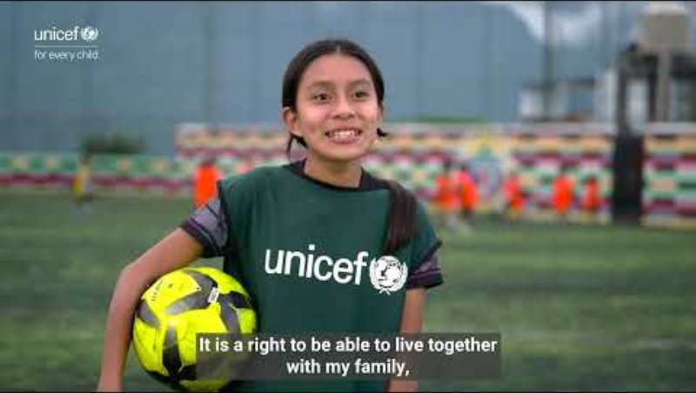
Guadelupe's Story
In this video, we meet Guadalupe, a young girl from Sololá in Guatemala, who shares her experience of playing football and learning about her rights. Speaking from the sidelines of a football training session, she reflects having access to play gives her confidence, a sense of belonging, and the chance to have her voice heard. Guadalupe’s story highlights how sport can be a powerful way for children to understand their rights and feel empowered in their communities.
Notes:
You can also access the video here: https://www.youtube.com/watch?v=qvvJD7mwdA8&t=3s

Slide 8
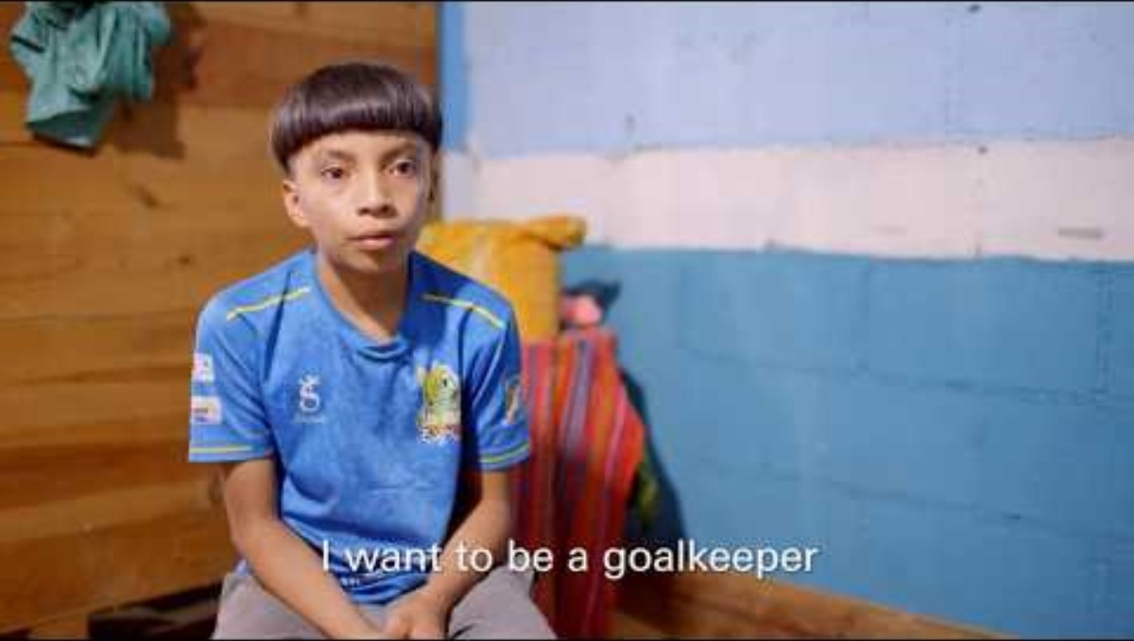
Adan's Story
In this video, Sam Thompson meets Adan, a young boy who has faced challenges in his life but is now finding new hope through football.
Thanks to a UNICEF-funded programme, Adan has access to free coaching, giving him a safe space to play, learn new skills, and build confidence. His story shows how sport can open doors, helping children overcome difficulties, build resilience and imagine a brighter future.
Notes:
This video mentions experiences of bereavement in early childhood.
We also have a video on the one-star page you may want to watch showing how access to play is helping more girls get involved in football through UNICEF's work. It highlights how breaking down barriers to participation not only builds confidence and skills on the pitch but supports wider opportunities for girls to thrive in their communities.
You can also access the video here: https://www.youtube.com/watch?v=qF594rgmm6Y

Slide 9

The rights link...
Look at the summary of the CRC with a partner – which articles do you think are particularly relevant to this case study? (Click to reveal some examples)
Why do you think we’ve highlighted this selection?
Did you identify others?

Slide 10
...and what about the Global Goals?
Why do you think we’ve highlighted this selection?
Did you identify others?

Slide 11
...and what about the Global Goals?
Why do you think we’ve highlighted this selection?
Did you identify others?
Notes:
SDG 3: Good Health and Well-being
Target: Ensure healthy lives and promote well-being for all at all ages
More information about this global goal can be found here: https://globalgoals.org/goals/3-good-health-and-well-being/
SDG 4: Quality Education
Target 4.5: By 2030, eliminate gender disparities in education and ensure equal access to all levels of education and vocational training for the vulnerable, including persons with disabilities, indigenous peoples and children in vulnerable situations
More information on this global goal can be found here: https://globalgoals.org/goals/4-quality-education/
SDG 5: Gender Equality
Target 5.1: End discrimination against women and girls.
More information on this global goal can be found here: https://globalgoals.org/goals/5-gender-equality/

Slide 12
Reflection
What new things did you learn about children’s rights from the videos?
What similarities or differences do you notice between your daily life and the lives of the children in the videos?
How do you think the children in the videos felt when their rights were supported?
How could you or your school help make sure all children are treated fairly and have their rights respected?
Have you watched Soccer Aid for UNICEF? How do you think the money raised by Soccer Aid can help children globally access their rights?
Notes:
Before ending the session encourage pupils to reflect on what they have learnt. You could ask them to share their reflections in pairs, small groups or to the whole group.

Slide 13
Activities
PART
2

Slide 14


Build your understanding
Activity: Capture the Right to Play!
Get Inspired
UNICEF's work in Guatemala has helped Guadelupe and Adan to access the right to participation and play. This month, we want you to explore how your school or other organisations you attend, help you do the same.
Visit the Goal Click website and scroll down to see how children and young people have used photos to tell stories about sport and play. Think about what makes their images powerful.
Take Your Photos
Use a camera or tablet to take pictures of sport and play in your school or community - games, teamwork, fun moments, or people getting ready to play.
Choose Your Best Shot
Pick one or two photos that show why play is important for children and how it links to your rights. You might also think about how it links to the International Day of Play on June 11th.
Share Your Story
Decide how you’d like to share your images, such as:
A gallery on the school website
A display in school foyer or out in your local community
A slideshow, poster, or class exhibition during an assembly.
Notes:
Please be sure to follow your schools consent and safeguarding procedures with regard to photography of children.

Slide 15
Build your understanding
Activity: Learn about Soccer Aid
Soccer Aid for UNICEF raises money to support children around the world to access their rights,
just like in Guadalupe and Adan's stories.
Challenge
Your challenge is to learn more about Soccer Aid and how this supports children around the world.
Watch this video, read about Soccer Aid on the following slides and/or look at this website.
Choose a way to share your learning. You could create:
A poster
A short advert (written or performed)
A social media-style post
A mini presentation or speech
What to Include
Explain what Soccer Aid is
Explain why it matters (helping children to access their rights)
Encourage people to take action (watch, donate, get involved)

Slide 16


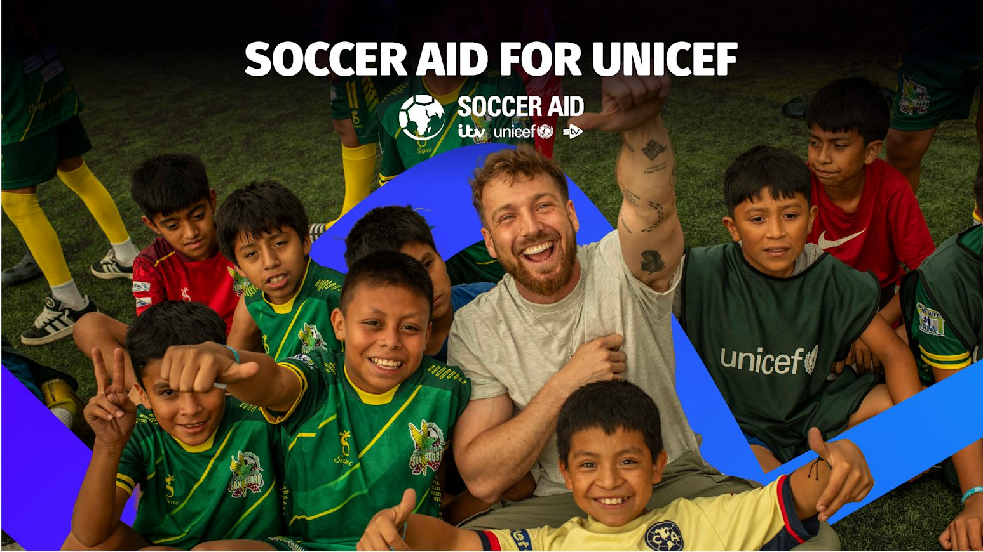
WHAT IS SOCCER AID?
Soccer Aid for UNICEF is the world’s biggest celebrity football match (England vs World XI)
Soccer Aid started in 2006, 20 years ago
Some of the biggest names we've had at Soccer Aid are Big Zuu, Usain Bolt, Gordon Ramsay and Jill Scott.
Last year, the Soccer Aid World XI team won by 5-4 and Big Zuu scored the winning goal in the 84th minute!
Notes:
Soccer Aid for UNICEF is the world’s biggest celebrity football match, where Team England play against the Soccer Aid World XI team. The teams are made up of famous football legends and well-known celebrities.
Soccer Aid was started 20 years ago by Robbie Williams. So this year is a big year for us, as it's out 20 year anniversary!
Some of the biggest names we’ve ever had at Soccer Aid include Diamond from Gladiator, Usain Bolt (the fastest man in the world), Wayne Rooney (one of England’s most famous footballers), and Gordon Ramsay, a world-famous chef.
Last year, the Soccer Aid World XI team won 5–4, and Big Zuu (a TV presenter, chef and music artist on the World XI team) scored the winning goal in the 84th minute, right near the end of the game! Do you want to watch the moment is scored and how he celebrated?

Slide 17

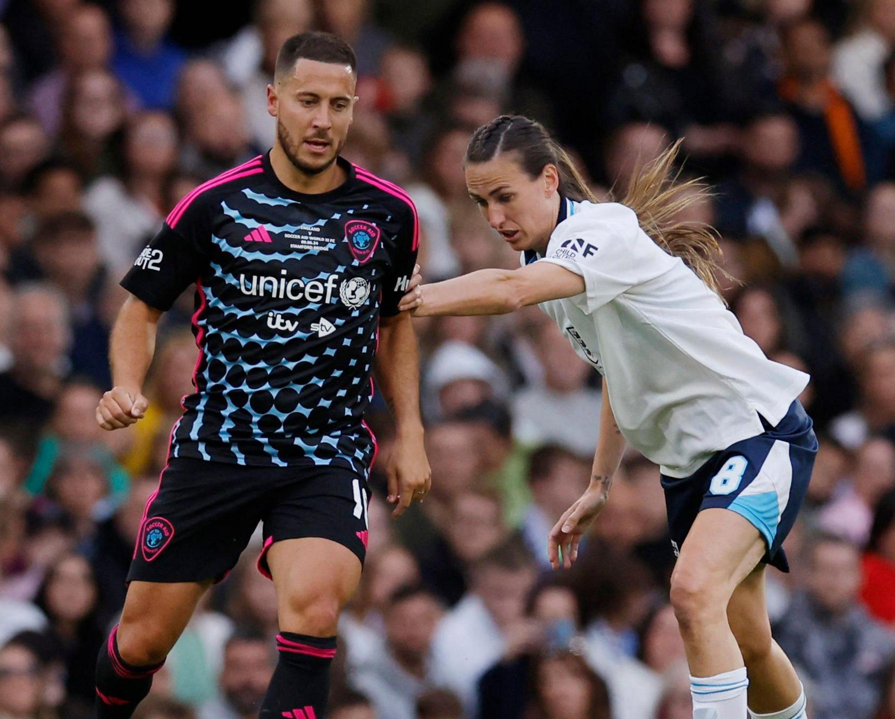
MEN AND WOMEN PLAY TOGETHER!
Notes:
Soccer Aid is the only FA recognised football match where men and women can play together. Last year, more women played than ever before, including football stars Jill Scott and Toni Duggan!
The FA is the Football Association, this is the group that runs football in England. They make the rules for everyone!

Slide 18

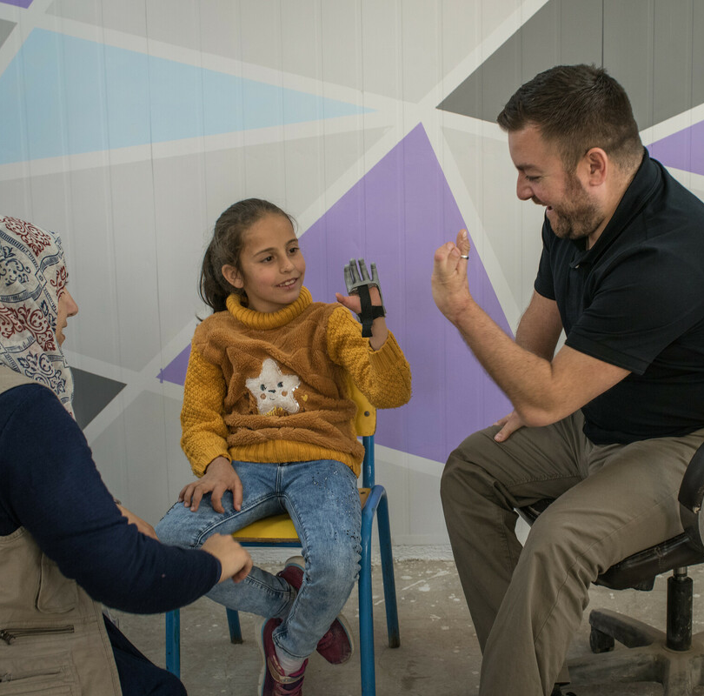
WHY IS SOCCER AID IMPORTANT?
Since it started, it’s raised £121million for UNICEF
The goal of Soccer Aid is to help protect play
children around the worl
Play is a big part of childhood.
How do you like to play?
Soccer Aid helps support children everywhere to have a happy childhood.
Elan and Alex Brooker, in Jordan, 2023.
Notes:
Since it started, it has raised £121 million for UNICEF to help children.
The main goal of Soccer Aid is to raise money, to help protect play for children around the world.
Play is a big part of childhood, from games like hide-and-seek to playing football with friends. It helps children like you move, learn, grow and use your imagination.
What kind of activities do you like doing?
Children everywhere love to play, learn and be happy but sometimes their lives are affected by things they can’t control, like war, illness or natural disasters. Soccer Aid helps support children everywhere, so they can still have a happy childhood.

Slide 19
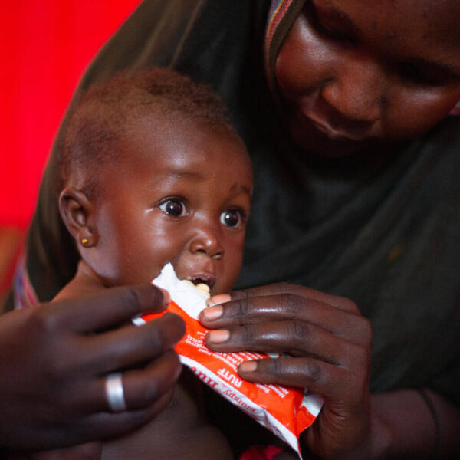
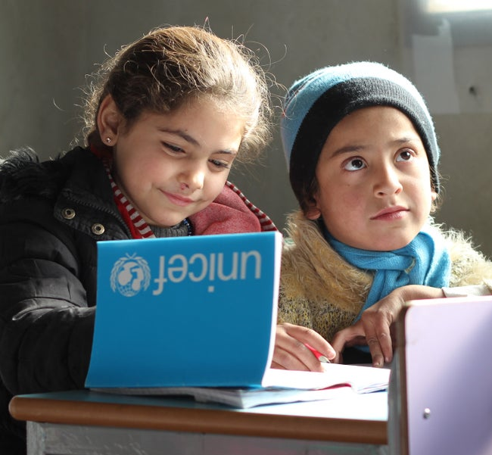
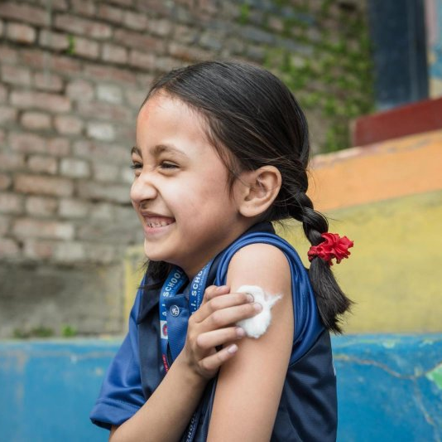
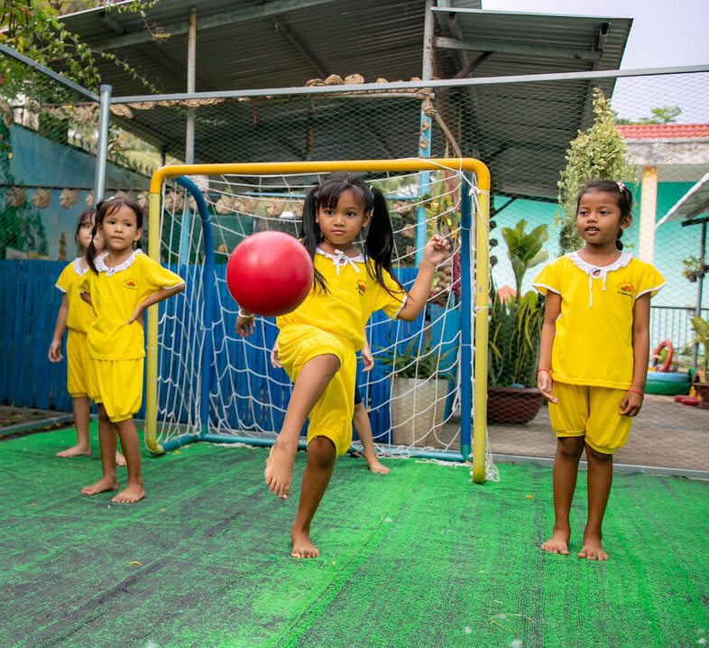
HOW DOES THE MONEY HELP?
Healthy food
Education
Vaccinations
Safe places to play
Notes:
The money raised at Soccer Aid helps UNICEF support children all around the world. It helps them get healthy food, important vaccinations, go to school, and have safe places to play.

Slide 20
Take your learning into the world
Take action
Fundraise for Soccer Aid
You could:
Hold a non-uniform day and encourage people to come in football strips/colours of their flags/football team
Hold a fun football match to fundraise for Soccer Aid. H
Get creative
Raise awareness of the International Day of Play (June 11th).
You could:
Create a display about the importance of the right to play using your play photos
Make posters to tell others about the International Day of Play
Share your creative work with your wider school community
Add to your passport
Create a page on Guatemala in your Rights Around the World passport.
Include a fact file on the case study and any actions you took as a result off your learning.
Notes:
Teachers notes:
Take action: Soccer Aid is on 31st May at London Stadium. Over £121 million pounds have been raised by Soccer Aid over the years with the 2025 event raising a record-breaking £15 million. What could you do to raise funds and/or awareness for Soccer Aid?
Get creative: The International Day of Play is on June 11th. How could you raise awareness so that people in your community are more aware of the day and what opportunities there are for play in your local community? Consider what opportunities there are that are free, and which ones you have to pay for.
Add to your passport: Add to your individual or class passport to record your learning.

Slide 21
Further information & Feedback
The next Rights Around the World Resource will be shared on June 4th 2026.
We would welcome your views as we continue to develop this resource. Click below to let us know your thoughts.
Thank you, and we hope you enjoy sharing this resource with your pupils!
https://forms.office.com/e/h39rbSZ0Hb

