Slide 1

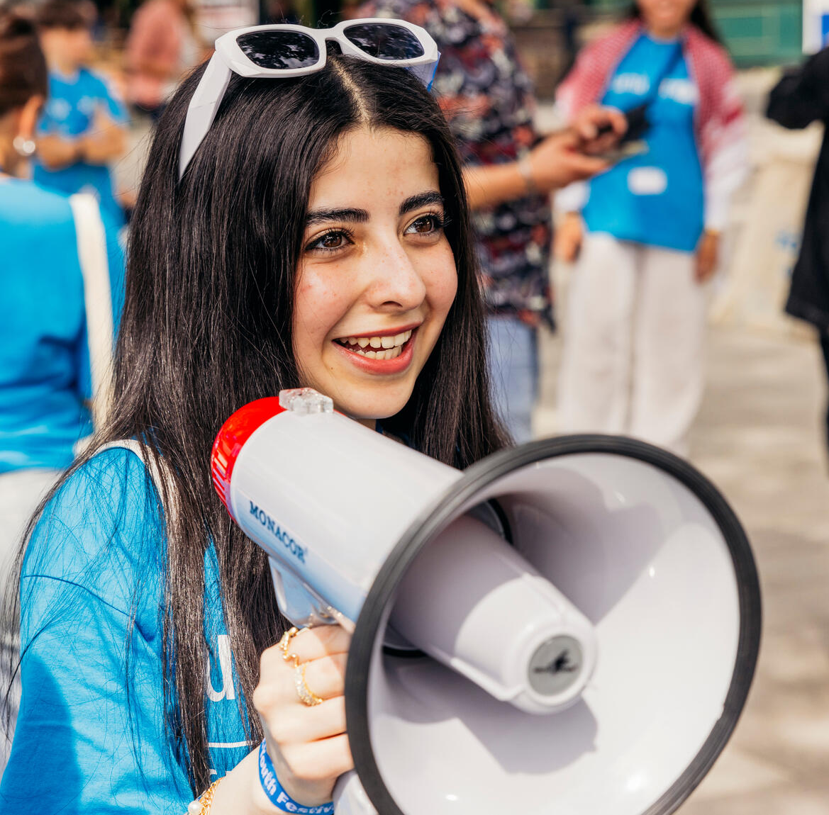

  ACTIVITY 3
  ELECTIONS
  AND USING
  YOUR VOICE
  IN DEMOCRACY
© UNICEF/Al-Safadi
Jannat, 15, rallies people with a megaphone at the UNICEF Youth Festival, Mannheim, Germany.
© UNICEF/Stroisch

Slide 2
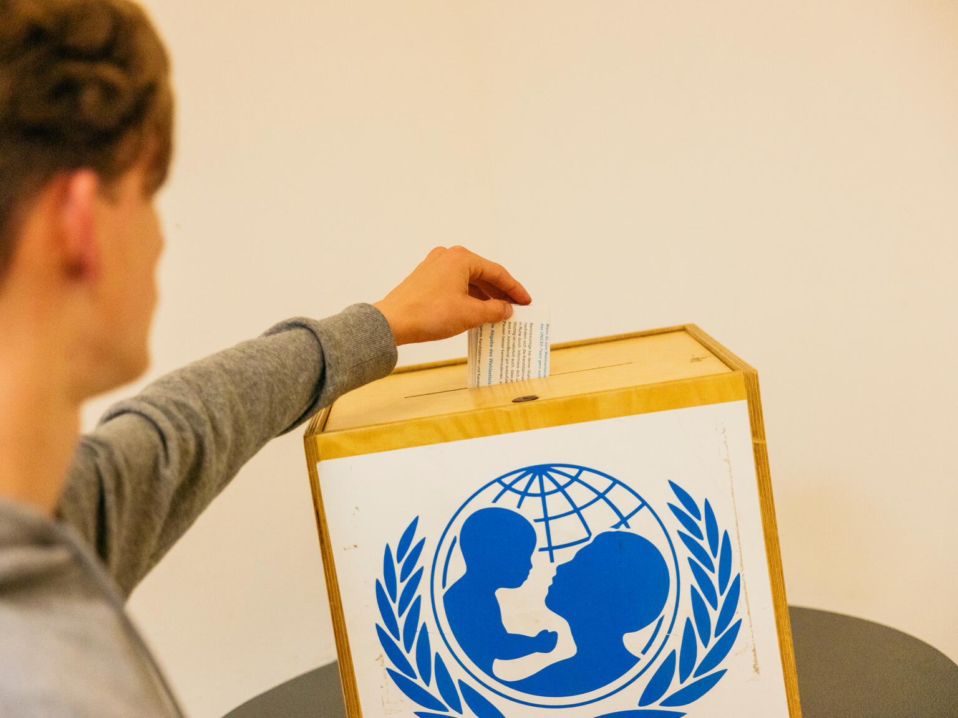
  PART 1
REVIEWING YOUR
RIGHTS WARM-UP
© UNICEF/Stroisch
Election time for the Youth Advisory Board at the 2024 Youth Festival, Mannheim, Germany.

Slide 3

  ARTICLE 3
  Best interests of the child
  The best interests of the child must be a top priority in all decisions and actions that affect children.

Slide 4

  ARTICLE 4
  Implementation of the CRC
  Governments must do all they can to make sure every child can enjoy their rights by creating systems and passing laws that promote and protect children’s rights.

Slide 5

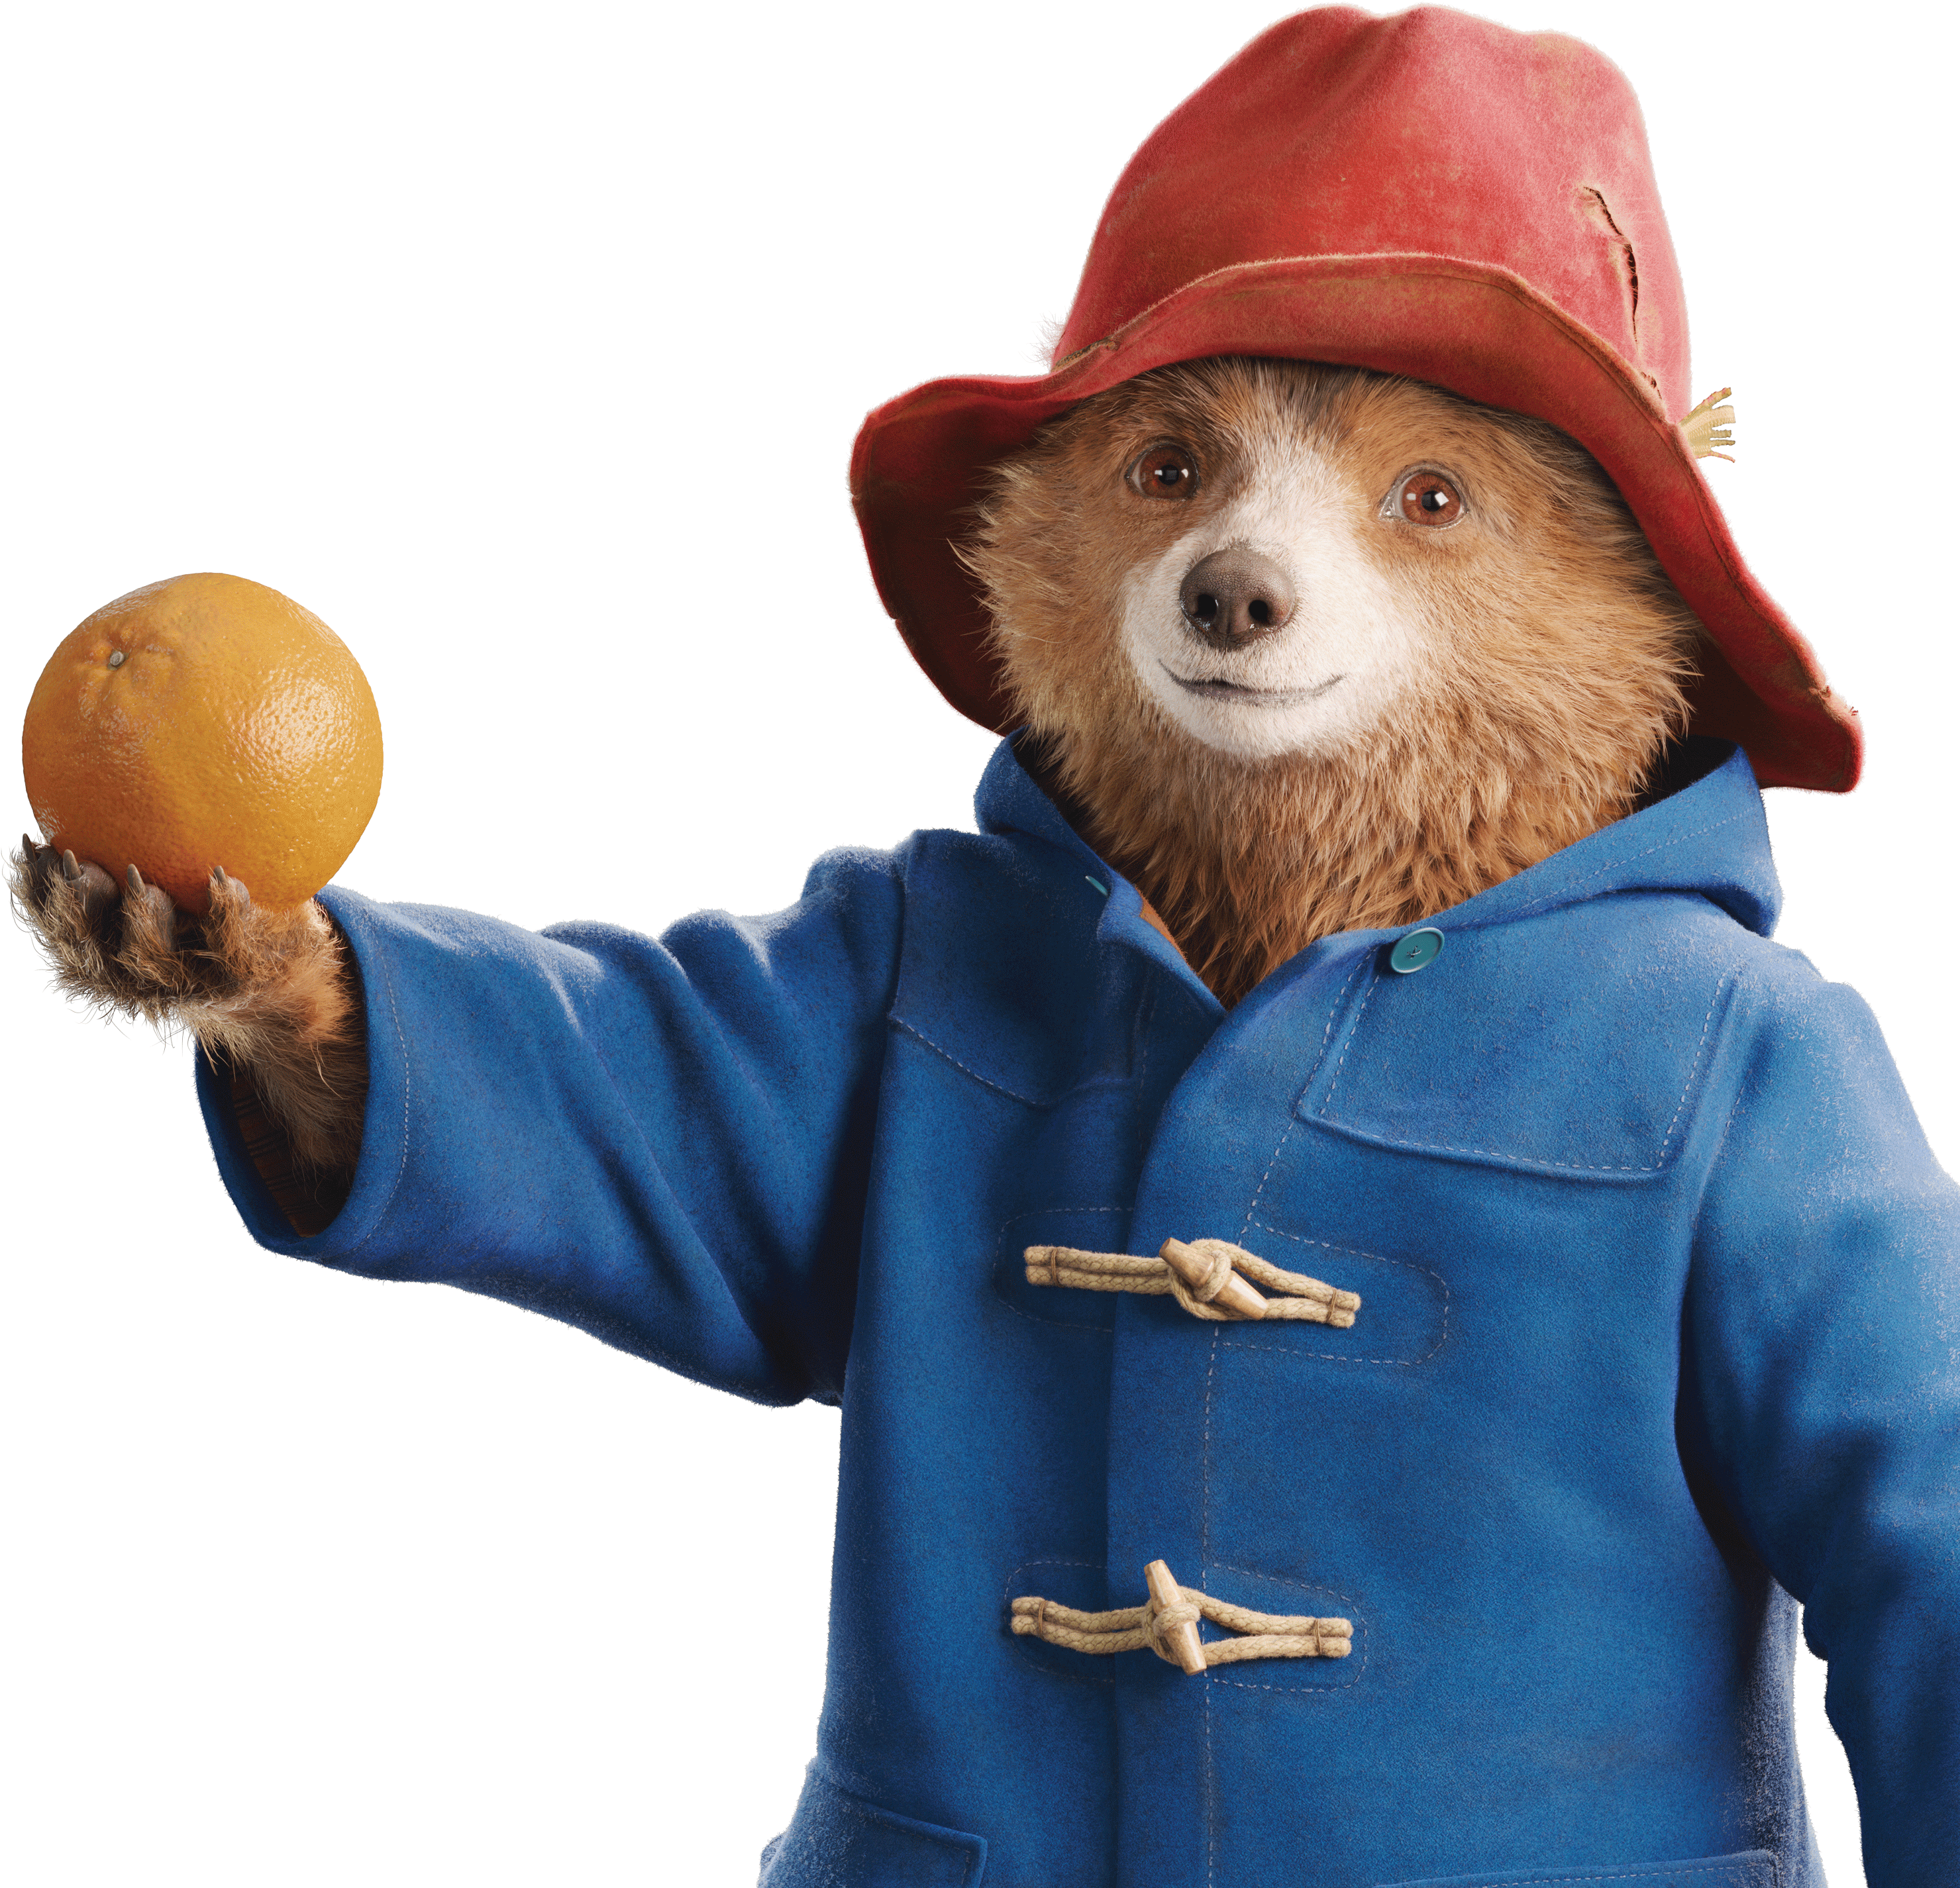


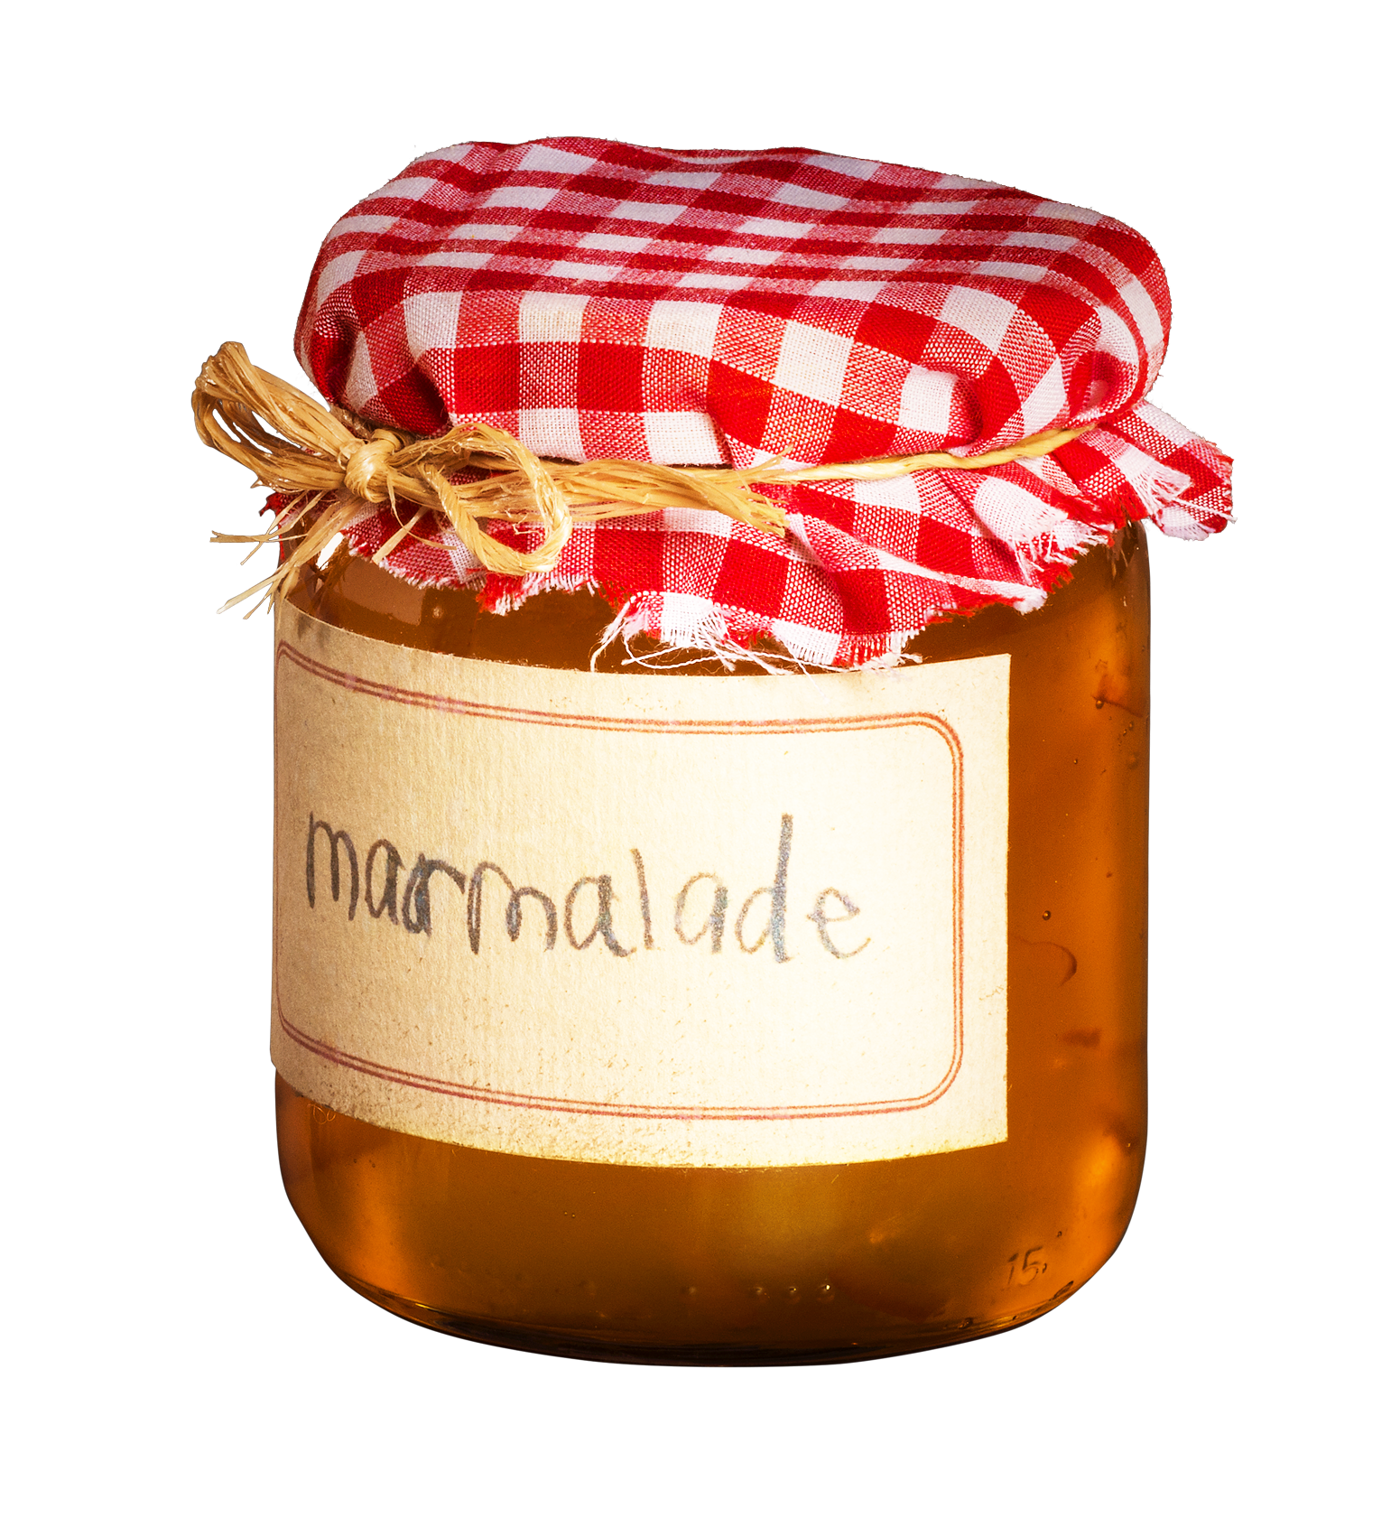
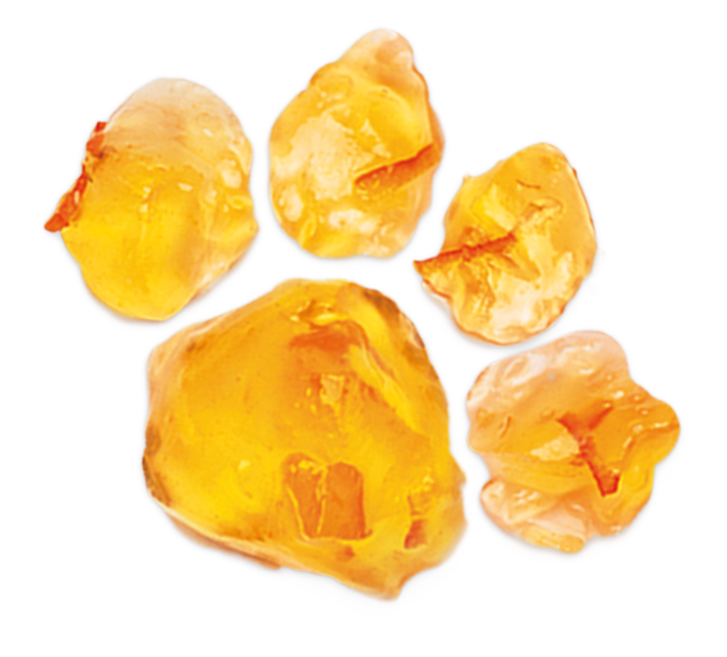
  PART 2
© P&Co. Ltd./SC 2024
How democracy works
Can a bear vote?

Slide 6
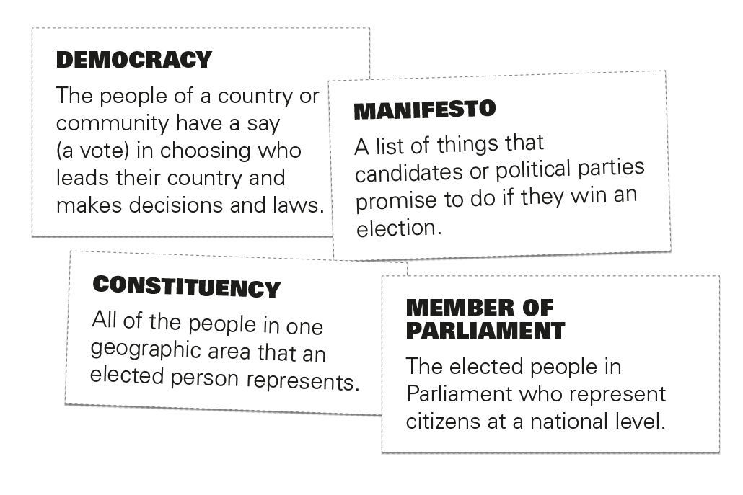
  PART 3
DEMOCRACY
DEFINITIONS:
A MATCHING
GAME

Slide 7
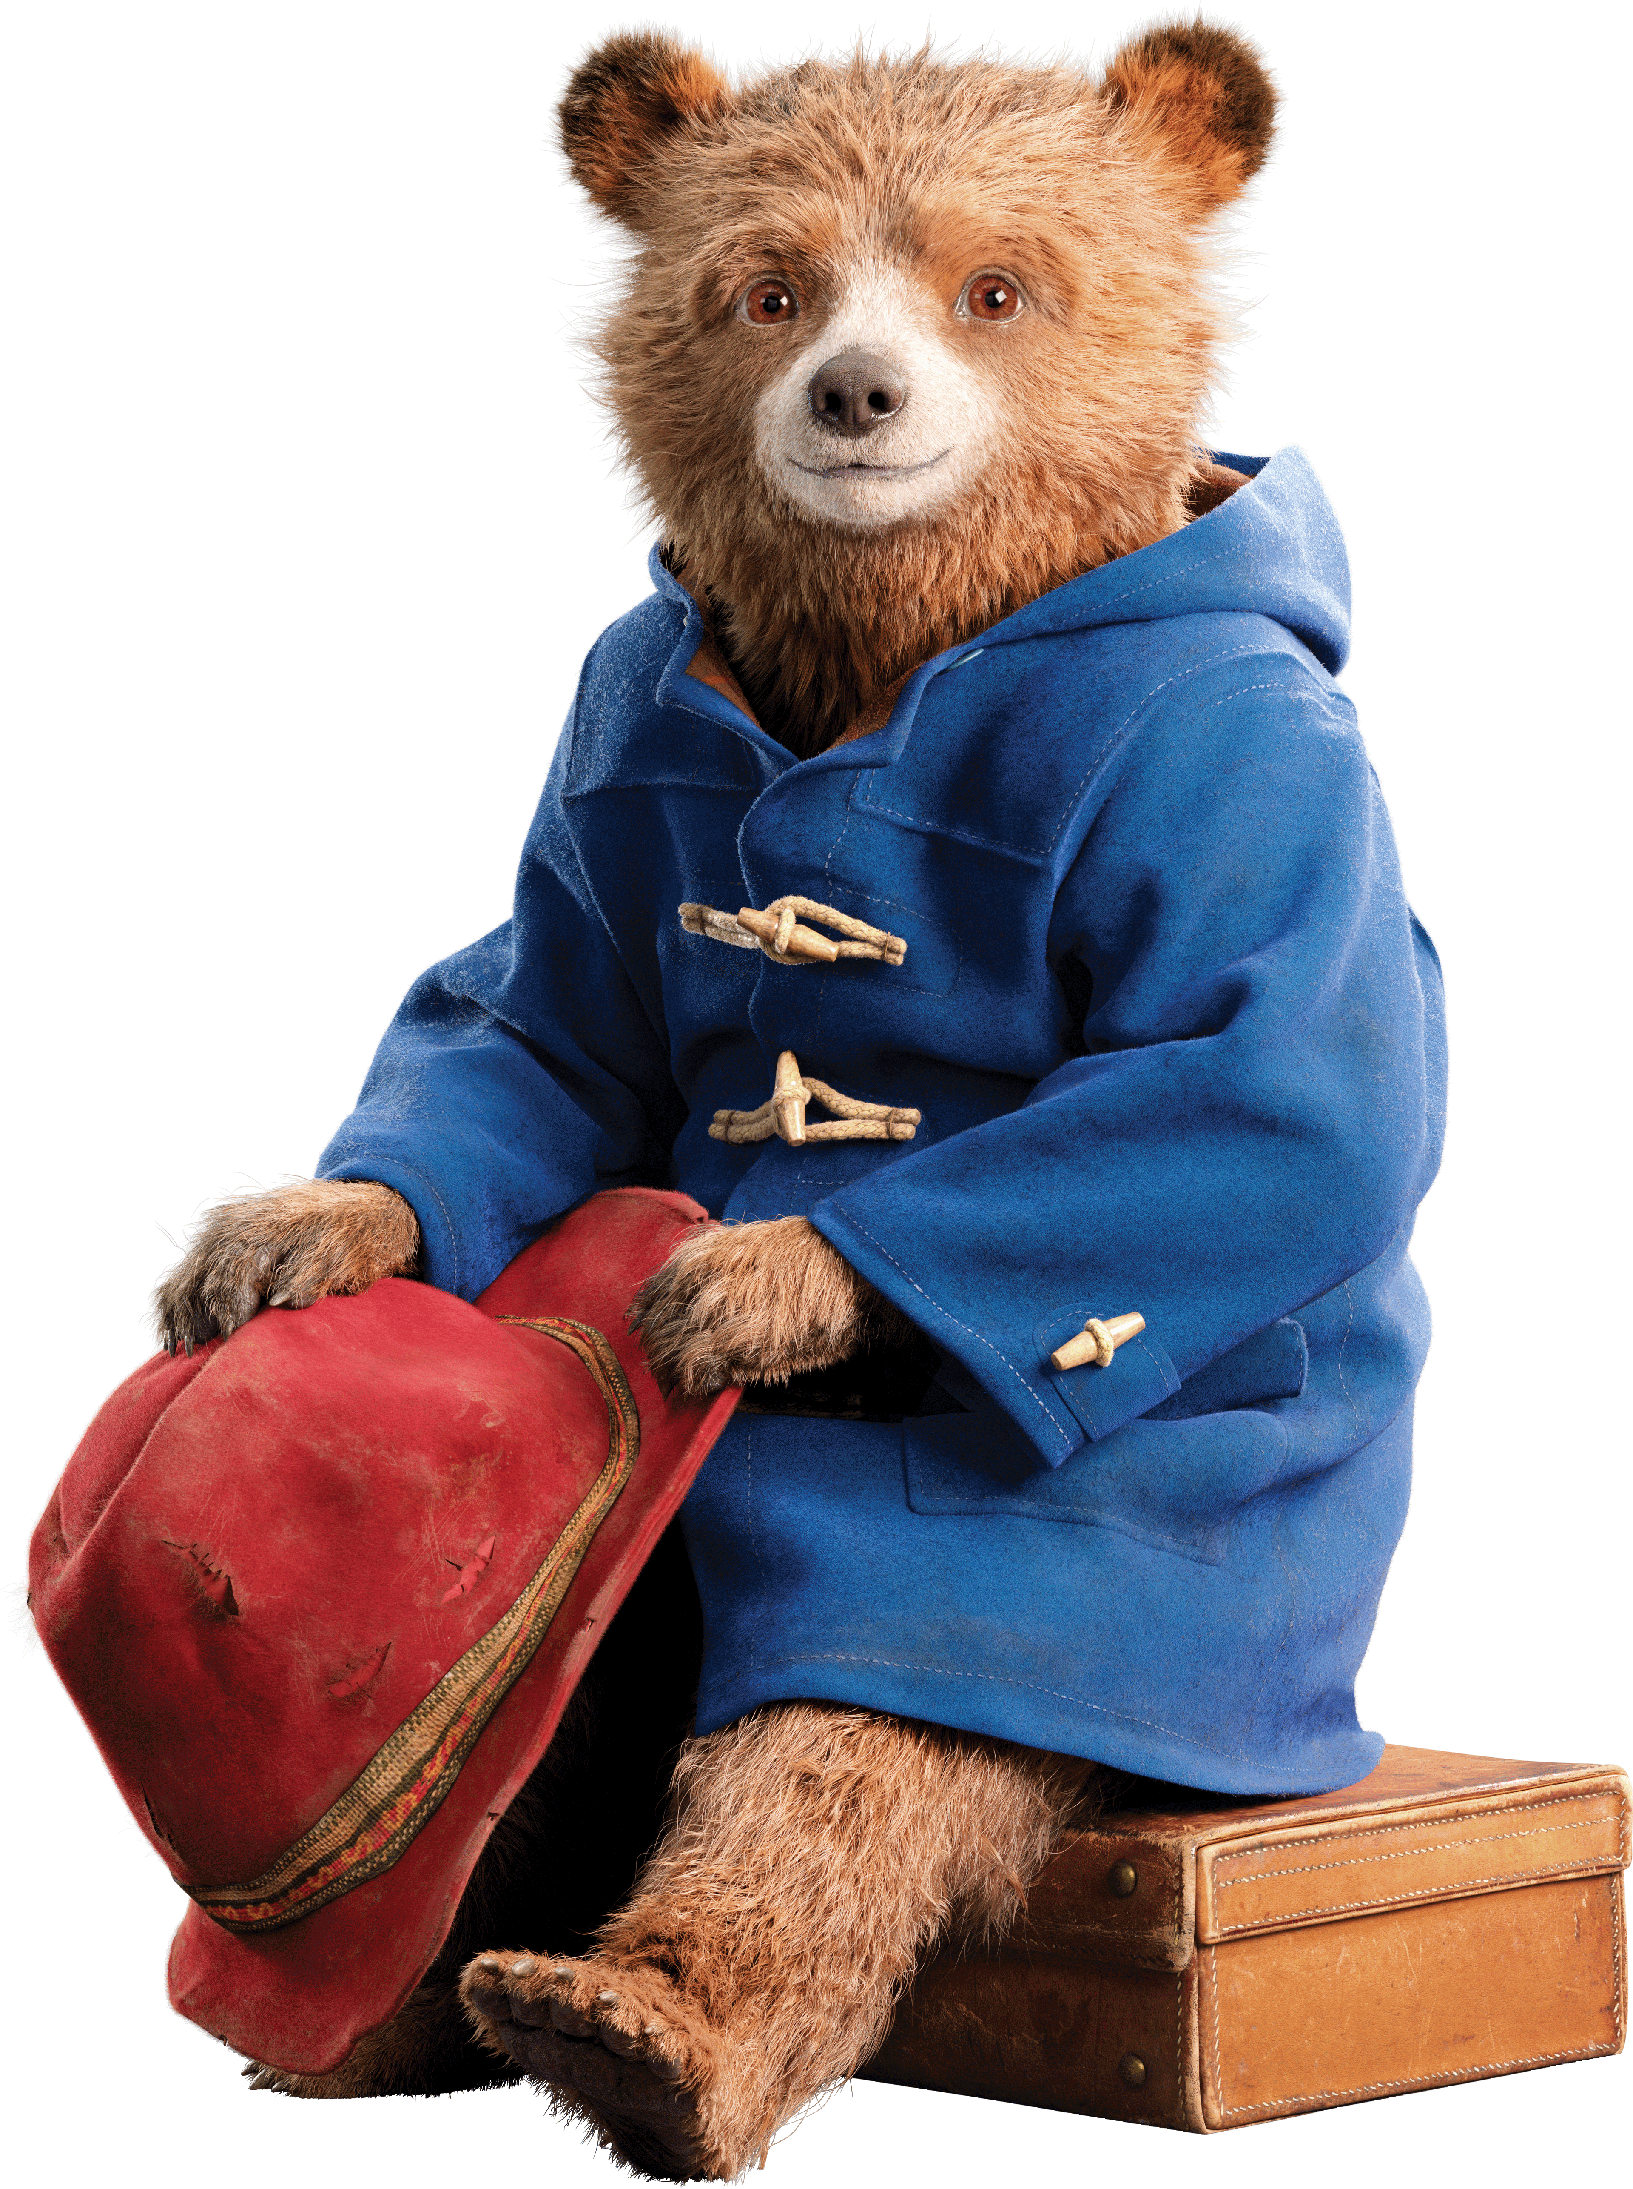

© P&Co. Ltd./SC 2024
LET'S VOTE!
Who will be Windsor Gardens
neighbourhood leader?

Slide 8
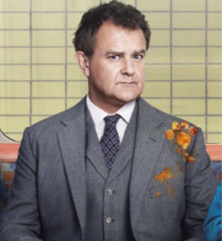
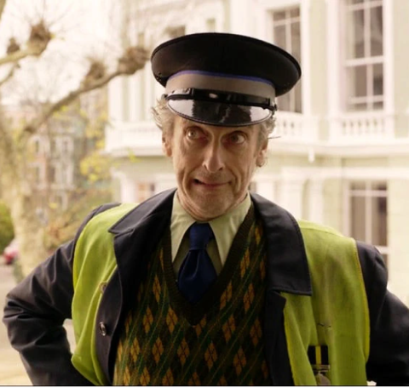
MEET THE CANDIDATES
© P&Co. Ltd./SC 2024
Mr Brown
Mr Curry
Paddington, 2014 produced by STUDIOCANAL.

