Slide 2
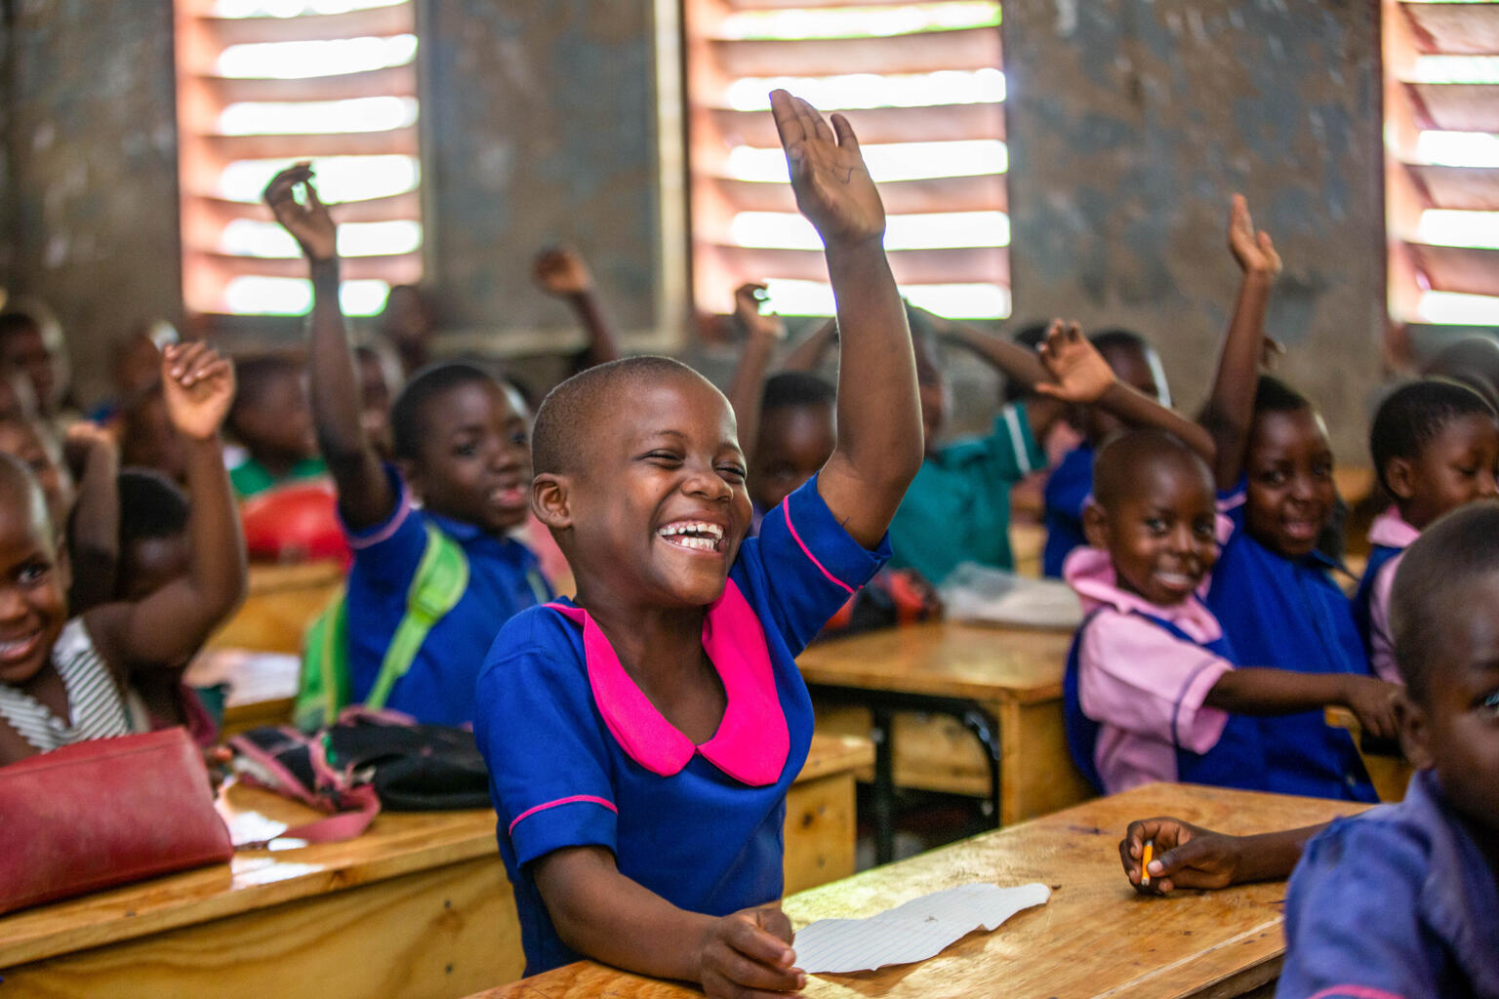


2026/27
Siteriya, 9, raises her hand to answer a question in class. Her school in Malawi is part of a UNICEF project to address barriers to education.
© UNICEF/Malawi

Slide 3
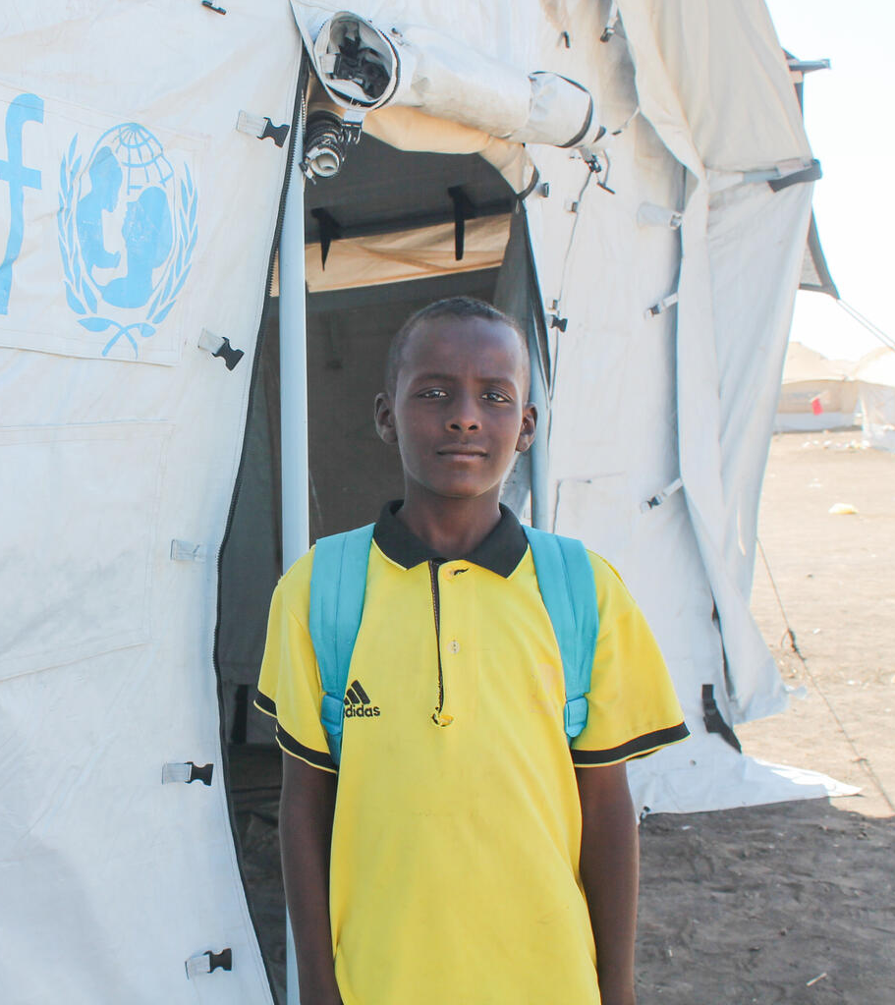
What is OutRight?
OutRight is a youth campaign run
by UNICEF UK that helps children and young people learn about,
and speak out about children’s
rights, across the world.
There are hundreds of children
across the UK who are taking part
in this campaign, just like you!
I like being able to take classes here, because I really missed studying," says 13-year-old Taha, outside a temporary learning space in a camp in Kassala state, Sudan. © UNICEF/Nakibuuka

Slide 4
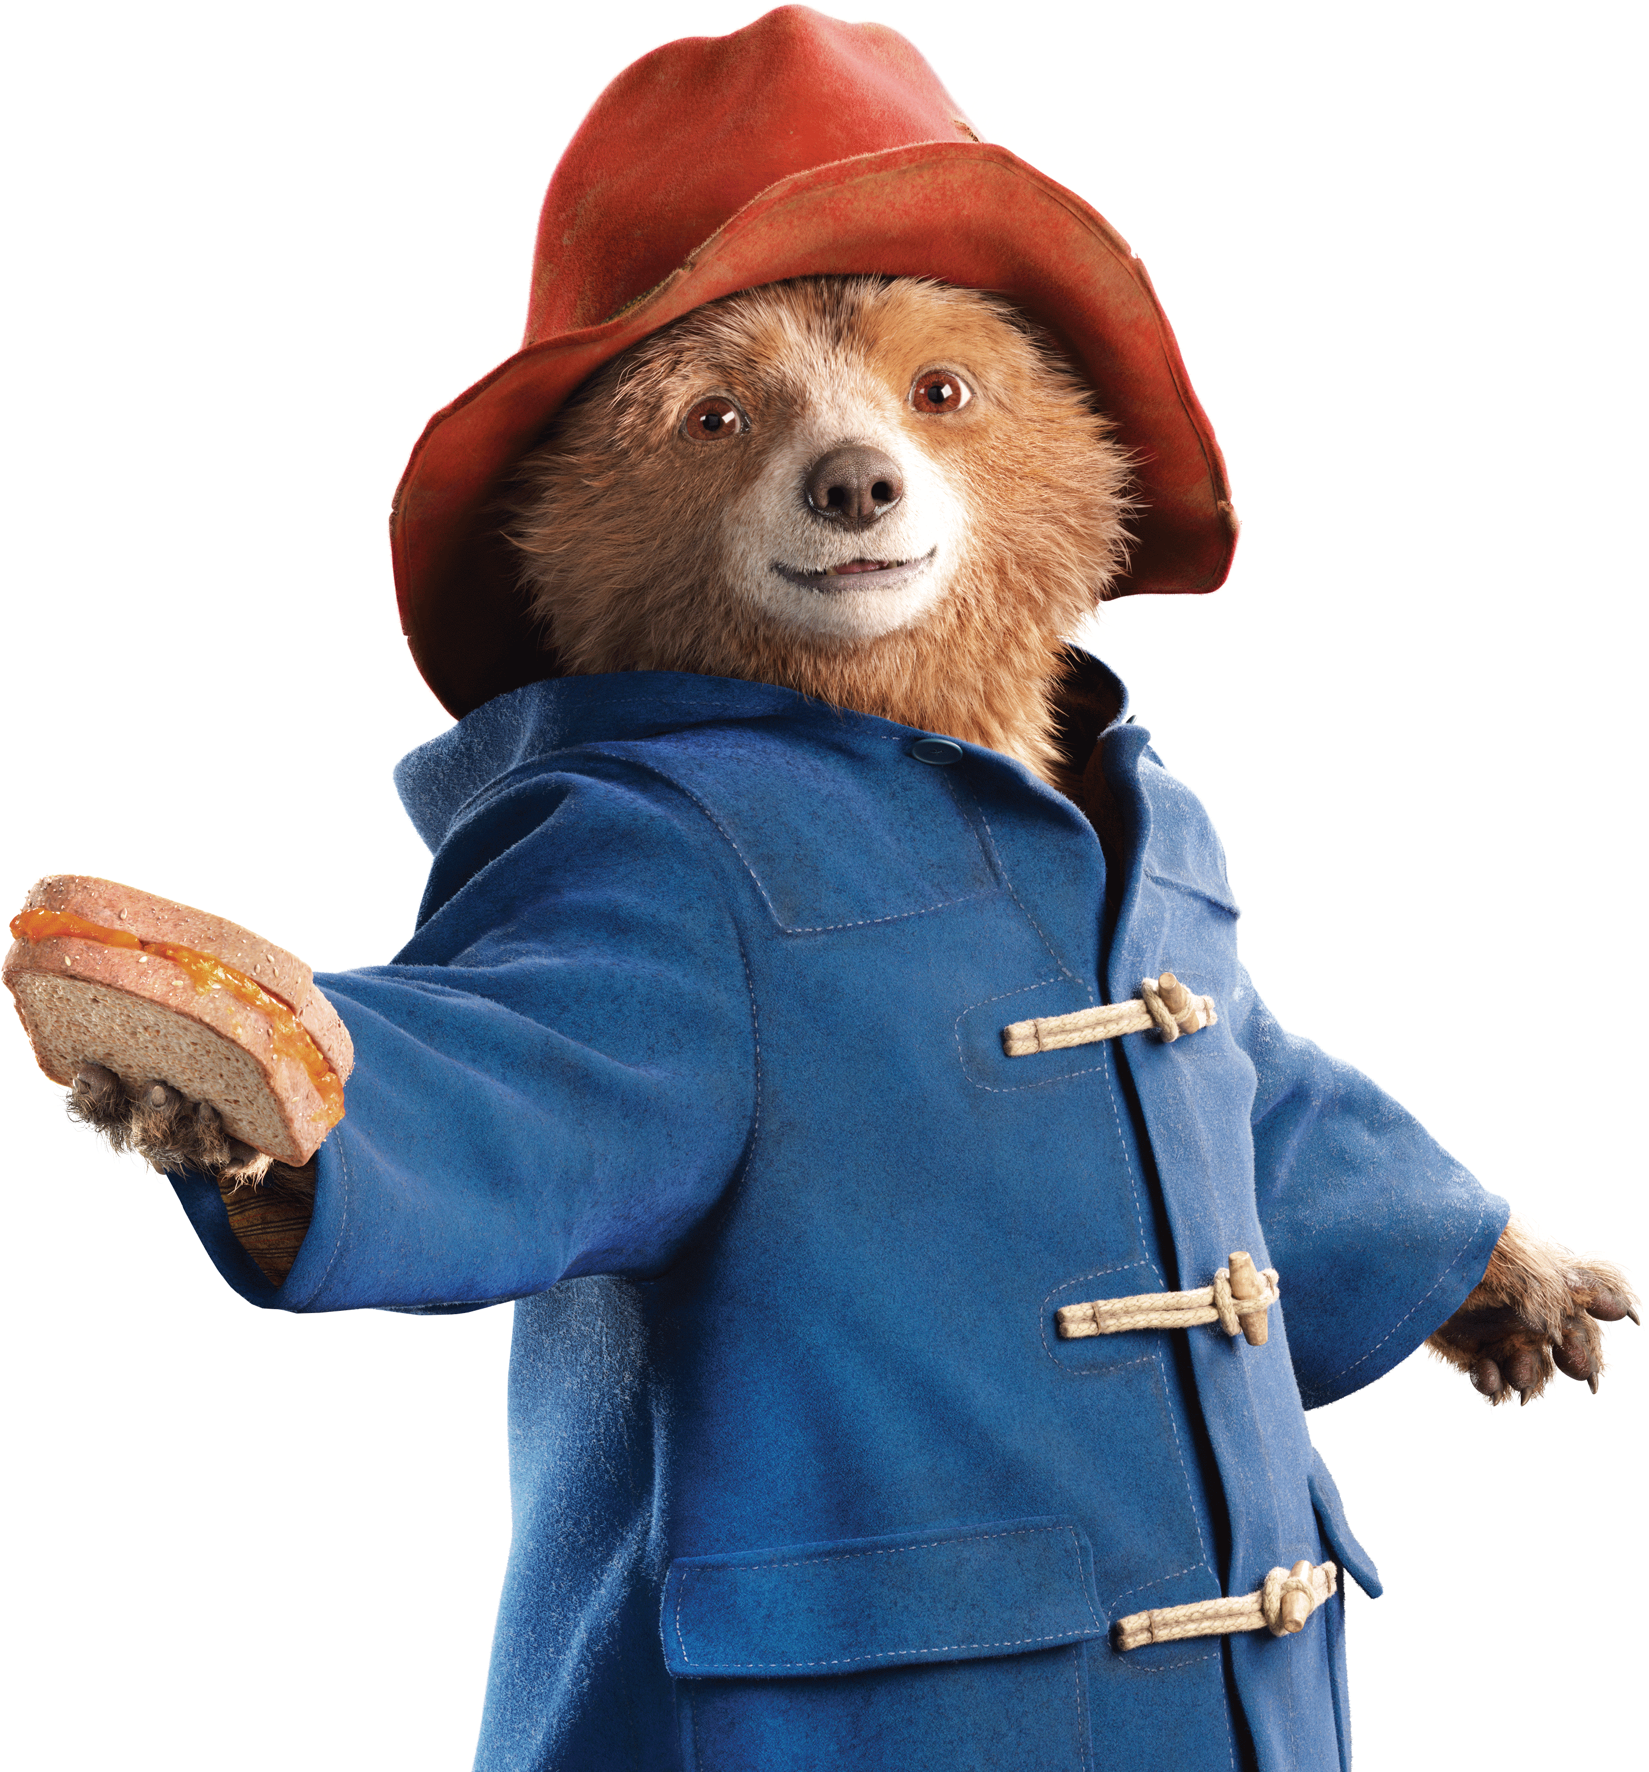
Make your voice heard
© P&Co. Ltd./SC 2026
This year, we’re going to be thinking about
Learning Spaces, and exploring how different
barriers can prevent children around the
world from accessing their rights.
We’ll have the support of our
campaign champion, PaddingtonTM
along the way.

Slide 5
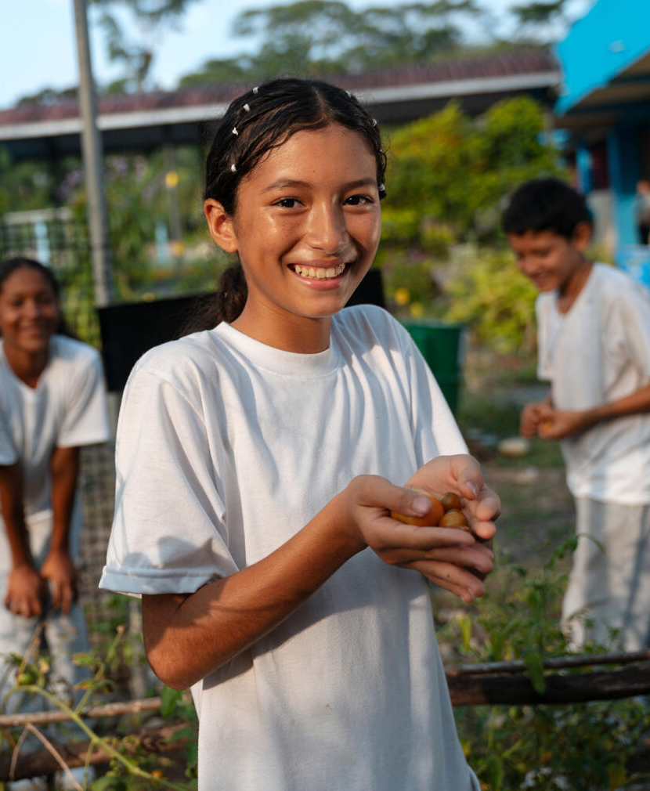
What will you learn?
Children like you have an important role to play in campaigning to make change.
Your voices matter and can make a difference – but we all need information and support to be able to speak out!
You’ll journey through five OutRight learning activities and then finish with our brand-new campaign action – it’s quick and easy to do but, we hope, will have an exciting collective impact!
Melanie looks after the plants in the garden at her school, which is part of a UNICEF project to help children in vulnerable areas of the Ecuadorian Amazon learn to care for the planet and get better access to safe water, hygiene facilities and renewable energy sources. © UNICEF/Arcos

Slide 6
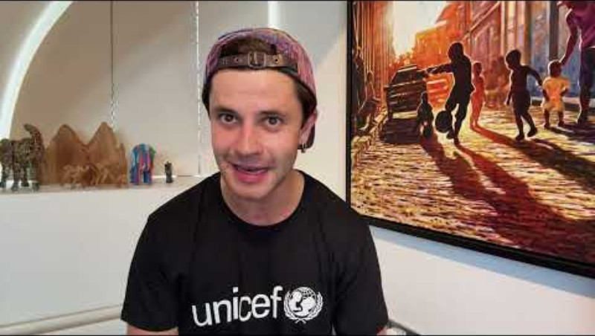
A message from Cel
Actor and UNICEF UK supporter Cel Spellman has this message for you about taking part in the OutRight campaign.

Slide 7
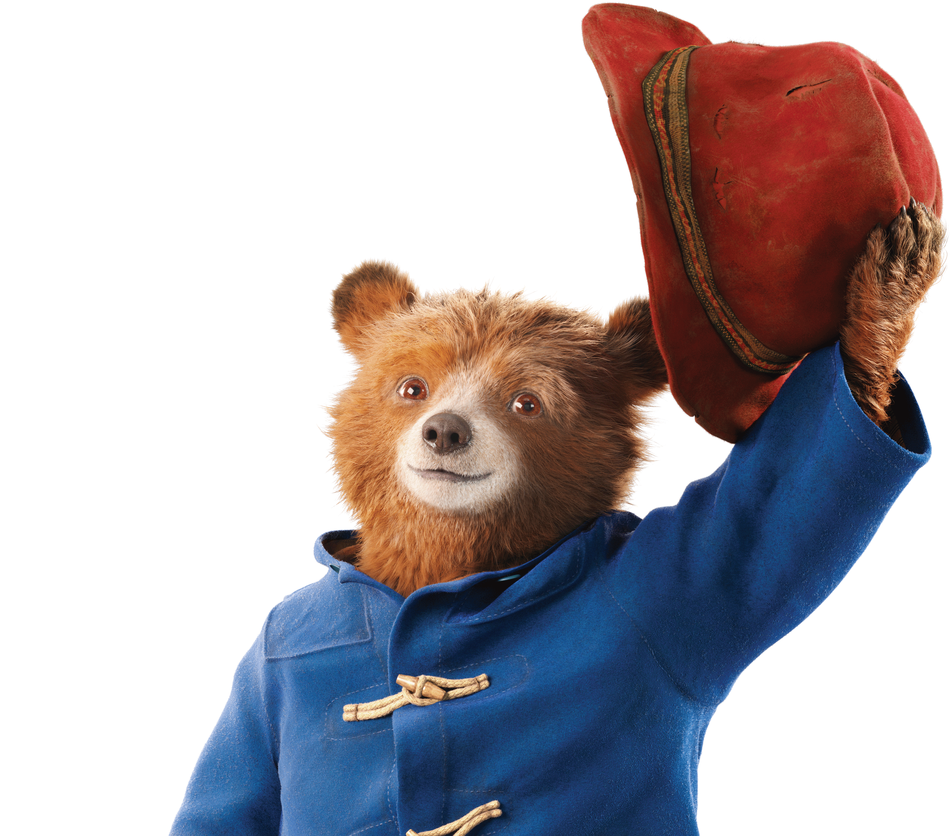
Thank you!
© P&Co. Ltd./SC 2026
Thank you for taking part in OutRight!
We’re so excited to have you on
this journey, and everyone at
UNICEF UK is excited to see
what you learn

