Slide 1
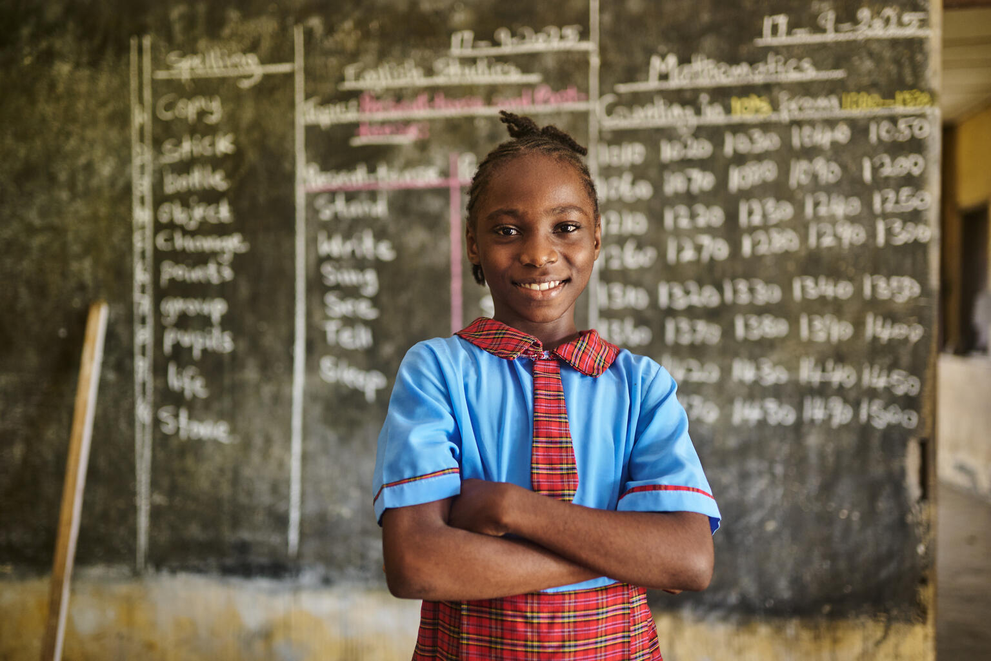


2026/27
Divine, 9, attends a government primary school in Akwa Ibom State. She was among the girls in her class who received the HPV vaccine.
© UNICEF/David

Slide 2
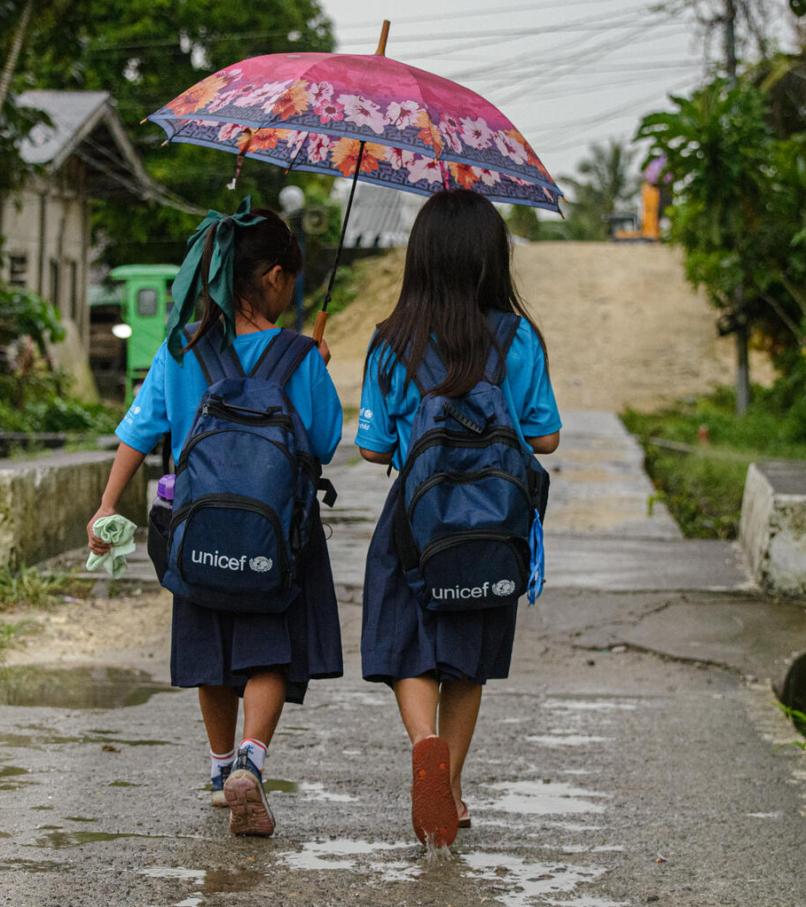
What is OutRight?
OutRight is a youth campaign run by UNICEF UK that helps children and young people learn about, and speak out about children’s rights around the world.
There are hundreds of young people all over the UK who are taking part in this campaign,
just like you.
Resha (left) walks home with her classmate in the Philippines. She receives Learning Kits provided by UNICEF as part of the back-to-school emergency response after Tropical Storm Kristine. ©UNICEF/Piojo

Slide 3

Make your voice heard
This year, we’re going to be thinking about learning spaces, and exploring how different barriers can prevent children around the world from accessing their rights.
We’re going to be looking at the barriers that children face to accessing learning spaces globally, and considering how these could be removed.

Slide 4
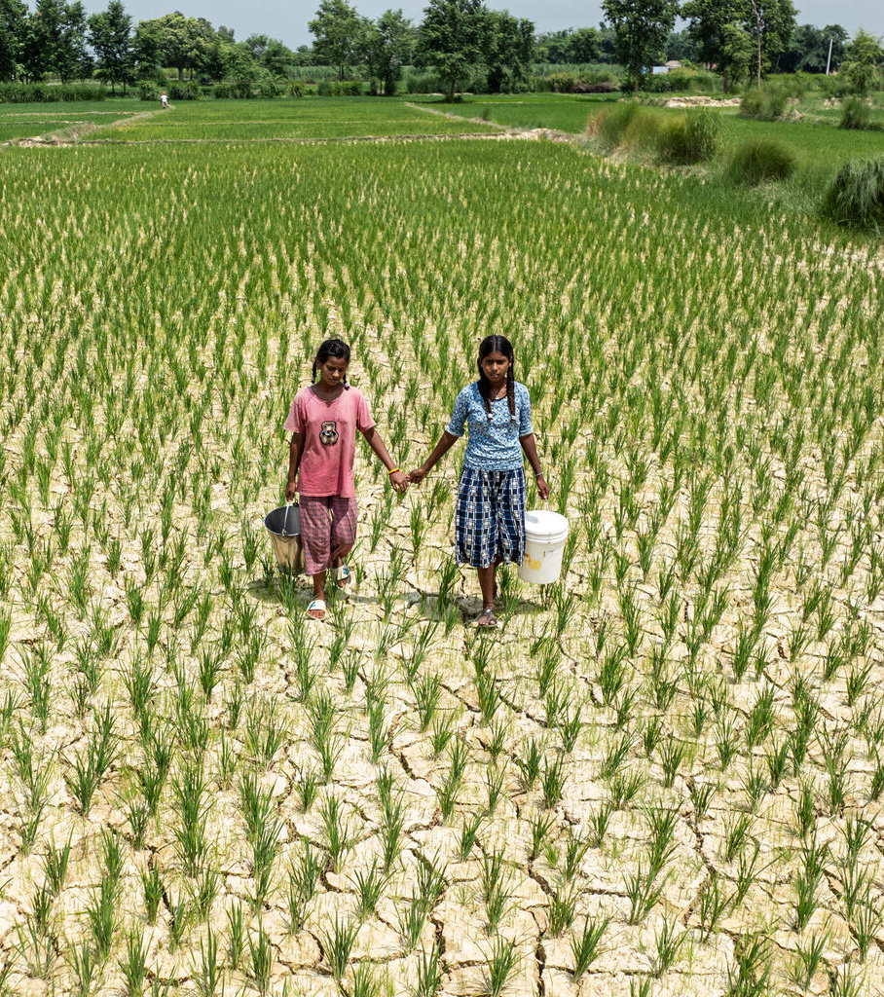
Taking part in OutRight
Your voices matter and can make a difference – but we all need information to be able to speak out.
You’ll journey through five OutRight learning activities and then finish with our brand-new campaign action – it’s quick and easy to do but, we hope, will have an exciting collective impact!
Neetu, 11 (left), and Rita, 14, are carrying water buckets from a UNICEF provided water tank for the cracked fields due to a lack of rainfall in Nepal.. © UNICEF/Ngakhusi

Slide 5
What will you learn?
This year, children and young people taking part in OutRight will
develop their knowledge of:
A variety of children’s rights and the importance of the UNCRC
The importance of safe learning spaces for children in realising
their rights
Barriers that children might face to accessing safe learning spaces
How to use your voices to help protect these spaces.

Slide 6
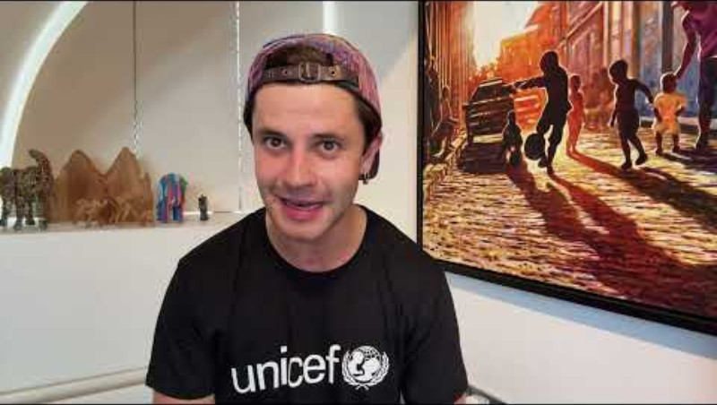
A message from Cel
Actor and UNICEF UK supporter Cel Spellman has this message for you about taking part in the OutRight campaign.

Slide 7
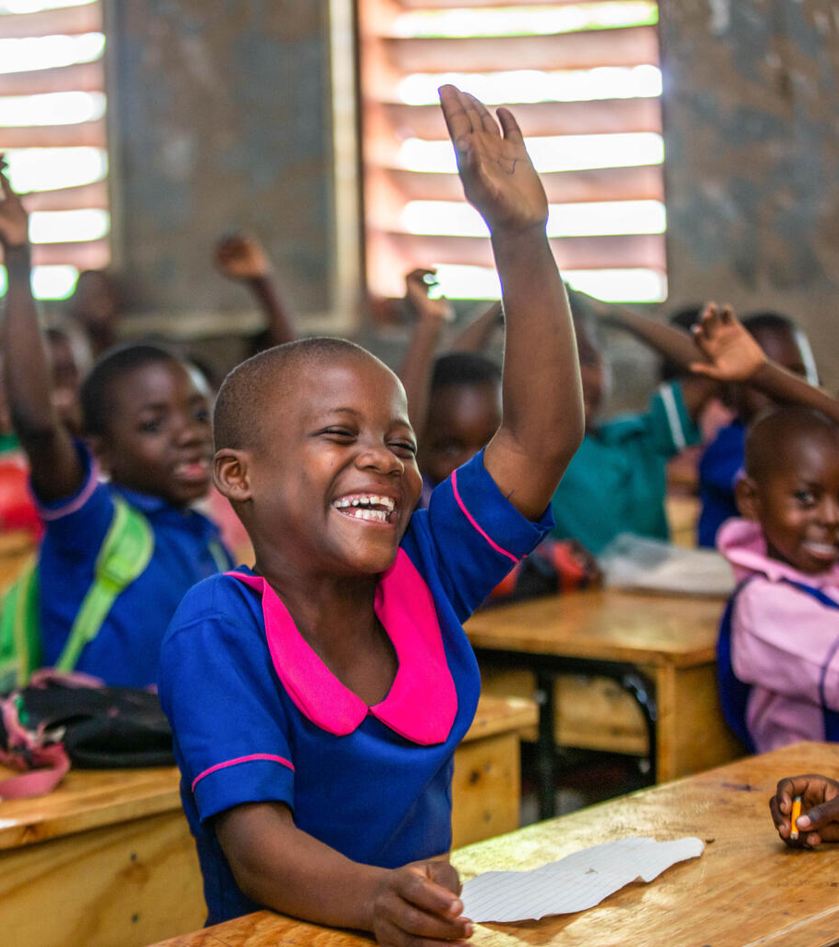
Thank you!
Thank you for taking part in OutRight! We’re so excited to have you on this journey, and everyone at UNICEF UK is excited to see what you learn and do.
Siteriya, 9, raises her hand to answer a question in class. Her school in Malawi is part of a UNICEF project to address barriers to education.
© UNICEF/Malawi

