Slide 1
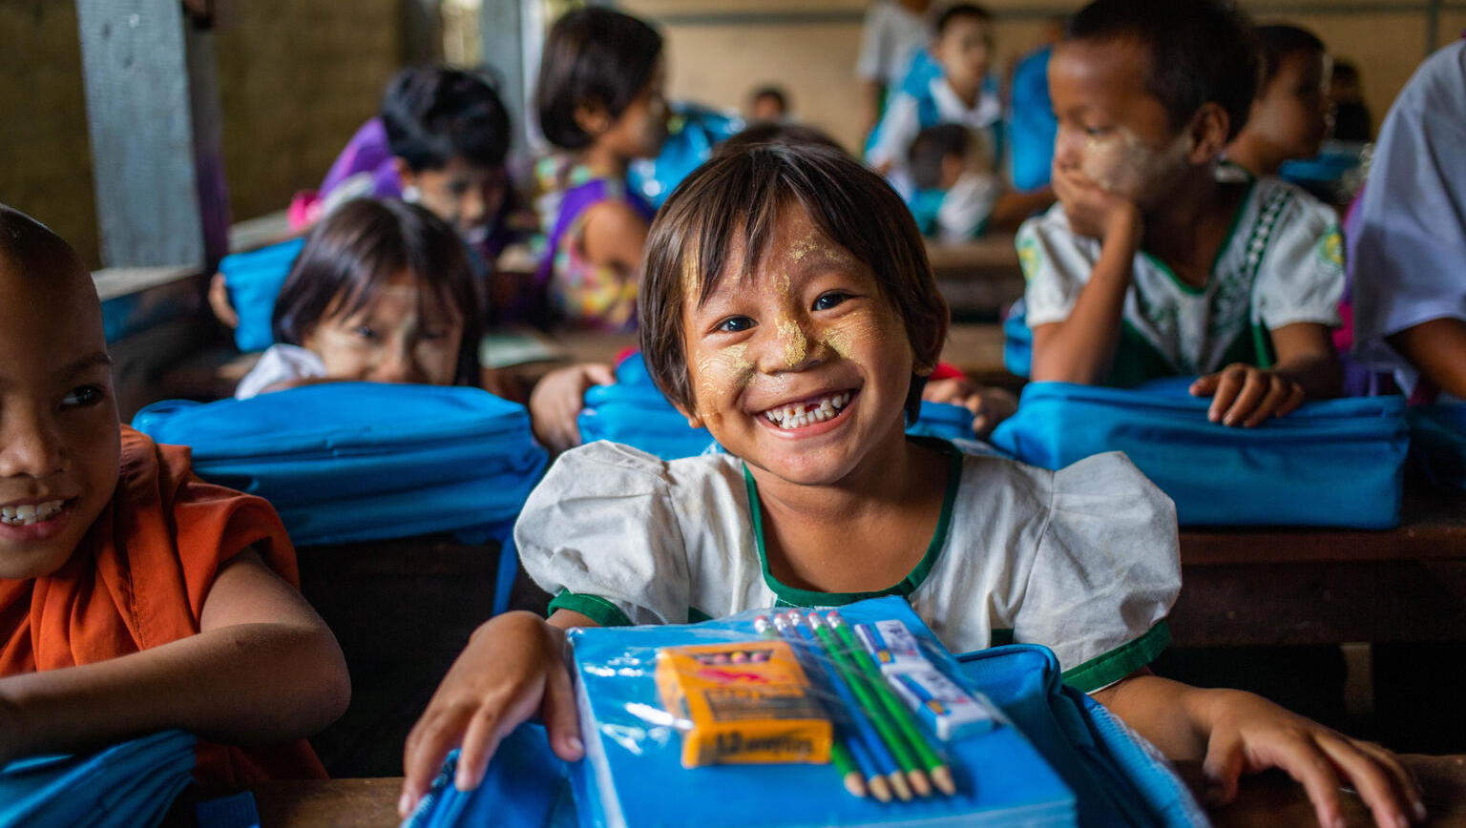
Activity 1
Education everywhere
San Mayann, 6, receives a new school kit and bag provided by UNICEF.
© UNICEF/Htet

Slide 2
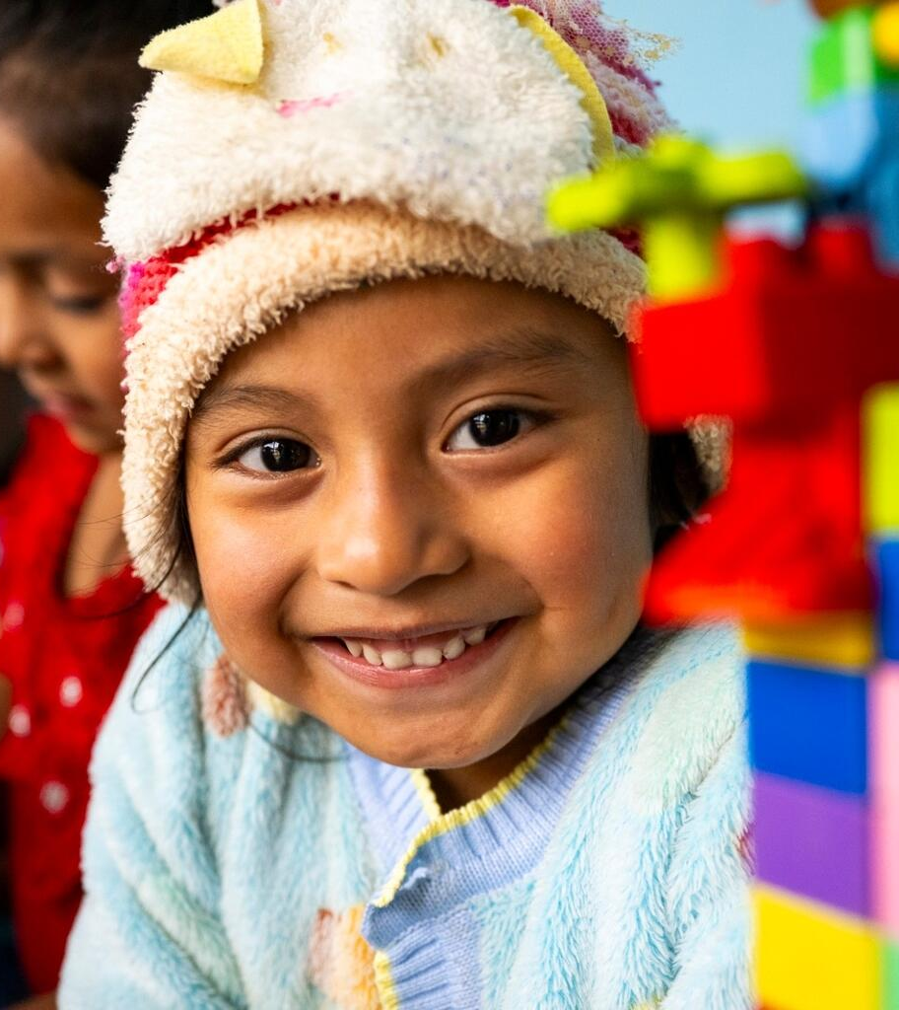
Part 1
Key rights
Article 19 – protection from violence and harm
Article 24 – the right to the best possible health
Article 28 – the right to education
Article 29 – the goals of education: helping children develop their talents, respect for others and love of learning
Article 31 – the right to rest, play and culture
Ceci, 4, takes part in an early childhood education session in Guatamela.
© UNICEF/Izquierdo

Slide 3

Key rights in action
Create: rights cards/icons/posters to map on your rights wall
Write: the article number and words to describe the right
Draw: what it might look like when children enjoy this right

Slide 4

Part 2
Where do
we learn?
© P&Co. Ltd./SC 2026
Notes:
5) Places to think about:
Schools
Library
Home and family
A caregiver's house
A place of worship
A market, shop or café
A sports ground, park or garden
Community centre
Online (everywhere)

Slide 5

Part 3
Community learning map
Where do I learn?
What do I learn here?
Who do I learn from?
Which rights am I enjoying in
this learning space?

Slide 6
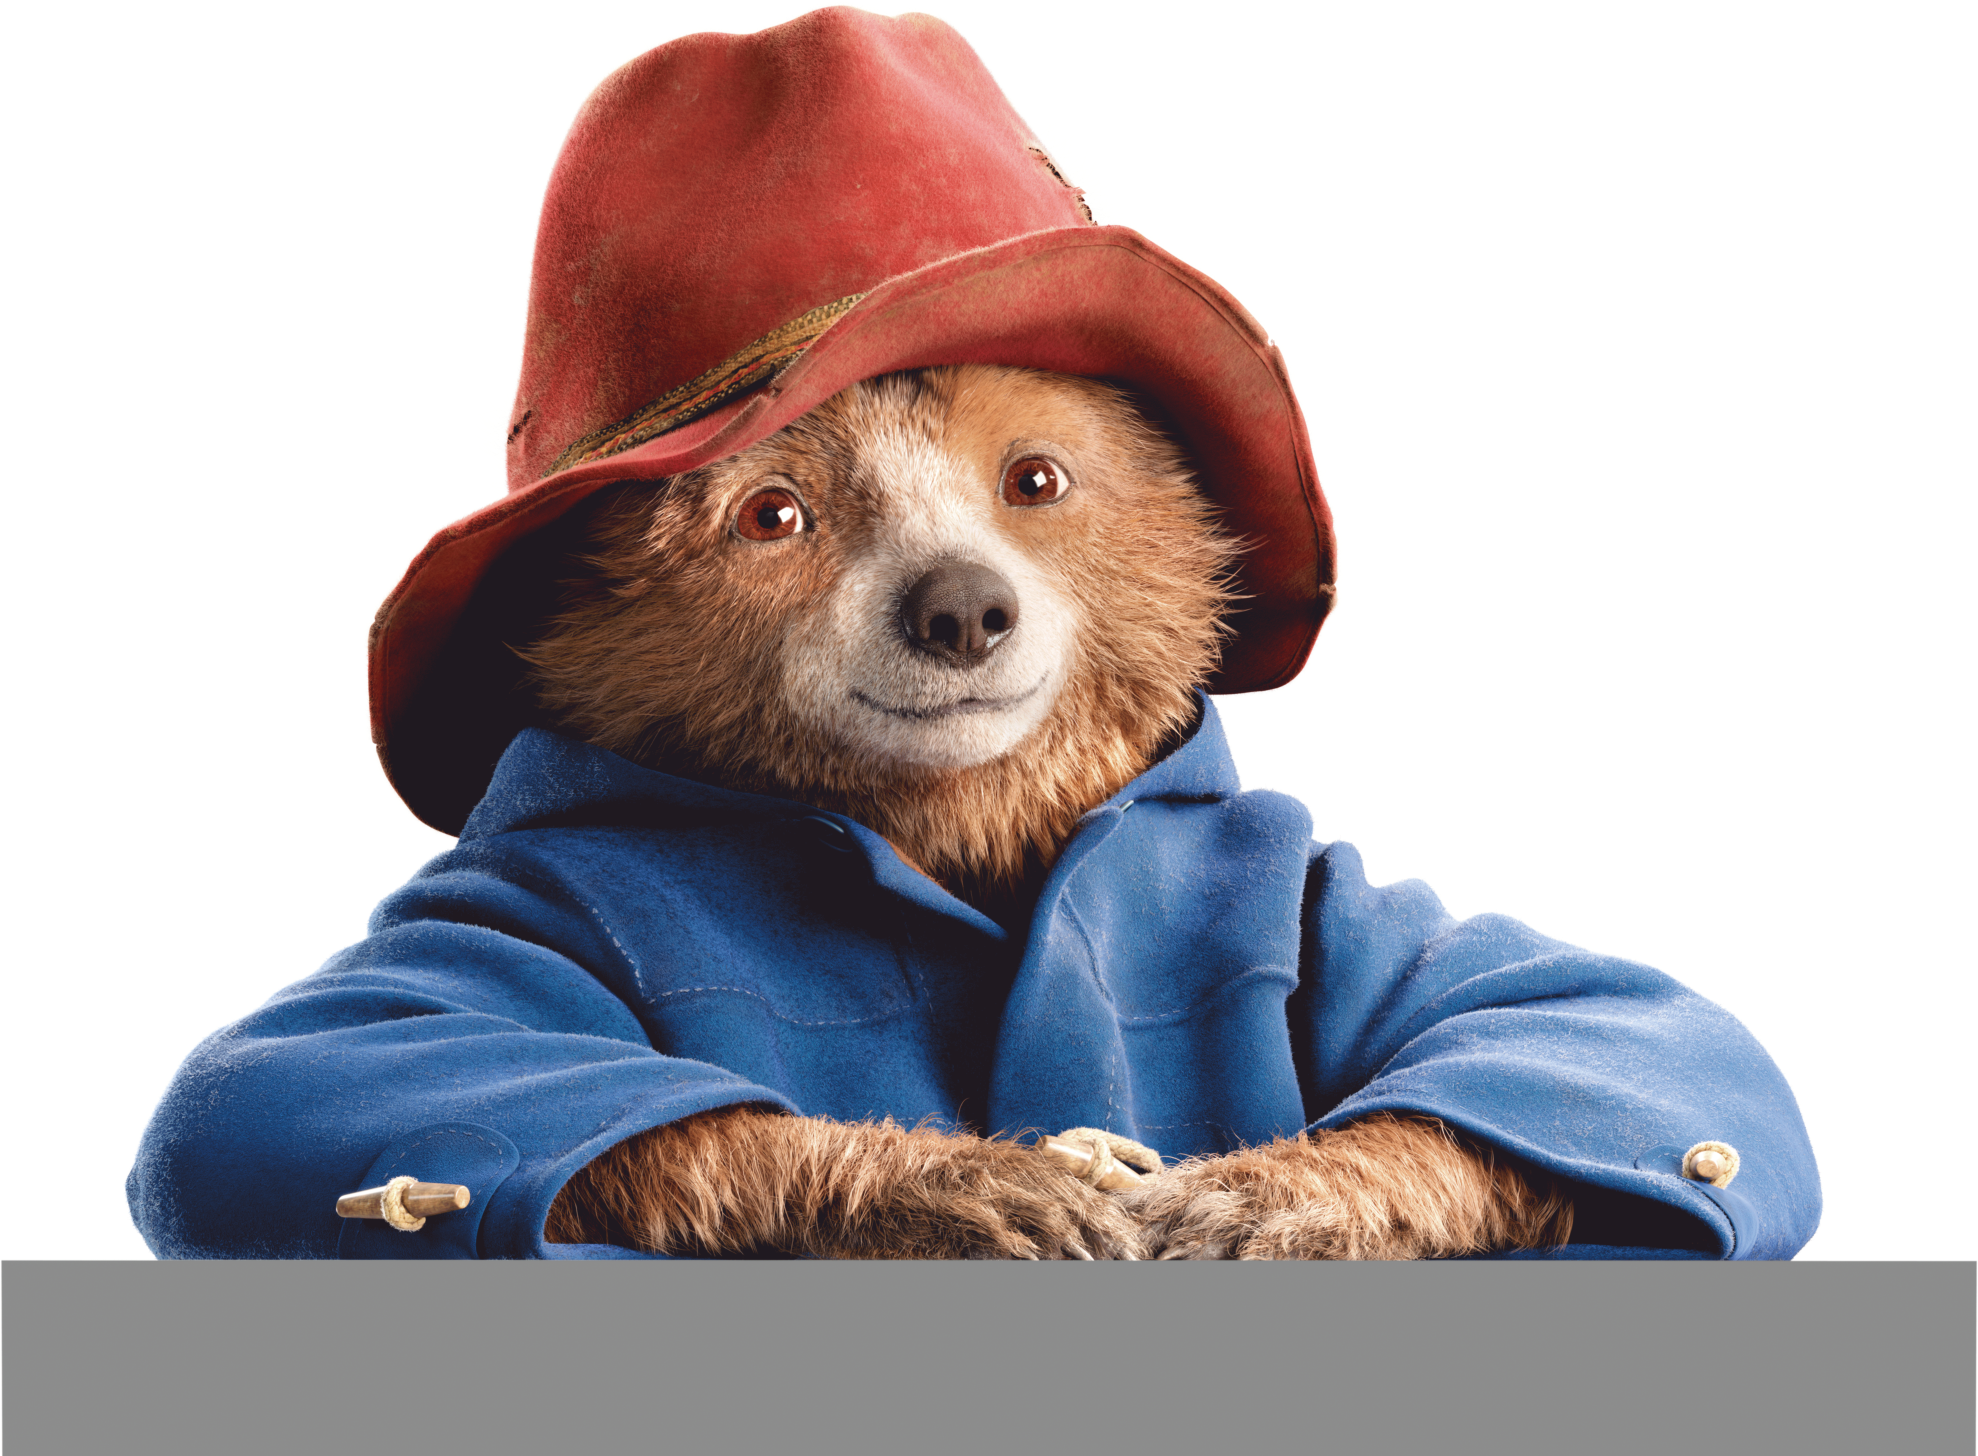
Part 4
Your learning
logbook
© P&Co. Ltd./SC 2026
Fold four pieces of A4 paper in half
and staple at the seam.
Decorate the front of your learning
log. You could use Paddington’s
pop-up book to inspire you.
Be sure to include your name.
You’ll use this book at the end
of every activity to log what
you've learned.

Slide 7
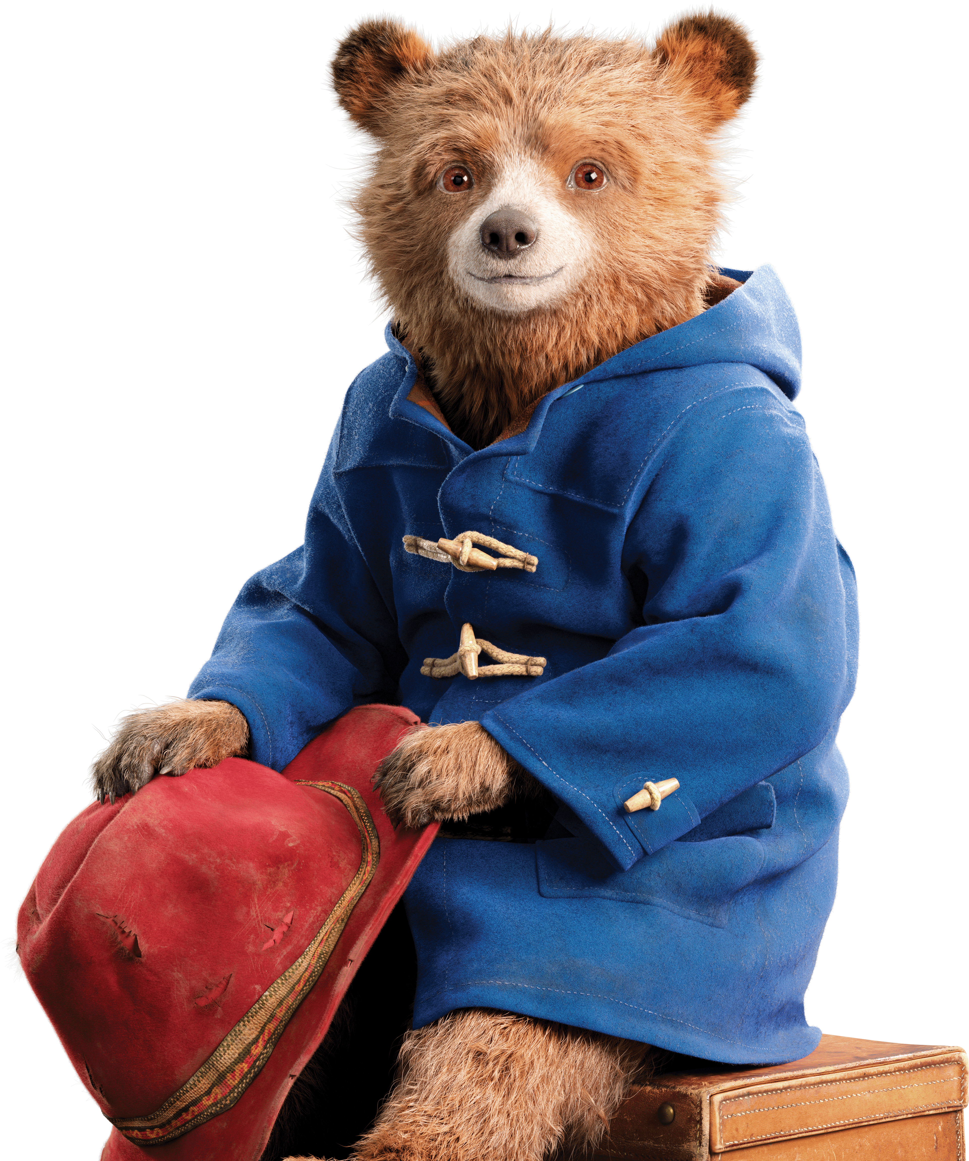
Part 5
Pause, ponder
and pop!
© P&Co. Ltd./SC 2026
Which of the key rights do you enjoy in
the learning spaces in your community?
PAUSE: take a moment to think about
what you've learned in this activity.
PONDER: write or draw your answer
and add a pop-up to your learning page.
POP!: share and vote on what your
class pop-up will be.

Slide 8
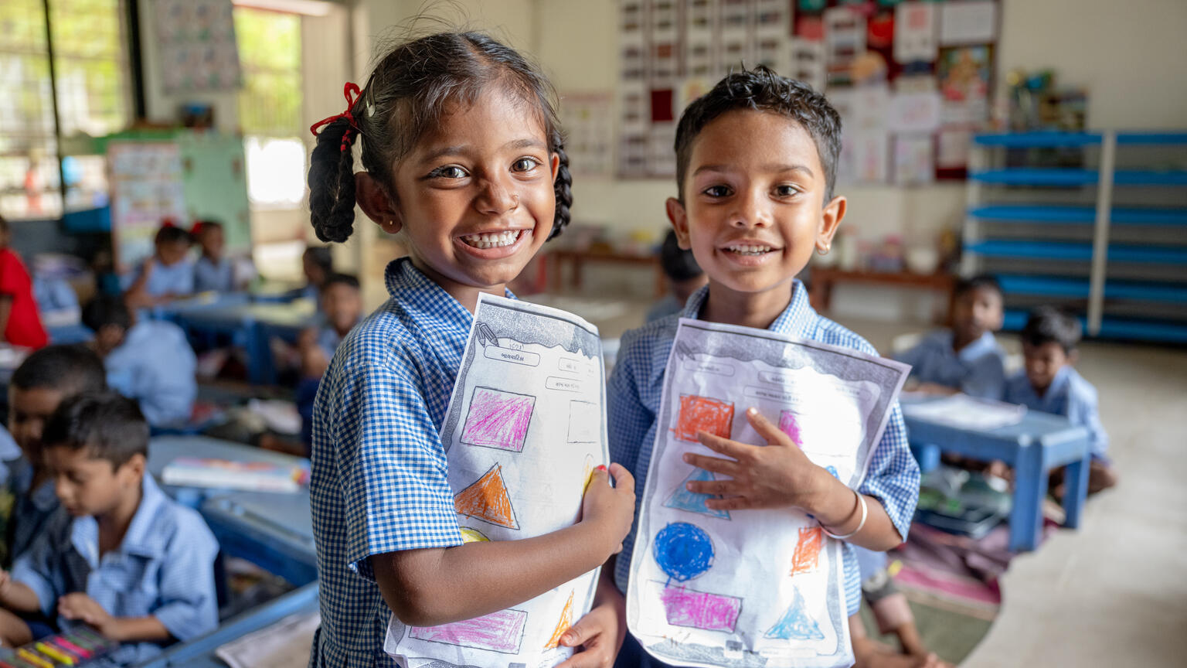
Activity 2
Exploring learning spaces
Fiona, 5, and Rudra, 5, in their inclusive classroom in Anand.
© UNICEF/Panjwani

Slide 9

Part 1
Guided
imagination

Slide 10
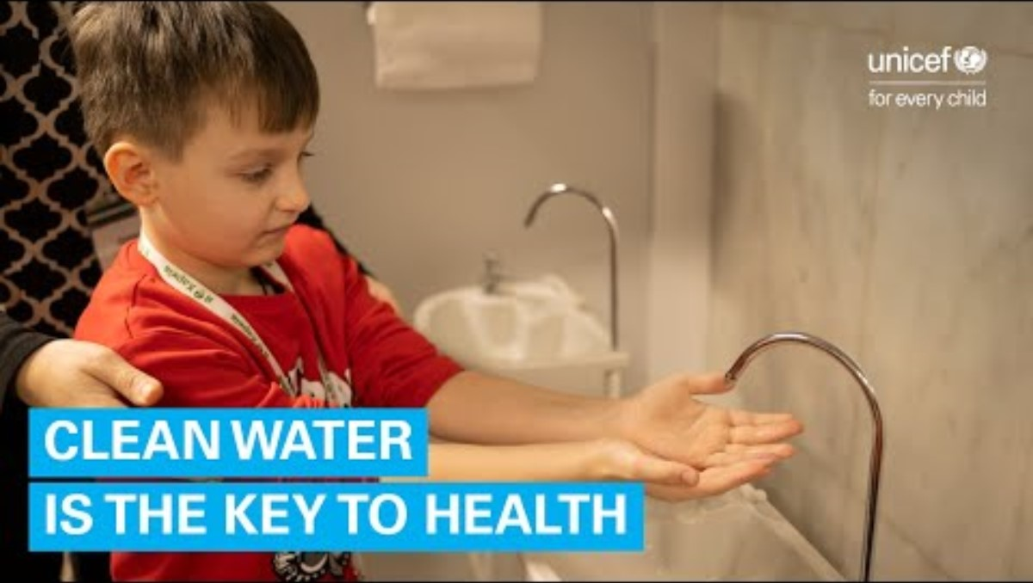
Part 2
Spot the rights
https://www.youtube.com/watch?v=PfcEmSFVmZE
Notes:
Watch the UNICEF Kharkiv Underground Learning case study on YouTube together as a group:
https://www.youtube.com/watch?v=PfcEmSFVmZE
As you watch, can you spot and count some of the rights that you see children enjoying in this space?
After watching:
Which rights did you see children enjoying?
What are some things you saw that help to make this a safe learning space for children?

Slide 11
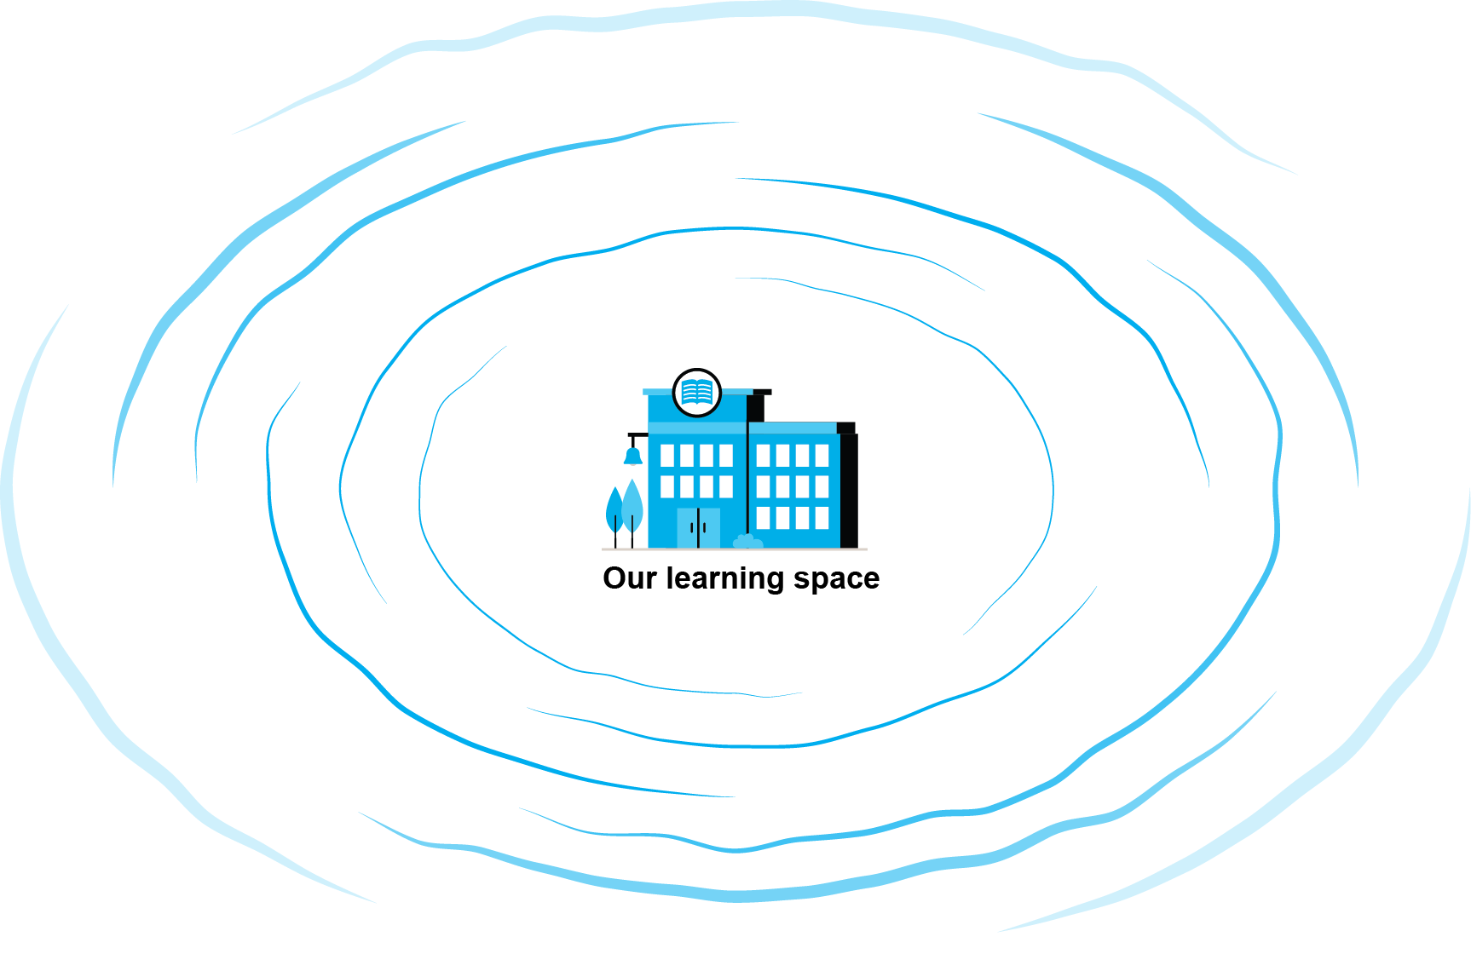
Part 3
A ripple of rights
What is
a ripple?
Notes:
If you'd like to show the movement of a ripple flowing outwards you can use this video: https://www.youtube.com/watch?v=FeXP7SxCKKE

Slide 12

Notes:
Video: https://www.youtube.com/watch?v=nvb6tvZOYIo

Slide 13
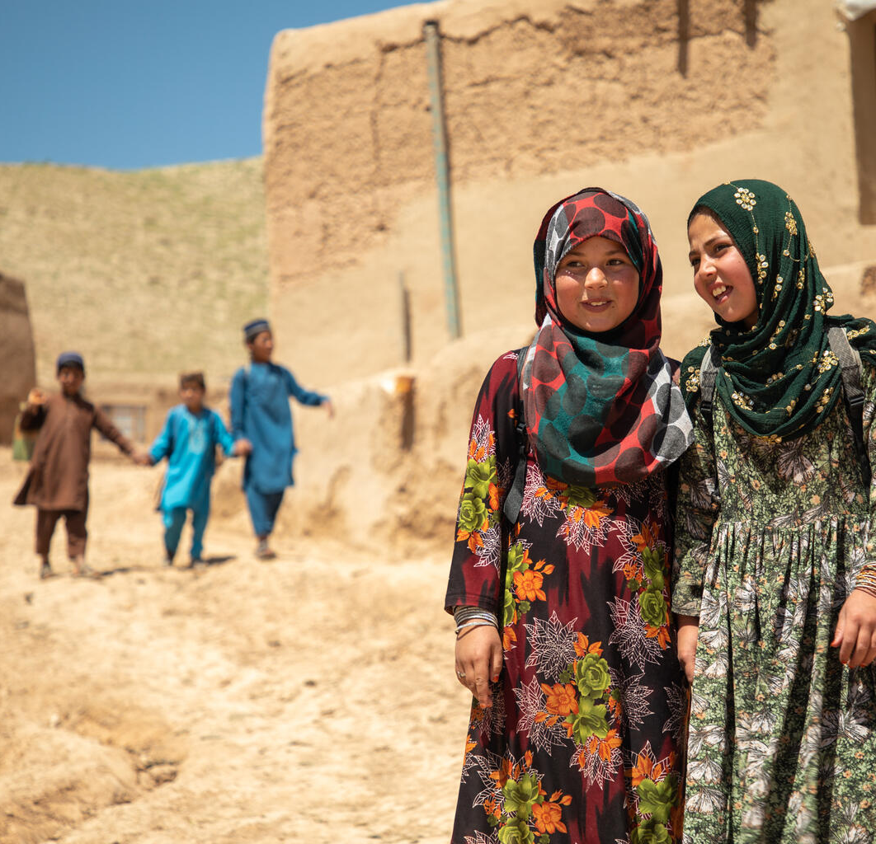
Amena,11 (right), walks home from school with her best friend Halima in Afghanistan.
© UNICEF/Meerzad
Part 4
Designing to
overcome barriers
If you were designing a learning space for a situation where children are facing barriers to access, what could it look like?
What might be missing?
How would you make it as safe as possible?
Who would be there?
What would children learn?
Notes:
Ask: What makes the learning space you’ve designed safe?
Ask: In what ways is your learning space is designed so that children can enjoy their rights?

Slide 14

What barriers might
prevent a learning space
from being safe?
Notes:
Begin adding Barrier cards to the Barriers Wall today. From the School Swap discussion and the Ripple of Rights mapping, invite children to name barriers that could prevent a learning space from being safe? Some ideas might include: broken buildings, no building at all, no clean water, too far to walk, no teachers, no toilets. Each idea becomes a card on the Barriers Wall.

Slide 15
Sheltered learning
Physical barrier
Language barrier
Floods
Notes:
A recap of the scenrios in your facilitator guidance:
Floods: heavy rain caused a river in a small town to flood. The road to the school is underwater, and the school building itself has mud and water in the classrooms. Classes have been cancelled until the school can be repaired, but no one knows how long that will take.
Sheltered learning: in one city, thousands of people have been forced to leave their homes due to conflict. They find safety in another city and are given shelter in schools. The children who used to study those spaces, and the displaced children who have just arrived, all now need an alternative learning space to use until the schools are no longer needed as a shelter for families to live in.
Language barrier: due to conflict and not being safe, a family has been forced to flee to a new country. There is a school nearby for their children to attend, but all of the lessons are taught in a language that the children do not speak.
Physical barrier: a child uses a wheelchair but is unable to access their nearest school because it has no ramp, and no accessible toilet – plus the desks aren’t adjustable. The teachers and students are welcoming, but the building isn’t.

Slide 16
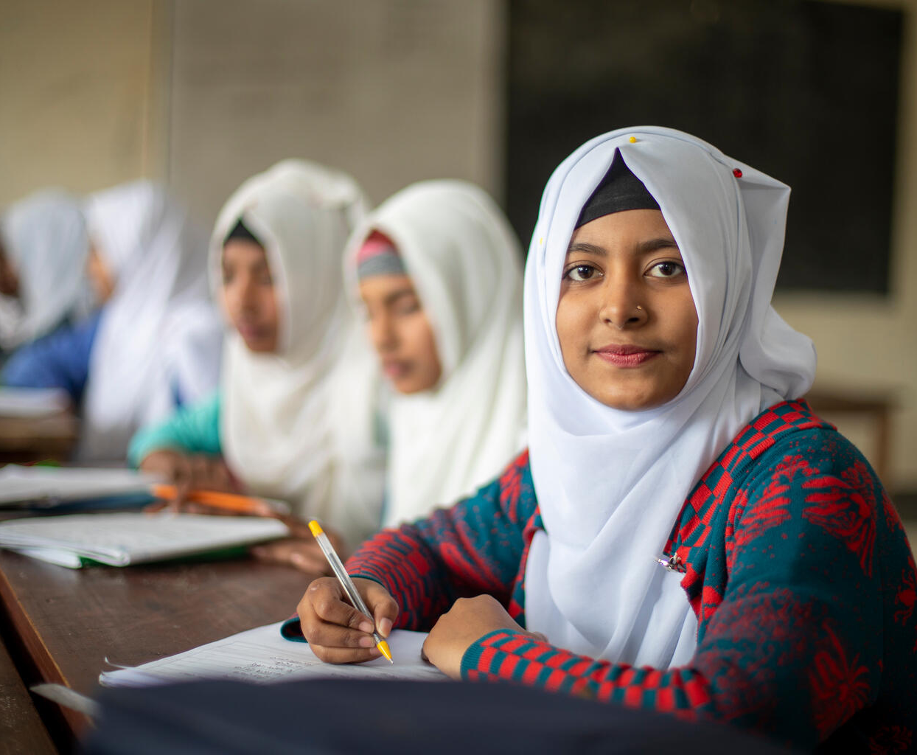
Part 5
Pause, ponder
and pop!
What is one thing you think every learning space needs so it's a safe place for all children to enjoy their rights?
Need picture and caption
Tabassum, 14, is interested in STEM education in Mymensingh.
© UNICEF/Rasnat

Slide 17
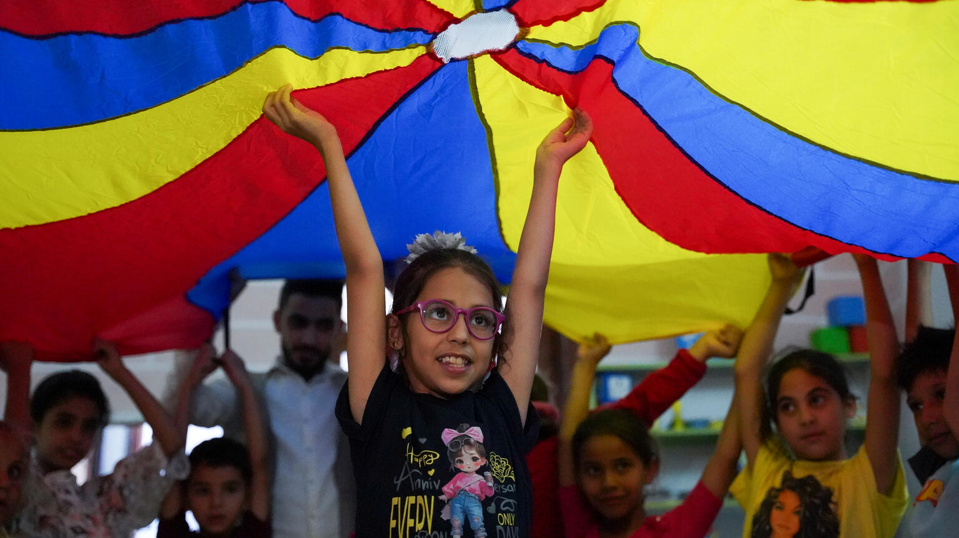
Activity 3
Education in emergencies
Ghuson, 10, says
"I draw, play and learn things I never knew" at a support session in Syria. © UNICEF

Slide 18
Part 1
What happens in an emergency?
Climate
emergencies
Natural
disasters
Disease
outbreak
Conflict
and war
Notes:
Discuss a broad range of emergencies and how they might prevent children being able to access learning spaces. Children in the UK may remember personal experience of climate disruption (flooding, heatwaves) or of limited access to learning during the pandemic.
Climate emergencies: flooding, extreme heat, wildfires, drought. Sometimes, if there's a heatwave, schools get too hot to learn in – has this ever happened to you? Or has snow stopped you going to school? Floods can destroy school buildings or make them unreachable or unusable. (To delve deeper into climate, take a look back at our OutRight 2023/24 resources here – the Activity Guidance can give you an overview, and Activity 6 looks at education amid climate change.)
Natural disasters: earthquakes and landslides can collapse schools and cut off road access. These also can often be linked to climate (in other words they're not completely 'natural', because human activity can make them more likely to happen!).
Disease outbreaks: a pandemic can close schools for months or even years.
Conflict and war: armed conflict is one of the most devastating barriers to children's education worldwide. Right now, millions of children can't reach their learning spaces because of conflict.
Create a barrier card for each type of emergency.
Ask: Think back to your ripple of rights diagram from Activity 2. If a learning space disappears because of an emergency – what happens to all those connected rights? Which rights would be hardest to enjoy?

Slide 19

Part 2
Safe learning spaces in emergencies

Slide 20
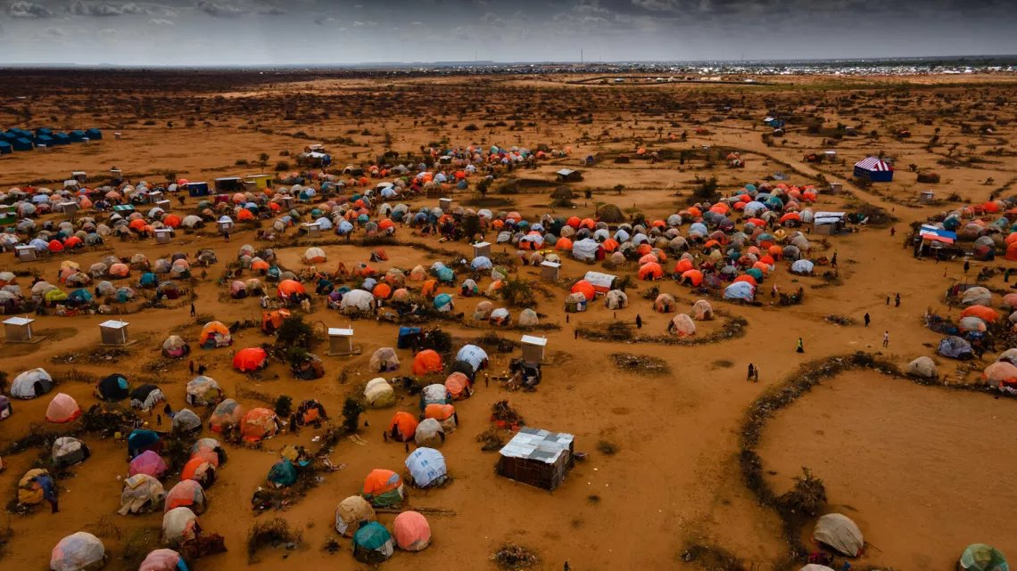
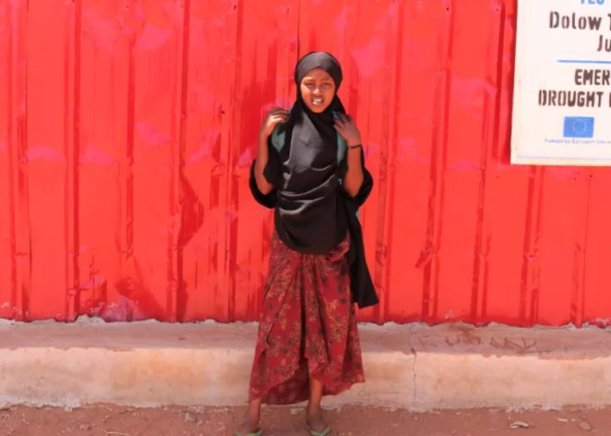
Temporary learning spaces
A camp in Dollow, Somalia, for people who've had to flee their homes. The tents here are made up of plastic sheets and fabric lashed with cord. ©UNICEF/Somalia. Fatuma, 11, learns reading, writing, maths, Arabic and Somali in a temporary learning space here. ©UNICEF/Mumin
Temporary learning spaces are places like schools that are set up wherever people are living when they've had to flee an emergency.
Notes:
In these spaces, children are usually able to continue their reading, writing, maths and language studies. Children can attend while they're living in a camp like this, with the hope that they'll be able to return to their own school without any learning gap once they're able to.

Slide 21
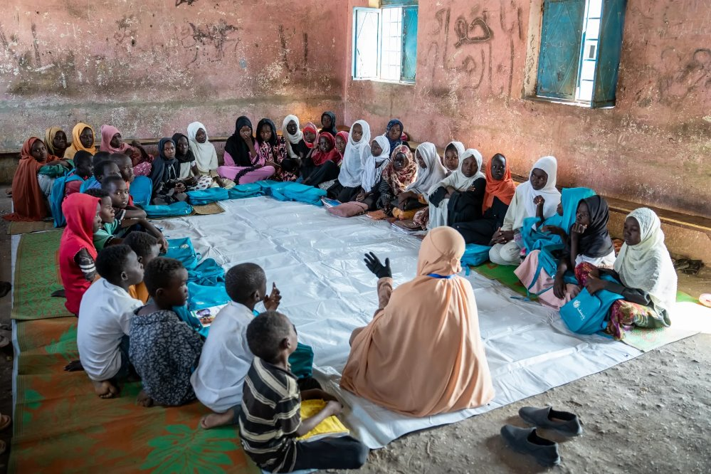
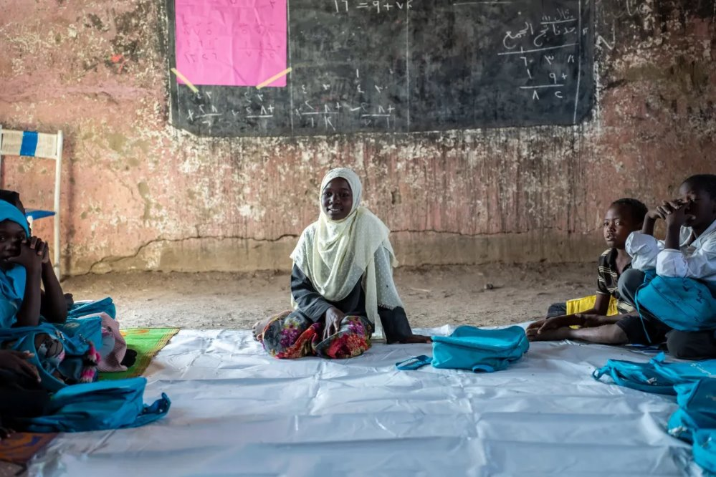
Child-friendly spaces in Sudan, called makannas
Marwa attends a UNICEF-supported Makanna where they talk about their hopes, dreams and fears. ©UNICEF/Osman
In child-friendly spaces, children affected by
emergencies can get different kinds of support
they need including: a safe place to be and
connect with other children, learning, mental
health support, and facilities like water and
sanitation to help keep them healthy.
Notes:
In Gedaref State, UNICEF has established makannas – safe spaces where children affected by conflict can get a range of support, including education, child protection, psychosocial support (that's expert emotional support), and water, sanitation and hygiene services like hand-washing stations and toilets.

Slide 22
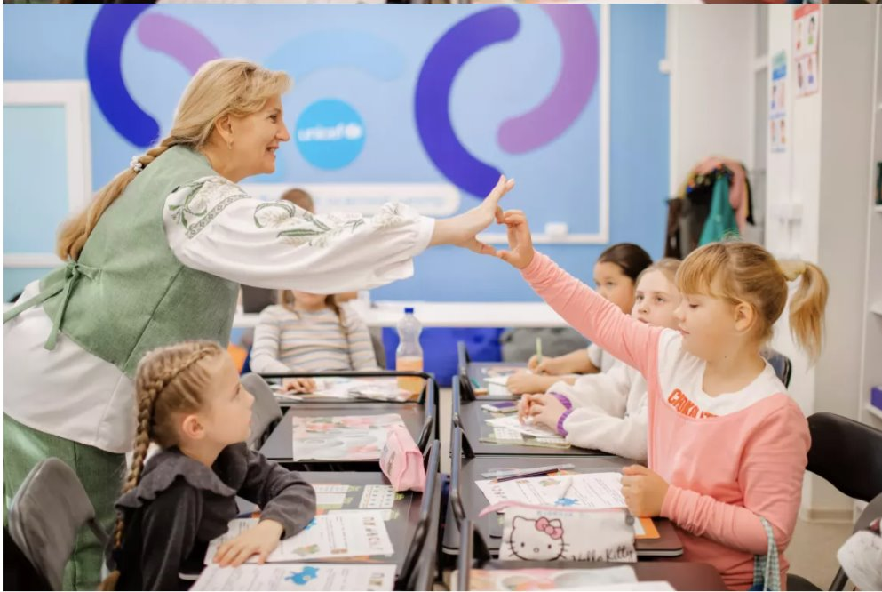
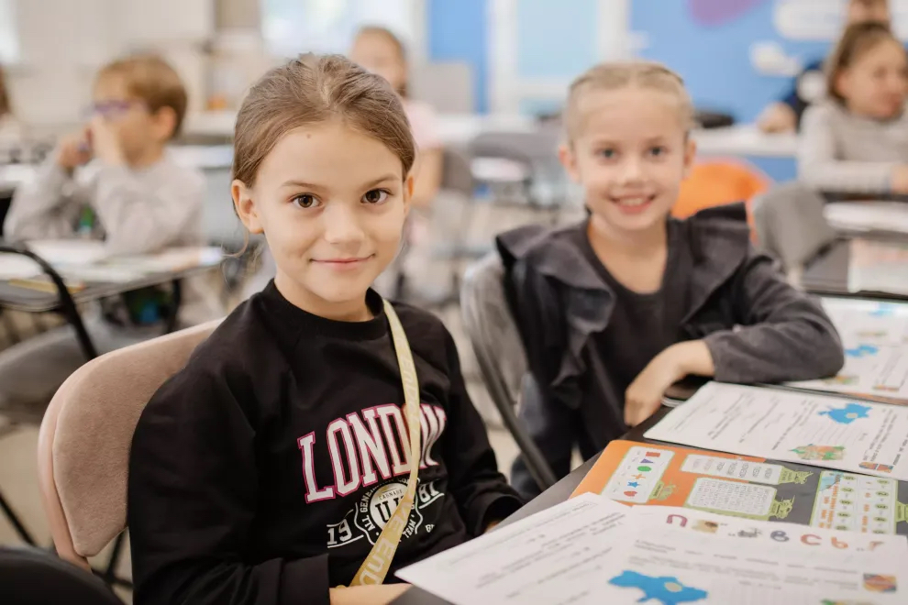
Liana, 8 (left in picture 2), attends a digital learning centre in Apostolove where she has catch up lessons due to her learning being interupted because of the ongoing war in Ukraine. ©UNICEF/Yagelska
Digital learning/
catch up
learning
Catch-up lessons at a digital learning centre allow children and young people who’ve missed out on learning because of conflict and emergency get their education back on track.
Notes:
When war started in Ukraine in 2022, eight-year-old Liana's family fled to Czechia to stay safe. Liana kept learning through online lessons, but they were difficult and lonely.
After a year, the family made the difficult decision to return home to Apostolove, a town near Kryvyi Rih, where one school had survived the shelling. While in-person classes restarted in September 2024, Liana had gaps in her learning to fill since she’d been out of school for half a year.
Liana’s mum enrolled her in a UNICEF digital learning centre, specially equipped with trained tutors, interactive lessons and other children.
After taking part in digital catch-up classes, Liana is getting back on track. Her teacher says she's bright, cheerful and works hard. Her mum says she does her homework on her own. And Liana? She's glad to be back in a room with people who can see her in real life..
Digital catch-up classes help children who have experienced disruption in their education from conflict or other emergency get back on track and catch up on the learning they missed. UNICEF digital learning centres, like this one in Ukraine are specially equipped with trained tutors and interactive lessons. Plus, children also enjoy getting to learn with other children – something that they often miss out on when they’re family has been displaced.

Slide 23
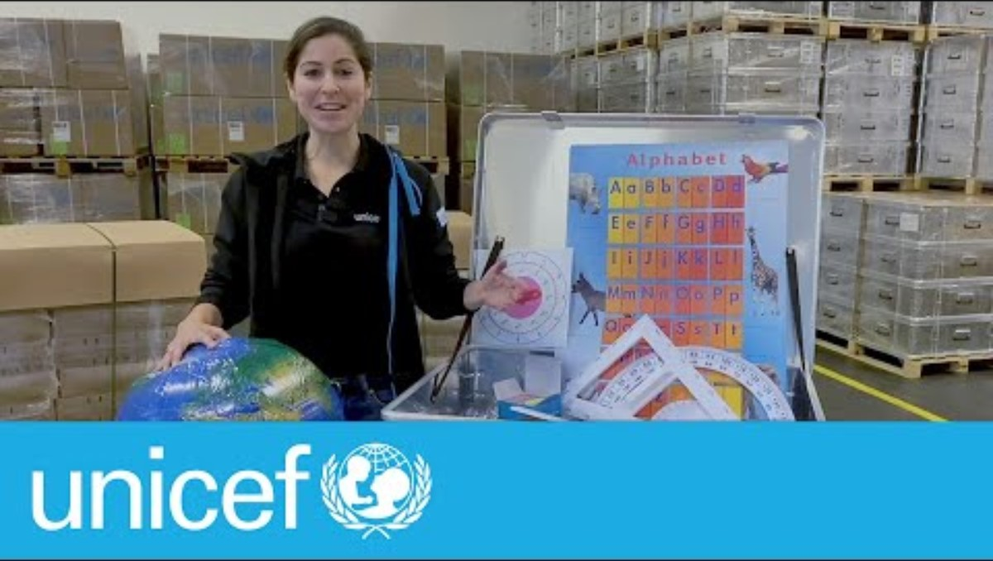
OPTIONAL: School-in-a-box
Notes:
Video: youtube.com/watch?si=UnsZSE2jmTHF6kDp&v=iWv5-iuQ7Pc&feature=youtu.be
A school-in-a-box is a portable learning kit that includes materials to help 40 children in an emergency, so they can access their right to learn. The kits include books, pencils, chalk, rulers and a guide for a teacher. A school-in-a-box can be set up in a tent, a community building, or under a tree.
For more on the school in a box visit https://www.unicef.org/supply/unicefs-school-box#:~:text=Inclusive%20classroom,%2C%20language%2C%20geography%20and%20more

Slide 24


Part 3
Unstoppable
children
Conflict in Sudan

Slide 25

What is happening in Sudan?
In Sudan, there are two main groups fighting each other for control
of the country. Most people in Sudan are not fighting but because
of the fighting, millions of people in Sudan are unsafe and have
had to leave their homes.
Many do not have enough food or medicine, and many children
cannot go to school.
15.3 million children in Sudan need help and protection.
S U D A N
Notes:
This is a very simple description of the Sudan conflict for children who are in their early stages of learning. For greater context and a more information about sharing the Sudan conflict with children, visit the ‘Rights Around the World’ Sudan activity and teacher notes:
Source:
https://www.unicef.org.uk/donate/sudan-appeal/?gad_source=1&gad_campaignid=20028312605&gbraid=0AAAAAD6VRshOv5iRc40qNP13kI57XEu7u&gclid=CjwKCAiA55rJBhByEiwAFkY1QOraI_6PafGC9PKXco_8jju3Vg4Tvgb1jQg5SNdH52xGYKfRTX2gCRoCyRkQAvD_BwE
Please note that this pack speaks of the impact of war and conflict on children. As ever, we know that you will want to make choices about how you address these important issues in a way that's appropriate for your children and young people. You might find this additional guidance helpful: https://www.unicef.org.uk/rights-respecting-schools/resources/teaching-resources/guidance-assemblies-lessons/discussing-war-and-conflict-in-class/

Slide 26
“I stayed home for three years, and couldn’t
learn a single letter… But when I took my exams
and received my results, I was overjoyed.”
Unstoppable Mustafa, age 12 , Kassala, Sudan

Slide 27
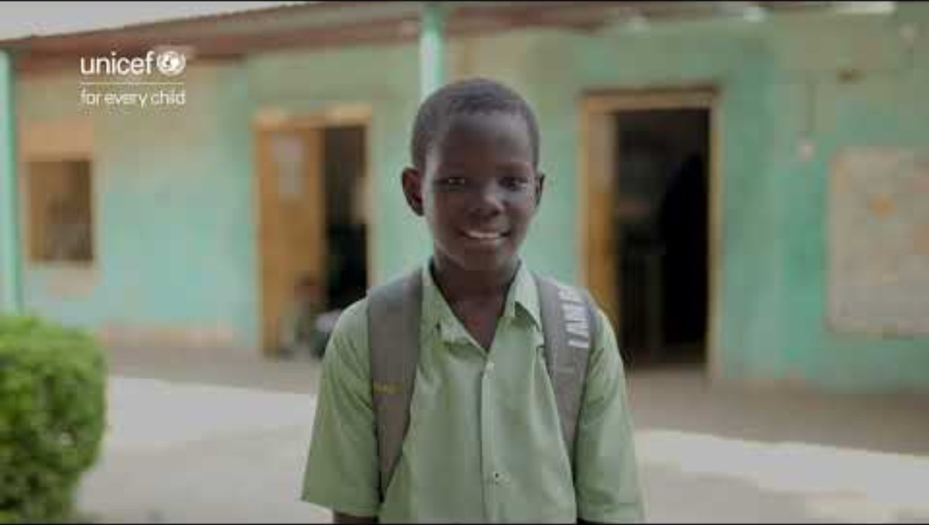
Mustafa returns to school
Notes:
Watch the video: https://www.youtube.com/watch?v=1_PX8qkOX3k
Discussion prompts:​
What change that supported Mustafa to go to school?​
What rights is Mustafa able to enjoy at school now?​

Slide 28
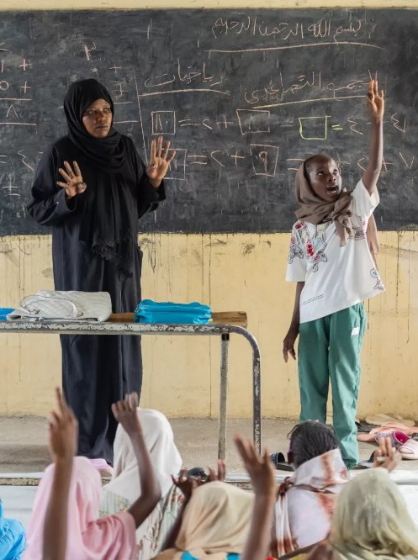
“For me, education is very important. I want to learn.
Without education, you won’t be able to understand the world around you when you grow up.”
Unstoppable Rabha, age 11, Gedaref, Sudan
©UNICEF/Elfatih
Notes:
Discussion prompts:​
What support did Rabha get that helped her attend school? ​
Think about the first time you learned something new – how did that feel? ​

Slide 29
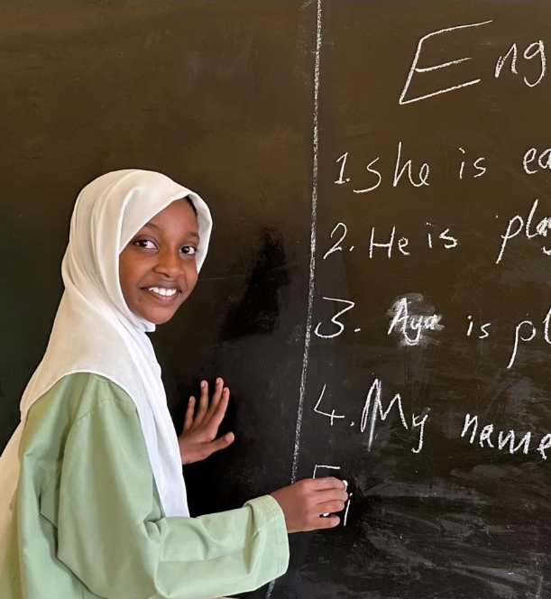
After leaving her home and missing school for more than one year, Aya has found a safe learning space to continue her studies and make new friends.
“The children here are
so kind. When I first
arrived, the class was
full, but they made
space for me.”
Unstoppable Aya, age 13, Kassala, Sudan
©UNICEF/Nakibuuka
Notes:
Discussion prompts:
Aya had to leave her home and start again somewhere new, but she kept going to school and is committed to learning.
Have you ever had to keep going with something even when it felt really hard? What made you carry on? How do you think Aya felt walking into the classroom of the new safe learning space for the first time after missing school for more than a year and a half?

Slide 30

Part 4
Pause, ponder
and pop!
Imagine you could meet with one of the children we’ve met in this activity. What question would you want to ask them?
Write one thing you’ve learned about where they live and how they're enjoying their rights even when their country is experiencing conflict.

Slide 31


Wish
box
Write a wish or
fold a paper crane
as a message of peace
and hope for children
experiencing conflict.
Notes:
Watch this video for a step by step guide to make an origami crane:
https://www.youtube.com/watch?v=fEcP4xm4iZk

Slide 32
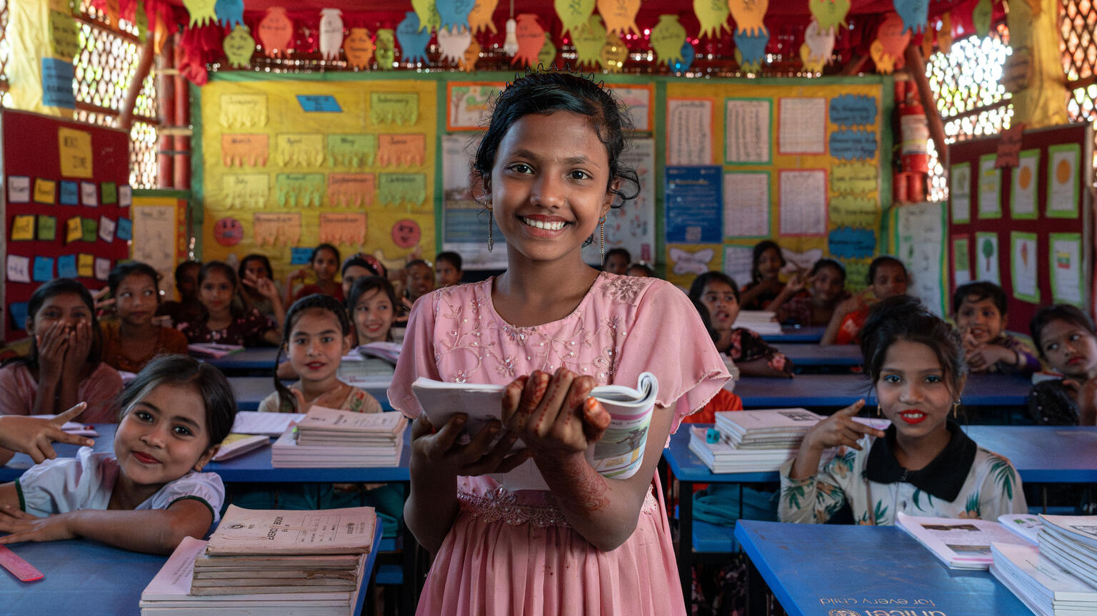
Activity 4
Education for everyone
Noor, 13, studies at the UNICEF learning centre at the Rohinga Refugee camps in Bangladesh.
© UNICEF/Kruglinski

Slide 33
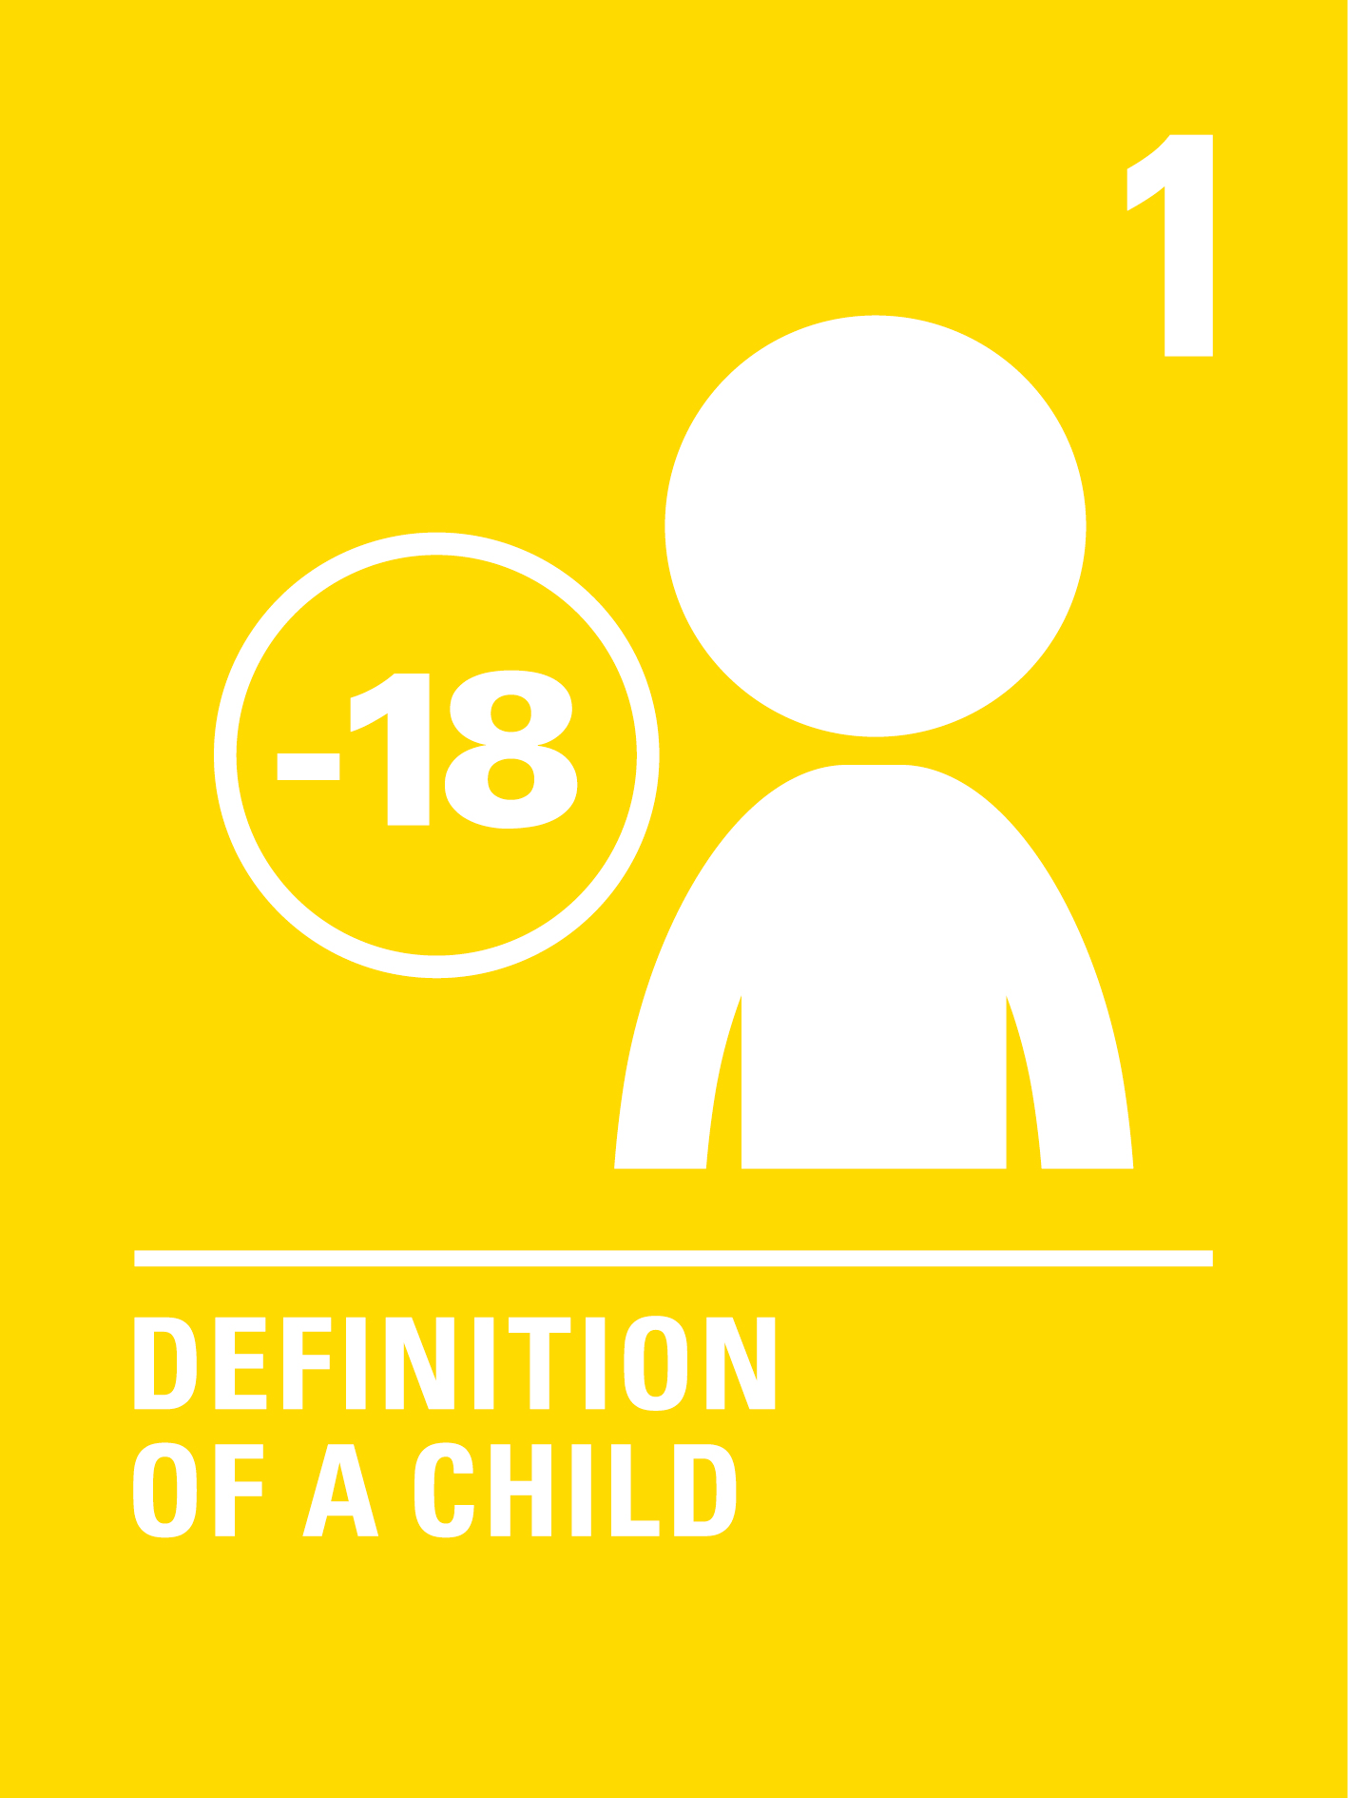

Part 1​
Who are rights for?​
Article 1:
The UNCRC
applies to every child. Everyone under the age
of 18.
Article 2:
Every child has rights
without discrimination.
That means regardless of
their race, language,
religion, gender, disability,
wealth, where they live,
or any other characteristic.
Notes:
Create rights cards for these two articles and add them to your rights wall
Ask: If rights belong to every child without exception – can you think of any reasons why some children might be absent from learning spaces?
Invite children to call out ideas. Write them on cards and begin placing them on your barriers wall.
If needed, prompt the conversation using the list in your activity guidance to consider why children may not go to a learning space, then consider beyond the UK.
Ask: In some parts of the world, girls are less likely to be in school than boys. Why might that be?
Note: As you guide the discussion, take care that it doesn't lead to blame of families or communities. The barriers that keep children out of school are often complex and linked with poverty and broken systems (whether those systems are administrative, like education systems, or more to do with societal and cultural norms, these go beyond individual choice or 'fault'). This understanding of changing systems to address barriers can later be tied to campaigning.
33)

Slide 34
Part 2​
Unstoppable
children
Notes:
Let’s meet some children from around the world who are unstoppable! Let’s look at how they’ve faced the barriers that were keeping them away from accessing learning spaces and, with support, how they are now enjoying their rights.

Slide 35
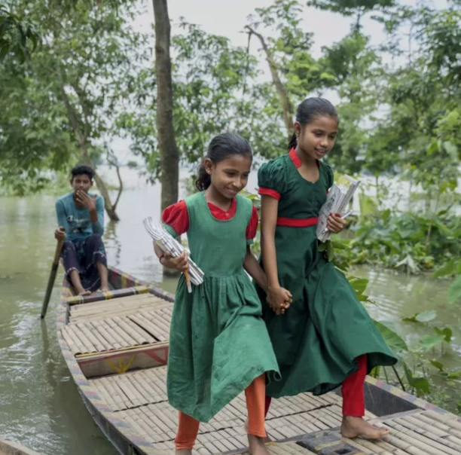
Tawhida and Tania are on their way to the learning centre. Tania aspires to become a teacher, while Tawhida dreams of a future
as a doctor.
Unstoppable Tawhida and Tania,
both age 12, Shantiganj sub-district
in Sylhet, Bangladesh
©UNICEF/Himu
Notes:
Discussion prompts:
Every child has the right to education, but Tawhida and Tania didn't start school until they were 12. What were the barriers that stopped them, and who do you think is responsible for removing those barriers?
Do you think "equal" education means every child gets the same thing, or every child gets what they need to catch up?

Slide 36
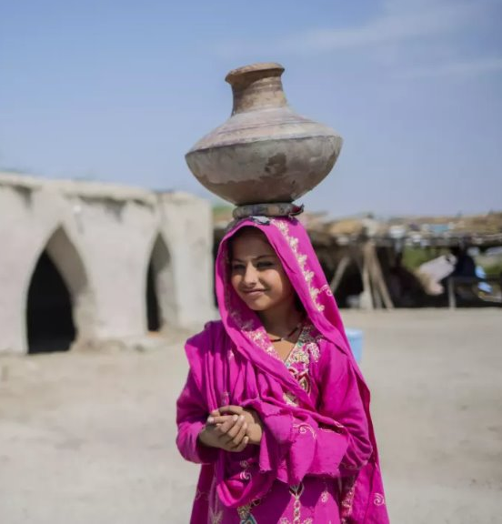
“I’m happy,” Farzana says now that the new water pump is just five minutes from her home.
“It saves time and now I can go to school and be with my friends. I like games, playing football and learning Sindhi.”
Unstoppable Farzana, age 12,
Pakistan
©UNICEF/Pakistan/Saiyna Bashir
Notes:
Discussion prompts:
What were the barriers that had stopped Farzana from going to school? (Map these on your barrier wall if they aren’t already there)
What rights is she able to enjoy now?

Slide 37
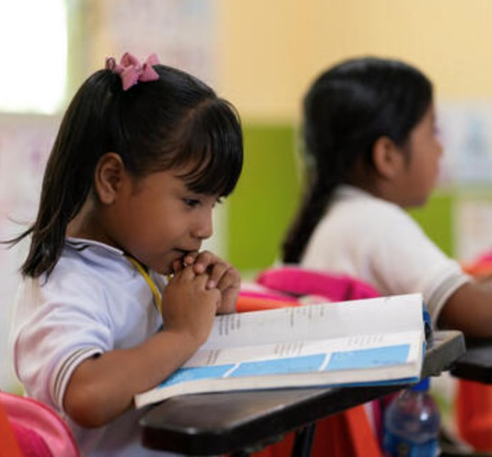
Learning in
your own
language is
a right, and
helps children
learn better.
Unstoppable Cristel Ana,
Libres, Guerrero, Mexico
©UNICEF/ALIMARINc
Notes:
Discussion prompts:
Imagine going to school and your teacher spoke a language you didn't understand very well. How do you think that would feel? How might it affect your learning?
UNICEF says that learning in your first language is a right. Why do you think language might be an important right?

Slide 38
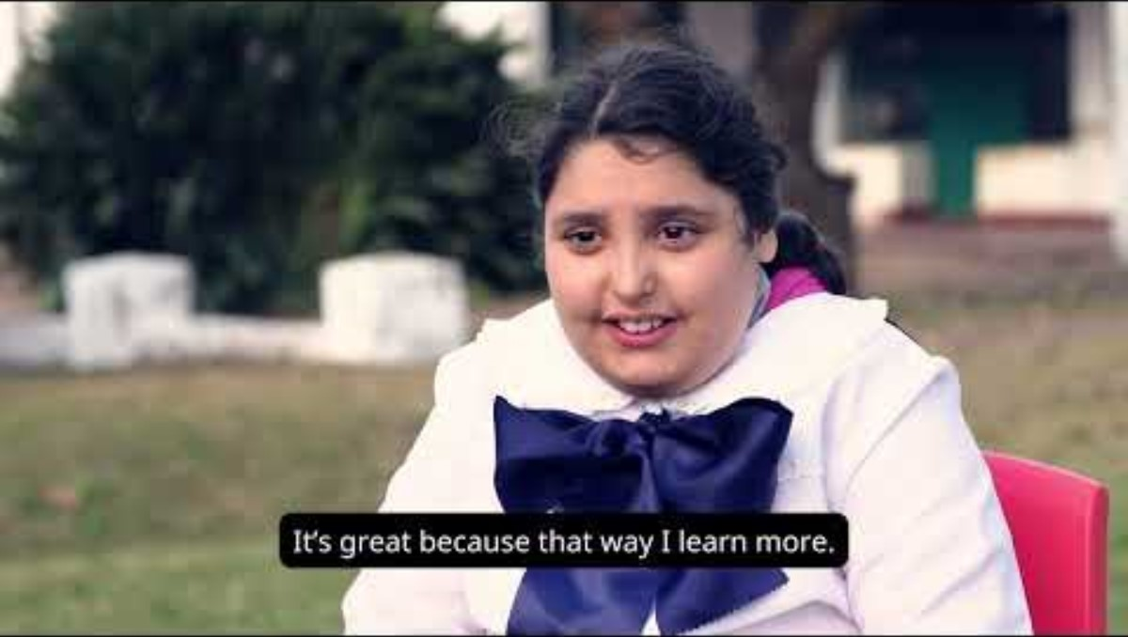
“It’s great. This way, I learn more.”
Unstoppable Julieta, Year 5, Uruguay
©UNICEF/Uruguay
Notes:
Video: https://youtu.be/egLxZRIry50
Discussion Prompts:
Every child has the right to education, but Julieta found school really hard at first. Do you think the right to go to school is enough, or does the way we learn matter too?
How does Julieta’s school make the learning safe space to meet the needs of children with different abilities?
What barriers has Julieta faced? How has she overcome them?

Slide 39
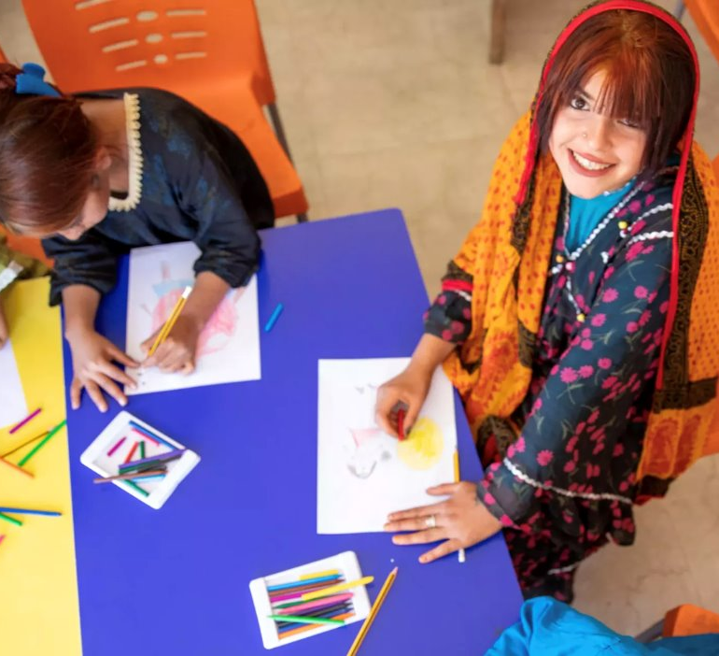
“My mum always
wanted to finish her
education before
getting married, but she
didn’t get the chance.
I want to change that.
“I hope one day I can
go back to school and
continue learning.
Makani is helping me
get there.”
Unstoppable Ghazala,
age 13, Jordan
©UNICEF/El-Noaimi
Notes:
Discussion prompts:
Can you think of a time when something felt really difficult or unfair?
What helped you keep going? What would you say to encourage someone else who was facing a hard time?

Slide 40

Part 3
Barriers and bridges mapping
Notes:
Map the ‘Education for Everyone’ barriers and bridges:
For each story shared, invite children to:
Name the barrier that has been overcome. Create a barrier card and add it to your barriers wall
Map the bridges:
Identify what changed: Was it a law? A school? A community attitude? Agency of the child? A resource like clean water or a school toilet?
Name who helped to make the change:
Government? An international organisation? A caregiver? The community?

Slide 41
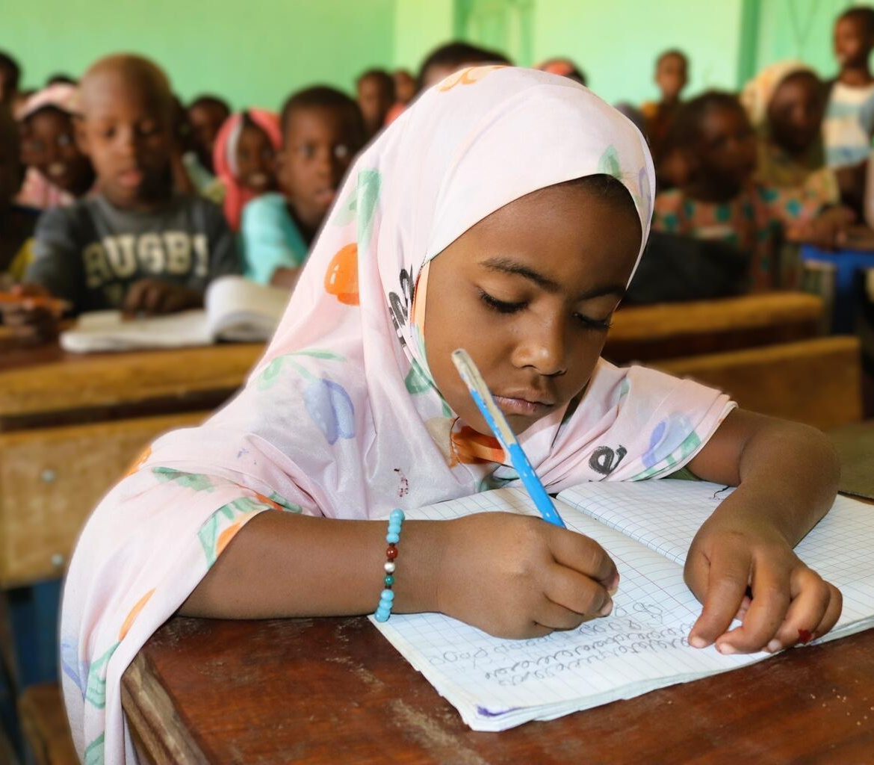
Aminatou, 7, attends school in Mali as she dreams of becoming a teacher.
© UNICEF/Nkurunziza
Part 4
Pause, ponder
and pop!
Ask: What is one thing you learned about that you think could make a big difference so that all children can access all learning spaces and enjoy their rights?
Who might be responsible for making this change?
Need picture and caption

Slide 42
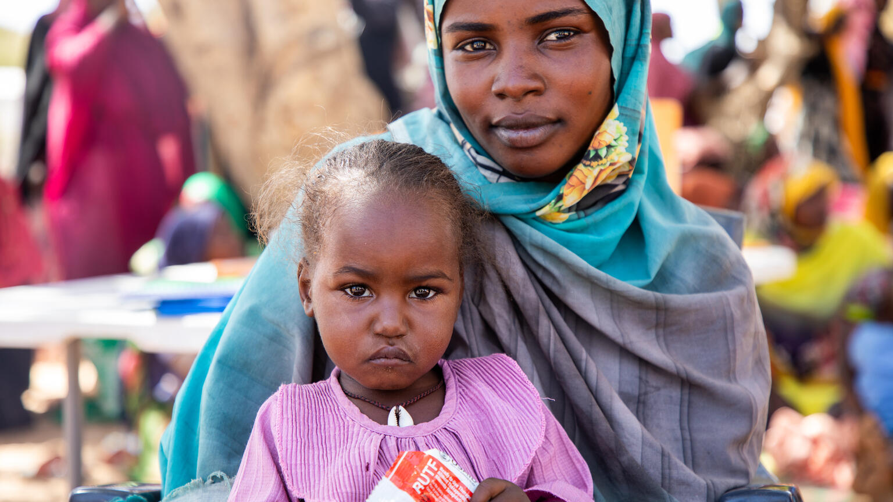
Activity 5
Attention, ask, act: how change happens
Watine, 2, and her mum live in a refugee camp in Chad.
© UNICEF/Da

Slide 43

Part 1​
What is campaigning and why do we do it?

Slide 44
Key vocabulary
Campaign: a planned set of actions to create change on an issue.
Duty bearer: a person or organisation with the responsibility to protect children's rights. This could be a government, a school, a caregiver or an international body.
Rights holder: a person who has rights. Every child (and adult too)!
Advocate (noun): someone who speaks up to protect rights.
Policy: rules, laws and guidelines made by governments. Organisations – and schools – have their own policies too.
We can ask for policies to be changed so children can better
access their rights.
Notes:
Advocate (verb): to speak up to protect rights.

Slide 45


Part 2​
Attention, ask, act: three steps to changemaking
Article 12:
Every child has the right to express their views on matters that affect them, and adults must take those views seriously.
Article 13:
Every child has the right to share information and ideas through art, writing, speech or other means.

Slide 46


Three steps to changemaking
Notes:
GET ATTENTION: Draw attention to the issue. What barrier needs to change? Who needs to know about it? [Signpost to old OutRight for how to create a message that gets attention]
ASK: Think about who you need to ask. Which duty bearer has the power to make a difference? What exactly are you asking them to do? Tip: Revisit the bridges from the Activity 3 and 4 unstoppable children stories, when you identified who helped to make the change.
ACT: Take the action. What will you do to get your message heard – a letter, a poster, a speech, a march, an exhibition?
Share: Paddington often leaves a trail of marmalade footprints wherever he travels! Just like Paddington leaves his mark, we do the same when we act as changemakers. We leave a trail from the issue we care about, step by step, all the way to the people who can build bridges and make a difference so that all children can enjoy their rights.

Slide 47
Part 3​
What does
campaigning
look like?

Slide 48
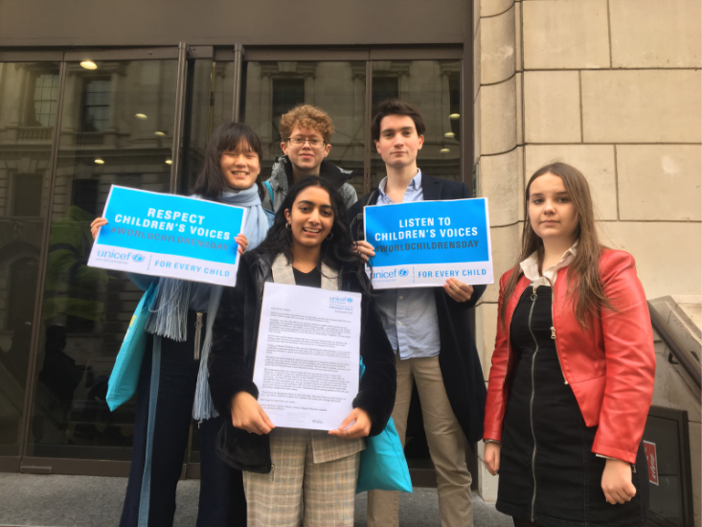
Youth
Advisory
Board
Left to right, back row:
Magali, Eddie and Michael ​
Left to right, front row:
Isabelle and Niamh ​
Notes:
When a General Election was called in 2019, Youth Advisory Board members from UNICEF UK delivered letters to Political Party Leaders in Westminster, calling on them to listen to children and young people’s voices on World Children’s Day.

Slide 49
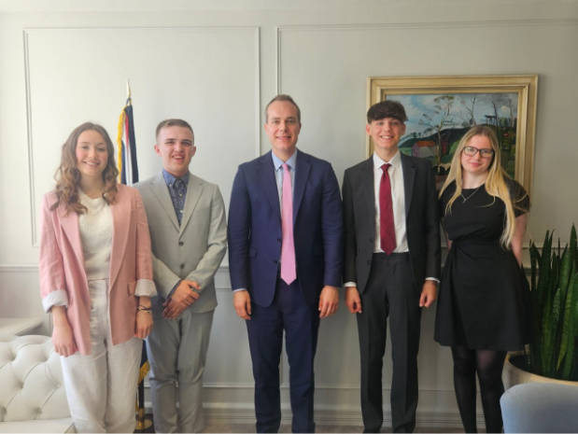
Meeting
with MPS
Left to right:
Ruby, Finn,
David Johnston MP,
Jonathan and Macey
Notes:
As part of UNICEF UK’s ongoing efforts to advocate for children’s rights in the UK, Youth Advisory Board members met with Children’s Minister David Johnston MP, to discuss their concerns for children in 2024.

Slide 50
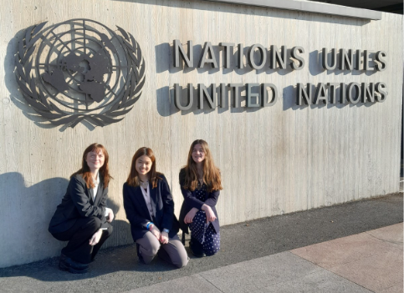
Youth
deligates
at the UN
Left to right:
Lauren, Jamie
and Poppy
Notes:
Youth Advisory Board members from UNICEF UK travelled to the United Nations in Geneva in 2023 during the UNCRC Periodic Review Process, to share their views, alongside other young people, about how children’s rights were being protected and promoted in the UK.

Slide 51
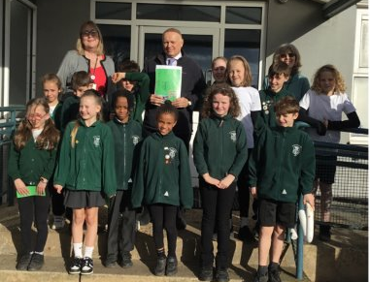
Meeting
with a law
maker
Chingford Primary School
Chingford and Woodford Green, Greater London
Notes:
Chingford Primary School invited Sir Ian Duncan Smith MP to their school. They created a booklet about their experience of being a Rights Respecting School and highlighted their campaign about local traffic. Sir Ian Duncan Smith attended and spoke with the children and offered his support for their campaign.

Slide 52
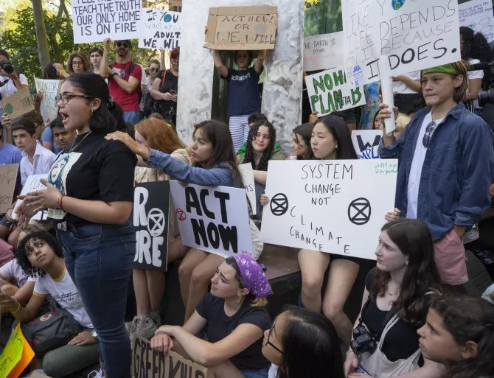
Peaceful
protests
Children join the climate strike peaceful protest in New York in August 2019

Slide 53
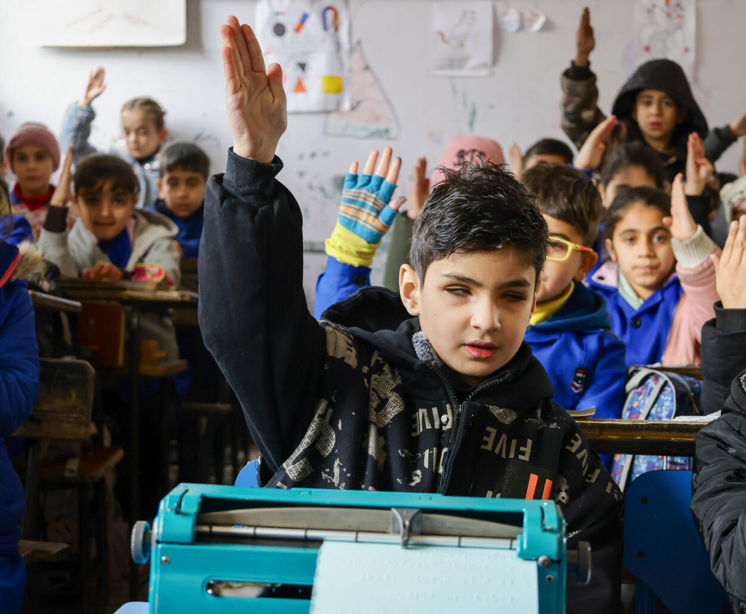
Part 4
What does a campaigner look like?
Youssef (13) uses a braille machine to take part in his classes in Syria.
© UNICEF/Ashawi
Need picture and caption

Slide 54
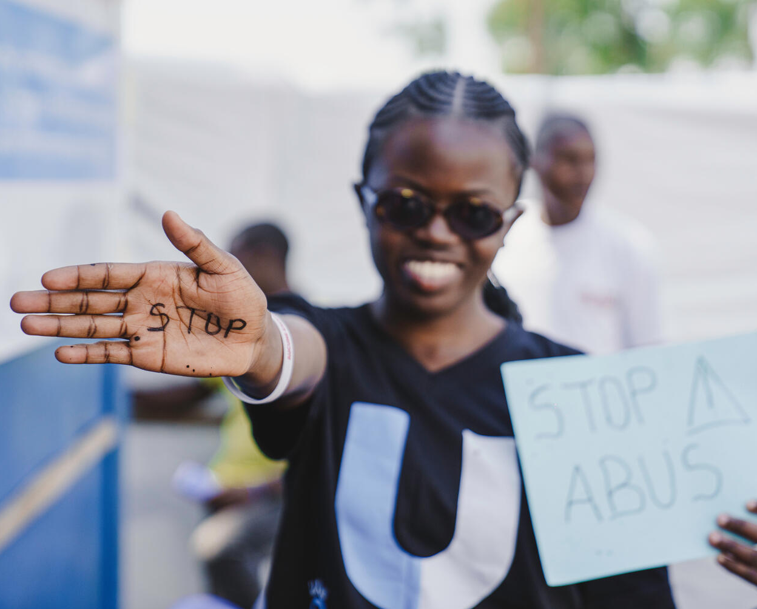
A U reporter takes part in a protest against violence towards women and girls in DRC.
© UNICEF/Benekire
Selfie wall
Create a placard with a slogan that either:
Draws ATTENTION to a barrier you’ve learned about
Makes an ASK, calling on a duty bearer to act
Celebrates an ACTION
Need picture and caption

Slide 55
Part 5
Final barriers and bridges reflection

Slide 56
Part 6
Pause, ponder
and pop!
© P&Co. Ltd./SC 2026
What is one thing
(attention, ask or act) you think you could do to help children enjoy their rights to safe learning spaces?

Slide 57

Well done and what's next?
Notes:
Invite the group to talk about what they'll do to share their display.

