Slide 1
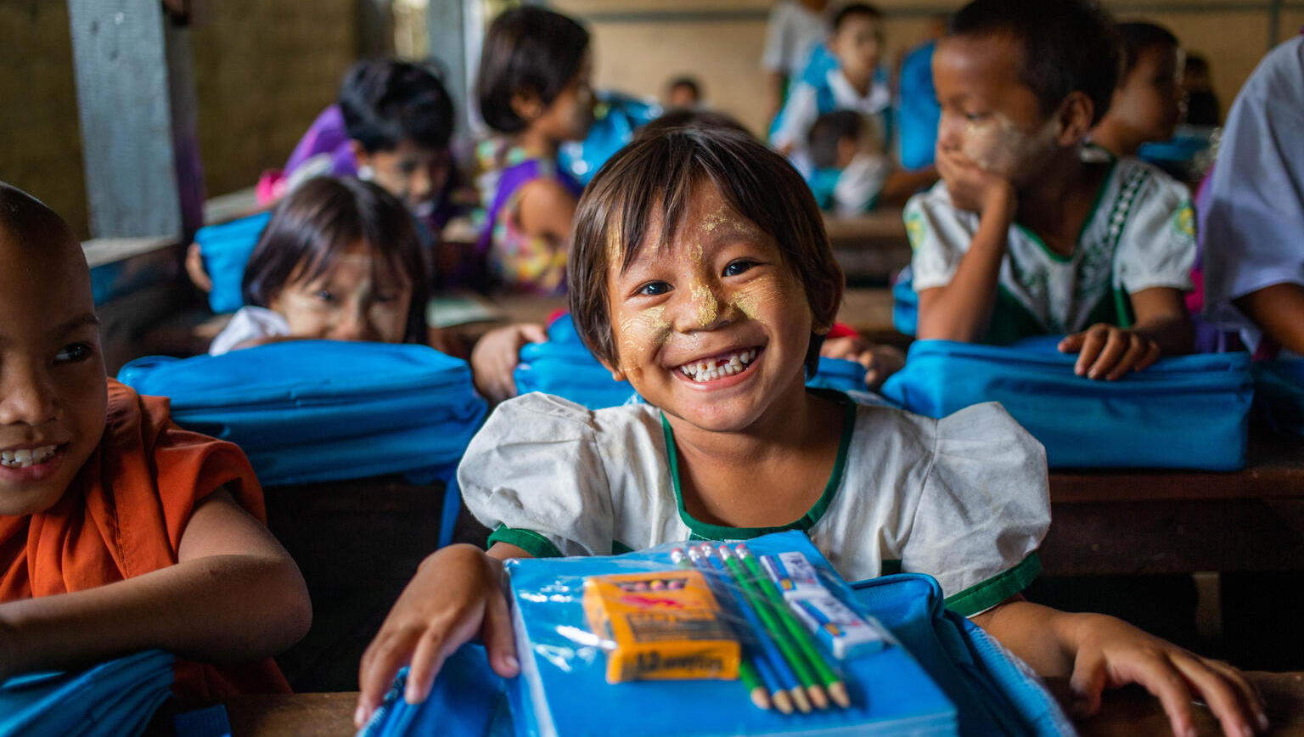
Activity 1
Education everywhere
San Mayann, 6, receives a new school kit and bag provided by UNICEF.
© UNICEF/Htet

Slide 2
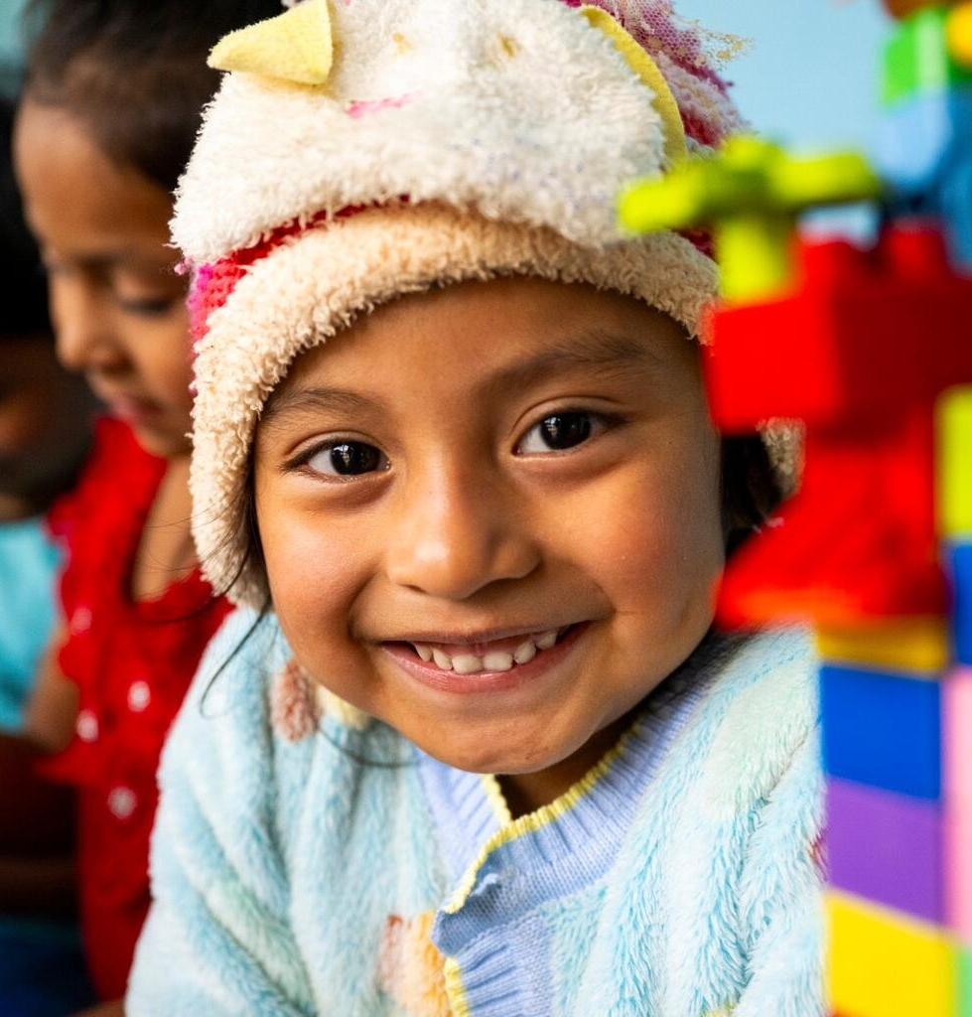
Part 1
Key rights
Article 19 – protection from violence
and harm
Article 24 – the right to the best
possible health
Article 28 – the right to education
Article 29 – the goals of education:
helping children develop their talents,
respect for others, and love of learning
Article 31 – the right to rest, play
and culture
Ceci, 4, takes part in an early childhood education session in Guatemala.
© UNICEF/Izquierdo
Notes:
What do you think this right looks like in real life?
Can you think of a time – maybe this week – when you accessed this right?

Slide 3
Rights in action
What does it look like when children or young people are enjoying this right?
What are some reasons why you think children and young people might not be enjoying
this right?
What does ​
the article say?
Leave empty for now, we’ll come back to this later.

Slide 4




Part 2
Introduction to learning spaces
What if these ‘learning spaces’ didn’t exist or weren’t safe to go to?
Where did you learn all of the things that you now know?
What are some different ways that we learn?
What rights do I enjoy in this space?
Where do you learn besides school?
Who do we learn from?
Notes:
Places to think about:
Schools
Library
Home and family
A caregiver's house
A place of worship
A market, shop or café
A sports ground, park or garden
Community centre
Online (everywhere)

Slide 5
Rights in action continued
What does it look like when children or young people are enjoying this right?
What are some reasons why you think children and young people might not be enjoying
this right?
What does ​
the article say?
How do learning spaces help children and young people to enjoy this right?​.
Notes:
Complete the final quadrant in your rights poster from part 1.

Slide 6
Part 3
Investigator, correspondent, advocate
Investigator
Searches for the facts and the ‘why’ behind every story.
Correspondent
Ask questions
(and takes results of
investigations)
to create reports and
share information.
Advocate
Uses insights from research and correspondence to argue for and make change.
Notes:
Correspondent: a journalist or reporter who gathers and shares information on a specialised subject or location.
Advocate: a person who uses information to express their views, support or defend a cause, and protect rights
Investigator: a person who gathers and analyses information to uncover truths and does research to solve puzzles and better understand why and how things happen.

Slide 7
Community learning interview
Acting as a correspondent:
Identify a trusted adult in your community and request
a 5-minute interview about their learning experiences.
Decide how you'll record the interview – written notes,
audio, video (get permission from the interviewee).
Prepare your opening question.

Slide 8
Digging deeper
Prepare 3–5 follow up questions to investigate deeper.
Ideas:
Why did you learn it there?
Why did that matter?
How do you think it helped your rights and your future?
The Five Whys ​
A simple cause-and-effect discovery technique.
​
Each 'why' question digs a bit deeper - it can take around five 'why' questions to reach the roots!

Slide 9
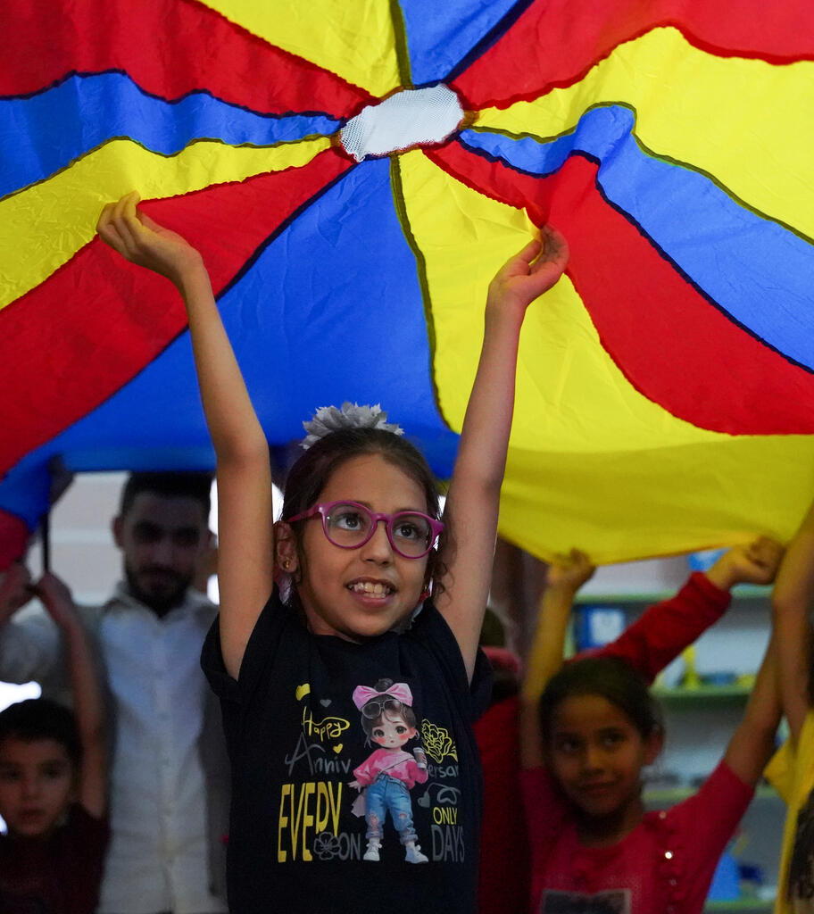
Part 4
Create your advocate's journal
Ghuson, 10, says
"I draw, play and learn things I never knew" at a support session in Syria. © UNICEF
If you're making your own journal,
fold four pieces of A4 paper in half and staple them at the seam.
Create the front cover of your journal, including a title with your name.
You could incorporate thematic words like 'learning spaces' and 'rights'.
You’ll use this book at the end of every activity to log what you've learned and note any ideas you want to investigate further.
Notes:
Throughout each of our OutRight activities, each of us will capture our learnings and our questions we want to explore further in our own Advocate’s Journal.

Slide 10
Part 5​
Reflect, respond, raise your voice​
Key questions: Where do you do important learning, other than in school?
What rights do you access there? Who's responsible for protecting those rights?
Reflect: Take a moment to think about what you've learned in this activity
Respond: Write in your advocate’s journal:
Your answer to the key question
One thing you were surprised by in this activity
One investigative question you want to ask to get a deeper understanding
Raise your voice: share your reflection/responses with the group

Slide 11
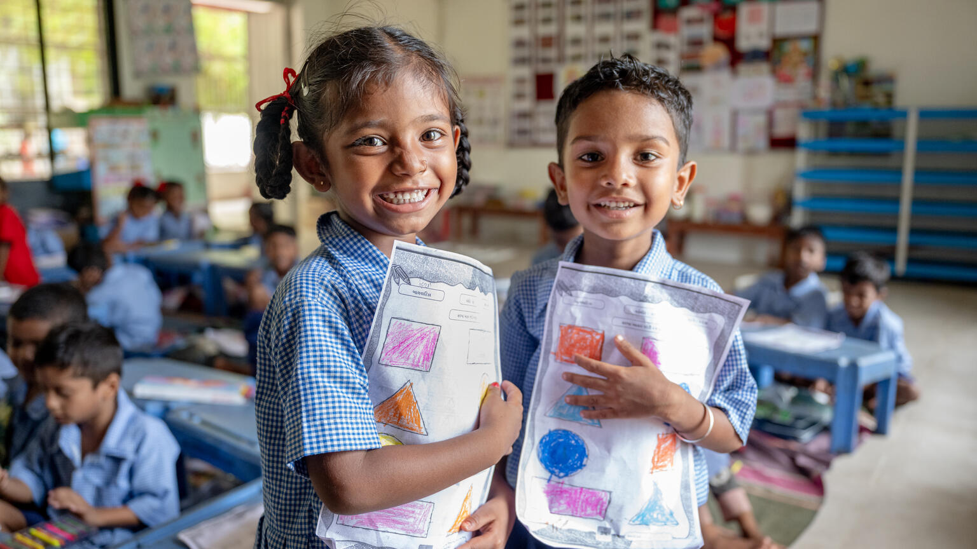
Activity 2
Exploring learning spaces
Fiona (5) and Rudra (5) in their inclusive classroom in Anand, India.
© UNICEF/Panjwani

Slide 12
Part 1
Guided
imagination

Slide 13
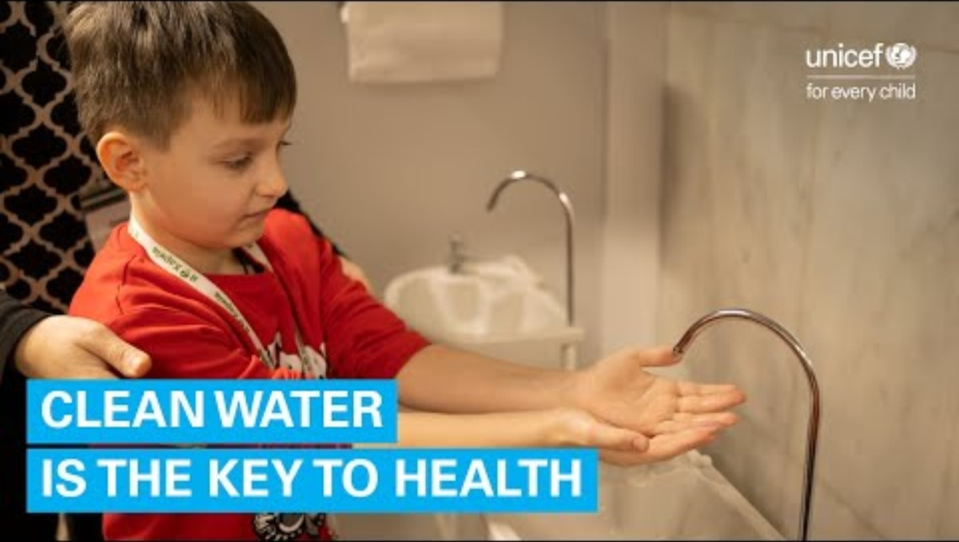
Part 2
Spot the rights
Notes:
Watch the UNICEF Kharkiv Underground Learning case study on YouTube together as a group:
https://www.youtube.com/watch?v=PfcEmSFVmZE
As you watch, can you identify some of the rights that you see children enjoying in this space?
After watching:
Which rights did you see children enjoying?
What are some things you saw that help to make this a safe learning space for children?

Slide 14
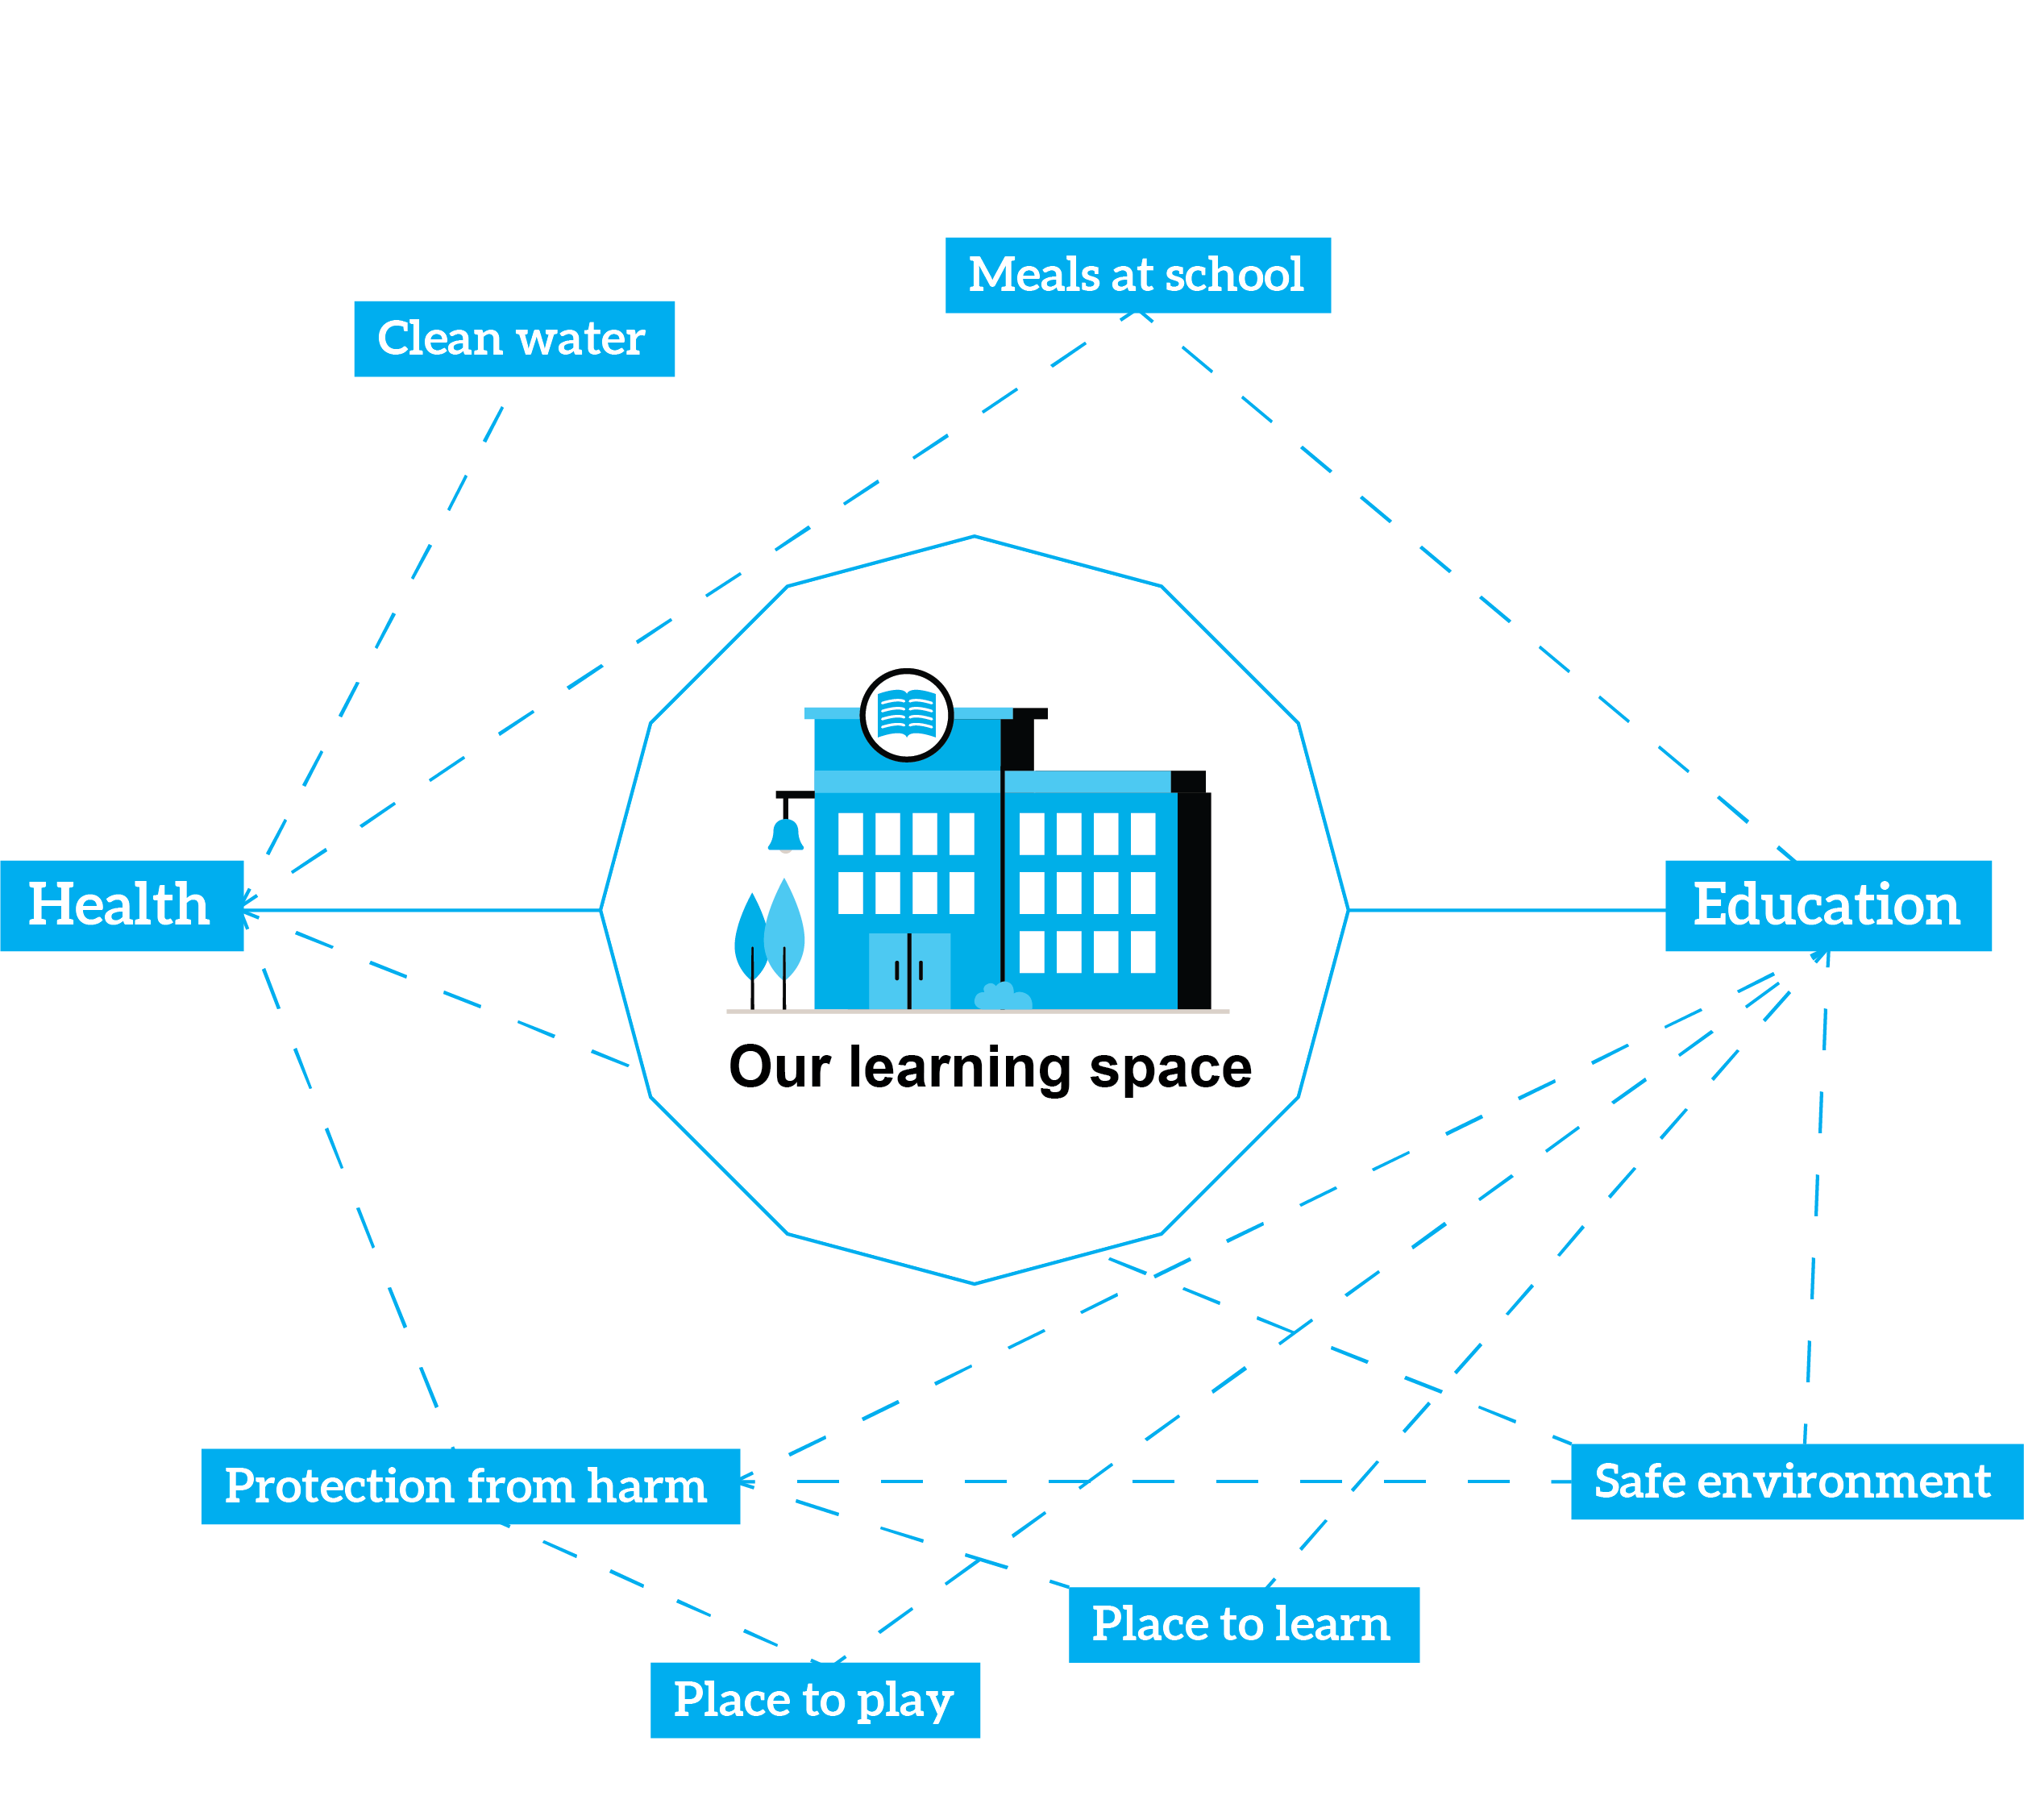
Part 3
A web
of rights

Slide 15
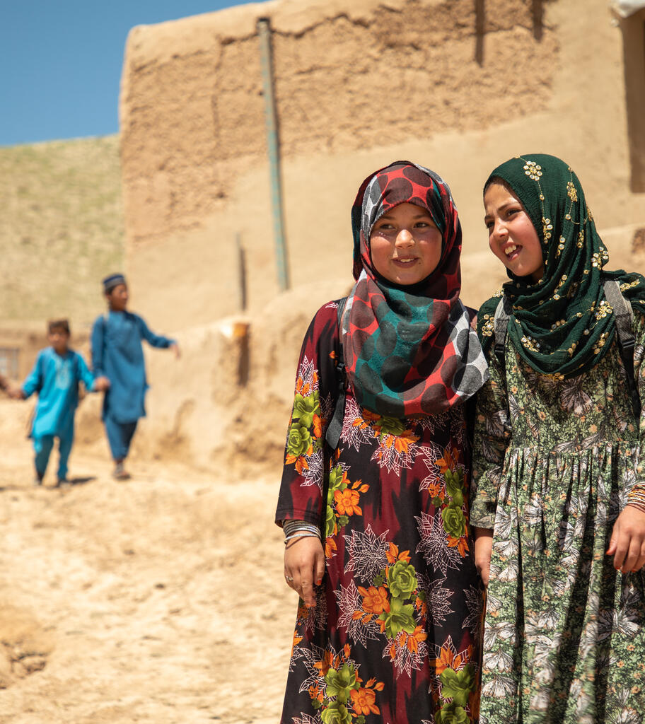
Amena, 11 (right), walks home from school with her best friend Halima in Afghanistan.
© UNICEF/Meerzad
Part 4
Space swapping
Using design to overcome barriers in a changing world
Design a safe learning space for children, working around the barriers you've set.
What does it look like?
What might be missing?
How would you make it as safe as possible?
Who would be there?
What would children and young people learn?
Notes:
Debrief questions:
What makes the learning space you’ve designed safe?
Who would learn there, and what would they learn?
Name some ways that your learning space is designed so that children and young people can access their rights?

Slide 16

Part 5
Barrier web
What barriers might
prevent a learning space
from being safe?
Notes:
Invite the group to share their designs and look for common themes and similar ideas. What are their favourite ideas? Can they add ideas to each other’s designs?
Begin mapping barriers in your web today. From the space swapping and design discussion, and the web of rights mapping, invite children to name barriers that could prevent a learning space from being safe.
Some ideas might include: damaged or destroyed buildings, lack of clean water, too far to walk, no teachers, no toilets. They might talk about accessibility barriers like differences in language or physical ability not being catered for.
For each barrier identified, invite young people to act as investigators and dig deeper with 'why' questions. The purpose is for young people to begin to see the root causes that stop children accessing their rights.
For example:
No toilets…. Why? No water…. Why? No water system in the local area?.... Why? No government support for supplying water or building water systems in rural areas?

Slide 17

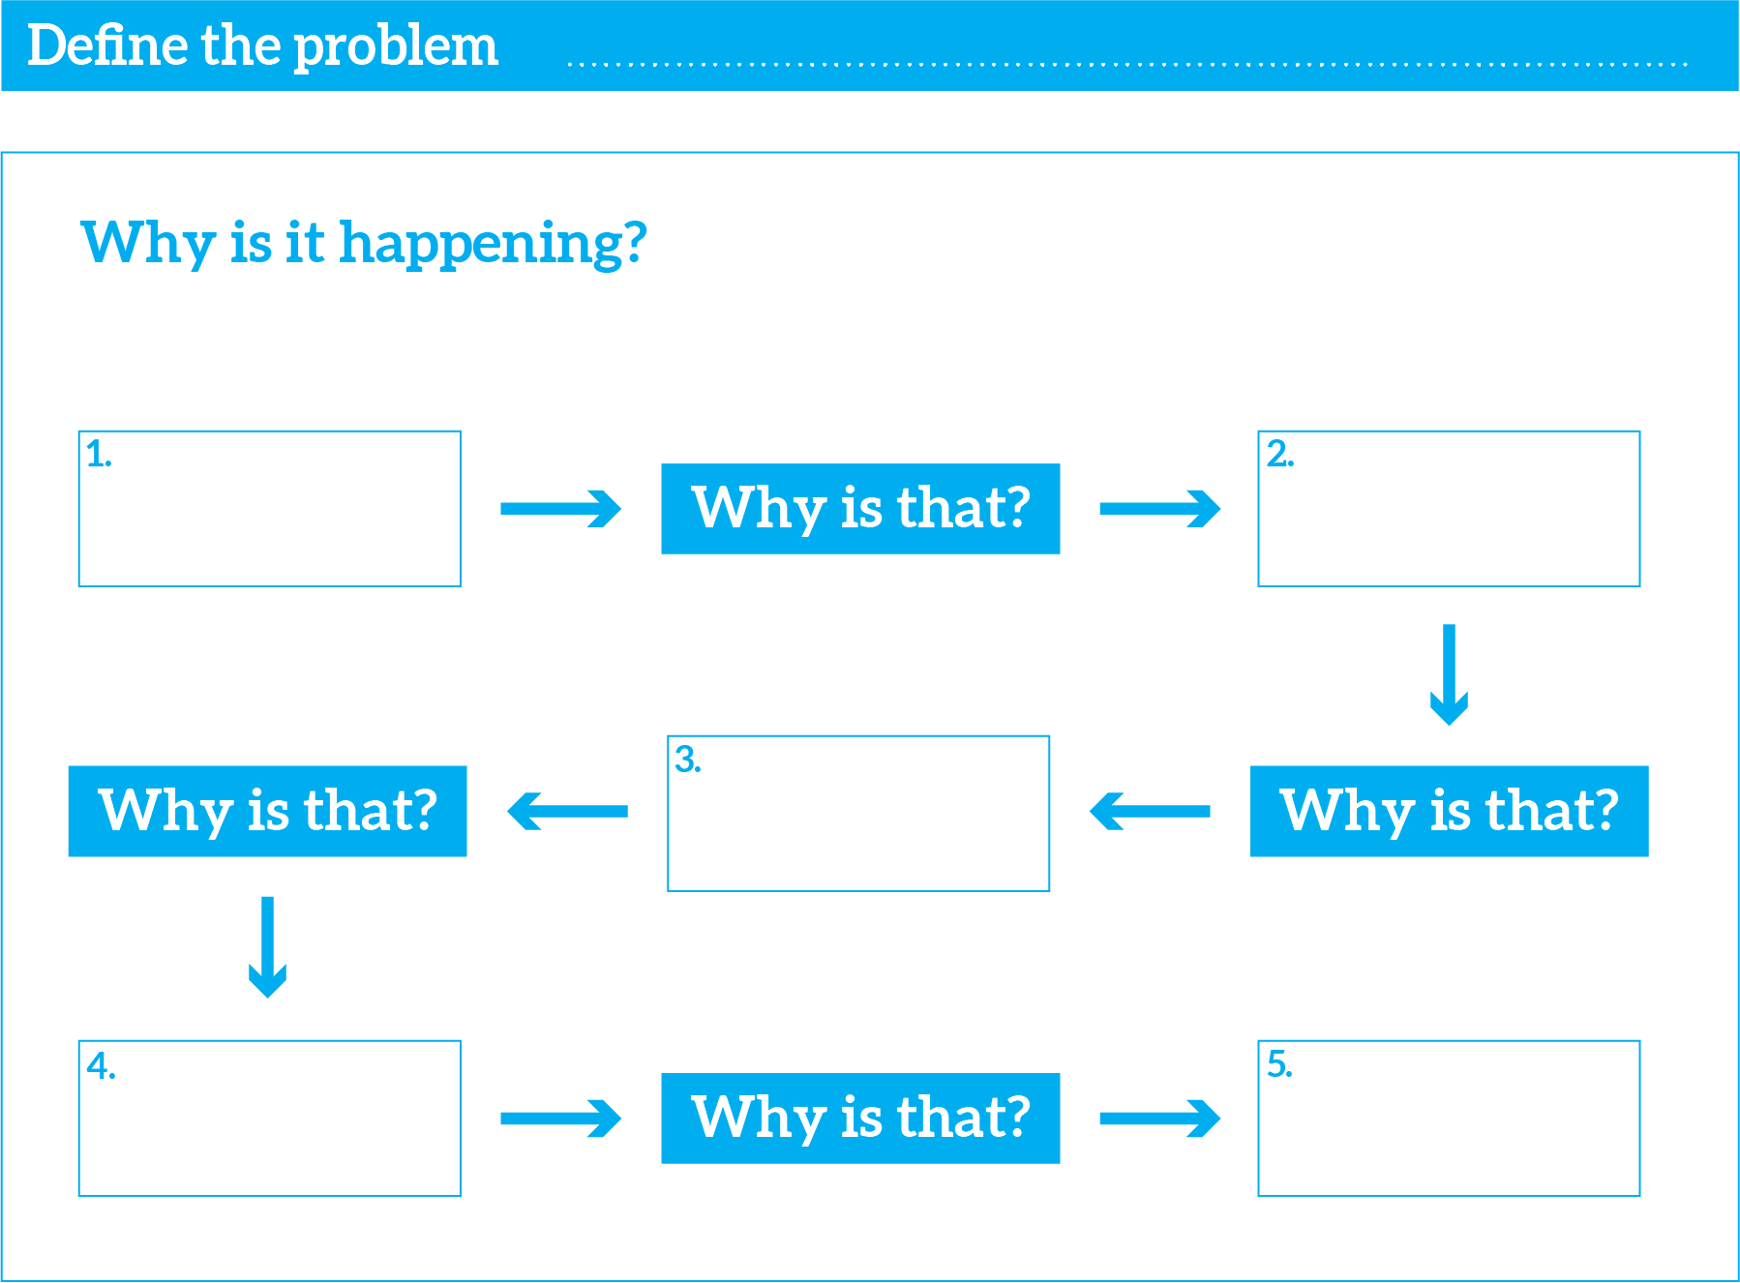
Investigate
deeper
Root cause:
the underlying, fundamental systemic factors – such as economic instability, conflict, inequity, social norms and policy failures – that create vulnerabilities, drive crisis, and prevent children from realising their rights. (UNICEF definition)

Slide 18
Part 6​
Reflect, respond, raise your voice​
Key questions:
What new ideas have you discovered about keeping children
and young people safe so they can access their rights?
Reflect, respond, raise your voice as usual

Slide 19
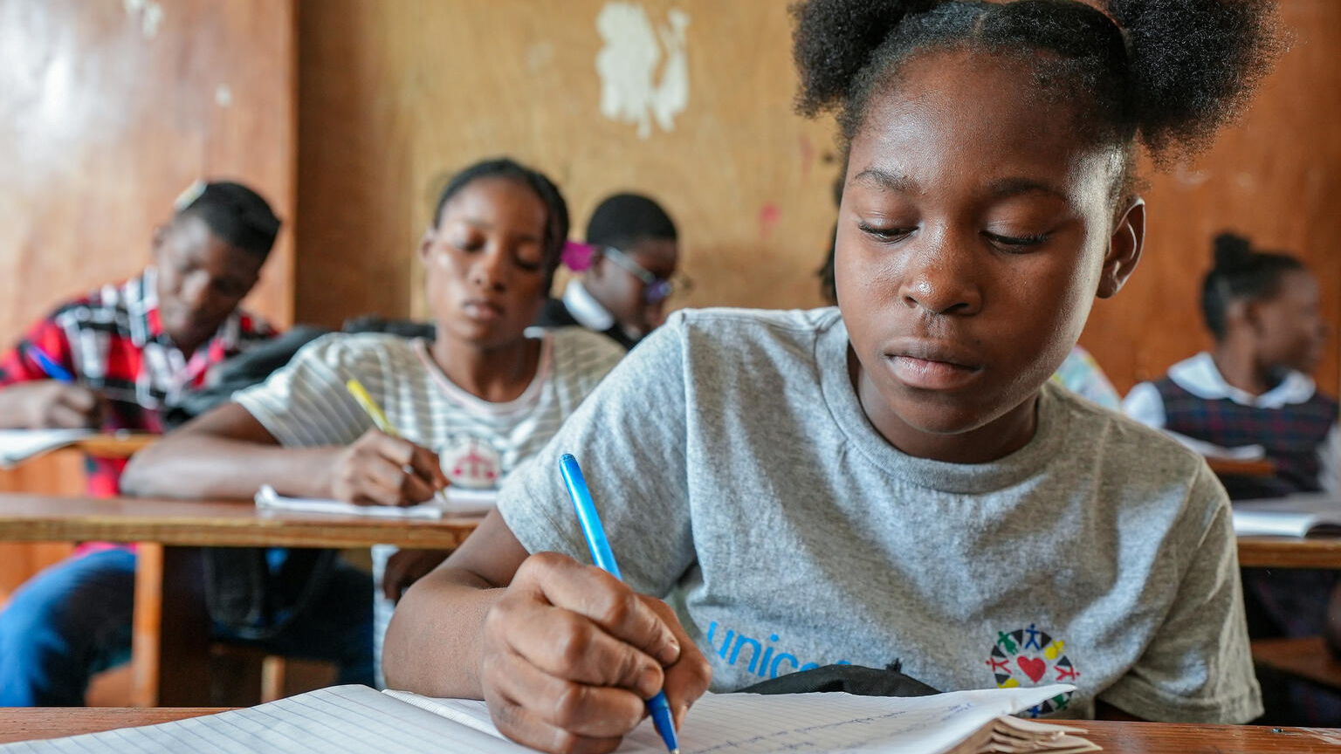
Activity 3
Education in emergencies
Dieussika had to flee her home because of violence in Haiti, but is now proud to have graduated thanks to the catch-up classes she was offered.
© UNICEF/El-Noaimi
Notes:
Read Dieussika's story here: https://www.unicef.org/haiti/en/stories/displaced-determined-dieussika-keeps-her-dreams-alive

Slide 20
Part 1
What happens in an emergency?
Climate
emergencies
Natural
disasters
Disease
outbreak
Conflict
and war
Notes:
Discuss a broad range of emergencies and how they might prevent children and young people from being able to access learning spaces. Children in your group may remember changes during the Covid pandemic, or climate disruption (flooding, heatwaves) that can ground the learning in their own experiences.
Climate emergencies: flooding, extreme heat, wildfires, drought. During heatwaves, schools can get too hot to use – has this happened to you? Or has snow or flooding ever stopped you accessing your learning space? Serious flooding can destroy school buildings or make them unreachable or unusable. (To delve deeper into climate, take a look back at our OutRight 2023/24 resources here – the Activity Guidance can give you an overview, and Activity 6 looks at education amid climate change.)
Natural disasters: earthquakes and landslides can collapse schools and cut off road access. These also can often be linked to climate (in other words they're not completely 'natural', because human activity can make them more likely to happen!).
Disease outbreaks: a pandemic can close schools for months or years.
Conflict and war: armed conflict is one of the most devastating barriers to children's education worldwide. Right now, millions of children and young people cannot reach safe learning spaces because of conflict.
Create a barrier card for each type of emergency.
Ask: Go back to your barriers and rights web. If a learning space disappears because of an emergency – what happens to all those connected rights? Which rights would be hardest to enjoy?

Slide 21

Part 2
Safe learning spaces in emergencies

Slide 22
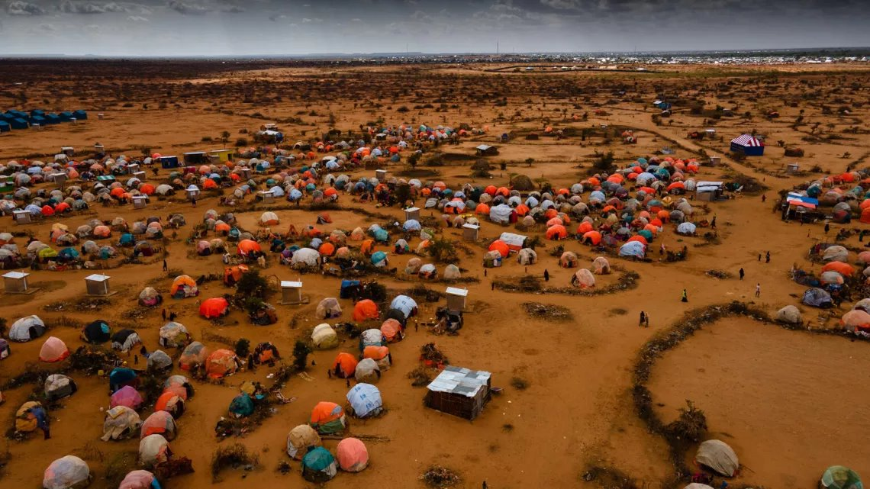
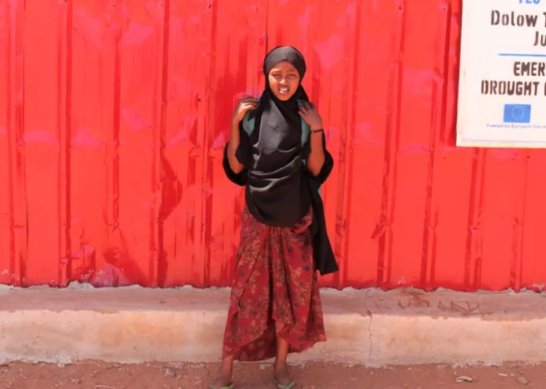
A camp in Dollow, Somalia, for people who've had to flee their homes. The tents here are made up of plastic sheets and fabric lashed with cord. ©UNICEF/Somalia. Fatuma, 11, learns reading, writing, maths, Arabic and Somali in a temporary learning space here. ©UNICEF/Mumin
Temporary
learning
spaces
Temporary learning spaces are places like schools that are set up wherever people are living when they've had to flee an emergency.
Notes:
In these spaces, children are usually able to continue their reading, writing, maths and language studies. Children can attend while they're living in a camp like this, with the hope that they'll be able to return to their own school without any learning gap once they're able to.

Slide 23
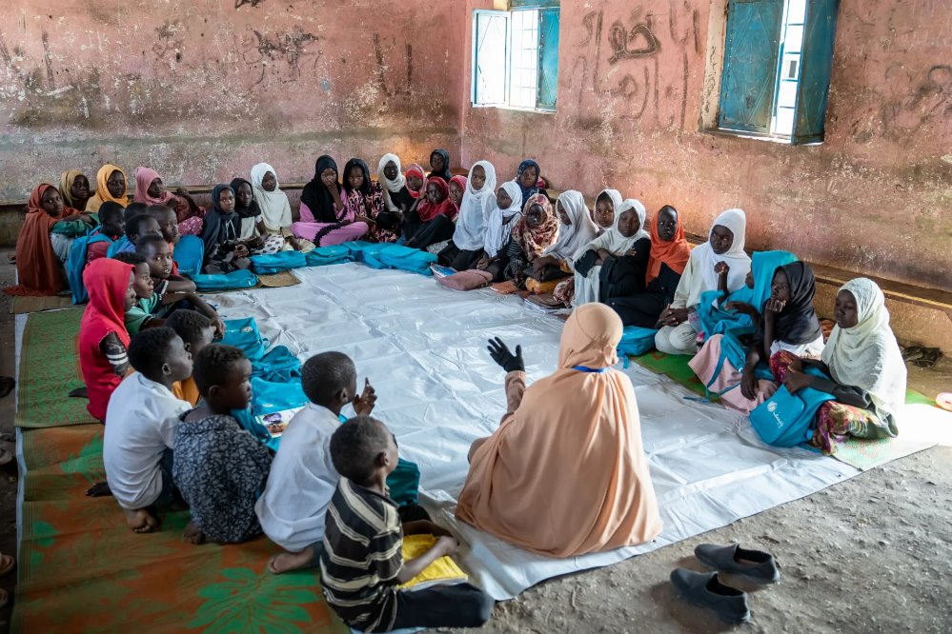
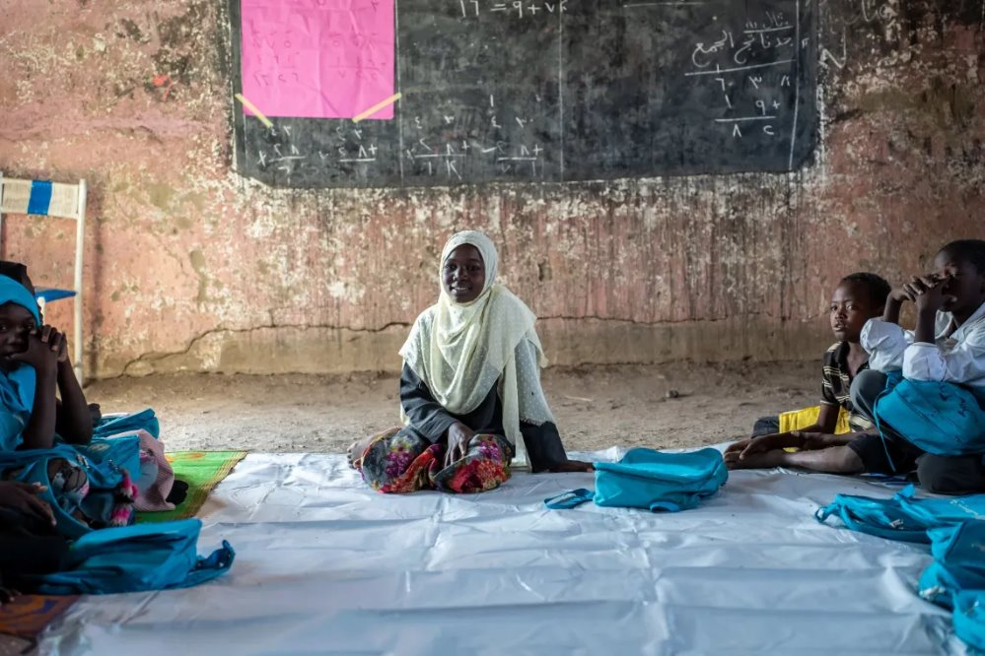
Marwa attends a UNICEF-supported Makanna where they talk about their hopes, dreams and fears. ©UNICEF/Osman
Child-friendly
spaces in Sudan, called makannas
In child-friendly spaces, children affected by
emergencies can get different kinds of support
they need including: a safe place to be and
connect with other children, learning, mental
health support, and facilities like water and
sanitation to help keep them healthy.
Notes:
Child-friendly spaces are safe spaces where children affected by conflict can get a range of support, including education, child protection, psychosocial support (that's expert emotional support), and water, sanitation and hygiene services like hand-washing stations and toilets. This child-friendly space in Sudan in Gedaref State, established by UNICEF is called a makanna – that means “My Space” in the Sudanese dialect of Arabic.

Slide 24
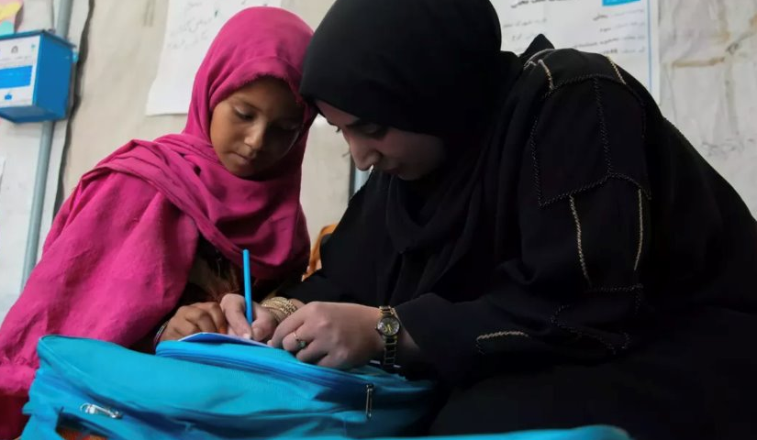
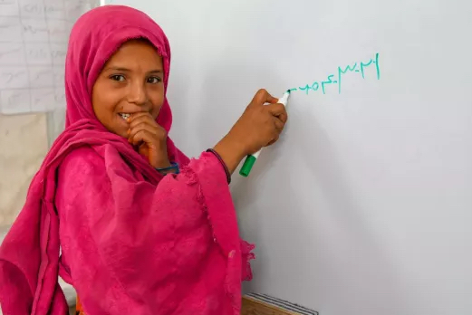
Community-based learning
Fatema, Age 10, Sharak Sabz village, Afghanistan. ©UNICEF
Fatema has learned to read and write in the community class, which is just a 15-minute
walk from her home. They have notebooks,
textbooks, pencils and, most importantly,
a committed teacher.
Notes:
When war started in Ukraine in 2022, eight-year-old Liana's family fled to Czechia to stay safe. Liana kept learning through online lessons, but they were difficult and lonely.
After a year, the family made the difficult decision to return home to Apostolove, a town near Kryvyi Rih, where one school had survived the shelling. While in-person classes restarted in September 2024, Liana had gaps in her learning to fill since she’d been out of school for half a year.
Liana’s mum enrolled her in a UNICEF digital learning centre, specially equipped with trained tutors, interactive lessons and other children.
After taking part in digital catch-up classes, Liana is getting back on track. Her teacher says she's bright, cheerful and works hard. Her mum says she does her homework on her own. And Liana? She's glad to be back in a room with people who can see her in real life..
Digital catch-up classes help children who have experienced disruption in their education from conflict or other emergency get back on track and catch up on the learning they missed. UNICEF digital learning centres, like this one in Ukraine are specially equipped with trained tutors and interactive lessons. Plus, children also enjoy getting to learn with other children – something that they often miss out on when they’re family has been displaced.

Slide 25
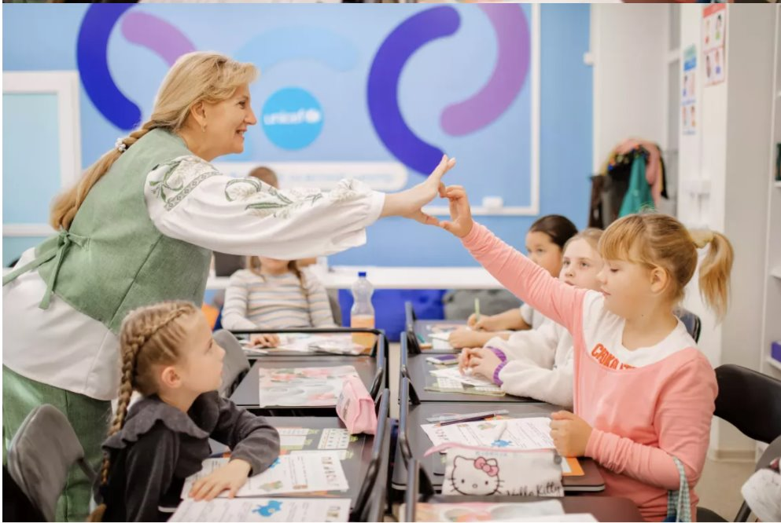
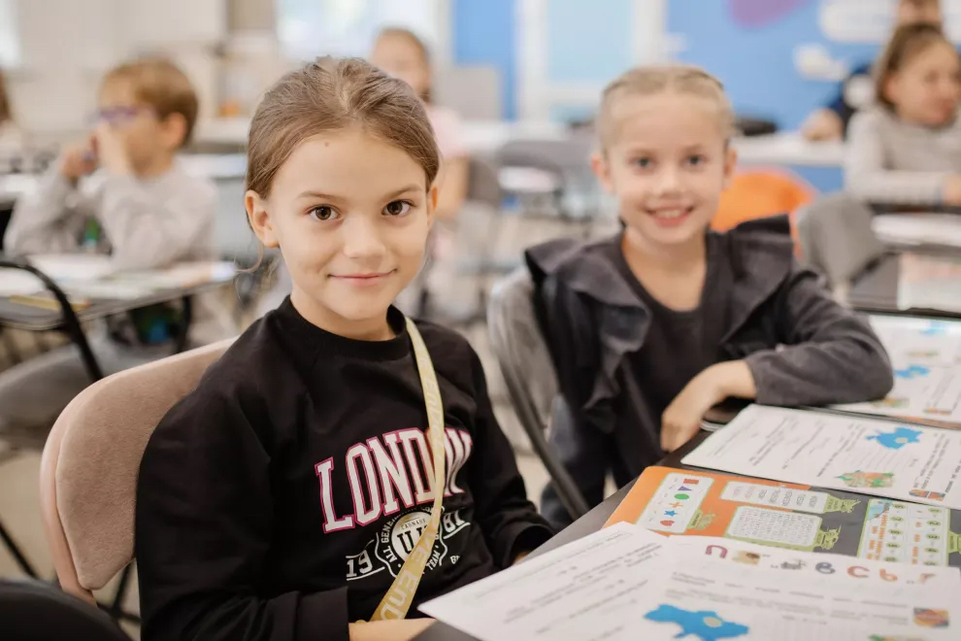
Digital learning/ catch up learning
Liana, 8 (left in picture 2), attends a digital learning centre in Apostolove where she has catch up lessons due to her learning being interupted because of the ongoing war in Ukraine. ©UNICEF/Yagelska
Catch-up lessons at a digital learning centre allow children and young people who’ve missed out on learning because of conflict and emergency get their education back on track.
Notes:
When war started in Ukraine in 2022, eight-year-old Liana's family fled to Czechia to stay safe. Liana kept learning through online lessons, but they were difficult and lonely.
After a year, the family made the difficult decision to return home to Apostolove, a town near Kryvyi Rih, where one school had survived the shelling. While in-person classes restarted in September 2024, Liana had gaps in her learning to fill since she’d been out of school for half a year.
Liana’s mum enrolled her in a UNICEF digital learning centre, specially equipped with trained tutors, interactive lessons and other children.
After taking part in digital catch-up classes, Liana is getting back on track. Her teacher says she's bright, cheerful and works hard. Her mum says she does her homework on her own. And Liana? She's glad to be back in a room with people who can see her in real life..
Digital catch-up classes help children who have experienced disruption in their education from conflict or other emergency get back on track and catch up on the learning they missed. UNICEF digital learning centres, like this one in Ukraine are specially equipped with trained tutors and interactive lessons. Plus, children also enjoy getting to learn with other children – something that they often miss out on when they’re family has been displaced.

Slide 26
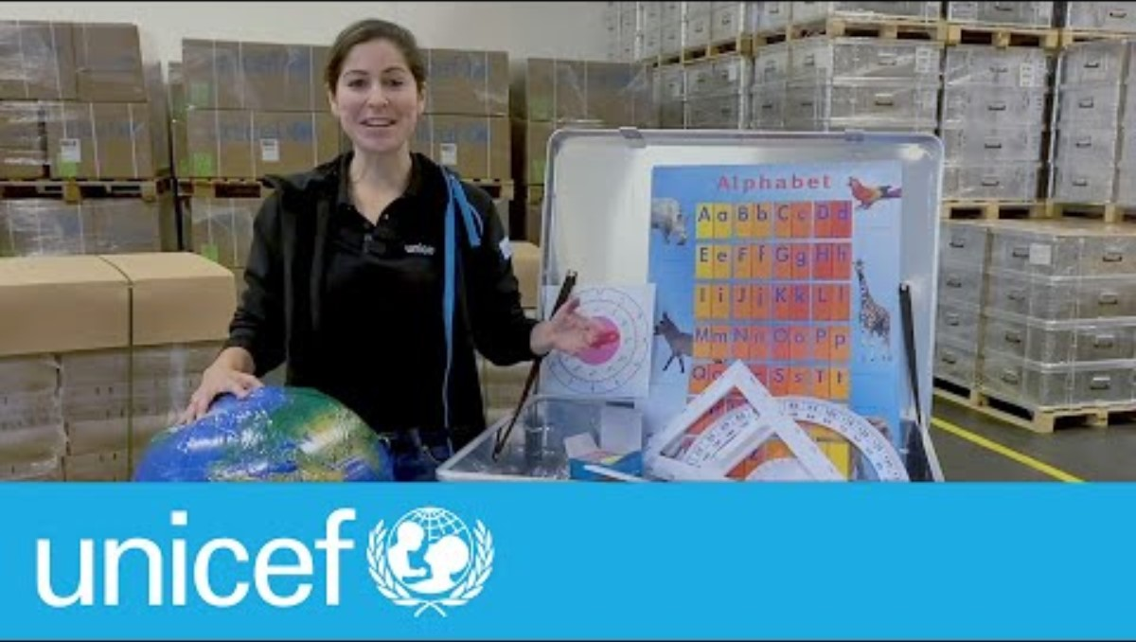
School-in-a-box
Notes:
A school-in-a-box is a portable learning kit that includes materials to help 40 children in an emergency, so they can access their right to learn. The kits include books, pencils, chalk, rulers and a guide for a teacher. A school-in-a-box can be set up in a tent, a community building, or under a tree.

Slide 27


Part 3
Unstoppable
children
Conflict in Sudan

Slide 28

What is happening in Sudan?
In Sudan, there are two main groups fighting each other for control
of the country. Most people in Sudan are not fighting but because
of the fighting, millions of people in Sudan are unsafe and have
had to leave their homes.
Many do not have enough food or medicine, and many children
cannot go to school.
15.3 million children in Sudan need help and protection.
S U D A N
Notes:
For greater context and a more information about sharing the Sudan conflict with children, visit the ‘Rights Around the World’ Sudan activity and teacher notes:
Source:
https://www.unicef.org.uk/donate/sudan-appeal/?gad_source=1&gad_campaignid=20028312605&gbraid=0AAAAAD6VRshOv5iRc40qNP13kI57XEu7u&gclid=CjwKCAiA55rJBhByEiwAFkY1QOraI_6PafGC9PKXco_8jju3Vg4Tvgb1jQg5SNdH52xGYKfRTX2gCRoCyRkQAvD_BwE
Please note that this pack speaks of the impact of war and conflict on children. As ever, we know that you will want to make choices about how you address these important issues in a way that is appropriate for your children and young people. Here is the link again to guidance on discussing war and conflict with young people.

Slide 29
What is happening in Sudan?
Since 2023, two groups are fighting each other for control of Sudan –
the government's Sudanese Armed Forces and the Rapid Support
Forces. Most people in Sudan are civilians; they're not fighting.
Because of the fighting, many people in Sudan are unsafe and have
had to flee their homes. Millions of Sudanese people are displaced,
do not have enough food or medicine and many children cannot
go to school.
Sudan is facing the world’s largest humanitarian crisis.
15.3 million children need protection and assistance.
S U D A N
Notes:
Sources:
https://www.bbc.co.uk/news/articles/cjel2nn22z9o
https://www.unicef.org.uk/donate/sudan-appeal/?gad_source=1&gad_campaignid=20028312605&gbraid=0AAAAAD6VRshOv5iRc40qNP13kI57XEu7u&gclid=CjwKCAiA55rJBhByEiwAFkY1QOraI_6PafGC9PKXco_8jju3Vg4Tvgb1jQg5SNdH52xGYKfRTX2gCRoCyRkQAvD_BwE
For further information on the war in Sudan and how this is affecting children, you could watch this BBC Newsround clip aired in October 2025 https://www.bbc.co.uk/newsround/videos/crmx7dmk840o
Please note that this pack speaks of the impact of war and conflict on children. As ever, we know that you will want to make choices about how you address these important issues in a way that is appropriate for your children and young people. Remember this guidance, provided in your avtivity guide as well, could be helpful for your discussion.

Slide 30
What is happening in Sudan?
Sudan is facing the world’s largest humanitarian crisis.
In 2018, people across Sudan began protesting because of economic collapse. People couldn't afford basics like food and fuel. So they protested for access to these rights and demanded that President Omar al-Bashir should resign, after ruling for nearly 30 years. In 2019, the army removed the President, but protestors continued to protest as they wanted a civilian rule, not a government led by the army.
While most people in Sudan wanted a democratic government, in 2023 two groups began fighting – the government's Sudanese Armed Forces and the Rapid Support Forces. They are fighting each other for control of Sudan. This is not only a civil war but also an international war as several foreign governments are supporting different groups in Sudan.
Most people in Sudan are civilians; they're not fighting. Because of the fighting, many people in Sudan are unsafe and have had to flee their homes. Millions of Sudanese people are displaced, do not have enough food or medicine and many children cannot go to school.
15.3 million children require protection and assistance.
Notes:
Sources:
https://www.bbc.co.uk/news/articles/cjel2nn22z9o
https://www.unicef.org.uk/donate/sudan-appeal/?gad_source=1&gad_campaignid=20028312605&gbraid=0AAAAAD6VRshOv5iRc40qNP13kI57XEu7u&gclid=CjwKCAiA55rJBhByEiwAFkY1QOraI_6PafGC9PKXco_8jju3Vg4Tvgb1jQg5SNdH52xGYKfRTX2gCRoCyRkQAvD_BwE
https://www.bbc.co.uk/news/world-africa-58970193
https://www.wilsoncenter.org/article/conflict-sudan-map-regional-and-international-actors
For further information on the war in Sudan and how this is affecting children, you could watch this BBC Newsround clip aired in October 2025 https://www.bbc.co.uk/newsround/videos/crmx7dmk840o
Please note that this pack speaks of the impact of war and conflict on children. As ever, we know that you will want to make choices about how you address these important issues in a way that is appropriate for your children and young people. Remember this guidance, provided in your avtivity guide as well, could be helpful for your discussion.

Slide 31
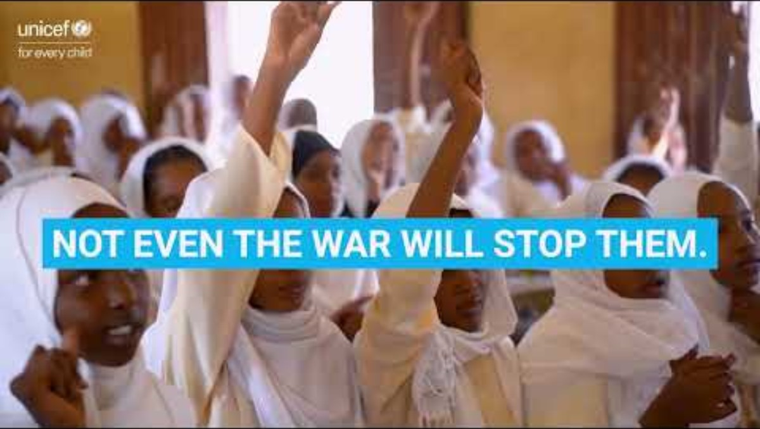
Unstoppable teachers in Sudan
Notes:
Watch the video: https://www.youtube.com/watch?v=PEUTcfHO6t8

Slide 32
“I stayed home for three years, and couldn’t
learn a single letter… But when I took my exams
and received my results, I was overjoyed.”
Unstoppable Mustafa, Age 12 , Kassala, Sudan

Slide 33
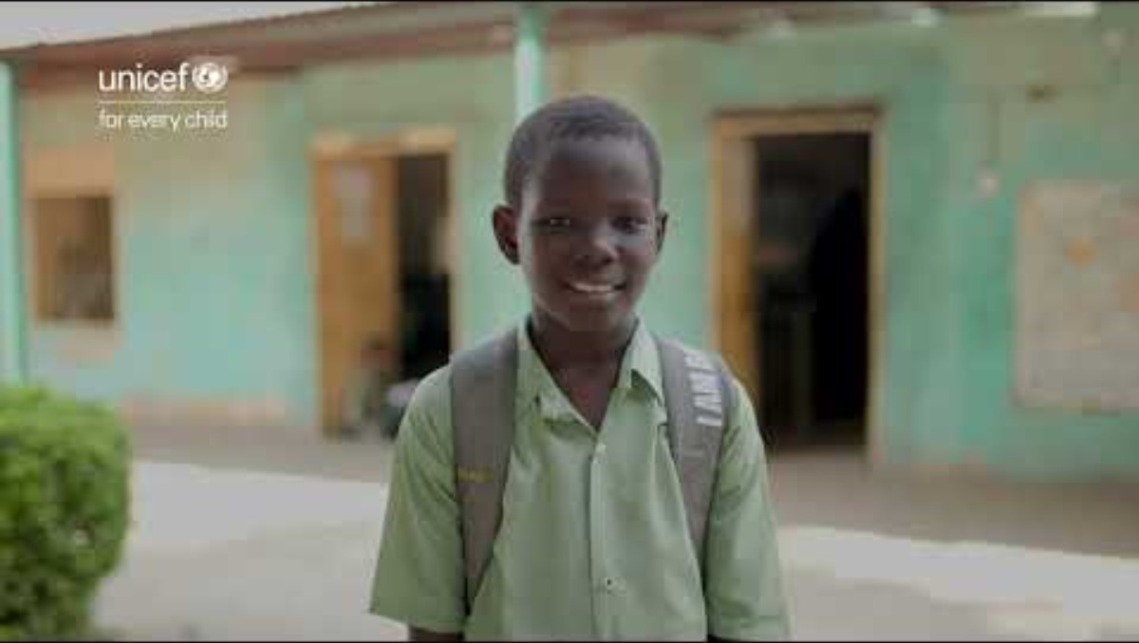
Mustafa returns to school
Notes:
Watch the video: https://www.youtube.com/watch?v=1_PX8qkOX3k
Discussion Prompts:
What was the action taken to help Mustafa overcome the barrier to access learning spaces? What rights is the ALP programme supporting Mustafa to enjoy?
Who acted and what changed?
Is this a short-term fix or a long-term solution?
Go deeper
Mustafa’s family couldn’t afford school fees. but the conflict made everything harder: displacement, lost income, disrupted services. Can you separate poverty and conflict as barriers, or do they feed each other? What does that tell you about how barriers are interlinked?

Slide 34
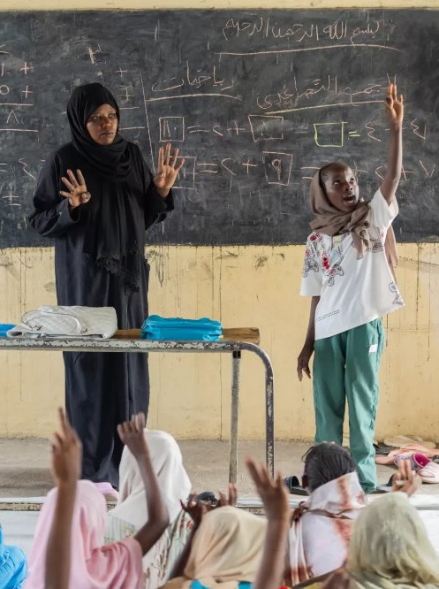
“For me, education is very important. I want to learn.
Without education, you won’t be able to understand the world around you when you grow up.”
Unstoppable Rabha, Age 11, Gedaref, Sudan
©UNICEF/Elfatih
Notes:
Discussion Prompts:
What was the action taken to help Rabha overcome the barrier to access learning spaces?
Who acted and what changed?
Is this a short-term fix or a long-term solution?
Go deeper
Rabha is afraid that when she returns home, the learning will stop. Who is responsible for making sure it doesn’t, and what would need to be in place in Khartoum for her right to education to be protected, not just in an emergency, but permanently?

Slide 35
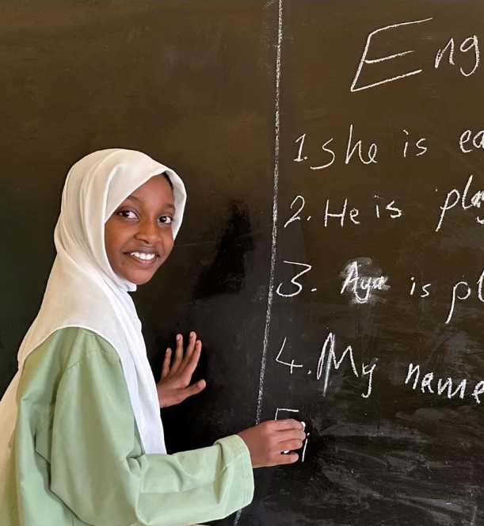
After leaving her home and missing school for more than one year, Aya has found a safe learning space to continue her studies and make new friends.
“The children here are
so kind. When I first
arrived, the class was
full, but they made
space for me.”
Unstoppable Aya, Age 13, Kassala, Sudan
©UNICEF/Nakibuuka
Notes:
Discussion Prompts:
What was the action taken to help Aya overcome the barrier to access learning spaces? What rights is safe learning space supporting her to enjoy?
Who acted and what changed?
Is this a short-term fix or a long-term solution?
Go deeper
Aya had to leave her home and start again somewhere new, but she kept going to school and is committed to learning. Have you ever had to keep going with something even when it felt really hard? What made you carry on? How do you think Aya felt walking into the classroom of the new safe learning space for the first time after missing school for more than a year and a half?
In Aya’s story, a neighbour volunteered lessons and a principal retrained teachers and opened the doors to 700 children. Without the programmes these individuals started, what do you think would have happened to Aya and her right to education? Who do you think should be responsible for protecting children's rights when an emergency happens?

Slide 36
Part 4
Child rights correspondent
Brief: Be a child rights correspondent (reporter). Create a report on a place in your community or one of the countries we've visited through children's stories so far.
Include:
Background on what's happening
Name the rights being accessed, or at risk, and the barriers
children might face – are there any links between barriers?
Has action been taken to overcome them?
Quote from a rights holder or duty bearer that backs up your story
Who has the power to change it?
A good
correspondent asks:
why does this
situation exist,
and who has
the power to
affect it?​

Slide 37
Part 5​
Reflect, respond, raise your voice​
Key questions: Choose one of the young people we've met today. If you could ask them one question – not about what happened to them, but about what they think should change – what would it be? And what duty bearer would you want to be in the room when they answered?
What would need to change in the system – not just for one child – so that an emergency like this no longer takes children's access to their rights away?
Reflect, respond, raise your voice as usual

Slide 38

Wish
box
Write a wish or
fold a paper crane
as a message of peace
and hope for children
experiencing conflict.

Slide 39
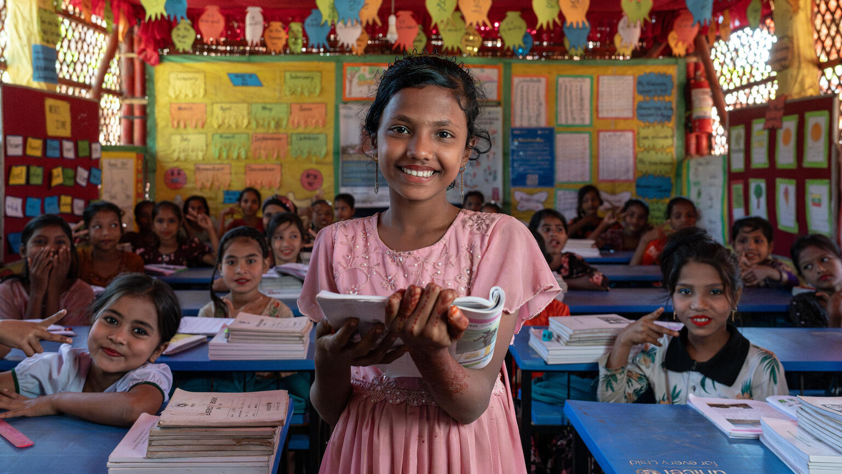
Activity 4
Education for everyone
Noor (13) studies at the UNICEF learning centre at the Rohinga Refugee camps in Bangladesh.
© UNICEF/Kruglinski

Slide 40
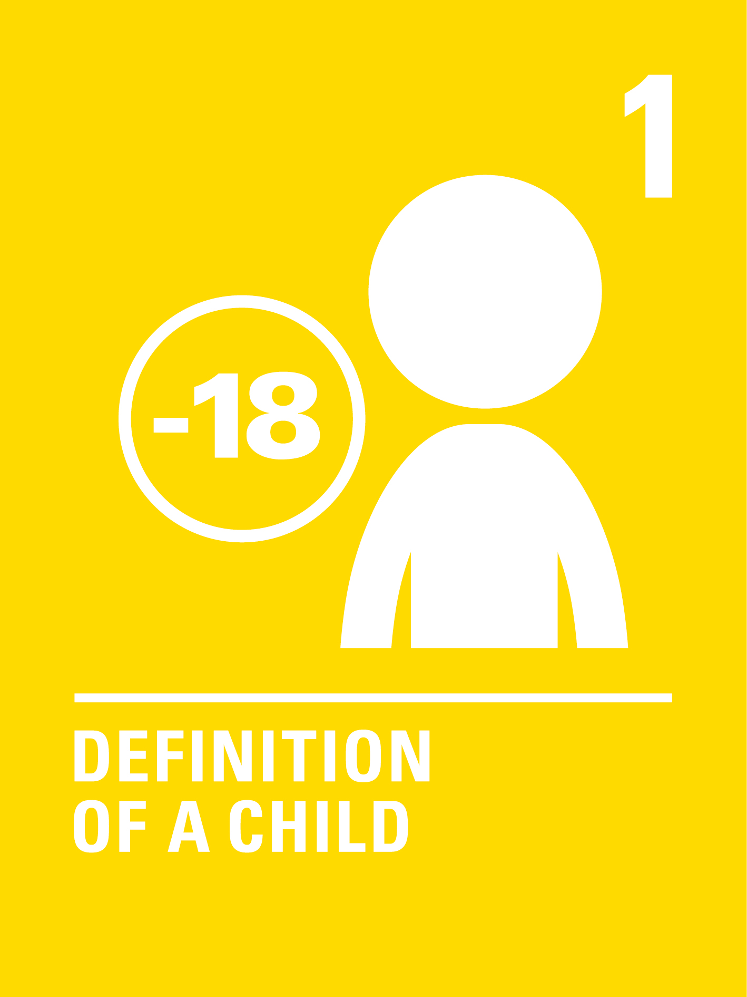

Part 1​
Who are rights for?​
Article 1:
The UNCRC
applies to every child. Everyone under the age
of 18.
Article 2:
Every child has rights
without discrimination.
That means regardless of
their race, language,
religion, gender, disability,
wealth, where they live,
or any other characteristic.
Notes:
Create rights cards for these two articles and add them to your rights and barriers web
Ask: If rights belong to every child without exception – can you think of any reasons why some children might be absent from learning spaces?
Invite children to call out ideas. Write them on cards and begin placing them on your web display.
If needed, prompt the conversation using the list in your activity guidance to consider why children may not go to a learning space.
Ask: In some parts of the world, girls are less likely to be in school than boys. Why might that be?
Note: As you guide the discussion, take care that it doesn't lead to blame of families or communities. The barrier that keep children out of school are often not personal, they are complex and linked with poverty, broken systems and norms. This understanding of changing systems to address barriers can later be tied to campaigning.

Slide 41
Part 2​
Unstoppable
children
Notes:
Let’s meet some children from around the world who are unstoppable! Let’s look at how they’ve faced the barriers that were keeping them away from accessing learning spaces, and are now accessing their rights.

Slide 42
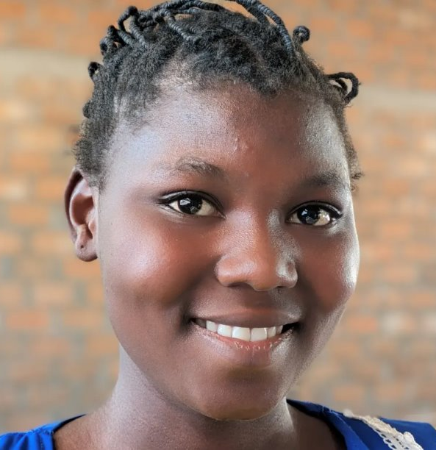
“I used to feel angry when
I had to stay home for five
days – ashamed, and because
the boys made fun of us.
Don’t be afraid. Monthly
periods are normal and natural – there is nothing
to be ashamed of. They
should never prevent you
from coming to school.”
Unstoppable Elda, age 13,
Central African Republic
©UNICEF/Rodriguez
Notes:
Discussion Prompts:
Elda faced two completely separate barriers (conflict displacement and menstrual health) that combined to push her further behind than either would have alone. What does that tell you about how barriers work? Can you think of other examples where two barriers together are worse than either one separately?
Period poverty isn’t only a problem in the Central African Republic. In the UK, roughly one in ten girls has missed school because they couldn’t afford period products, and that number rises significantly for girls from lower-income households. Some schools now provide free products; many don’t. Who do you think should be responsible for making sure no girl in the UK misses school because of her period? What would you ask them to do?
The dignity kit programme reaches 300 girls in two towns. Is distributing kits a temporary fix or a long-term solution? What would a systemic solution actually look like in Elda’s community? Who do you think would be responsible to help make it happen?

Slide 43
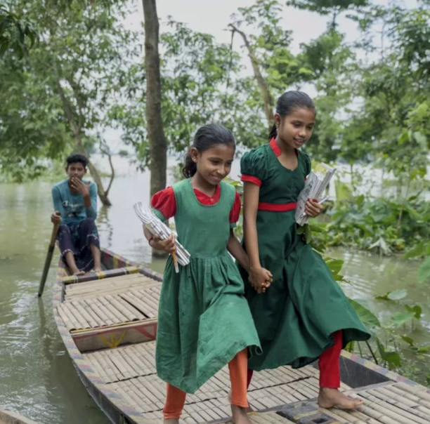
Tawhida and Tania are on their way to the learning centre. Tania aspires to become a teacher, while Tawhida dreams of a future
as a doctor.
Unstoppable Tawhida and Tania,
age 12, Shantiganj sub-district
in Sylhet, Bangladesh
©UNICEF/Himu
Notes:
Discussion prompts:
Every child has the right to education, but Tawhida and Tania didn't start school until they were 12. What were the barriers that kept them away from the learning space for so long? What links do you see?
Do you think "equal" education means every child gets the same thing, or every child gets what they need to catch up? Do you know the difference between 'equality' and 'equity'?

Slide 44
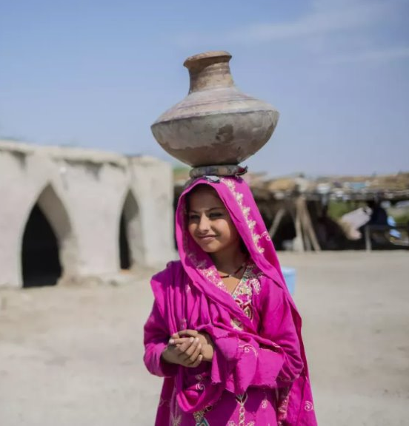
“I’m happy,” Farzana says now that the new water pump is just five minutes from her home.
“It saves time and now I can go to school and be with my friends. I like games, playing football and learning Sindhi.”
Unstoppable Farzana, Age 12,
Pakistan
©UNICEF/Pakistan/Saiyna Bashir
Notes:
Discussion prompts:
Farzana faced more than one barrier at once that kept her away from the learning space and enjoying her rights. What barriers can you name? (water access, gender expectations, cultural norms, climate disaster)
When you map the barriers onto your web and ask why, what do you think the root cause might be?

Slide 45
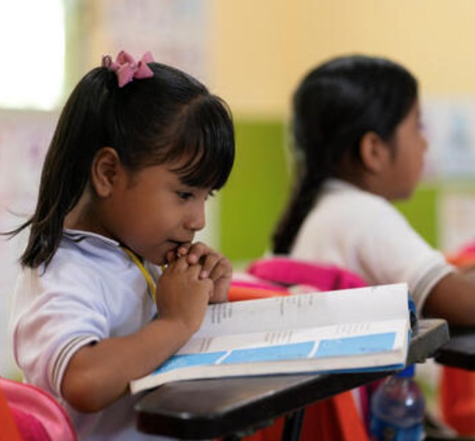
Learning in
your own
language is
a right, and
helps children
learn better.
Unstoppable Cristel Ana,
Libres, Guerrero, Mexico
©UNICEF/ALIMARIN
Notes:
Discussion prompts:
Imagine if your teacher spoke a language you didn't understand very well. How do you think that might affect your learning?
Cristel Ana’s school didn’t change because one teacher decided to try something different – a university, a government programme and local education authorities all had to act together. What does that tell you about what kind of change may be needed to address this kind of barrier?
A the articles we’ve already explored, how might Articles 17 and 30 also be interlinked to this story? Why do you think language might be an important right?

Slide 46
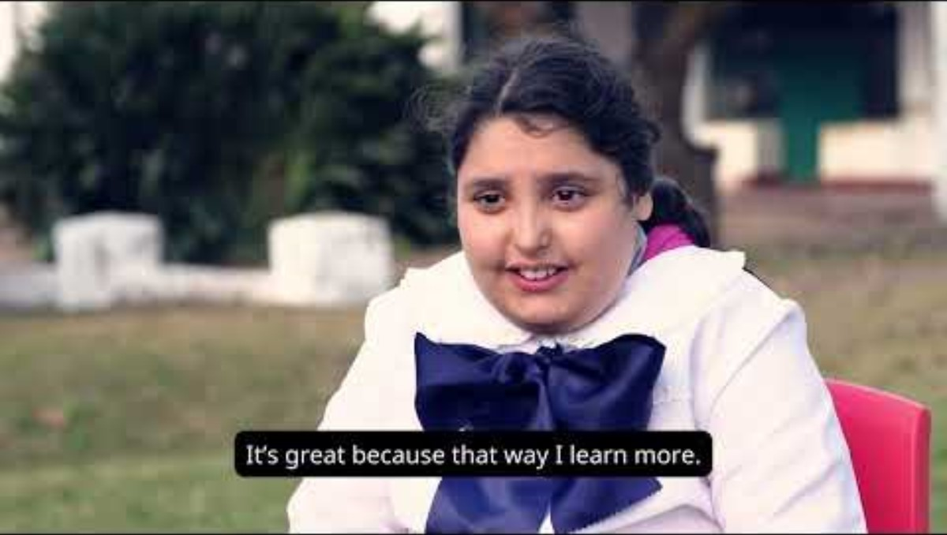
“It’s great.
This way,
I learn
more.”
Unstoppable
Julieta, Year 5,
Uruguay
©UNICEF/Uruguay
Notes:
Discussion prompts:
Every child has the right to education, but Julieta found school really hard at first. Do you think the right to go to school is enough, or does the way we learn matter too?
Julieta’s barrier wasn’t her learning disability, it was a learning system that wasn’t designed for her. What’s the difference between those two things, and why does it matter for how we think about solutions?

Slide 47
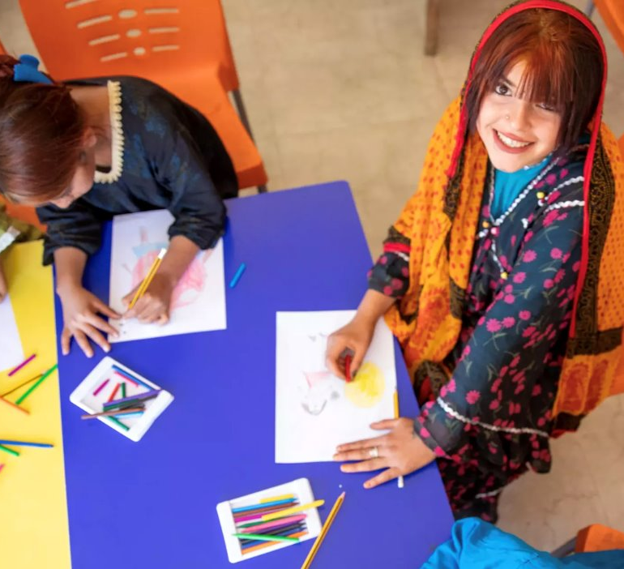
“My mum always
wanted to finish her
education before
getting married, but she
didn’t get the chance.
I want to change that.
“I hope one day I can
go back to school and
continue learning.
Makani is helping me
get there.”
Unstoppable Ghazala,
Age 13, Jordan
©UNICEF/El-Noaimi
Notes:
Discussion prompts:
What are the barriers that have kept Ghazala and Dom girls out of formal school? (e.g., nomadic migration, poverty, gender expectations, early marriage, a school system not built around children like her) Who do you think might have the power to change these barriers?
As you map these into your web, what links and root causes do you see?
Ghazala is already changing her own story, but individual determination is not the same as system change. What systems do you think need to be changed and who are the duty bearers responsible?

Slide 48

Part 3
Barriers and
systems
mapping
Notes:
Map the ‘Education for Everyone’ stories in your web of rights/barriers
For each story shared, invite children to:
Name the barrier that the unstoppable child has overcome.
Identify what changed: Was it a law? A school? A community attitude? Agency of the child? A resource like clean water or a school toilet?
Name who helped to make the change: Government? An international organisation? A caregiver? The community?
Was this a temporary solution or a systemic change?
Did this solution address a root cause for long-term change?

Slide 49
Part 4​
Reflect, respond, raise your voice​
Key questions: If you were advising a government,
what is the one change – to a law, a policy or a system –
that would remove the most barriers at once that prevent
children from accessing learning spaces?
Reflect, respond, raise your voice as usual
Notes:
What were the most important/interesting things we learned through this OutRight activity? Share ideas and take a vote on what you want to include in this group dispatch.

Slide 50
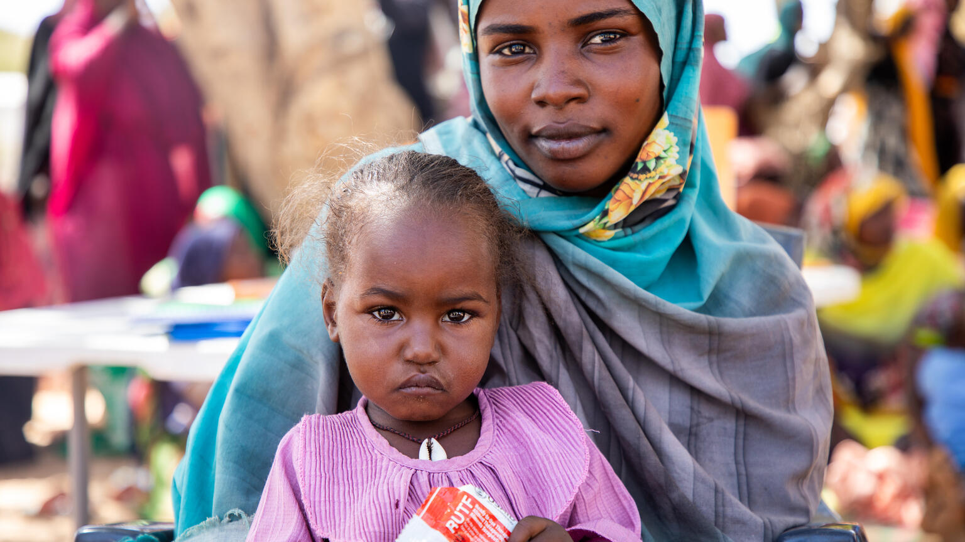
Activity 5
Education for everyone
Watine (2) and her mum live in a refugee camp in Chad.
© UNICEF/Da

Slide 51

Part 1​
What is campaigning and why do we do it?

Slide 52
Key vocabulary
Campaign: a planned set of actions to create change on an issue.
Duty bearer: a person or organisation with the responsibility to protect children's rights. This could be a government, a school, a caregiver or an international body.
Rights holder: a person who has rights. Every child (and adult too)!
Advocate (noun): someone who speaks up to protect rights.
Policy: rules, laws and guidelines made by governments. Organisations – and schools – have their own policies too.
We can ask for policies to be changed so children can better
access their rights.
Notes:
Advocate (verb): to speak up to protect rights.

Slide 53


Part 2​
Attention, ask, act: three steps to changemaking
Article 12:
Every child has the right to express their views on matters that affect them, and adults must take those views seriously.
Article 13:
Every child has the right to share information and ideas through art, writing, speech or other means.

Slide 54

Three steps to changemaking
Notes:
GET ATTENTION: Draw attention to the issue. What barrier needs to change? Who needs to know about it? [Signpost to old OutRight for how to create a message that gets attention]
ASK: Think about who you need to ask. Which duty bearer has the power to make a difference? What exactly are you asking them to do? Tip: Revisit the bridges from the Activity 3 and 4 unstoppable children stories, when you identified who helped to make the change.
ACT: Take the action. What will you do to get your message heard – a letter, a poster, a speech, a march, an exhibition?

Slide 55
Part 3​
What does
campaigning
look like?

Slide 56
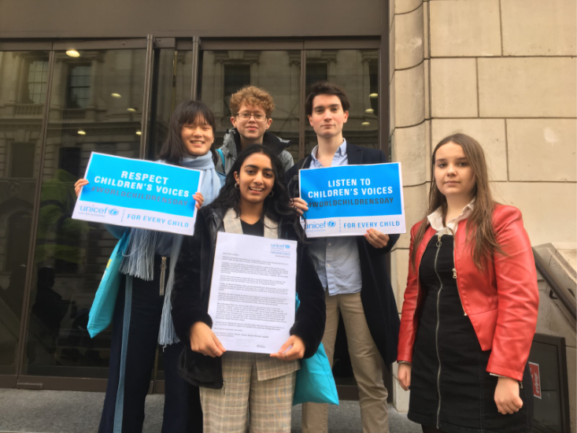
Youth
Advisory
Board
Left to right, back row:
Magali, Eddie and Michael ​
Left to right, front row:
Isabelle and Niamh ​
Notes:
When a General Election was called in 2019, Youth Advisory Board members from UNICEF UK delivered letters to Political Party Leaders in Westminster, calling on them to listen to children and young people’s voices on World Children’s Day.

Slide 57
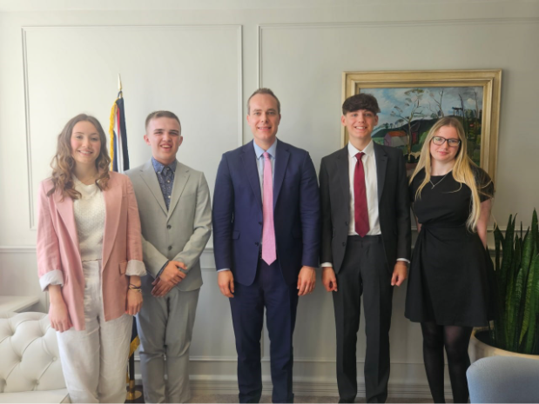
Meeting
with MPS
Left to right:
Ruby, Finn,
David Johnston MP,
Jonathan and Macey
Notes:
As part of UNICEF UK’s ongoing efforts to advocate for children’s rights in the UK, Youth Advisory Board members met with Children’s Minister David Johnston MP, to discuss their concerns for children in 2024.

Slide 58
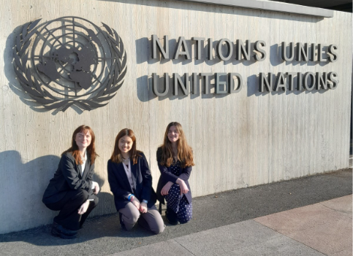
Youth
deligates
at the UN
Left to right:
Lauren, Jamie
and Poppy
Notes:
Youth Advisory Board members from UNICEF UK travelled to the United Nations in Geneva in 2023 during the UNCRC Periodic Review Process, to share their views, alongside other young people, about how children’s rights were being protected and promoted in the UK.

Slide 59
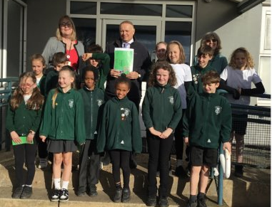
Meeting
with a law
maker
Chingford Primary School
Chingford and Woodford Green, Greater London
Notes:
Chingford Primary School invited Sir Ian Duncan Smith MP to their school. They created a booklet about their experience of being a Rights Respecting School and highlighted their campaign about local traffic. Sir Ian Duncan Smith attended and spoke with the children and offered his support for their campaign.

Slide 60
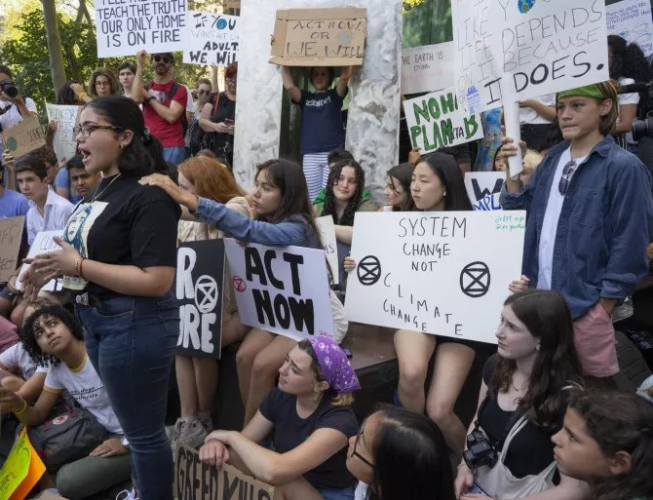
Peaceful
protests
Children join the climate strike peaceful protest in New York in August 2019
© UNICEF/Nesbitt

Slide 61
Part 4​
Unravelling the web​
Look at your finished web
If you could influence a duty bearer to make change that would remove one barrier or
root cause from your web, which change would unravel the most?
Which barrier/root cause have you chosen, and why that one?
Who has the power to change it, and why them specifically?
What exactly would you ask them to do to support children to enjoy their rights?
Which rights would this most help children and young people access?

Slide 62
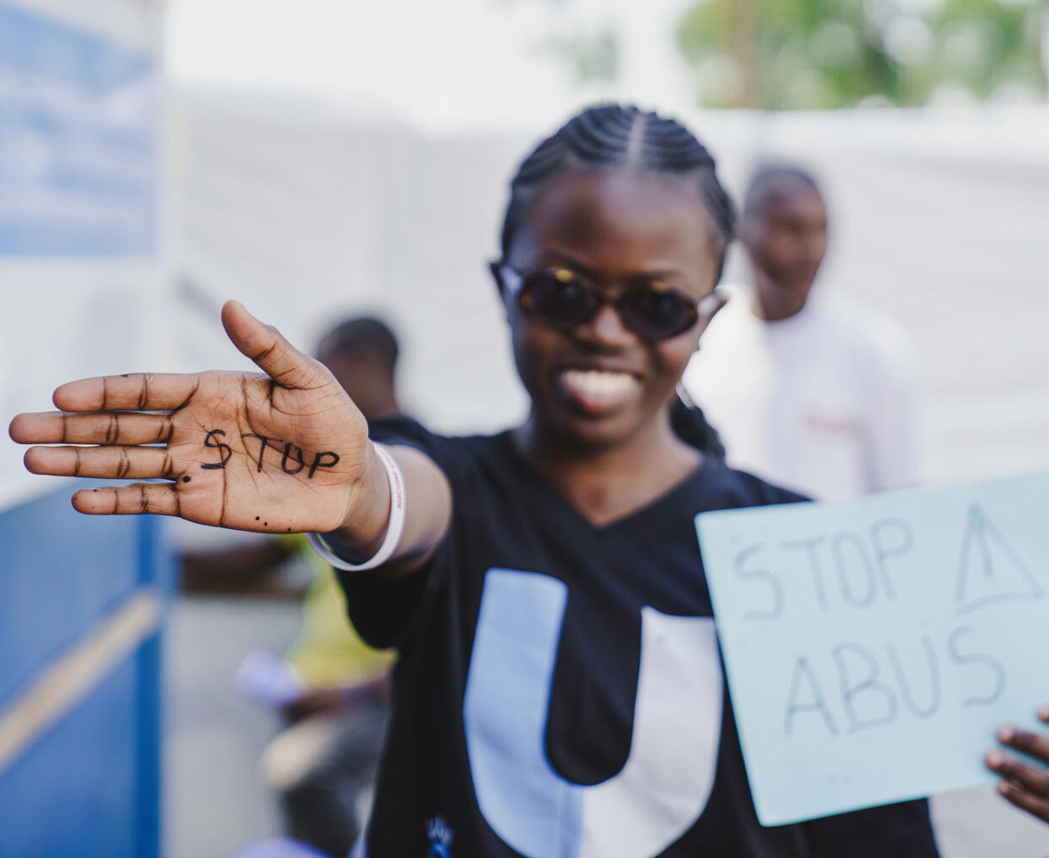
A U reporter takes part in a protest against violence towards women and girls in DRC.
© UNICEF/Benekire
Part 5
What does a campaigner look like?
Create a placard with
a slogan that either:
Draws ATTENTION
to a barrier you’ve learned about
Makes an ASK, calling on a duty bearer to act
Celebrates an ACTION

Slide 63
Part 6​
Final reflections
Look over your web of rights and barriers:
What surprised you in our learning journey?
What are you most proud of?
Is there anything that you still want to add to the display?
What question do you still have?
Something you want to keep thinking about?

Slide 64
​
Reflect, respond, raise your voice​
Key questions: What is a root cause you’ve identified through
our OutRight activities that you most want to see addressed? Name the duty bearer responsible, the change
you want them to make and one action you could take to
make that ask heard.
Reflect, respond, raise your voice as usual

Slide 65

Well done and what's next?
Notes:
Invite the group to discuss and decide how they want to share what they've learned and produced and what they want to take forward into their campaigning actions.

