Slide 1
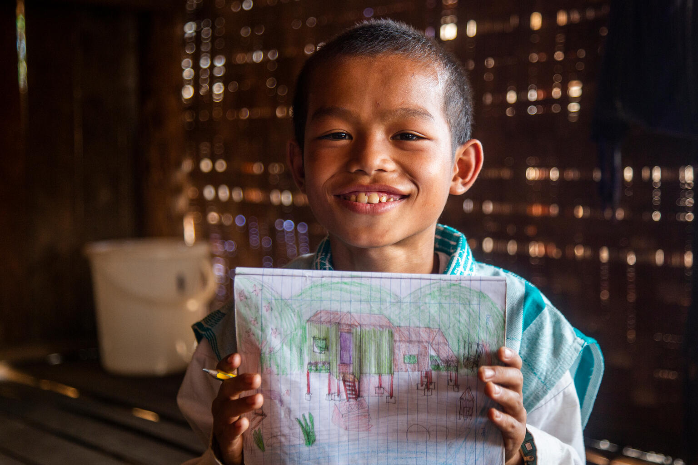


2026/27
Saw Kyaw San, 11, learns at a temporary school in Myanmar.
© UNICEF/Htet

Slide 2

CAMPAIGN ACTION
Now you’ve finished all your learning activities, it’s time to move on to the campaign action!
This year, every single child and young person taking part in OutRight will be doing the same action – so we can show just how powerful the OutRight campaign is.
We’re going to be creating a digital map –
and we need you to help us fill the map with messages to the UK Government.

Slide 3
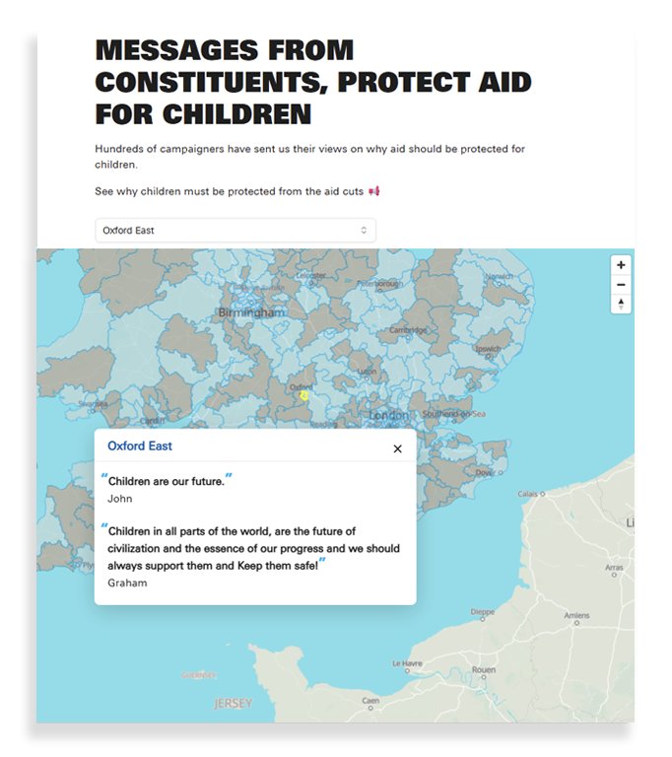
The map
We have some work to do
first, but eventually the map
will look something like this one.
When people type in the
postcode of your school,
it will bring up your very
own message!

Slide 4

Creating your message
To create your message, you’ll need
to use these writing prompts:
Learning spaces are important because:
To protect learning spaces,
the UK Government should:

Slide 5
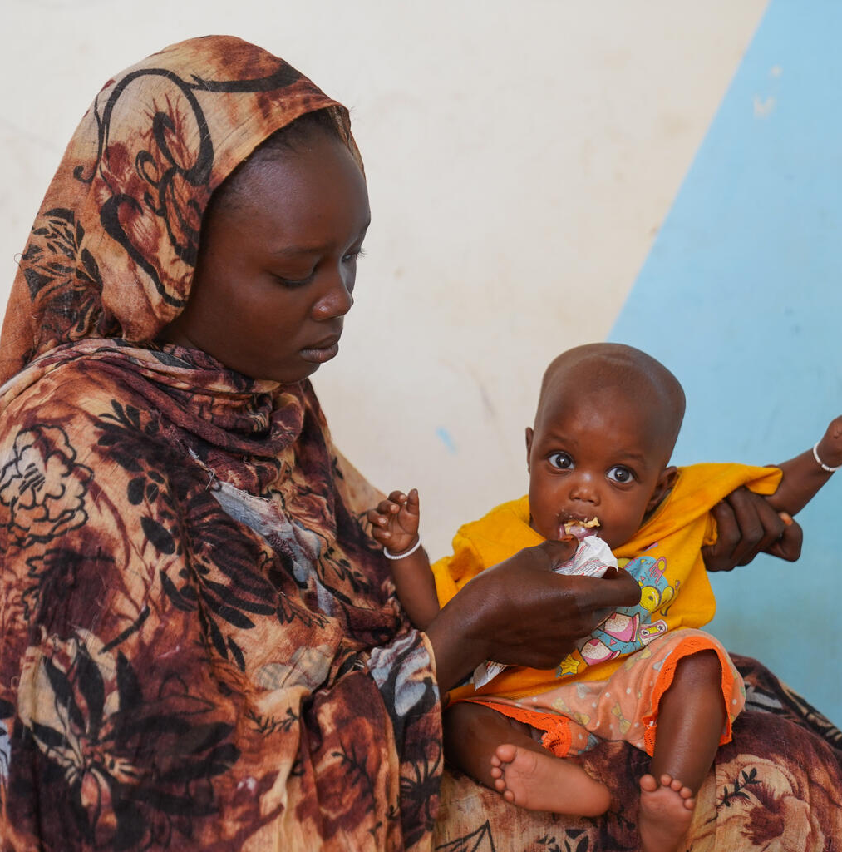
Hadiat feeds her daughter Fatima with ready to use therapeutic food at a health facility in North Darfur, which provides life saving nutrition care for children.
© UNICEF/Jamal
Thank you!
Once you’ve created your
message, submit it to us at
UNICEF UK.
We’ll be in touch with a link
as soon as the map is ready,
and you can see the impact
you’ve helped to create.
Thank you for taking part in
OutRight!

