Slide 1
Supporting Girls’ Education in Afghanistan

Slide 2
How to use this resource
Rights Around the World is a regular resource series from UNICEF UK’s Rights Respecting Schools Award that pairs global citizenship with learning about rights and selected stories from UNICEF’s work around the world.
If you are a Rights Respecting School, this resource will help you to meet Outcomes
1 and 9 of RRSA accreditation:
Children, young people and the wider school community know about and understand the United Nations Convention on the Rights of the Child and can share how it impacts on their lives and on the lives of children everywhere.
Children and young people have taken action to claim their rights and promote
the rights of others, locally and globally.
This resource is separated into two parts.
For use in assemblies, tutor time, circle time or a similar session where adults present and discuss a story or topic with children and young people.
PART
1
Filled with activity ideas for building greater understanding on the themes within the story as well as ideas for taking the learning out into the world or building on that learning through creation of a Rights Around the World display board of a passport (or learning journal).
Throughout the pack you will see some items labeled with stars. These are to give you, as the educator, an idea of the level at which the content is pitched.
One star: simple - for children in early years settings and/or those more confident with simpler concepts.
Two stars: intermediate - for children and young people who have a good level of comprehension and reflection ability.
Three stars: advanced – for young people who have the confidence and maturity to explore more challenging themes, concepts and ideas.
You know your children and young people best so feel free to adapt this resource and always review content before you use it within your setting.
PART
2

Slide 3
For assemblies or group sessions
PART
1

Slide 4
This month we are in…
Afghanistan
Notes:
This month we are in Afghanistan. Afghanistan is located in Central Asia with Iran to the west and Pakistan to the east.

Slide 5
Traveller's guide: Afghanistan
Pashto and Dari are Afghanistan’s two main languages.
Afghanistan is more than twice the size of the UK but has less than half the UK’s population.
Kite flying is a national sport in Afghanistan with an 800-year-old tradition. Children make kites out of paper, then have battles, trying to knock each other's kites out of the sky.
Tall mountains and dry deserts cover most of the landscape of Afghanistan. Many Afghans live in the fertile valleys between the mountains. Only 20 percent of the land is used as fields.
The country is rich in the vibrant blue stone, lapis lazuli, which was used to decorate the tomb of the Egyptian king Tutankhamun.
Notes:
Pashto and Dari are Afghanistan’s two main languages - https://www.bbc.co.uk/newsround/59881582
Kite flying is a national sport in Afghanistan with an 800-year-old tradition. Children would make kites out of paper, then have battles, trying to knock each others kites out of the sky - https://www.bbc.co.uk/newsround/62596469
Afghanistan is more than twice the size of the UK but has less than half the UK’s population - https://www.bbc.co.uk/newsround/59881582
Tall mountains and dry deserts cover most of the landscape of Afghanistan. Many Afghans live in the fertile valleys between the mountains and grow their crops and tend to their animals. Only 20 percent of the land is used as fields - https://kids.nationalgeographic.com/geography/countries/article/afghanistan
The country is rich in the vibrant blue stone, lapis lazuli, which was used to decorate the tomb of the Egyptian king Tutankhamun - https://kids.nationalgeographic.com/geography/countries/article/afghanistan
You may notice that we have not included a flag in this month's Traveller's Guide, and some pupils may ask why. This is because there is currently no internationally agreed flag for Afghanistan. Since the Taliban returned to power in 2021, different groups have used different flags to represent the country. As there is no single flag that is universally recognised, we have chosen not to include one in this resource.

Slide 6
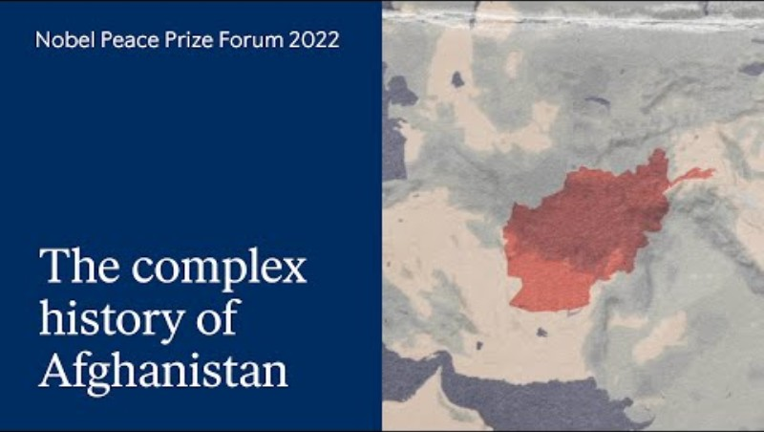
Country Context: Afghanistan
This slide is intended for teachers and for young people who have the confidence and maturity to explore more challenging themes, concepts and ideas. You know your leaners best, please review any materials provided here before sharing with pupils.
The political situation in Afghanistan is highly sensitive and continues to change, with the Taliban having retaken control in 2021. This video from the Nobel Prize Peace Forum provides a summary of this country’s complex history up until 2022.
People in Afghanistan continue to face an array of interconnected crises – natural disasters, poverty, climate change and limited access to essential services – all preventing recovery from more than four decades of conflict. In 2026, an estimated 21.9 million people, including 11.6 million children, need humanitarian assistance. The crisis is deepening, with women of reproductive age, children, youth and marginalized groups facing escalating risks. As conditions worsen, UNICEF’s continued presence is vital to deliver essential services and safeguard the most vulnerable.
Afghan women and girls face a systemic rights crisis. Since March 2022 girls have been banned from accessing secondary education but are still permitted to access primary education. Bans on secondary education and workforce participation, coupled with restrictive daily-life rules, have escalated protection risks and threaten long-term resilience. The impacts will be felt for generations to come.
UNICEF is campaigning for humanitarian funding to reach 12 million people, including 6.5 million children, with life-saving aid and basic services.
The core theme of this pack is girls’ access to education. We explore this theme through a video case study of Rabia, a girl accessing education in rural Afghanistan with support from UNICEF, and through suggested classroom activities.
Notes:
Afghanistan Humanitarian Action for Children 2026 - https://www.unicef.org/afghanistan/documents/humanitarian-action-children-hac-2026
Recent news articles you may wish to explore include the following:
Five years on: UNESCO calls for the full restoration of the right to education for Afghan Girls and Women
As new school year starts in Afghanistan, almost 400,000 more girls deprived of their right to education, bringing total to 2.2 million

Slide 7
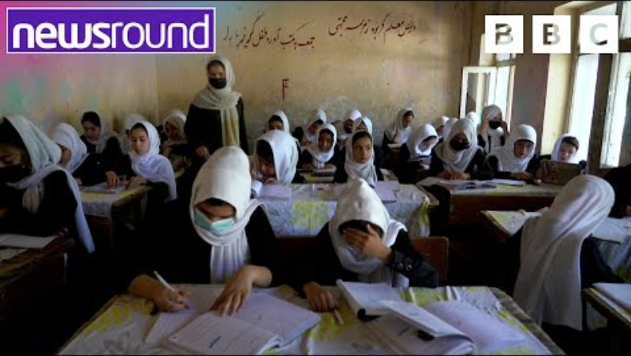
Country Context: Afghanistan
This slide is intended to support teachers to set the scene for children and young people who have a good level of comprehension and reflection ability. You know your leaners best, please review any materials provided here before sharing with pupils.
Afghanistan is a country in Asia with a rich history and many different cultures and traditions.
For thousands of years, people have lived, traded and travelled through the region and in recent decades, Afghanistan has experienced conflict and political change, making life difficult for many families. Children and young people have often been among those most affected. Many people in Afghanistan also face other challenges in their daily lives, due to natural disasters, poverty and climate change.
Because of these difficulties, many children and families need help to access food, healthcare, clean water and education. UNICEF works in Afghanistan to support children and families, especially those who are most vulnerable. This includes helping children stay safe, healthy and able to learn.
The main theme of this pack is girls' access to education. In Afghanistan, girls can attend primary school, but since 2022 many girls have not been allowed to continue their education at secondary school. This report from Newsround explains more, but this means that millions of girls are missing out on learning opportunities that could help them achieve their goals and contribute to their communities in the future. UNICEF is working alongside communities and partners to help children in Afghanistan access education and other essential services, and to make sure children's rights are protected.
Through the story of Rabia, a girl living in rural Afghanistan, you will learn about some of the challenges girls face in going to school and how UNICEF is helping.
Notes:
Afghanistan Humanitarian Action for Children 2026 - https://www.unicef.org/afghanistan/documents/humanitarian-action-children-hac-2026
Recent news articles you may wish to explore include the following:
Five years on: UNESCO calls for the full restoration of the right to education for Afghan Girls and Women
As new school year starts in Afghanistan, almost 400,000 more girls deprived of their right to education, bringing total to 2.2 million
You may wish to use this slide as part of an assembly or as part of further learning about the context in Afghanistan. You know your learners best – use what works for them to give them enough information to understand the case study.

Slide 8
UNICEF’s work in Afghanistan
UNICEF runs many different types of programmes in Afghanistan. Some explore health, education, nutrition, protection of children, and water, sanitation and hygiene.
UNICEF will always work pragmatically with whoever is in power in a country, so UNICEF engages with the Taliban to deliver work. UNICEF also advocates for girls and children’s rights more generally in its engagement with the Taliban, aiming to influence their approach to secure better lives for children, and girls in particular.
On education, UNICEF has helped to establish Community-Based Schools and Accelerated Learning Centres within a three-kilometre range of each child’s community. This helps children to access primary education, especially those in rural areas and girls. UNICEF also works with partners to improve the quality of education and also provides emergency education to ensure children continue going to school during disasters and conflicts.
UNICEF has also launched a global appeal, called the Humanitarian Action for Children 2026, aiming to raise US$950 million to support the basic needs of people in Afghanistan.
Notes:
Use this slide with children, as appropriate for age/stage/ability, to make the link to UNICEF’s work. The following slides will bring this to life through the case study of Rabia's story.
Learn more about UNICEF in Afghanistan:
https://www.unicef.org/afghanistan
https://www.unicef.org/afghanistan/stories
https://www.unicef.org/afghanistan/documents/dismantling-barriers-one-time

Slide 9
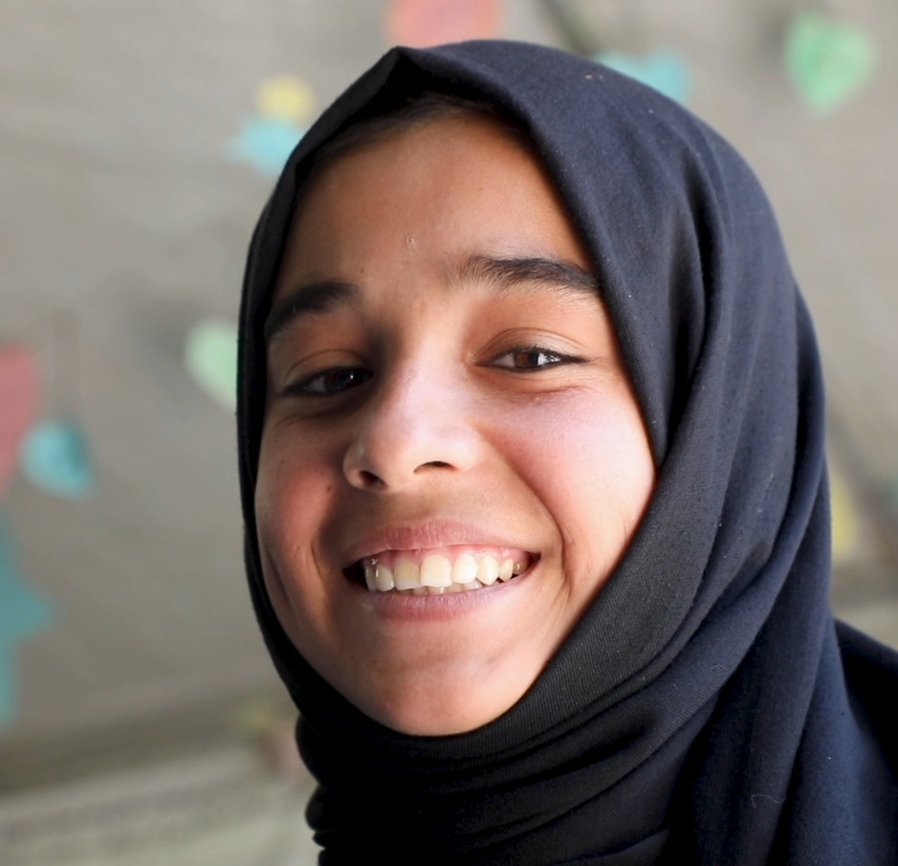
Meet Rabia
On the next slide you will meet Rabia*. She lives in a small village in Afghanistan. Her village is far from the nearest school and, like many other girls in Afghanistan, she faces extra challenges when trying to access her right to education.
The Taliban, who hold power in Afghanistan, have stopped girls from going to secondary school. For some girls, even getting to primary school can be difficult, especially if, like Rabia, they live in remote areas.
UNICEF supports Accelerated Learning Centres to help more children, especially girls, access their right to education. Rabia and the other girls in her community can now attend a school closer to home. Built with UNICEF’s support, these centres help children catch up on their education, learning to read and write and studying up to six subjects.
Rabia attends an accelerated learning centre, which reaches girls left behind by the formal education system. Unicef/Naftalin
Notes:
*Names, age and exact location have been changed/ omitted to protect identity of adolescent girls enrolled in primary education in Afghanistan. Consent obtained.
In Afghanistan, Accelerated Learning Centres are a form of community-based education, enrolling children in primary education who may be behind, missed a year of studies or need to catch up. Accelerated Learning Centres allow students to complete two grade levels in one calendar year, up through primary Grade 6. UNICEF aims specifically to enrol girls, who experience higher barriers to entering the public school system and may not have any other opportunity for a formal education. Throughout Afghanistan, UNICEF supports 3,500 of these centres, providing an education to 107,000 children – 85,000 or 79 per cent of whom are girls. UNICEF also supports salaries and in-service training for teachers in Accelerated Learning Centres, and provides backpacks, notebooks, pens, pencils and other materials to the students.

Slide 10
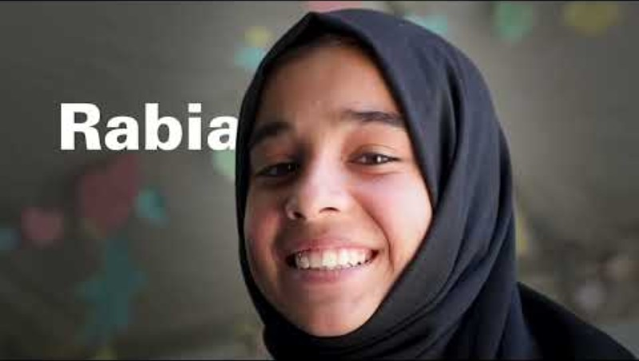
Notes:
This video can also be viewed on our YouTube channel, The Rights Respecting Schools Award UNICEF UK.
Here is the direct link to the video case study: https://youtu.be/x8-UWQv0_SI

Slide 11


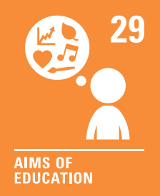
The rights link...
Look at the summary of the CRC with a partner – which articles do you think are particularly relevant to this case study? (Click to reveal some examples)
Why do you think we’ve highlighted this selection?
Did you identify others?
Notes:
Remember rights are interdependent and many others could be relevant here too - these are just the ones we thought of.
Article 2: The right to No Discrimination is relevant because in Afghanistan "Women and girls are being systematically punished based on their gender." https://www.unicef.org/afghanistan/documents/dismantling-barriers-one-time. In the video you will have seen that Rabia had struggled to access her right to education and it shows how UNICEF are supporting girls like Rabia in Afghanistan.
Article 28: States that every child has the right to education, which is being denied for girls in particular, in Afghanistan. UNICEF is supporting girls like Rabia to access education through the accelerated learning centres (referenced on slide 7).
Article 29: Is about the goals of education, to develop every child's personality, talents and abilities to the full. You will see in the video that Rabia wants to become a doctor and is keen to develop her knowledge. UNICEF's support (seen in the video) is about fulfilling these dreams but you may (or may not) want to open a sensitive discussion with older pupils about the challenges around this. A good source of information could be https://www.unicef.org/afghanistan/education
You may wish to have copies of the CRC available if your pupils are less familiar with the articles from the convention.​
​You can find a simplified version here: https://www.unicef.org.uk/wp-content/uploads/2019/10/UNCRC_summary-1_1.pdf​
And you can access the icons here: https://www.unicef.org.uk/rights-respecting-schools/wp-content/uploads/sites/4/2019/11/UN0332751.pdf

Slide 12
...and what about the Global Goals?
Why do you think we’ve highlighted this selection?
Did you identify others?
Notes:
Optional slide​​
​​If your pupils are not currently familiar with the Global Goals please remove this slide and the next one.​​
​​
To find out more about the Global Goals: https://worldslargestlesson.globalgoals.org/ or https://globalgoals.org/

Slide 13
...and what about the Global Goals?
Why do you think we’ve highlighted this selection?
Did you identify others?
Notes:
SDG 4: Quality education
Ensure inclusive and equitable quality education and promote lifelong learning opportunities for all.
Find out more: https://globalgoals.org/goals/4-quality-education/
SDG 5: Gender Equality
Achieve gender equality and empower women and girls.
Find out more: https://globalgoals.org/goals/5-gender-equality/
SDG 16: Peace, Justice and Strong Institutions
Promote peaceful and inclusive societies for sustainable development, provide access to justice for all and build effective, accountable and inclusive institutions at all levels.
Find out more: https://globalgoals.org/goals/16-peace-justice-and-strong-institutions/

Slide 14
Reflection
What have you learned about the barriers that prevent some girls in Afghanistan from accessing their right to education?
Why is education an important right for every child?
How does UNICEF help children in Afghanistan access education and continue learning?
Why do you think education is important for girls, their families and communities?
Did anything surprise you or make you think differently?
Next step…
Think about your Rights Around the World display or passport. You could find out one surprising fact about Afghanistan, draw a picture based on facts in the Travelers Guide slide or share your reflections to the questions above in a piece of writing.
Notes:
Teacher Notes:
Before ending the session, encourage pupils to reflect on what they have learnt. You may wish to only use some of the questions depending on the needs of your pupils. You could ask them to share their reflections in pairs, small groups or to the whole group.
There are some more images on slide 20 which you could use if you create a display.

Slide 15
Activities
PART
2
Notes:
Part 2: Activities.
These have been designed with the intention that teachers will use discretion based on the children in their class – age, ability & life experiences. Please consider whether the activities are relevant for your children – delete any that are not and please do adapt accordingly to suit the needs of your learners.

Slide 16
Build your understanding
My Future Self
In the video, Rabia says she wants to become a doctor. Think about what you would like to do in the future. Can you think of some words which are associated with this, such as caring, helping, curing, entertaining, inventing, leading, winning? Draw or paint a self-portrait of your future self, the achiever of your dream goal.
Storytime
Read The Library Bus by Bahram Rahman. Pari travels with her mother on a library bus around Afghanistan. Pari’s mum asks her how learning makes her feel and she replies, “Free!” After reading the book, ask each child how learning makes them feel. Then talk about why it is important that everyone has an equal chance to learn.
Fly a Kite
In Afghanistan, many children enjoy flying kites. Kites can soar high into the sky and remind us of our hopes and dreams. Create your own colourful kite using paper or card. Decorate your kite with pictures or words that show what you love about learning, such as your favourite book, numbers you enjoy exploring, or learning with your friends. You could hang your kites together to create a display or try and fly your kites to see how they move in the wind.
School in a Box
UNICEF’s School-in-a-Box helps children continue learning during emergencies. Imagine you could create your own School-in-a-Box. What would you put inside to help you learn, grow and enjoy school? Draw your own box and fill it with pictures of things you think are important for learning or use a real box and collect objects to place inside. When you have finished, discuss your box with your group and explain why each item is important.
Notes:
These are a set of simpler more hands-on activities linked this this month’s topic, they are idea for early years or learners who are more confident with hands on, practical activities.
Storytime The Library Bus is written by Afghan-Canadian author Bahram Rahman. If you can't find a physical copy, you can find videos of people reading the book on YouTube such as: https://www.youtube.com/watch?v=xp0SSvPvhNE
School in a Box You can see the contents of UNICEF’s School-in-a-Box here: https://www.unicef.org/supply/unicefs-school-box

Slide 17
Build your understanding
Design a school
Imagine you were asked to design a school for children in Afghanistan to help them access their right to education. Think about what children might need to feel safe, welcomed and ready to learn. Work in pairs or small groups to create your design – this could be a floor plan, a 3D model, or a drawing with labels to show what you have included. Present your design to your class, explaining how this helps children access education and any other rights you thought of.
Explore a ‘School in a Box’
Find out about UNICEF’s School-in-a-Box and explore the items. Why do you think each item has been included? How might these items help children to learn during emergencies? Apart from Articles 28 and 29, which other rights from the CRC are being addressed by having these items in the box? Are there any items you don't understand and would like to learn more about? Is there anything you think should be added to the box or removed? Work together to agree your answers and present your ideas to your class.
International Day of the Girl Child
International Day of the Girl Child is celebrated every year on 11 October. Why do you think this is important to celebrate and promote? Plan one action your group, class or school could take during October to promote children's rights and raise awareness of girls' rights.
Malala’s Magic Pencil
Malala Yousafzai is known for campaigning for girls’ education. Read Malala’s Magic Pencil, then complete a pencil-shaped template with words or drawings showing why education is important and why all children should enjoy their rights under Articles 28 and 29. Display your pencils in a prominent place so visitors can see how much you value learning.
Notes:
These are a set of activities linked this this month’s topic, they are idea for KS2/progression step 2&3/P4-7
Please be mindful of your learners, particularly if any have experienced discrimination related to education or if they are from Afghanistan.
Design a school: Consider the key items the children would include – not necessarily the ideal school, it's more about considering essentials/basics - perhaps linked to needs/wants discussions. The Needs & wants cards could help to frame some of these discussions – these can be purchased here https://www.unicef.org.uk/rights-respecting-schools/resources/teaching-resources/want-needs-cards/ or you could make your own. If your pupils are taking part in OutRight in 2026/7, you can do this activity as part of that learning journey Outright - Learning Spaces
Explore school in a box: Looking at contents of UNICEF’s School-in-a-Box to discuss pupil's ideas and opinions on this. There are no right or wrong, just an opportunity to support pupils to consider what they think to be most relevant and important (related to Article 13). https://www.unicef.org/supply/unicefs-school-box
International Day of the Girl Child: An opportunity to create a small campaign about girls' education, but you don't necessarily need to fulfil the campaign, more about planning it. You could however use our Youth Advocacy Toolkit to support with planning and fulfilling a campaign if you wish. https://www.unicef.org.uk/working-with-young-people/youth-advocacy-toolkit/
Malala’s Magic Pencil Why explore Malala? Although Malala Yousafzai is from neighbouring Pakistan rather than Afghanistan, her story helps children understand why education is a fundamental right and why some girls face barriers to learning. After surviving an attack for speaking out in support of girls’ education, Malala became a global advocate for children’s right to learn. In 2014, she became the youngest-ever recipient of the Nobel Peace Prize in recognition of her work. Through the Malala Fund and her campaigning, she has helped raise awareness of the challenges many girls face in accessing education and inspired people around the world to take action in support of this right. Find out more about Malala’s story on the Malala Fund website Malala's Story | Malala Fund | Malala Fund

Slide 18
Build your understanding
Why Are Girls Missing Out?
Explore UNICEF’s webpage on girls’ education. Identify three statistics that show the scale of the issue and how it changes as girls get older. Investigate the barriers preventing girls from accessing education and create a diagram to show how they connect and reinforce one another. Which barriers can you identify in Rabia’s story? How could you raise awareness of this issue?
What If School Disappeared Tomorrow?
Imagine your access to education disappeared tomorrow. Think beyond missing lessons: what else might change in your daily life, relationships and future opportunities? Create a consequence wheel showing what could change after one day, one year and five years. Use Rabia’s story to explore your ideas. Which other rights are affected when children can't access education?
Afghanistan: More Than One Story
Research Afghanistan beyond Rabia’s story, exploring its history, culture, geography, achievements and everyday life. Create an ‘Afghanistan: More Than One Story’ infographic or presentation with five things you think other young people should know. Include a range of different perspectives. Why can representing a country only through conflict, poverty or crisis create stereotypes?
What Can’t You Put in a Box?
Explore UNICEF’s School-in-a-Box. It contains materials to help children continue learning during emergencies – but can everything needed for a quality education fit inside? Create a second ‘box’ of things you cannot pack: safety, teachers, friendships, trips, sport, clubs or creativity. Why do these experiences matter to ensure that children access their rights under Articles 28 and 29?
Notes:
These are a set of activities linked to this month’s topic, ideal for secondary school students.
Why Are Girls Missing Out? If your pupils would like to take action on this issue, UNICEF UK’s Youth Advocacy Toolkit provides guidance, resources and activities to help young people explore advocacy, understand how change happens, and develop their skills as campaigners and changemakers: https://www.unicef.org.uk/working-with-young-people/youth-advocacy-toolkit/
What If School Disappeared Tomorrow Oxfam's ‘Global Citizenship in the Classroom: A guide for teachers’ resource explains how to run a ‘consequences wheel’ activity on page 14. https://oxfamilibrary.openrepository.com/server/api/core/bitstreams/d3a1541c-f4c2-4062-b3ff-ae5da3d8023f/content
Afghanistan: More Than One Story You may find this TED Talk useful: 'The danger of a single story' by Chimamanda Ngozi Adichie: https://www.ted.com/talks/chimamanda_ngozi_adichie_the_danger_of_a_single_story
What Can’t You Put in a Box? You can see the contents of UNICEF’s School-in-a-Box here: https://www.unicef.org/supply/unicefs-school-box

Slide 19
Take your learning into the world
Take action
Join in with a campaign about the right to education. This year UNICEF UK’s OutRight campaign will help you learn about the importance of education and safe learning spaces, and how they help children realise their rights around the world. Or you could explore the Send My Friend to School campaign.
Get creative
Create a display to showcase what you have learned about girls’ access to education. Include artwork, facts, quotes or campaign messages that highlight why education matters and why every child should be able to enjoy their rights under Articles 28 and 29. Share your display with others to raise awareness of this important issue.
Add to your passport
Think about your Rights Around the World display or passport. You could find out one surprising fact about Afghanistan, draw a picture based on facts in the Travelers Guide slide or share your reflections to the questions on slide 16 in a piece of writing.
Notes:
Take Action:
OutRight is UNICEF UK’s advocacy campaign for children and young people. We provide you with the resources that you need to follow an exciting campaign journey, learning about children’s rights and how to take action. This year, through OutRight, we’ll be learning about the importance of education, and safe learning spaces, and how they help children realise their rights around the world. You can sign up to take part here: Outright - Learning Spaces
Send My Friend to School UNICEF UK is also part of the coalition of organisations that runs the Send My Friend to School campaign. Your school could decide to take part in the 2025-2027 campaign ‘Invest in My Friends’ Learning’ and join thousands of other schools in asking the UK Government to reprioritise and protect funding for global education. Home - Send My Friend to School
Rights Around the World passport and display materials can be found here: Rights Around the World - Rights Respecting Schools Award
Why not create a whole school display and add to this to show your learning after every pack. Each child could create their own passport, or you could create class passports to capture learning.

Slide 20
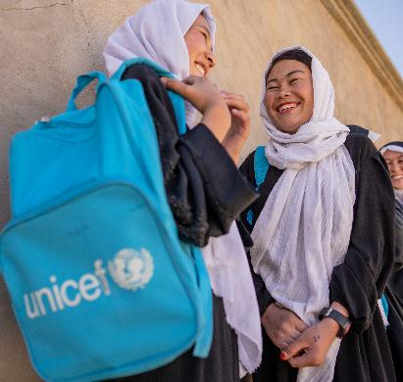
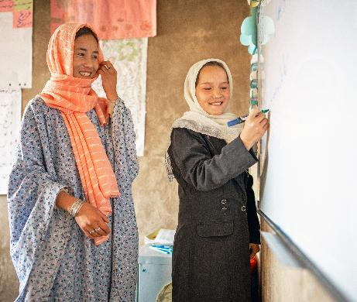
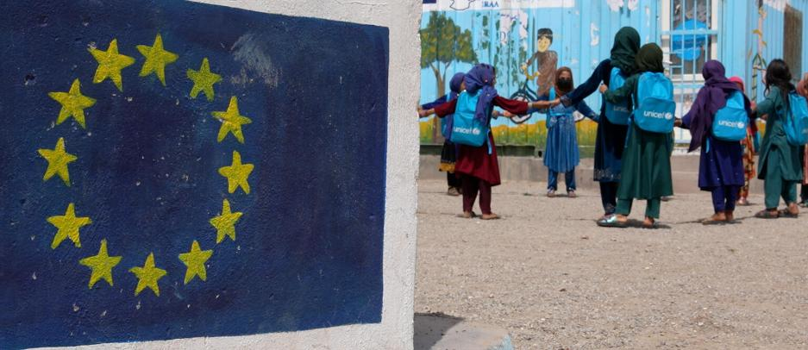
For your display
These images can provide a starting point for your Rights Around the World display or passport.
Please include the image credit and description if using.
1. ©UNICEF/Naftalin – Girls chat outside the UNICEF-supported Accelerated Learning Centre in central Afghanistan. The Centre is for girls that have missed a significant amount of schooling and enables them to catch up with their peers.
2. ©UNICEF/Naftalin – A teacher and a pupil at an Accelerated Learning Centre in central Afghanistan. UNICEF specifically enrols girls as they experience higher barriers to entering the public school system and may not have any other opportunity to formally learn.
3. ©UNICEF/Fazel – A teacher at a grade 3 class during playtime at a UNICEF-supported communication-based educations class in Herat, Afghanistan.
1
2
3

Slide 21
Keep an eye on the RRSA website for further information about upcoming Rights Around the World resources.
We would welcome your views as we continue to develop this resource. Click below to let us know your thoughts. Rights Around the World Feedback 26/27 – Fill out form
Thank you, and we hope you enjoy sharing this resource with your pupils!

