Slide 1
Accessible Digital Textbooks in Paraguay

Slide 2
How to use this resource
Rights Around the World is a regular resource series from UNICEF UK’s Rights Respecting Schools Award that pairs global citizenship with learning about rights and selected stories from UNICEF’s work around the world.
If you are a Rights Respecting School, this resource will help you to meet Outcomes
1 and 9 of RRSA accreditation:
Children, young people and the wider school community know about and understand the United Nations Convention on the Rights of the Child and can share how it impacts on their lives and on the lives of children everywhere.
Children and young people have taken action to claim their rights and promote
the rights of others, locally and globally.
This resources is separated into two parts.
For use in assemblies, tutor time, circle time or a similar session where adults present and discuss a story or topic with children and young people.
PART
1
Filled with activity ideas for building greater understanding on the themes within the story as well as ideas for taking the learning out into the world or building on that learning through creation of a Rights Around the World display board of a passport (or learning journal).
Throughout the pack you will see some items labeled with stars. These are to give you, as the educator, an idea of the level at which the content is pitched.
One star: simple - for children in early years settings and/or those more confident with simpler concepts.
Two stars: intermediate - for children and young people who have a good level of comprehension and reflection ability.
Three stars: advanced – for young people who have the confidence and maturity to explore more challenging themes, concepts and ideas.
You know your children and young people best so feel free to adapt this resource and always review content before you use it within your setting.
PART
2

Slide 3
For assemblies or group sessions
PART
1

Slide 4
This month we are in…
Paraguay
Notes:
This month we are in Paraguay, South America.

Slide 5

Traveller's guide: Paraguay
Paraguay is a country in South America. It is landlocked, which means it is surrounded by land and does not have a coastline.
The capital of Paraguay is a city called, Asunción.
Paraguay has two official languages: Spanish and Guaraní. Guaraní is an indigenous language and is spoken by many people. Paraguayan Sign Language was also officially recognised by law in 2020.
The Paraguay River runs through the country.
Paraguay covers about 406,752 square kilometres. That means it is roughly 1.7 times the size of the UK.​
The Paraguay flag is one of very few flags that have a different design on the front and back.
Notes:
Sources:
https://kids.britannica.com/kids/article/Paraguay/345765
https://kids.kiddle.co/Paraguay
https://theworldfactbook.org/country/paraguay.html
Flag of Paraguay Facts for Kids
For information on the legal recognition of sign language across the world see this map: https://wfdeaf.org/the-legal-recognition-of-national-sign-languages/?_country_map=-21.572198892978978%2C-36.421884613559996%2C52.081832214679565%2C111.93749038644%2C3

Slide 6
UNICEF’s work in Paraguay
UNICEF’s work in Paraguay has four main themes:
Early childhood: Working with families and communities to help babies and young children grow up healthy, happy and ready to learn.
Education: Helping to make sure more children stay in school and have the support they need to learn. This includes providing accessible digital textbooks and supporting children to learn in different languages
Keeping children safe and healthy: Working to protect children and support children's mental health and emotional well-being.
Water, sanitation, hygiene and the environment: Helping communities prepare for challenges such as extreme weather and climate change, improving access to clean water, toilets and handwashing facilities.
Notes:
Afghanistan Humanitarian Action for Children 2026 - https://www.unicef.org/afghanistan/documents/humanitarian-action-children-hac-2026
Recent news articles you may wish to explore include the following:
Five years on: UNESCO calls for the full restoration of the right to education for Afghan Girls and Women
As new school year starts in Afghanistan, almost 400,000 more girls deprived of their right to education, bringing total to 2.2 million

Slide 7
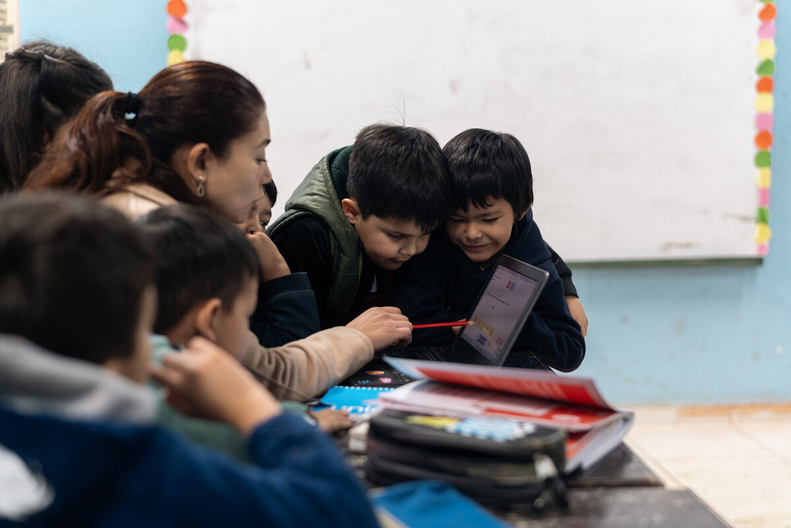
Meet Dylan
Dylan is 6 years old and has just started Year 1 at his primary school in Paraguay. He loves Spiderman and drawing is one of his favourite things to do.
Dylan has a speech difference and communicates through gestures, signs, symbols and drawing.
Learn how Dylan’s teacher, Eve, uses something called an accessible digital textbook, developed by UNICEF and our partners, to help Dylan learn alongside his classmates.
This has helped Dylan ease into school life and has opened a whole new world of learning and possibility.
Accessible digital textbooks are helping Dylan become more independent and develop new friendships. UNICEF/Brizuela
Notes:
*Pupils might remember learning about these digital textbooks when we learned about Ari in the Rights Around the World Jamaica pack.
We recognise that the story we are sharing this month may be very close to the experiences of some of the children in your class or school. Please plan ahead to ensure that the information and activities are meaningful to and supportive of all your children. You may wish to use this pack to focus on and celebrate the great work you do to bring equity and inclusion to the centre of your practice.
Having trouble viewing the video? Find this video on our YouTube channel here: https://youtu.be/4fKmFiQ2r7I
We recommend viewing this video in full screen.
https://www.unicef.org/innocenti/media/4251/file/UNICEF-Accessible-Digital-Textbooks-Paraguay-EN.pdf

Slide 8
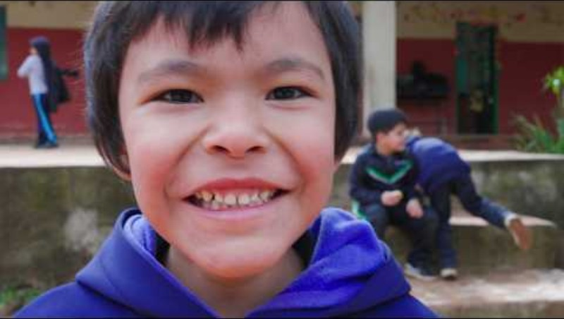
Notes:
If the content above is showing as an image rather than a video, please close the pack and reopen ensuring that you click ‘Enable Content’ when prompted on opening.
This video can also be viewed on our YouTube channel, The Rights Respecting Schools Award UNICEF UK.
Here is the direct link to the video case study: https://youtu.be/4LuX5uzdCDY

Slide 9
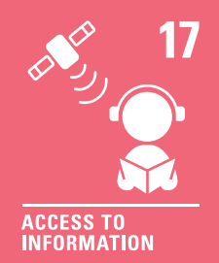


The rights link...
Look at the summary of the CRC with a partner – which articles do you think are particularly relevant to Dylan’s story? (Click to reveal some examples)
Why do you think we’ve highlighted this selection?
Did you identify others?
Notes:
Remember rights are interdependent and many others could be relevant here too - these are just the ones we thought of.
You may wish to have copies of the CRC available if your pupils are less familiar with the articles from the convention.​
​You can find a simplified version here: https://www.unicef.org.uk/wp-content/uploads/2019/10/UNCRC_summary-1_1.pdf​
And you can access the icons here: https://www.unicef.org.uk/rights-respecting-schools/wp-content/uploads/sites/4/2019/11/UN0332751.pdf

Slide 10
...and what about the Global Goals?
Why do you think we’ve highlighted this selection?
Did you identify others?
Notes:
Optional slide​​
​​If your pupils are not currently familiar with the Global Goals please remove this slide and the next one.​​
​​
To find out more about the Global Goals: https://worldslargestlesson.globalgoals.org/ or https://globalgoals.org/

Slide 11
...and what about the Global Goals?
Why do you think we’ve highlighted this selection?
Did you identify others?
Notes:
SDG 4: Quality education
Ensure inclusive and equitable quality education and promote lifelong learning opportunities for all.
Find out more: https://globalgoals.org/goals/4-quality-education/
SDG10: Reduce inequalities
Sometimes, a small number of people have much more money and resources than everyone else. This can make life unfair for many people. UNICEF believes that everyone should have the same chances to do well in life, no matter who they are, where they come from, what they believe, or how much money they have. When people are treated fairly and have what they need to thrive, communities, countries and the whole world become stronger.
Find out more: https://globalgoals.org/goals/10-reduced-inequalities/

Slide 12
Reflection
Think back to what you have learnt about accessible digital textbooks in Paraguay.
Why is it important that all children can learn in a way that works for them?
How can accessible digital textbooks help children with different learning needs take part in lessons?
What could schools do to make sure everyone feels included and able to learn?
And finally… add Paraguay to your Rights Around the World passport!
You could include one fact about Paraguay, one fact about UNICEF’s work in Paraguay and one fact about accessible digital textbooks.
Notes:
Teacher Notes:
Before ending the session, encourage pupils to reflect on what they have learnt. You could ask them to share their reflections in pairs, small groups or to the whole group.

Slide 13
Activities
PART
2

Slide 14
Build your understanding
Different ways to enjoy a book
Choose a picture book, such as Can Bears Ski? or Susan Laughs, and enjoy the story together. How did you find out what was happening in the story? Did you listen to the words, look carefully at the pictures, use signs or get help with tricky words? Talk about how you best enjoy or understand stories.
Helping Hands display
Create a Helping Hand to show how you could make learning easier for everyone. On each hand add an idea such as listen to the words, make the words bigger, add a picture, explain a picture or use simpler words. Put your hands together to create a class display showing how learning can be accessible and inclusive for everyone.
Circle time: Different ways to learn
Think about Dylan’s story and how accessible digital textbooks help him learn. Take turns to finish:
'One thing that helps me learn is…'
You might choose listening, reading, pictures, symbols or signing. Did everyone choose the same thing? Talk about how your school makes sure that everyone can learn and take part.
Fair Shares: What is fair?
After reading Fair Shares by Pippa Goodhart, talk about what it means to be fair. Does being fair always mean everyone gets the same thing? Or might we sometimes need different things, so everyone has the same chance?
Remember, all children have the same rights but may need different support to enjoy them.
Notes:
These are a set of simpler more hands-on activities linked this this month’s topic, they are idea for early years or learners who are more confident with hands on, practical activities.
Teacher notes: Different ways to enjoy a book
Can Bears Ski? by Raymond Antrobus and Polly Dunbar https://youtu.be/jTIwK3THPp8
Susan Laughs by Jeanne Willis and Tony Ross https://www.youtube.com/watch?v=JRZFsg31B7Y
Helping Hands display
Give each child a cut out of a hand, or encourage them to draw around their own or each other's hands. Discuss what makes learning easier for different people. Each child can then add an idea through drawing or writing to their helping hand. Use the hands to create a class display showing how learning can be accessible and inclusive for everyone.
Fair Shares
You can see Pippa Goodhart read her book Fair Shares here https://www.youtube.com/watch?v=TB3cxqEBVkE
This links to the concept of equity in a really easy to understand way.
Please be mindful of your learners, particularly if any are experiencing/have experienced learning challenges related to this discussion.

Slide 15
Build your understanding
Be an accessibility designer!
Look at a page from a book or worksheet. What could you add or change to make it easier for everyone to use? Think about bigger text, simpler words, symbols, pictures, read-aloud options or sign language.
Try learning in different ways
Take a short piece of information and try learning it in different ways. You could listen to it, look at a picture, act it out or read it. Which way helped you most? Why?
Do you think everyone would choose the same way? Talk about why different children might need different ways to help them learn.
Match the feature to the learner
Look at some cards showing different ways learning materials could help you learn, such as audio, picture descriptions, simpler text, interactive activities and sign language. Now look at the learner cards. Which features might help each child? Match them together and talk about why you chose them. Remember, the same feature might help lots of different children, and each child might find more than one feature helpful.
Create an equitable classroom promise
Sometimes we need different things to help us learn and take part. This is called equity. Think about what everyone needs to learn, join in and enjoy their right to education. Write or draw your ideas to finish the sentence:
In our classroom, we will make sure everyone can…
Bring your ideas together to create a classroom promise that is fair and inclusive for everyone.
Notes:
These are a set of activities linked this this month’s topic, they are idea for KS2/progression step 2&3/P4-7
Please be mindful of your learners, particularly if any are experiencing/have experienced learning challenges related to this discussion.
Teacher notes: Match the feature to the learner
Before the activity, create two sets of cards:
Feature cards showing different ways learning materials can be made accessible, for example: audio/read aloud, image descriptions, larger text, simplified text, symbols, interactive features and sign language.
Learner cards describing children who may benefit from different features, for example: a child who finds reading difficult, a child who is blind or visually impaired, a child who is deaf or hard of hearing, or a child who finds it easier to understand information through pictures.
Give children the cards and ask them to match features with learners they think might find them helpful, explaining their choices.
Encourage children to make more than one match. Emphasise that there is not always one correct answer: the same feature can support different children, and one child may benefit from several features.
Teaching point: Use the discussion to reinforce that children learn and access information in different ways, and accessible resources can help everyone participate.

Slide 16
Build your understanding
Accessibility audit
Pick a textbook page, worksheet or online learning resource and identify barriers for learners with different needs. Suggest practical changes, such as audio support, clearer layout, image descriptions, simplified wording, captions or sign language.
Design for inclusion challenge
In groups, design a prototype page for an accessible digital textbook. Include features that would support different learners and explain how each feature links to the right to education.
Debate: Is technology enough?
Hold a discussion or debate on the question: Can digital technology make education fully inclusive? Consider the benefits of accessible digital textbooks, but also wider issues such as teacher training, internet access, attitudes, cost and inclusive school policies.
Rights and barriers case study
Read this blog written by a UNICEF Youth Advocate about inclusion. Write your own blog about how your school helps to make learning accessible for all young people. Can you publish this on your newsletter or school website?
Notes:
These are a set of activities linked to this month’s topic, ideal for secondary school students.
Please be mindful of your learners, particularly if any are experiencing/have experienced learning challenges related to this discussion.

Slide 17
Take your learning into the world
Take action
Carry out an 'accessibility check' of your classroom, school library or learning resource. Look for things that might make learning harder for some children, such as small print, unclear instructions, missing picture descriptions, videos without captions or displays that are difficult to read. Share your findings with your teacher or school council and suggest one or two changes to help more children access learning.
Get creative
Create a class display called Everyone Has the Right to Learn. Design your own accessible textbook pages, showing features such as read-aloud buttons, larger text, image descriptions, simpler words, symbols, captions or sign language, and share your designs as a class.
Add to your passport
Write or draw one way you can help make learning more inclusive in your own school, inspired by children in Paraguay using accessible digital textbooks..

Slide 18
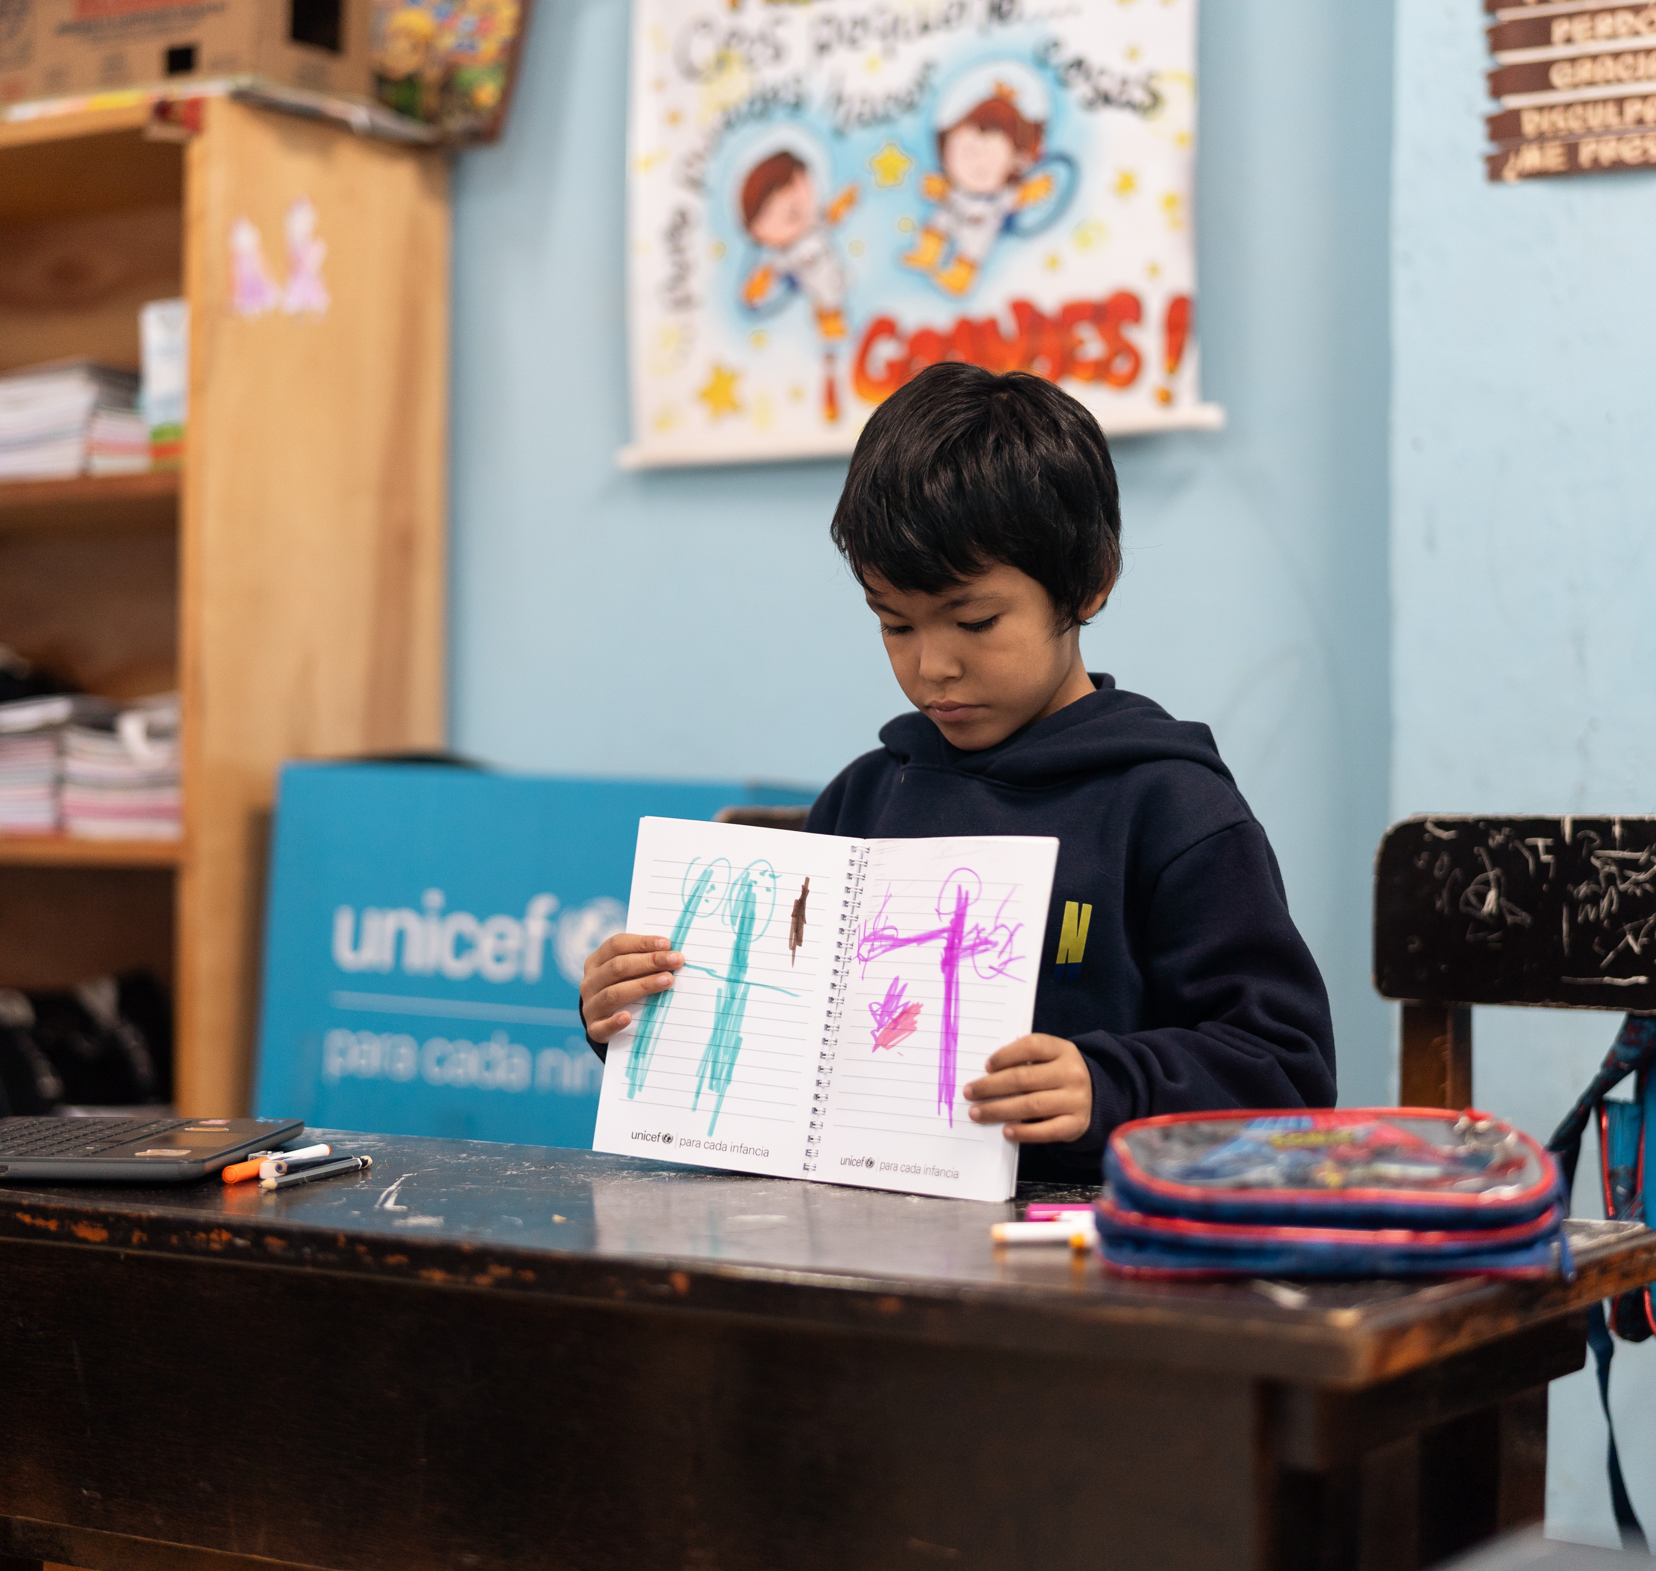
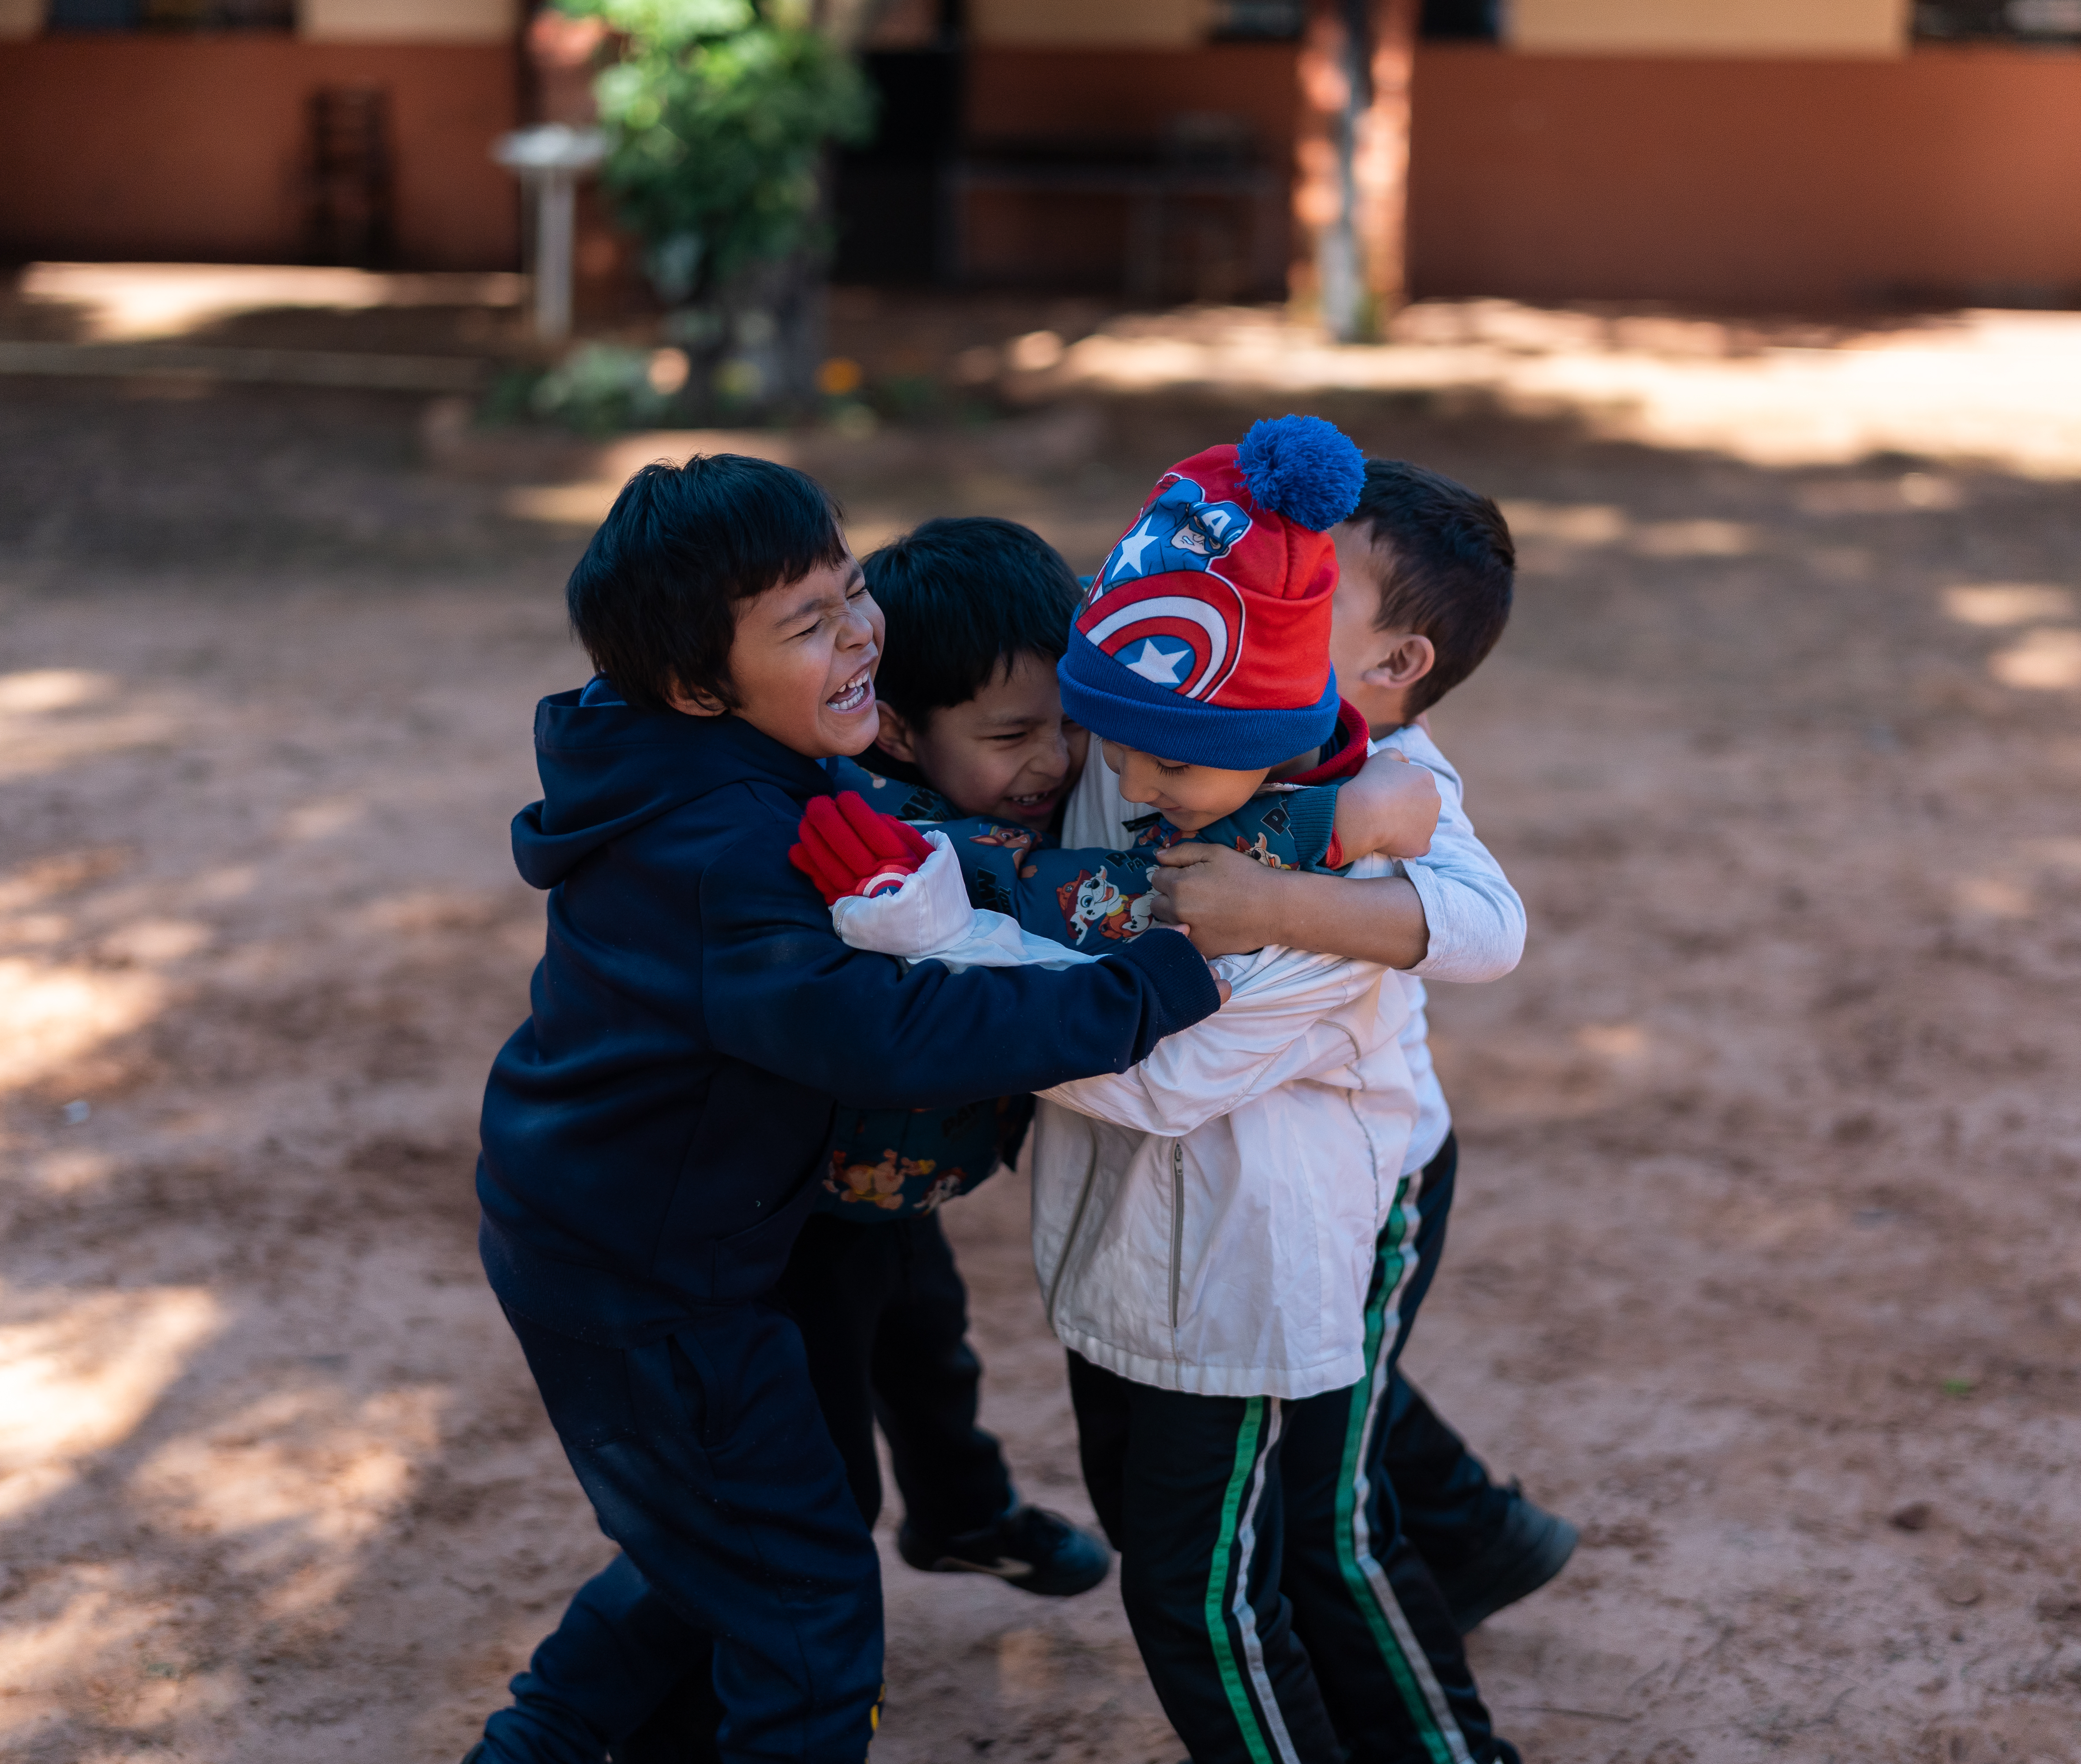
For your display
These images can provide a starting point for your Rights Around the World display or passport.
Please include the image credit and description if using.
©UNICEF/Brizuela – Dylan loves dogs, drawing, eating noodles and dreams of becoming a firefighter one day.
2. ©UNICEF/Brizuela – Dylan is 6 years old; he has recently started school and is excited to learn with his friends.
3. ©UNICEF/Brizuela – Accessible digital textbooks are helping Dylan become more independent and develop new friendships.
1
2
3

Slide 19
Keep an eye on the RRSA website for further information.
We would welcome your views as we continue to develop this resource. Click below to let us know your thoughts.
Thank you, and we hope you enjoy sharing this resource with your pupils!
https://forms.office.com/e/h39rbSZ0Hb

