Slide 1
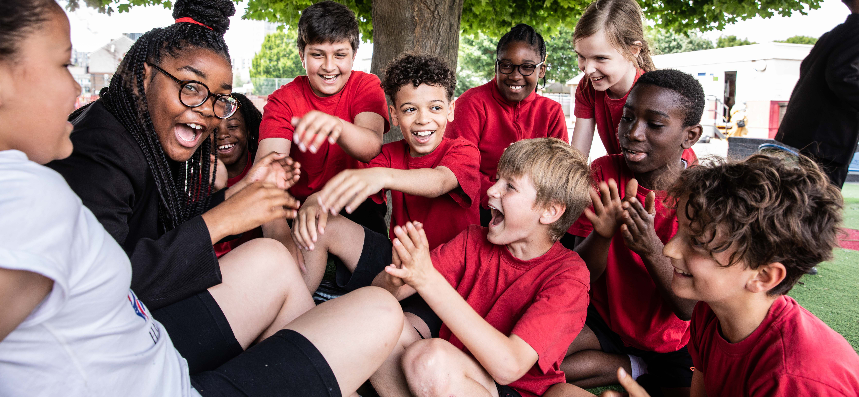
Activity 7
Working together to create stronger health systems
©UNICEF/Dawe
UNICEF UK, registered charity England & Wales (1072612) Scotland (SC043677).

Slide 2
Young people support stronger health systems
©UNICEF/Dawe
Notes:
The voices of children are just as important as the voices of adults in calling for change on important issues. In this session we’ll look at the power of young voices in calling for change to make health systems stronger, and we’ll use our own voices to call on adults to ask them how they’ll fulfil their responsibilities to make the health systems we rely on stronger to ensure the best possible health for children.

Slide 3
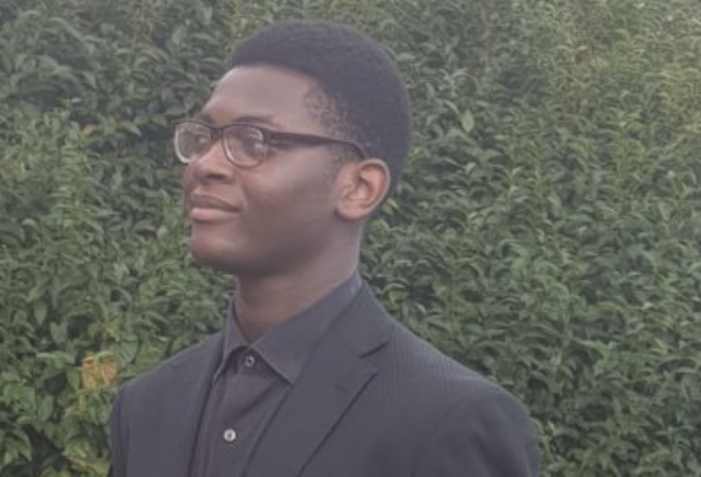
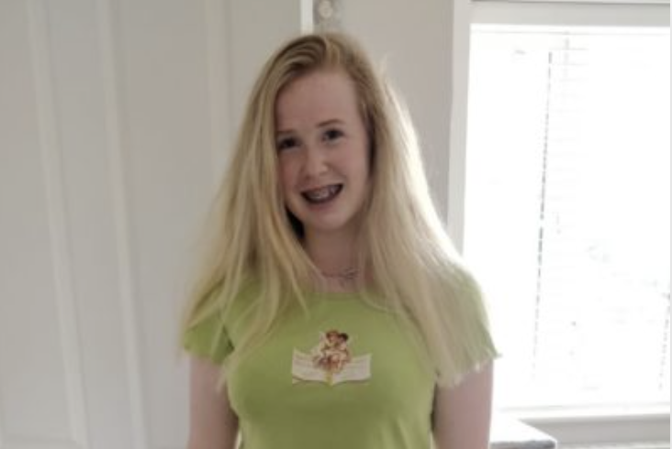
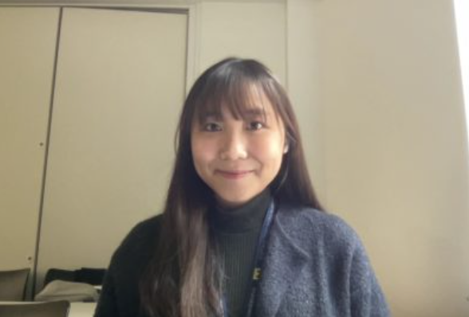
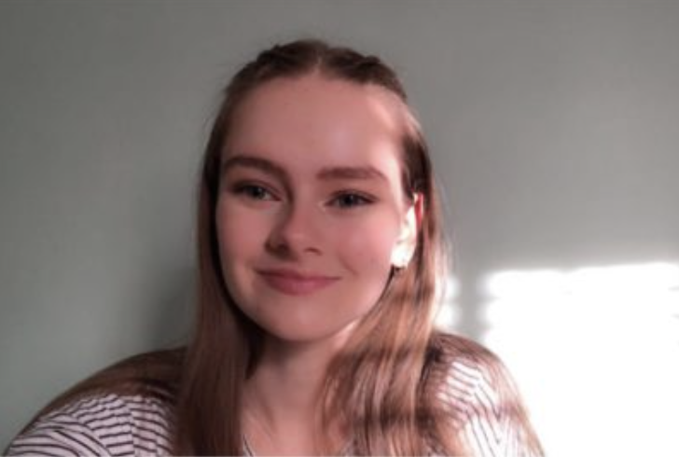
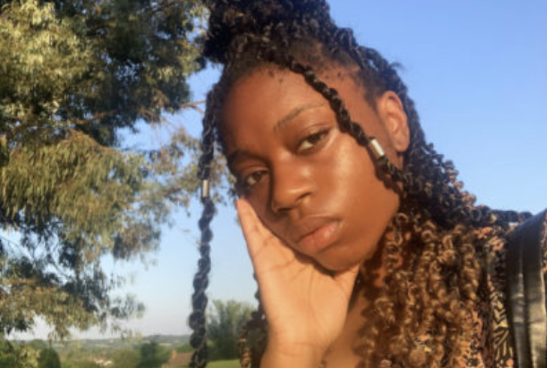
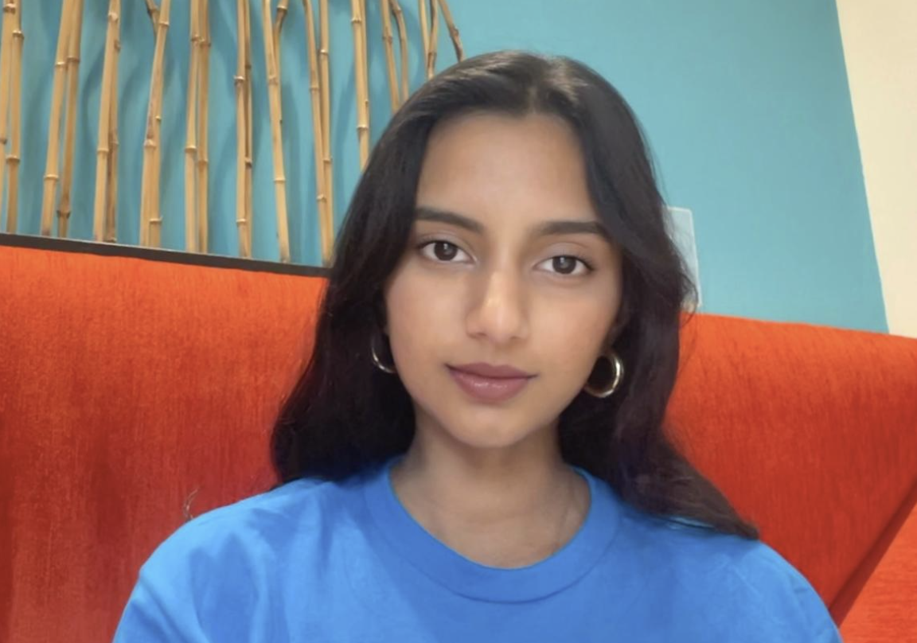
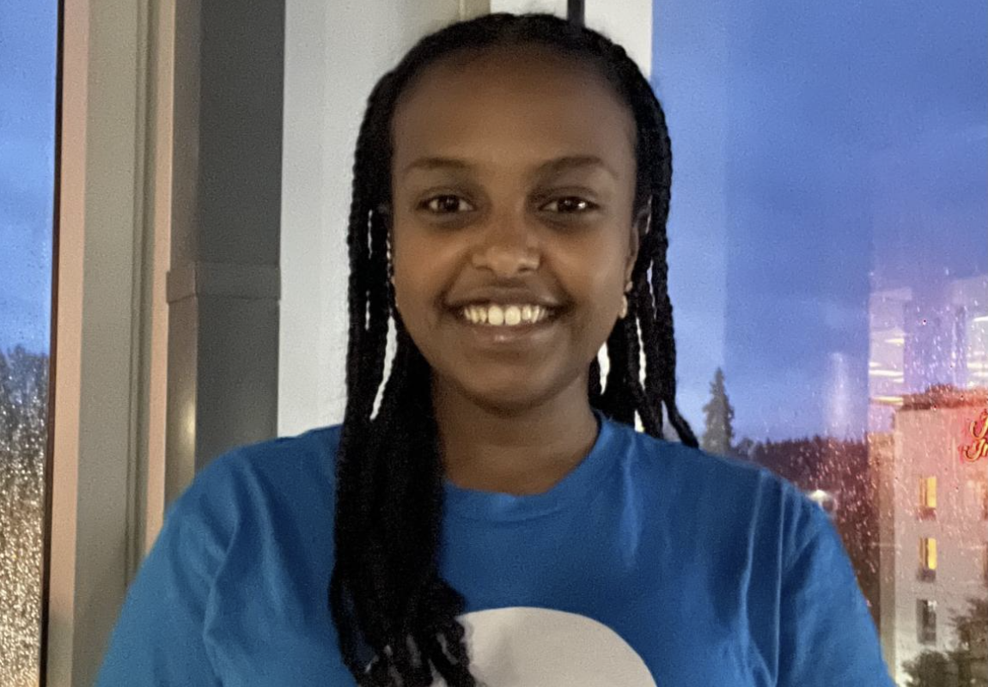
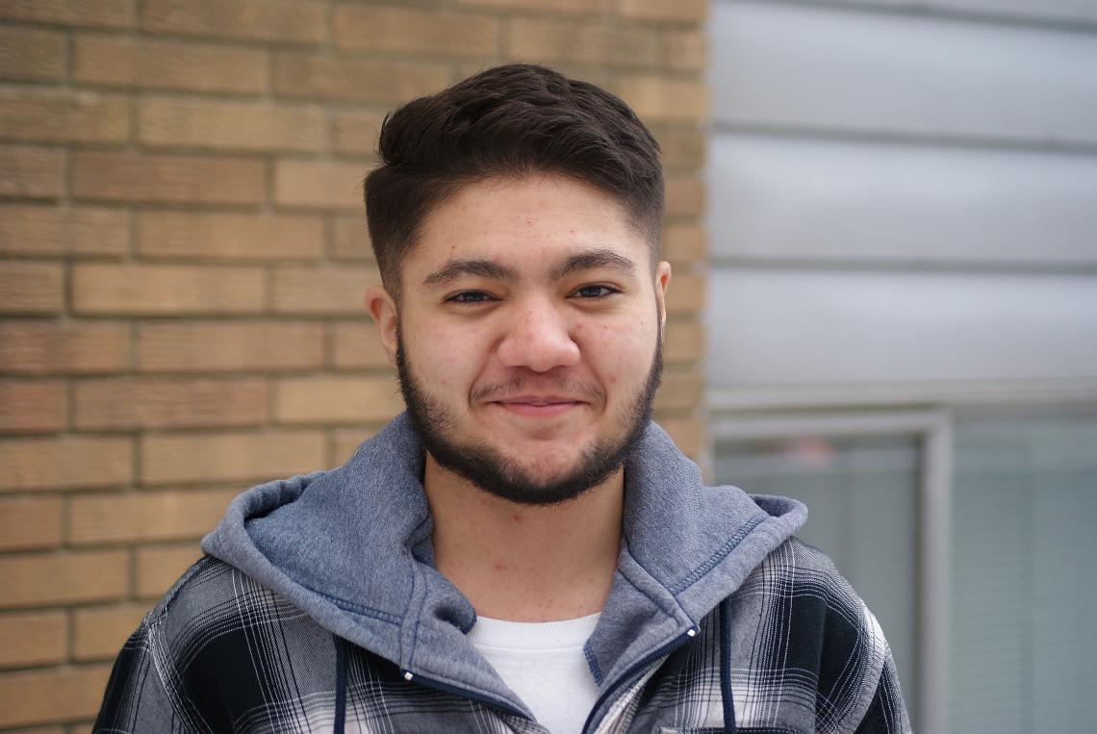
Young people like you, speaking up for health systems
Victor, 16
Birmingham
Sophie, 15
East Midlands
Jamie, 17
South East
Maddi, 17
South West
Kristie, 15
London
Subhi, 20
Indiana, USA
Tirsitemariyam, 15
Washington, USA
Alexander, 19
Canada
Notes:
As part of the NHS Youth Forum, Victor wants to be involved in bringing change and improvements, and helping young people in his city with their physical and/or psychological needs.
As a young person with a chronic health condition, Sophie wants to support other young people through health struggles by ensuring the NHS is hearing young people’s perspectives.
Jamie is an NHS youth advocate who wants to share her experience as a teen who has been diagnosed with a mental health problem. She wants to influence the decision-making process of the NHS to make healthcare services more accessible to teens.
Maddi wants young people to feel empowered about their health and healthcare and have positive experiences when accessing care. She advocates for recognition of invisible illnesses and tackling health misconceptions in our communities.
Kristie is a youth advocate with a passion for black, Asian, and minority ethnic access within healthcare.
Shubi is an advocate in health, gender, and education equity. Influenced by her background as a first-generation immigrant born and raised in India, Shubi aspires to be a medical doctor to provide immigrants, minority groups and lower-income communities with access to quality and affordable medical care. She became a UNICEF volunteer at age 13.
Tirsitemariyam is a UNICEF youth advocate for children's rights to nutrition and education.
Alexander is a UNICEF youth advocate who raises awareness for the LGBTQ+ community and for mental health.

Slide 4
Talk about the questions you might like to ask a health leader in your community
©UNICEF/Dawe
Notes:
You can share the tips from your OutRight introductory pack and media resources to help your group plan this activity.

